Slide 1
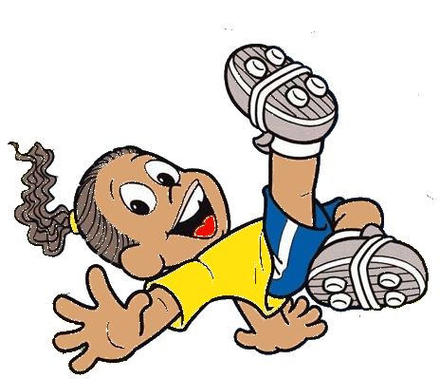
体育

Slide 2
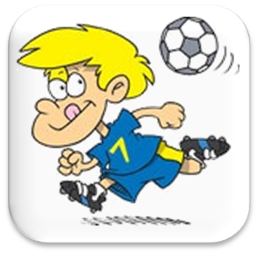
Football, UK Soccer, USA

Slide 3
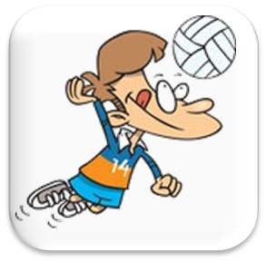
Volleyball

Slide 4
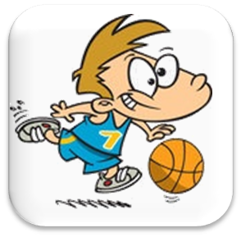
Basketball

Slide 5
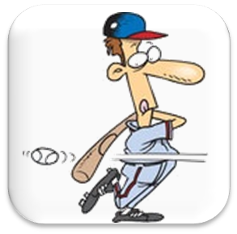
Baseball

Slide 6
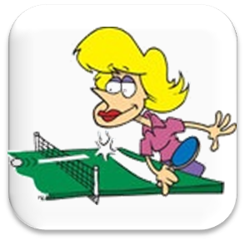
Table Tennis

Slide 7
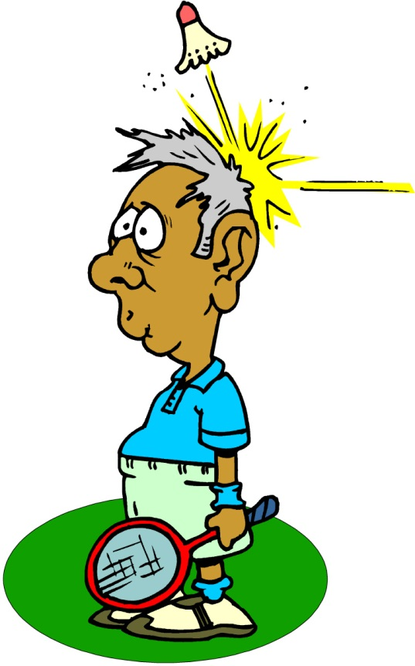
Badminton

Slide 8
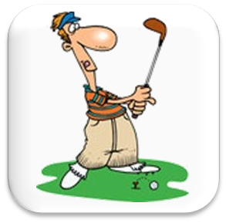
Golf

Slide 9
I like playing ...
football volleyball basketball baseball
table tennis badminton golf
What do you like playing?

Slide 10
Let’s watch a video Guess the sport – Pancake Manor https://www.youtube.com/watch?v=HjreEfMcxH4

Slide 11
Playing Game!!

Slide 12
1) badminton
What do I like playing?
I like playing badminton.
2) table tennis
3). golf

Slide 13
1). basketball
What do I like playing?
I like playing volleyball.
2) volleyball
3) baseball

Slide 14
1) football
What do I like playing?
I like playing football.
2) table tennis
3). volleyball

Slide 15
1) table tennis
What do I like playing?
I like playing golf.
2) baseball
3) . golf

Slide 16
1). football
What do I like playing?
I like playing basketball.
2) basketball
3) baseball

Slide 17
1) badminton
What do I like playing?
I like playing table tennis.
2) baseball
3) . Table tennis

Slide 18
SPORT
SOUNDS
Guessing game

Slide 19
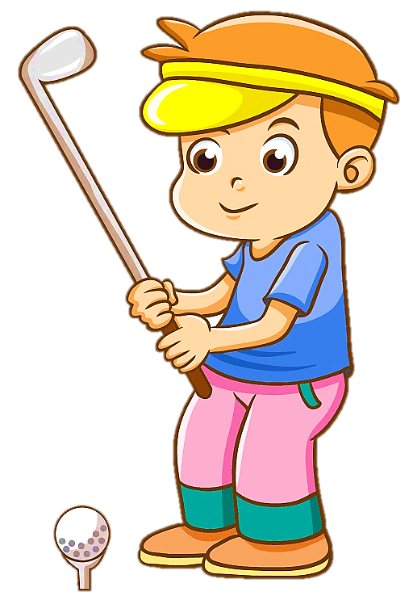
check
I play golf .

Slide 20
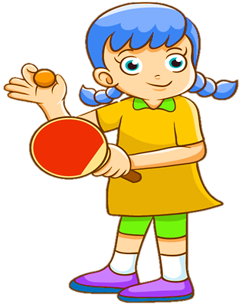
check
I play table
tennis.

Slide 21
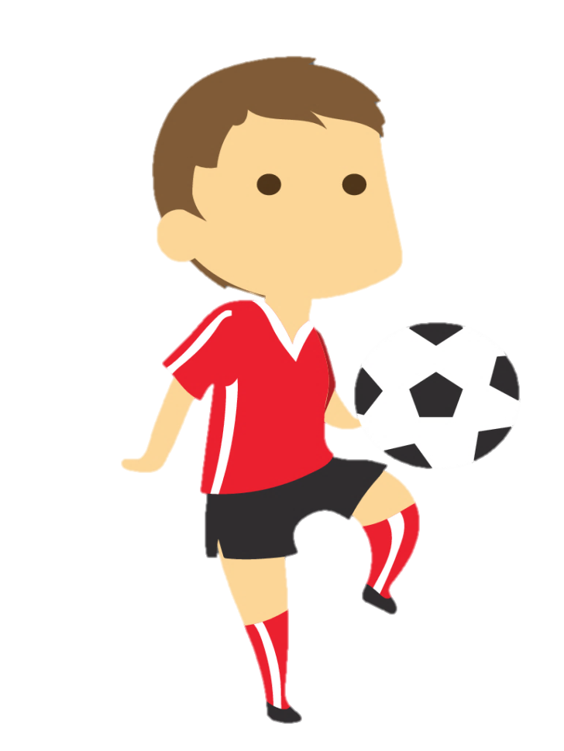
check
I play soccer.

Slide 22
check
I go swimming.

Slide 23
Let’s watch a video Sports balls!- Pancake Manor https://www.youtube.com/watch?v=EZXI7l3eaOs

Slide 24
What sport is it?
A sport with two (2) teams. A team has five (5) people. They play with a large orange ball. The people are often tall.

Slide 25
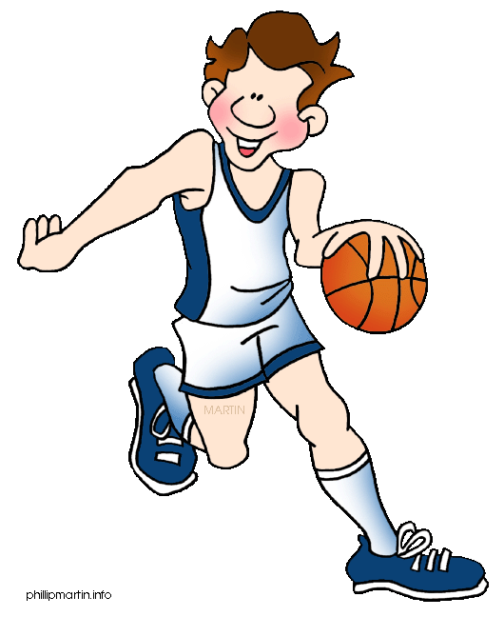
What sport is it?
Basketball

Slide 26
What sport is it?
A sport with two (2) people. They play with a small round white ball. They play on a green table. They play fast.

Slide 27
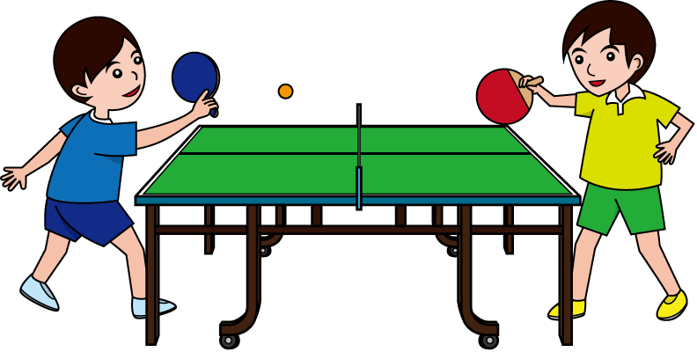
What sport is it?
table tennis

Slide 28
What sport is it?
A sport with two (2) teams. A team has eleven (11) people. They play with a large round white ball. They run and like goals!!!

Slide 29
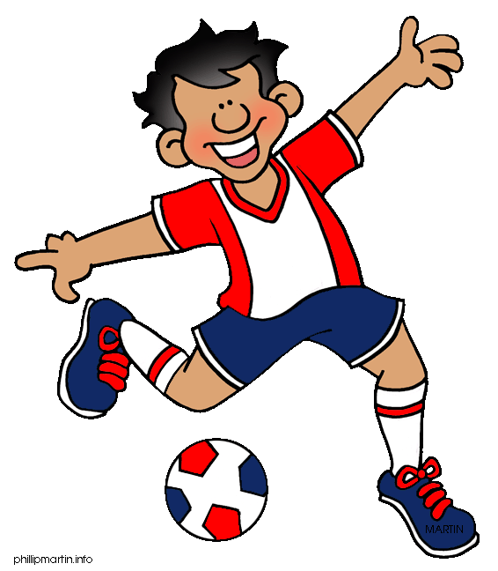
What sport is it?
football.

Slide 30
What sport is it?
A sport with two (2) people. They play with a very small white hard ball. They play with a long stick. They play slow.

Slide 31
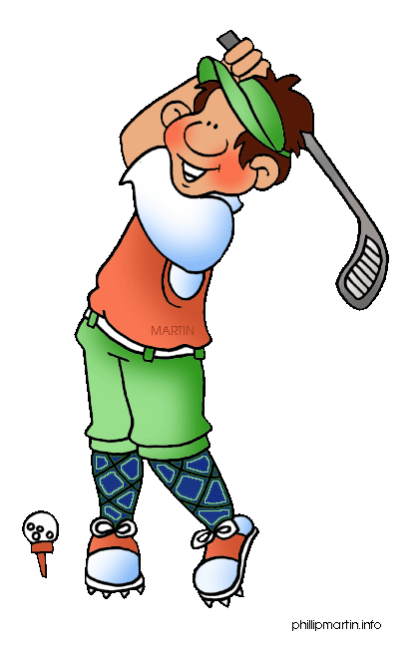
What sport is it?
golf.

Slide 32
Let’s play an game. https://www.gamestolearnenglish.com/basketball/

Slide 33
Charades game.
I like playing ...
football
volleyball basketball
baseball table tennis badminton golf
He / She likes playing?

Slide 34
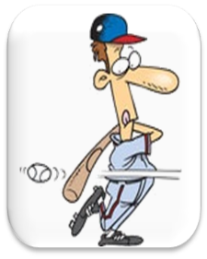
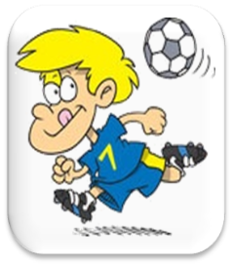
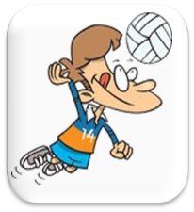
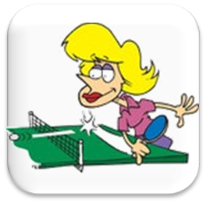
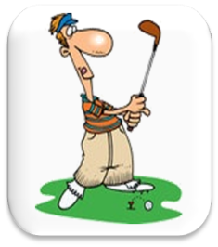
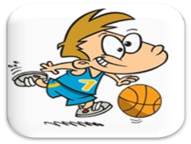
1 2 3 4 5
A
B
C
badminton
baseball
volleyball
golf
football
table
tennis
basketball
Sports memory game
Example:
B1
C4
badminton

