Slide 1
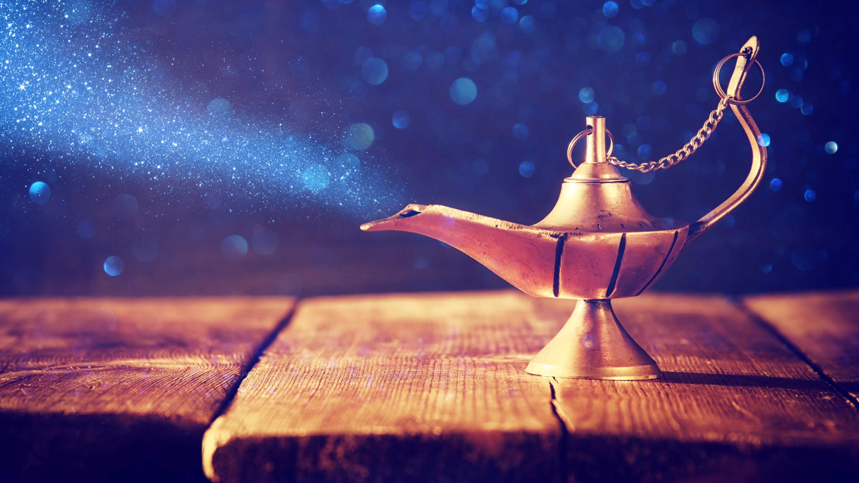
LO: Introduce the topic and get to know each other.
Say hello to Ss and ask Ss to introduce themselves to each other.
Introduce the topic and ask Ss to discuss the given question.
What’s your favorite story about genies?
The Evil Genie 1
ORT-G2A Lesson 26
1:30
1/34

Slide 2
LO: Get to know the learning objectives.
Go through the learning goals with the Ss. Make sure they know what they’re going to learn in the lesson.
Note: Don’t read the goals to Ss.
Learning Goals
Decode words with the following common suffix: –ity.
Learn the key words and phrases experiment, reason, stick out, reach, cork, rotten, puff out, and snap, and understand them in context.
Apply the different reading strategies and skills when analyzing and comprehending the content; compare and contrast versions of a story.
Talk about the story and discuss what you would do if you were trapped in an isolated place.
0:30
2/34

Slide 3
LO: Present the writing assignment from the last lesson.
Let Ss take turns presenting the writing assignment from the last lesson.
Give feedback.
Presentation
Presentation Time
Did you finish the homework you were assigned in the last lesson? Deliver your presentation and tell us about whether or not children should get pocket money when they do housework.
1:30
3/34

Slide 4
LO: Identify the common suffix –ity of these words.
Click and read the first group of words to Ss; have them identify the suffix –ity of these words.
Click and read the second group of words to Ss; have them identify the suffix –ity of these words.
Phonics Learning
Phonics
What do these words end with?
personality
quality
responsibility
generosity
ability
charity
1:30
4/34

Slide 5
LO: Decode the words in the text accurately and fluently; read the text fluently.
Guide Ss to read the story aloud together and with rhythm.
Ask Ss to take turns reading the text one sentence at a time.
Phonics
Read on Your Own
A person with a good personality tends to have a life of high quality. Generosity is a good personality trait. Parents have the responsibility to teach their children how to be generous. Parents can encourage their children to take part in some charity events, which can help children improve their ability to care about other people in the world.
1:00
5/34

Slide 6
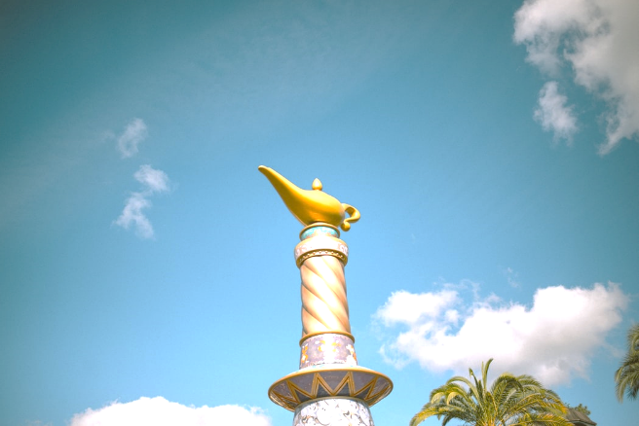
LO: Activate Ss’ background knowledge on the topic;
get to know more about genies.
Ask Ss to read the given passage silently.
Have Ss discuss the given questions.
Discussion
Background
Genies
A genie can refer to any supernatural creature or specific type of supernatural creature. Genies are often mentioned in connection with devils/demons in folk lore, and are held responsible for misfortune, possession and diseases. However, Genies are sometimes supportive and benevolent. They are mentioned frequently in magical works, such as the One Thousand and One Nights story of The Fisherman and the Genie, the story of Ma’ruf the Cobbler and the story of Aladdin and the Wonderful Lamp, etc.
What is a genie?
What magical stories are about genies? How are genies portrayed in them? Are they good or evil? Give some examples.
1:30
6/34

Slide 7
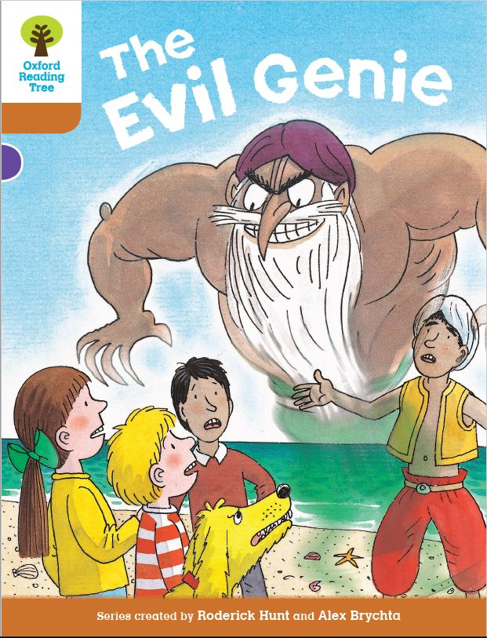
LO: Use the book cover to identify details and to make predictions.
Guide Ss to look at the book cover closely and to talk about the given questions.
Encourage Ss to talk more about the connections question and give feedback.
Book Cover
Lead-in
Before Reading
Where do you think the genie comes from? Why do you think the genie looks so angry?
Where might the children be? Who do you think the boy wearing the white hat is?
Connections
What other stories, movies, or songs about genies can you think of? Do you like them? Why?
1:00
7/34

Slide 8
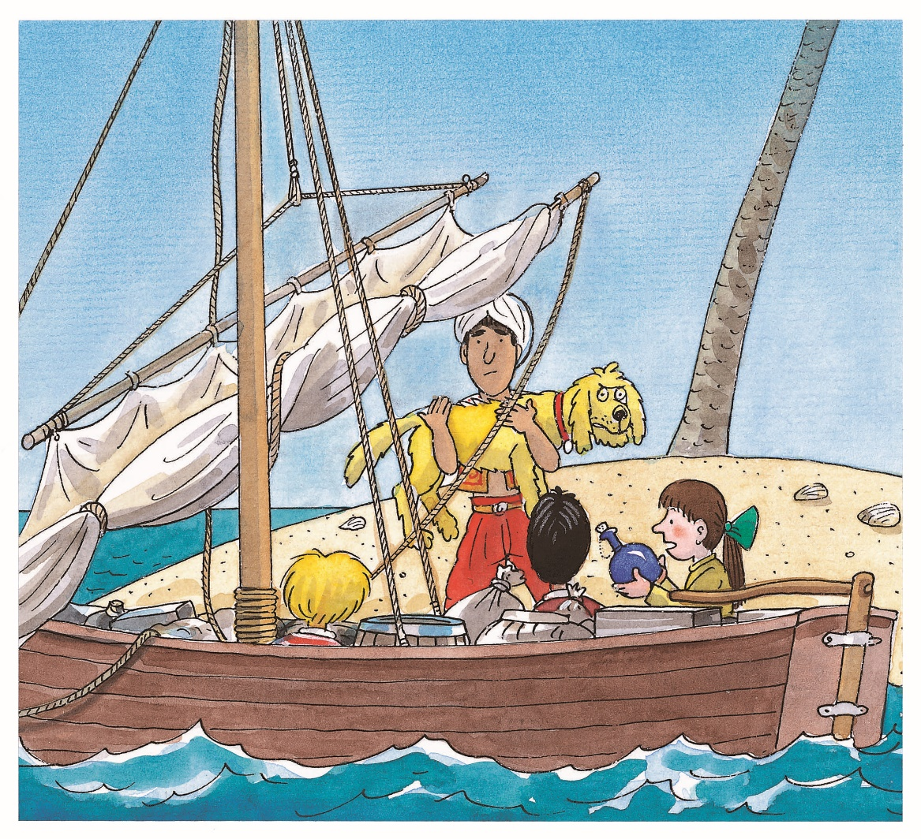
LO: Use details from the picture to make predictions.
Guide Ss to make predictions by using the provided questions.
Ask them to make guesses prior to reading the story by looking at the pictures.
Make Predictions
Lead-in
Use details from the illustration to make guesses.
Why are the children sitting in the boat? What is the boy in a white hat doing with Floppy?
Why do you think Biff is holding a bottle? What do you think might be inside it?
1:30
8/34

Slide 9
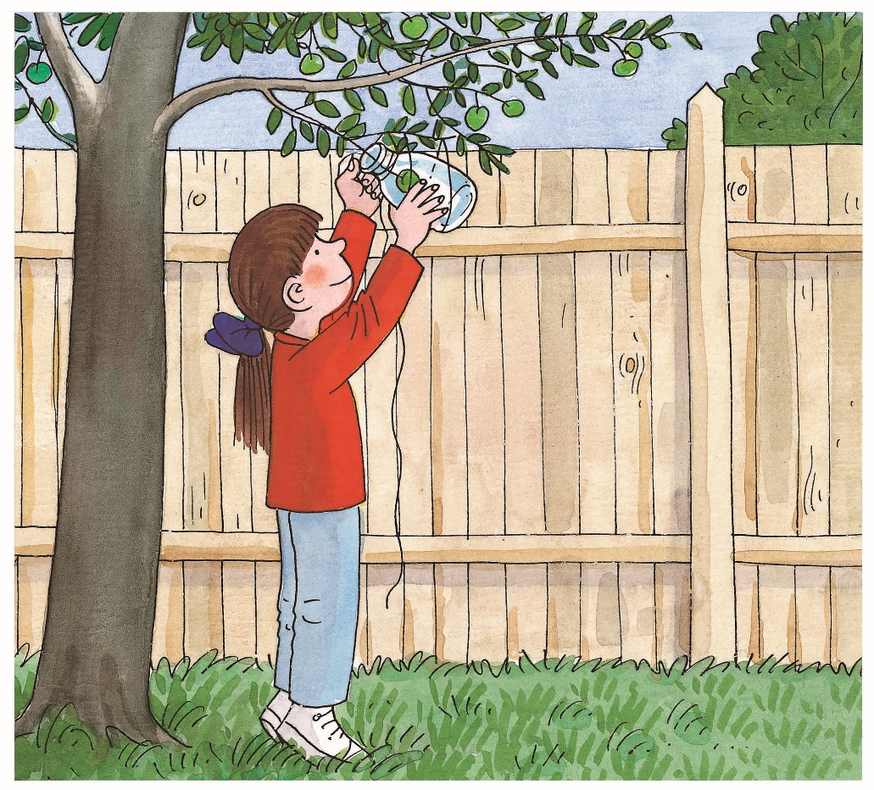
LO: Utilize the reading strategies and skills to assist in reading comprehension.
Ask Ss to discuss the comprehension questions; give feedback.
Have Ss talk about the question in the connection section.
The Evil Genie 1
Reading
Comprehension
What experiment did Biff want to try? What did she want to know?
What do you think would happen at the end of the experiment? Why?
Connections
Have you ever done an experiment, or is there an experiment you would like to try? Tell us about it.
Page 1
1:00
9/34
Notes:
Suggested Time: 2 mins (Understanding & Applying)
Learning Objectives:
Ss will be able to use the reading strategies and skills: making connections to analyze the story.
Ss will be able to understand the core academic word “pack” in context and use it in sentences.
TD
Choose one S to read aloud the passage.
Then explain the key word “pack" with the sample sentence and ask Ss to make sentences.
Ask Ss to discuss the given questions and give feedback.

Slide 10
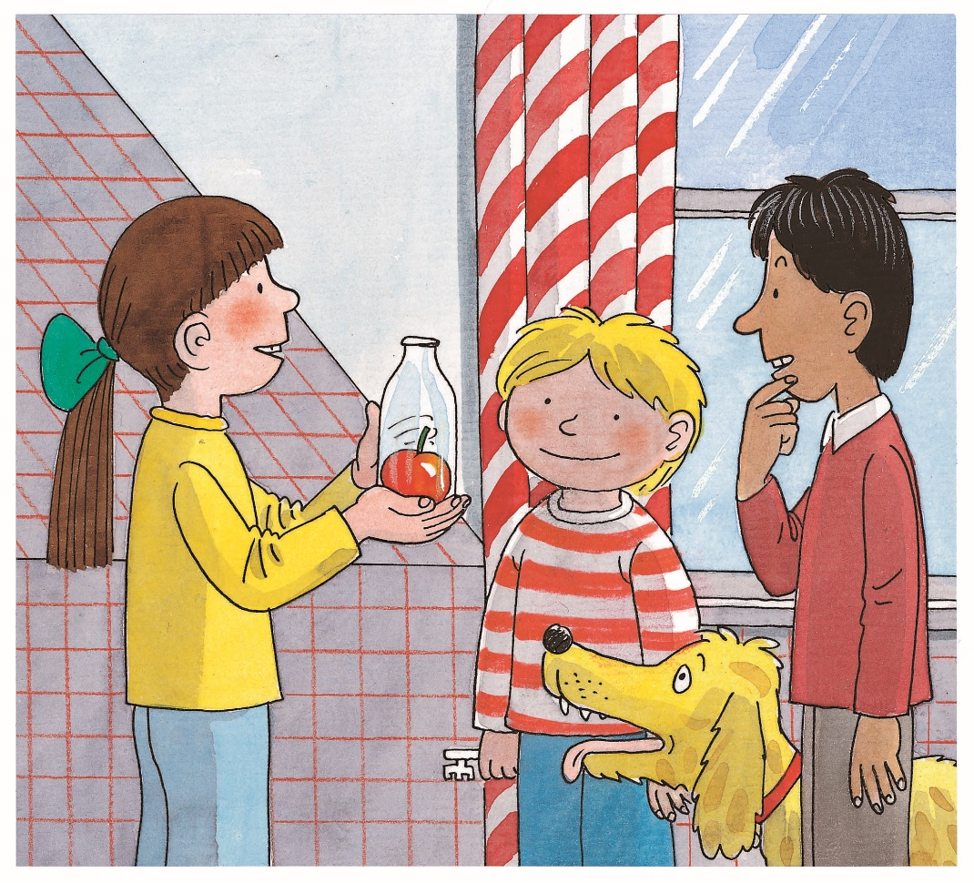
LO: Define the unfamiliar word experiment in context.
Have Ss use the illustration and context clues to define the word experiment; give feedback.
Note: If Ss can present a correct understanding of the unfamiliar word(s), it’s not necessary to teach the word(s) on the next slide.
The Evil Genie 1
Reading
After a long, long time, Biff went to see if the experiment was working. It was! In the bottle was a big apple. Biff showed the bottle to Nadim. When he saw the apple, he was amazed.
“How did you get that in there?” he asked.
Vocabulary
Pages 2-3
Use the illustration and context clues to define the word experiment.
1:00
10/34
Notes:
Suggested Time: 2 mins (Understanding & Applying)
Learning Objectives:
Ss will be able to use the reading strategies and skills: making connections to analyze the story.
Ss will be able to understand the core academic word “pack” in context and use it in sentences.
TD
Choose one S to read aloud the passage.
Then explain the key word “pack" with the sample sentence and ask Ss to make sentences.
Ask Ss to discuss the given questions and give feedback.

Slide 11
LO: Utilize the reading strategies and skills to assist in
reading comprehension and in making connections; understand the word experiment in context.
If the Ss can present a good understanding of the word experiment from the previous slide, skip the vocabulary teaching part. If not, explain the word with the sample sentence and ask Ss to make new sentences with it.
Ask Ss to take turns discussing the comprehension questions; give feedback.
The Evil Genie 1
Reading
Read Pages 2-3
experiment
(n.)
Comprehension
What did Biff see after a long period of time? How do you think Biff felt when the experiment worked?
How did Nadim react when Biff showed him the bottle?
Definition: a test that is done to learn something or to discover whether something works or is true
He spends nearly ten hours a day doing experiments in his lab.
2:00
11/34
Notes:
Suggested Time: 2 mins (Understanding & Applying)
Learning Objectives:
Ss will be able to use the reading strategies and skills: making connections to analyze the story.
Ss will be able to understand the core academic word “pack” in context and use it in sentences.
TD
Choose one S to read aloud the passage.
Then explain the key word “pack" with the sample sentence and ask Ss to make sentences.
Ask Ss to discuss the given questions and give feedback.

Slide 12
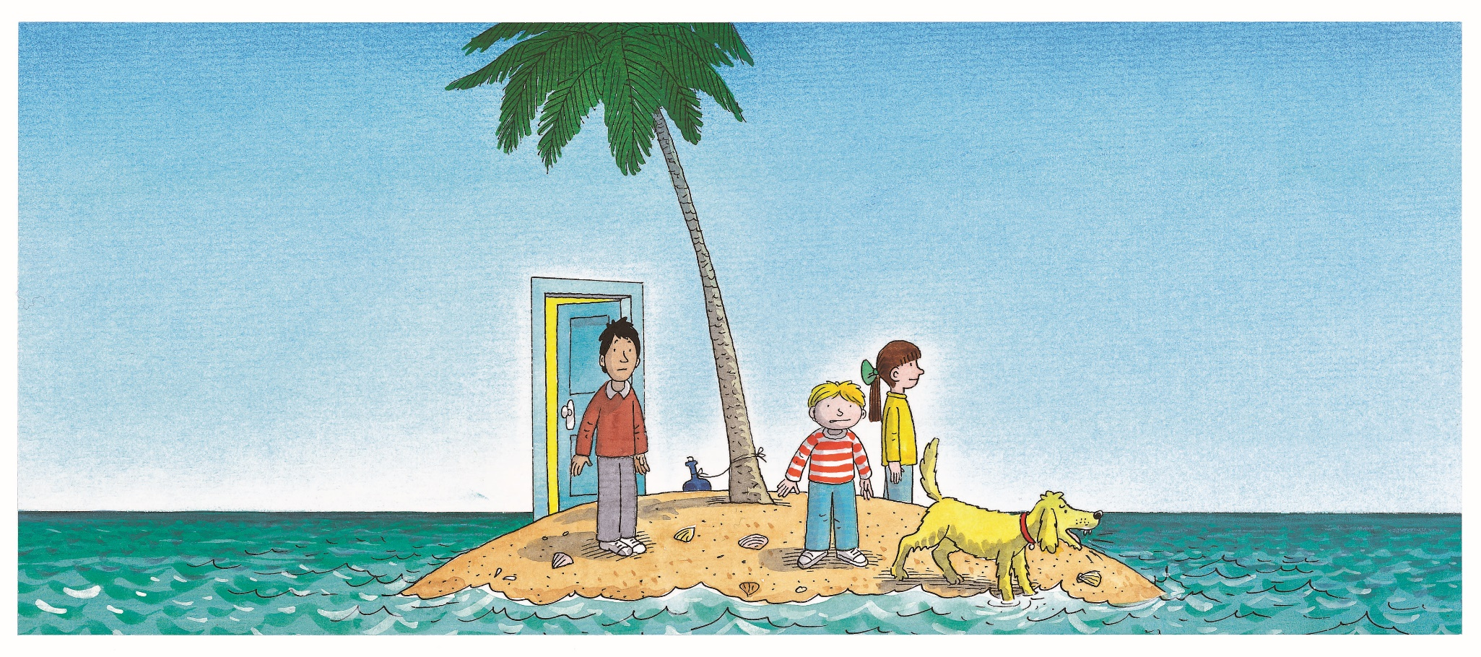
LO: Define the unfamiliar word reason in context;
read the text fluently.
Take turns reading the passage aloud. Guide Ss to pay attention to the intonation and emotion of the passage when reading the in-text quotes.
Have Ss go through the text quickly and have Ss use the illustration and context clues to define the word reason.
Note: If Ss can present a correct understanding of the unfamiliar word(s), it’s not necessary to teach the word(s) on the next slide.
The Evil Genie 1
Reading
Vocabulary
Use the illustration and context clues to define the word reason.
Pages 4-5
1:00
12/34

Slide 13
LO: Utilize the reading strategies and skills to assist in
reading comprehension and in making connections; understand the word reason in context.
If the Ss can present a good understanding of the word reason from the previous slide, skip the vocabulary teaching part. If not, explain the word with the sample sentence and ask Ss to make new sentences with it.
Ask Ss to take turns discussing the comprehension questions; give feedback.
The Evil Genie 1
TG
Reading
Read Pages 4-5
reason
(n.)
Comprehension
Where did the magic take the children? Why do you think the magic took them there?
How did everyone feel about their adventure?
Definition: a cause or an explanation for an event, situation, or something that has happened
He is explaining his reasons for adding some charts in the report.
2:00
13/34

Slide 14
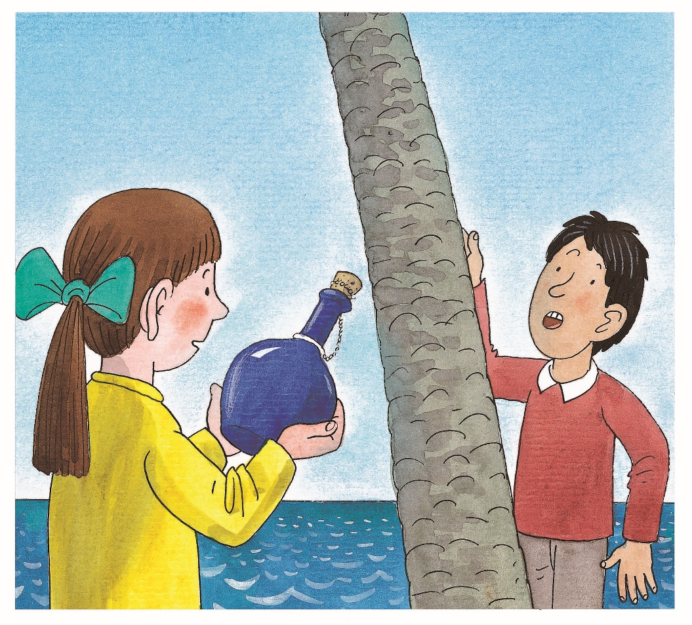
LO: Define the unfamiliar phrase stick out in context.
Have Ss use the illustration and context clues to define the phrase stick out; give feedback.
Note: If Ss can present a correct understanding of the unfamiliar word(s), it’s not necessary to teach the word(s) on the next slide.
TG
The Evil Genie 1
Reading
“Help me climb the tree,” said Nadim, “and maybe I can see a ship going past.”
Biff saw a bottle sticking out of the sand. It was tied to the base of the tree.
“How strange,” thought Biff.
She untied the bottle and picked it up.
Vocabulary
Use the illustration and context clues to define the phrase stick out.
Pages 6-7
1:00
14/34

Slide 15
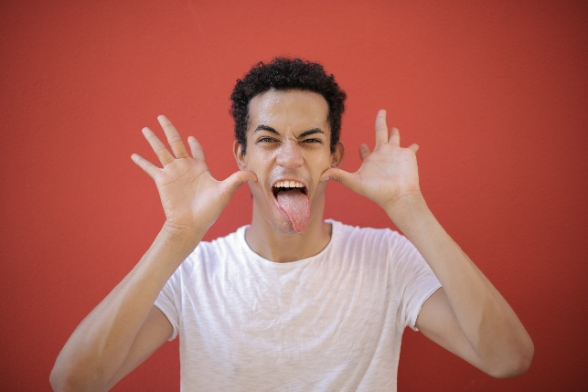
LO: Utilize the reading strategies and skills to assist in
reading comprehension; understand the phrase
stick out in context.
If Ss can present a good understanding of the phrase stick out from the previous slide, skip the vocabulary teaching part. If not, explain the phrase with the sample sentences and ask Ss to make new sentences with it.
Ask Ss to take turns discussing the comprehension questions; give feedback.
The Evil Genie 1
Reading
Read Pages 6-7
Comprehension
What did Nadim do on the island? Why did he do that?
What did Biff find on the island? Why did she think it was strange? What do you think she would do with it?
stick out
Definition: to go past the surface, or to be further out than something else
The boy likes to make a face by sticking out his tongue.
2:00
15/34

Slide 16
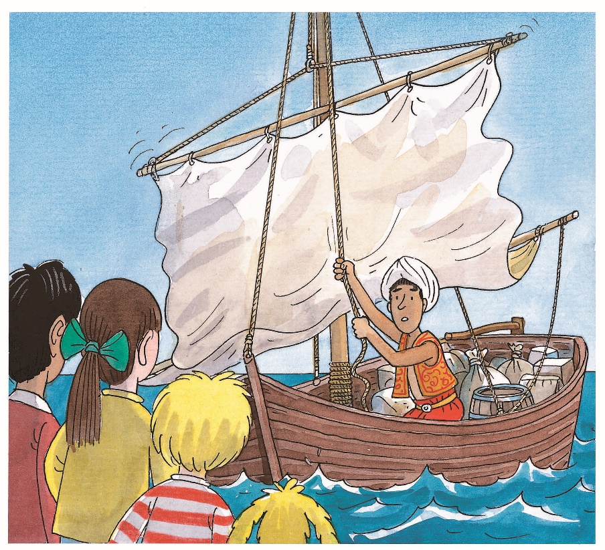
LO: Define the unfamiliar word reach in context;
read the text fluently.
Take turns reading the passage aloud. Guide Ss to pay attention to the intonation and emotion of the passage when reading the in-text quotes.
Have Ss go through the text quickly and have them use the illustration and context clues to define the word reach.
Note: If Ss can present a correct understanding of the unfamiliar word(s), it’s not necessary to teach the word(s) on the next slide.
The Evil Genie 1
Reading
The boat reached the island. There was a boy sailing it.
“What are you doing on this tiny island?” he asked.
“You wouldn’t believe us, even if we told you,” said Biff.
Vocabulary
Pages 8-9
Use the illustration and context clues to define the word reach.
1:00
16/34

Slide 17
LO: Utilize the reading strategies and skills to assist in
reading comprehension; understand the word reach in context.
If Ss can present a good understanding of the word reach from the previous slide, skip the vocabulary teaching part. If not, explain the word with the sample sentence and ask Ss to make new sentences with it.
Ask Ss to take turns discussing the comprehension questions; give feedback.
The Evil Genie 1
Reading
Read Pages 8-9
Comprehension
Who was sailing to rescue the children? What was he like?
What might be in the bottle? Discuss some ideas with your partner.
reach (v.)
Definition: to get to a place
When she reached New York, she gave her friend a call immediately.
2:00
17/34

Slide 18
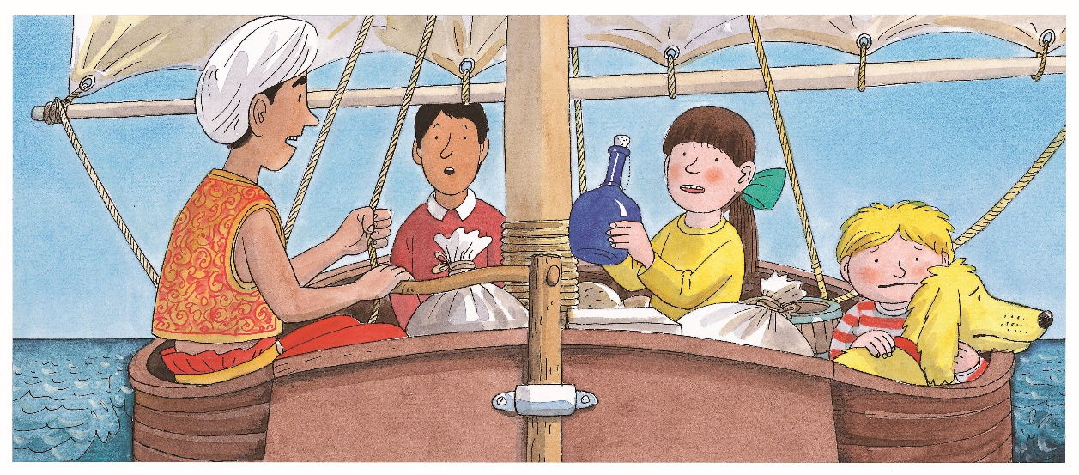
LO: Utilize the reading strategies and skills to assist in
reading comprehension.
Ask Ss to take turns discussing the comprehension questions; give feedback.
Have Ss talk about the question in the connection section.
The Evil Genie 1
Reading
Comprehension
Why was Kamar alone in the boat?
What did Kamar tell Biff to do when Biff showed him the bottle? Do you think Kamar was right or not? Why?
Connections
If you got a bottle like the bottle Biff had found, would you open it or not? Why?
Pages 10-11
1:00
18/34

Slide 19
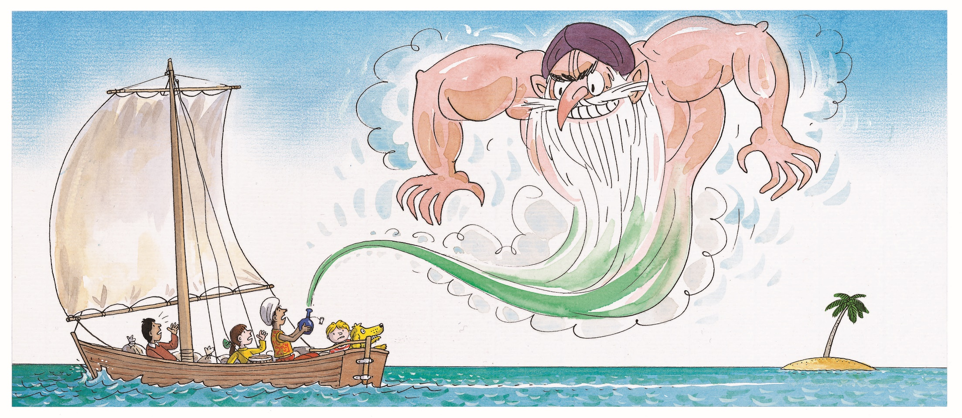
LO: Define the unfamiliar words cork and rotten in context.
Have Ss use the illustration and context clues to define the words cork and rotten; give feedback.
Note: If Ss can present a correct understanding of the unfamiliar word(s), it’s not necessary to teach the word(s) on the next slide.
The Evil Genie 1
Reading
Vocabulary
Pages 12-13
Use the illustration and context clues to define the words cork and rotten.
1:00
19/34

Slide 20
LO: Utilize the reading strategies and skills to assist in
reading comprehension; understand words cork and
rotten in context.
If Ss can present a good understanding of the words cork and rotten from the previous slide, skip the vocabulary teaching part. If not, explain the words with the sample sentences and ask Ss to make new sentences with them.
Ask Ss to take turns discussing the comprehension questions; give feedback.
The Evil Genie 1
Reading
Read Pages 12-13
cork (n.)
Definition: a small object used for closing bottles
Comprehension
What happened as the genie came out of the bottle? How did the genie feel? Why?
How do you think Biff felt about letting the genie out?
She picked up the cork of a wine bottle when sweeping the floor.
rotten (adj.)
Definition: decayed; no longer good to use or eat, etc.
The bananas will become rotten very quickly after being peeled.
2:00
20/34

Slide 21
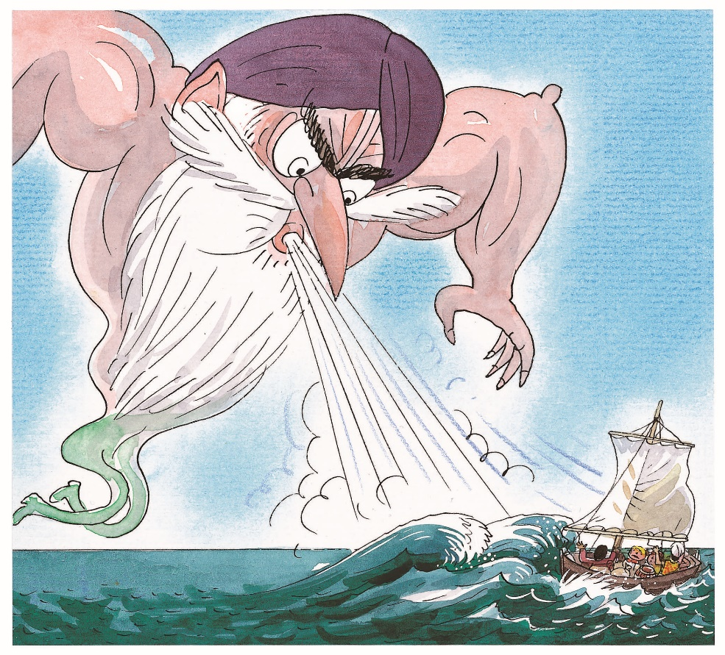
LO: Define the unfamiliar word puff in context.
Have Ss go through the text quickly and have them use the illustration and context clues to define the word puff.
Note: If Ss can present a correct understanding of the unfamiliar word(s), it’s not necessary to teach the word(s) on the next slide.
TG
The Evil Genie 1
Reading
“His name is Hassan,” cried the genie. “And now I’m off to deal with him.”
Then the genie grew very big.
“First I will deal with you,” he said.
He puffed out his cheeks and blew very hard.
“Help!” called Kamar. “He’s making a storm.”
Vocabulary
Page 14
Use the illustration and context clues to define the phrase puff out.
1:00
21/34

Slide 22
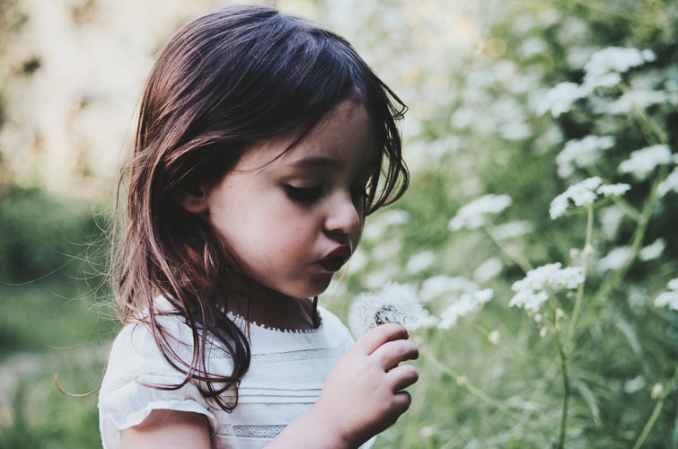
LO: Utilize the reading strategies and skills to assist in
reading comprehension; understand the word puff in context.
If Ss can present a good understanding of the word puff from the previous slide, skip the vocabulary teaching part. If not, explain the word with the sample sentence and ask Ss to make new sentences with it.
Ask Ss to take turns discussing the comprehension questions; give feedback.
TG
The Evil Genie 1
Reading
Read Page 14
puff out
Comprehension
How did the genie feel about people? Who did the genie want to deal with most?
How did the genie cause the storm?
Definition: to make (something) bigger and rounder by filling it with air
She puffed out her face and blew the seeds of the dandelions away.
1:00
22/34

Slide 23
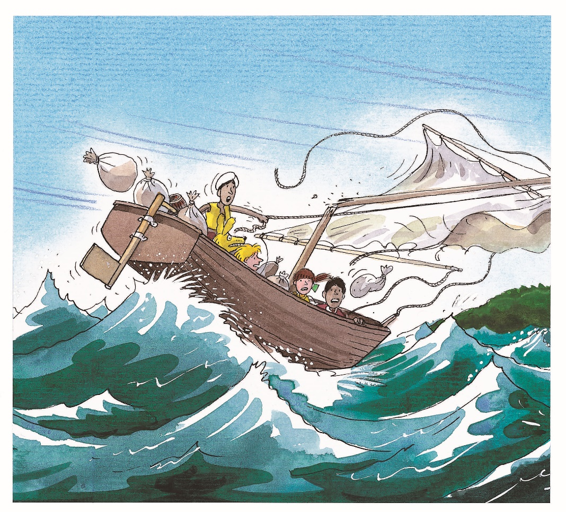
LO: Define the unfamiliar word snap in context; read
the text fluently.
Have Ss go through the text quickly and have them use the illustration and context clues to define the word snap.
Note: If Ss can present a correct understanding of the unfamiliar word(s), it’s not necessary to teach the word(s) on the next slide.
TG
The Evil Genie 1
Reading
The wind snapped off the mast. Big waves tossed the boat up and down.
“Hang on everyone,” yelled Kamar. “We’re being blown on to a big island.”
“Biff said this wasn’t going to be a good adventure,” shouted Kipper.
Vocabulary
Page 15
Use the illustration and context clues to define the word snap.
1:00
23/34

Slide 24
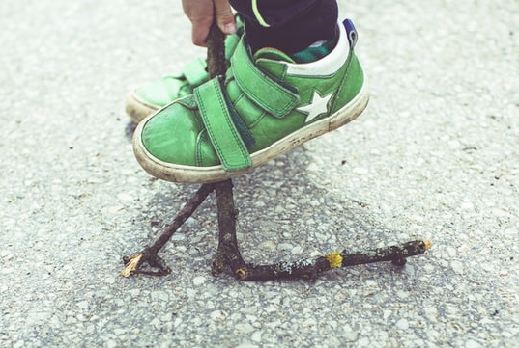
LO: Utilize the reading strategies and skills to assist in
reading comprehension; understand the word snap in context.
If Ss can present a good understanding of the word snap from the previous slide, skip the vocabulary teaching part. If not, explain the word with the sample sentence and ask Ss to make new sentences with it.
Ask Ss to take turns discussing the comprehension questions; give feedback.
TG
Victorian Adventure 1
Reading
Read Page 15
Comprehension
snap (v.)
What damage did the storm do to the boat?
Do you think Biff was right when she said this wasn't going to be a good adventure? What do you think will happen in the next part of the story?
Definition: to break (something) suddenly with a sharp noise
The boy snapped the twig into two shorter parts with his foot.
1:00
24/34

Slide 25
LO: Introduce what is to compare and contrast similar stories or different versions of a story; teach how to compare and contrast stories
Introduce to Ss what is to compare and contrast similar stories or different versions of a story.
Click and show parts of two stories.
TG
Reading Strategy
Compare and Contrast Versions of a Story
Reading
Read one part from each story, and then compare and contrast them.
A part from The Evil Genie
Pages 12-15
A part from Aladdin and The Magic Lamp
Aladdin found an old lamp in the cave and started cleaning it. Suddenly, a strange fog filled up the cave and a voice said, “My Master, I am the genie of this lamp. What is your wish?” It was a huge man who looked very strange, and Aladdin was afraid of him. But the genie assured him that he would do as Aladdin asked him. “Take me to my home” he said. The next instant, Aladdin was home and with his mother. They hugged each other, and Aladdin told her all about his adventure.
When you compare and contrast similar stories or different versions of a story, you can tell how they are alike, and how they are different.
Read two stories and ask yourself:
How are the two stories alike?
How are the two stories different?
Story A
Story B
23/32
3:00
25/34

Slide 26
LO: Utilize the reading strategies and skills to assist in comparing and contrasting versions of a story.
Model how to compare and contrast versions of a story; click and display the sample answer and give feedback.
have Ss work together to compare and contrast versions of a story by completing the given chart.
Give feedback.
How are the two stories alike? How are the two stories different?
vs.
Aladdin and The Magic Lamp
The Evil Genie
Differences
Similarities
Differences
evil
a genie in a container
kind
bottle
a genie came out
lamp
It’s your turn.
It’s your turn.
It’s your turn.
26/34

Slide 27
LO: Check if Ss understand the words in context.
Ask Ss to take turns reading the words aloud.
Ask Ss to fill in the blanks and to read the sentences.
Vocabulary
Read & Choose
My brother ___________ Beijing after driving for two hours.
The teacher ____________ the chalk in two and wrote with the shorter piece.
I don’t know the _____________ why he didn’t come to my party.
There was a disgusting smell of ____________ eggs in the kitchen.
reached
snapped
reason
rotten
Complete the sentences. Use the correct form of the words in the box.
snap, rotten, reach, readon
1:00
27/34
Notes:
Suggested Time: 1.5 mins (Remembering & Understanding)
Learning Objective: Check if Ss will understand the words/phrases in context.
TD
Ask Ss to take turns reading their familiar words, and then guide Ss to read their unfamiliar words aloud.
Ask Ss to read the sentences and compete to find the answers.

Slide 28
LO: Use details to talk about what the children did when they were trapped in the bare island.
Instruct Ss to discuss the given question.
Encourage Ss to answer questions by using the given clues, and encourage Ss to present their answers with at least 3 complete sentences; assist Ss if necessary.
Listening & Speaking
What did the children do when they were trapped on the island?
climbed the tree
waved and shouted
talked to the boy sailing a boat
climbed into the boat
1:30
28/34

Slide 29
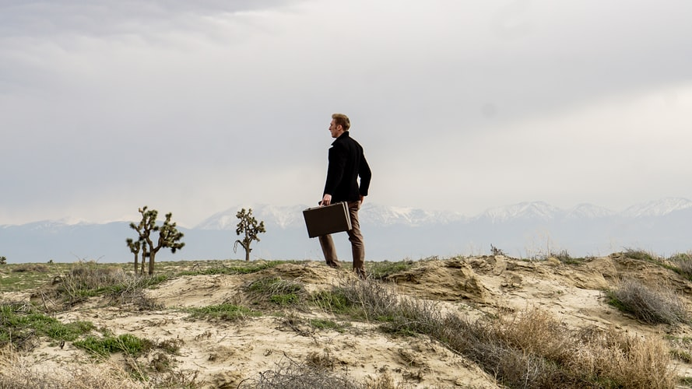
LO: Talk about what you would do if you were
trapped in some isolated places.
Ask Ss to talk about the given question.
Encourage Ss to answer the question in complete sentences with the given clues; assist Ss if necessary.
Listening & Speaking
What would you do if you were trapped in an isolated place?
look for someone who could help
call for help
use fire as a signal
make an SOS signal
. . .
1:30
29/34

Slide 30
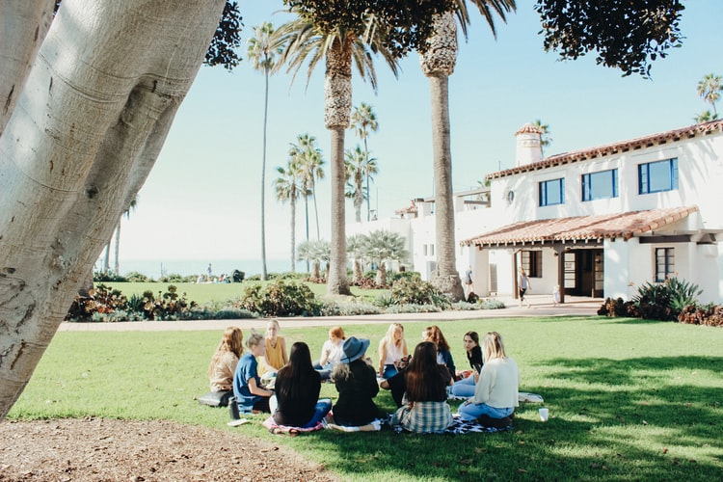
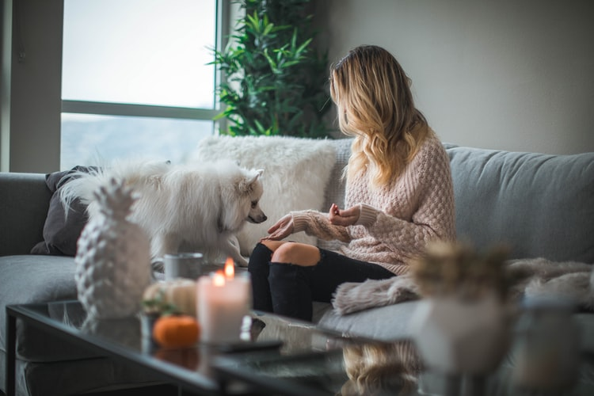
LO: Talk about how you avoid dangerous situations.
Guide Ss to look at the pictures; have Ss talk about the given question.
Guide Ss to realize the importance of avoiding dangerous situations; assist Ss if necessary.
Value
How do you avoid dangerous situations?
1:30
30/34

Slide 31
LO: Give a character sketch of the genie with the help
of the character profile below.
Explain the task to Ss.
Model first; have Ss describe the boat by answering the questions in the character profile.
Give feedback.
Get Ready to Present
Writing
Create a character sketch of the genie with the help of the character profile below.
Work together to complete the task.
The Genie
What did the genie look and smell like?
What evil power did the genie have?
What did the genie do after getting out of the bottle?
What do you think of the genie?
2:30
31/33

Slide 32
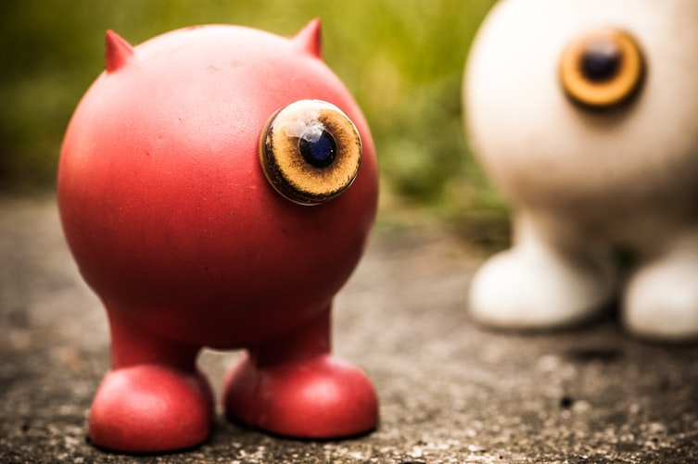
LO: Understand what the writing task is; know to
complete the writing task with the help of the post-class instructional video.
Introduce and explain the writing task to Ss.
Ask Ss to finish the task before the next class and to be ready to present.
Remind Ss to watch the post-class video before writing.
Homework: A Folk Tale
Writing
Rewrite a folk tale with a genie in three paragraphs.
Step 1. Brainstorm: Collect Ideas
Step 2. Prewrite: Make a Plan for Your Writing
Step 3. Draft: Write the First Version of Your Story
Watch the post-class video before you start writing.
1:00
32/34

Slide 33
LO: Review the whole lesson.
Review the key words with Ss by asking Ss to make sentences.
Review the story with Ss by asking the given questions.
Review
Let’s Review
Story: The Evil Genie 1
Key Words:
experiment, reason, stick out,
reach, cork, rotten, puff out, snap
Key Questions:
What did the children do when they were trapped on the island?
What would you do if you were trapped in an isolated place?
1:00
33/34

Slide 34
LO: End the lesson and encourage Ss to perform
better in the next class.
Briefly comment on Ss’ performance.
Say goodbye to Ss.
Ask Ss to preview the next lesson.
0:30
34/34
Notes:
Suggested Time: 0.5min
TD
Give briefly comments to Ss and say goodbye.

