Slide 1
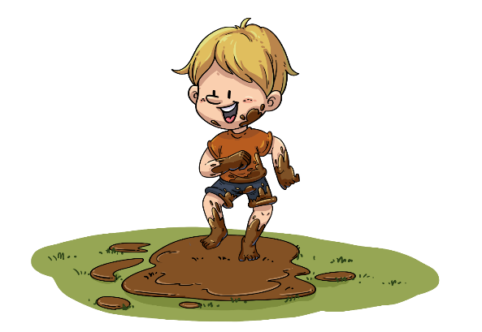
TG
LO: Get to know their partners; get a basic idea about the topic of today’s lesson.
1. Say hello to Ss; ask Ss to introduce themselves and to greet each other.
2. Guide Ss to describe the pictures on the first page.
3. Introduce the topic of the lesson.
The Mud Bath
ORT-GKA
Lesson 26
1:00
1/26

Slide 2
Learning
Goals
TG
LO: Get to know and understand what will be learned in this lesson.
Go through the learning goals with Ss.
We are
going to . . .
Isolate and pronounce the initial, medial vowel, and final sounds in CVC words.
Learn the different words and phrases football, kick, fell over, luck, and bathroom, and make sentences with them.
Read the story The Mud Bath, and identify the setting of the story by using the pictures.
Practice using the sentence structure
_______ kicked/fell over _____.
0:30
2/26

Slide 3
TG
LO: Present and share the writing that was assigned last lesson.
1. Let Ss present in turns.
2. Encourage Ss to listen carefully and to ask questions.
3. After both of the Ss have finished, give them feedback and awards (Click the picture of
the book beside the boy or girl so that they can get some awards). Click and give each
S a trophy to mark their good performance.
Note: You can click the picture of the boy or the girl to give Ss the trophy.
Presentation
Let’s show!
This is a retelling of the book The Ice Rink.
2:00
3/26

Slide 4
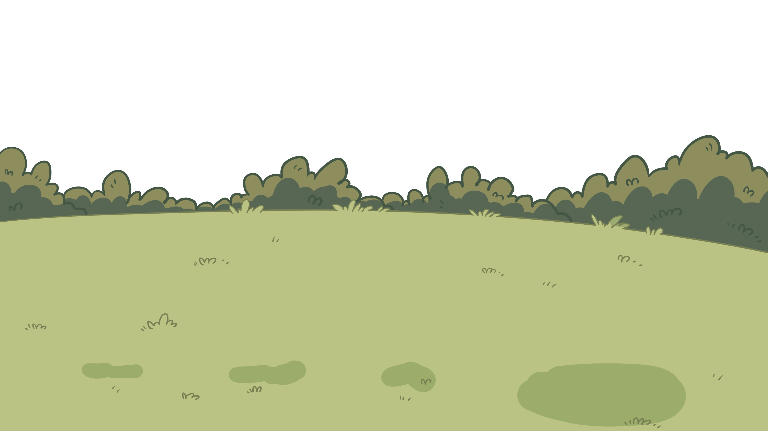
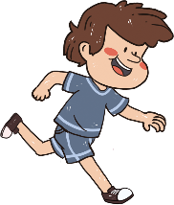
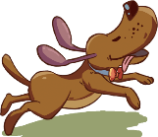
Phonics
TG
LO: Isolate and pronounce the initial, medial vowel, and final sounds (phonemes) in three-phoneme (CVC) words
Ask Ss to talk about what they can see in the picture; click and tell them to help the child and the dog in the picture kick and catch the ball by isolating and pronouncing the initial, medial vowel, and final sounds in three-phoneme words.
First click and guide Ss to read the word mom; next guide Ss to read the initial, medial vowel and final sounds in the word mom; give feedback and click to show the initial, medial vowel and final sounds in the word mom; guide Ss to read the word in this way: m-o-m, mom; last click and help the child and the dog in the picture kick and catch the ball.
Repeat this practice for the rest of the words; Ss will learn three words on this slide.
Click and tell Ss the dog got muddy.
Let’s listen and speak!
mom
had
bed
You need isolate each sound, and then you can play.
Can you read the words?
m
o
m
h
a
d
b
e
d
Oh, no!
2:30
5/26

Slide 5
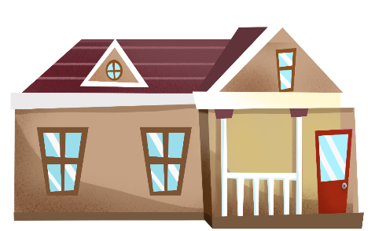
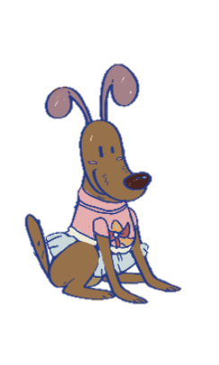
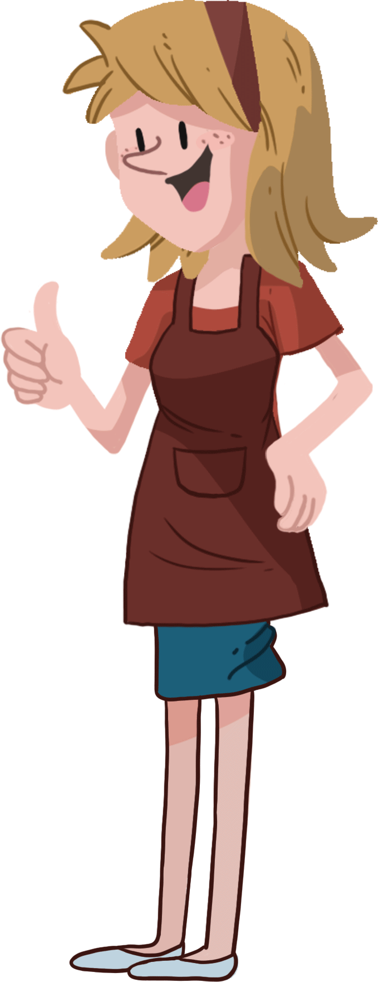
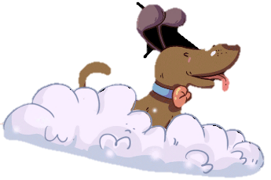
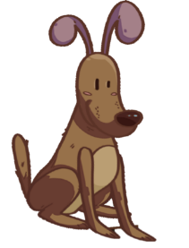
Phonics
TG
Phonics
LO: Isolate and pronounce the initial, medial vowel, and final sounds (phonemes) in three-phoneme (CVC) words.
Ask Ss to talk about what they can see in the picture; click and tell them to help the dog take a shower and get presents by isolating and pronouncing the initial, medial vowel, and final sounds in three-phoneme words.
First click and guide Ss to read the word vet; next guide Ss to read the initial, medial vowel, and final sounds in the word vet; give feedback and click to show the initial, medial vowel, and final sounds in the word vet; guide Ss to read the word in this way: v-e-t, vet; last click and help the dog in the picture take a shower and get presents.
Repeat this practice for the rest of the words; Ss will learn three words on this slide.
Let’s listen and speak!
What a beautiful dog!
fed
Can you isolate the sound?
vet
jam
Can you read the words?
j
f
d
v
m
t
e
e
a
2:30
4/26

Slide 6
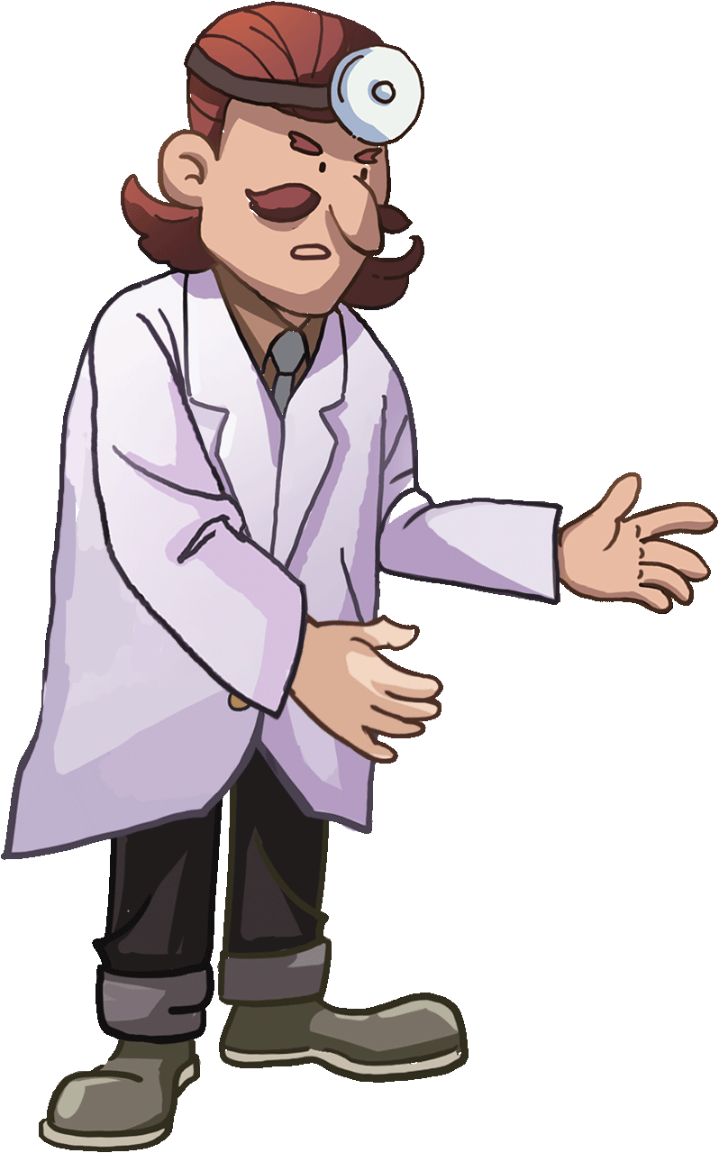
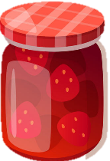
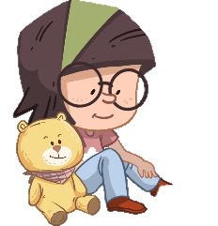
Phonics
TG
Let’s chant!
LO: Read the text fluently; isolate and pronounce the initial, medial vowel, and final sounds (phonemes) in three-phoneme (CVC) words.
Click and read the text to Ss with rhythm.
Guide Ss to repeat after you; ask Ss to take turns reading each sentence until they finish reading the text; give feedback.
Ask Ss to take turns isolating the words like this: m-o-m, mom; model first.
Mom had a fever, so she stayed in bed.
Lily helped take the puppy to a vet.
Lily fed the puppy with a can.
She served Mom bread with yummy jam.
“What a good girl!” Mom said.
“What a good owner!” thought the puppy.
2:00
6/26

Slide 7
Lead-in
TG
LO: Look at the book cover closely and have Ss talk about the first two questions by using the illustration and the title.
Have Ss look at the book cover closely and have Ss talk about the first two questions by using the illustration and the title.
Encourage Ss to talk about the connections questions.
Before Reading
1. Look at the title. What does a
mud bath mean? Does it really
mean mud in a bath?
2. How does Dad look like? What
happened to him?
Connections
Did you play football with your friends before? What interesting things happened?
Written by Roderick Hunt
Illustrated by Alex Brychta
2:00
7/26

Slide 8
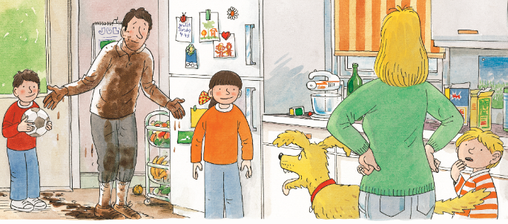
TG
Reading
Let’s predict!
LO: Identify details and make predictions about the story by using the illustration; activate Ss’ interest in reading.
Ask them to make guesses prior to reading the story by looking at the illustration.
Have Ss observe the illustration carefully and have Ss talk about the given questions.
Before Reading
How does Mum feel about Dad? How do you know?
What do you think Dad will do next?
2:00
8/26

Slide 9
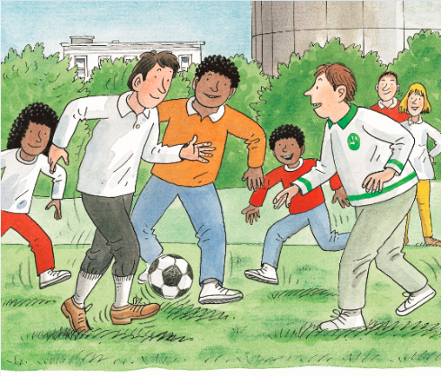
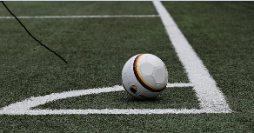
TG
Reading
LO: Understand the meaning of the vocabulary word football, and make sentences with it; identify the setting on this page by using the illustration and textual clues; understand the text; read the text fluently.
Read the text aloud to Ss.
Ask one S to find the vocabulary word football in the text; click the penguin card and explain its purpose to Ss; have Ss read the word and have Ss make sentences with it.
Have Ss talk about the comprehension questions by using the text and illustration.
Guide Ss to talk about the setting question by using the illustration and text clues.
Ask Ss to take turns reading the text fluently; give feedback.
The Mud Bath
Comprehension
Vocabulary
1. What was Dad doing?
2. What kind of shoes
did Dad wear? Were
they the right shoes
for playing football?
How about the other
people?
football
There is a football on the ground.
Setting
Where was Dad playing football? Look at the illustration.
Dad was playing football.
football
2:30
9/26

Slide 10
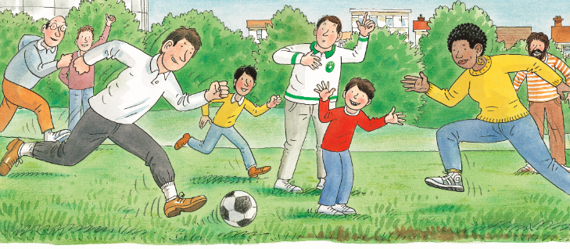
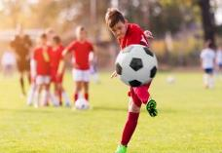
TG
Reading
The Mud Bath
LO: Understand the meaning of the vocabulary word football, and make sentences with it; understand the text; decode the sight words accurately; read the text fluently.
Read the text to Ss.
Ask one S to find the vocabulary word kick in the text; click the penguin card and explain its purpose to Ss; have Ss read the word and have Ss make sentences with it.
Guide Ss to talk about the comprehension questions by using the illustration and text.
Ask Ss to find the sight word with in the text and guide them to read it accurately.
Ask Ss to take turns reading the text aloud; give feedback.
Comprehension
Vocabulary
What did Dad do?
What did Chip hope Dad would do next? Read the text.
What would Dad do next?
kick
The boy can catch the ball and kick
it far.
Sight Word
He ran with the ball.
with
“Go on Dad!” called Chip. “Kick it!”
kick
4:00
10/26
The girl can kick the ball very far.

Slide 11
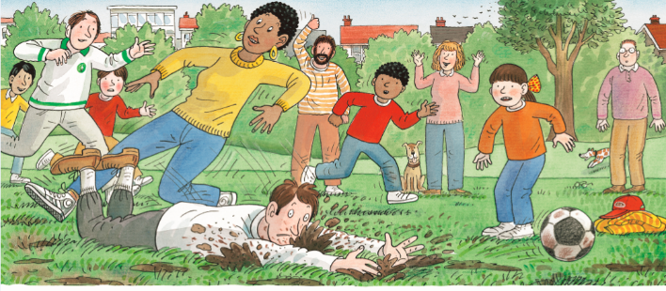
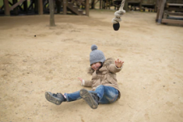
Reading
TG
The Mud Bath
LO: Understand the meaning of the vocabulary word football, and make sentences with it; understand the text; make connections; read the text fluently and at an appropriate rate.
Read the text to Ss.
Ask one S to find the vocabulary word and phrase luck and fell over in the text; click the penguin card and explain the word’s purpose to Ss; have Ss read the words and have Ss make sentences with them.
Have Ss talk about the comprehension questions by using the text and the illustration.
Encourage Ss to talk about the connections questions.
Have Ss read the text fluently and at an appropriate rate; give feedback.
Comprehension
Vocabulary
Vocabulary
1. What happened to Dad?
2. How did Dad get so
muddy? Did everyone
get muddy, or only Dad?
fell over
luck
Connections
She fell over on the ground just now.
What kinds of sports do you like? Why?
This gesture means good luck.
Dad fell over in the mud. Splat!
“Bad luck, Dad!” said Biff.
fell over
luck
2:30
11/26

Slide 12
Reading
TG
The Mud Bath
LO: Understand the text; identify the setting on this page by using the illustration and textual clues; read the text fluently and at an appropriate rate.
Read the text to Ss.
Guide Ss to talk about the setting question by using the illustration and text clues.
Guide Ss to talk about the comprehension questions by using the illustration and text.
Have Ss read the text fluently and at an appropriate rate; give feedback.
Setting
Where was Dad? Look at the illustration.
Comprehension
What did Mum say? How do you think Mum felt?
What did Dad want? What would he do next?
“Oh Dad,” said Mum. “What a mess.”
Decoding
“I want a bath,” said Dad.
Fluency.
2:30
12/26

Slide 13
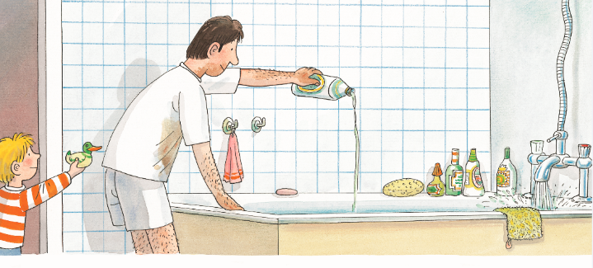
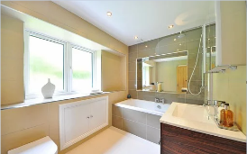
Reading
TG
The Mud Bath
LO: Understand the meaning of the vocabulary word bathroom and make sentences with it; identify the setting on this page by using the illustration and textual clues; understand the text; read the text fluently.
Ask one S to read the text; give feedback.
Ask another S to look for the vocabulary word bathroom; click the penguin card and explain the word’s purpose; have Ss read the word and have Ss make sentences with it.
Guide Ss to talk about the setting question by using the illustration and text clues.
Guide Ss to talk about the comprehension questions by using the illustration.
Have Ss read the text fluently; give feedback.
Setting
Vocabulary
1. Where did Dad go?
2. Was the bathroom on
the first or the second
floor? Look for clues
from the text.
bathroom
Comprehension
This bathroom is so clean.
What did Dad do?
Dad went up to the bathroom.
He ran a bath.
bathroom
2:00
13/26

Slide 14
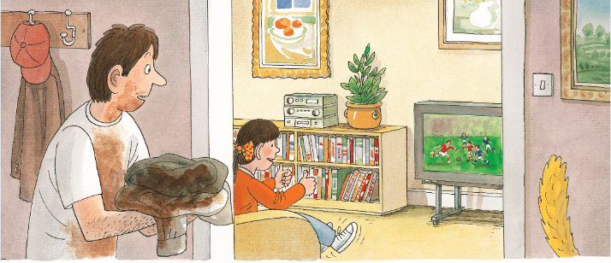
Reading
TG
The Mud Bath
LO: Understand the text; identify the setting on this page by using the illustration and textual clues; read the text fluently.
Read the text to Ss.
Guide Ss to talk about the setting question by using the illustration and text clues.
Guide Ss to talk about the comprehension questions by using the illustration and text.
Ask Ss to take turns reading the text; give feedback.
Setting
Where was Dad?
Comprehension
Why did Dad come downstairs? What did he want to do? Look at the illustration.
What was playing on the TV?
What would Dad do next?
Dad came down.
There was football on TV.
2:00
14/26

Slide 15
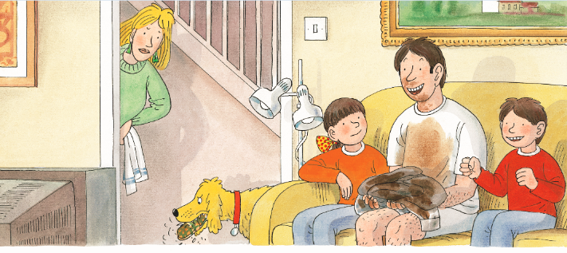
Reading
TG
LO: Understand the text; read the text fluently.
Ask one S to read the text; give feedback.
Guide Ss to talk about the comprehension questions by using the illustration and the text.
Ask Ss to read the text fluently; give feedback.
The Mud Bath
Comprehension
What did Dad do?
Did Dad remember that he ran a bath in the bathroom? Why?
What do you think would happen in the bathroom?
Dad looked at the football.
“Go on!” he called. “Kick it!”
2:00
15/26

Slide 16
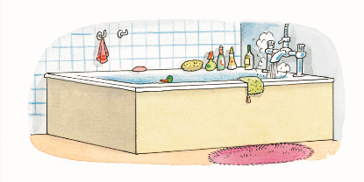
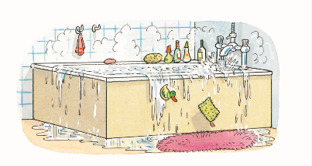
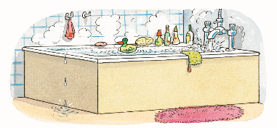
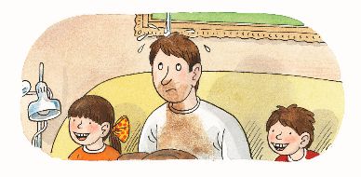
Reading
TG
The Mud Bath
LO: Understand the text; read the text fluently.
Ask one S to read the text; give feedback.
Guide Ss to talk about the comprehension questions by using the illustration and the text.
Ask Ss to read the text fluently; give feedback.
Comprehension
What did Dad forget?
What happened in the bathroom?
What was dropping on Dad’s head?
Dad forgot the bath.
Plop! Plop! Splat!
Drip! Drop! Drip!
“What was that?” said Dad.
2:00
16/26

Slide 17
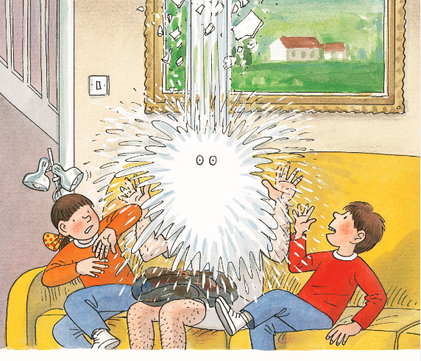
Reading
TG
LO: Understand the text; have a discussion; make connections; read the text fluently.
Read the text to Ss.
Guide Ss to talk about the comprehension questions.
Encourage Ss to talk about the discussion question; modest first; give feedback.
Click and encourage Ss to talk about the connections questions.
Have Ss read the text fluently; give feedback.
The Mud Bath
Comprehension
What happened to Dad?
Why did that happen?
Discussion
Was it a good idea for Dad to come down to watch TV while he was running a bath?
Connections
Did you forget to do anything while watching TV?
Splash! “Oh no,” said Dad.
2:30
17/26

Slide 18
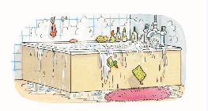
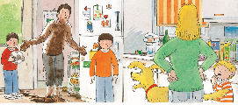
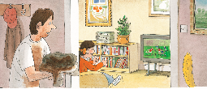
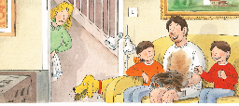
Reading
TG
Let’s retell!
LO: Retell the story with the visual support and assistance.
Guide Ss to recall the story; model first.
Have Ss work together to retell the story by using the visual aids.
__ was playing __.
___ fell over ___.
___ ran a ___.
___ watch ____.
2:00
18/26

Slide 19
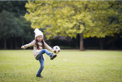
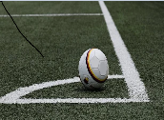
TG
Vocabulary
LO: Check Ss’ understanding of the words in this lesson.
The steps are as follows:
Click and a picture will appear; ask Ss to race and be the first to identify the word that matches the picture; click again to check their answer; last, click the winner’s pea to hit the zombie.
Note: 1. There are five words on this slide and each word has the same operational process.
2. The peas in the picture trigger the animation.
Let’s guess!
fell over
luck
bathroom
kick
football
A
B

Slide 20
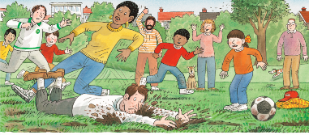
Listening &
Speaking
TG
LO: Talk about the given question by utilizing the sentence structures.
Have Ss work in pairs to talk about the given illustration by using the sentence structures and helping words; model first.
Assist Ss if necessary.
Let’s talk!
—What did Dad do?
—Dad
kicked _________.
fell over in _________.
Helping Words
the ball the cap
Biff
Chip
Kipper
TV
the mud
the water
2:00
20/26

Slide 21
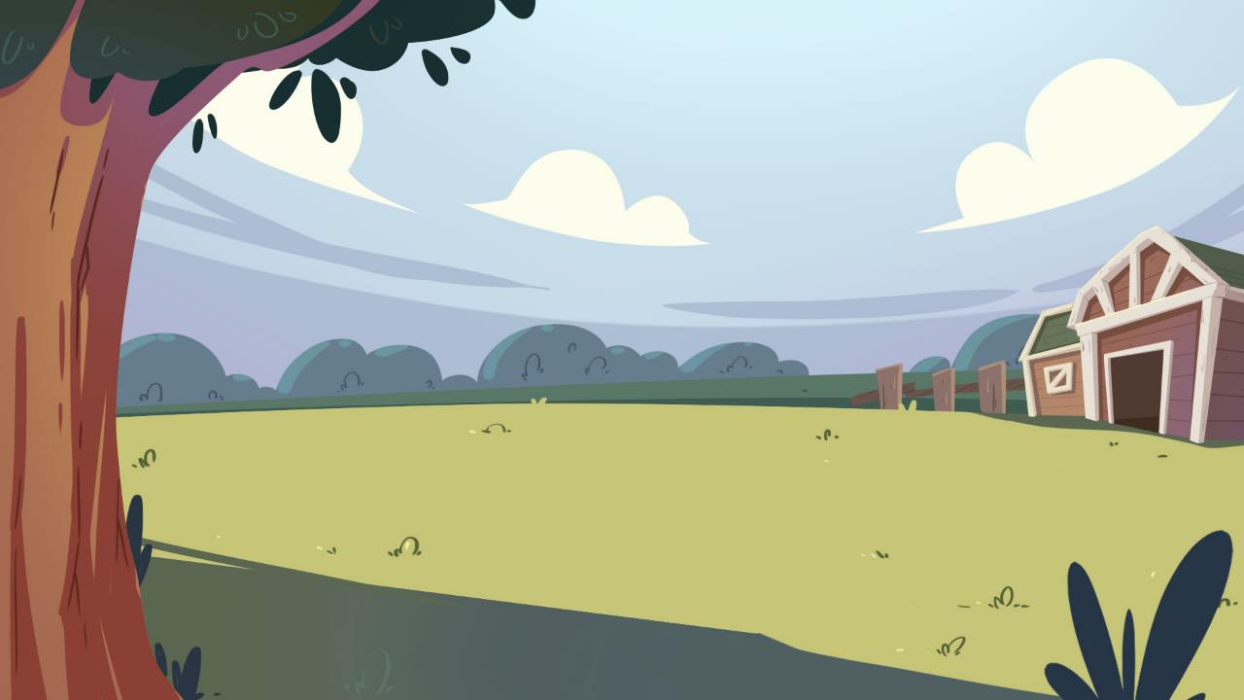
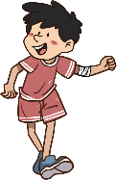
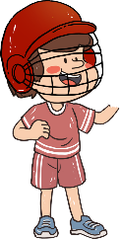
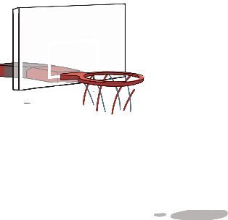
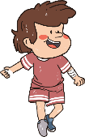
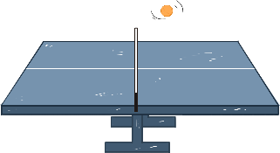
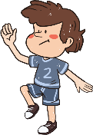
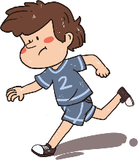
Listening &
Speaking
TG
LO: Talk about what sports you like to play.
Tell Ss to observe the picture carefully and to talk about what sports they like to play.
Have Ss take turns discussing at least three activities they like to do; model first.
Have Ss work in pairs to ask and answer questions about the given picture by using the given language structures; assist Ss if necessary.
Notes: T can click Let’s Talk to present the sentence structure, and then click again to make it disappear.
Let’s talk!
—What sports do you like to play?
—I like to play ____.
basketball
football
Ping-Pong
rugby
. . .
2:30
21/26

Slide 22
TG
Value
LO: Talk about the values presented in the lesson: Good children always finish their homework first.
1. Ask Ss the given question; model first.
2. Guide Ss to talk about the question by using the given pictures.
Encourage Ss to talk more about what they should do when they have homework but their friends want to
play.
Good children always finish their homework first.
You are doing your homework.
What should you do when your friend wants you to play your favorite sport?
What should you do when your favorite cartoon is on TV?
2:00
22/26

Slide 23
TG
Oral Writing
LO: Talk about what they’ve learned from the story by using the language support.
Guide Ss to talk about what Dad did in the rink.
Help Ss organize their ideas about the story with the given visual support and tell them, “This is the practice before your homework.”
Model the questions; ask Ss to work together to present their answers.
Get ready to present!
What did Dad do in the story?
outside
at home
Why did Dad need a bath?
2:00
23/26

Slide 24
TG
Writing
LO: Understand what the homework is.
1. Explain the writing task to Ss and check their understanding.
Tell Ss that they should finish their writing before next class. Make sure that they know to upload their homework to the platform. They will present their work next class.
3. Remind Ss to watch the post-class video and to finish the writing task.
A Retelling
Let’s draw and write!
Retell the story The Mud Bath.
Now, please follow the steps to finish your homework, and then present it in the next class:
1. Retell the story The Mud Bath in
your own words.
2. Write at least two complete
sentences to fill in the retelling
sheet.
Watch the post-class video about the writing task.
0:30
24/26

Slide 25
TG
Review
LO: Review today’s lesson.
Guide Ss to review the phonics by asking Ss to read the words.
Guide Ss to review the words by asking Ss to make sentences with them.
Guide Ss to review the sentence patterns by asking each S to make sentences with them.
Review
Let’s review!
Phonics:
mom/had/bed/
vet/jam/fed
Sentence Structure:
___ kicked/fell over ___.
Vocabulary:
football/fell over/
luck/kick/bathroom
1:00
25/26

Slide 26
TG
LO: End the lesson and encourage Ss to prepare well for the next class.
1. Briefly comment on Ss.
2. Say goodbye to students.
3. Ask Ss to preview the next lesson.
0:30
26/26

