Slide 1
LO: Introduce the topic and get to know each other.
Say hello to Ss and ask Ss to introduce themselves to each other.
Introduce the topic and ask Ss to discuss the given question.
What kind of genie do you want to have?
The Evil Genie 2
ORT-G2A Lesson 27
1:30
1/30

Slide 2
LO: Get to know the learning objectives.
Go through the learning goals with Ss. Make sure they know what they’re going to learn in the lesson.
Note: Don’t read the goals to the Ss.
Learning Goals
Decode words with the following common suffix: –ion.
Learn the key words wreck, hut, treasure, chest, whoosh, snarl, touch, and power, and understand them in context.
Apply the different reading strategies and skills when analyzing and comprehending the content; analyze a story.
Talk about the story and discuss how you can better understand other people.
0:30
2/30

Slide 3
LO: Present the writing assignment from the last lesson.
Let Ss take turns presenting the writing assignment from the last lesson.
Give feedback.
Presentation
Presentation Time
Have you finished the homework you were assigned in the last lesson?
Give your presentation and tell us about
a rewrite of a folk tale with a genie.
1:30
3/30

Slide 4
LO: Identify and pronounce the words end with -ion.
Click and read the first group of words to Ss; have them identify what the words end with.
Guide Ss to take turns reading the remaining words.
Phonics Learning
Phonics
What do these words end with?
suggestion
exhibition
examination
obsession
observation
explanation
0:30
4/30

Slide 5
LO: Decode the words in the text accurately and fluently; read the text fluently.
Guide Ss to read the story aloud together and with rhythm.
Ask Ss to take turns reading the text one sentence at a time.
Phonics
Read on Your Own
John has an obsession with history. He accepted his friends’ suggestion and went to an exhibition about ancient China after his examination. In the art and history museum, John carried out a close observation, obtained an adequate explanation, and learned more about Chinese tradition and its development in ancient times.
1:00
5/30

Slide 6
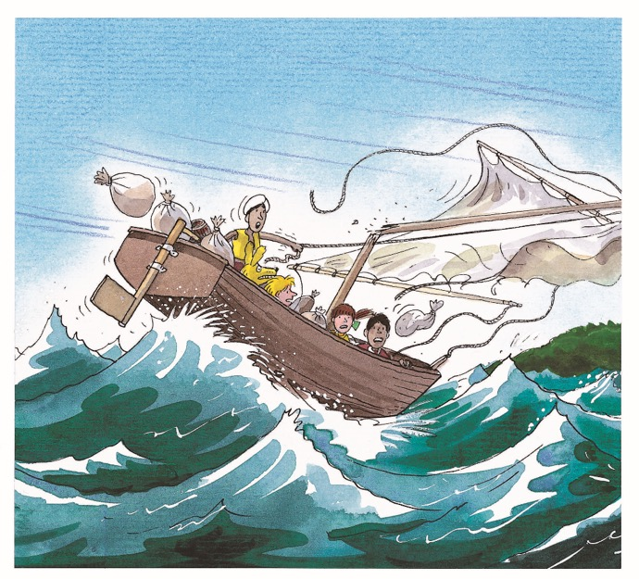
LO: Review the first part of the story.
Review what happened in the first part of the story.
Discuss the given questions and give feedback.
Background
Story Review
In our previous lesson we read about how the children magically traveled to an island.
Where are Biff, Nadim, Kipper, and Floppy? Who are they with?
Can you remember what was in the blue bottle?
1:00
6/30

Slide 7
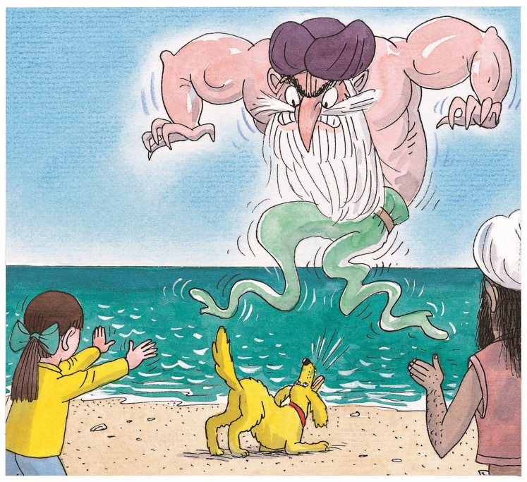
LO: Identify details and to make predictions.
Guide Ss to look at the picture closely and to talk about the given questions.
Encourage Ss to talk more about the connections question and give feedback.
Make Predictions
Lead-in
Use details from the illustration to make guesses.
Who is the Genie looking at?
How do you think the genie will react to Floppy?
1:30
7/30

Slide 8
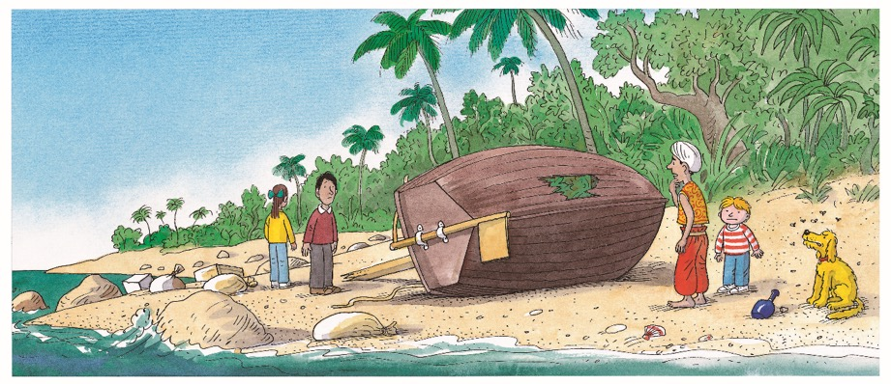
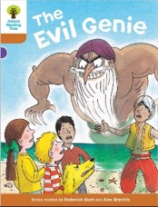
LO: Utilize the reading strategies and skills to assist in reading comprehension;
Ask Ss to take turns discussing the comprehension questions; give feedback.
The Evil Genie 2
Reading
Comprehension
What happened to the boat in the storm?
How did Nadim, Biff, and Kamar feel when they were thrown onto the beach?
How did Floppy feel, and why?
Pages 16-17
1:00
8/30

Slide 9
LO: Define the unfamiliar words wreck and hut in context.
Have Ss use the illustration and context clues to define the words wreck and hut; give feedback.
Note: If Ss can present a correct understanding of the unfamiliar word(s), it’s not necessary to teach the word(s) on the next slide.
The Evil Genie 2
Reading
Hasson told them that his ship had been wrecked on the island.
“I live in a hut made out of bits of wood. I have been alone for four years,” he said.
“Then I will take you home,” said Kamar.
“All we have to do is mend my boat.”
Vocabulary
Use the illustration and context clues to define the words wreck and hut.
Pages 18-19
2:00
9/30

Slide 10
LO: Utilize the reading strategies and skills to assist in reading comprehension; understand the words wreck and hut in context.
If Ss can present a good understanding of the words wreck and hut from the previous slide, skip the vocabulary teaching part. If not, explain the words with the sample sentences and ask Ss to make new sentences with them.
Ask Ss to discuss the comprehension questions; give feedback.
The Evil Genie 2
Reading
Read Pages 18-19
wreck (v.)
Definition: to damage a ship so much that it sinks or can no longer sail
Comprehension
Why was Kamar's father on the island?
What did Kamar want to do with his father?
What would they need to do first?
The ship was wrecked off the coast of France.
hut (n.)
Definition: a small, simply built house or shelter
A hut is a small house with only one or two rooms.
2:00
10/30

Slide 11
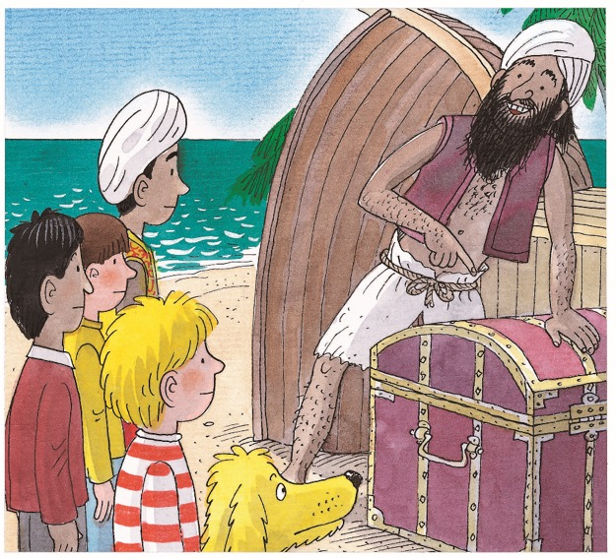
LO: Define the unfamiliar words wreck and hut in context.
Have Ss use the illustration and context clues to define the words wreck and hut; give feedback.
Note: If Ss can present a correct understanding of the unfamiliar word(s), it’s not necessary to teach the word(s) on the next slide.
The Evil Genie 2
Reading
Kamar’s father showed them a big chest.
“It was washed up in a storm,” he said. “It may be full of treasure, but I can’t open it. I don’t have a key.”
Nadim looked at the chest.
“It would need a special key to open it,” he said.
Vocabulary
Use the illustration and context clues to define the words chest and treasure.
Page 20
2:00
11/30

Slide 12
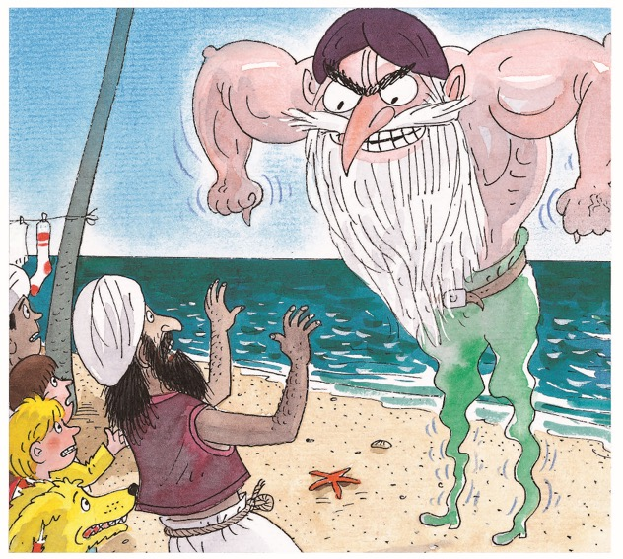
LO: Define the unfamiliar word whoosh in context; read the text fluently.
Take turns reading the passage aloud. Guide Ss to pay attention to the intonation and emotion of the passage when reading the in-text quotes.
Have Ss go through the text quickly and have Ss use the illustration and context clues to define the word whoosh.
Note: If Ss can present a correct understanding of the unfamiliar word(s), it’s not necessary to teach the word(s) on the next slide.
The Evil Genie 2
Reading
Suddenly there was a whooshing sound and a terrible smell of rotten eggs. The evil genie appeared! His voice sounded like thunder.
“Aha!” he shouted. “You trapped me in a bottle. Now I will deal with you, Hassan!”
Vocabulary
Use the illustration and context clues to define the word whoosh.
Page 21
2:00
12/30

Slide 13
LO: Utilize the reading strategies and skills to assist in reading comprehension; understand the words chest, treasure and whoosh in context.
If Ss can present a good understanding of the words chest, treasure and whoosh from the previous slides, skip the vocabulary teaching part. If not, explain the words with the sample sentences and ask Ss to make new sentences with them.
Ask Ss to take turns discussing the comprehension questions; give feedback.
The Evil Genie 2
Reading
Read Pages 20-21
chest (n.)
whoosh (v.)
Definition: a large strong box, usually made of wood
Definition: to move quickly and suddenly
Help me lift the chest up on the table.
Cool air whooshes up through the grates on the street.
treasure (n.)
Comprehension
Where did the chest come from?
Why was the genie angry with Hassan?
Definition: a collection of valuable old objects such as gold coins and jewels that has been hidden or lost
There's a lot of treasure buried here.
2:00
13/30

Slide 14
LO: Define the unfamiliar word snarl in context; read the text fluently.
Take turns reading the passage aloud. Guide Ss to pay attention to the intonation and emotion of the passage when reading the in-text quotes.
Have Ss go through the text quickly and have them use the illustration and context clues to define the word snarl.
Note: If Ss can present a correct understanding of the unfamiliar word(s), it’s not necessary to teach the word(s) on the next slide.
The Evil Genie 2
Reading
Floppy hated the adventure, and he hated the genie even more. He began to bark and snarl at the genie。
“Floppy!” called Biff. “Don’t do it.”
But Floppy barked even more.
“Help!” cried the genie. “I hate dogs.”
Vocabulary
Use the illustration and context clues to define the word snarl.
Pages 22-23
2:00
14/30

Slide 15
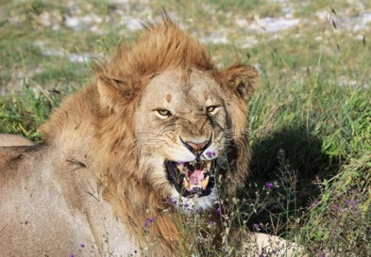
LO: Utilize the reading strategies and skills to assist in reading comprehension; understand the word snarl in context.
If Ss can present a good understanding of the word snarl from the previous slide, skip the vocabulary teaching part. If not, explain the word with the sample sentence and ask Ss to make new sentences with it.
Ask Ss to take turns discussing the comprehension questions; give feedback.
The Evil Genie 2
Reading
Read Pages 22-23
Comprehension
snarl
(v.)
How did Floppy feel? What did he do?
Why was Hassan upset? What was he confused about?
Why did the genie fly away?
Definition: to show its teeth and make a deep angry noise in its throat
The fierce lion snarled at us.
2:00
15/30
Notes:
Suggested Time: 2 mins (Understanding & Applying)
Learning Objectives:
Ss will be able to use the reading strategies and skills: making connections to analyze the story.
Ss will be able to understand the core academic word “pack” in context and use it in sentences.
TD
Choose one S to read aloud the passage.
Then explain the key word “pack" with the sample sentence and ask Ss to make sentences.
Ask Ss to discuss the given questions and give feedback.

Slide 16
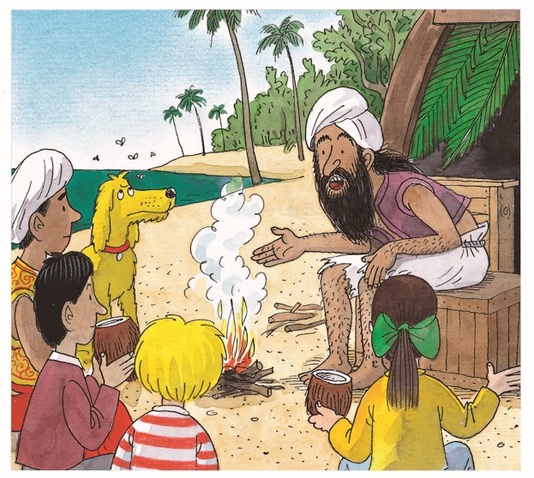
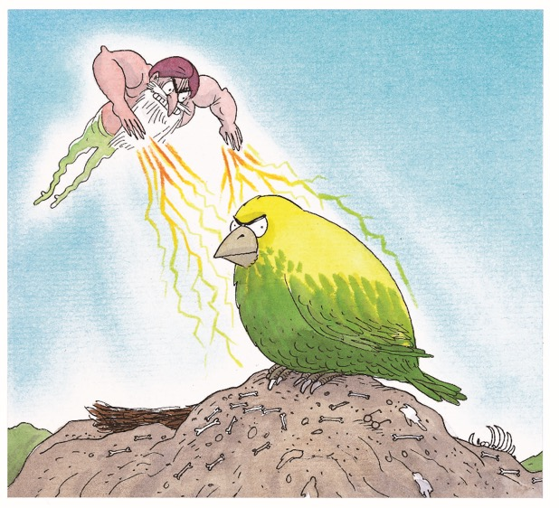
LO: Utilize the reading strategies and skills to assist in reading comprehension; understand the words touch and power in context.
If Ss can present a good understanding of the words touch and power from the previous slide, skip the vocabulary teaching part. If not, explain the words with the sample sentences and ask Ss to make new sentences with them.
Ask Ss to discuss the comprehension questions; give feedback.
The Evil Genie 2
Reading
Vocabulary
Pages 24-25
Use the illustration and context clues to define the words touch and power.
1:00
16/30

Slide 17
LO: Utilize the reading strategies and skills to assist in reading comprehension; understand the words touch and power in context.
If Ss can present a good understanding of the words touch and power from the previous slide, skip the vocabulary teaching part. If not, explain the words with the sample sentences and ask Ss to make new sentences with them.
Ask Ss to discuss the comprehension questions; give feedback.
The Evil Genie 2
Reading
Read Pages 24-25
touch (v.)
Comprehension
Definition: to place one’s hand on an object in order to feel it or to make contact with it
The genie made a storm. How many more bad things could he do after that on that day?
What do you think the bird would do?
Don’t touch my cellphone.
power (n.)
Definition: the ability to control people or things
He has the power to make things very unpleasant for us.
2:00
17/30

Slide 18
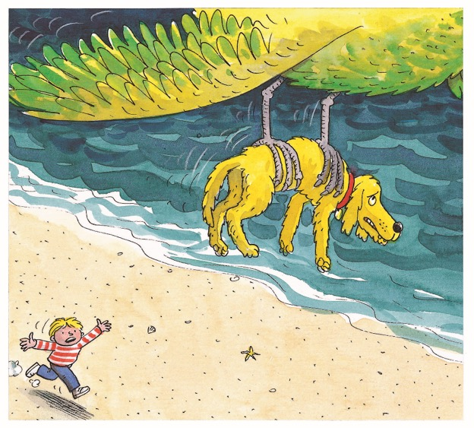
LO: Utilize the reading strategies and skills to assist in reading comprehension and in making connections;
Ask Ss to discuss the given questions; give feedback.
The Evil Genie 2
Reading
Comprehension
Why did Floppy run away?
Where were the children?
How do you think everyone felt when the bird came?
Connections
Can you remember all the things that Floppy didn't like about this adventure so far?
Page 27
2:00
18/30
Notes:
Suggested Time: 2 mins (Understanding & Applying)
Learning Objectives:
Ss will be able to use the reading strategies and skills: making connections to analyze the story.
Ss will be able to understand the core academic word “pack” in context and use it in sentences.
TD
Choose one S to read aloud the passage.
Then explain the key word “pack" with the sample sentence and ask Ss to make sentences.
Ask Ss to discuss the given questions and give feedback.

Slide 19
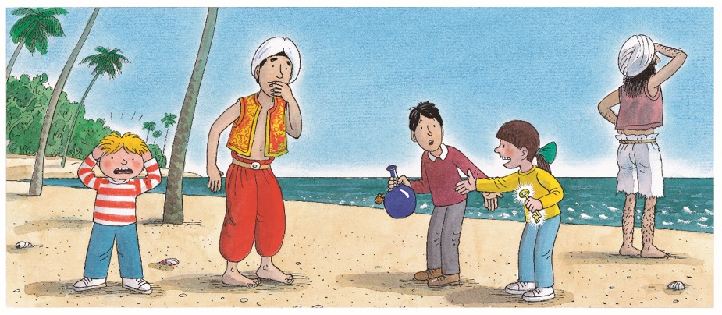
LO: Utilize the reading strategies and skills to assist in reading comprehension and in making connections;
Ask Ss to discuss the given questions; give feedback.
The Evil Genie 2
Reading
Comprehension
How did Kipper feel? How do you know?
Why did Nadim ask the key to stop glowing?
Connections
Can you think of a way to get the genie back into the bottle? Discuss your ideas with your partner.
Page 29
2:00
19/30
Notes:
Suggested Time: 2 mins (Understanding & Applying)
Learning Objectives:
Ss will be able to use the reading strategies and skills: making connections to analyze the story.
Ss will be able to understand the core academic word “pack” in context and use it in sentences.
TD
Choose one S to read aloud the passage.
Then explain the key word “pack" with the sample sentence and ask Ss to make sentences.
Ask Ss to discuss the given questions and give feedback.

Slide 20
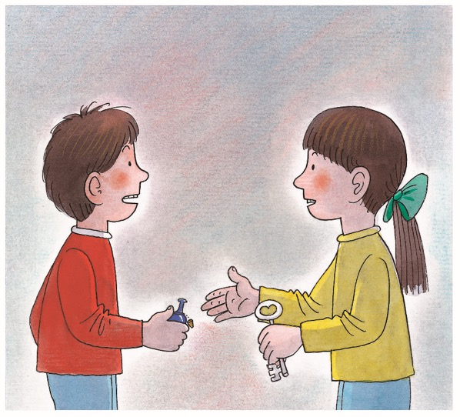
LO: Utilize the reading strategies and skills to assist in reading comprehension.
Ask Ss to take turns discussing the comprehension questions; give feedback.
The Evil Genie 2
Reading
Comprehension
How did Biff, Kipper, and Nadim feel when the magic took them home? Why?
Why did Biff want the key to glow again?
What do you think would happen to Floppy?
Page 32
2:00
20/30
Notes:
Suggested Time: 2 mins (Understanding & Applying)
Learning Objectives:
Ss will be able to use the reading strategies and skills: making connections to analyze the story.
Ss will be able to understand the core academic word “pack” in context and use it in sentences.
TD
Choose one S to read aloud the passage.
Then explain the key word “pack" with the sample sentence and ask Ss to make sentences.
Ask Ss to discuss the given questions and give feedback.

Slide 21
LO: Introduce the concept of analyze a story.
Introduce the concept of a point of view. The main story elements include setting, characters, and plot.
Click and model to identify the main story elements of The Evil Genie.
Analyze a Story
The main story elements include the setting, the characters, and the plot. The setting is when and where a story takes place. The characters are people and animals in the story. The plot refers to the important events and actions that occur in a story.
Story
Settings
Plots
Characters
Instructions:
Identify the settings, characters, and plots of the story.
Analyze main characters’ actions.
2:00
21/30

Slide 22
Identify the main story elements of The Evil Genie.
The Evil Genie
Settings
Plots
Characters
in Biff’s hometown
on a tiny and bare island
on the sea
on a big island
in Biff’s home
Biff did an experiment.
The magic took the children to a tiny island.
Kamar sailed to rescue the children.
The genie made a storm, blowing the children to a big island.
Floppy barked at the genie.
The genie used his power to take Floppy away.
The magic took the children home.
Biff, Nadim, Kipper, Floppy, Kamar, the genie, Hassan, the large bird, Mum, Chip
What happened next? Please have a try.
2:00
22/30

Slide 23
LO: Apply the reading strategies and skills designed to analyze the main characters in the story, and discuss how these skills and strategies can help in the analysis of a story.
Click and have Ss work together to identify the character’s actions and traits in the story.
Give feedback.
Analyze the main characters in the story.
Characters | Characters’ Actions | Characters’ traits
Biff
Kamar
did an experiment
picked up a bottle
tried to stop Floppy barking
called Floppy to come back to the hut
told Chip about Floppy
curious
caring
It’s your turn.
It’s your turn.
1:00
23/30

Slide 24
LO: Check if Ss understand the words in context.
Ask Ss to take turns reading the words aloud.
Ask Ss to fill in the blanks and read the sentences.
Read & Choose
Many people came to the island in search of __________.
When an animal _______ , it makes a fierce, rough sound in its throat while showing its teeth.
Don’t _______ that plate. It’s very hot.
The ship was _________ by an explosion.
treasure
snarls
touch
wrecked
Complete the sentences. Use the correct form of the words in the box.
touch, snarl, treasure, wreck
1:30
24/30

Slide 25
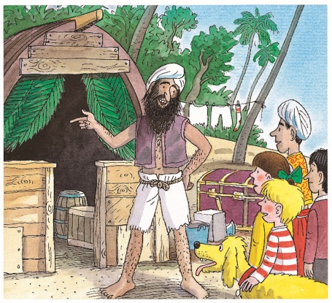
LO: Talk about what Hassan told the children when they met on the big island.
Instruct Ss to discuss the given question.
Encourage Ss to answer questions using the given clues and to present their answers with at least 3 complete sentences; assist Ss if necessary.
Listening & Speaking
What did Hassan tell the children when they met on the big island?
his ship had been wrecked
lived in a hut
couldn’t open a big chest full of treasure
put the genie in a bottle
. . .
1:30
25/30

Slide 26
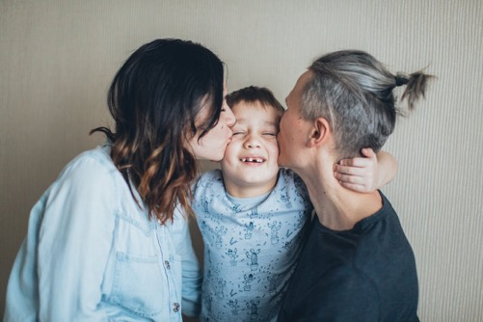
LO: Talk about what you share with others.
Ask Ss to talk about what they share with others.
Encourage Ss to answer the question in complete sentences with the given clues; assist Ss if necessary.
Listening & Speaking
What do you usually tell your family and friends about after you’ve been away for a long time?
new knowledge and skills
new friends
special places
. . .
1:30
26/30

Slide 27
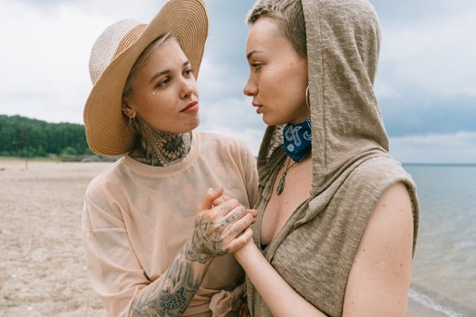
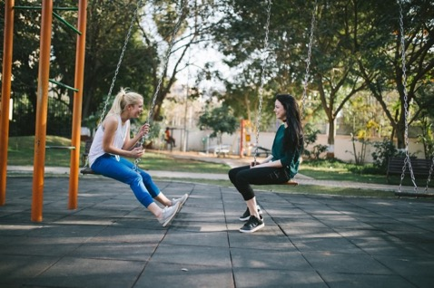
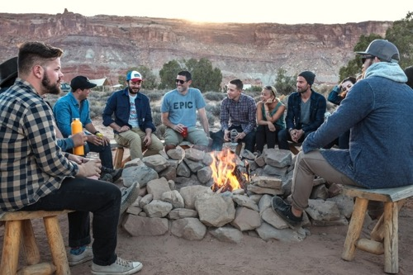
LO: Have Ss talk about what you would tell your family and friends after a period of separation.
Guide Ss to look at the pictures; have Ss talk about the given question; assist Ss if necessary.
Value
How can you better understand other people?
2:00
27/30

Slide 28
LO: Describe the two bad things the genie did throughout the story with the help of the given chart.
Explain the task to Ss.
Model first; have Ss d escribe the two bad things the genie did throughout the story.
Give feedback.
Writing
Get Ready to Present
Describe the bad things the genie did throughout the story with the help of the given chart.
Work together to complete the task.
What was the first bad thing the genie did?
What was the second bad thing the genie did?
Why did the genie do that?
How did the genie do that?
What happened after that?
Why did the genie do that?
How did the genie do that?
What happened after that?
28/30
2:30

Slide 29
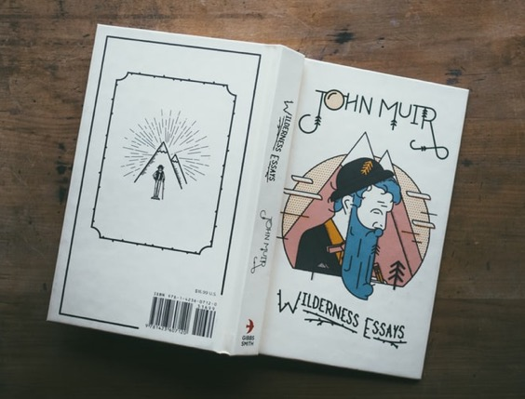
LO: Understand what the writing task is; know to complete the writing task with the help of the post-class instructional video.
Introduce and explain the writing task to Ss.
Ask Ss to finish the task before the next class and to be ready to present.
Remind Ss to watch the post-class video before writing.
Writing
Homework: A Folk Tale
Rewrite a folk tale with a genie in three paragraphs.
Step 4. Revise: Change Your Writing
Step 5. Edit: Check Your Writing
Step 6. Publish: Make Your Final Copy
Watch the post-class video before you start writing.
1:30
29/30

Slide 30
LO: Review the whole lesson.
Review the key words with Ss by asking Ss to make sentences.
Review the story with Ss by asking the given questions.
Let’s Review
Story: The Evil Genie 2
Key Words:
wreck, hut, treasure, chest,
whoosh, snarl, touch, power
Key Questions:
What did Hassan tell the children when they met on the big island?
What do you usually tell your family and friends about after you’ve been away for a long time?
1:30
30/30

Slide 31
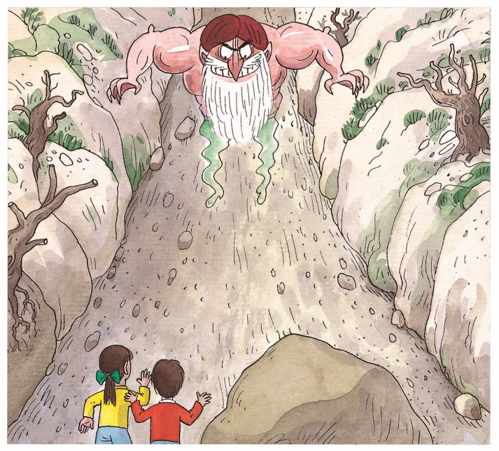
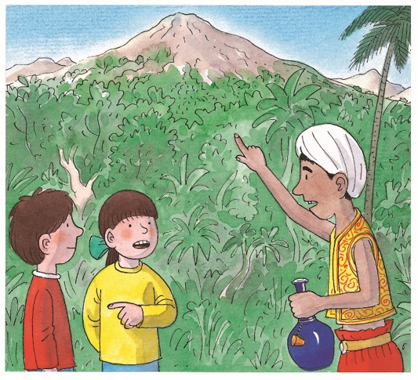
TG
LO: End the lesson and encourage Ss to perform better
in the next class.
1. Briefly comment on Ss’ performance.
2. Say goodbye to Ss.
3. Ask Ss to preview the next lesson.
0:30
31/31

