Slide 1
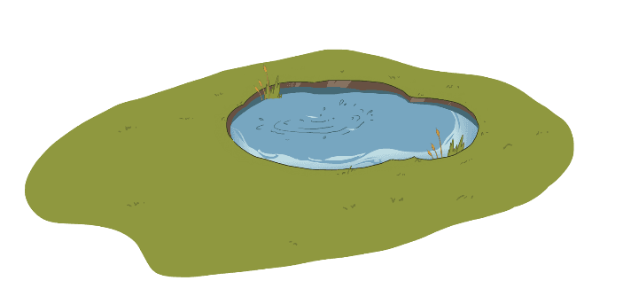
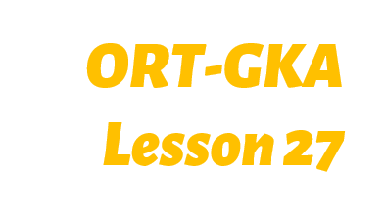
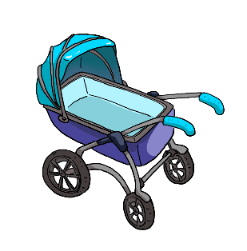
TG
LO: Get to know their partners; get a basic idea about the topic of today’s lesson.
1. Say hello to Ss; ask Ss to introduce themselves and to greet each other.
2. Guide Ss to describe the pictures on the first page.
3. Introduce the topic of the lesson.
1:00
1/26

Slide 2
Learning
Goals
TG
LO: Get to know and understand what will be learned in this lesson.
Go through the learning goals with Ss.
We are
going to . . .
Blend letters’ sounds in one-syllable words.
Learn the different words pond, junk, pram, frog, and fish, and make sentences with them.
Read the story Pond Dipping, and learn to ask questions about a story to self-check throughout the reading process.
Practice using the sentence structure
_______ pulled/pulled out ________.
0:30
2/26

Slide 3
Presentation
TG
TG
LO: Present and share the writing that was assigned last lesson.
1. Let Ss present in turns.
2. Encourage Ss to listen carefully and to ask questions.
3. After both of the Ss have finished, give them feedback and awards (Click the picture of
the book beside the boy or girl so that they can get some awards). Click and give each
S a trophy to mark their good performance.
Note: You can click the picture of the boy or the girl to give Ss the trophy.
Let’s show!
This is a retelling of the book The Mud Bath.
2:00
3/26

Slide 4
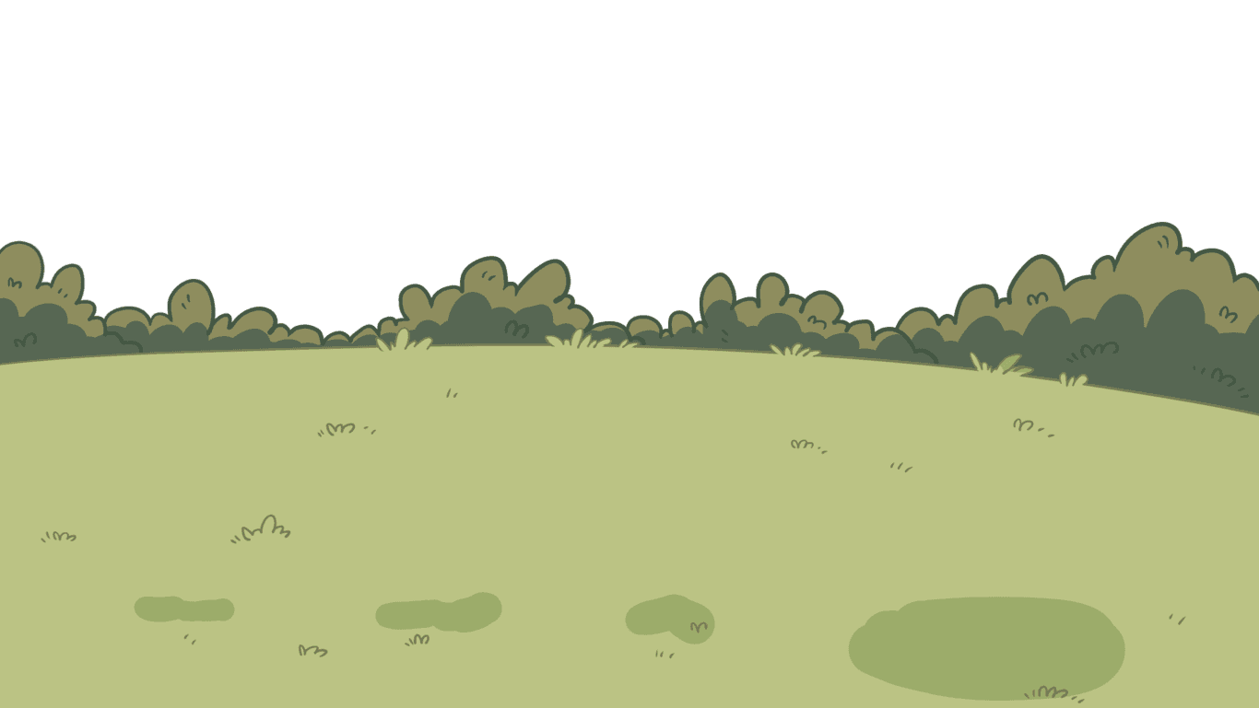
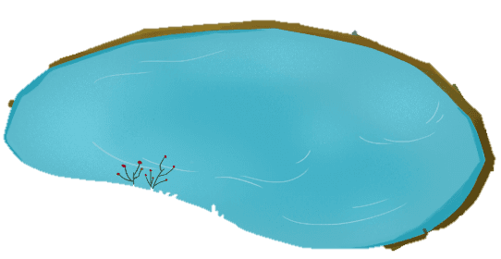
Phonics
TG
LO: Identify the different sounds accurately; blend different letter sounds into one word; read the words accurately.
Ask Ss to talk about what they can see in the picture; click and tell them to help the children in the picture pick up the bottles on the ground.
Ask Ss to blend different letter sounds into one word.
The process is as follows:
Ask Ss to read the letter sounds on this slide; click and help the children pick up the bottles in their basket, and ask Ss to read the sounds and words in this way: b-a-t, bat, bat.
Repeat this practice for the rest of the words; Ss will learn three words on this slide.
Let’s listen and speak!
There are some letters on the bottles. Can you blend these letters to make words?
b
a
t
There are so much garbage. Let’s pick them up!
t
a
g
d
o
g
bat
tag
dog
t
a
b
Let’s try!
o
g
d
2:30
4/26

Slide 5
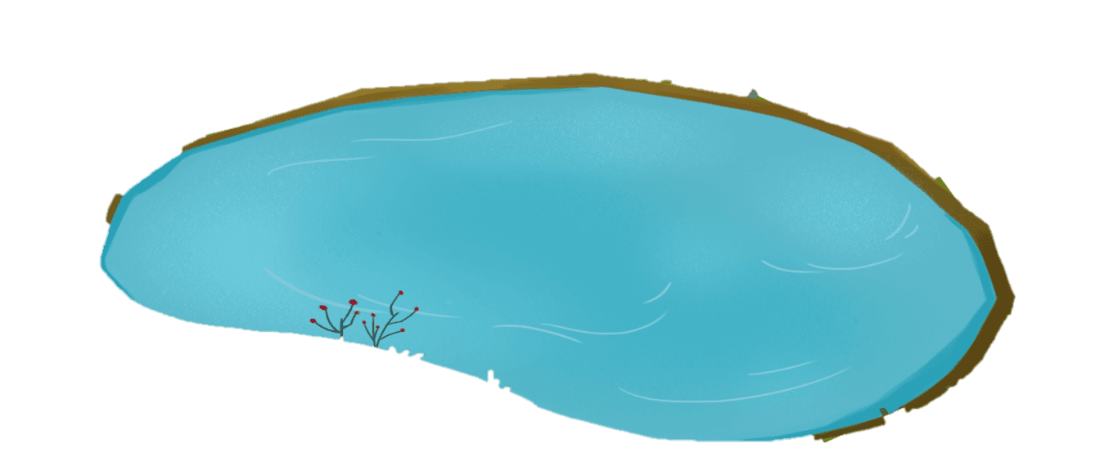
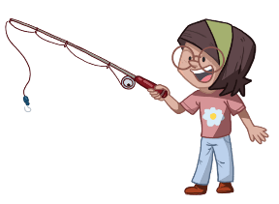
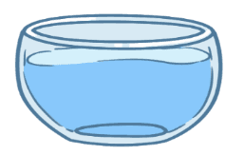
Phonics
TG
Let’s listen and speak!
Phonics
LO: Identify the different sounds accurately; blend different letter sounds into one word; read the words accurately.
Ask Ss to talk about what they can see in the picture; click and tell them to help the children in the picture pick up the rubbish in the lake.
Click and guide Ss to read the sounds when the bottles are picked up; click and guide Ss to read the words in this way: g-o-t, got, got.
Repeat this practice for the rest of the words; Ss will learn three words on this slide.
g
o
t
g
o
d
b
a
d
got
god
bad
d
b
g
t
a
g
o
o
t
b
a
2:30
5/26

Slide 6
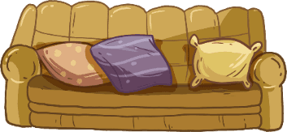
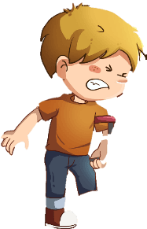
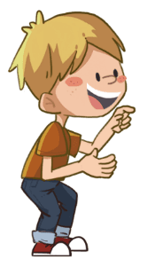
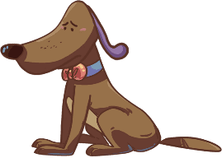
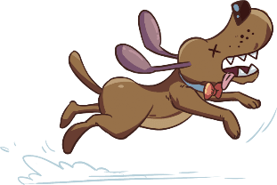
Phonics
TG
Let’s chant!
LO: Read the text fluently; isolate and pronounce the initial, medial vowel, and final sounds (phonemes) in three-phoneme (CVC) words.
Click and read the text to Ss with rhythm.
Guide Ss to repeat after you; ask Ss to take turns reading each sentence until they finish reading the text; give feedback.
Ask Ss to take turns isolating the words like this: m-o-m, mom; model first.
A kid was happy to get a new bat.
He tore off the tag from the bat.
His dog was interested in the bat.
It played with the bat and gnawed it away.
The kid got the news and ran back home.
“Oh my god!” the kid yelled. “What a bad dog!”
2:00
6/26

Slide 7
Lead-in
TG
LO: Look at the book cover closely and have Ss talk about the first two questions by using the illustration and the title.
Have Ss look at the book cover closely and have Ss talk about the first two questions by using the illustration and the title.
Encourage Ss to talk about the connections questions.
Before Reading
1. Where is the family? What
are the children doing?
2. What do you think “pond
dipping” means? What do you
think the story is about?
Connections
Did you try to catch something in a pond before? What did you find in the pond?
Written by Roderick Hunt
Illustrated by Alex Brychta
2:00
7/26

Slide 8
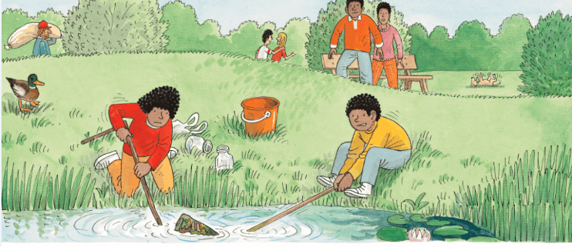
TG
Reading
Let’s predict!
LO: Identify details and make predictions about the story by using the illustration; activate Ss’ interest in reading.
Ask them to make guesses prior to reading the story by looking at the illustration.
Have Ss observe the illustration carefully and have Ss talk about the given questions.
Before Reading
1. What are Wilf and
Wilma doing? What
look is on Wilf’s face?
What do you think Dad
and Mum will do next?
2. What do you think
the family will pull out
from the pond?
2:00
8/26

Slide 9
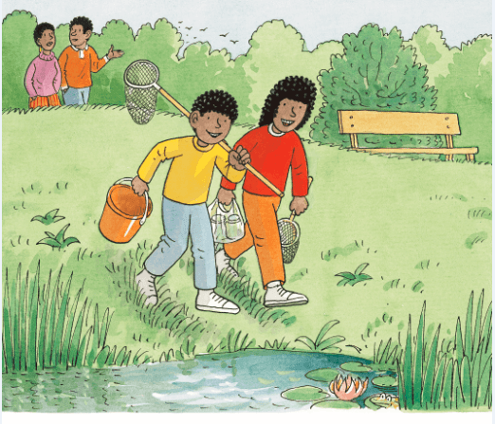
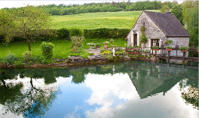
TG
Reading
LO: Understand the meaning of the vocabulary word pond, and make sentences with it; understand the
text; read the text fluently.
Read the text aloud to Ss.
Ask one S to find the vocabulary word pond in the text; click the penguin card and explain its purpose to Ss; have Ss read the word and have Ss make sentences with it.
Have Ss talk about the comprehension questions by using the text and illustration.
Ask Ss to take turns reading the text fluently; give feedback.
Pond Dipping
Vocabulary
Comprehension
Where were Wilf and Wilma?
What tools were Wilf and Wilma holding? What do you think Wilf and Wilma would do? Look at the illustration.
pond
There is a pond near the cabin.
Wilf and Wilma were at the pond.
pond
2:30
9/26

Slide 10
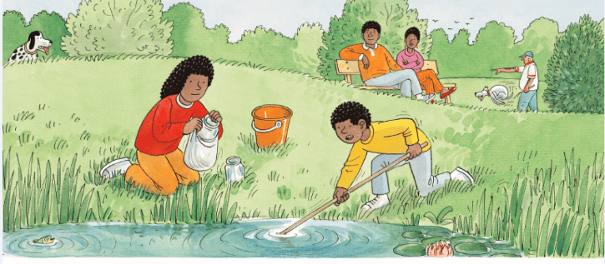
TG
Reading
Pond Dipping
LO: Understand the text; read the text fluently.
Read the text to Ss.
Guide Ss to talk about the comprehension questions by using the illustration and text.
Ask Ss to take turns reading the text aloud; give feedback.
Comprehension
What happened to the net? What did Wilf want Wilma to do to help him?
2. What do you think the
children wanted to do
at the pond? How do
you know?
The net got stuck.
“Help me pull,” said Wilf.
4:00
10/26

Slide 11
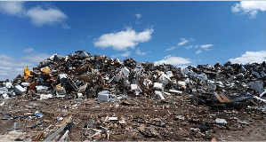
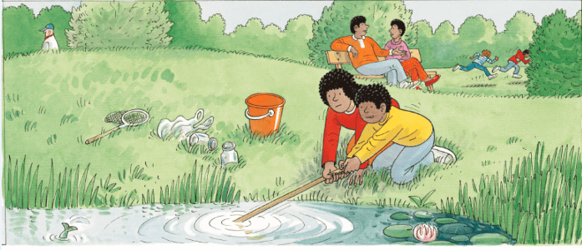
Reading
TG
LO: Understand the meaning of the vocabulary word junk, and make sentences with it; understand the text;
self-check through reading; decode the sight words accurately; read the text fluently.
Read the text to Ss.
Ask one S to find the vocabulary word junk in the text; click the penguin card and explain the word’s purpose to Ss; have Ss read the word and have Ss make sentences with it.
Have Ss talk about the comprehension questions by using the text and the illustration.
Encourage Ss to talk about the monitoring question; assist if necessary.
Click and ask Ss to find the sight word with in the text and guide them to read it accurately.
Have Ss read the text fluently; give feedback.
Pond Dipping
Comprehension
Vocabulary
1. What did Wilf and Wilma do?
2. What happened to the net?
3. What animals do you think
lived in the pond?
Monitoring
junk
Ask yourself:
Is it a good idea to get rid of junk in the pond? Why?
(Tips: You can talk about it with
your partner.)
There is lots of junk in this area.
Sight Word
pulled
They pulled the net.
It was stuck on some junk.
junk
2:30
11/26

Slide 12
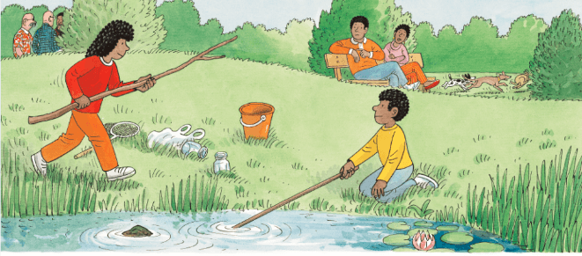
Reading
TG
LO: Understand the text; read the text fluently and at an appropriate rate.
Read the text to Ss.
Guide Ss to talk about the comprehension questions by using the illustration and text.
Have Ss read the text fluently and at an appropriate rate; give feedback.
Pond Dipping
Comprehension
What did Wilma get?
What did Wilma want to do with it?
Decoding
Read at an appropriate rate.
Wilma got a big stick.
“Let’s pull it out,” she said.
2:30
12/26

Slide 13
Reading
TG
LO: Understand the text; read the text fluently and at an appropriate rate.
Read the text to Ss.
Guide Ss to talk about the comprehension questions by using the illustration and text.
Have Ss read the text fluently and at an appropriate rate; give feedback.
Pond Dipping
Comprehension
What did Wilf and Wilma do with the stick？What was the result?
What would Mum and Dad do next? Look at the illustration.
What do you think the family would pull out from the pond?
Wilf and Wilma pulled.
They couldn’t pull the junk out.
Decoding
Read at an appropriate rate.
2:00
13/26

Slide 14
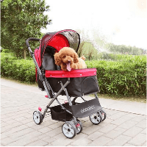
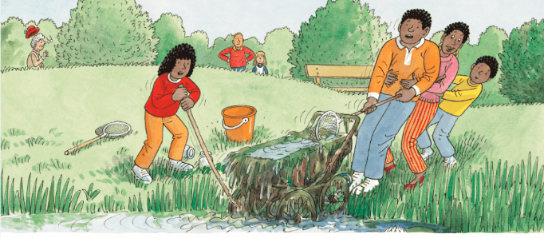
Reading
TG
LO: Understand the meaning of the vocabulary word pram, and make sentences with it; understand the text; self-check through reading; read the text fluently.
Read the text to Ss.
Ask one S to find the vocabulary word pram in the text; click the penguin card and explain the word’s purpose to Ss; have Ss read the word and have Ss make sentences with it.
Guide Ss to talk about the comprehension questions by using the illustration and text.
Encourage Ss to talk about the monitoring question; assist if necessary.
Ask Ss to take turns reading the text; give feedback.
Pond Dipping
Vocabulary
Comprehension
What did Dad and Mum do?
What did the family pull out from the pond? What do you think should live in the pond?
What do you think was in the pram?
pram
There is a dog in
the pram.
Monitoring
Mum and Dad helped.
Ask yourself:
Why was the pram in the pond?
(Tips: You can talk about it with
your partner.)
They pulled out an old pram.
pram
2:00
14/26

Slide 15
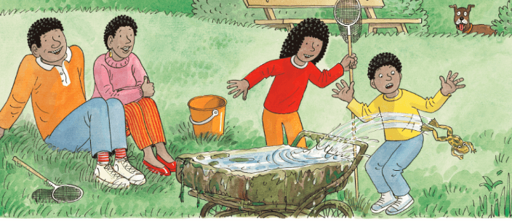
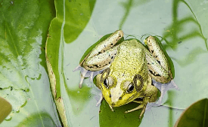
Reading
TG
Pond Dipping
LO: Understand the meaning of the vocabulary word frog, and make sentences with it; understand the text; read the text fluently.
Read the text to Ss.
Ask one S to find the vocabulary word frog in the text; click the penguin card and explain the word’s purpose to Ss; have Ss read the words and have Ss make sentences with it.
Guide Ss to talk about the comprehension questions by using the illustration and text.
Ask Ss to read the text fluently; give feedback.
Vocabulary
Comprehension
What hopped out of the pram?
2. What did Wilf do? How
did he feel? Why?
frog
This frog is sitting on a big leaf.
Plop! A frog hopped out.
It made Wilf jump.
frog
2:00
15/26

Slide 16
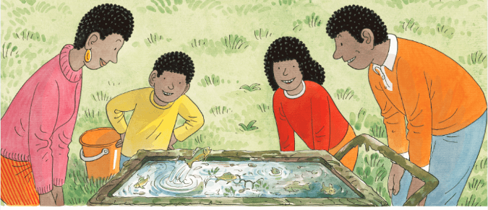
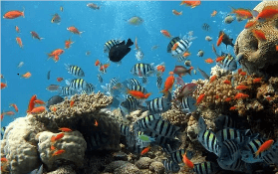
Reading
TG
Pond Dipping
LO: Understand the meaning of the vocabulary word fish, and make sentences with it; understand the text; read the text fluently.
Read the text to Ss.
Ask one S to find the vocabulary word fish in the text; click the penguin card and explain the word’s purpose to Ss; have Ss read the word and have Ss make sentences with it.
Guide Ss to talk about the first and second comprehension questions by using the illustration and the text.
Click and guide Ss to talk about the third comprehension question.
Ask Ss to read the text fluently; give feedback.
Vocabulary
Comprehension
What jumped out of the pram?
What were in the pram? Look for clues in the text and the illustration.
fish
3. How did everyone feel
when they found fish in the
pram? Why did they feel
that way?
There are so many fish in the sea.
Splash! A fish jumped up.
“A pram full of fish,” said Dad.
fish
2:00
16/26

Slide 17
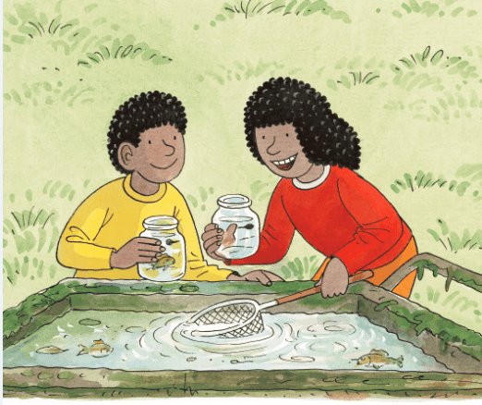
Reading
TG
Pond Dipping
LO: Understand the text; ask questions throughout the reading process; have a discussion; read the text fluently.
Read the text to Ss.
Guide Ss to talk about the comprehension questions.
Encourage Ss to talk about the monitoring question; assist if necessary.
Click and encourage Ss to talk about the discussion question; modest first; give feedback.
Have Ss read the text fluently; give feedback.
Comprehension
What were Wilf and Wilma doing?
Discussion
What lives in ponds? Fish or junk? Should we get rid of junk in ponds and rivers? Why?
Monitoring
Ask yourself:
Do I understand the meaning of pram dipping here?
A. Yes. It means _______.
B. No.
(Tips: You can look for clues
in the whole text.)
“Pram dipping!” said Wilma.
2:30
17/26

Slide 18
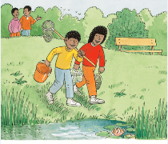
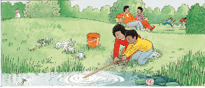
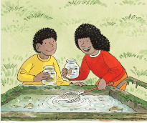
Reading
TG
Let’s retell!
LO: Retell the story with the visual support and assistance.
Guide Ss to recall the story; model first.
Have Ss work together to retell the story by using the visual aids.
2:00
18/26

Slide 19
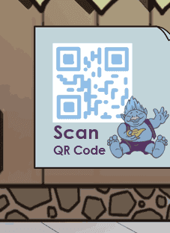
TG
Vocabulary
Let’s guess!
LO: Check Ss’ understanding of the words in this lesson.
Guide Ss to talk about what they can see in the picture; invite Ss to scan the code together.
The steps are as follows:
Click and a picture will appear; next, ask Ss to identify the picture with the correct vocabulary word; click and the answer will appear.
Note: There are five words on this slide.
pond
junk
pram
frog
fish
2:00
19/26

Slide 20
Listening &
Speaking
TG
Let’s talk!
LO: Talk about the given question by utilizing the sentence structures.
Have Ss work in pairs to talk about the given illustration by using the sentence structures and helping words; model first.
Assist Ss if necessary.
—What did ___ do in the story?
____ pulled ______.
—
____ pulled out _____ from the pond.
Helping Words
Biff
Chip
Kipper
TV
Wilf
Wilma
Dad & Mum
net
net with a stick
pram
2:00
20/26

Slide 21
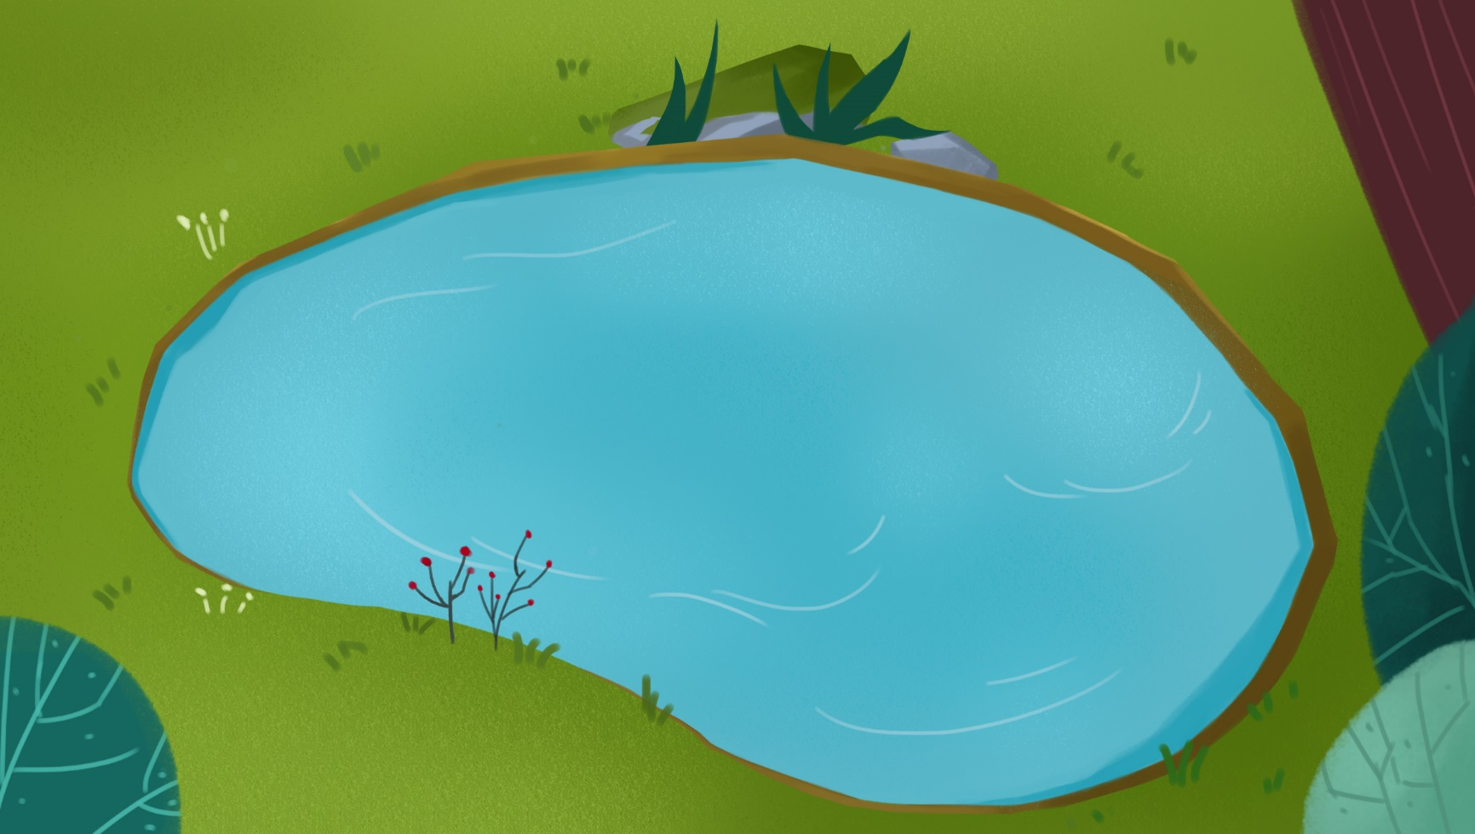
Listening &
Speaking
TG
LO: Talk about what junk they found in the pond.
Tell Ss to observe the picture carefully and to talk about what junk they found in the pond.
Have Ss take turns discussing at least three activities they like to do; model first.
Have Ss work in pairs to ask and answer questions about the given picture by using the given language structures; assist Ss if necessary.
Click and guide Ss to talk about the discussion question; click and show the right answer.
Notes: T can click Let’s Talk to present the sentence structure, and then click again to make it disappear.
Let’s talk!
—What junk did they find in the pond?
—They found _______ in the pond.
beverage bottles
peels
abandoned wheels
. . .
Should we get rid of some junk in ponds or the rivers?
No, we shouldn’t.
2:30
21/26

Slide 22
TG
Value
LO: Talk about the values presented in the lesson: We should protect our environment.
1. Ask Ss the given question; model first.
2. Guide Ss to talk about the question by using the given pictures.
3. Encourage Ss to talk more about what we should do to protect our environment.
What should we do to protect our environment?
throw garbage
into bins
pick up garbage
2:00
22/26

Slide 23
TG
Oral Writing
LO: Talk about what they’ve learned from the story by using the language support.
Guide Ss to talk about what the family did in the story Pond Dipping.
Help Ss to organize their ideas about the story with the given visual support and tell them, “This is practice before your homework.”
Model the questions; ask Ss to work together to present their answers.
Get ready to present!
What did the family do in the story Pond Dipping?
Wilf
Wilma
pull
helped Wilf pull
helped Wilf with the stick
Mum & Dad
helped pull
______ pulled/pulled out _______.
2:00
23/26

Slide 24
TG
Writing
LO: Understand what the homework is.
1. Explain the writing task to Ss and check their understanding.
Tell Ss that they should finish their writing before next class. Make sure that they know to upload their homework to the platform. They will present their work next class.
3. Remind Ss to watch the post-class video and to finish the writing task.
A Picture Story
Let’s draw and write!
A Picture Story
Now, please follow the steps to finish your homework, and then present it in the next class:
1. Create a picture story about
an outdoor activity.
2. Write two complete sentences
to describe it.
Watch the post-class video about the writing task.
0:30
24/26

Slide 25
TG
Review
LO: Review today’s lesson.
Guide Ss to review the phonics by asking Ss to read the words.
Guide Ss to review the words by asking Ss to make sentences with them.
Guide Ss to review the sentence patterns by asking each S to make sentences with them.
Review
Let’s review!
Phonics:
bat/tag/dog/got
/god/bad
Sentence Structure:
____ pulled/pulled out ____.
Vocabulary:
pond/junk/
pram/frog/fish
1:00
25/26

Slide 26
TG
LO: End the lesson and encourage Ss to prepare well for the next class.
1. Briefly comment on Ss.
2. Say goodbye to students.
3. Ask Ss to preview the next lesson.
0:30
26/26

