Slide 1
SEASONS

Slide 2
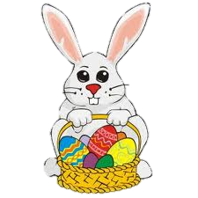

Slide 5
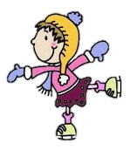

Slide 10
Let’s sing a song. ‘don’t do that’
TenchiAbel https://www.youtube.com/watch?v=P3Sj17aSuPA

Slide 11
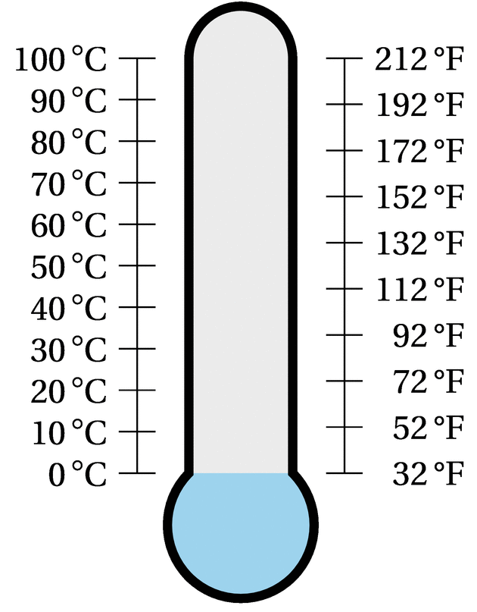
temperatures

Slide 12
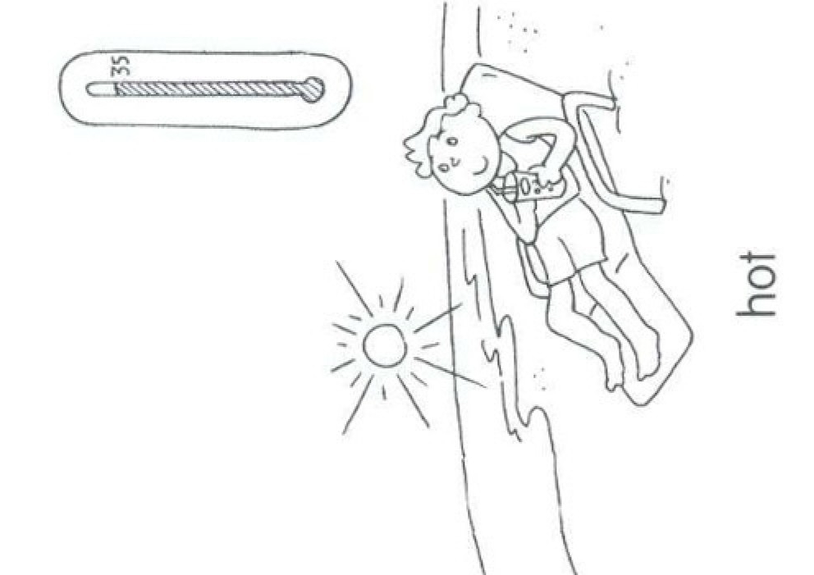
It’s Hot

Slide 13
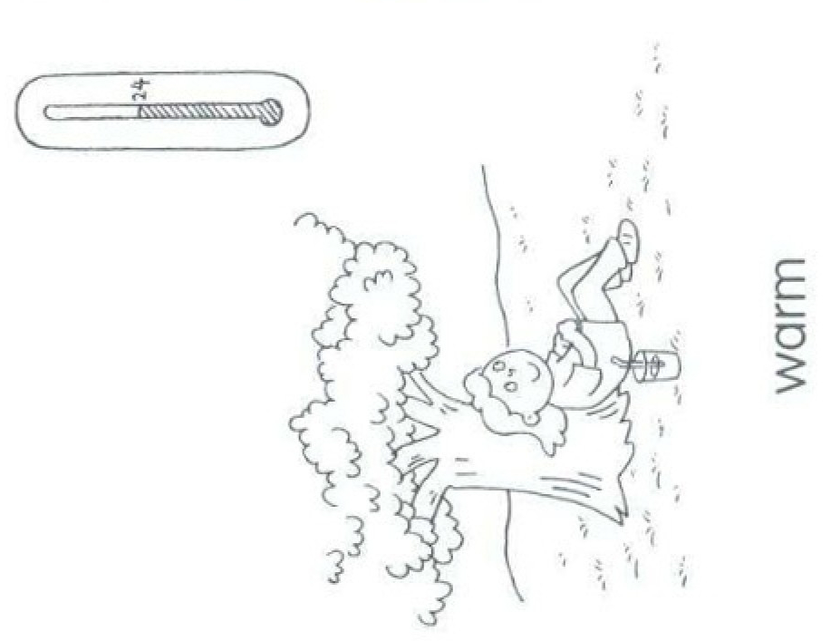
It’s warm

Slide 14
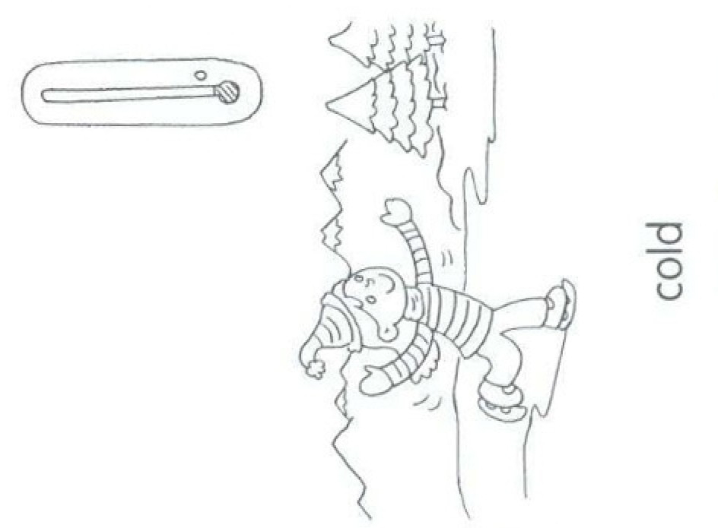
It’s cold

Slide 15
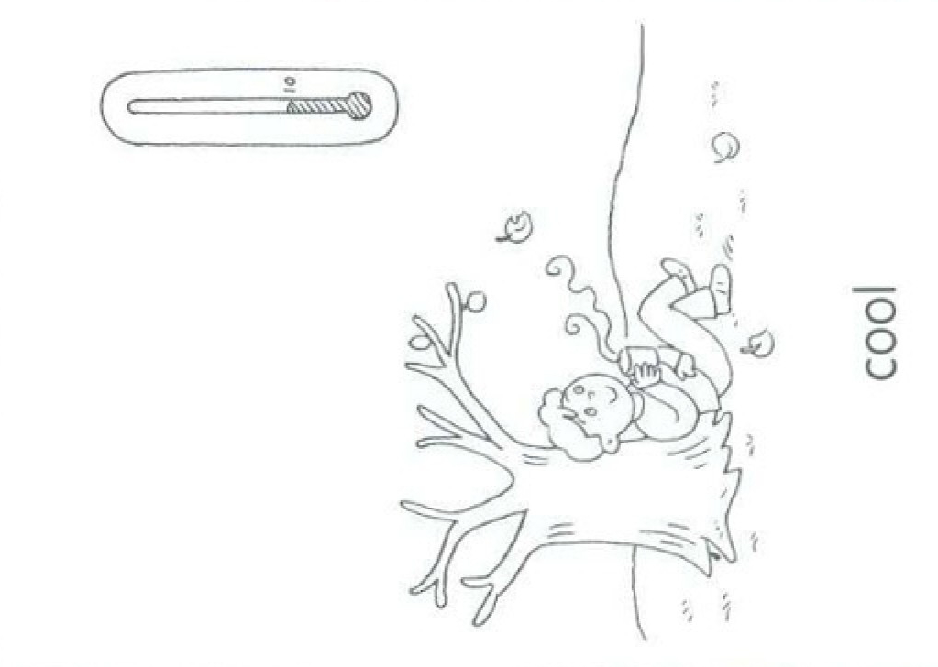
It’s cool

Slide 16
What’s the weather like?
GREAT
It’s cold.
It’s hot.
It’s cool.

Slide 17
What’s the weather like?
GREAT
It’s hot.
It’s warm.
It’s cold.

Slide 18
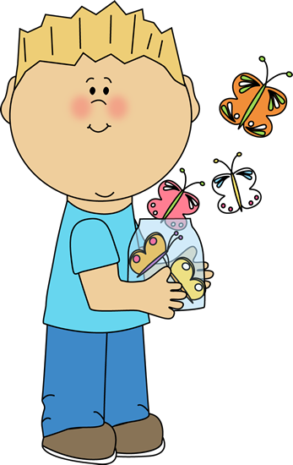
What’s the weather like?
GREAT
It’s cold.
It’s warm.
It’s cool.

Slide 19
What’s the weather like?
GREAT
It’s hot.
It’s warm.
It’s cool.

Slide 20
Let’s watch a video. Guess the season by sesame st
https://www.youtube.com/watch?v=R_tadm4uaQ4

Slide 21
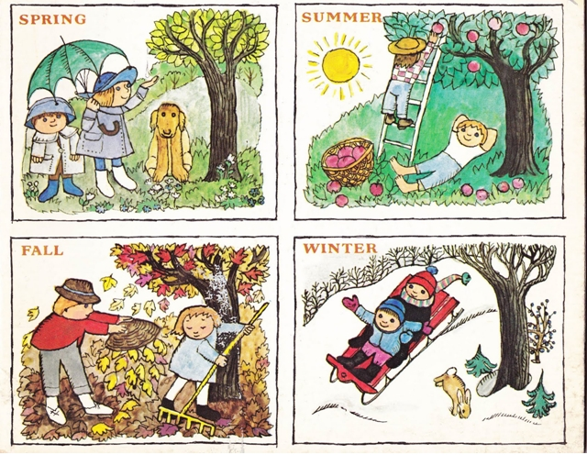
SEASONS
+
temperatures

Slide 22
In SPRING,
It’s warm

Slide 23
In SUMMER,
It’s hot

Slide 24
In AUTUMN ,
It’s cool

Slide 25
In WINTER,
It’s cold

Slide 26
Seasons GAMES

Slide 27
In SPRING, it is?
hot
warm
cold
cool

Slide 28
What season is it?
The temperature is hot. We can swim in the swimming pool and eat ice cream
It’s …
1 spring
2 summer
summer
3 winter
OK
4 autumn

Slide 29
In SUMMER, it is?
cool
cold
hot
warm

Slide 30
What season is it?
The temperature is cool. The trees are orange and brown. It’s halloween soon.
It’s …
1 spring
2 summer
autumn
3 winter
OK
4 autumn

Slide 31
In WINTER it is?
hot
cold
warm
cool

Slide 32
What season is it?
The temperature is warm. The are a lot of baby animals and beautiful flowers.
It’s …
1 spring
2 summer
spring
3 winter
Great!
4 autumn

Slide 33
In AUTUMN it is?
cool
cold
hot
warm

Slide 34
What season is it?
1 spring
The temperature is cold. We can make a snowman in the snow
It’s …
2 summer
winter
3 winter
OK
4 autumn

Slide 35
Let’s sing a song. ‘seasons song’
p.jenkins
https://www.youtube.com/watch?v=kC9Dy4L6GqU

Slide 36
Let’s watch a video seasons, weather, clothes
https://www.youtube.com/watch?v=eXFe4tUCd40

Slide 37
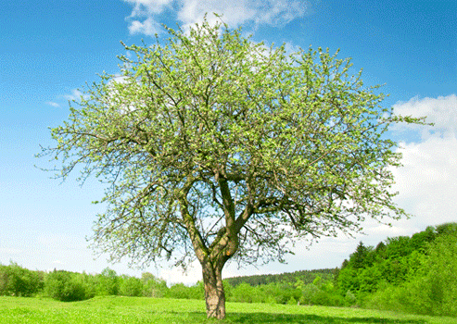
SEASON Story

Slide 39
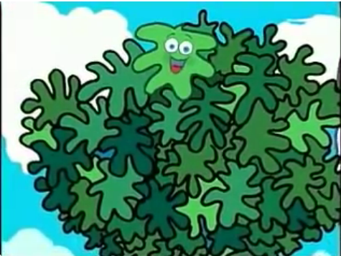
LEAFY LIVES ON A TREE.

Slide 40
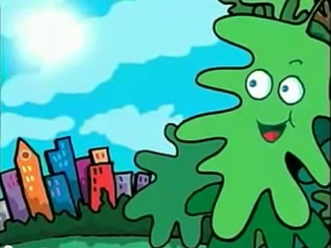
HE CAN SEE THE WORLD

Slide 41
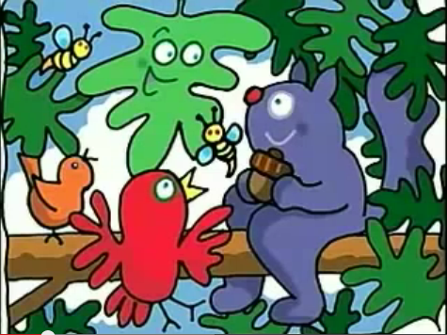
LEAFY HAS MANY FRIENDS IN THE TREE, HE IS A HAPPY LEAF.

Slide 42
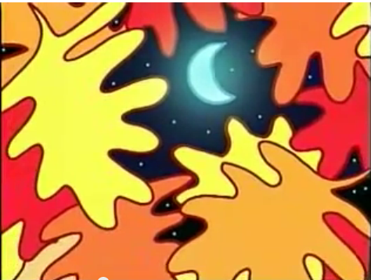
BUT IT’S COLD NIGHT... THE LEAVES IN THE TREE TURN ORANGE, YELLOW, RED AND BROWN!

Slide 43
AND THE LEAVES FALL ON THE GROUND...

Slide 44
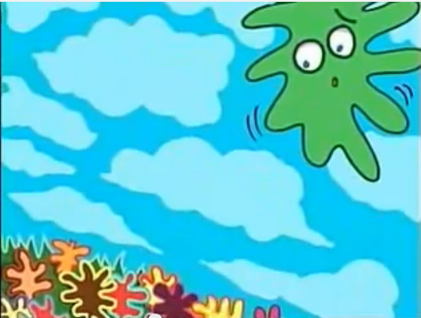
LEAFY DOESN’T WANT TO GO…

Slide 45
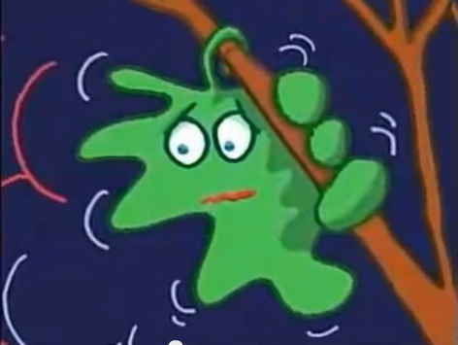
HE IS SCARED TO GO!!!

Slide 46
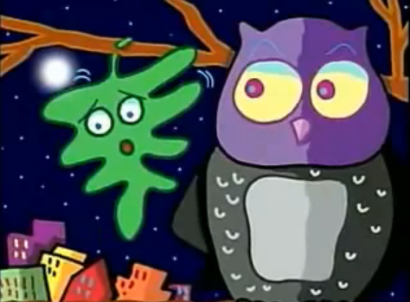
THE OWL TELLS LEAFY TO GO SEE THE WORLD.

Slide 47
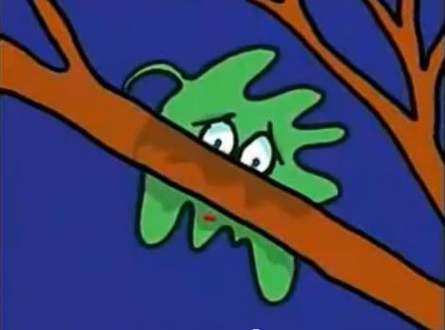
BUT HE IS JUST A LEAF!

Slide 48
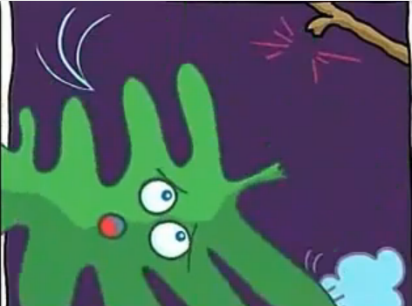
SUDDENLY… THE WIND TAKES LEAFY FROM THE TREE!

Slide 49
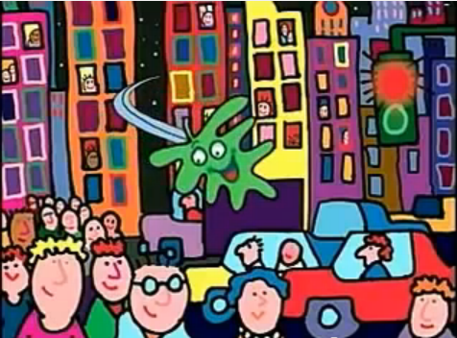
AND LEAFY SEES WONDERFUL PEOPLE.

Slide 50
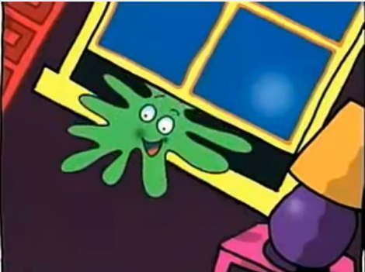
FINALLY, HE GOES THROUGH A WINDOW…

Slide 51
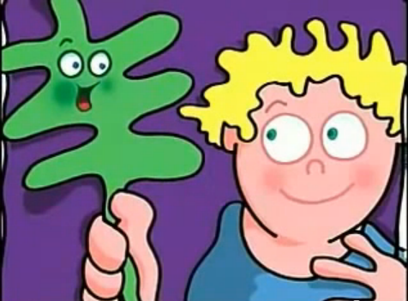
HE SEES A BOY. HE BECOMES HIS FRIEND!

Slide 52
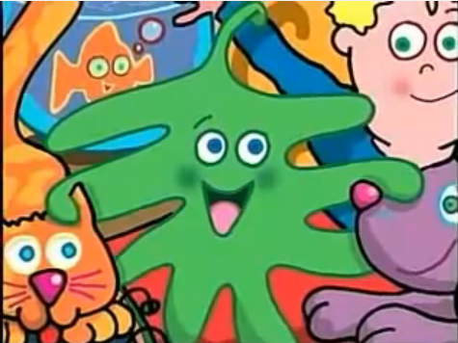
AND LEAFY SAYS… “I’M SO HAPPY HERE! I WILL NEVER LEAVE”.

Slide 53
Let’s sing a song. ‘seasons rap’
Harry kindergatern
https://www.youtube.com/watch?v=F-zOCgn5CyA

