Slide 1
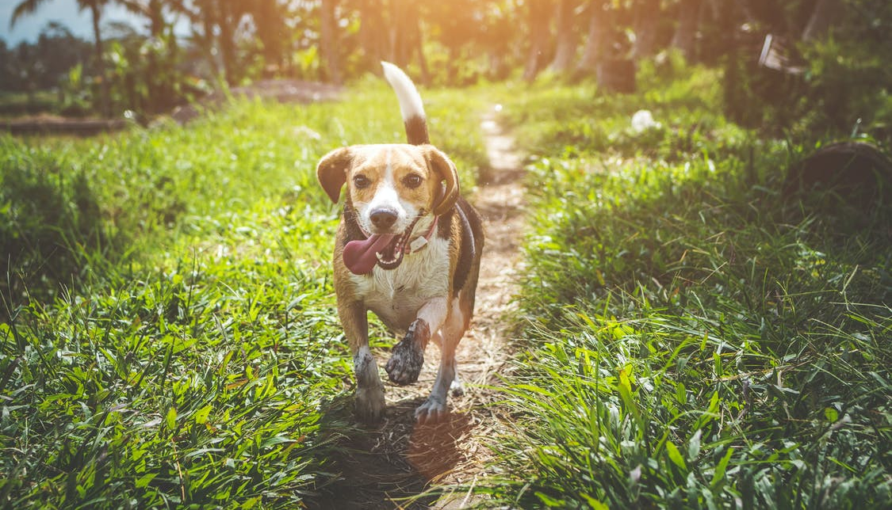
LO: Greet Ss; introduce the topic to Ss.
Guide Ss to ask and answer the given question.
Introduce the topic of the lesson.
How do you get along with you pet？
Save Floppy! 1
ORT-G2A Lesson 28
1:30
1/34

Slide 2
LO: Get to know what they will learn in this class.
Go through the learning goals with Ss. Make sure they know what they’re going to learn in the lesson.
Note: Don’t read the learning goals to the Ss.
Learning Goals
Recognize and read grade-appropriate irregularly spelled words. read second-grade irregularly spelled words in isolation (words & sentences)
Learn the key words giant, evil, gully, clap, rush, safety, across, and pleased, and understand them in context.
Apply the different reading strategies and skills when analyzing the characters, settings, and plot of the story.
Talk about the story and discuss what you can do to become a good mountain climber.
0:30
2/34

Slide 3
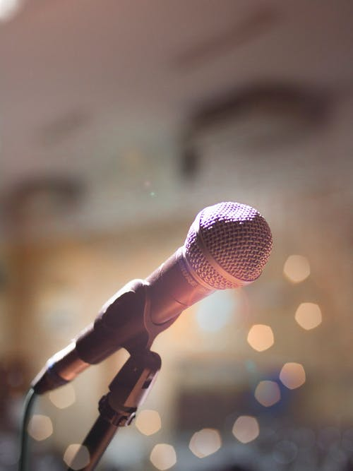
LO: Present the writing assignment from the last lesson.
Let Ss take turns presenting the writing assignment from the last lesson.
Give feedback.
Presentation
Presentation Time
Did you finish the homework you were assigned in the last lesson?
Deliver your presentation and tell us about your rewrite of a folk tale with a genie.
1:30
2/34

Slide 4
LO: Identify and pronounce the sight words.
Click and read all the sight words.
Phonics Learning
Phonics
want
become
because
busy
any
come
1:30
4/34

Slide 5
LO: Decode the words in the text accurately and fluently; read the text fluently.
Guide Ss to read the story aloud together and with rhythm.
Ask Ss to take turns reading the text one sentence at a time.
Phonics
Read on Your Own
Peter lived in a small town when he was young. He wanted to become a businessman, making a lot of money in a big city. Now his dream has come true, but he doesn’t feel happy, because he is so busy that he can’t spare any time with his family. So, he wishes he hadn’t come to the city at all.
1:00
5/34

Slide 6
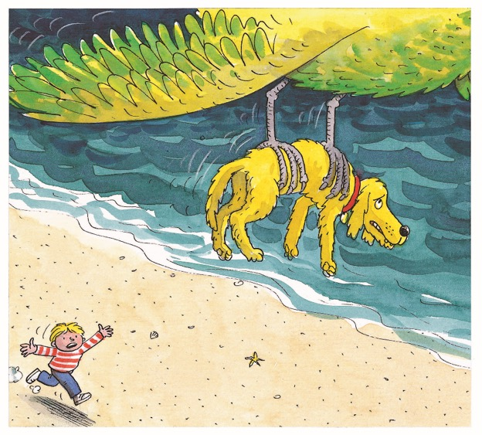
LO: Review the first part of the story.
Review what happened in the first part of the story.
Discuss the given questions and give feedback.
Background
Story Review
In our previous lesson, the children met an evil genie on their adventure.
What happened to the children’s boat in the storm?
What happened to Floppy? How did he feel?
1:30
6/32

Slide 7
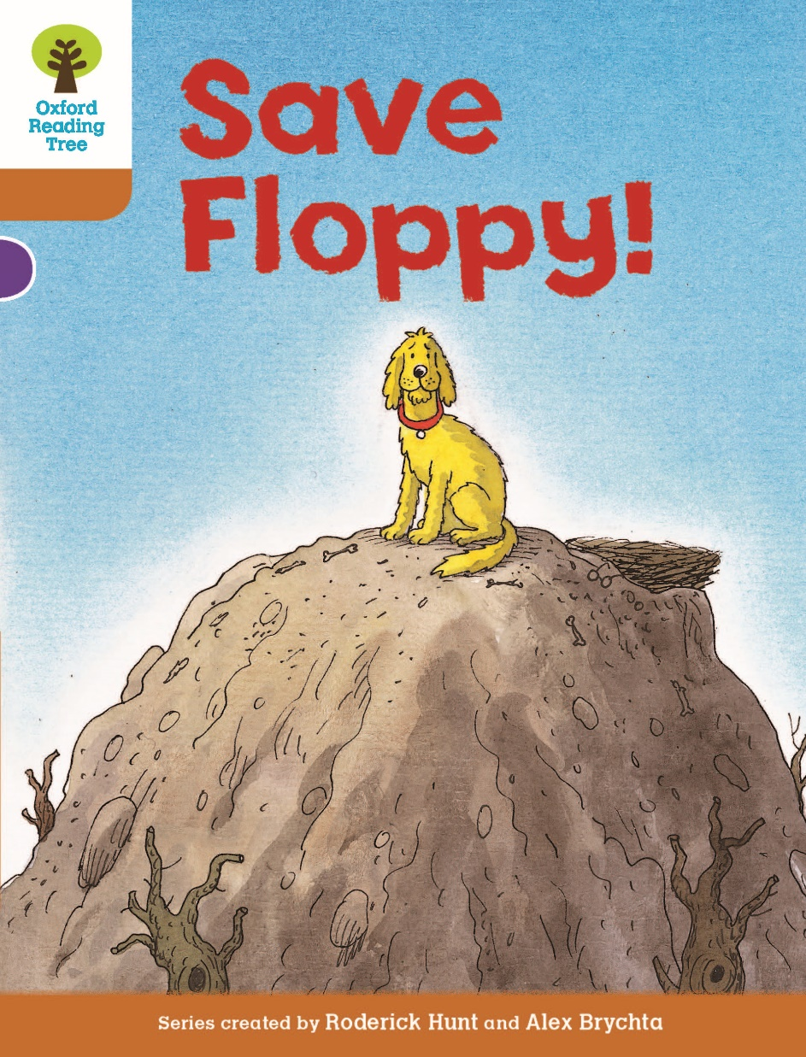
LO: Ask Ss to look at the book cover and to talk about what they can learn from the book cover; predict what might happen in the story and connect the story to real life experiences.
Have Ss discuss the given questions before reading.
Have Ss discuss the given questions in the connections section.
Book Cover
Lead-in
Before Reading
Can you remember what happened in the last story, The Evil Genie? What happened to Floppy?
Where do you think Floppy is?
Connections
What would you do if you lost your pet?
1:00
7/34

Slide 8
LO: Use details from the pictures to make predictions.
Help Ss to recall how to make predictions.
Guide Ss to make predictions by using the provided questions. Encourage Ss to answer the questions.
Make Predictions
Lead-in
Use details from the illustration to make guesses.
What do you think Biff and Chip are doing? Where do you think they are?
Do you think the genie will try to stop them? How?
1:30
8/34

Slide 9
LO: Define the word giant in context.
Have Ss go through the text quickly to find the word and have Ss work together to define the word giant by using the illustration and the context clues; give feedback.
Note: If Ss can present a correct understanding of the unfamiliar word(s), it’s not necessary to teach the word(s) on the next slide.
Save Floppy! 1
Reading
The last magic adventure had gone wrong. Floppy had been left behind. A giant bird had flown off with him. This was because a horrid genie had escaped from a bottle.
“And it was all my fault,” said Biff.
Vocabulary
Pages 1-3
Use the illustration and context clues to define the word giant.
1:00
9/34
Notes:
Suggested Time: 2 mins (Understanding & Applying)
Learning Objectives:
Ss will be able to use the reading strategies and skills: making connections to analyze the story.
Ss will be able to understand the core academic word “pack” in context and use it in sentences.
TD
Choose one S to read aloud the passage.
Then explain the key word “pack" with the sample sentence and ask Ss to make sentences.
Ask Ss to discuss the given questions and give feedback.

Slide 10
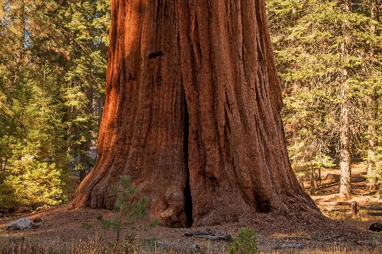
LO: Utilize the reading strategies and skills to assist in reading comprehension; understand the academic word giant in context.
If Ss can present a good understanding of the word from the previous slide, skip the vocabulary teaching part. If not, explain the word giant with the sample sentence and ask Ss to make sentences with it.
Ask Ss to discuss the comprehension questions and encourage them to support their answers with details.
Save Floppy! 1
Reading
Read Pages 1-3
Comprehension
giant
(adj.)
Why did Biff think it was her fault that Floppy had been caught?
What did Biff and Chip hope would happen next, and why? What was their goal?
Definition: very large; very big
This old tree has a giant root.
2:00
10/34
Notes:
Suggested Time: 2 mins (Understanding & Applying)
Learning Objectives:
Ss will be able to use the reading strategies and skills: making connections to analyze the story.
Ss will be able to understand the core academic word “pack” in context and use it in sentences.
TD
Choose one S to read aloud the passage.
Then explain the key word “pack" with the sample sentence and ask Ss to make sentences.
Ask Ss to discuss the given questions and give feedback.

Slide 11
LO: Utilize the reading strategies and skills to assist in
reading comprehension.
Have Ss take turns discussing the comprehension questions and encourage them to support their answers with details.
Have Ss discuss the questions in the connections section.
Save Floppy! 1
Reading
Comprehension
Do you remember who Kamar and Hassan were? Why were they on the island?
Why didn't Biff tell Kamar where she had been since he last saw her?
Pages 4-5
1:00
17/34

Slide 12
LO: Define the word evil in context.
Have Ss go through the text quickly to find the word and have Ss work together to define the word evil by using the illustration and the context clues; give feedback.
Note: If Ss can present a correct understanding of the unfamiliar word(s), it’s not necessary to teach the word(s) on the next slide.
Save Floppy! 1
Reading
“I know,” said Biff, “and that’s where we’re going. We must get up there as fast as we can.”
“Stop!” shouted Kamar. “Don’t go! Have you forgotten about the evil genie?”
“We’ll worry about him later,” said Chip.
Vocabulary
Pages 6-7
Use the illustration and context clues to define the word evil.
1:00
9/34
Notes:
Suggested Time: 2 mins (Understanding & Applying)
Learning Objectives:
Ss will be able to use the reading strategies and skills: making connections to analyze the story.
Ss will be able to understand the core academic word “pack” in context and use it in sentences.
TD
Choose one S to read aloud the passage.
Then explain the key word “pack" with the sample sentence and ask Ss to make sentences.
Ask Ss to discuss the given questions and give feedback.

Slide 13
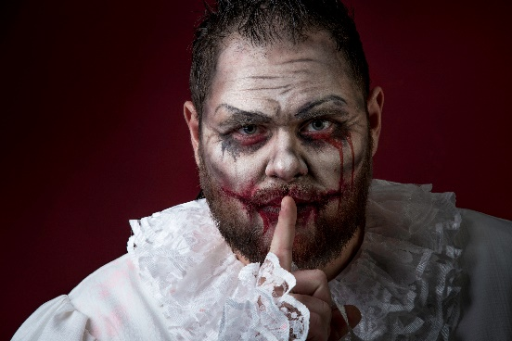
LO: Utilize the reading strategies and skills to assist in reading comprehension; understand the word evil in context.
If Ss can present a good understanding of the word from the previous slide, skip the vocabulary teaching part. If not, explain the word evil with the sample sentence and ask Ss to make sentences with it.
Ask Ss to discuss the comprehension questions and give feedback.
Save Floppy! 1
Reading
Read Pages 6-7
Comprehension
What did Kamar think when Biff told him that they had to come to rescue Floppy?
Why did Kamar tell them not to go?
evil
(adj.)
Definition: enjoying harming others; morally bad and cruel
Connections
If your pet was in danger, would you do something dangerous to rescue it? How else could you try to save it?
The fat man did many evil deeds.
2:00
10/34
Notes:
Suggested Time: 2 mins (Understanding & Applying)
Learning Objectives:
Ss will be able to use the reading strategies and skills: making connections to analyze the story.
Ss will be able to understand the core academic word “pack” in context and use it in sentences.
TD
Choose one S to read aloud the passage.
Then explain the key word “pack" with the sample sentence and ask Ss to make sentences.
Ask Ss to discuss the given questions and give feedback.

Slide 14
LO: Define the word gully in context.
Have Ss go through the text quickly to find the word and have Ss work together to define the word gully by using the illustration and the context clues; give feedback.
Note: If Ss can present a correct understanding of the unfamiliar word(s), it’s not necessary to teach the word(s) on the next slide.
Save Floppy! 1
Reading
Vocabulary
Use the illustration and context clues to define the word gully.
Pages 8-9
1:00
11/34

Slide 15
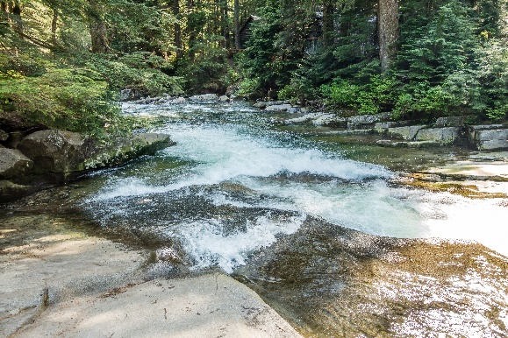
LO: Utilize the reading strategies and skills to assist in reading comprehension; understand the word gully in context.
If Ss can present a good understanding of the word from the previous slide, skip the vocabulary teaching part. If not, explain the word gully with the sample sentence and ask Ss to make sentences with it.
Ask Ss to discuss the comprehension questions and give feedback.
Save Floppy! 1
Reading
Read Pages 8-9
Comprehension
How was the journey up the mountain? Describe how Biff felt during the climb.
What did Chip discover and why did he think it would be an easier way up the mountain?
gully
(n.)
Definition: a long narrow valley with steep sides
Connections
There is a gully in the forest.
Have you ever went for a walk in the mountains? What was it like?
2:00
10/34
Notes:
Suggested Time: 2 mins (Understanding & Applying)
Learning Objectives:
Ss will be able to use the reading strategies and skills: making connections to analyze the story.
Ss will be able to understand the core academic word “pack” in context and use it in sentences.
TD
Choose one S to read aloud the passage.
Then explain the key word “pack" with the sample sentence and ask Ss to make sentences.
Ask Ss to discuss the given questions and give feedback.

Slide 16
LO: Define the words clap and rush in context.
Have Ss go through the text quickly to find the word and have Ss work together to define the words clap and rush by using the illustration and the context clues; give feedback.
Note: If Ss can present a correct understanding of the unfamiliar word(s), it’s not necessary to teach the word(s) on the next slide.
Save Floppy! 1
Reading
The genie clapped his hands. Water began to gush down the gully. Biff and Chip had no time to climb out. The water rushed towards them.
“Quickly, Biff! Climb on to this rock and hang on,” shouted Chip.
Vocabulary
Use the illustration and context clues to define the words clap and rush.
Pages 10-11
1:00
11/34

Slide 17
LO: Utilize the reading strategies and skills to assist in reading comprehension; understand the academic words clap and rush in context.
If Ss can present a good understanding of the words from the previous slide, skip the vocabulary teaching part. If not, explain the words clap and rush with the sample sentence and ask Ss to make sentences with them.
Ask Ss to discuss the comprehension questions and encourage them to support their answers with details.
Save Floppy! 1
Reading
Read Pages 10-11
Comprehension
clap (v.)
What happened when the genie appeared? Use different senses to describe what happened.
What did the genie do to stop Biff and Chip?
What did Chip tell Biff to do, and why?
Definition: to hit your hands together
The audience cheered and clapped.
rush (v.)
Definition: to flow suddenly and quickly
Water rushes out of the huge tunnels.
2:00
18/34

Slide 18
LO: Define the words safety and across in context.
Have Ss go through the text quickly to find the word and have Ss work together to define the words safety and across by using the illustration and the context clues; give feedback.
Note: If Ss can present a correct understanding of the unfamiliar word(s), it’s not necessary to teach the word(s) on the next slide.
Save Floppy! 1
Reading
Vocabulary
Use the illustration and context clues to define the words safety and across.
Pages 12-13
1:00
11/34

Slide 19
LO: Utilize the reading strategies and skills to assist in reading comprehension; understand the academic words clap and rush in context.
If Ss can present a good understanding of the words from the previous slide, skip the vocabulary teaching part. If not, explain the words safety and across with the sample sentence and ask Ss to make sentences with them.
Ask Ss to discuss the comprehension questions and encourage them to support their answers with details.
Save Floppy! 1
Reading
Read Pages 12-13
safety (n.)
Comprehension
Definition: a place where you are safe from danger
How did Biff and Chip feel when they were on the rock?
Who came to help them, and what did he bring with him to use?
It's on fire. Get out and move to safety.
across (prep.)
Definition: from one side to the other side of something
He walked across the field.
2:00
18/34

Slide 20
LO: Define the word pleased in context.
Have Ss go through the text quickly to find the word and have Ss work together to define the word pleased by using the illustration and the context clues; give feedback.
Note: If Ss can present a correct understanding of the unfamiliar word(s), it’s not necessary to teach the word(s) on the next slide.
Save Floppy! 1
Reading
Biff and Chip climbed to safety on the rope.
“We are so pleased to see you!” said Biff. “I thought we’d never get off that rock.”
“The evil genie did this,” said Chip.
“It’s a good job I came when I did,” said Kamar. “I came to help you rescue Floppy.”
Vocabulary
Use the illustration and context clues to define the word pleased.
Page 14
1:00
11/34

Slide 21
LO: Utilize the reading strategies and skills to assist in reading comprehension; understand the word pleased in context.
If Ss can present a good understanding of the word from the previous slide, skip the vocabulary teaching part. If not, explain the word pleased with the sample sentence and ask Ss to make sentences with it.
Ask Ss to discuss the comprehension questions and give feedback.
Save Floppy! 1
Reading
Read Page 14
Comprehension
Look at Chip and Biff's faces. How did they feel when they were climbing to safety?
pleased
(adj.)
Definition: happy and glad
Connections
Have you ever crossed a rope bridge or climbed a rope? Do you think it would be easy or difficult? Give reasons for your answer.
She is very pleased to be here to read her favorite books.
2:00
10/34
Notes:
Suggested Time: 2 mins (Understanding & Applying)
Learning Objectives:
Ss will be able to use the reading strategies and skills: making connections to analyze the story.
Ss will be able to understand the core academic word “pack” in context and use it in sentences.
TD
Choose one S to read aloud the passage.
Then explain the key word “pack" with the sample sentence and ask Ss to make sentences.
Ask Ss to discuss the given questions and give feedback.

Slide 22
LO: Utilize the reading strategies and skills to assist in
reading comprehension.
Have Ss take turns discussing the comprehension questions and encourage them to support their answers with details.
Have Ss discuss the questions in the connections section.
Save Floppy! 1
Reading
Comprehension
How did Biff and Chip feel about Kamar coming to help them?
How do you think Kamar felt?
What do you think the bird did with Floppy?
Page 15
1:00
11/34

Slide 23
LO: Teach Ss how to analyze a story and explain the three elements of a story.
Teach Ss how to analyze a story.
Explain the three elements of a story and show the story bubble map.
Reading Strategy
Analyze a Story
Read Save Floppy! (pages 1-15) and identify the settings, characters, and the plot in this part of the story.
Save Floppy! (P:1-15)
Settings
Plot
Characters
in Biff’s home
on the big island
on the mountain
The magic key glowed and took the children to the big island.
Biff and Chip climbed up the gully.
Biff, Chip, Floppy, Kammar, Hassan, the genie, the large bird
It’s your turn.
23/32
3:00

Slide 24
LO: Analyze the characters from the text by utilizing the reading skills and strategies.
Model how to analyze the characters from the text and complete the character, character’s action and character’s traits of the character chart.
Show and help Ss complete tasks.
Give feedback.
Analyze the main characters in the story.
Characters | Character’s Actions | Character’ s traits
Biff
Chip
Kammar
climbed up the mountain
hung on the rock
climbed to safety on the rope
yelled at the bird
brave
tough
found a gully
climbed up the mountain
noticed the rock
climbed to safety on the rope
steady
acute
brave
tough
It’s your turn.
It’s your turn.

Slide 25
LO: Check if Ss understand the words in context.
Ask Ss to take turns reading the words aloud.
Ask Ss to fill in the blanks and to read the sentences.
Read & Choose
Vocabulary
safety
If you reach _______, you reach a place where you are safe from danger.
Everyone _________ with the music.
This fairy tale tells the story of a _______.
Look at the traffic lights before you walk ________ the road.
clapped
giant
across
Complete the sentences. Use the correct form of the words in the box.
giant, clap, across, safety
1:00
25/32
Notes:
Suggested Time: 1.5 mins (Remembering & Understanding)
Learning Objective: Check if Ss will understand the words/phrases in context.
TD
Ask Ss to take turns reading their familiar words, and then guide Ss to read their unfamiliar words aloud.
Ask Ss to read the sentences and compete to find the answers.

Slide 26
LO: Using details from the text, talk about how the children climb up the mountain to rescue Floppy.
Instruct Ss to discuss the given question.
Encourage Ss to answer questions by using the given clues; Encourage Ss to present their answers with at least 3 complete sentences; assist Ss if necessary.
Listening & Speaking
How did the children climb up the mountain to rescue Floppy?
went as fast as they could
climbed over big rocks
sat on a rock for a rest
. . .
1:30
26/32

Slide 27
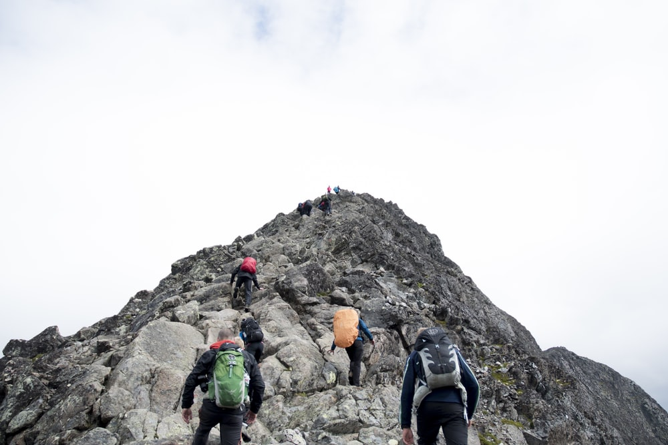
LO: Using details from the text, talk about how
Climbing a mountain up can keep you fit.
Instruct Ss to discuss the given question.
Encourage Ss to answer questions by using the given clues; encourage Ss to present their answers with at least 3 complete sentences; assist Ss if necessary.
Listening & Speaking
take tools, phones, food, and water
choose a route
climb up carefully
rest regularly
put up a tent if needed
. . .
How do you climb up a mountain to keep fit?
1:30
27/32

Slide 28
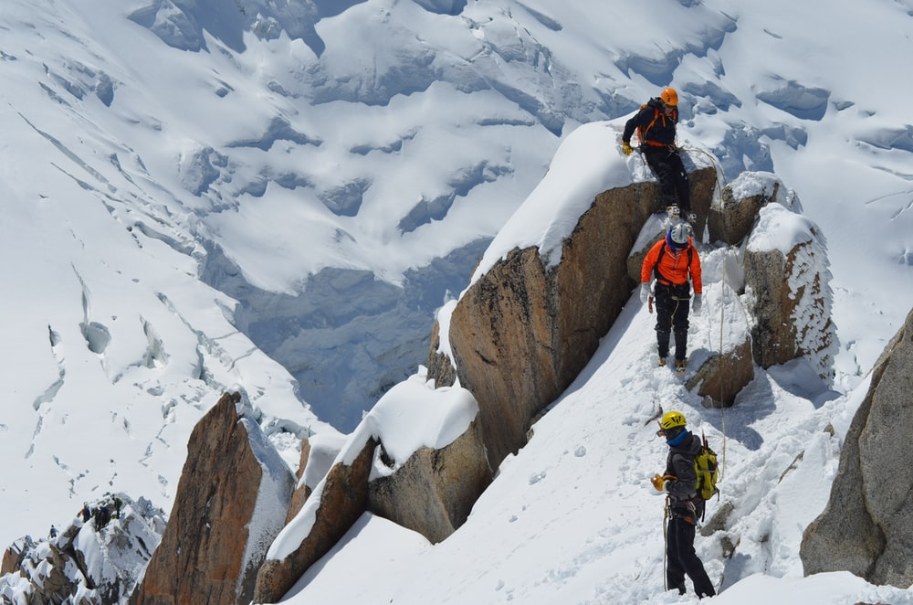
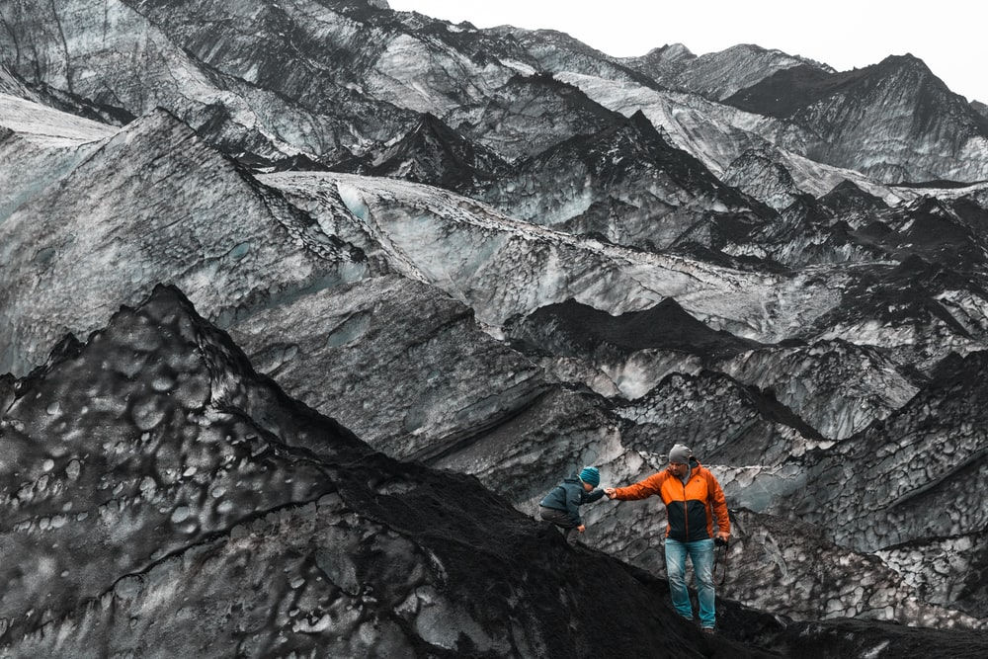
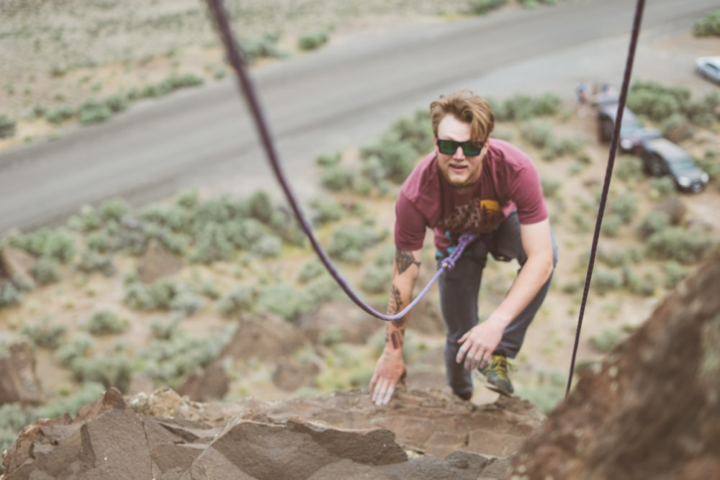
LO: Talk about what you can do to become a good mountain climber.
Guide Ss to look at the pictures; have Ss talk about the given question.
Guide Ss to realize the benefits of traveling; assist Ss if necessary.
Value
What can you do to become a good mountain climber?
1:30
28/32

Slide 29
LO: Describe the story Save Floppy by using the visual
aids and given guideline.
Explain the task to Ss.
Model first; have Ss talk about the story Save Floppy by using the sequence map.
Give feedback.
Get Ready to Present
Oral Writing
Describe how Biff’s and Chip’s feelings changed when they were climbing the mountain with the help of the sequence chart below.
Work together to complete the task.
How did the children feel when they knew where Floppy was taken?
How did the children feel when they saw the genie standing at the top of the gully?
How did the children feel when they hung on to the rock?
How did the children feel when Kamar came to help them?
How did the children feel when they saw the giant bird flying above?
2:30
29/32

Slide 30
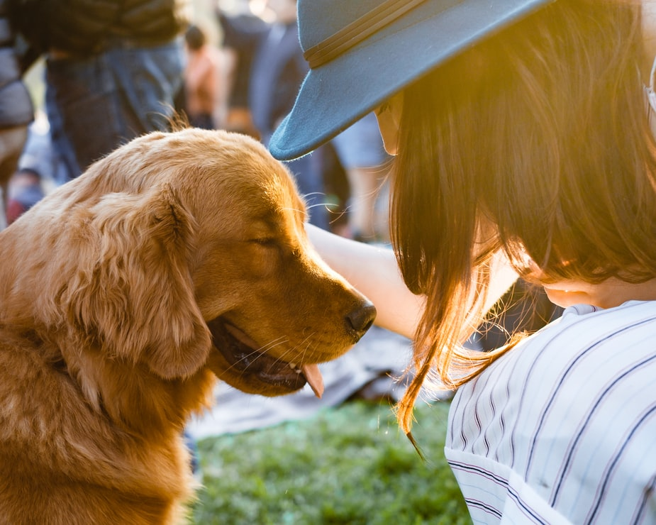
LO: Understand what the writing task is; know to complete the writing task with the help of the post-class instructional video.
Introduce and explain the writing task to Ss.
Ask Ss to finish the task before the next class and to be ready to present.
Remind Ss to watch the post-class video before writing.
Homework: A Persuasive Essay
Writing
Write a persuasive essay explaining why every family should own a pet in three paragraphs.
Step 1. Brainstorm: Collect Ideas
Step 2. Prewrite: Make a Plan for Your Writing
Step 3. Draft: Write the First Version of Your Story
Watch the post-class video before you start writing.
1:00
30/32

Slide 31
LO: Review the whole lesson.
Review the key words with Ss by asking Ss to make sentences.
Review the story with Ss by asking the given questions.
Let’s Review
Review
Story: Save Floppy!
Key Words:
giant, evil, gully, clap, rush, safety, across, pleased
Key Questions:
How did the children climb up the mountain to rescue Floppy?
What is the best way to climb a mountain?
1:00
31/32

Slide 32
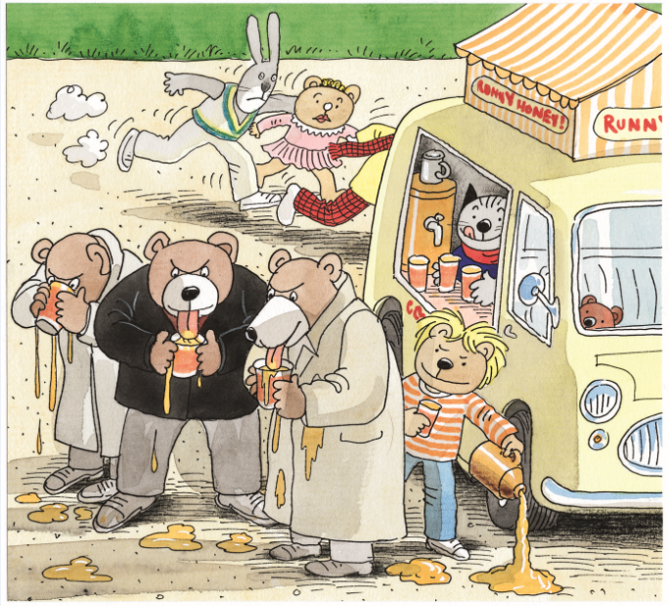
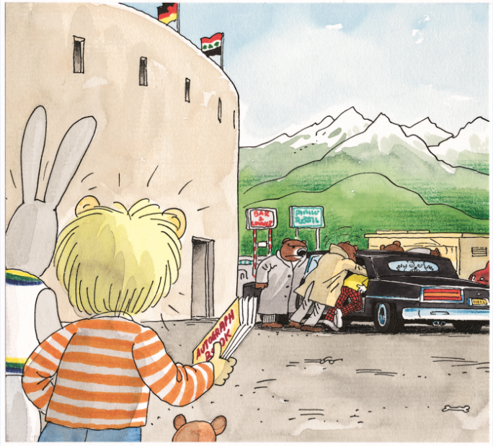
LO: End the lesson and encourage Ss to perform better in the next class.
Briefly comment on Ss’ performance.
Say goodbye to Ss.
Ask Ss to preview the next lesson.
0:30
32/32
Notes:
Suggested Time: 0.5min
TD
Give briefly comments to Ss and say goodbye.

