Slide 1
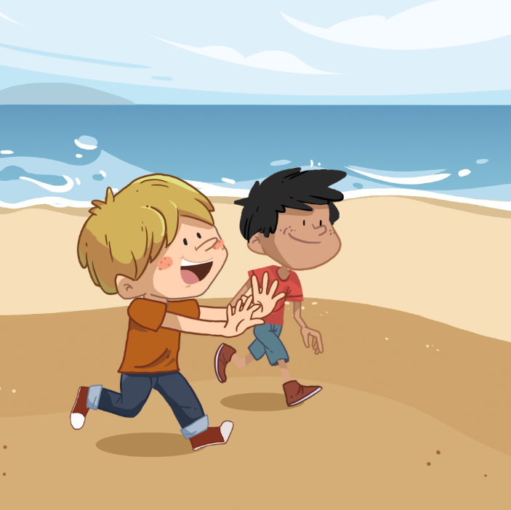
LO: Greet their partners; get a basic idea about the topic of today’s lesson.
Say hello to Ss; ask Ss to greet each other.
Guide Ss to describe the pictures on the first page.
Introduce the topic of the lesson.
TG
At the Seaside
ORT-GKA
Lesson 28
2:00
1/26

Slide 2
Learning
Goals
TG
LO: Get to know and understand what will be learned in this lesson.
Go through the learning goals with Ss.
We are going to …
Blend different letters’ sounds into one word.
Learn the different words seaside, family, hotel, expensive, farmer, and holiday, and make sentences with them.
Read the story At the Seaside, and recognize the sequence of events.
Practice using the sentence structure:
___ looked at ___.
0:30
2/26

Slide 3
LO: Present and share writing assignments from last lesson;
Invite Ss to take turns presenting their homework. If time is limited, tell Ss they have one or two mins to present their writing.
Encourage Ss to listen carefully and to ask questions.
After both of the Ss have finished, give them feedback and awards (Click the picture of the book beside the boy or girl so that they can get some awards).
Click and give each S a trophy to mark their good performance.
Note: You can click the picture of the boy or the girl to give Ss the trophy.
TG
Presentation
Let’s show!
This is what I like to do in summer.
1:30
3/26

Slide 4
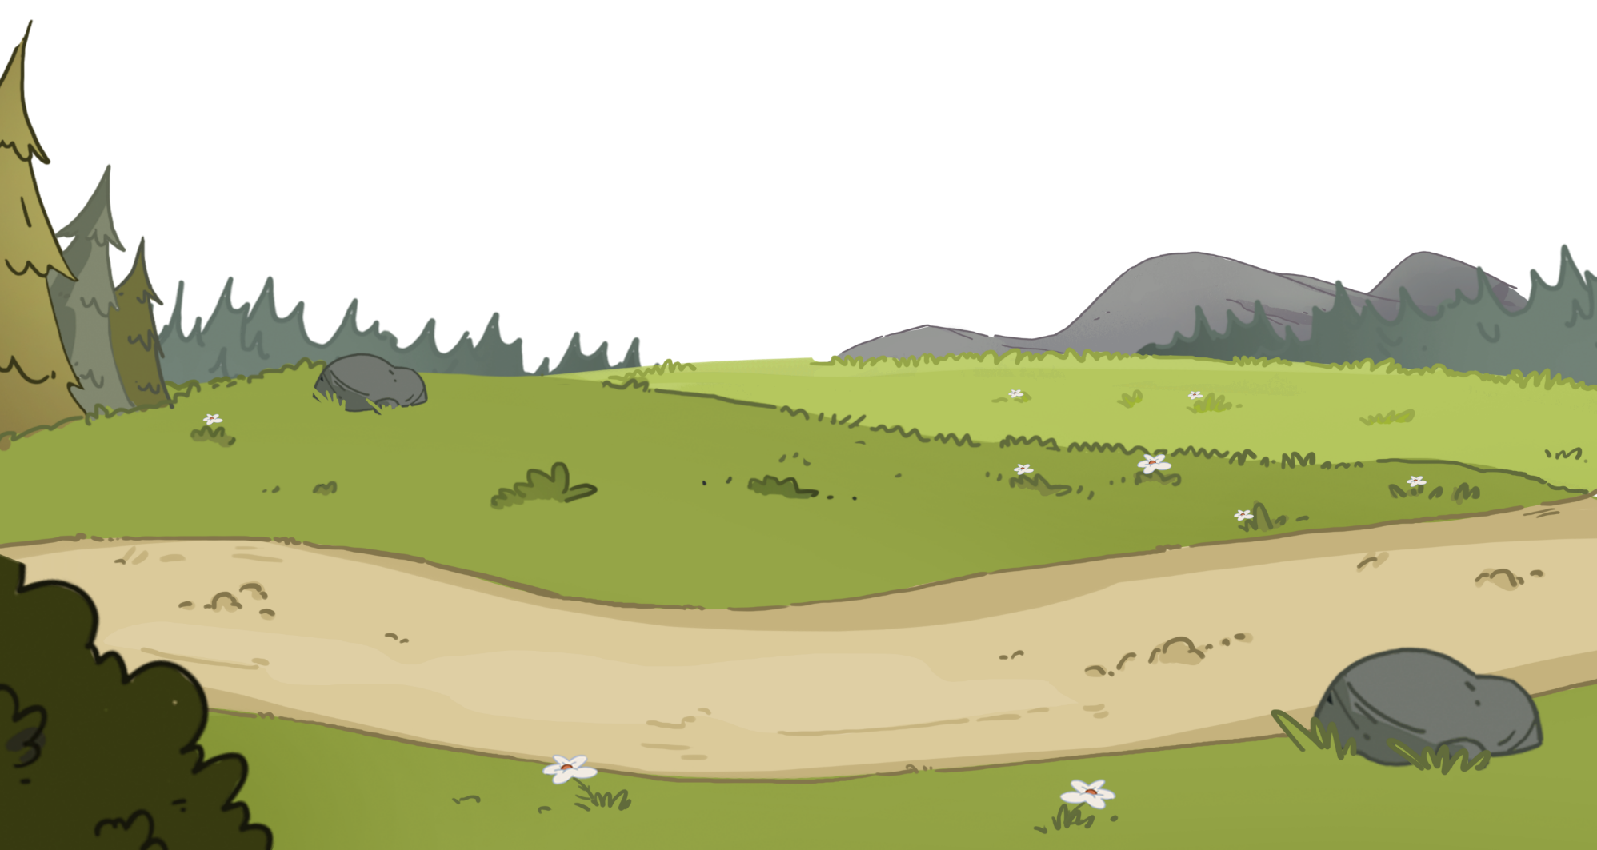
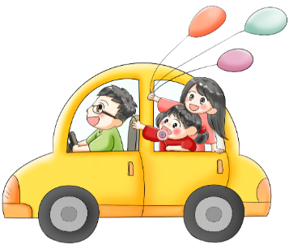
TG
Let’s listen and speak!
LO: Identify the different sounds accurately; blend different letter sounds into one word; read the words accurately.
Ask Ss to talk about what they can see in the picture; click and tell them to help the family go on a holiday.
Ask Ss to blend different letter sounds into one word.
The process is as follows:
Ask Ss to read the letter sounds on this slide; click and help the family’s car move ahead, and ask Ss to read the sounds and words in this way: h-a-t, hat, hat.
Repeat this practice for the rest of the words; Ss will learn three words on this slide.
hat
pot
lot
Can you blend some sounds into one word?
Can you read these sounds?
p
o
t
p
o
t
t
o
h
a
t
h
a
l
l
5/26

Slide 5
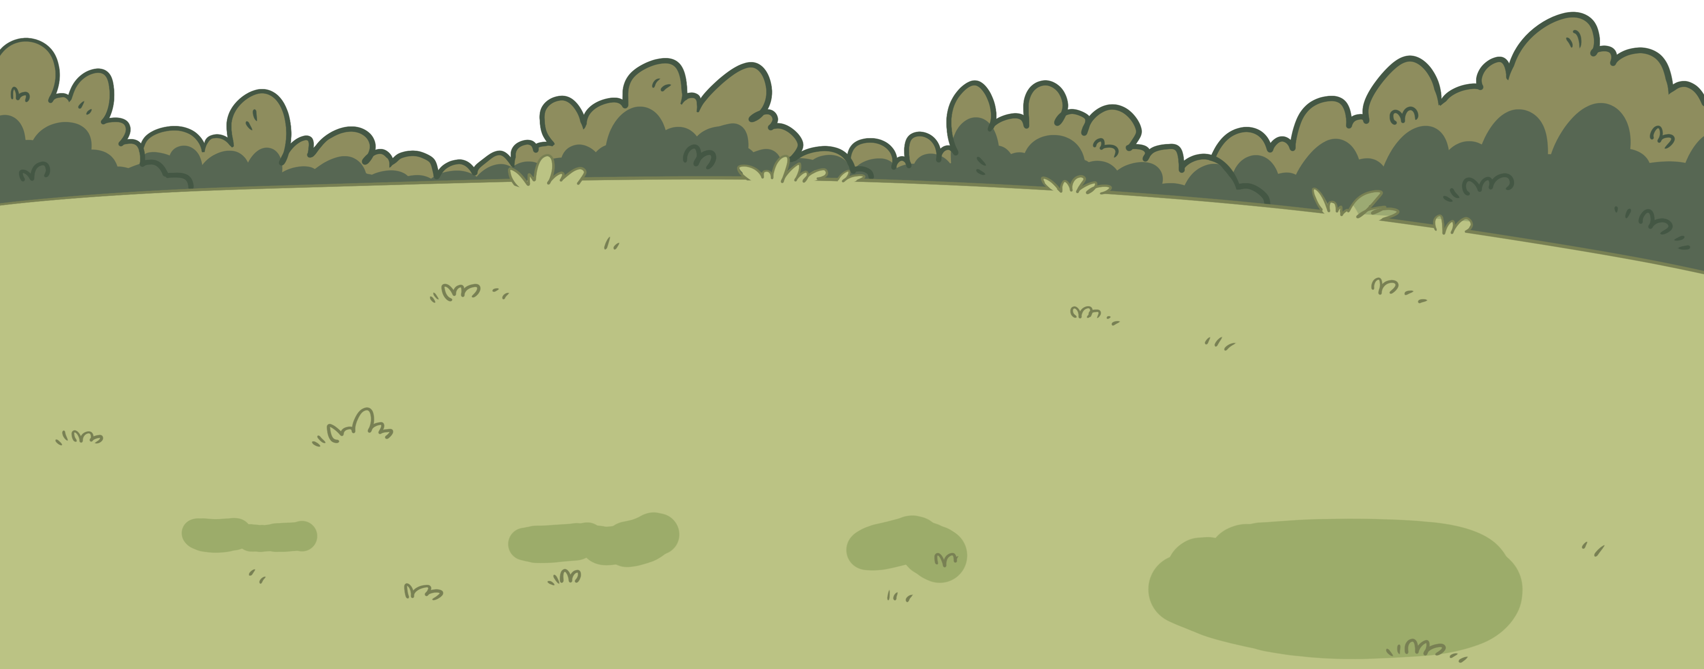
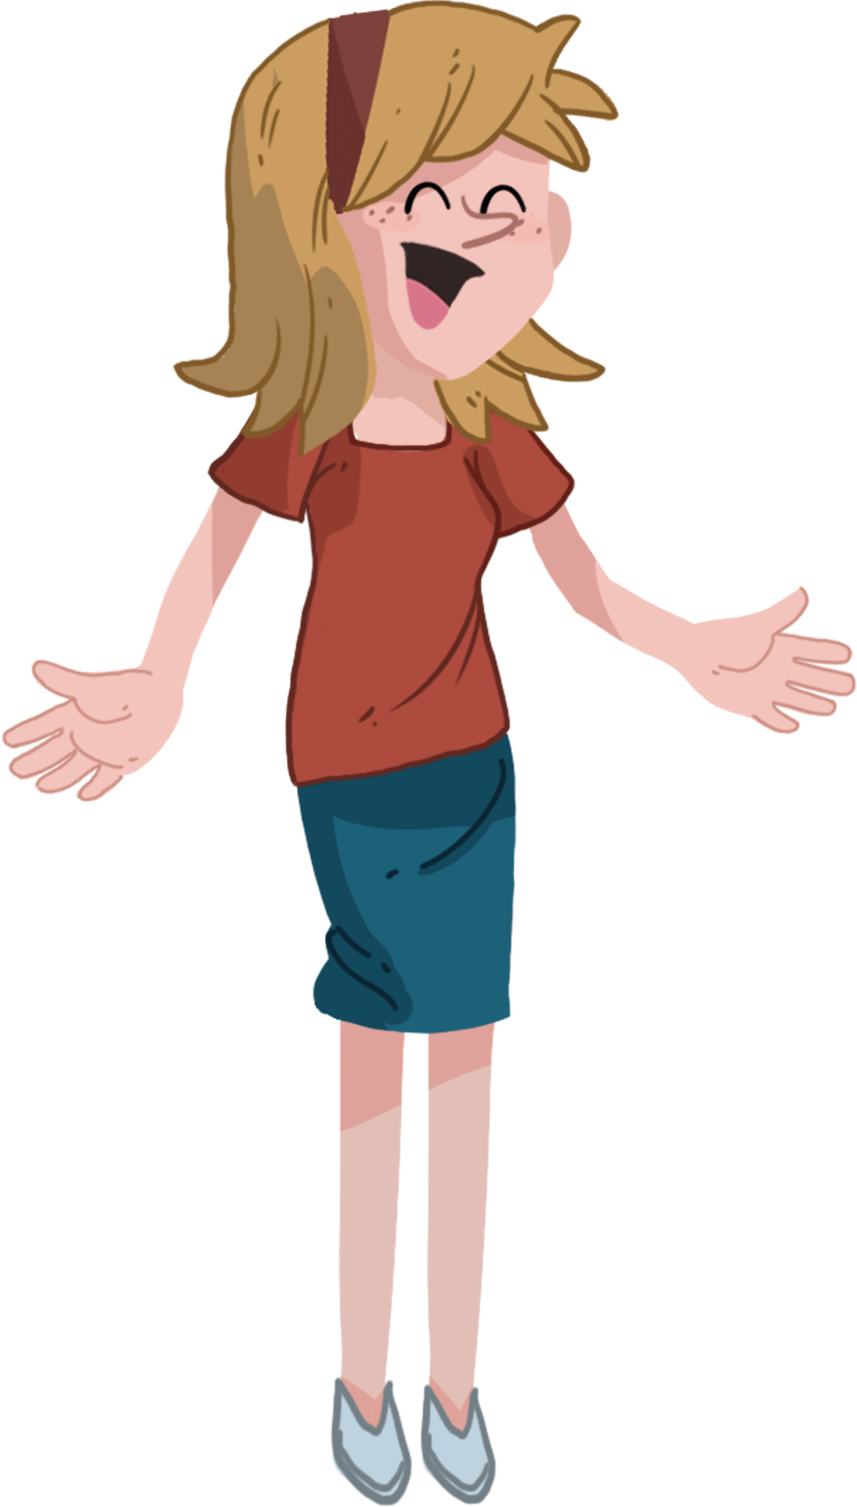
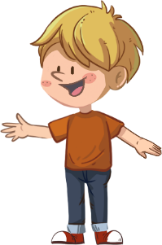
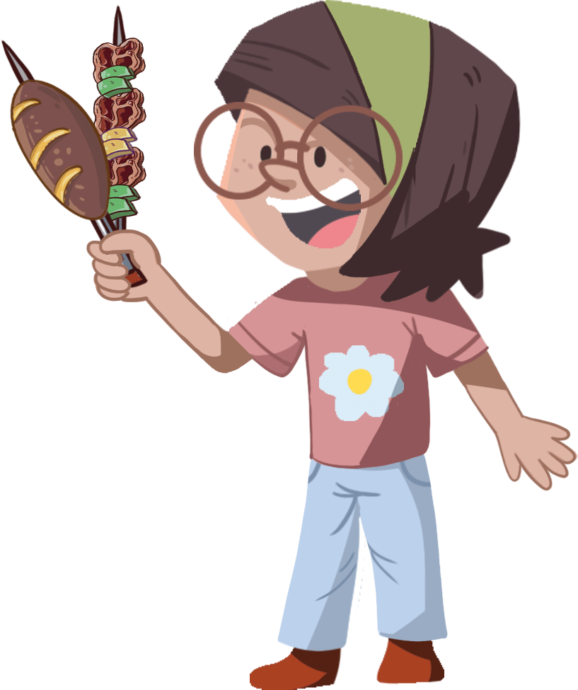
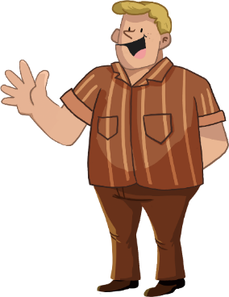
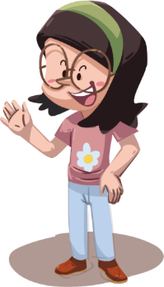
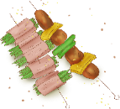
Phonics
TG
Let’s listen and speak!
LO: Identify the different sounds accurately; blend different letters’ sounds into one word; read the words accurately.
Ask Ss to talk about what they can see in the picture; click and tell them to help the family prepare for their picnic.
Click and guide Ss to read the sounds; click and guide Ss to blend these sounds into new words; and read the words in this way: p-a-l, pal, pal.
Click and one of the family members will complete one task for the picnic.
Repeat this practice for the rest of the words; Ss will learn three words on this slide.
Let’s have a picnic!
Can you blend some sounds into one word?
Good job! Let’s have a picnic!
pal
top
hot
Can you read these sounds?
p
p
p
a
t
o
a
h
l
t
o
h
l
t
o
2:30

Slide 6
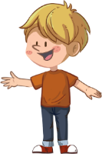
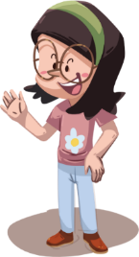
Phonics
TG
LO: Read the chant fluently; decode the words learned in the text.
Read the chant to Ss with rhythm; have Ss observe the picture and the highlighted words.
Guide Ss to repeat after you; ask them to take turns reading each sentence.
Give feedback.
Let’s chant!
Alex and his pal planned to play.
They climbed up to the mountain top on a hot day.
Each of them took a hat and a bag.
They brought a pot and heated the ham.
They took a lot of photos on their way.
2:00
6/26

Slide 7
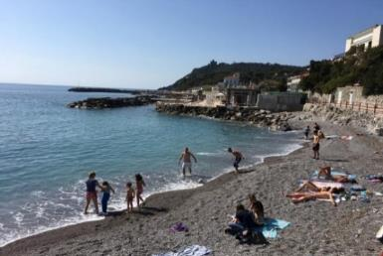
TG
Lead-in
TG
LO: Understand the meaning of the vocabulary word seaside, and make sentences with it; activate Ss’ interest in reading; use the illustration and the title to identify details and make connections.
Ask one S to find the vocabulary word seaside in the text; click the penguin card and explain its purpose to Ss; have Ss read the word and have Ss make sentences with it.
Have Ss look at the book cover closely and have Ss talk about the first two questions by using the illustration and the title.
Encourage Ss to talk about the connections questions.
Before Reading
Vocabulary
What’s wrong with Dad, Mum and the children?
Look at the title and illustration. Where are the children?
What do you think they are doing here?
seaside
Connections
They’re playing
at the seaside.
Did you go on holiday at the seaside before? Who was with you? What did you do at the seaside?
Written by Roderick Hunt
Illustrated by Alex Brychta
seaside
2:00
7/26

Slide 8
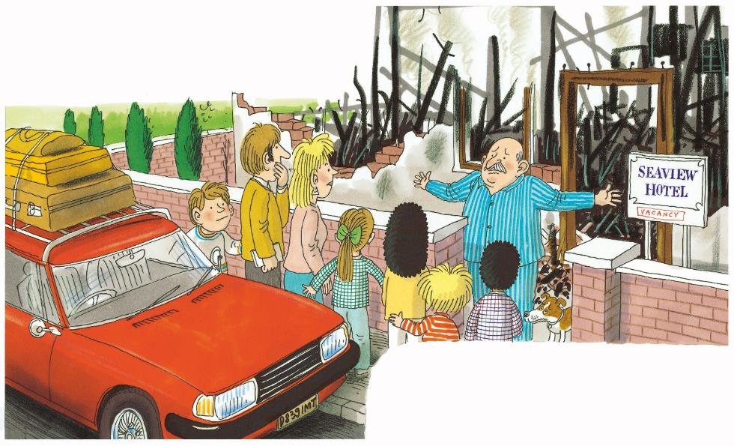
Let’s predict!
Reading
TG
LO: Identify details and make predictions about the story by using the illustration; activate Ss’ interest in reading.
Ask them to make guesses prior to reading the story by looking at the illustration.
Have Ss observe the illustration carefully and have Ss talk about the given questions.
Before Reading
Where are Dad, Mum and the children? What do you think they come here for?
2. Do you think they will
live in this hotel? Why?
3. Where do you think
they will live?
1:30
8/26

Slide 9
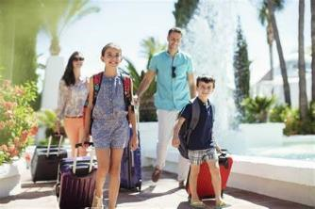
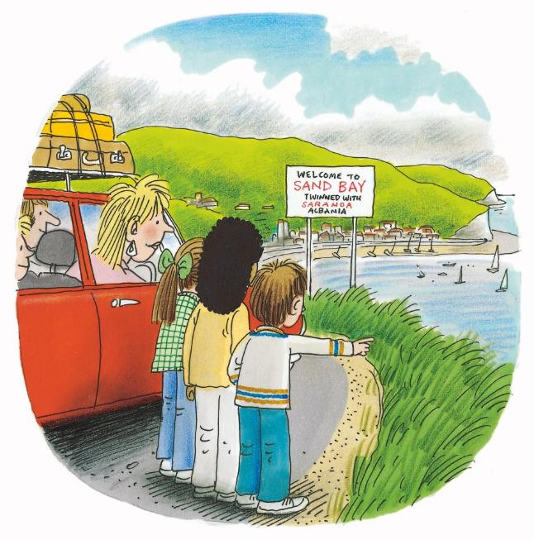
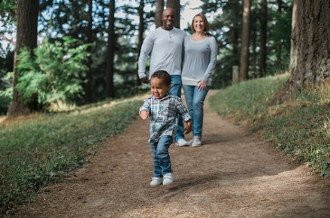
At the Seaside
Reading
TG
LO: Understand the meaning of the vocabulary words family and holiday, and make sentences with them; understand the text; read the text fluently.
Read the text aloud to Ss.
Ask one S to find the vocabulary words family and holiday in the text; click the penguin card and explain its purpose to Ss; have Ss read the words and have Ss make sentences with them.
Have Ss talk about the comprehension questions by using the text and illustration.
Ask Ss to take turns reading the text fluently; give feedback.
Vocabulary
Vocabulary
Comprehension
1. What did the family do?
2. Who else went on the
holiday with the family?
3. Where did the family go?
Where were they looking
at? Look for clues in the
illustration.
holiday
family
The children feel very happy to go on holiday.
The family is taking
a walk in the forest.
The family went on holiday.
Wilf and Wilma went, too.
family
holiday
2:30
17/26

Slide 10
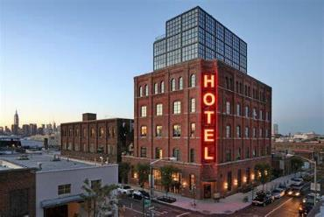
At the Seaside
Reading
TG
LO: Understand the meaning of the vocabulary word hotel, and make sentences with it; understand the text; read the text fluently.
Read the text to Ss.
Ask one S to find the vocabulary word hotel in the text; click the penguin card and explain its purpose to Ss; have Ss read the word and have Ss make sentences with it.
Guide Ss to talk about the comprehension questions by using the illustration and text.
Ask Ss to take turns reading the text aloud; give feedback.
Vocabulary
The hotel had burned down.
Comprehension
Where did Dad, Mum, and the children go? Look for clues in the illustration.
hotel
2. Could Dad, Mum, and
the children stay at this
hotel? Why? Read the
text to find the answer.
This hotel is so big and tall.
“Sorry!” said the man.
hotel
2:30
9/26
Notes:
Was it a real aeroplane or a model aeroplane?

Slide 11
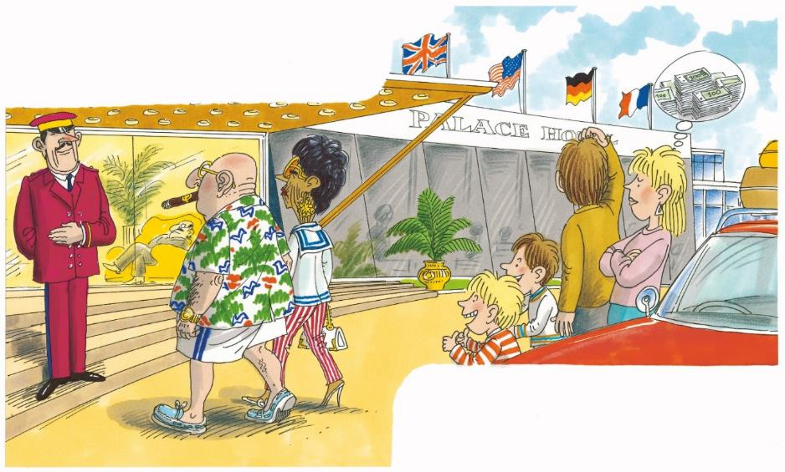
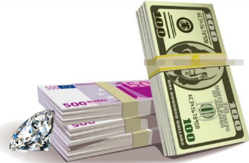
At the Seaside
Reading
TG
LO: Understand the meaning of the vocabulary word expensive, and make sentences with it; understand the text; read the text fluently.
Read the text to Ss.
Ask one S to find the vocabulary word expensive in the text; click the penguin card and explain the word’s purpose to Ss; have Ss read the word and have Ss make sentences with it.
Have Ss talk about the comprehension questions by using the text and the illustration.
Have Ss read the text fluently; give feedback.
Comprehension
They looked at a new hotel.
Vocabulary
1. What did they do?
2. What did Mum think of
this hotel? Look for
clues in the illustration
and the text.
3. Did Kipper and Chip
like this hotel? Look at
the illustration. What
did they think the
rooms in this hotel
might look like?
expensive
The diamond is so expensive.
“Too expensive,” said Mum.
expensive
2:30
10/26
Notes:
Did you make any toys before?

Slide 12
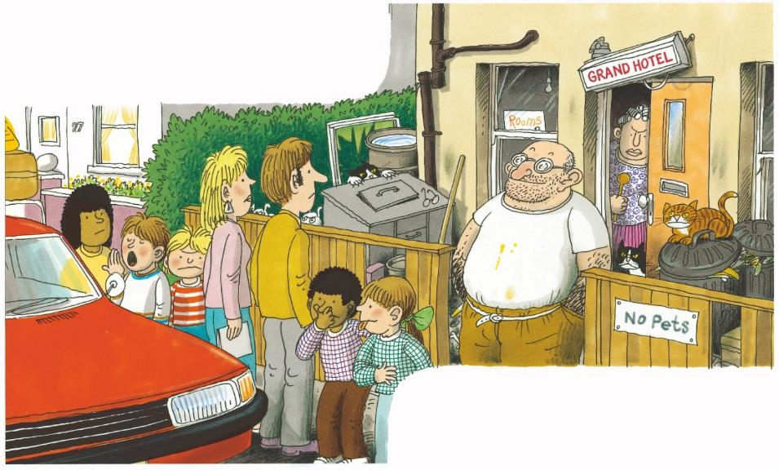
At the Seaside
Reading
TG
LO: Understand the text; recognize the sequence of events; read the text accurately and fluently.
Read the text to Ss.
Guide Ss to talk about the comprehension questions by using the illustration and text.
Encourage Ss to talk more about the sequence of events in the sequence section.
Have Ss take turns reading the text accurately and fluently.
Comprehension
They looked at an old hotel.
What kind of hotel did they find?
Did Dad, Mum, and the children want to stay at this hotel? Why?
Sequence
Put the events in the right order.
Where did Dad, Mum, and the children go?
They went to a new hotel.
They went to a seaview hotel.
They went to an old hotel.
LO:
Answer: B-A-C
“No, thank you,” said Dad.
2:30
11/26

Slide 13
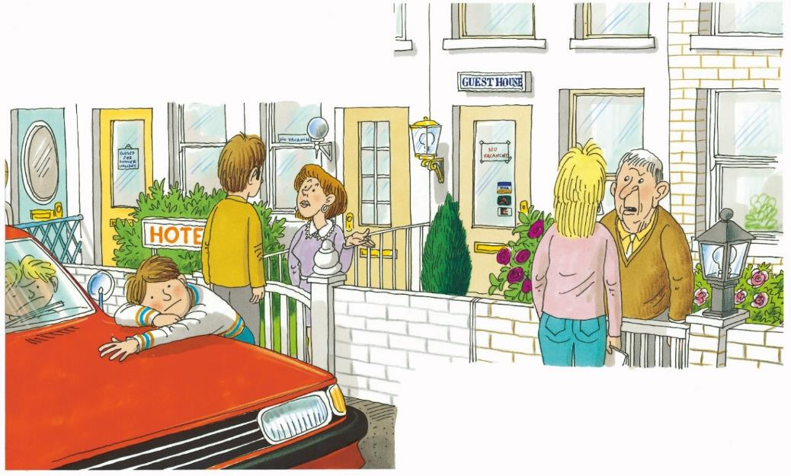
At the Seaside
Reading
TG
LO: Understand the text; make connections; read the text fluently.
Read the text to Ss.
Guide Ss to talk about the comprehension questions by using the illustration and text.
Guide Ss to talk about the connections question.
Have Ss read the text fluently; give feedback.
Comprehension
Every hotel was full.
Could they stay in these hotels? Why?
What do you think they would do next?
Connections
Did you stay in a hotel before? What did the hotel look like?
“Sorry!” said everyone.
2:30
12/26

Slide 14
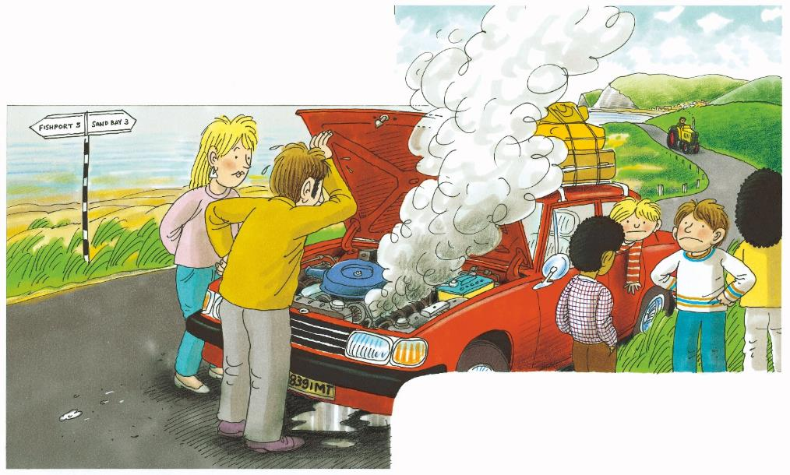
At the Seaside
Reading
TG
LO: Understand the text; recognize the sequence of events; read the text accurately and fluently.
Read the text to Ss.
Guide Ss to talk about the comprehension questions by using the illustration and text.
Encourage Ss to talk more about the sequence of events in the sequence section.
Have Ss take turns reading the text accurately and fluently.
They had to go home.
Comprehension
1. What went wrong on the
way home?
2. What do you think they
would do next? Do you
think anybody would help
them? Look at the
illustration.
Sequence
What did Dad, Mum, and the children do when they couldn’t stay in the hotels?
Decoding
But the car broke down.
Read it accurately.
2:30
13/26

Slide 15
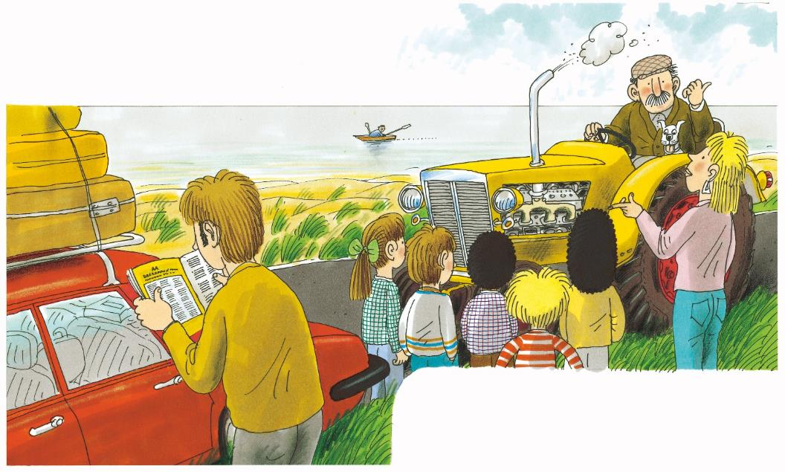
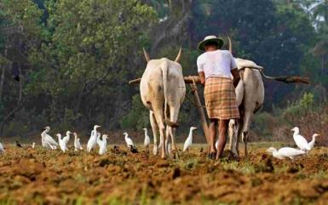
At the Seaside
Reading
TG
LO: Understand the meaning of the vocabulary word farmer, and make sentences with it; understand the text;
read the text fluently.
Read the text to Ss.
Ask one S to find the vocabulary word farmer in the text; click the penguin card and explain the word’s purpose to Ss; have Ss read the words and have Ss make sentences with it.
Guide Ss to talk about the comprehension questions by using the illustration and text.
Ask Ss to read the text fluently; give feedback.
Vocabulary
A farmer stopped his tractor.
Comprehension
1. Who passed by?
2. How do you think the
farmer would help
them?
farmer
The farmer is doing hard work on the farm.
“Can I help?” he said.
farmer
2:30
14/26

Slide 16
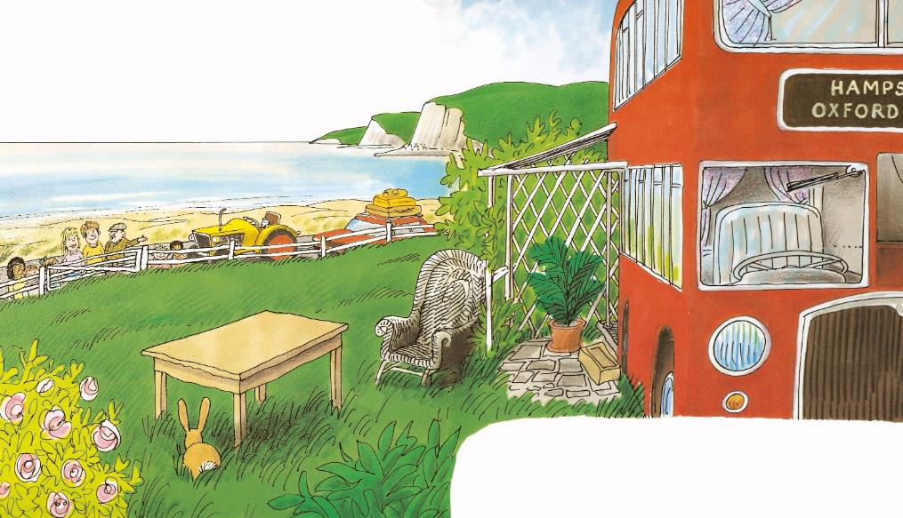
At the Seaside
Reading
TG
LO: Understand the text; read the text fluently.
Read the text to Ss.
Guide Ss to talk about the comprehension questions by using the illustration and the text..
Ask Ss to read the text fluently; give feedback.
The farmer had a bus.
Comprehension
Where did the farmer take Dad, Mum, and the children?
Could they stay here? Read the text.
What did the bus look like?
What do you think of it?
“You can stay here,” he said.
2:30
15/26

Slide 17
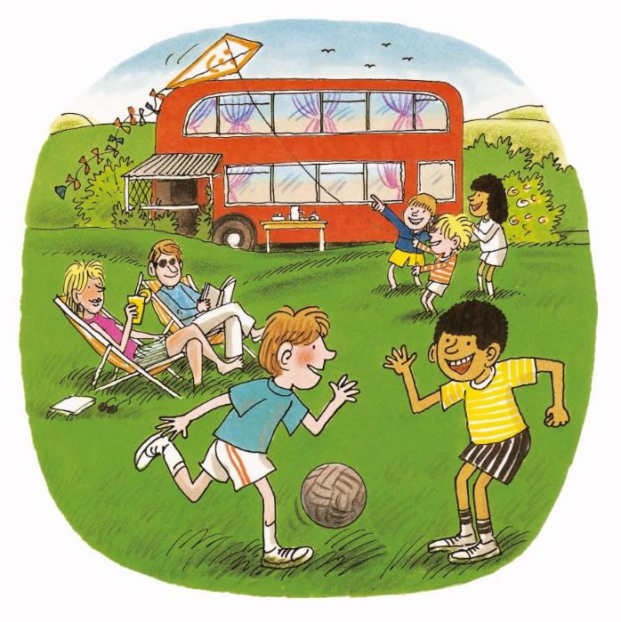
At the Seaside
Reading
TG
LO: Understand the text; recognize the sequence of events; make connections; read the text fluently.
Read the text to Ss.
Guide Ss to talk about the comprehension questions.
Encourage Ss to talk more about the sequence of events in the sequence section.
Click and encourage Ss to talk about the connections question; modest first; give feedback.
Have Ss read the text fluently; give feedback.
Comprehension
1. What did the children
think of the holiday? Why?
2. What were the children
doing? What were Dad
and Mum doing?
Connections
Sequence
Did you have an unforgettable holiday? Why was it unforgettable? What happened?
What happened at the end of the story?
“What a good holiday!” said Wilf.
2:30
16/26

Slide 18
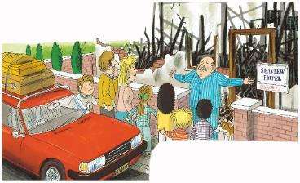
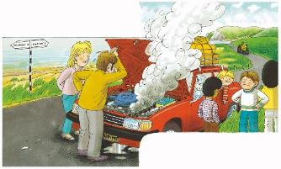
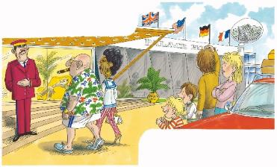
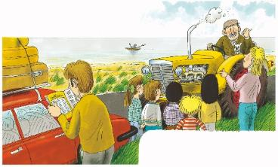
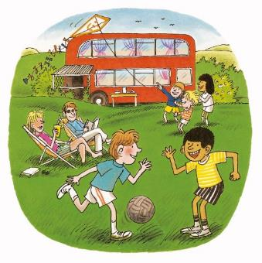
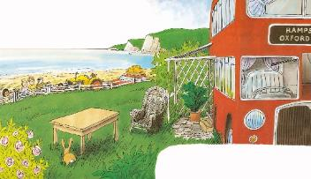
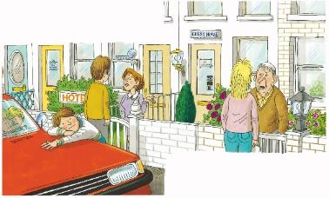
Reading
TG
Let’s retell!
LO: Retell the story with the visual support and assistance.
Guide Ss to recall the story; model first.
Have Ss work together to retell the story by using the visual aids.
in the end
in the beginning
in the middle
2:00
18/26

Slide 19
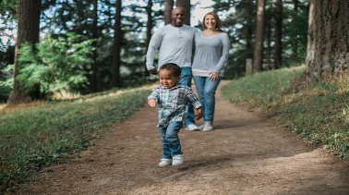
Let’s play!
TG
Vocabulary
Vocabulary
LO: Check Ss’ understanding of the words in this lesson.
Guide Ss to talk about what they can see in the picture; invite Ss to work together and help the children in the picture hit the dates.
The steps are as follows:
Click and a picture will appear; next, ask Ss to identify the picture with the correct vocabulary word; click and the answer will appear; then click and one date will fall down.
Note: There are six words on this slide.
holiday
expensive
family
farmer
hotel
seaside
2:00
19/26

Slide 20
Listening &
Speaking
TG
LO: Talk about the given question by utilizing the sentence structures.
Have Ss work in pairs to talk about the given illustration by using the sentence structures and helping words; model first.
Assist Ss if necessary.
Let’s talk!
—What kind of hotels did they look at when
they went on their holiday?
—They looked at a/an _________.
Helping Words
new hotel
old hotel
a sandwich
2:00
20/26

Slide 21
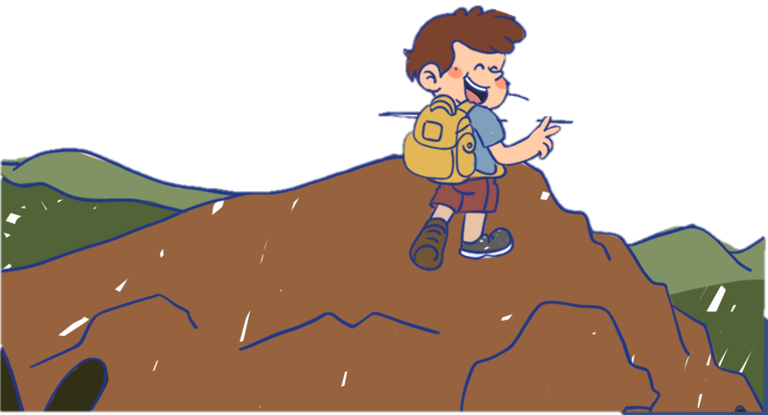
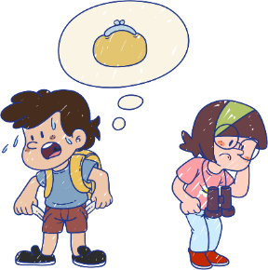
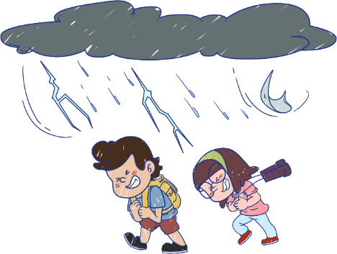
Listening &
Speaking
TG
LO: Talk about what bad things you might encounter on holiday.
Tell Ss to observe the picture carefully and to talk about what bad things they might encounter on holiday.
Have Ss take turns discussing at least three activities they like to do; model first.
Have Ss work in pairs to ask and answer questions about the given picture by using the given language structures; assist Ss if necessary.
Click and guide Ss to talk about the discussion question; click and show the right answer.
Notes: T can click Let’s Talk to present the sentence structure, and then click again to make it disappear.
Let’s talk!
Please name at least three things.
—What bad things might you encounter
on a holiday?
—I might encounter _____.
heavy rain;
a cold;
getting lost
. . .
21/26

Slide 22
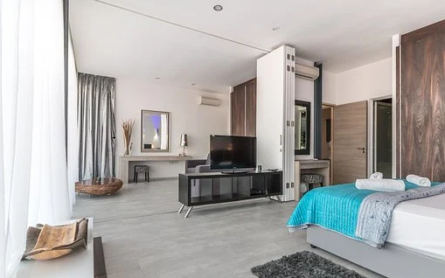
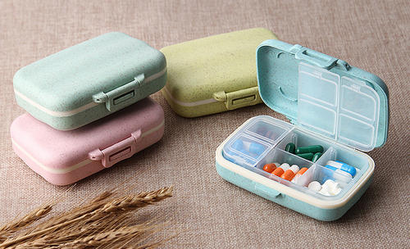
TG
Value
LO: Talk about the values presented in the lesson: We should prepare well before going on holiday.
1. Ask Ss the given question; model first.
2. Guide Ss to talk about the question by using the given pictures.
3. Encourage Ss to talk more about what good suggestions they can give their friends who want to go on holiday.
What good suggestions can you give if your friends want to go on holiday?
book a hotel in advance
prepare some medicine
2:00
22/26

Slide 23
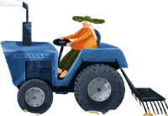
Oral Writing
TG
LO: Talk about what they’ve learned from the story by using the language support.
Guide Ss to talk about what troubles Dad, Mum and the children encountered. Who helped them in the end?
Help Ss organize their ideas about the story with the given visual support and tell them, “This is practice before your homework.”
Model the questions; ask Ss to work together to present their answers.
Get ready to present!
What troubles did Dad, Mum, and the children encounter? Who helped them in the end?
burn down
too
expensive
too old
full
a farmer helped
stay in a bus

Slide 24
TG
Writing
LO: Understand what the homework is.
1. Explain the writing task to Ss and check their understanding.
Tell Ss that they should finish their writing before next class. Make sure that they know to upload their homework to the platform. They will present their work next class.
3. Remind Ss to watch the post-class video and to finish the writing task.
Let’s draw and write!
Now, please follow the steps to finish your homework, and present it in the next class:
Create a picture story of an unexpected event while traveling.
Write two complete sentences to describe it.
Watch the post-class video about the writing task.
2:00
24/26

Slide 25
TG
LO: Review today’s lesson.
Guide Ss to review the phonics by asking Ss to read the words.
Guide Ss to review the words by asking Ss to make sentences with them.
Guide Ss to review the sentence structures by asking each S to make a sentence with them.
Review
Let’s review!
Review
Phonics:
pal/top/hot/hat/pot/
lot
Sentence Structure:
They looked at ____.
Vocabulary:
seaside/family/
hotel/expensive/ farmer/holiday
1:00
25/26

Slide 26
TG
LO: End the lesson and encourage Ss to prepare well for the next class.
1. Briefly comment on Ss.
2. Say goodbye to students.
3. Ask Ss to preview the next lesson.
0:30
26/26

