Slide 1
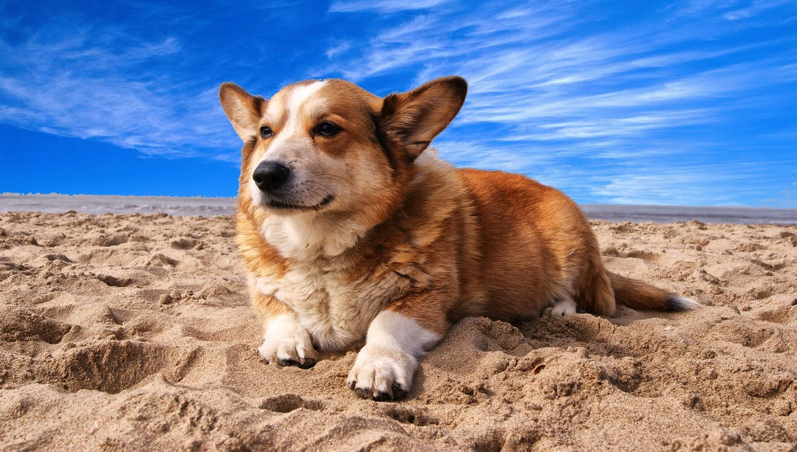
LO: Greet Ss; introduce the topic to Ss.
1. Guide Ss to ask and answer the given question.
2. Introduce the topic of the lesson.
What do you think are the benefits of owning a dog?
Save Floppy! 2
ORT-G2A Lesson 29
1:30
1/33

Slide 2
LO: Get to know what they will learn in this class.
1. Go through the learning goals with Ss. Make sure they know what they’re going to learn in the lesson.
Note: Don’t read the learning goals to the Ss.
Learning Goals
Recognize and read grade-appropriate irregularly spelled words. Read irregularly spelled, second-grade words from the text.
Learn the key words contented, wag, lend, lid, crackle, valuable, slam, and keyhole, and understand them in context.
Apply the different reading strategies and skills about analyzing a story.
Talk about the story and discuss the best way to adapt to a new environment.
0:30
2/33

Slide 3
LO: Present the writing assignment from the last lesson.
1. Let Ss take turns presenting the writing assignment from the last lesson.
2. Give feedback.
Presentation
Presentation Time
Have you finished your homework you were assigned in the last lesson?
Give your presentation and tell us why every family should own a pet.
1:30
3/33

Slide 4
LO: Identify and pronounce the sight words.
Click and read all the sight words.
Phonics Learning
Phonics
have
height
journey
friendly
give
find
1:30
4/33

Slide 5
LO: Decode the words in the text accurately and fluently; read the text fluently.
1. Guide Ss to read the story aloud together and with rhythm.
2. Ask Ss to take turns reading the text one sentence at a time.
Phonics
Read on Your Own
Tom used to have a strong fear of heights, but he always wanted to challenge himself by climbing mountains. One day, he went on a journey with a group of climbers. They were very friendly and ready to give Tom a hand if he got into trouble. Finally, they managed to find a safe road to get to the top of the mountain together.
1:00
5/33

Slide 6
LO: Review the first part of the story.
1. Review what happened in the first part of the story.
2. Discuss the given questions and give feedback.
Background
Story Review
In our previous lesson, we read about how the children used magic to return to their adventure.
Where are Biff, Chip, and Kamar?
What did the bird do?
1:30
6/33

Slide 7
LO: Ask Ss to look at the illustration and to talk about what they can learn from the picture; predict what might happen in the story and connect the story to real life experiences.
Have Ss discuss the given questions before reading.
Have Ss discuss the given questions in the connections section.
Make Predictions
Lead-in
Use details from the illustration to make guesses.
What do you think is in the chest?
What do you think will happen to the genie?
1:30
7/33

Slide 8
LO: Define the words contented and wag in context.
Have Ss go through the text quickly to find the word and have Ss work together to define the words contented and wag by using the illustration and the context clues; give feedback.
Note: If Ss can present a correct understanding of the unfamiliar word(s), it’s not necessary to teach the word(s) on the next slide.
Save Floppy! 2
Reading
Vocabulary
Use the illustration and context clues to define the words contented and wag.
Pages 16-17
1:00
8/33

Slide 9
LO: Utilize the reading strategies and skills to assist in
reading comprehension; understand the academic words contented and wag in context.
If Ss can present a good understanding of the words from the previous slide, skip the vocabulary teaching part. If not, explain the words contented and wag with the sample sentence and ask Ss to make sentences with them.
Ask Ss to discuss the comprehension questions and encourage them to support their answers with details.
Save Floppy! 2
Reading
Read Pages 16-17
contented (adj.)
Comprehension
Definition: feeling happiness or satisfaction
Why did they have to climb the mountain?
How was Floppy when they found him? Why?
How do you think Biff and Chip felt, and why?
Whenever he returns to this place, he is happy and contented.
wag (v.)
Definition: to move something back and forth, from side to side, such as a finger or a tail
The dog wagged his tail, as if to tell me how happy he was.
2:00
9/33

Slide 10
LO: Utilize the reading strategies and skills to assist in reading comprehension.
Have Ss take turns discussing the comprehension questions and encourage them to support their answers with details.
Save Floppy! 2
Reading
Comprehension
How did Floppy feel about leaving the nest, and why?
What was Kamar worried about?
Why had Hassan been worried while they were gone?
Pages 18-19
1:00
10/33

Slide 11
LO: Utilize the reading strategies and skills to assist in reading comprehension.
Have Ss take turns discussing the comprehension questions and encourage them to support their answers with details.
Have Ss discuss the questions in the connections section.
Save Floppy! 2
Reading
Comprehension
Why was Hassan still worried?
What did Hassan think they should do?
Connections
Do you think Hassan and the children should open the chest? Why or why not? Would you open it?
Pages 20-21
1:00
11/33

Slide 12
LO: Define the words lend and lid in context.
Have Ss go through the text quickly to find the words and have Ss work together to define the words lend and lid by using the illustration and the context clues; give feedback.
Note: If Ss can present a correct understanding of the unfamiliar word(s), it’s not necessary to teach the word(s) on the next slide.
Save Floppy! 2
Reading
Chip had an idea.
“Lend me the magic key, Biff,” he said. He put the key in the lock and turned it. The lid of the chest sprang open. Everyone looked in the chest, but it was completely empty.
Vocabulary
Page 22
Use the illustration and context clues to define the words lend and lid.
1:00
12/33
Notes:
Suggested Time: 2 mins (Understanding & Applying)
Learning Objectives:
Ss will be able to use the reading strategies and skills: making connections to analyze the story.
Ss will be able to understand the core academic word “pack” in context and use it in sentences.
TD
Choose one S to read aloud the passage.
Then explain the key word “pack" with the sample sentence and ask Ss to make sentences.
Ask Ss to discuss the given questions and give feedback.

Slide 13
LO: Utilize the reading strategies and skills to assist in reading comprehension; understand the academic words lend and lid in context.
If Ss can present a good understanding of the word from the previous slide, skip the vocabulary teaching part. If not, explain the words contented and wag with the sample sentence and ask Ss to make sentences with them.
Ask Ss to discuss the comprehension questions and encourage them to support their answers with details.
Save Floppy! 2
Reading
Read Page 22
lend (v.)
Comprehension
Definition: to offer something to someone, or to allow someone to use one’s belongings
What idea did Chip have to try to open the chest?
How do you think the children felt when they saw what was inside the chest?
I lent my pen to a friend of my friends.
lid (n.)
Definition: the top of a box or other container
I can't get the lid off this jar.
2:00
13/33

Slide 14
LO: Define the words crackle and valuable in context.
Have Ss go through the text quickly to find the words and have Ss work together to define the words crackle and valuable by using the illustration and the context clues; give feedback.
Note: If Ss can present a correct understanding of the unfamiliar word(s), it’s not necessary to teach the word(s) on the next slide.
Save Floppy! 2
Reading
Vocabulary
Use the illustration and context clues to define the words crackle and valuable.
Pages 23-25
1:00
14/33

Slide 15
LO: Utilize the reading strategies and skills to assist in reading comprehension; understand the academic words crackle and valuable in context.
If Ss can present a good understanding of the word from the previous slide, skip the vocabulary teaching part. If not, explain the words contented and wag with the sample sentence and ask Ss to make sentences with them.
Ask Ss to discuss the comprehension questions and encourage them to support their answers with details.
Save Floppy! 2
Reading
Read Pages 23-25
Comprehension
crackle (v.)
What did the genie smell like when he appeared this time?
How do you think Chip would trick the genie?
Why do you think Chip told the genie he wasn't looking hard enough? What did Chip want the genie to do?
Definition: to make short sharp sounds, like something that is burning in a fire.
A log fire crackled in the hearth.
valuable (adj.)
Definition: worth a lot of money
Luckily, nothing valuable was stolen.
2:00
15/33

Slide 16
LO: Define the word slam in context.
Have Ss go through the text quickly to find the word and have Ss work together to define the word slam by using the illustration and the context clues; give feedback.
Note: If Ss can present a correct understanding of the unfamiliar word(s), it’s not necessary to teach the word(s) on the next slide.
Save Floppy! 2
Reading
Suddenly Chip pushed the genie into the chest and slammed down the lid. Then he locked it with the magic key.
“How dare you!” shouted the genie. “You will pay for this when I get out.”
“But you can’t get out,” called Chip.
Vocabulary
Pages 26-27
Use the illustration and context clues to define the word slam.
1:00
16/33
Notes:
Suggested Time: 2 mins (Understanding & Applying)
Learning Objectives:
Ss will be able to use the reading strategies and skills: making connections to analyze the story.
Ss will be able to understand the core academic word “pack” in context and use it in sentences.
TD
Choose one S to read aloud the passage.
Then explain the key word “pack" with the sample sentence and ask Ss to make sentences.
Ask Ss to discuss the given questions and give feedback.

Slide 17
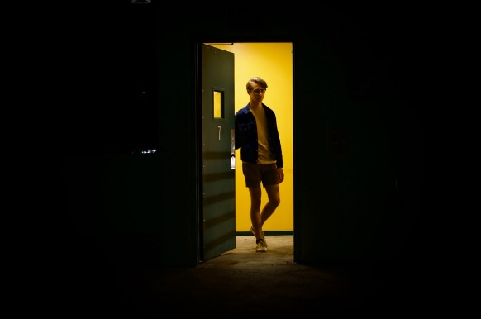
LO: Utilize the reading strategies and skills to assist in
reading comprehension; understand the word slam in context.
If Ss can present a good understanding of the word from the previous slide, skip the vocabulary teaching part. If not, explain the word slam with the sample sentence and ask Ss to make sentences with it.
Ask Ss to discuss the comprehension questions and give feedback.
Save Floppy! 2
Reading
Read Pages 26-27
Comprehension
What did Chip and the genie argue about?
Do you think the genie would be able to get out? If you think he would, how?
Did Chip's trick work? Explain your answer.
slam
(v.)
Definition: to shut, or to make something shut, with a lot of force
I heard the door slam behind him.
2:00
17/33
Notes:
Suggested Time: 2 mins (Understanding & Applying)
Learning Objectives:
Ss will be able to use the reading strategies and skills: making connections to analyze the story.
Ss will be able to understand the core academic word “pack” in context and use it in sentences.
TD
Choose one S to read aloud the passage.
Then explain the key word “pack" with the sample sentence and ask Ss to make sentences.
Ask Ss to discuss the given questions and give feedback.

Slide 18
LO: Define the word keyhole in context.
Have Ss go through the text quickly to find the word and have Ss work together to define the word keyhole by using the illustration and the context clues; give feedback.
Note: If Ss can present a correct understanding of the unfamiliar word(s), it’s not necessary to teach the word(s) on the next slide.
Save Floppy! 2
Reading
The genie made himself thin and started to slip through the keyhole. Chip held the bottle over the keyhole. And the genie slid into it.
“He fell for my trick,” said Chip. “I thought he would.”
Vocabulary
Pages 28-29
Use the illustration and context clues to define the word keyhole.
1:00
18/33
Notes:
Suggested Time: 2 mins (Understanding & Applying)
Learning Objectives:
Ss will be able to use the reading strategies and skills: making connections to analyze the story.
Ss will be able to understand the core academic word “pack” in context and use it in sentences.
TD
Choose one S to read aloud the passage.
Then explain the key word “pack" with the sample sentence and ask Ss to make sentences.
Ask Ss to discuss the given questions and give feedback.

Slide 19
LO: Utilize the reading strategies and skills to assist in reading comprehension; understand the word keyhole in context.
If Ss can present a good understanding of the word from the previous slide, skip the vocabulary teaching part. If not, explain the word keyhole with the sample sentence and ask Ss to make sentences with it.
Ask Ss to discuss the comprehension questions and give feedback.
Save Floppy! 2
Reading
Read Pages 28-29
Comprehension
How did the genie get out of the chest?
How did Chip catch him? Did Chip's trick work? Explain your answer.
How do you think the genie felt now? How about Chip?
keyhole
(n.)
Definition: the hole in a lock that you put a key in
Insert the key into the keyhole and turn it around.
2:00
19/33
Notes:
Suggested Time: 2 mins (Understanding & Applying)
Learning Objectives:
Ss will be able to use the reading strategies and skills: making connections to analyze the story.
Ss will be able to understand the core academic word “pack” in context and use it in sentences.
TD
Choose one S to read aloud the passage.
Then explain the key word “pack" with the sample sentence and ask Ss to make sentences.
Ask Ss to discuss the given questions and give feedback.

Slide 20
LO: Utilize the reading strategies and skills to assist in reading comprehension.
Have Ss take turns discussing the comprehension questions and encourage them to support their answers with details.
Have Ss discuss the questions in the connections section.
Save Floppy! 2
Reading
Comprehension
Which parts of the adventure did Chip enjoy, and which parts did he not?
What happened to the bone Floppy brought home?
Pages 30-31
1:00
20/33

Slide 21
LO: Utilize the reading strategies and skills to assist in reading comprehension.
Have Ss take turns discussing the comprehension questions and encourage them to support their answers with details.
Have Ss discuss the questions in the connections section.
Save Floppy! 2
Reading
Comprehension
Why was Kipper glad they hadn't brought the bottle back with them?
Connections
If you found a genie, what would you do? If it was a good genie, what would you wish for?
Pages 32
1:00
21/33

Slide 22
LO: Teach Ss how to analyze a story and explain the three elements of a story.
Teach Ss how to analyze a story.
Reading Strategy
Analyze a Story
Read Save Floppy! (pages 16-32) and identify the settings, characters, and plot.
Look through The Evil Genie and its sequel Save Floppy! and analyze how the settings changed and how the main characters and the plot developed throughout the two stories.
Story
Settings
Plot
Characters
Settings
Characters
Plot
3:00
22/33

Slide 23
LO: Teach Ss how to analyze a story and explain the three elements of a story.
Teach Ss how to analyze a story.
Identify the settings, characters, and plot of Save Floppy! (pages 16-32).
Save Floppy! (P:16-32)
Setting
Plot
Characters
on the mountain
on the beach
in Biff’s home
Biff, Chip, and Kamar saved Floppy.
Chip opened the chest.
The genie came.
It’s your turn.
Biff, Chip, the big bird, Floppy, Kamar, Hassan, the genie, Kipper
23/33

Slide 24
LO: Teach Ss how to analyze a story and explain the three elements of a story.
Teach Ss how to analyze the main characters in the story.
Analyze the main characters in the story.
Characters | Characters’ Actions | Characters’ traits
Biff
Chip
Kamar
found Floppy
lend Chip the magic key
careful
helpful
opened the chest
tricked the genie to get into the bottle
clever
brave
It’s your turn.
It’s your turn.
24/33

Slide 25
LO: Teach Ss how to analyze a story and explain the three elements of a story.
Analyze how the settings changed and how the main characters and the plot developed throughout the two stories.
Analyze how the settings changed and how the main characters and the plot developed throughout the two stories.
Settings
Characters
Plot
in Biff’s home
on the tiny island
on the sea
A magical adventure started.
Kamar rescued the children.
The genie came out.
curious
Kamar:
?
Biff:
on the big island
in Biff’s home
on the big island
caring
brave
tough
Floppy were taken away.
The children was taken home.
The children came back to rescue Floppy.
Biff:
?
Kamar:
on the big island
in Biff’s home
careful
helpful
Chip locked up the genie again.
Hassan and Kamar left.
The children came back home.
Biff:
?
Kamar:
25/33

Slide 26
LO: Check if Ss understand the words in context.
Ask Ss to take turns reading the words aloud.
Ask Ss to fill in the blanks and to read the sentences.
Read & Choose
Vocabulary
wagging
The dog was biting, growling, and _________ its tail.
I can _____ the books to her friends.
His face relaxes into a ___________ smile.
He has a _________ collection of stamps in his office.
lend
contented
valuable
Complete the sentences. Use the correct form of the words in the box.
contented, wag,
lend, valuable
1:00
26/33

Slide 27
LO: Use details to talk about how Hassan and Kamar prepared before leaving the island.
Instruct Ss to discuss the given question.
Encourage Ss to answer questions using the given clues and to present their answers with at least three complete sentences; assist Ss if necessary.
Listening & Speaking
How did Hassan and Kamar prepare before leaving the island?
mended the boat
packed their belongings
loaded the boat
. . .
2:00
27/33

Slide 28
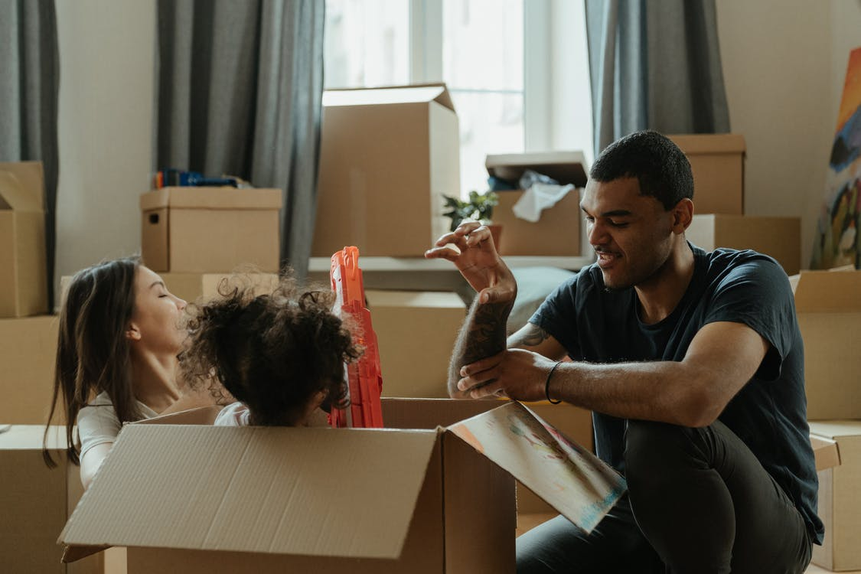
LO: Talk about how you would prepare to move into a new house.
Ask Ss to talk about the given question.
Encourage Ss to answer the question in complete sentences with the given clues; assist Ss if necessary.
Listening & Speaking
How would you prepare to move into a new house?
make a schedule
gather moving boxes and tools
sort my stuff
pack the things that need to be moved
rent a moving truck
. . .
2:00
28/33

Slide 29
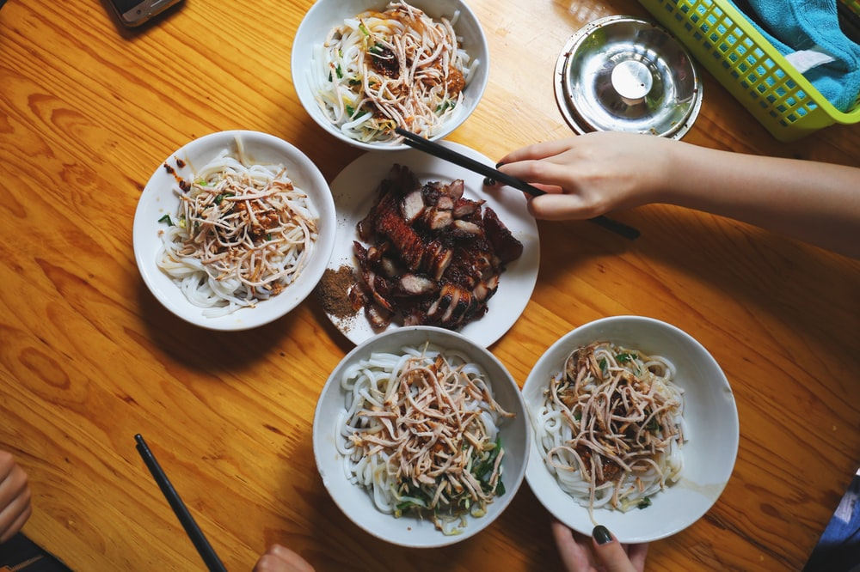
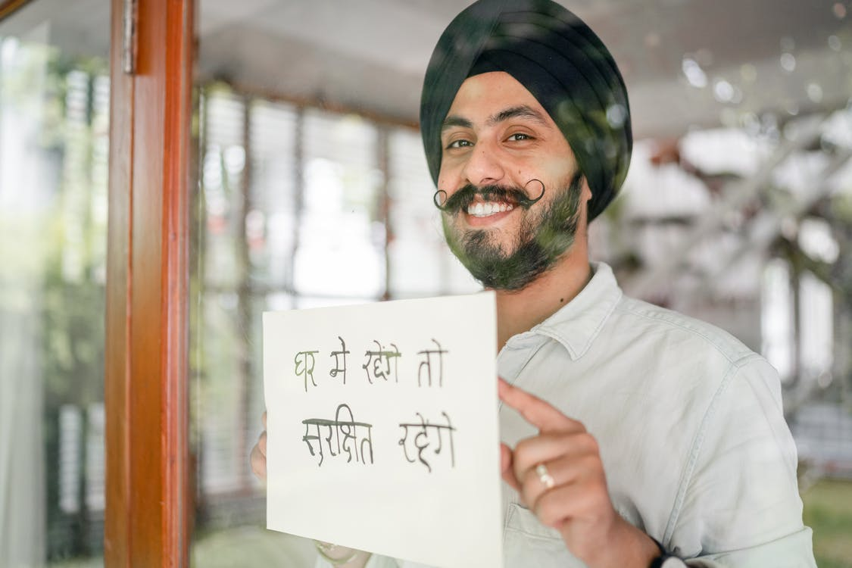
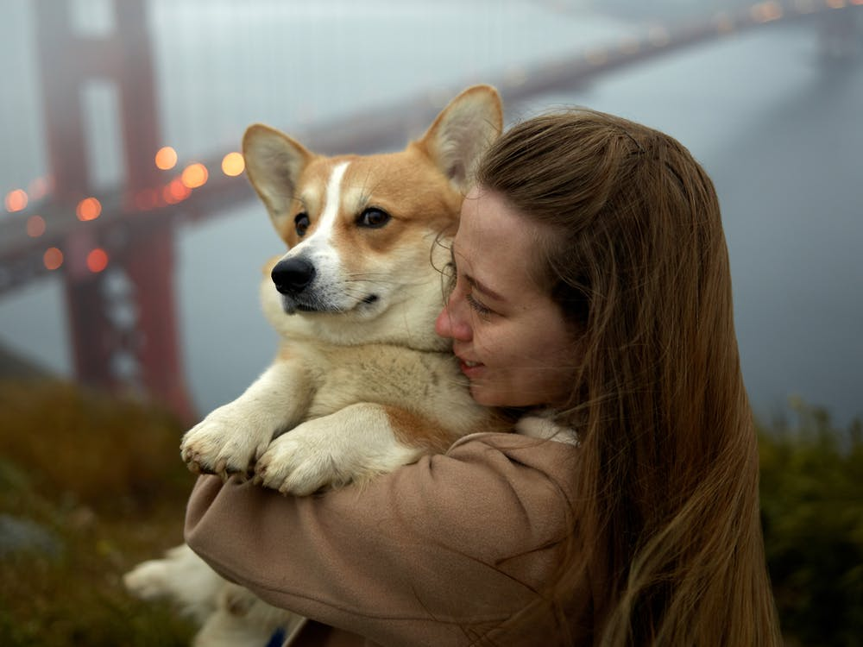
LO: Discuss the the best way to adapt to a new environment.
Guide Ss to look at the pictures; have Ss talk about the given question.
Guide Ss to realize that it is not difficult to adapt to a new environment; assist Ss if necessary
Value
What is the best way to adapt to a new environment?
2:00
29/33

Slide 30
LO: Describe Chip’s idea to trick the genie getting back into the bottle with the help of the sequence chart below.
Explain the task to Ss.
Model first; have Ss describe Chip’s idea to trick the genie getting back into the bottle.
Give feedback.
Get Ready to Present
Writing
Describe Chip’s idea to trick the genie getting back into the bottle with the help of the sequence chart below.
Work together to complete the task.
shut the lid of the chest
told the genie something valuable was inside
pushed the genie into the chest
locked the chest
held the bottle over the keyhole
let the genie slide into the bottle
3:00
30/33

Slide 31
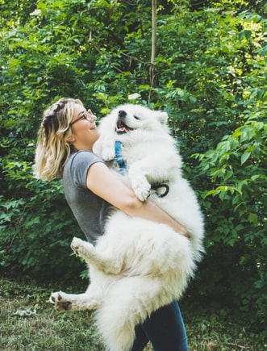
LO: Understand what the writing task is; know to complete the writing task with the help of the post-class instructional video.
Introduce and explain the writing task to Ss.
Ask Ss to finish the task before the next class and to be ready to present.
Remind Ss to watch the post-class video before writing.
Homework: A Persuasive Essay
Writing
Write a persuasive essay explaining why every family should own a pet in three paragraphs.
Step 4. Revise: Revise Words and Add Details
Step 5. Edit: Check Spelling, Punctuation, and Capitalization
Step 6. Publish: Share Your Writing With Others
Watch the post-class video before you start writing.
1:30
31/33

Slide 32
LO: Review the whole lesson.
Review the key words with Ss by asking Ss to make sentences.
Review the story with Ss by asking the given questions.
Review
Let’s Review
Story: Save Floppy!
Key Words:
contented, wag, lend, lid, crackle, valuable, slam, keyhole
Key Questions:
How did Hassan and Kamar prepare before leaving the island?
How would you prepare to move into a new house?
1:00
32/33

Slide 33
LO: End the lesson and encourage Ss to perform better in the next class.
Briefly comment on Ss’ performance.
Say goodbye to Ss.
Ask Ss to preview the next lesson.
0:30
33/33

