Slide 1
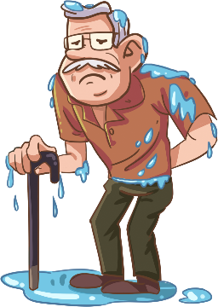
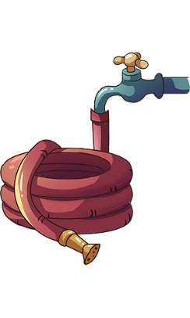
TG
LO: Get to know their partners; get a basic idea about the topic of today’s lesson.
1. Say hello to Ss; ask Ss to introduce themselves and to greet each other.
2. Introduce the topic of the lesson.
ORT-GKB
Lesson 29
0:30
1/32

Slide 2
Learning
Goals
TG
LO: Get to know and understand what will be learned in this lesson.
Go through the learning goals with Ss.
We are going to . . .
Read common, high-frequency words fluently.
Learn the key words butt, patch, roses, tap, bricks, and grass, and make sentences with them.
Read the story Everyone Got Wet and compare and contrast what happened to the characters.
Practice using the sentence structure
_____ mended ________.
0:30
2/32

Slide 3
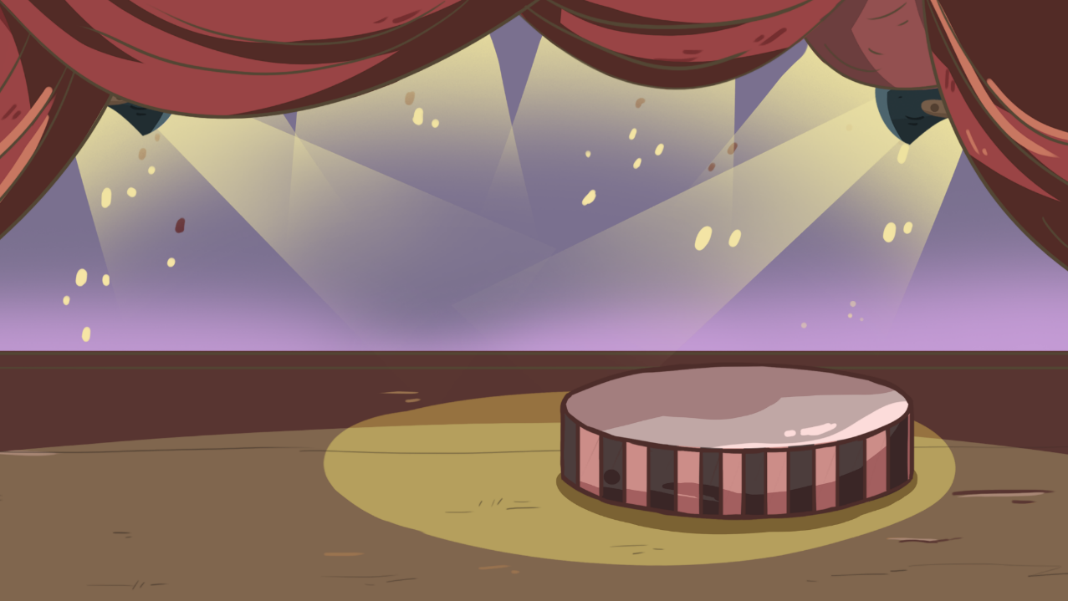
TG
LO: Present the writing assigned last lesson.
1. Let Ss present in turns.
2. Give feedback.
Presentation
Let’s show!
Share your writing from last lesson with your partner!
2:00
3/32

Slide 4
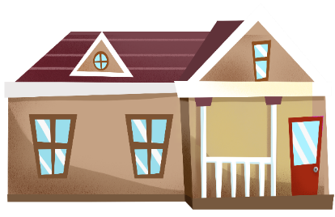
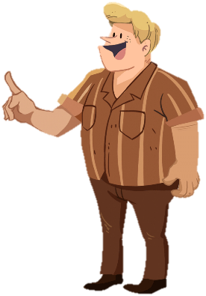
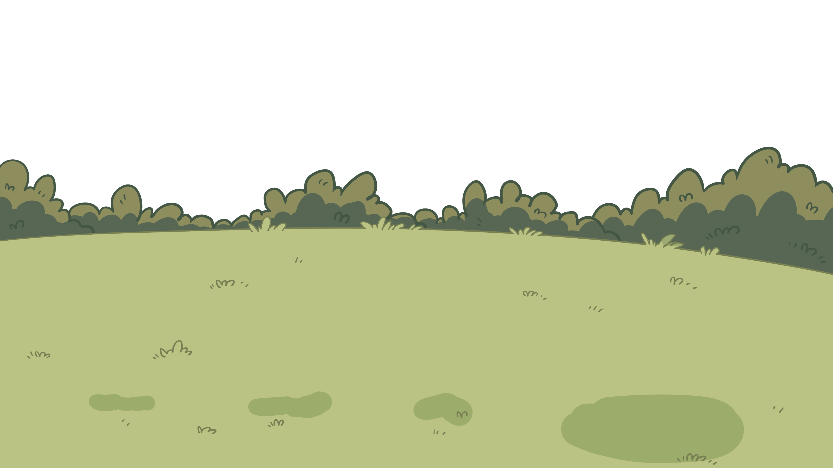
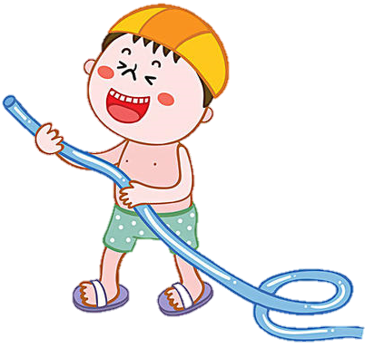
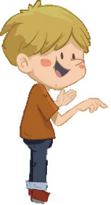
LO: Read common high-frequency words fluently and accurately.
Ask Ss to talk about what they can see in the picture; ask Ss to help the children in the picture water the flowers.
Click and ask Ss to read the high-frequency words.
The process is as follows:
Click and ask Ss to read the high-frequency words on this slide; click and the children in the picture will water the flowers.
Repeat this practice for the rest of the words; there are three words on this slide.
Last time the boys splashed water on the girl, then click and Dad will come out and guide Ss to know that we shouldn’t splash water on others.
TG
Phonics
Let’s listen and speak!
last
that
fast
Can you read
these words?
Let’s water the flowers!
2:00
2:00
4/32
6/26

Slide 5
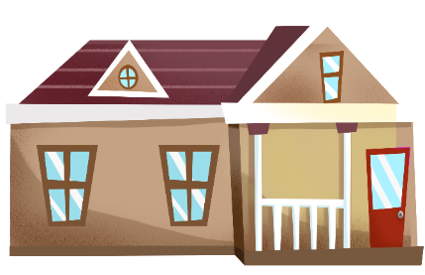
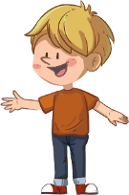
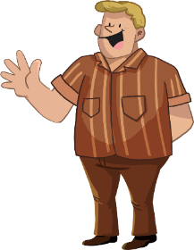
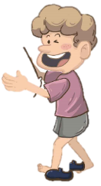
TG
LO: Read common high-frequency words fluently and accurately.
Ask Ss to talk about what they can see in the picture; ask Ss to help the children in the picture put water in the bucket.
Ask Ss to blend different letter sounds into one word.
The process is as follows:
Click and ask Ss to read the common high-frequency words fluently and accurately on this slide; click and help the children in the picture put water in the bucket.
Repeat this practice for the rest of the words; there are three words on this slide.
Let’s listen and speak!
Can you read these words?
played
teddy
liked
Good job!
Let’s store some water.
5/32
2:00

Slide 6
TG
Phonics
Let’s chant!
LO: Read the chant fluently; decode the words learned in the text.
Read the chant to Ss with rhythm; have Ss observe the picture and the highlighted words.
Guide Ss to repeat after you; ask them to take turns reading each sentence.
Give feedback.
This was a match to skate.
The boy came in last.
He was sad about that.
The girl skated very fast.
She came in first.
She got a teddy as a prize.
Then she and the boy shared and played with the teddy..
They all liked it very much.
2:00
6/32

Slide 7
Lead-in
TG
LO: Use the book cover to identify details and make predictions.
1. Guide Ss to look at the book cover closely and talk about the given questions.
2. Encourage Ss to talk more about the connections question.
Before Reading
What things are in front of the family?
What can the family do with these
things?
How do you think everyone will get
wet in the story?
Written by Roderick Hunt
Illustrated by Alex Brychta
1:30
7/32

Slide 8
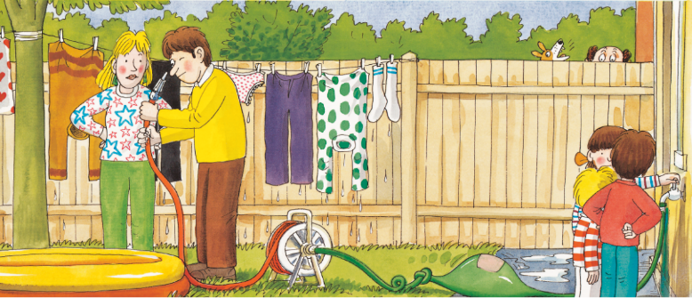
Let’s predict!
Reading
TG
Reading
LO: Make predictions about the story by using the illustration; motivate Ss’ interest in reading the story.
Guide Ss to recall what it means to predict and ask them to make guesses prior to reading the story by looking at the pictures.
Guide Ss to talk about the given questions.
Before Reading
What will come out of the hose?
What do you think will happen to the children next? Why?
1:30
8/32

Slide 9
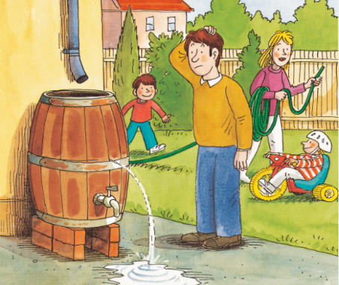
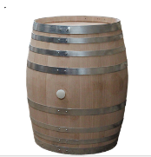
Everyone Got Wet
TG
Reading
LO: Understand the meaning of the vocabulary word butt, and make sentences with it; understand the text; read the text fluently.
Read the text aloud to Ss.
Ask Ss to find the vocabulary word butt in the text and the illustration; explain it and the example sentence to Ss by using the illustration and the picture; have Ss read the word and have Ss make sentences with it.
Have Ss talk about the comprehension questions by using the illustration and the text.
Have Ss read the text fluently and give feedback.
Vocabulary
Comprehension
1. What did Dad look at?
What happened to it?
butt
2. What happened to the
water butt? What do you
think Dad would do next?
This is a wood butt.
Dad looked at the water butt. The water butt was leaking.
butt
1:30
9/32

Slide 10
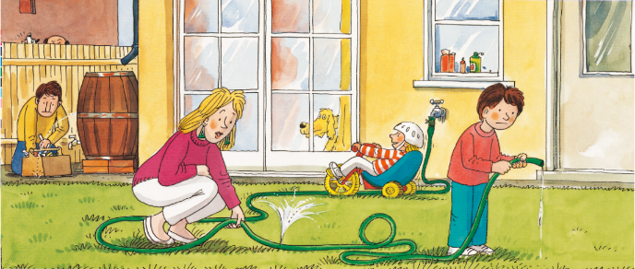
Everyone Got Wet
TG
Reading
LO: Understand the text; read the text fluently.
Read the text aloud to Ss.
Have Ss talk about the comprehension questions by using the illustration and the text.
Have Ss read the text fluently and give feedback.
Comprehension
1. What happened to the
hose?
2. What did Mum say?
Why did she say that?
Mum looked at the hose. The hose was leaking.
“Oh bother!” said Mum.
1:30
10/32

Slide 11
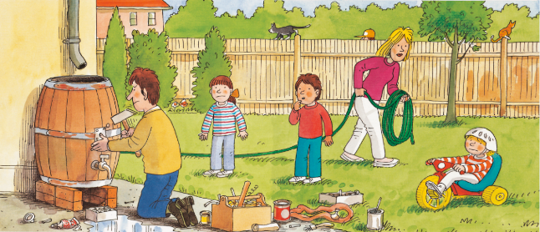
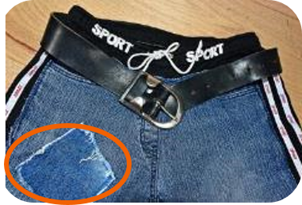
Everyone Got Wet
LO: Understand the meaning of the key vocabulary word patch, and make sentences with it; understand the text; read the text fluently.
Read the text aloud to Ss.
Ask Ss to find patch in the text and the illustration; explain the word and the example sentence to Ss by using the illustration and the pictures; have Ss read the word and have Ss make sentences with it.
Have Ss talk about the comprehension questions one by one by using the illustration and the text.
Ask one S to read the text; give feedback.
TG
Reading
Vocabulary
Comprehension
1. What did Dad do?
2. How did Dad mend the
water butt? What did Dad
think of this job?
patch
Dad mended the water butt. He put a patch on it.
“What a tricky job!” he said.
There is a patch on this pair of jeans.
patch
1:30
11/32

Slide 12
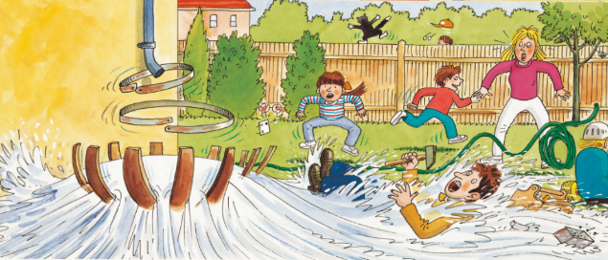
Everyone Got Wet
TG
Reading
LO: Understand the text; read the text fluently.
Read the text aloud to Ss.
Have Ss talk about the comprehension questions one by one by using the illustration and the test.
Ask Ss to read the text; give feedback.
Comprehension
Did Dad mend the water butt well? What happened to it?
What happened to Dad? What would Dad do next?
The water butt burst. All the water came out.
Dad got wet.
1:30
12/32

Slide 13
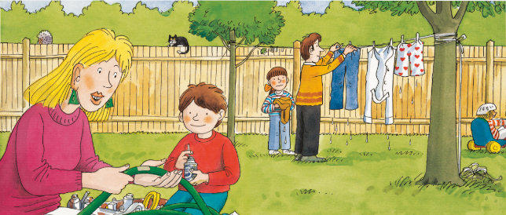
Everyone Got Wet
TG
Reading
LO: Understand the text; read the text fluently and at an appropriate rate.
Read the text aloud to Ss.
Have Ss talk about the comprehension questions by using the illustration and the text.
Read the text fluently and at an appropriate rate; give feedback.
Comprehension
1. What did Mum do? Who
helped Mum?
2. How did Mum mend
the hose?
3. What did Dad do? Who
helped Dad?
Mum mended the hose. She put a patch on it.
“What a tricky job!” she said.
Decoding
Read at an appropriate rate.
1:30
13/32

Slide 14
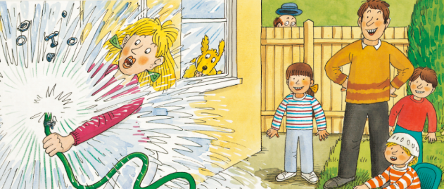
Everyone Got Wet
Reading
TG
LO: Understand the text; make connections; read the text fluently and at an appropriate rate.
Read the text aloud to Ss.
Have Ss talk about the comprehension questions by using the illustration and the text.
Guide Ss to talk about the connection question; Encourage Ss talk more about themselves; give feedback.
Read the text fluently and at an appropriate rate; give feedback.
Comprehension
1. What happened to Mum?
2. How did Mum get wet?
Connections
What would you do next if you got wet?
Mum put the hose on the tap. The top of the tap came off.
Mum got very wet.
Decoding
Read at an appropriate rate.
1:30
14/32

Slide 15
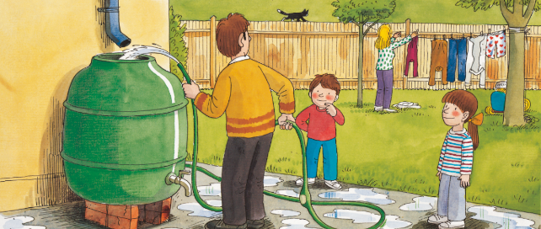
Everyone Got Wet
Reading
TG
LO: Understand the meaning of the key vocabulary word bricks, and make sentences with it; understand the text; read the text fluently.
Read the text aloud to Ss.
Ask Ss to find bricks in the text and the illustration; explain the word and the example sentence to Ss by using the illustration and the pictures; have Ss read the word and have Ss make sentences with it
Have Ss talk about the comprehension questions by using the illustration and the text.
Have Ss read the text fluently and give feedback.
Vocabulary
Comprehension
1. What did Dad get?
What did Dad do next?
2. What did Mum do? Why?
bricks
This wall was built with bricks.
Dad got a new water butt. He put it on the bricks.
He got the hose. He filled up the water butt.
bricks
1:30
15/32

Slide 16
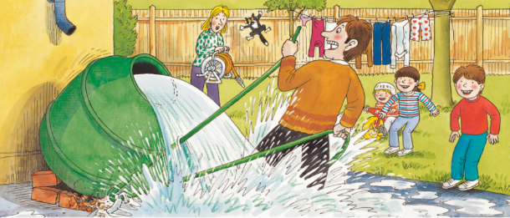
Everyone Got Wet
TG
Reading
LO: Understand the text; decode the sight word; read the text fluently.
Read the text aloud to Ss.
Have Ss talk about the comprehension questions by using the illustration and the text.
Ask Ss to find the sight phrase get married in the text and guide them to read it accurately.
Have Ss read the text fluently and give feedback.
Comprehension
What happened to the new water butt?
What happened to Dad? Why was Dad wet again?
The water butt fell over.
The water poured out. Dad got wet again.
Sight Word
over
1:30
16/32

Slide 17
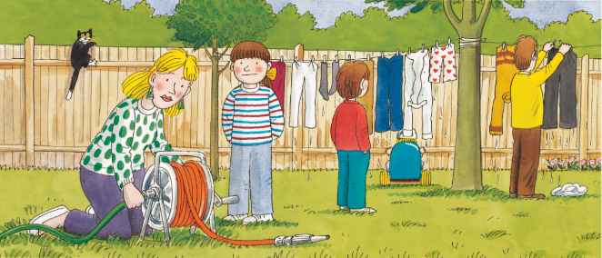
Everyone Got Wet
TG
Reading
LO: Understand the meaning of the key vocabulary word roses, and make sentences with it; understand the text; read the text fluently.
Read the text aloud to Ss.
Ask Ss to find roses in the text and the illustration; explain the word and the example sentence to Ss by using the illustration and the pictures; have Ss read the word and have Ss make sentences with it.
Have Ss talk about the comprehension questions by using the illustration and the text.
Have Ss read the text fluently and give feedback.
Vocabulary
Comprehension
1. What did Mum get?
2. What did Mum do with the
new hose? Why?
3. What did Dad do? How
many times did Dad get
wet?
roses
How beautiful these roses are!
Mum got a new hose. She joined it to the old hose.
She wanted to water the roses.
roses
1:30
17/32

Slide 18
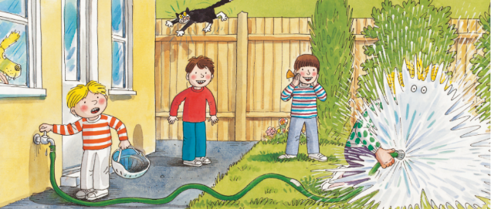
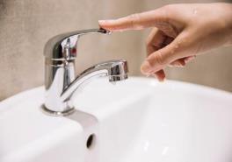
Everyone Got Wet
LO: Understand the meaning of the key vocabulary word tap, and make sentences with it; understand the text; make connections; read the text fluently.
Read the text aloud to Ss.
Ask Ss to find tap in the text and the illustration; explain the word and the example sentence to Ss by using the illustration and the pictures; have Ss read the word and have Ss make sentences with it.
Have Ss talk about the comprehension questions by using the illustration and the text.
Encourage Ss to talk about the connections questions; give feedback.
Have Ss read the text fluently and give feedback.
TG
Reading
Vocabulary
Comprehension
What did Kipper want to do? How did he help?
What happened to Mum?
How do you think Mum felt when she got wet again?
tap
Kipper wanted to help. He turned the tap on.
Mum got wet again. “Oh no!” said Mum.
Please turn off the tap after washing your hands!
tap
1:30
18/32

Slide 19
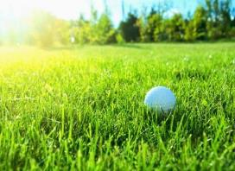
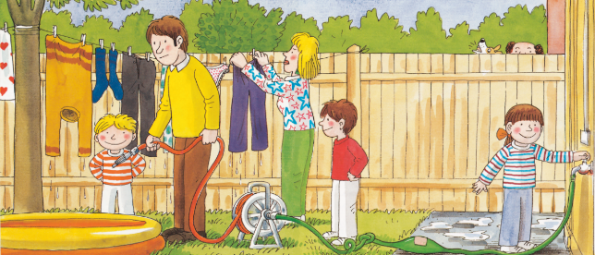
Everyone Got Wet
TG
Reading
LO: Understand the meaning of the key vocabulary word bricks, and make sentences with it; understand the text; read the text fluently.
Read the text aloud to Ss.
Ask Ss to find bricks in the text and the illustration; explain the word and the example sentence to Ss by using the illustration and the pictures; have Ss read the word and have Ss make sentences with it.
Have Ss talk about the comprehension questions by using the illustration and the text.
Have Ss read the text fluently and give feedback.
Vocabulary
Comprehension
1. What did the children get?
Where did they put it?
grass
2. What did Dad and Biff do
next?
There is a ball on
the grass.
The children got the paddling pool. They put it on the grass.
Dad got the new hose. Biff turned on the tap.
grass
1:30
19/32

Slide 20
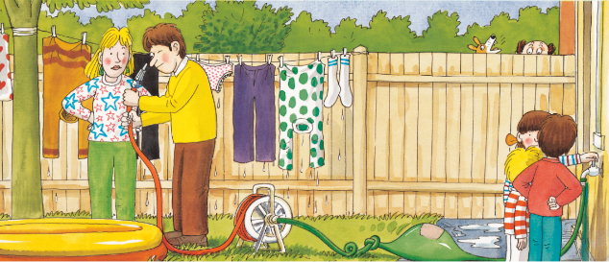
Everyone Got Wet
TG
Reading
LO: Understand the text; read the text fluently.
Read the text aloud to Ss.
Have Ss talk about the comprehension questions one by one by using the illustration and the text.
Ask Ss to read the text; give feedback.
Comprehension
What should come out of the hose?
2. What did Dad say and do
next when no water
came out of the hose?
No water came out of the hose. “Funny!” said Dad.
He looked down the hose.
1:30
20/32

Slide 21
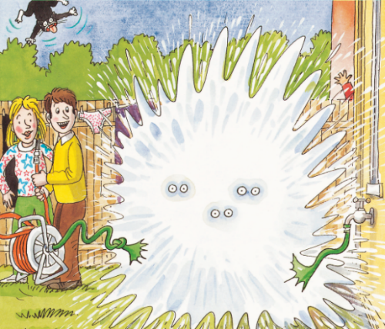
Everyone Got Wet
TG
Reading
LO: Understand the text; read the text fluently.
Read the text aloud to Ss.
Have Ss talk about the comprehension questions one by one by using the illustration and the text.
Ask Ss to read the text; give feedback.
Comprehension
What happened to the children at the end of the story?
2. Why did the children get
wet? How did they feel
after they got wet?
Oh no! The children got wet.
1:30
21/32

Slide 22
TG
LO: Understand the following reading strategy: Compare and Contrast. Understand how to use this reading strategy in the story.
Understand what it means to identify key details.
Guide Ss to understand it more clearly by doing the exercise.
Compare and contrast what happens to the characters.
To compare is to see how two or more things are the same or similar.
contrast
contrast
compare
Dad
Mum
What same things happened to both Dad and Mum?
What are the reasons for Mom and Dad getting wet?
To contrast is to see how two or more things are different.
1. The water
butt burst.
2. The water
came down.
1. Put the hose
on the tap.
2. The top of
the tap came off.
Got wet.
Dad: 1. The water butt burst.
2. The water came down
Mum: 1. Put the hose on the tap.
2. The top of the tap came off.
Both of them got wet.
2:30
22/32

Slide 23
TG
Compare and contrast what happens to the characters.
LO: Check their understanding on how to use the Compare and Contrast reading strategy.
Guide Ss to talk about the first illustration; ask Ss to talk about the first question.
Click and show the right answer; give feedback.
contrast
contrast
compare
Dad
Mum
1. The water
butt fell over.
1. Kipper turned
the tap on.
Got wet again.
2. The water
poured out.
2. Mum didn’t
prepare.
2:00
23/32

Slide 24
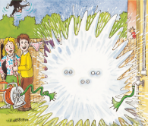
TG
Reading
Let’s retell!
LO: Retell the story with the visual support and assistance.
Ask Ss to work in pairs and to talk about the given questions; have them work in pairs to recall details from the story in the correct sequential order; model first.
Have Ss take turns retelling the story by using the visual aids.
1
2
What happened to the water butt?
What happened to Dad?
Why did Mum get wet?
Did the children get wet on this page?
What happened to Mum?
3
4
Did the water come out of the hose?
Biff turned the tap on, but where did
the water go?
What happened to the children?
Did all the family members get wet in the story?
2:00
24/32

Slide 25
Let’s review the words!
TG
Vocabulary
LO: Check their understanding of the words in this lesson.
Invite students to guess the pictures by identifying the pictures and vocabulary words.
Ask Ss to identify the word that matches the picture; click to show the answer.
Repeat this practice for the rest of the words.
Note: There are six words on this slide.
bricks
butt
tap
roses
grass
patch
2:00
25/32

Slide 26
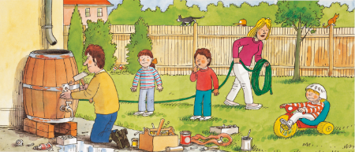
Let’s talk!
TG
Listening & Speaking
LO: Talk about what the people mend in the story.
Have Ss work in pairs to talk about the given illustration by using the sentence structure and the helping words; model first.
Assist Ss if necessary.
Dad, Mum
—What did ______ mend?
—____ mended ______.
Helping Words
water butt
hose
1:30
26/32

Slide 27
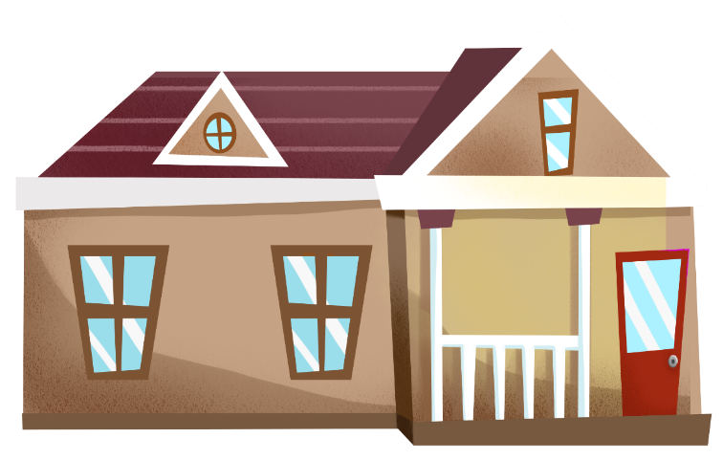
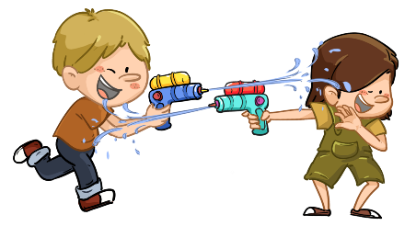
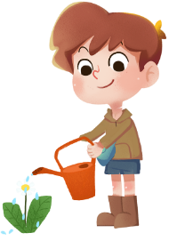
TG
Let’s talk!
Listening & Speaking
LO: Use the sentence structure to discuss the following question: What are all the children doing with the water in the picture?
Ask Ss to observe the picture carefully; have Ss talk about what problems they can see in the picture; encourage them to speak more.
Ask Ss to work in pairs and to talk about the given picture by using the given sentence structure; each S will have at least three chances to talk; model first.
Assist Ss if necessary.
Notes: T can click Let’s Talk to present the sentence structure, and T can click again to make it disappear.
—What are all the children doing with
water in the picture?
—The children are _______.
watering the flowers / playing with water guns / paddling in the pool
…
2:30
27/32

Slide 28
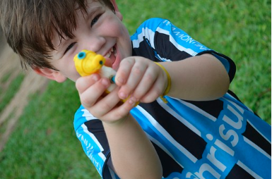
TG
Value
LO: Talk about the following question: What should you pay attention to when playing with water?
Ask Ss to think about the given question; model first.
Guide Ss to talk about the question with the help of the given pictures.
Encourage Ss to talk more about the topic.
Help Ss understand that they should not play near water without their parents nearby. Help them understand that large bodies of water can be dangerous.
What should you pay attention to when playing with water?
change clothes quickly after getting wet
don't spray water on people
Don't go to the river to play without your parents!
2:00
28/32

Slide 29
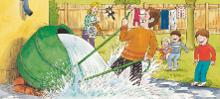
TG
Oral Writing
LO: Talk about how everyone got wet in the story.
Guide Ss to talk about what they’ve learned from the story.
Ask Ss to think about the given questions; help Ss organize their ideas with the given visual support; model the first question, and then ask Ss to complete the task in turns.
Get ready to present!
Talk about how everyone got wet in the story.
Dad
Mum
the children
first time
water butt burst
second time
water butt fell over
first time
the tap came off
second time
Kipper helped
The hose
leaked.
2:00
29/32
Notes:
她们的

Slide 30
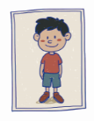
TG
LO: Understand what the homework is.
1. Explain the writing task to Ss and check their understanding.
2. Tell Ss that they should finish their writing before next class; make sure they know they can
upload their homework to the platform; they will present their homework next class.
3. Remind Ss to watch the post-class video and finish the writing task.
Writing
Let’s write!
Journal Writing
Let’s write a journal entry!
Directions:
Write a journal to describe one of your friends who helped you before.
Write three sentences to describe your friends.
Watch the post-class video about the writing task.
0:30
30/32

Slide 31
TG
Review
Review
LO: Review today’s lesson.
Guide Ss to review the phonics by asking Ss to read the words aloud.
Guide Ss to review the words by inviting Ss to read and explain some of the words.
Guide Ss to review the sentence structures by asking each S to make sentences with them.
Let’s review!
Phonics:
last/that/fast/
played/teddy/liked
Sentence Structure:
_____ mended _____.
Vocabulary:
butt/patch/roses/
tap/bricks/grass
1:00
31/32

Slide 32
TG
LO: End the lesson and encourage Ss to perform better in the next class.
1. Briefly comment on Ss.
2. Say goodbye to students.
3. Ask Ss to preview the next lesson.
0:30
32/32

