Slide 1
LO: Introduce the topic and get to know each other.
Say hello to Ss and ask Ss to introduce themselves to each other.
Introduce the topic and ask Ss to discuss the given question.
What special things may be buried underground?
A Lucky Find
Review and Stage Test
G2 L1
G2A L30
1:30
1/20

Slide 2
LO: Get to know the learning objectives.
Go through the learning goals with the Ss. Make sure they know what they’re going to learn in the lesson.
Note: Don’t read the goals to the Ss.
Learning Goals
Learn that vowel teams in two-syllable words usually have long vowel sounds: ee and ai. Learn that in CVCe two-syllable words, the vowel letter usually has a long vowel sound: i_e and a_e. Recognize and read second-grade irregularly spelled words. Learn that some words can start with some common prefixes: un-. Learn that some words can end with some common suffixes: -ment.
Read the story A Lucky Find and utilize some reading skills and strategies to help with story comprehension.
Talk about the story and discuss the ancient places you know about and how you can learn about them.
0:30
2/20

Slide 3
LO: Identify and pronounce the sounds of the vowel
teams ai, o_e, all, igh, and ear.
Click and read the words to Ss; have them identify what sounds the vowel teams ai, o_e, all, igh, and ear make.
Guide Ss to read the words together.
Phonics Learning
Phonics
What sounds do the circled parts of the following words make?
decide
treehouse
daisy
give
environment
unusual
2:00
3/20

Slide 4
On this slide, test Ss’ foundational skills; each S should be tested; give each S a mark according to the assessment rubrics.
LO: Decode the highlighted words accurately and fluently in the text; read the text fluently.
Have Ss read the highlighted words aloud.
Have Ss read the story aloud and with rhythm.
Read on Your Own
Phonics
Jack studies hard at school, but he thinks this is insufficient. Last weekend, he worked as a waiter in a restaurant. He introduced the dishes to people, took their orders, and served them food and drink. When he made mistakes, he gave his sincerest apologies to people. Jack had a very busy weekend, but he thought it was very meaningful.
1:30
4/20

Slide 5
LO: Use the book cover to identify details and to make predictions.
Guide Ss to look at the book cover closely and to talk about the given questions.
Encourage Ss to talk more about the connections question and give feedback.
Book Cover
Background
Before Reading
Where might Kipper and Lee be?
What do you think Kipper and Lee will find? Why might it be lucky?
Connections
Have you ever found anything interesting or unusual on the ground? What was it? What did you do with it?
1:30
5/20

Slide 6
LO: Use details from the picture to make predictions.
Guide Ss to make predictions using the provided questions.
Ask them to make guesses prior to reading the story by looking at the pictures.
Make Predictions
Make Predictions
Lead-in
Use the text and the illustration to make guesses.
Why do you think Kipper and Lee are on TV? Do you think that they found something good or something bad? Why?
Make two predictions based on the given picture from the book.
1:30
6/20

Slide 7
LO: Apply the reading strategies and skills for reading comprehension.
Ask Ss to discuss the comprehension questions; give feedback.
A Lucky Find
Reading
Comprehension
What was the weather like before Saturday? Why did Floppy look miserable?
How did the weather change later that day? What do you think Kipper would do next?
Pages 1-3
0:30
7/20

Slide 8
A Lucky Find
LO: Apply the reading strategies and skills for reading comprehension.
Ask Ss to discuss the comprehension questions; give feedback.
Reading
Comprehension
What were Biff, Chip, and their parents doing? Why wouldn't they take Floppy for a walk?
What did Mum suggest that Kipper do instead?
Pages 4-6
0:30
8/20

Slide 9
A Lucky Find
Apply the reading strategies and skills for reading comprehension and connections.
Ask Ss to take turns discussing the comprehension questions; give feedback.
Have Ss talk about the questions in the connection section.
Reading
Comprehension
What did Lee want Kipper to do?
What did Kipper's fortune cookie say? What did Kipper and Lee want to do then? Why?
Connections
What kind deeds have you done recently? Have they brought you good luck?
Pages 6-8
0:30
9/20

Slide 10
A Lucky Find
LO: Apply the reading strategies and skills for reading comprehension.
Ask Ss to discuss the comprehension questions; give feedback.
Reading
Comprehension
Where did Grandpa Chen take the boys? What was the place like?
What happened that made the boys fall? What did they notice? Why was Grandpa Chen worried?
Connections
Where do you like to go for a walk most?
Pages 9-13
0:30
10/20

Slide 11
A Lucky Find
LO: Apply the reading strategies and skills for reading comprehension.
Ask Ss to discuss the comprehension questions; give feedback.
Reading
Comprehension
Who did Grandpa Chen call? What did those people do when they arrived?
What did the disposal unit do when they arrived? Why did one of them say, “It isn’t a job for us after all”?
Pages 14-18
0:30
11/20

Slide 12
A Lucky Find
Apply the reading strategies and skills for reading comprehension and connections.
Ask Ss to take turns discussing the comprehension questions; give feedback.
Have Ss talk about the questions in the connection section.
Reading
Comprehension
Who was Anne? What did she do when she arrived? What did she find inside the pot?
Who came to the site next? Why did they come?
Imagine you are Kipper or Lee. Tell the man how you found the pot and the coins.
Pages 19-23
0:30
12/20

Slide 13
A Lucky Find
LO: Apply the reading strategies and skills for reading comprehension.
Ask Ss to discuss the comprehension questions; give feedback.
Reading
Comprehension
What did Kipper say to Chip? Why? Why do you think Kipper didn’t tell Mum and Dad or Biff and Chip his news?
How did the family find out about what Kipper had done? How did they feel?
Pages 24-27
0:30
13/20

Slide 14
A Lucky Find
On this slide, test Ss’ classroom engagement; each S
should be tested; give each S a mark according to the assessment rubrics.
LO: Apply the reading strategies and skills for reading comprehension.
Ask Ss to discuss the comprehension questions; give feedback.
Reading
Comprehension
What happened? Why wasn't there much left of it?
What did Anne show the children in her hand? What did it look like?
Why do you think Kipper said, “The fortune cookie was right”? Do you agree? Why or why not?
Pages 28-32
0:30
14/20

Slide 15
On this slide, test Ss’ reading skills; each S should be tested; give each S a mark according to the assessment rubrics.
LO: Review the structure of a summary; make a summary about a character with the given guide.
Review the structure of a summary.
Have Ss choose one character from the story and have them make a summary by using the given guide.
Give feedback.
Analyze Characters
Reading Strategy
Identify what different people did to the black object and figure out their different traits.
Analyze the actions of all the different characters. Choose one of the characters you agree or disagree with and state your opinion of the character.
Characters | What did the character do? | Why did the character do that? | What’s your opinion of the character?
Kipper/Lee
Grandpa Chen
the police officer
the disposal expert
Anne
the television crew
Character | Character’s Actions | Character’s Traits
3:00
15/20

Slide 16
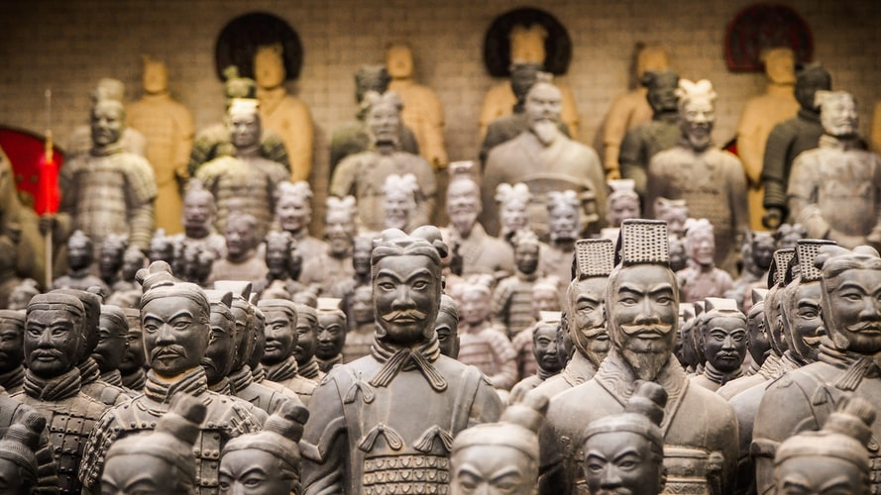
On this slide, test Ss’ listening and speaking skills; each S should be tested; give each S a mark according to the assessment rubrics.
LO: Have Ss talk about what important roles A Lucky Find played in the story with the help of given details; have Ss talk about what their favorite means of transportation is and what important roles transportation plays in their lives with the help of given pictures.
Ask Ss to talk about what important roles A Lucky Find played in the story with the help of given details.
Click and ask Ss to talk about what their favorite means of transportation is and what important roles transportation plays in their lives with the help of given pictures.
Encourage Ss to answer the question in complete sentences with the given clues; assist Ss if necessary.
Listening & Speaking
What other ancient places do you know about? What are they like? How can you learn about them?
What did the children know about the Saxon village? How did they learn about it?
the old gold coins
A Saxon king called Eadbald
. . .
Tip: Use the given clues to discuss the question.
1:30
16/20

Slide 17
On this slide, test Ss’ oral writing skills; each S should be tested; give each S a mark according to the assessment rubrics.
LO: Describe A Lucky Find in the adventure by using the visual aids and given guideline.
Explain the task to Ss.
Have Ss describe A Lucky Find in the adventure by using the bubble map.
Give feedback.
Get Ready to Present
Oral Writing
Describe how the Saxon village was found with the help of the sequence chart below.
Choose one of the events that you think is the most important and explain why you think it is the most important and how it helped people discover the Saxon village.
What kind deed did Kipper and Lee do?
What did the children and Grandpa find?
What did the police find?
What did the history expert find?
2:30
17/20

Slide 18
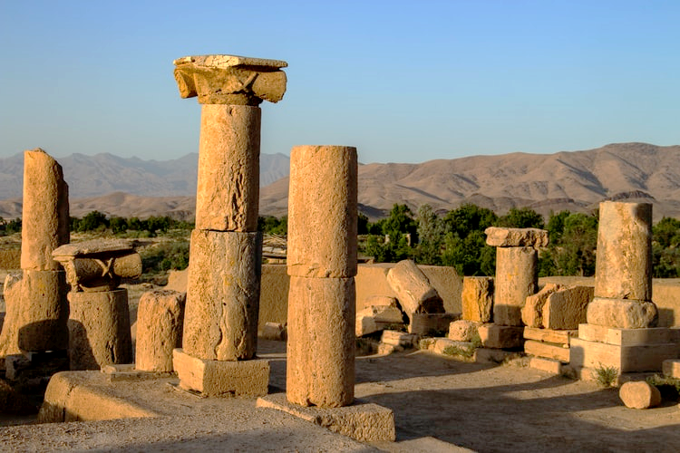
LO: Understand what the writing task is; know to
complete the writing task with the help of the post-class instructional video.
Introduce and explain the writing task to Ss.
Ask Ss to finish the task before the next class and to be ready to present.
Remind Ss to watch the post-class video before writing.
Writing
Homework: A Persuasive Essay
Write a persuasive essay explaining why people should protect ancient things in three paragraphs.
Step 1. Brainstorm: Collect Ideas
Step 2. Prewrite: Make a Plan for Your Writing
Step 3. Draft: Write the First Version of Your Story
Step 4. Revise: Change Your Writing
Step 5. Edit: Check Your Writing
Step 6. Publish: Make Your Final Copy
Watch the post-class video before you start the task .
1:00
18/20

Slide 19
LO: Review the whole lesson.
Review the story with Ss by asking the given questions.
Review
Let’s Review
Story: A Lucky Find
Key Questions:
What did the children know about the Saxon village? How did they learn about it?
What other ancient places do you know about? What are they like? How can you learn about them?
1:00
19/20

Slide 20
LO: End the lesson and encourage Ss to perform better
in the next class.
Briefly comment on Ss’ performance.
Say goodbye to Ss.
Ask Ss to preview the next lesson.
1:00
20/20

