Slide 1
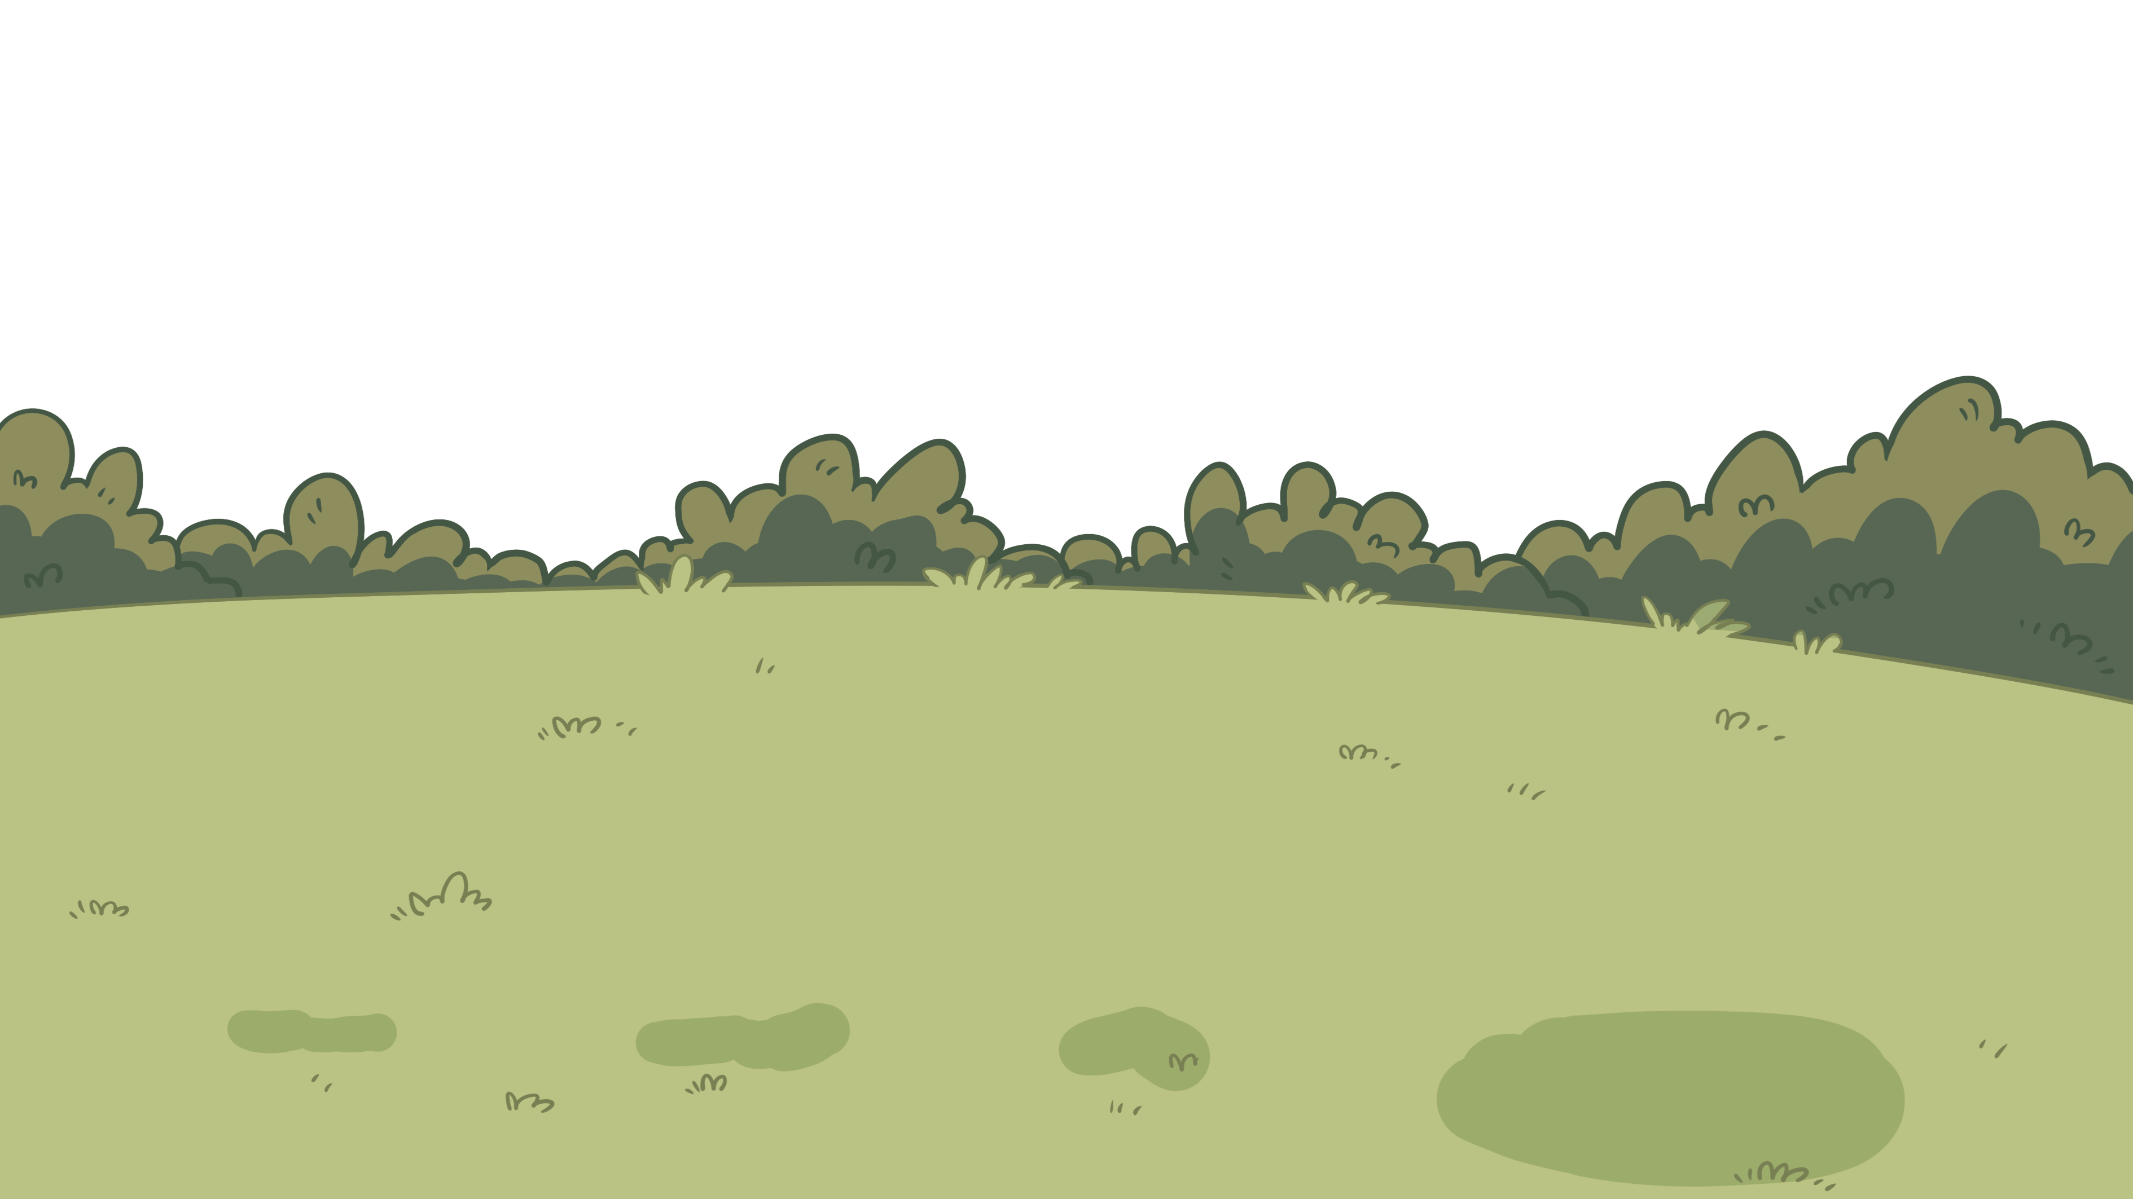
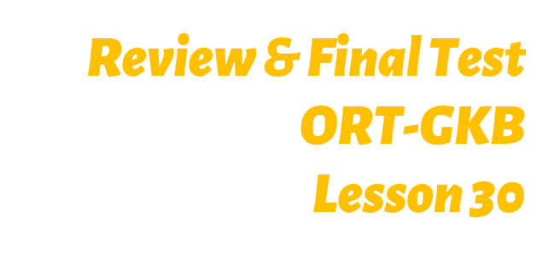
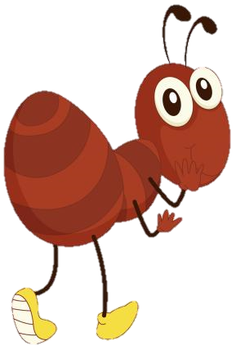
TG
LO: Get to know their partners; get a basic idea about the topic of today’s lesson.
1. Say hello to Ss; ask Ss to introduce themselves and greet each other.
2. Introduce the topic of the lesson.
0:30
1/25

Slide 2
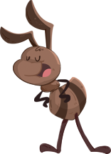
Learning
Goals
TG
LO: Get to know and understand what will be learned in this lesson.
Go through the learning goals with Ss.
We are
going to . . .
Add and substitute individual sounds (phonemes) in simple, single-syllable words in order to make new words; distinguish similarly spelled words by identifying the sounds of the different letters; blend letter sounds in single-syllable words.
Read the story The Ant and the Butterfly and utilize the reading skills and strategies to assist in reading comprehension.
Practice using the following sentence structure _________ store ________.
0:30
2/25

Slide 3
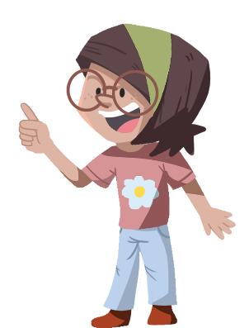
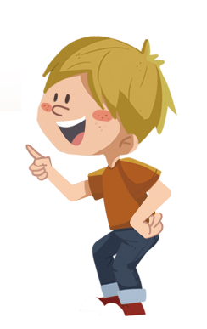
TG
Presentation
TG
LO: Present homework; talk about what they have drawn.
Ask Ss to present their homework.
Encourage Ss to describe their homework.
Give feedback.
Let’s show!
This is one of my friends who helped me before.
2:00
3/25

Slide 4
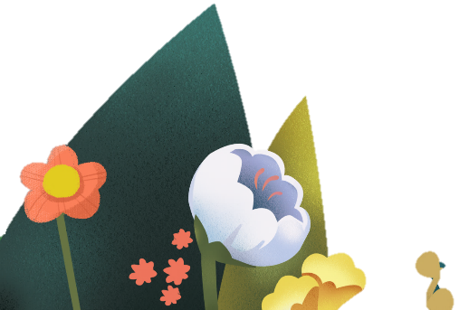
p
b
l
v
f
TG
Let’s listen and speak!
LO: Review the phonics rules from the past fourteen lessons, such as adding and substituting individual sounds in order to make new words.
Have Ss help the bee in the picture get the honey by adding or substituting a single sound in order to make a new word. Read the words aloud.
Click and the bee with the letter will fly to the corresponding rime in order to make a new word; guide Ss to read the word like this: m-all, mall, mall; then click and honey from the flowers will enter the bucket of the bee. Notes: Guide Ss to practice the second word by following the same process.
Click and the letters will scroll up; click and one of the letters will be chosen in order to make a new word; guide Ss to read the word like this: p-air, pair, pair; then click and the honey from the flowers will enter the bucket for the bee. Notes: Guide Ss to practice the second word by following the same process; the order of the words is as follows: lair, pair.
Click and the bee will go home.
p
air
l
mall
m
all
c
call
m
c
2:00
4/25

Slide 5
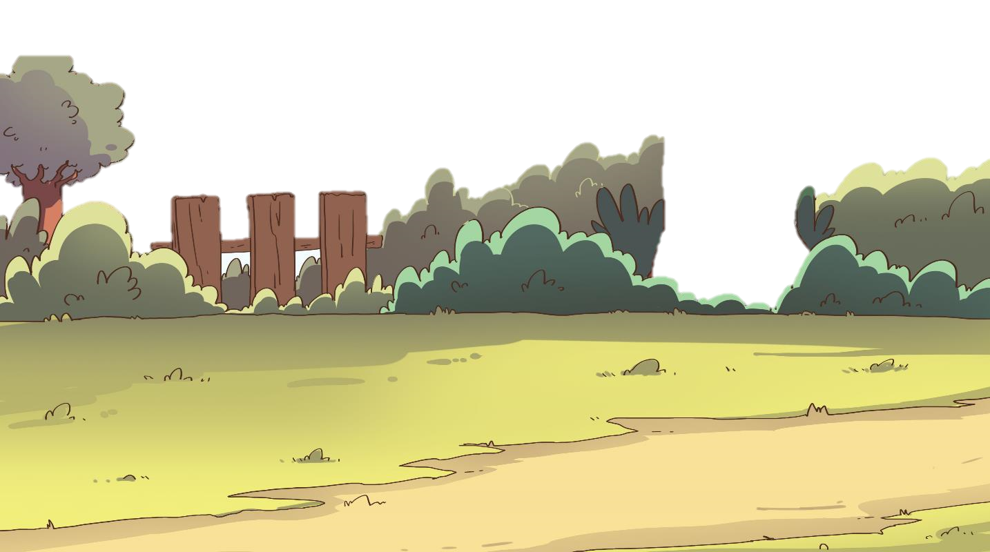
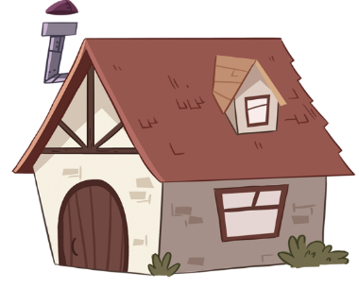
TG
LO: Review the phonics rules from the past fourteen lessons, such as blending different sounds
into new words.
Guide Ss to talk about what they can see in the picture; ask Ss to help the ant in the picture go home.
Ask Ss to read the sounds on the apples one by one; click and three sounds will come together to make a new word; guide Ss to read the sounds in this way: h-a-m, ham, ham; click and the ant with the food will take one step beyond the obstacle.
Repeat this process for the rest of the words; there are three words on this slide.
Let’s listen and speak!
ham
hat
gam
a
a
a
a
h
h
h
m
m
m
g
g
t
t
2:00
5/25

Slide 6
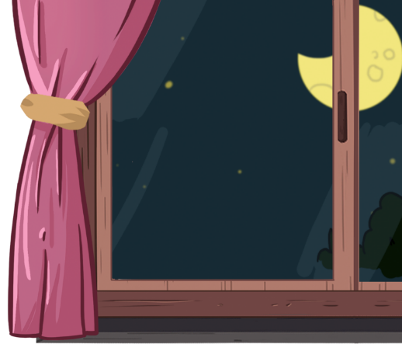
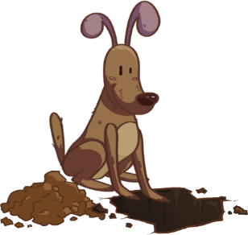
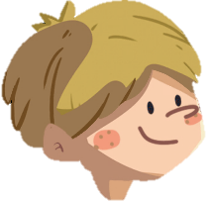
TG
Phonics
Let’s read!
LO: Test Ss on this page; read the chant fluently; decode the words learned in the text.
Ask Ss to observe the picture and the highlighted words, then read the chant to Ss sentence by sentence; guide Ss to choose the missing letters in the word, then guide Ss to pronounce the missing sounds or syllables separately; decode the words accurately.
Ask them to take turns reading each sentence one at a time. If necessary, give some support and ask them to read after you.
Give feedback.
The boy was reading a book on the mat.
The book was about a dog and an ant.
The dog dug a hole near the ant’s home.
The ant carried food to its home, but it fell into the hole.
The ant asked for help, and the dog helped it get out.
The ant wiped a tear and thanked the dog.
The boy was reading a book on the mat.
The book was about a d g and an ant.
The dog d g a hole __ear (n/d/b) the ant’s home.
The ant carried food to its home, but it fell into the hole.
The ant asked for help, and the dog helped it get out.
The ant wiped a __ear (h/t/g) and thanked the dog.
o
u
n
t
3:00
6/25

Slide 7
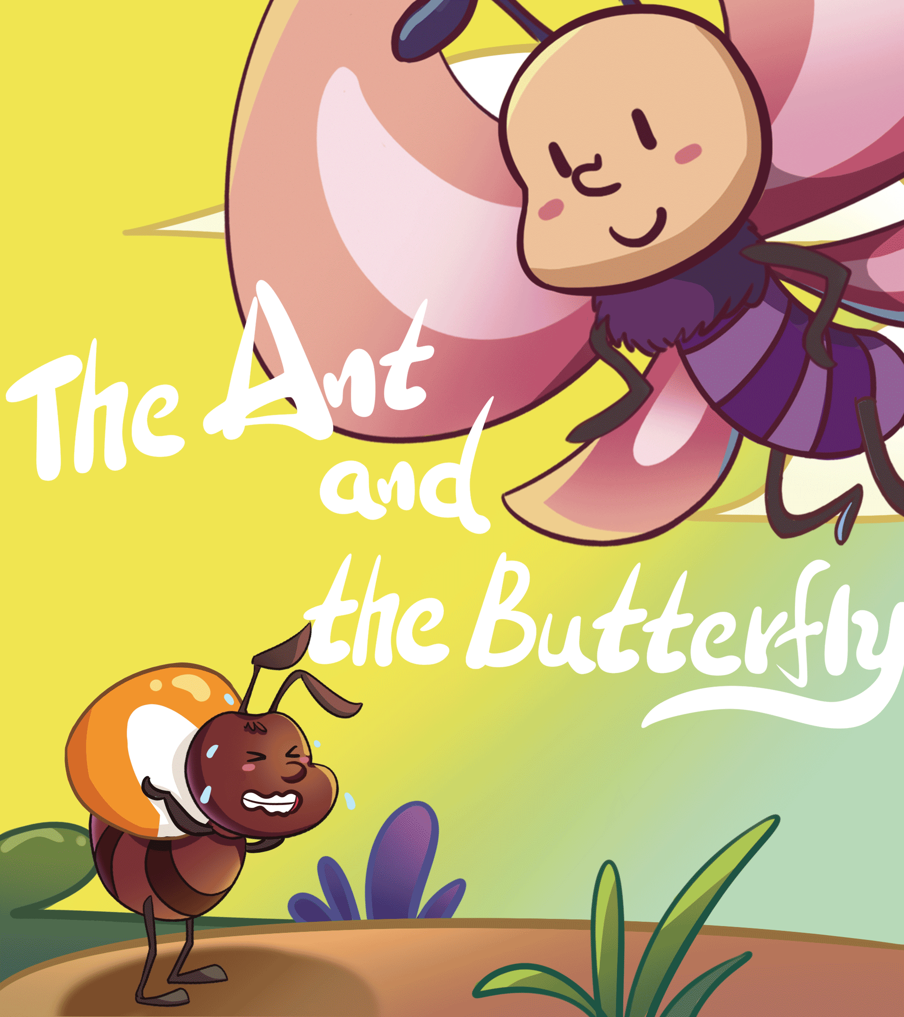
Lead-in
TG
LO: Use the book cover to identify details and to make predictions.
1. Guide Ss to look at the book cover closely and talk about the given questions.
2. Encourage Ss to talk more about the connections question.
Before Reading
What is the Ant doing? Look at the illustration. Why is Ant doing that?
2. Which season do you think it is?
Why?
3. What will the story be about?
2:00
7/25

Slide 8
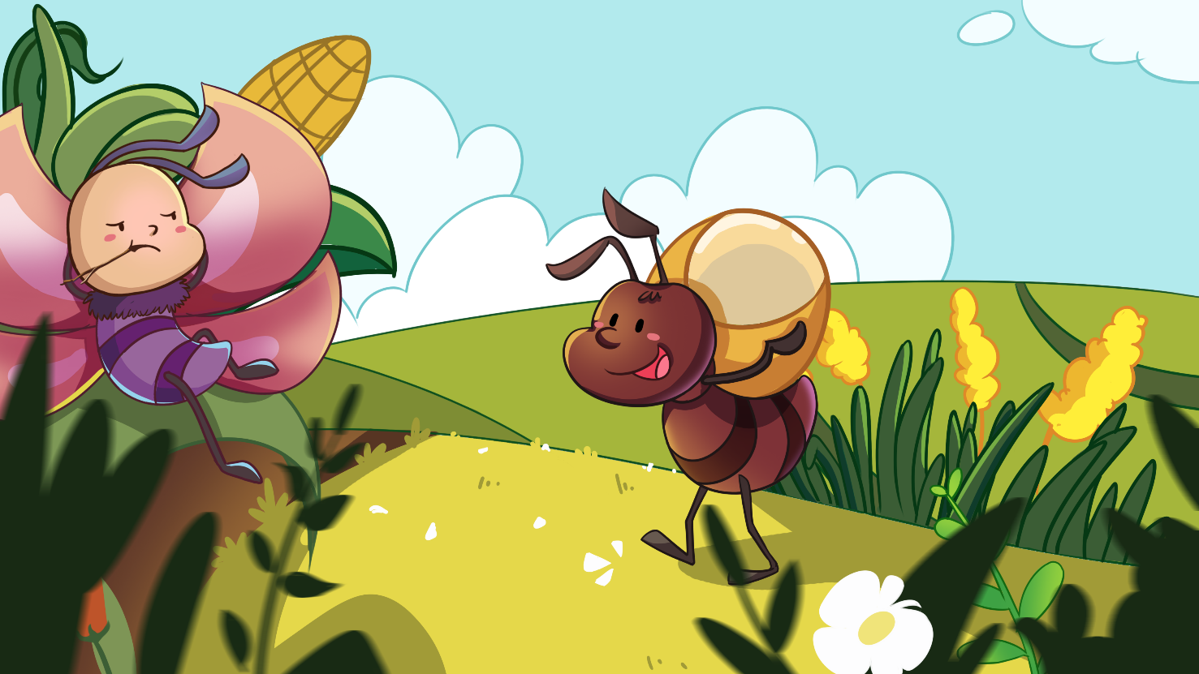
Let’s predict!
Reading
TG
LO: Make predictions about the story by using the illustration; motivate Ss’ interest
in reading the story.
Guide Ss to recall what it means to predict and ask them to make guesses prior to reading the story by
looking at the pictures.
2. Guide Ss to talk about the given questions.
Before Reading
What is Butterfly doing?
How do you think Butterfly feels about the Ant? How do you know?
Do you think Butterfly will have food in the winter? Why?
2:00
8/25

Slide 9
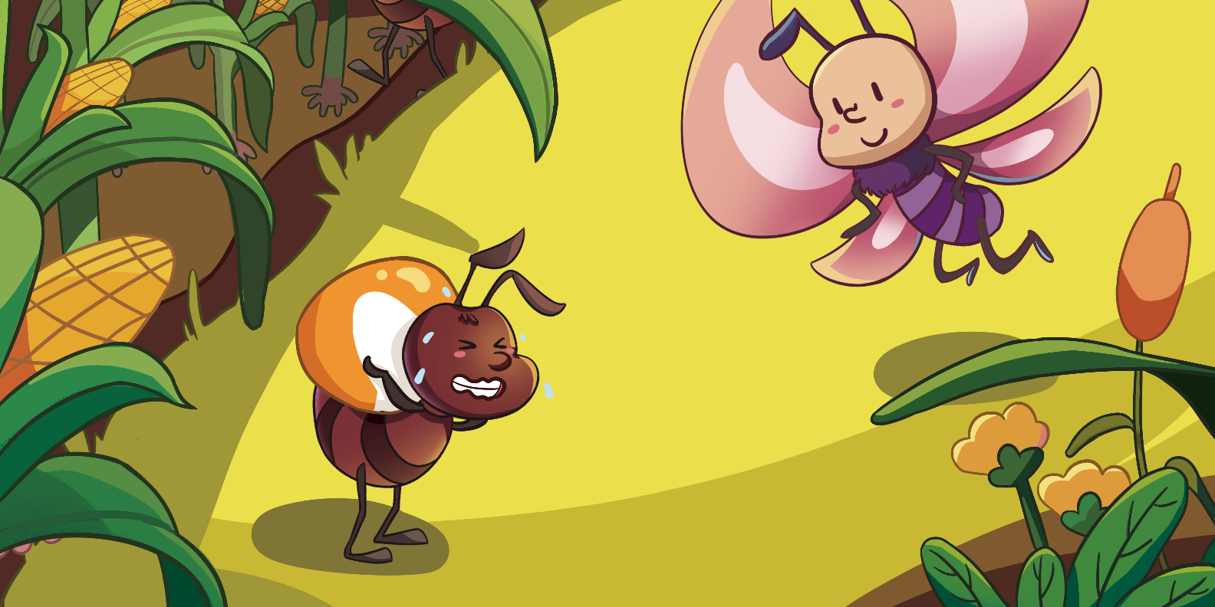
The Ant and the Butterfly
Reading
TG
LO: Understand the text; read the text fluently.
Read the text aloud to Ss.
Have Ss observe the illustration and the text, then talk about the comprehension questions.
Have Ss read the text fluently and give feedback.
Comprehension
Where did Ant and Butterfly live?
What did Butterfly like to do in spring?
What did Ant always do in spring?
Once upon a time in a big orchard, there lived a butterfly and an ant.
In spring, Butterfly liked to play in the sun. But Ant always worked.
2:00
9/25

Slide 10
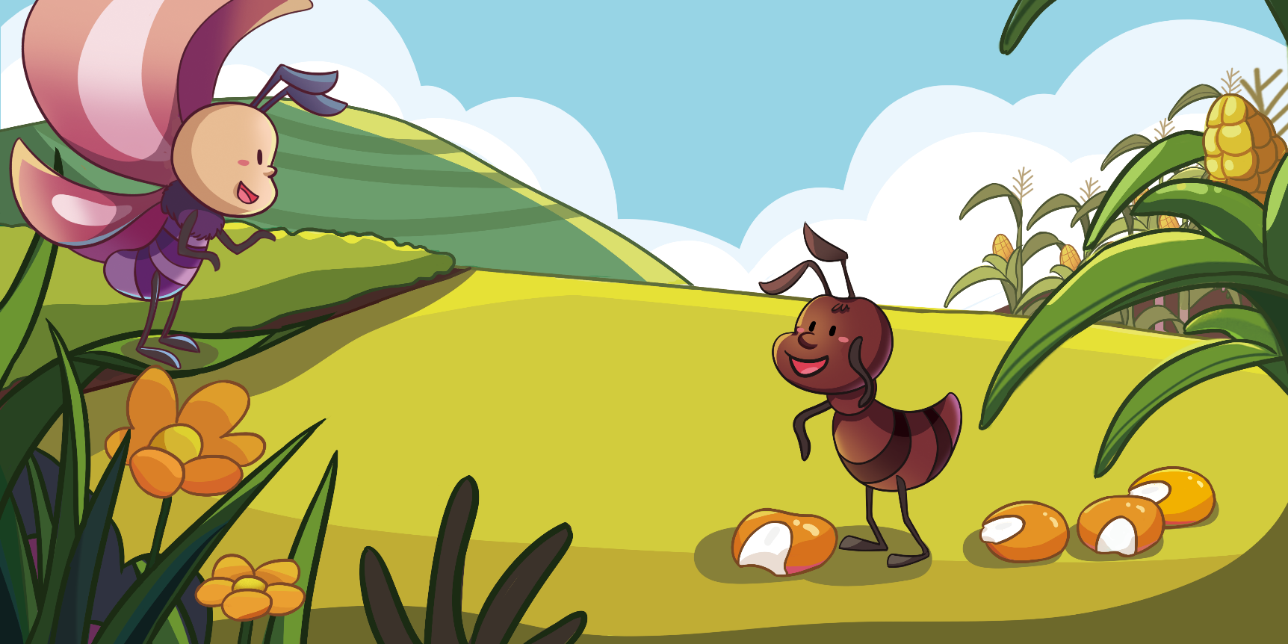
The Ant and the Butterfly
Reading
TG
LO: Understand the text; read the text fluently.
Read the text aloud to Ss.
Have Ss observe the illustration and the text, then talk about the comprehension questions.
Have Ss read the text fluently and give feedback.
Comprehension
What did Butterfly ask Ant to do? Why did Butterfly ask Ant to do that?
Did Ant play with Butterfly? Why?
“Come and play with me, Ant!” said Butterfly. “The flowers here are so sweet! Let’s enjoy them together!”
“I can’t, Butterfly, ” Said Ant. “I need to store a lot of food for the winter.”
2:30
10/25

Slide 11
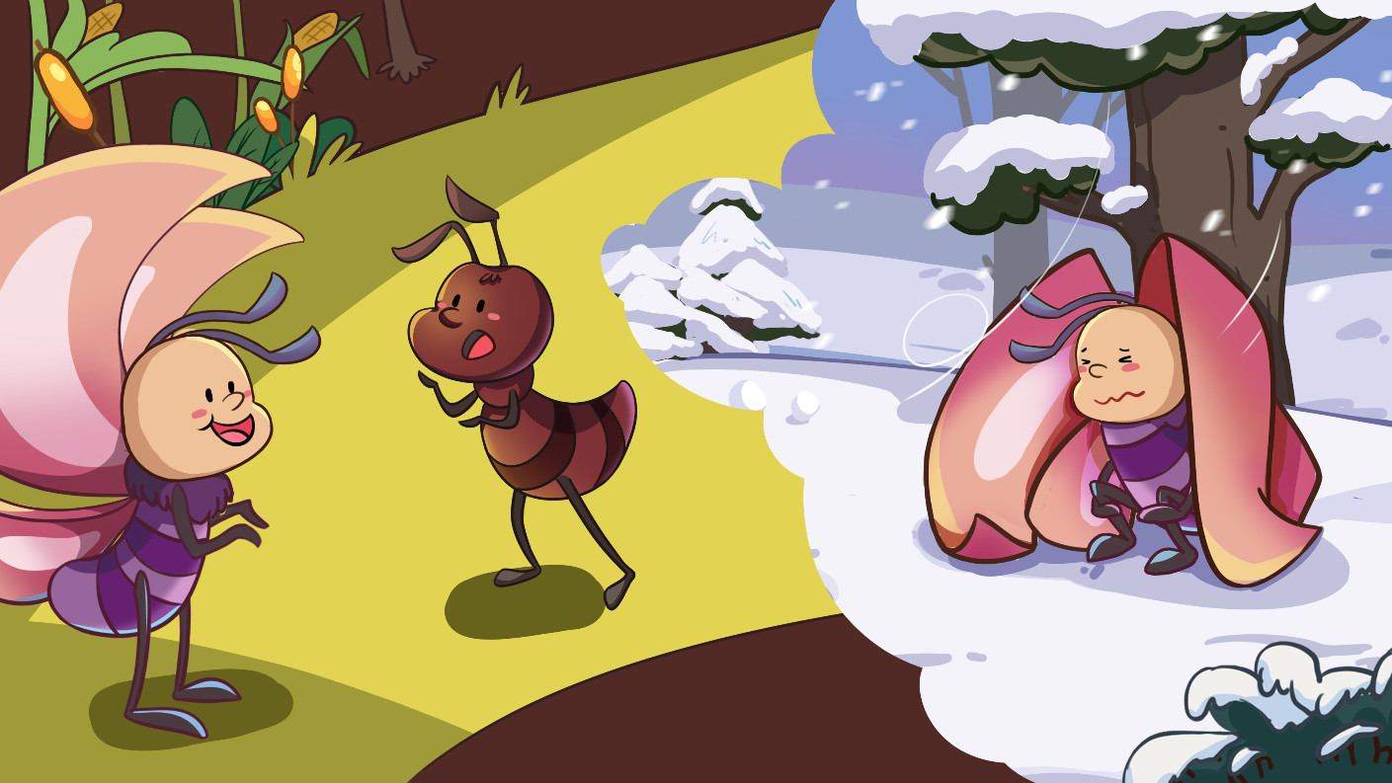
The Ant and the Butterfly
Reading
TG
LO: Understand the text; make connections; read the text fluently.
Read the text aloud to Ss.
Have Ss observe the illustration and the text, then talk about the comprehension questions.
Guide Ss to talk about the connections questions; model first.
Ask Ss to read the text fluently; give feedback.
Comprehension
Why did Butterfly think Ant could work tomorrow?
How did Ant answer Butterfly? Do you agree with Ant?
Connections
“Don’t be stupid! The food here is enough,” said Butterfly. “You can do it tomorrow!”
“Never put off what you can do today till tomorrow,” said Ant. “Winter will come soon. And you will be hungry if you don’t store food now.”
Did you put off what you should do today till tomorrow before? What was that?
2:30
11/25

Slide 12
The Ant and the Butterfly
Reading
TG
LO: Understand the text; read the text fluently.
Read the text aloud to Ss.
Have Ss observe the illustration and the text, then talk about the comprehension questions.
Have Ss read the text fluently and give feedback.
Comprehension
1. When day after day
passed by, what did
Butterfly do? What
was his opinion?
2. What did Ant do?
How did he look?
3. What would happen
to Butterfly and to Ant
in the winter?
Ant always worked hard, and he continued to carry food to his home. When Butterfly laughed at him, he didn’t care.
Day after day passed by. Butterfly played happily in the orchard. He still believed he could store his food tomorrow.
12/25
2:30

Slide 13
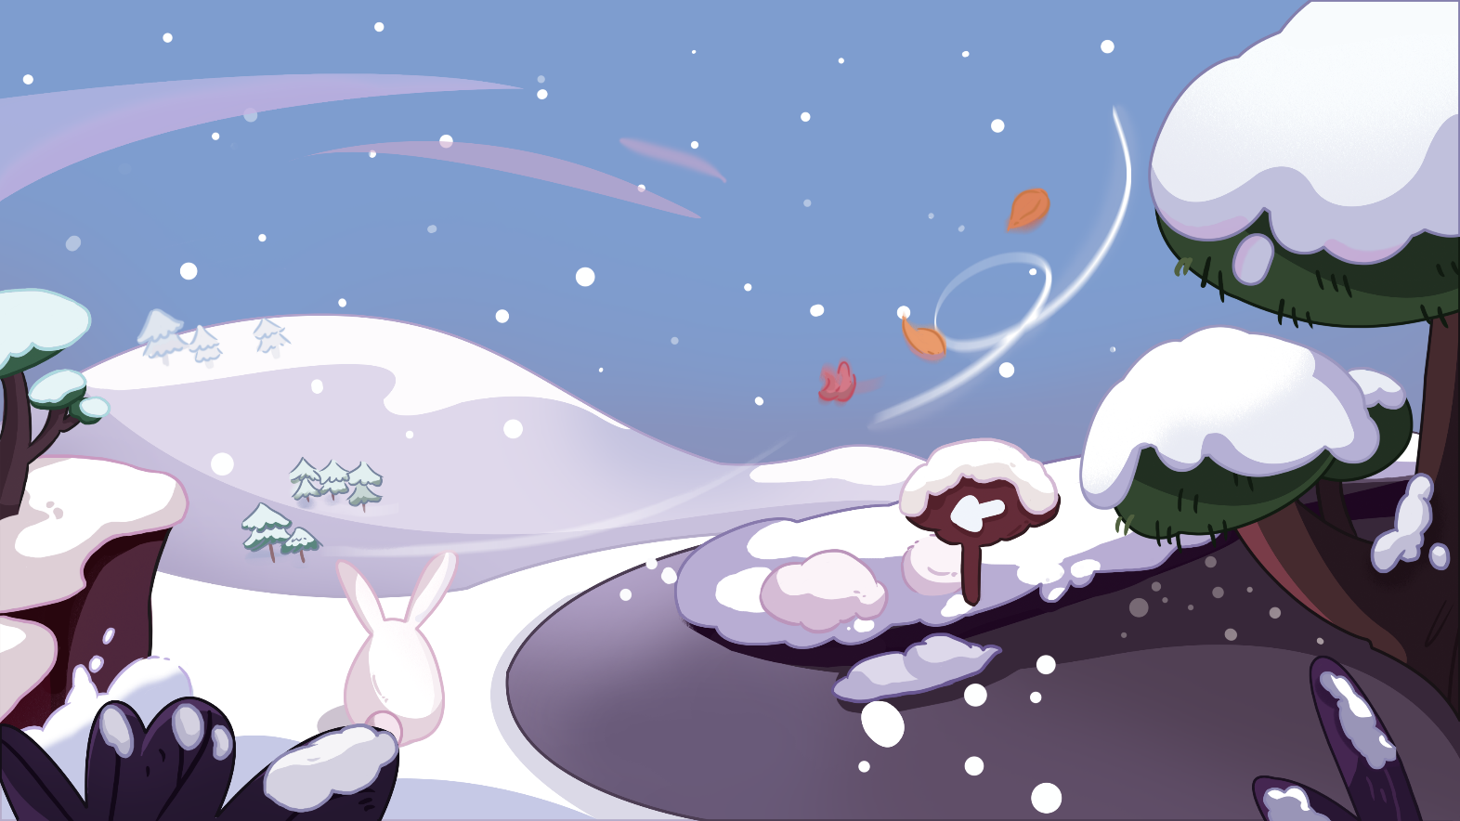
The Ant and the Butterfly
Reading
TG
LO: Understand the text; read the text fluently and accurately.
Read the text aloud to Ss.
Have Ss observe the illustration and the text, then talk about the comprehension questions.
Have Ss read the text fluently and accurately and give feedback.
Comprehension
What did the orchard look like in the winter?
What did Butterfly want to do in the winter? Why?
Winter came. The orchard was covered with snow. And all plants died.
Butterfly didn’t store any food at home. He decided to find food outside.
Decoding
Fluency.
2:30
13/25

Slide 14
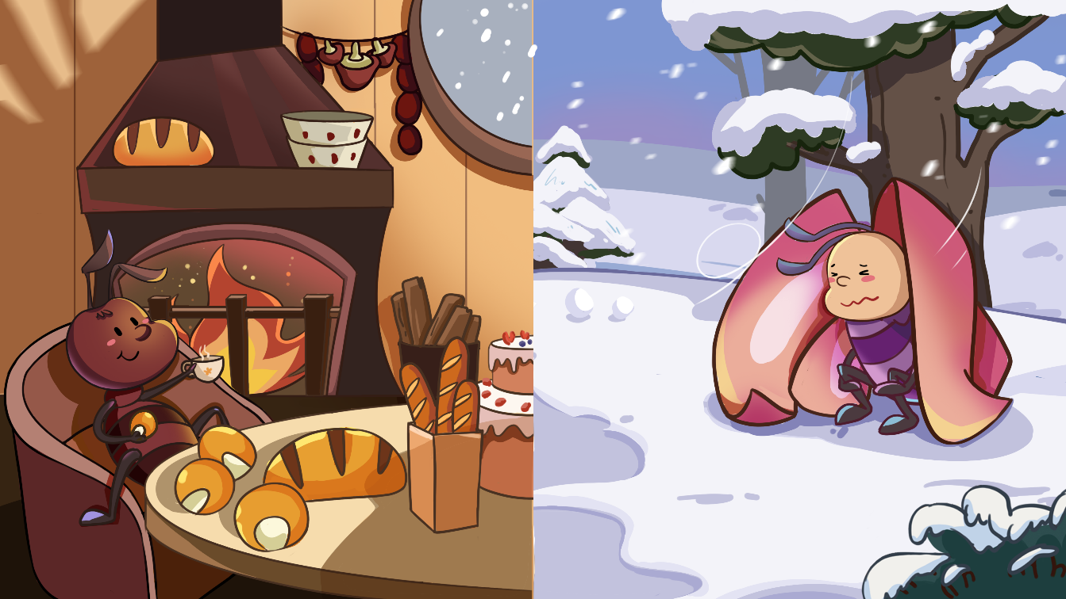
The Ant and the Butterfly
Reading
TG
LO: Test Ss on this page; identify the setting of the story; identify the key details by using the pictures and the text; recognize the sequence of events; identify the main idea of the story by using the pictures and the text; read the text fluently.
1. Read the text aloud to Ss.
2. Have Ss talk about the questions by using the reading strategies that they have learned.
3. Have Ss read the text fluently in turns and give feedback.
Notes: Setting and Details. (3 points) Sample Answer: Ant was at home. Butterfly was outside; Setting and
Details. (4 points) Sample Answer: The ant stayed at home, and the butterfly stayed outside in the cold;
Predictions. (4 points) Sample Answer: He won’t die. He will ask ant for help;
Compare and Contrast/Point of View. (5 points) Sample Answer: The butterfly was happy in spring, but then
he became hungry and cold in winter; OR: Ant worked hard in the spring, and he was able to enjoy his
food in winter.
Setting
Where was Ant in the winter? Where was Butterfly?
Predictions
Would Butterfly die that winter? What do you think he would do next?
Point of View
Compare and Contrast
Describe what happened to Butterfly from spring to winter from Butterfly’s point of view.
Did Ant look any different from spring to winter?
At the same time, Ant enjoyed his food at home. “Thanks to my hard work, I can live a happy life this winter!” said Ant.
All of the plants died that winter. Butterfly couldn’t find any food outside. He was hungry and cold in the snow.
2:30
14/25

Slide 15
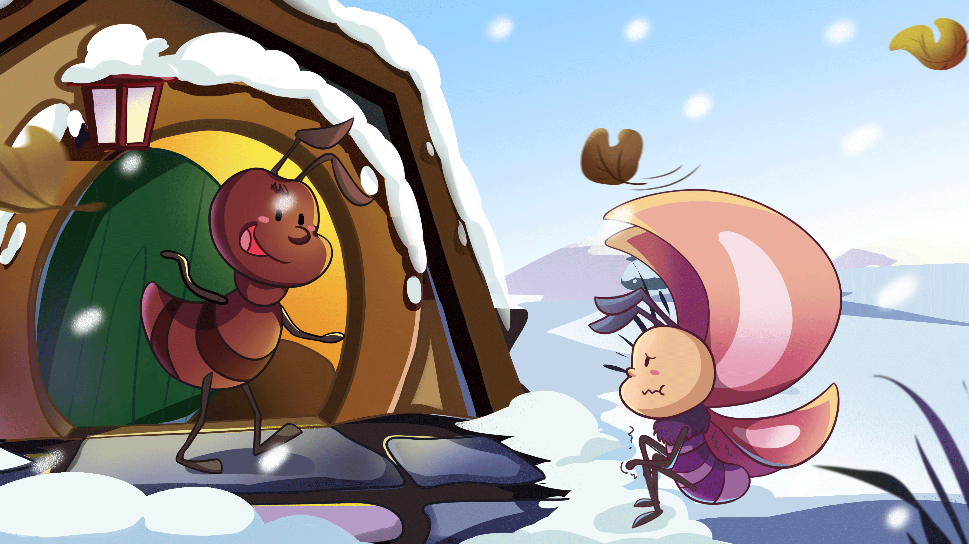
The Ant and the Butterfly
Reading
TG
LO: Understand the text; read the text fluently.
1. Ask Ss to read through the chant.
2. Have Ss observe the illustration and the text, then talk about the comprehension questions.
3. Have Ss read the text fluently and give feedback.
Comprehension
Where did Butterfly go? Why?
How did Ant feel when he saw Butterfly? What did Ant want to do for Butterfly?
Butterfly came to Ant’s home and asked for help. “An…An…Ant! I am so cold and hungry. Could you give me some food, please?” asked Butterfly.
Ant opened the door and felt surprised. “Please come in, Butterfly.
I have enough food, and I can share with you,” said Ant.
2:30
15/25

Slide 16
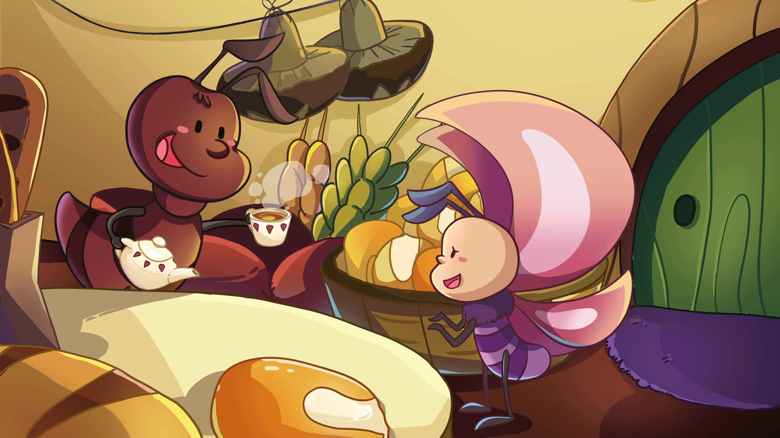
The Ant and the Butterfly
Reading
TG
LO: Understand the text; read the text fluently and accurately.
1. Read the text aloud to Ss.
2. Have Ss observe the illustration and the text, then talk about the comprehension questions.
3. Have Ss read the text fluently and accurately and give feedback.
Comprehension
1. What did Ant do?
Why did Ant have
food in the winter?
2. How did Butterfly feel?
3. Why was Butterfly
ashamed of himself?
Ant shared a part of his food with Butterfly.
Butterfly was moved, but he also felt ashamed of himself.
Decoding
Fluency.
2:30
16/25

Slide 17
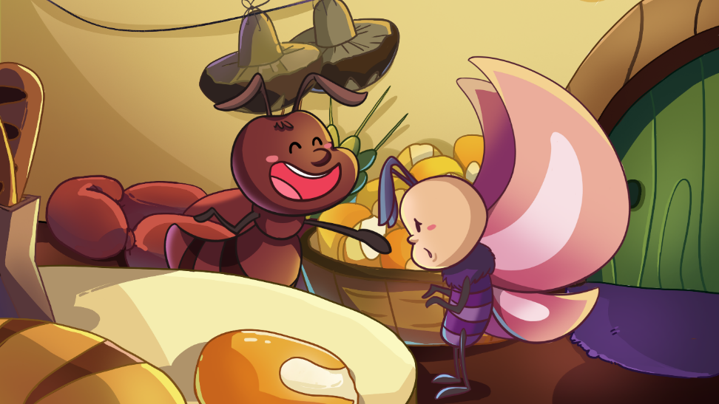
The Ant and the Butterfly
Reading
TG
LO: Understand the text; read the text fluently.
1. Ask Ss to read through the chant.
2. Have Ss observe the illustration and the text, then talk about the comprehension questions.
3. Have Ss read the text fluently and give feedback.
Comprehension
Did Butterfly understand his mistake? What would he do the next year?
Would Ant laugh at Butterfly? What would he do the next year?
“Ant, it was wrong of me to laugh at you,” Butterfly said. “I will work hard next year. Thank you very much, Ant, my brother and friend!”
“You’re welcome, Butterfly!” said Ant. “Let’s work hard together next year!”
17/25
2:30

Slide 18
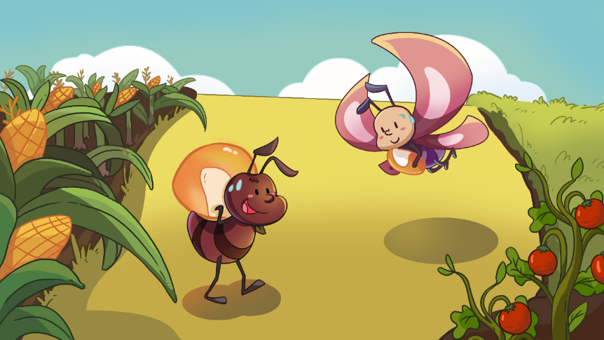
The Ant and the Butterfly
Reading
TG
LO: Test Ss on this page; identify the characters in the story; understand the plot of the story; have a discussion; read the text fluently.
1. Read the text aloud to Ss.
2. Have Ss observe the illustration and the text; talk about the provided questions; give feedback.
4. Have Ss read the text fluently and give feedback.
Characters
Who worked in the orchard next year?
Plot
What did Ant and Butterfly do at the end of the story?
Discussion
The next year came. The orchard was full of food again. Ant still worked hard and carried food to his home.
Butterfly didn’t play this spring, but worked hard. Would Butterfly feel cold and hungry again this winter?
What do you think of Ant and Butterfly in this story? Why?
(Helping words: hard-working, playful, beautiful)
3:00
18/25

Slide 19
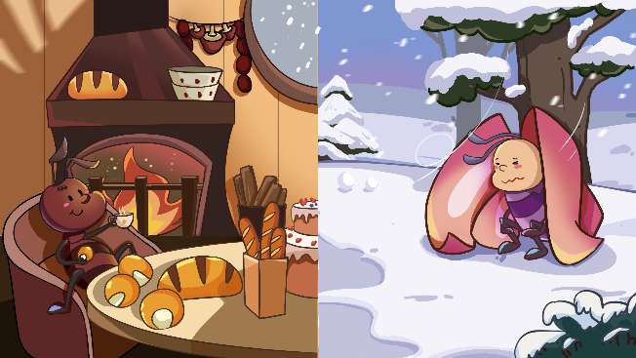
Reading
TG
Let’s retell!
LO: Retell the story with the helping words.
Guide Ss to recall some of the details from the story.
Click and model first; have Ss work together to retell the story by using the given illustrations and helping words.
Give feedback.
2
1
Where were Ant and Butterfly live?
What did Ant and Butterfly do
differently?
Where were Ant and Butterfly in winter?
What happened to Butterfly in winter?
3
4
5
1. What did Butterfly do?
2. What did Ant do?
Did Butterfly work when the next spring came?
Did Butterfly get food?
3:00
19/25

Slide 20
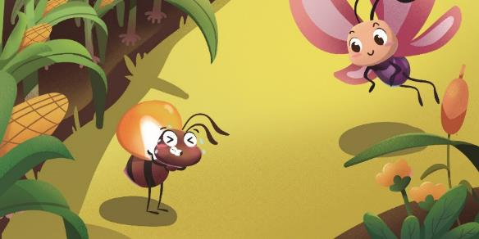
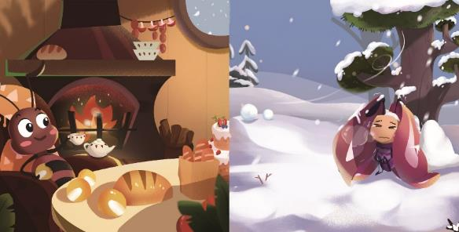
TG
LO: Talk about the illustrations with the given sentence structure.
Ask Ss to look at the illustrations and to identify the characters.
Ask Ss to take turns answering the questions—one question for each S.
Give feedback.
Note: Ss should use complete sentences.
Let’s talk!
—What did _____ do?
— ______ _______.
Helping Words
Ant Butterfly | played found food outside in winter worked hard carried food enjoyed his food
Biff
Chip
Kipper
TV
2:00
20/25

Slide 21
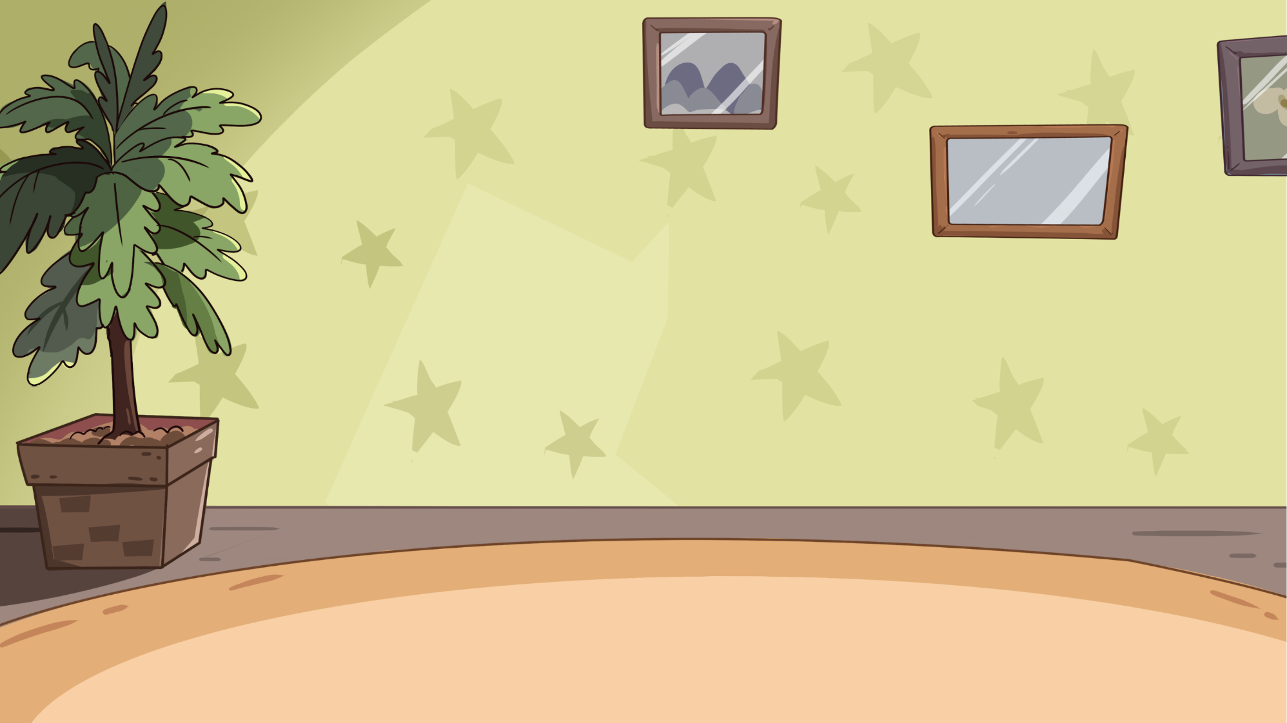
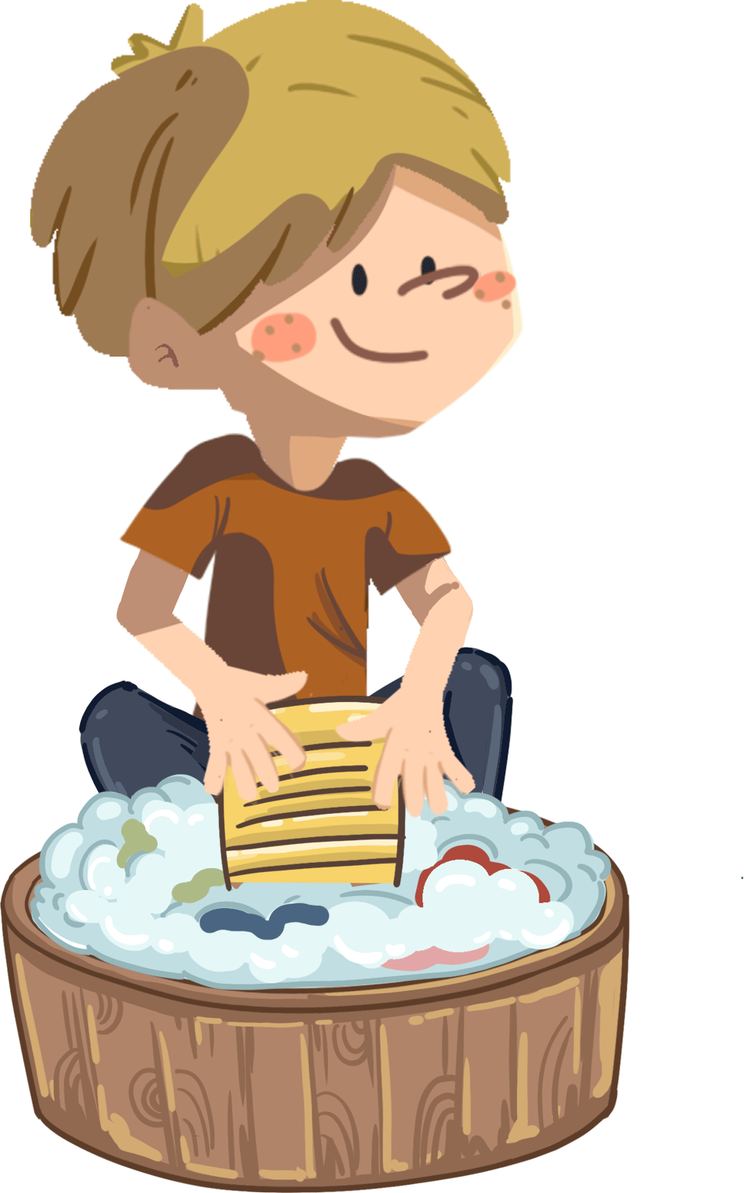
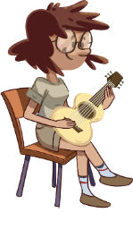
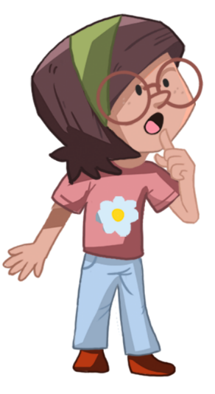
LO: Test Ss on this page; ask Ss if they need any help using the given sentence structure.
1. Ask students who they think is the most diligent person they know; encourage them to speak more.
2. Ask Ss to work in pairs and to talk about the given picture by using the given sentence structure; model first.
3. Assist Ss if necessary.
Notes: T can click Let’s Talk to present the sentence structure, and T can click again to make it disappear.
(3 points) Sample Question: Who do you think is a hard-working person in your life?
(for support) Sentence Structure: I think _____ is a hard-working person.
(4 points) Sample Answer: Because my mom always cooks for us.
(5 points) Sample Answer: I think my mom is a hard-working person because she always cooks for us.
Listening & Speaking
TG
Let’s talk!
—Who do you think is a hard-working person
in your life?
—I think _____ is a hard-working person.
2. Why do you think he/she is a hard-working
person?
my dad, my mom, my English teacher, Lily
21/25
2:00

Slide 22
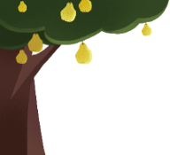
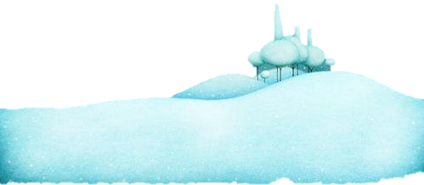
TG
LO: Test Ss on this page; talk about who got wet in the story and why.
1. Guide Ss to talk about what they’ve learned from the story.
2. Ask Ss to think about the given questions; help Ss organize their ideas with the given visual support; model the first question, and then ask
Ss to complete the task in turns.
Note: Each S should respond with at least three sentences.
Example Question: What did Ant and Butterfly do from Spring to Winter?
(3 points) Ss’ Answer: Ant worked and Butterfly played in spring;
(4 points) Ss’ Answer: Ant worked hard because he wanted to store food for winter. OR: Ant enjoyed food, but Butterfly was hungry
and cold in the winter.
(5 points) Ss’ Answer: Butterfly will feel cold and hungry next winter because he played throughout the spring.
Oral Writing
Get ready to present!
Talk about what Ant and Butterfly did from spring to winter.
1. What did Ant and Butterfly do at the
beginning of the story?
(store food, played)
3. How did Ant and Butterfly feel
when winter came?
4. Would Butterfly feel cold and
hungry the next winter? Why?
2. Why did Ant work hard in the spring?
2:00
22/25
Notes:
她们的

Slide 23
TG
Writing
LO: Understand what the homework is; know the post-class video will help them finish their homework.
Explain the writing task to Ss and remind them to watch the post-class video before doing their homework.
Remind Ss to get ready to present their homework next class.
A Thank-You Letter
Let’s draw and write!
Write a thank-you letter to one of your foreign teachers.
Now, please follow the steps to finish your homework and present it in the next class:
Choose one of your foreign teachers who you want to write a thank-you letter to.
Write a thank-you letter in three complete sentences.
Watch the post-class video about the writing task.
0:30
23/25

Slide 24
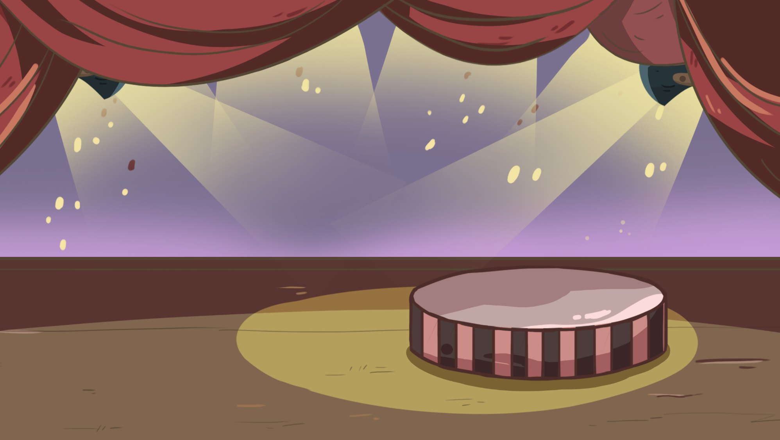
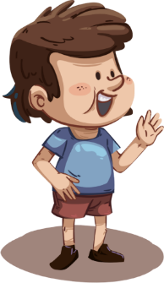
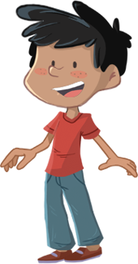
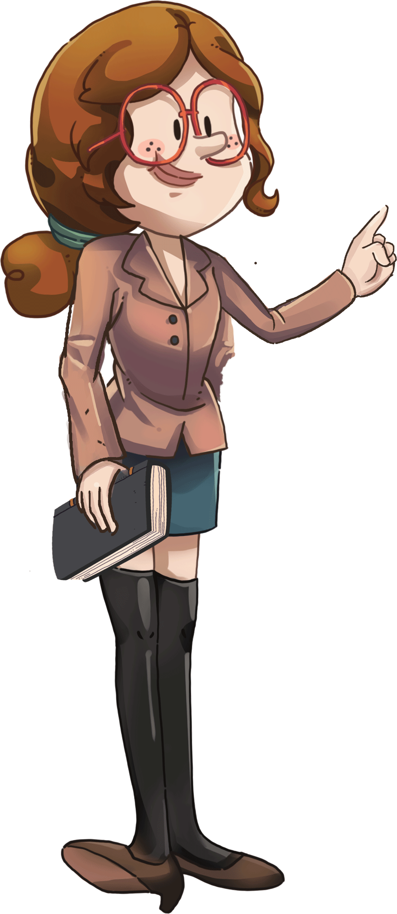
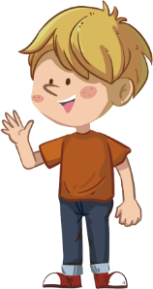
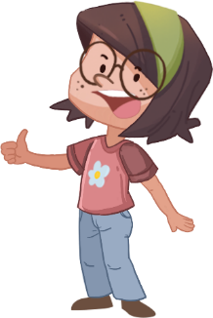
TG
Let’s show!
LO: Hold a staged graduation ceremony for students.
Congratulate the students for their victory in the ORT course.
Click and give graduation caps to students.
Notes: There are four caps for four Ss.
Congratulations!
1:00
24/25

Slide 25
TG
Briefly comment on Ss' progress and praise them for doing a good job.
Say goodbye to Ss.
0:30
25/25

