Slide 1
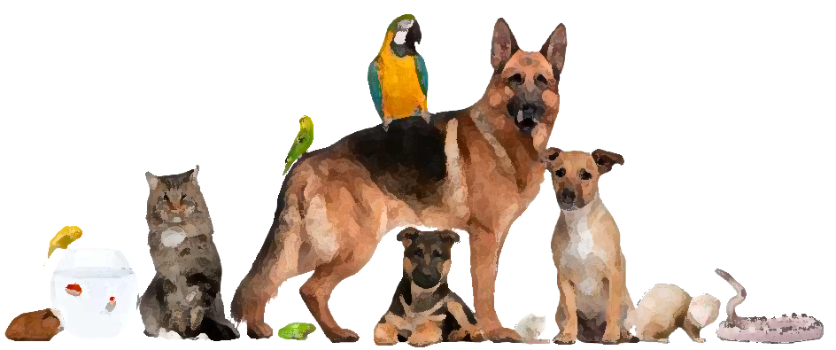
NEXT

Slide 2
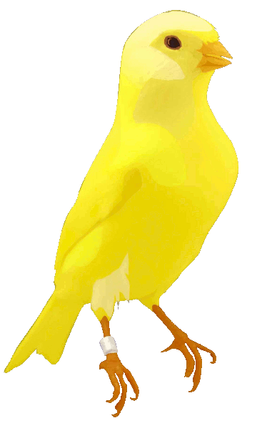
bird

Slide 3
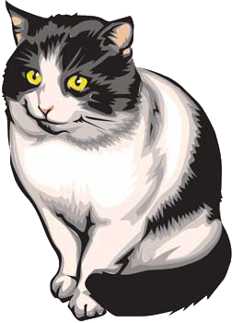
cat

Slide 4
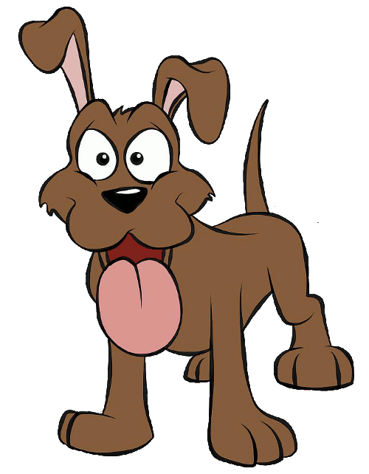
dog

Slide 5
fish

Slide 6
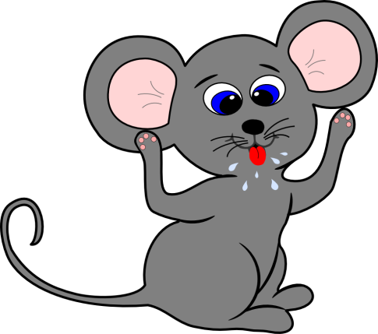
Mouse

Slide 7
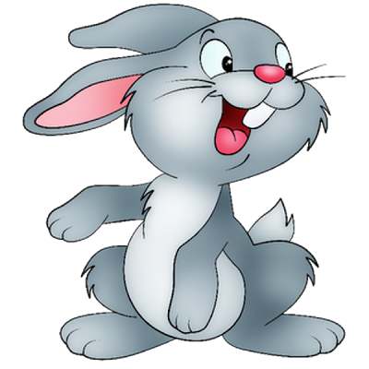
rabbit

Slide 8
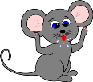
What pet do you have?
1 rabbit =
2 dog =
3 cat =
4 mouse =
5 fish =
6 bird =
NEXT
I have a …

Slide 9
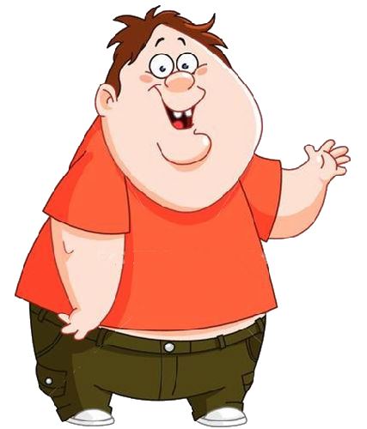
Lets sing a song. ‘I have a pet’ by supersimple
https://www.youtube.com/watch?v=pWepfJ-8XU0
NEXT

Slide 10
Lets read a story
NEXT

Slide 11
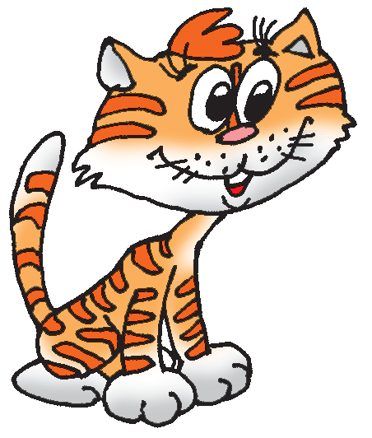
Little Cat and Little Mouse
NEXT
(Little = Small)

Slide 12
Little mouse,
little mouse,
Where is your
house?
NEXT

Slide 13
- Little cat, little cat, I have no flat,
I’m a poor mouse,
I have no house!
NEXT

Slide 14
- Little mouse, little mouse,
Come into my house!
NEXT

Slide 15
NEXT
- Little cat, little cat,
I cannot do that,

Slide 16
You want to eat me!
NEXT

Slide 17
Lets play a game ‘what is it?’
NEXT

Slide 18
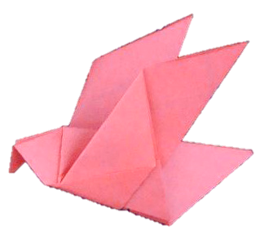
What pet can you see?
It’s a
bird
NEXT

Slide 19
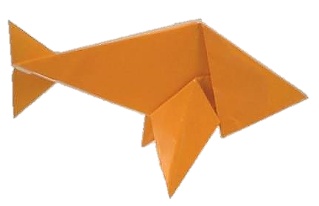
What pet can you see?
It’s a
fish
NEXT

Slide 20
What pet can you see?
It’s a
rabbit
NEXT

Slide 21
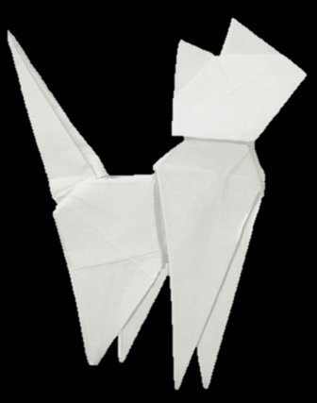
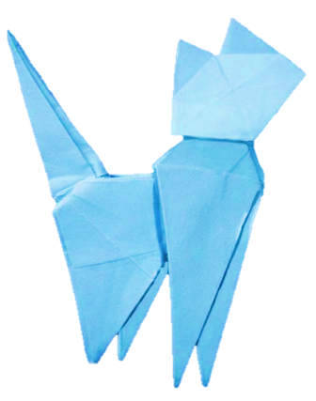
What pet can you see?
It’s a
cat
NEXT

Slide 22
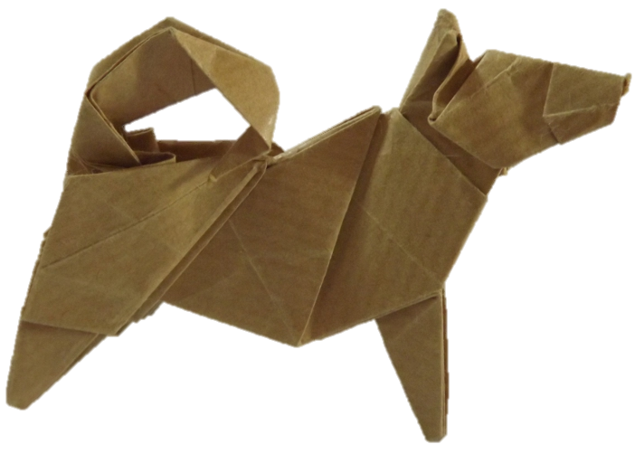
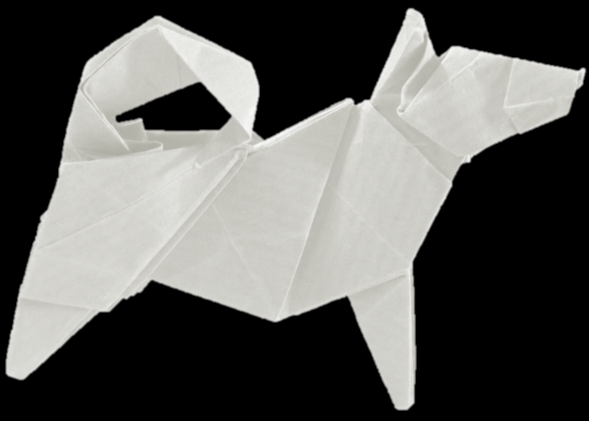
What pet can you see?
It’s a
dog
NEXT

Slide 23
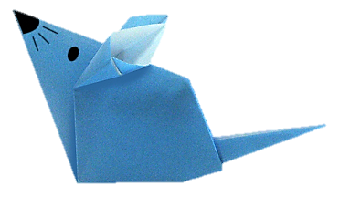
What pet can you see?
It’s a
mouse
NEXT

Slide 24
Lets watch a vid. ‘what is it?’ by fun english kids
https://www.youtube.com/watch?v=D_sdGxUxz_4
NEXT

Slide 25
My pet is lost. It swims very well. It’s thin.
NEXT
fish
It’s a …

Slide 26
I’m looking for my pet. It is yellow. It sings beautifully.
NEXT
bird
It’s a …

Slide 27
My pet is lost. Its ears are big. It wags its tail. It doesn’t like cats.
NEXT
dog
It’s a …

Slide 28
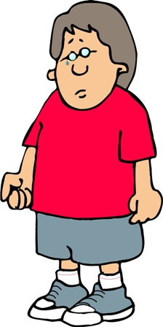
My pet is lost. Its ears are small. Its tail is long. It eats a mouse.
NEXT
cat
It’s a …

Slide 29
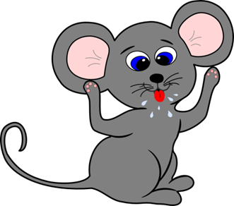
My pet is lost. Its ears are big. Its tail is long. It eats cheese.
NEXT
mouse
It’s a …

Slide 30
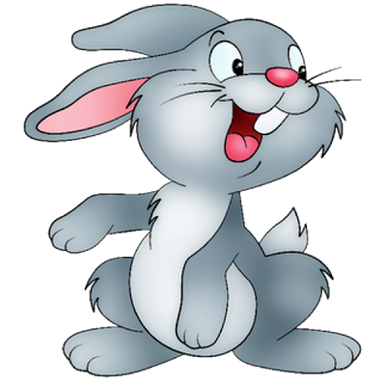
My pet is lost. Its ears are long. Its tail is short. It jumps well.
NEXT
rabbit
It’s a …

Slide 31
Lets sing a song. ‘wag your tail’ by supersimple
https://www.youtube.com/watch?v=GukdT4gUlZs
NEXT

Slide 32
Pet Guess Game
1 rabbit =
2 dog =
3 cat =
4 mouse =
5 fish =
6 bird =
Its tail is long/short Its mouth is big/small Its eyes are big/small Its ears are big/small It’s …(colour; black, white, brown, yellow) What is it?
NEXT

Slide 33
1 Rabbit or 2+ Rabbits
1 fish or 2+ fish
1 mouse or 2+ mice
Pets
Next
1 one
+1
+3
2 two
+3
+5
3 three
+2
+3
4 four
+4
+2
+5
5 five
+5
+1
+4

Slide 34
Pet Charades Game
1 rabbit =
2 dog =
3 cat =
4 mouse =
5 fish =
6 bird =
What is it? It’s a ….
NEXT

