Slide 1

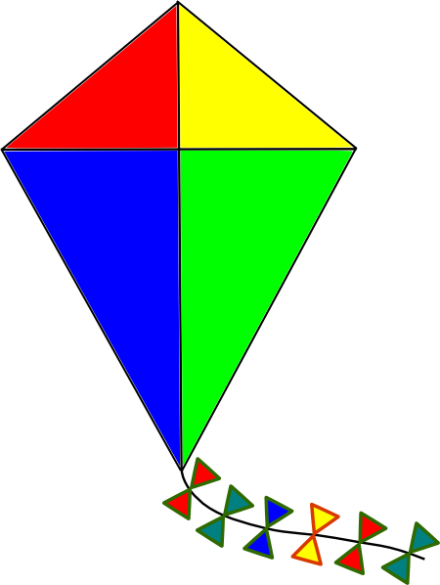
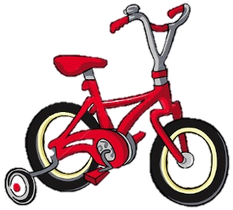
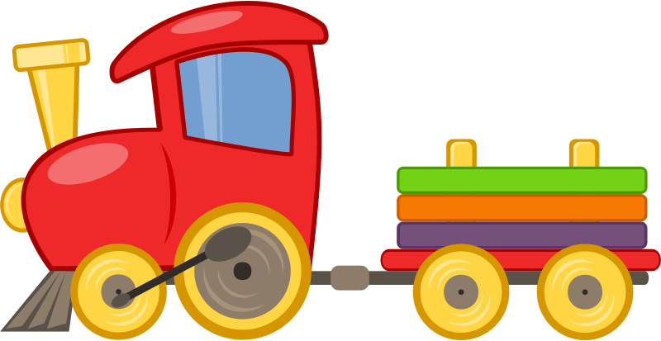

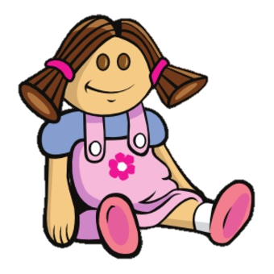
next

Slide 2
KITE
next

Slide 3
DOLL
next

Slide 4

BALL
next

Slide 5
BICYCLE
next

Slide 6

TEDDY BEAR
next

Slide 7
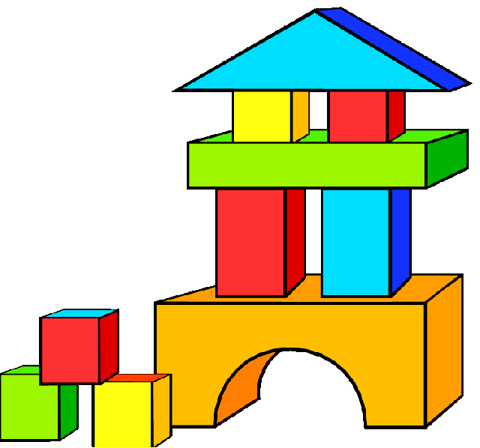
LEGO BLOCKS
next

Slide 8

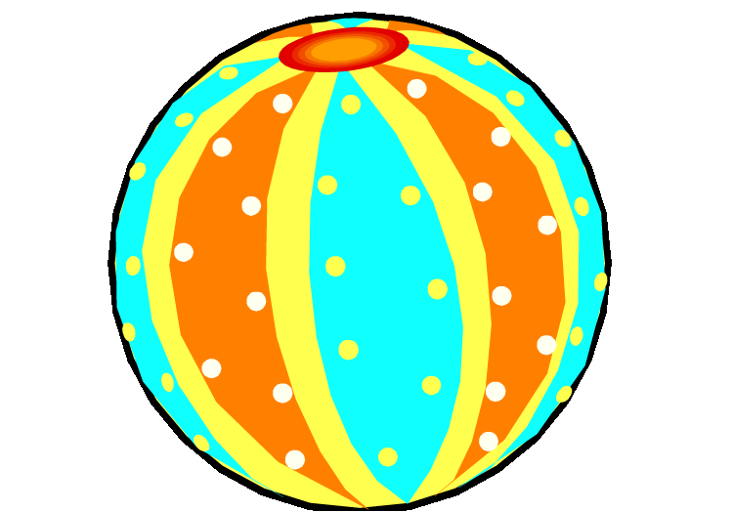

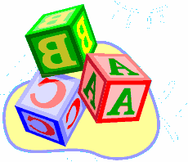
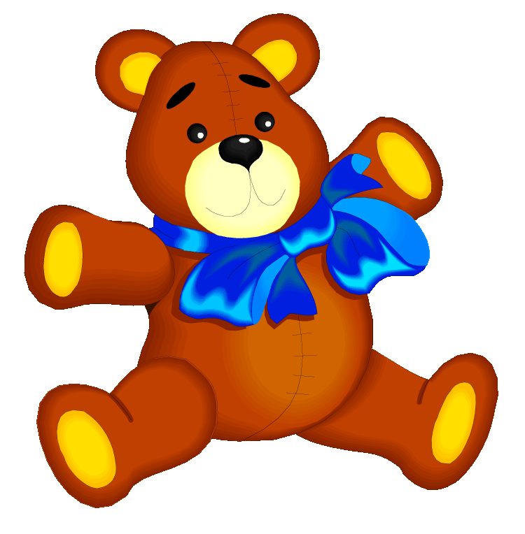

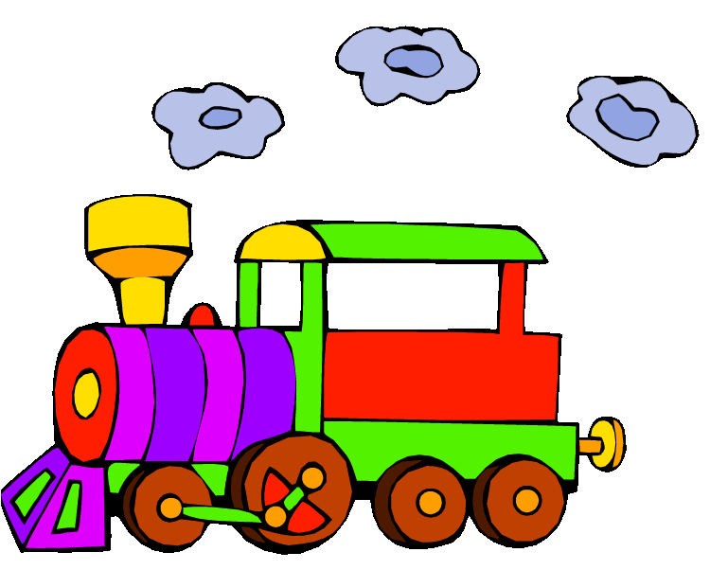
My toys
Let’s play a game!
PLAY

Slide 9

It’s a kite.
1
3
2
Very good!
Next

Slide 10

It’s a doll.
1
3
2
Very good!
Next

Slide 11
It’s a teddy bear.
1
3
2
Very good!
Next

Slide 12
It’s a train.
1
3
2
Very good!
Next

Slide 13
It’s a ball.
1
3
2
Very good!
Next

Slide 14
?
next

Slide 15
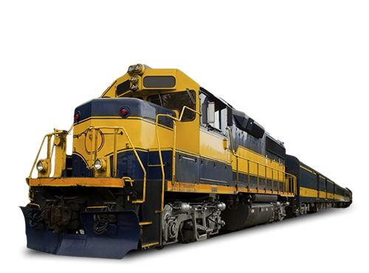
TOY
TRAIN
next

Slide 16
TOY TRAIN
TRAIN
next

Slide 17
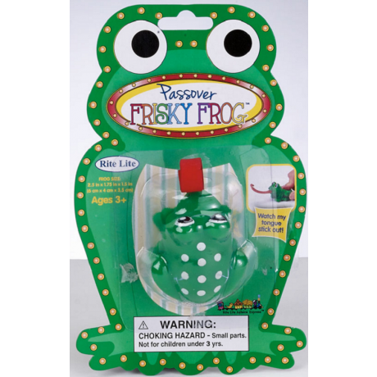
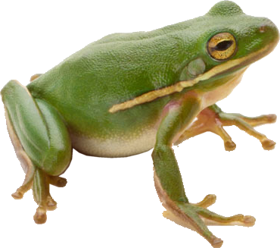
TOY FROG
FROG
next

Slide 18
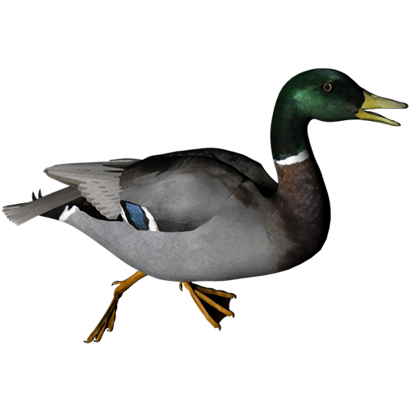
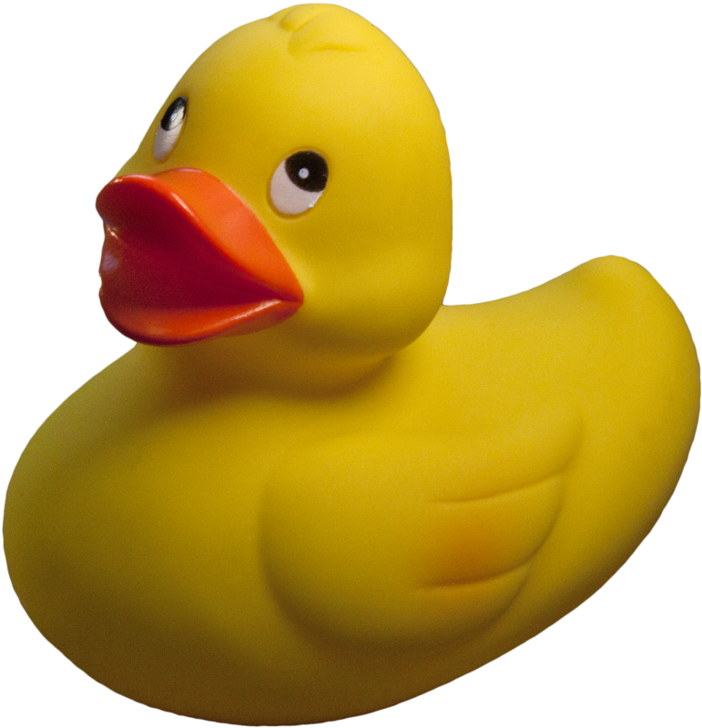
TOY DUCK
DUCK
next

Slide 19
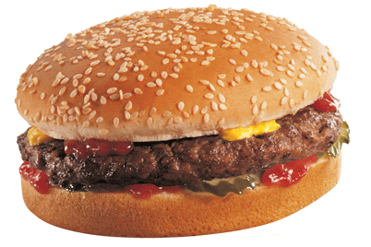
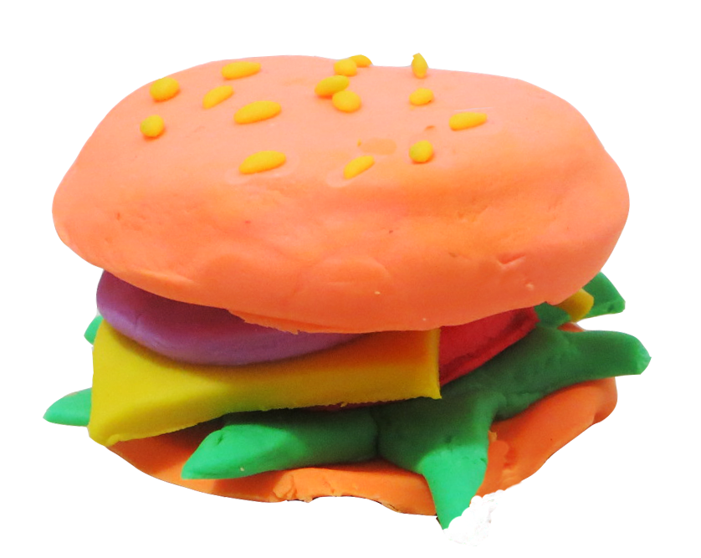
HAMBURGER
next
TOY HAMBURGER

Slide 20
What toy
do you see?
I see a toy …
next

Slide 21

Let’s read a story.

Slide 22
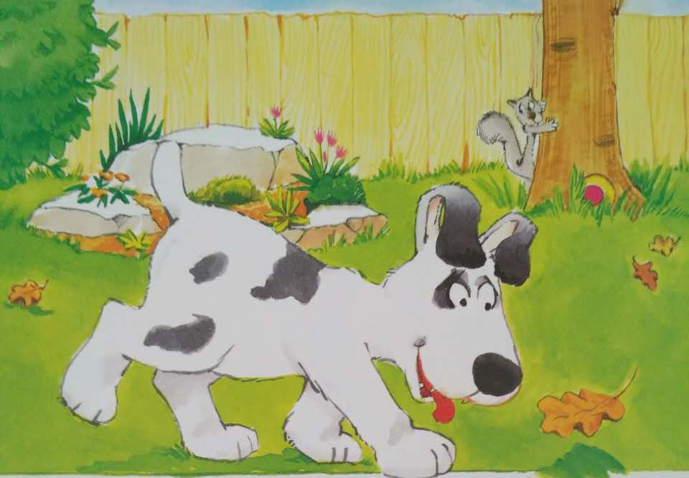
This dog’s name is Bingo.
He likes to play.
next

Slide 23
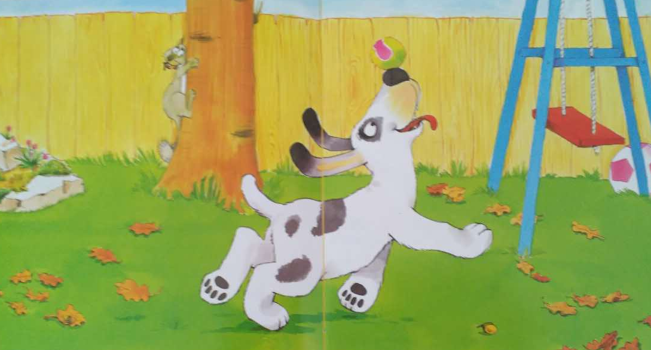
”I like this ball.” said Bingo.
“I can play.”
next

Slide 24
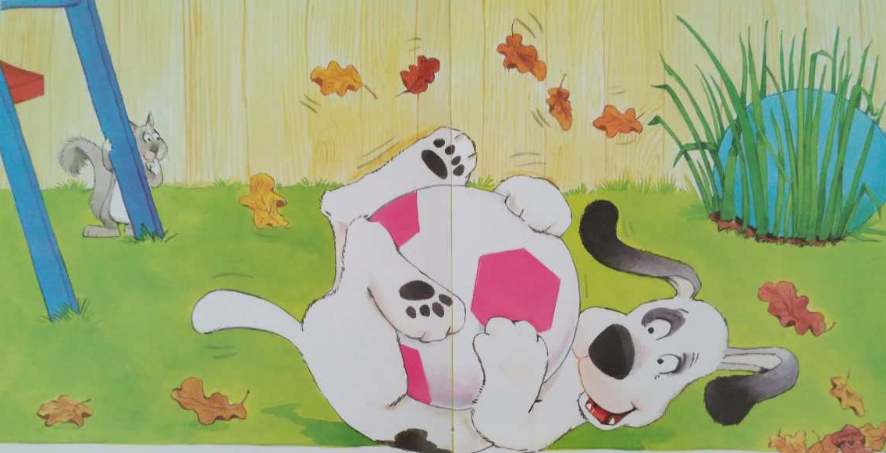
”I like that ball.” said Bingo.
“I can play.”
next

Slide 25
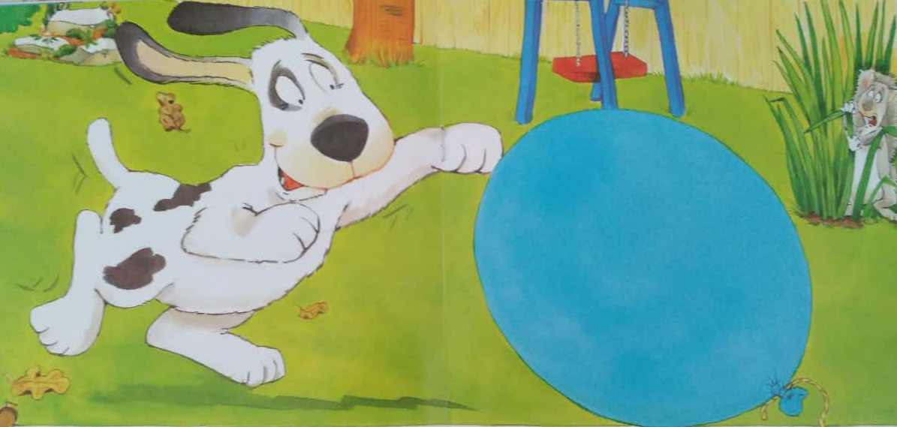
”I like this big ball.”
said Bingo.
“I can play.”
next

Slide 26
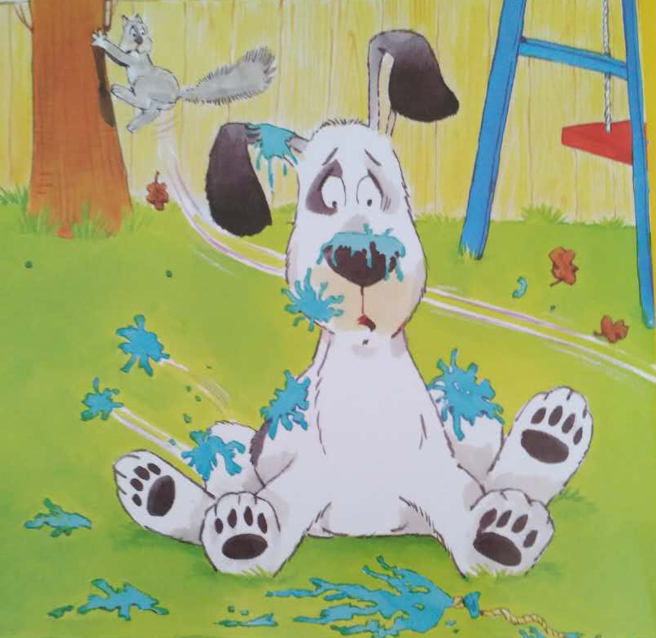
Bang!
next

Slide 27
Let’s sing a song
My Toys song - Tutoriales America
https://www.youtube.com/watch?v=tJKPHvGvEMM
next

Slide 28
GUESS
THE TOY
???
START

Slide 29

bikes
The kids like their ___________
NEXT
CHECK

Slide 30
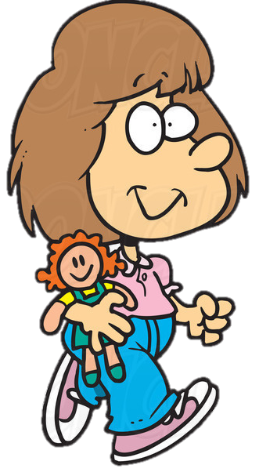
doll
The girl likes her _________
NEXT
CHECK

Slide 31
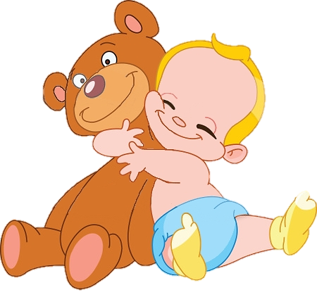
teddy bear
The baby likes his ______________
NEXT
CHECK

Slide 32

ball
The kids like their ________
NEXT
CHECK

Slide 33
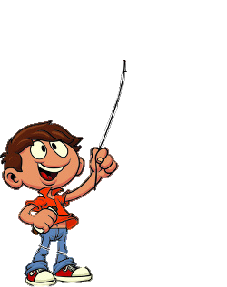
kite
The boy likes his ________
NEXT
CHECK

Slide 34
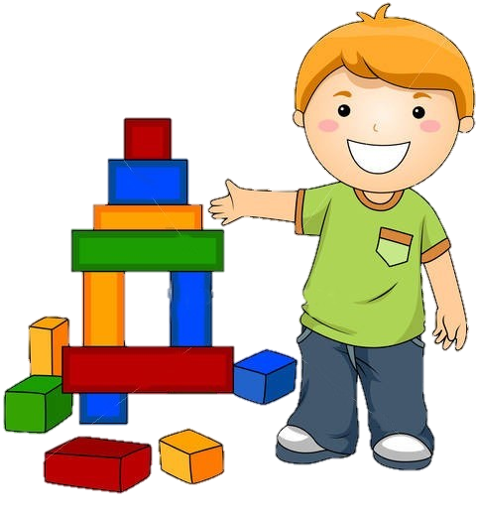
Lego blocks
The boy likes his _________________
NEXT
CHECK

Slide 35

Jigsaw Puzzle
What is it?

Slide 38


Slide 39


Slide 41

I like ….s
next
bicycles
LEGO blocks
Teddys
kites
toy trains
dolls
balls

Slide 42

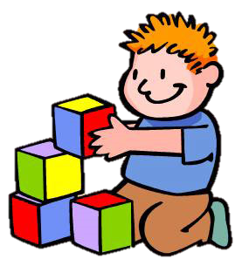
L
C
S
B
O
K
PLAY

Slide 43
Click on the blocks in the correct order to make the word corresponding to the toy
I
R
A
N
T

Slide 44
I
R
A
N
T

Slide 45
I
A
N
T
R

Slide 46
I
N
T
R
A

Slide 47
N
T
R
A
I

Slide 48
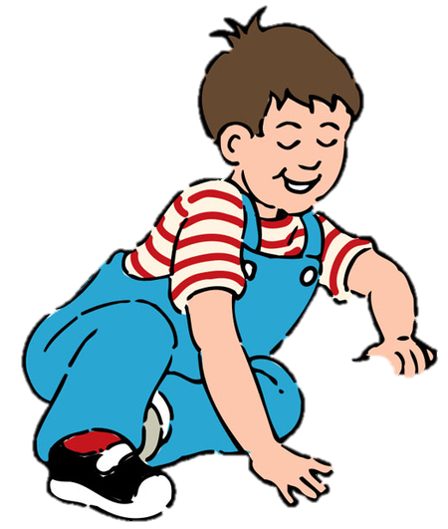
GOOOOOOD!
T
R
A
I
N
NEXT

Slide 49
E
I
K
T

Slide 50
E
I
T
K

Slide 51
E
T
K
I

Slide 52
E
K
I
T

Slide 53
GOOOOOOD!
K
I
T
E
NEXT

Slide 54
O
L
L
D

Slide 55
O
L
L
D

Slide 56
L
L
D
O

Slide 57
L
D
O
L

Slide 58
GOOOOOOD!
D
O
L
L
NEXT

Slide 59


Ball
or
Balls
Doll
or
Dolls
Kite
or
Kites
TOYS
Next
1 one
+1
+3
2 two
+3
+5
3 three
+2
+3
4 four
+4
+2
+5
5 five
+5
+1
+4

