Slide 1
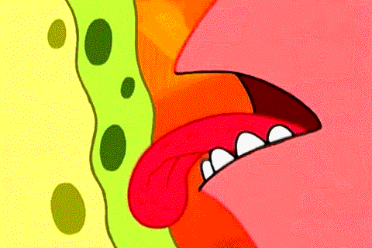
Taste

Slide 2
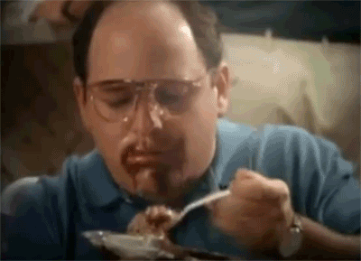
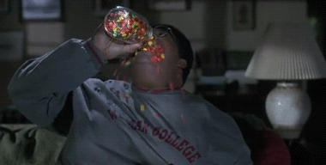
sweet

Slide 3
Candy (USA)
Sweets (UK)
How is it? It’s sweet

Slide 4
ice cream
How is it? It’s sweet

Slide 5
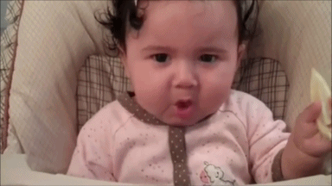
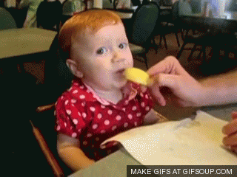
sour

Slide 6
lemon
How is it? It’s sour

Slide 7
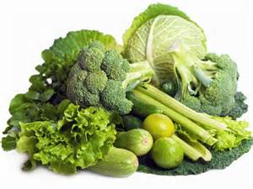
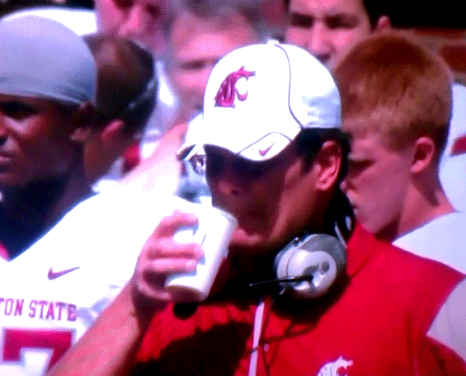
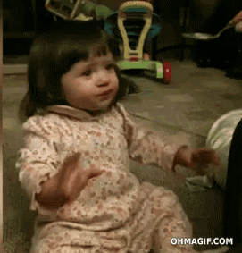
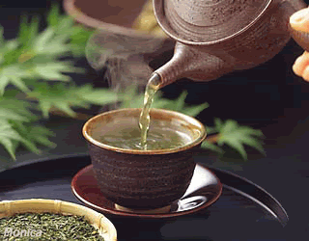
Bitter

Slide 8
coffee
How is it? It’s bitter

Slide 9
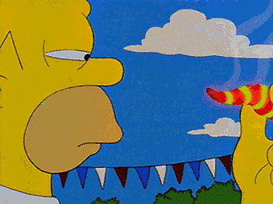
Spicy

Slide 10
pepper
How is it? It’s spicy

Slide 11
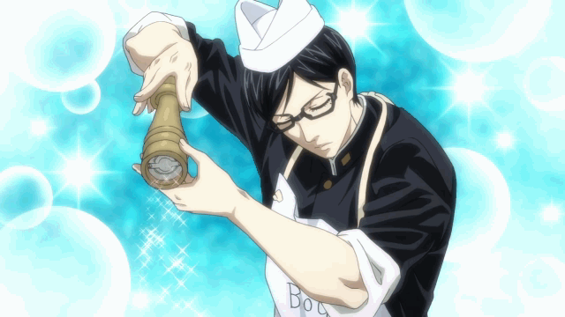
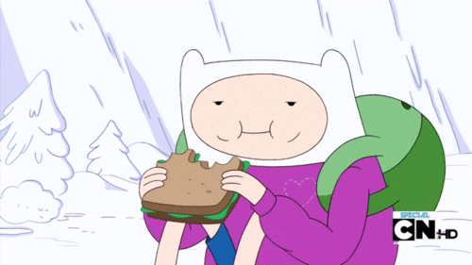
Salty

Slide 12
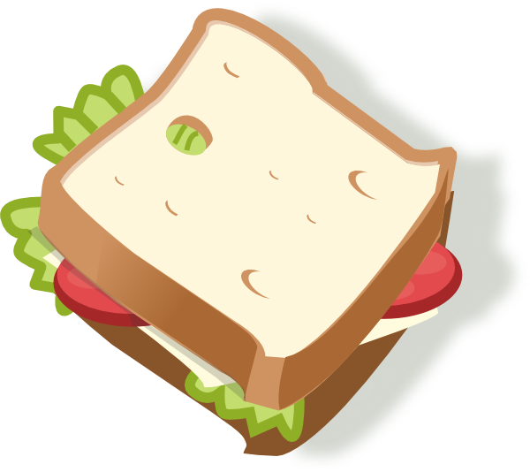
sandwich
How is it? It’s salty

Slide 13
Let’s sing the Let's Taste the Food – YBM https://www.youtube.com/watch?v=qQIGOFXboZw

Slide 14
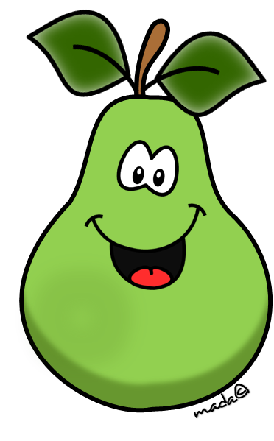
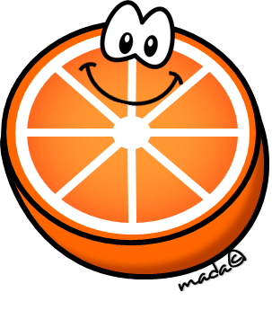
It’s … sweet / sour
sweet
sour

Slide 15
It’s … long / round
long
round

Slide 16
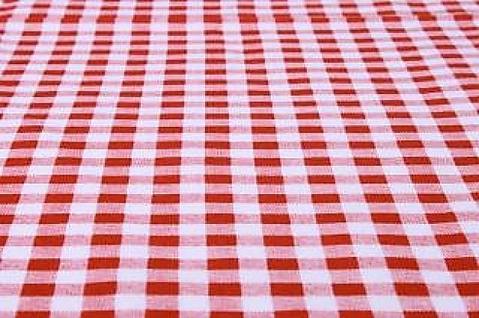
What is it? It’s a / an …
It’s red
It’s round.
It’s an apple
It’s a fruit.
It’s sweet.

Slide 17
What is it? It’s a / an …
It’s long
It’s yellow.
It’s a banana
It’s a fruit.
It’s sweet.

Slide 18
What is it? It’s a / an …
It’s yellow, red and green.
It’s long
It’s a pepper
It’s hot.
It’s spicy.

Slide 19
What is it? It’s a / an …
It’s long and round
It’s yellow.
It’s a mango
It’s sweet.
It’s a fruit.

Slide 20
What is it? It’s a / an …
It’s a drink.
It’s bitter.
It’s a coffee
It’s hot.
It’s brown.

Slide 21
What is it? It’s a / an …
It’s sweet
It’s orange.
It’s an orange
It’s sour.
It’s round.

Slide 22
What is it? It’s a / an …
It’s many colours.
It’s sweet.
It’s an ice cream
It’s cold.
It’s long and round.

Slide 23
What is it? It’s a / an …
It’s a fruit.
It’s sweet.
It’s a peach
It’s orange.
It’s round.

Slide 24
What is it? It’s a / an …
It’s a drink.
It’s bitter.
It’s a coffee
It’s hot.
It’s brown.

Slide 25
Let’s sing the I like to eat apples and bananas By babygenius https://youtu.be/kxHsNldGZVY

Slide 27
2
4
1
3
5
Eat the ice cream
6
8
10
7
9

Slide 28
2
4
1
3
5
Eat the ice cream
Eat the red and white candy
6
8
10
7
9

Slide 29
2
4
1
3
5
Eat the cake
Eat the candy cane
6
8
10
7
9

Slide 30
2
4
1
3
5
Eat the cake
Eat the gingerbread man cookie
6
8
10
7
9

Slide 31
2
4
1
3
5
Winner!!!!
Eat the gingerbread man cookie
6
8
10
7
9

Slide 32
Let’s sing the The Five Senses By peekaboo kids https://www.youtube.com/watch?v=q1xNuU7gaAQ

Slide 33
Let’s sing the Five Senses Song by The Kiboomers https://www.youtube.com/watch?v=vXXiyIGqliE

Slide 34
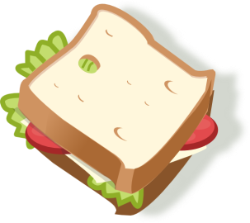
Guess Game
1 pepper =
2 sandwich =
3 lemon =
4 orange =
5 banana =
6 coffee =
7 apple =
It’s (colour .. red , blue, etc) It’s round / long It’s sweet / sour / bitter spicy / salty What is it?
It’s a …

