Slide 1
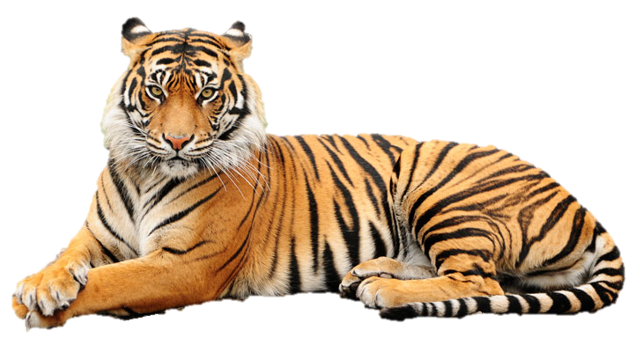

Slide 2
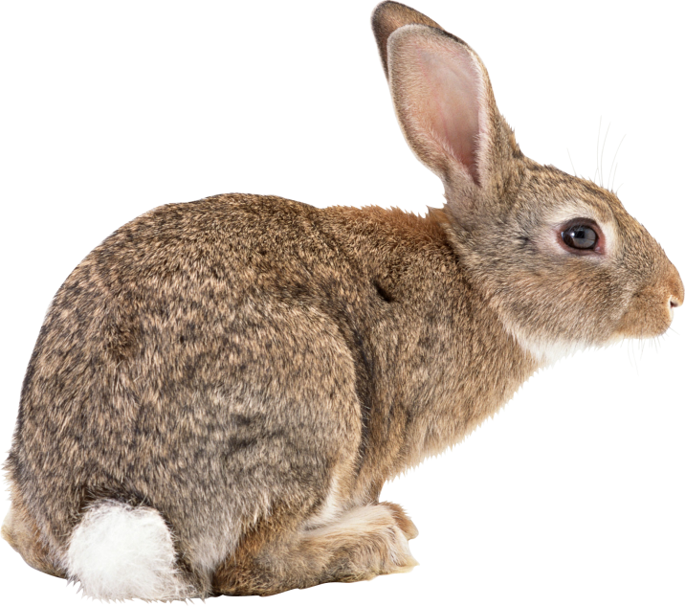
rabbit

Slide 3
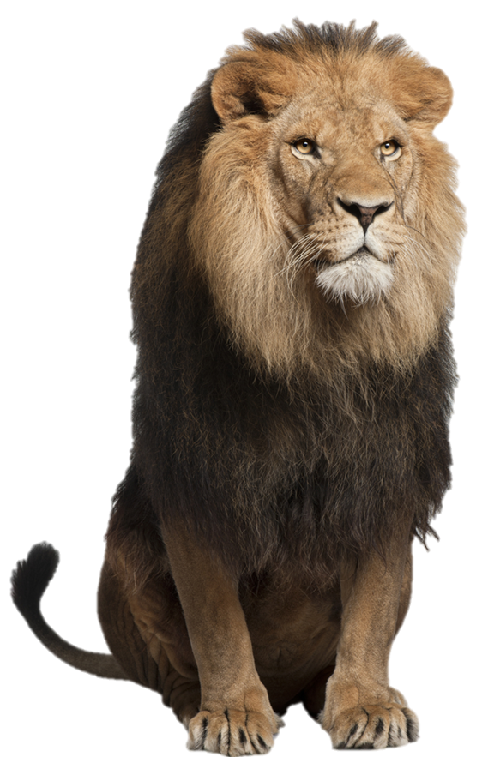
lion

Slide 4
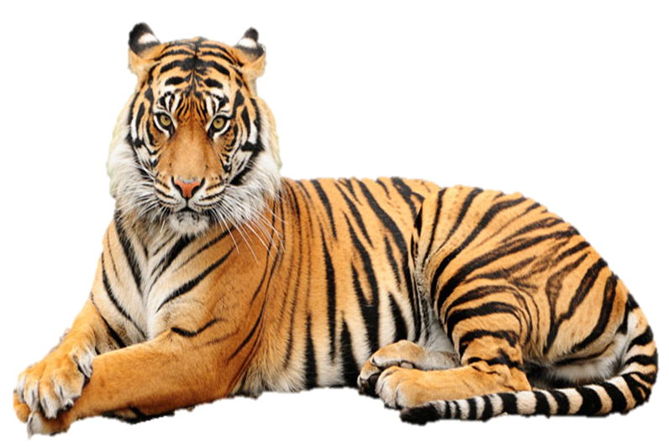
tiger

Slide 5
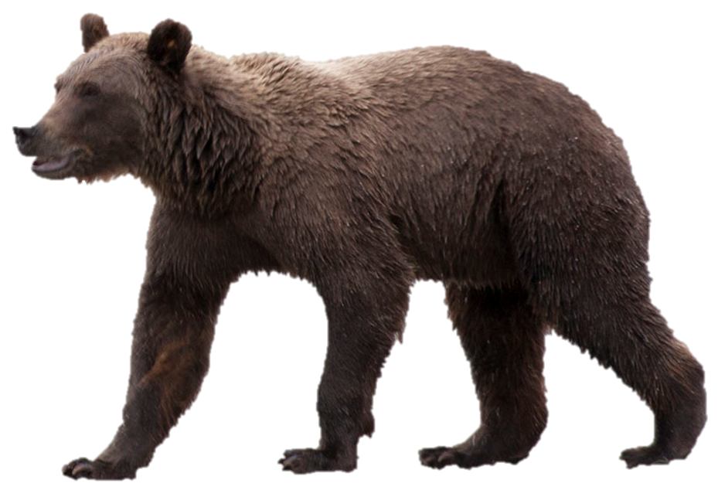
bear

Slide 6
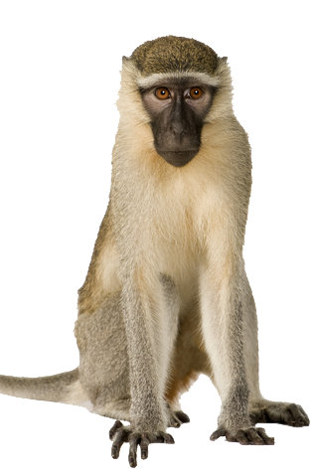
monkey

Slide 7
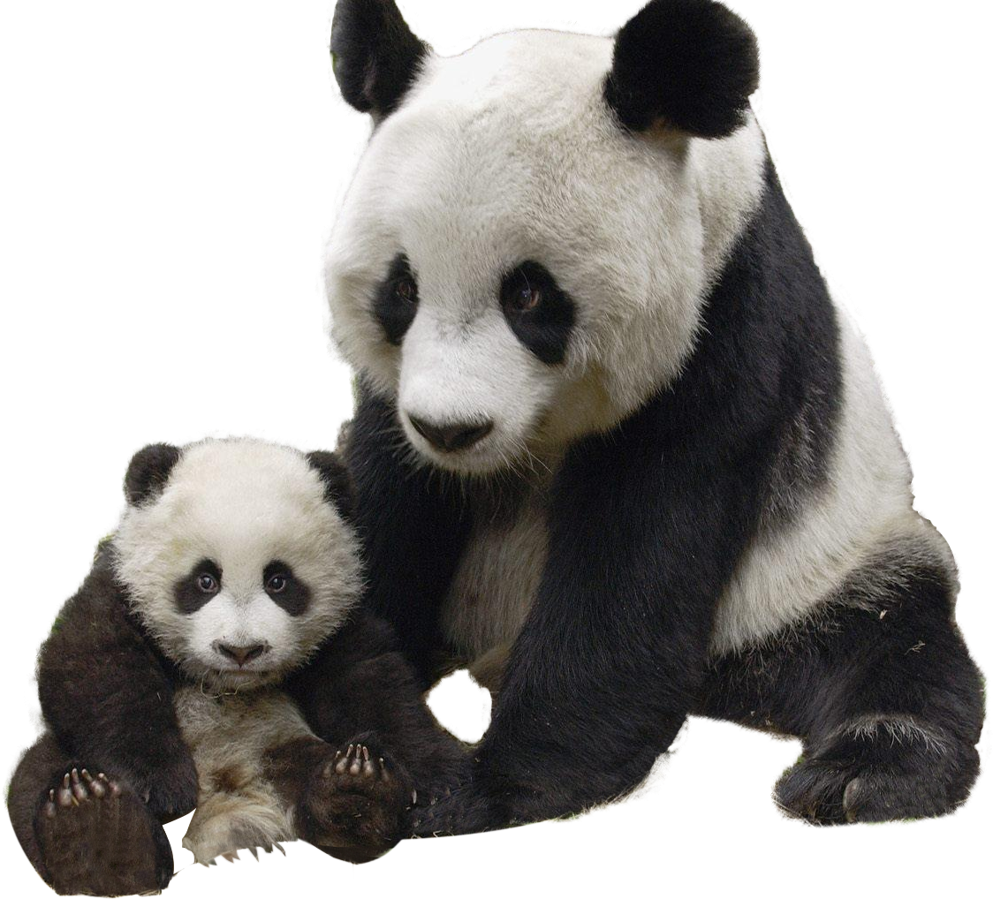
panda

Slide 8
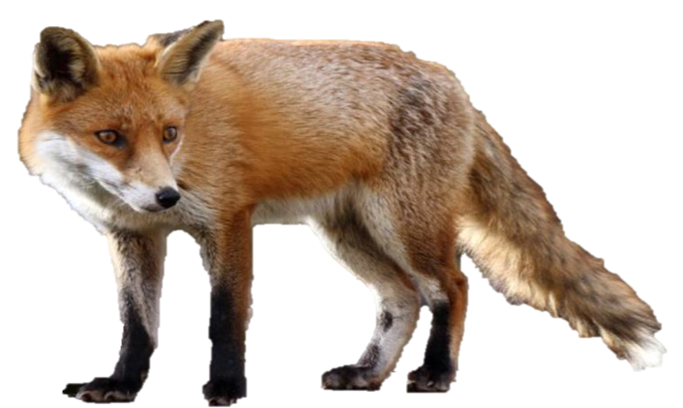
fox

Slide 9
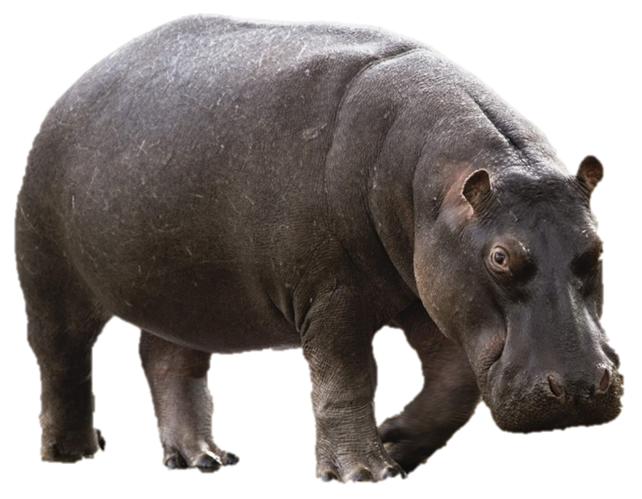
hippo

Slide 10
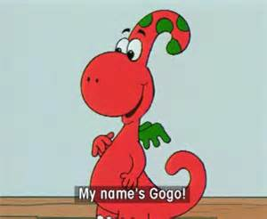
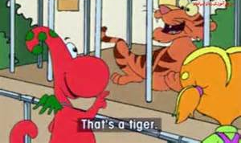
Let’s watch Gogo at the zoo https://www.youtube.com/watch?v=XREZd9YAuFY

Slide 11
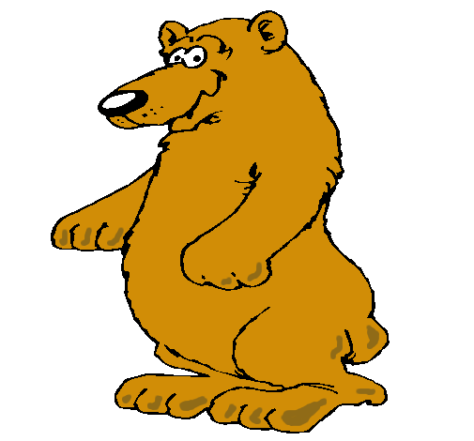
What is this?
It’s a bear

Slide 12
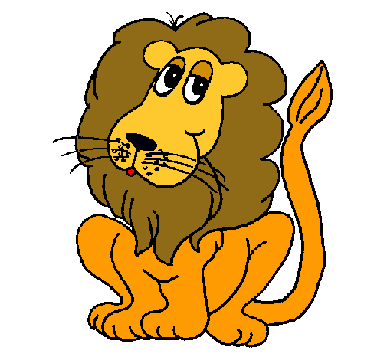
What is this?
It’s a lion

Slide 13
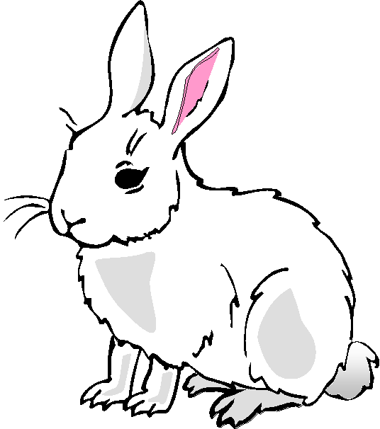
What is this?
It’s a rabbit

Slide 14
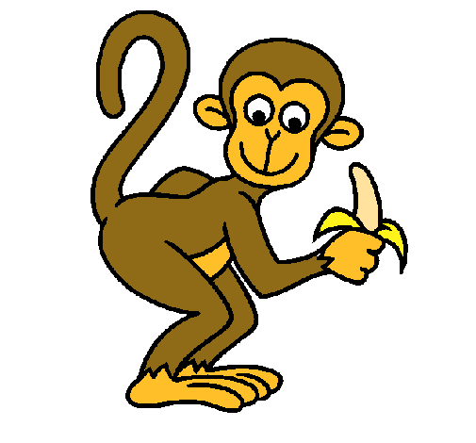
What is this?
It’s a monkey

Slide 15
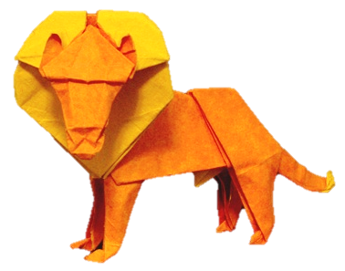
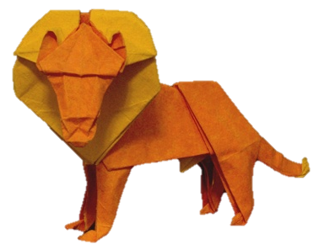
What animal can you see?
It’s a
lion
NEXT

Slide 16
What animal can you see?
It’s a
hippo
NEXT

Slide 17
What animal can you see?
It’s a
rabbit
NEXT

Slide 18
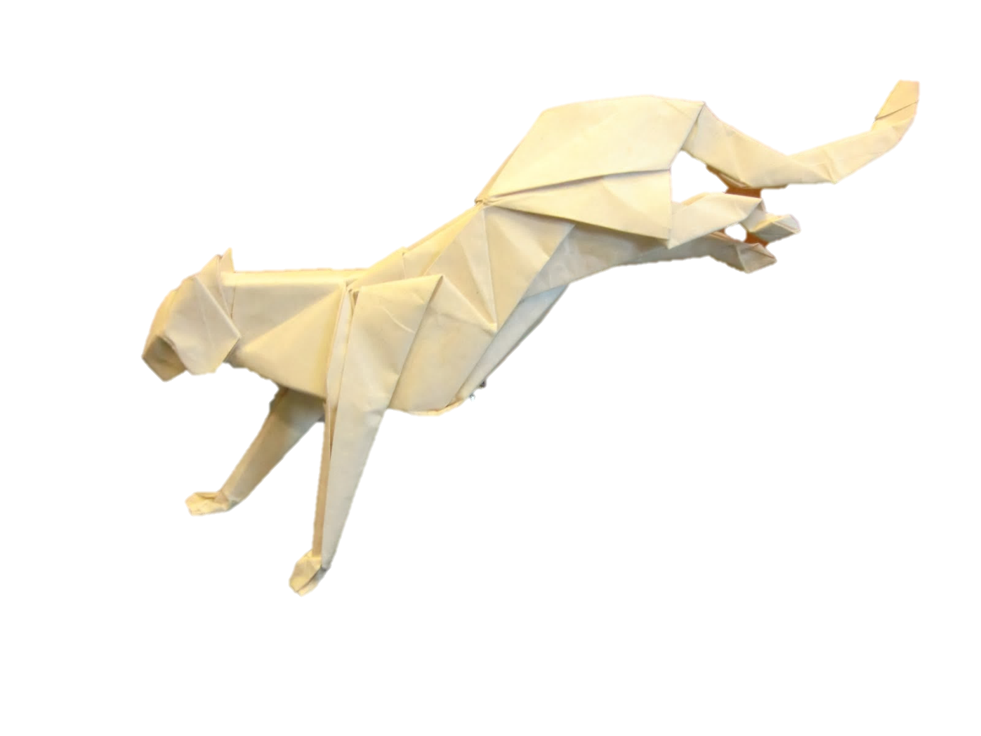
What animal can you see?
It’s a
tiger
NEXT

Slide 19
What animal can you see?
It’s a
bear
NEXT

Slide 20
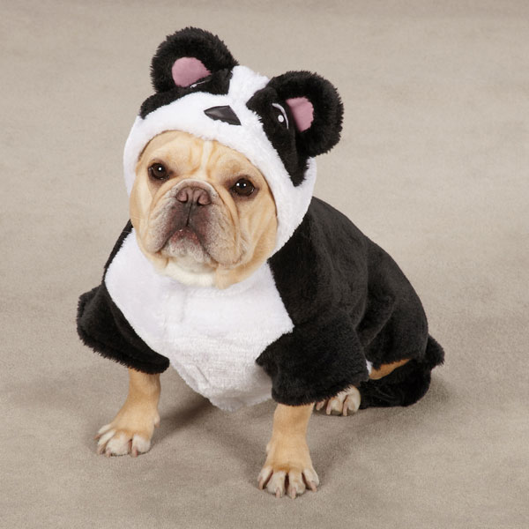
Yes. It’s a panda
Is this a panda?
No. It’s a dog
NEXT

Slide 21
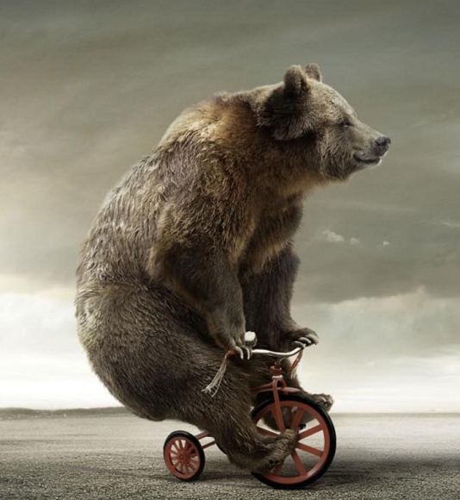
Is this a bear?
Yes. It’s a bear
No. It’s a panda
NEXT

Slide 22
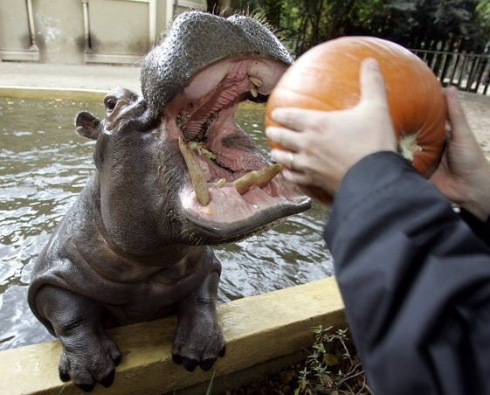
Is this a hippo?
Yes. It’s a hippo
No. It’s a pig
NEXT

Slide 23
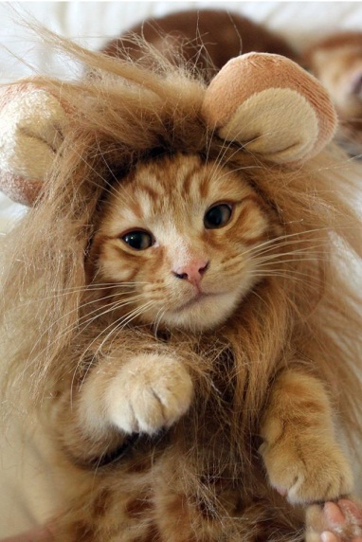
Yes. It’s a lion
Is this a lion?
No. It’s a cat
NEXT

Slide 24
Let’s sing a song. ‘takin us to the zoo’ world of song https://www.youtube.com/watch?v=aZlRT59cjus

Slide 25
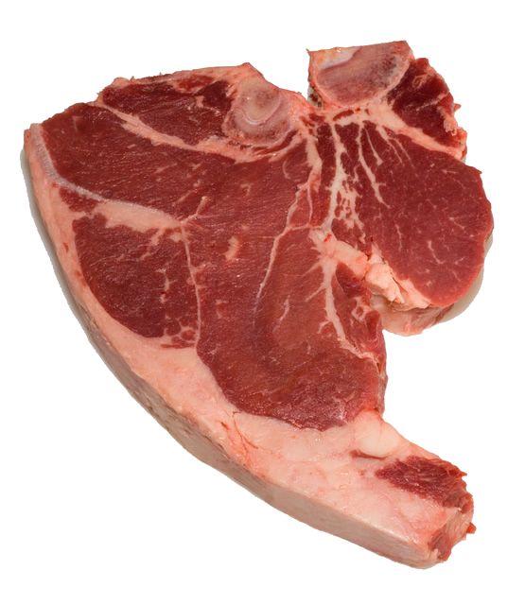
meat

Slide 26
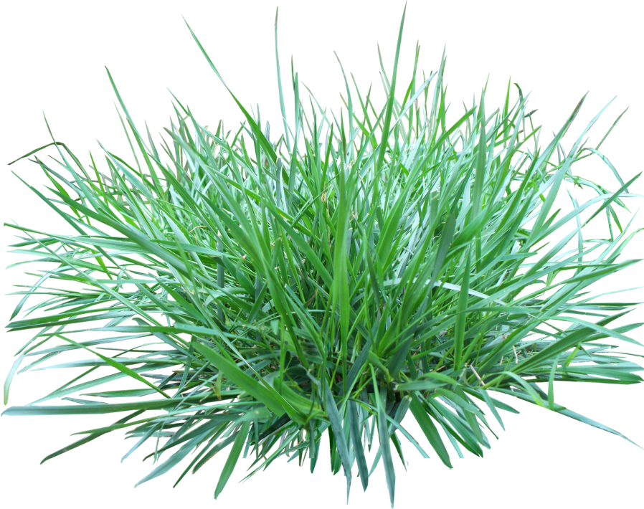
grass

Slide 27
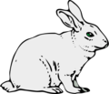
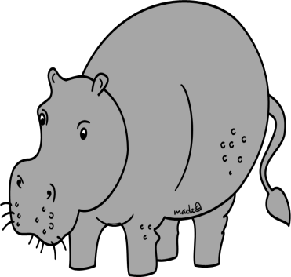
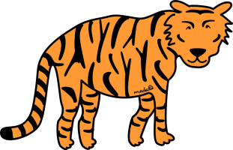
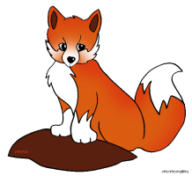
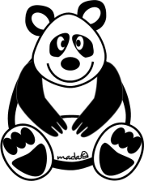
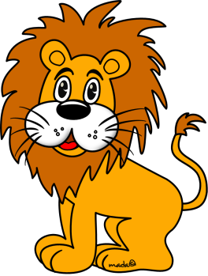
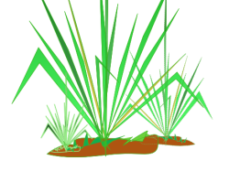
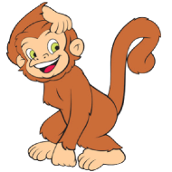
I like meat
I like grass

Slide 28
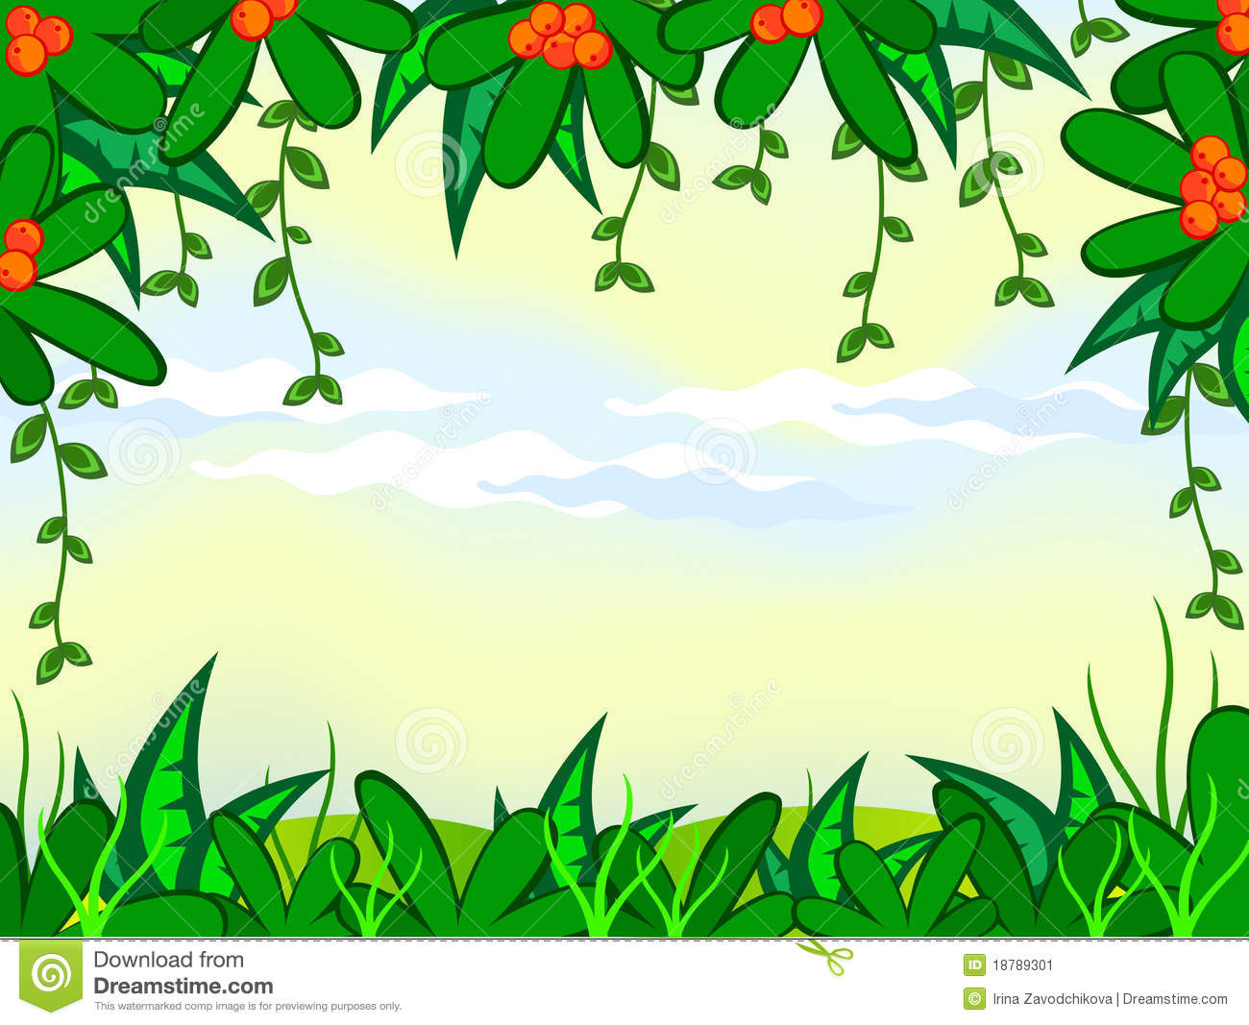
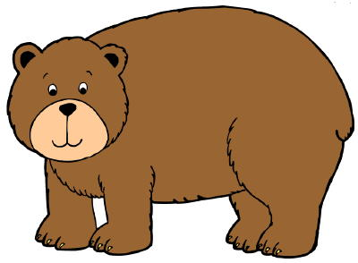
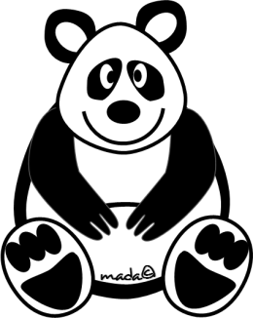
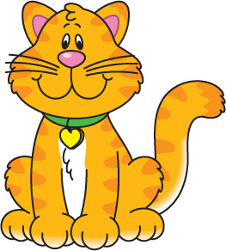
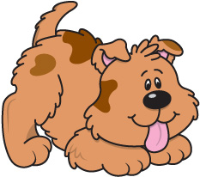
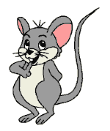
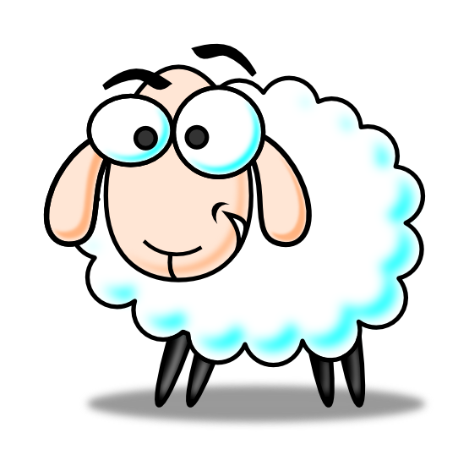
I am … I like ..
I am a/an… Game
1
2
3
4
5
6
7
8
10
11
12
9

Slide 29
Look at me. I am big and fat. I like grass.
It’s a ….
1
2
3
4
Correct
5
6
7
8
10
11
12
9

Slide 30
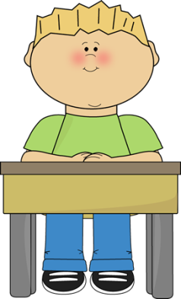
Look at me. I am cute and thin. I like bananas.
It’s a ….
1
2
3
4
5
6
7
8
Correct
10
11
12
9

Slide 31
Look at me. I am big and yellow. I like meat.
It’s a ….
1
2
3
4
5
6
7
8
10
11
12
9
Correct

Slide 32
Look at me. I am small and orange. I like meat.
It’s a ….
1
2
3
4
Correct
5
6
7
8
10
11
12
9

Slide 33
Look at me. I am big and fat. I like meat.
It’s a ….
1
2
3
4
Correct
5
6
7
8
10
11
12
9

Slide 34
Look at me. I am black and white. I like grass.
It’s a ….
1
2
3
4
Correct
5
6
7
8
10
11
12
9

Slide 35
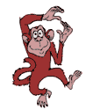
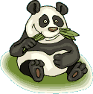
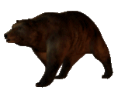
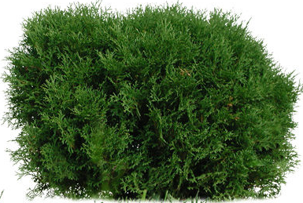
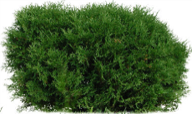
What can you see… …in the forest?
4
5
3
6
2
1

Slide 36
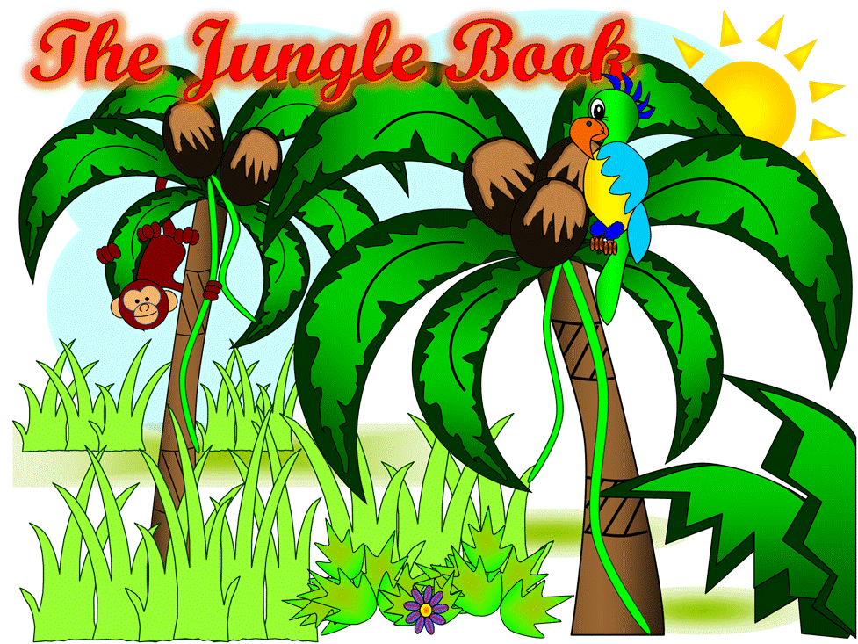
ANIMAL SOUNDS GAME Listen to the animal sound, and choose the correct animal.

Slide 37
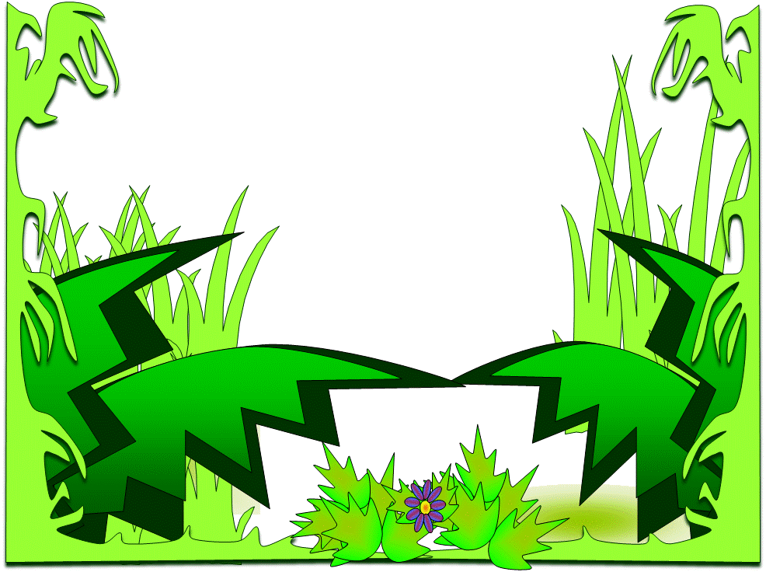
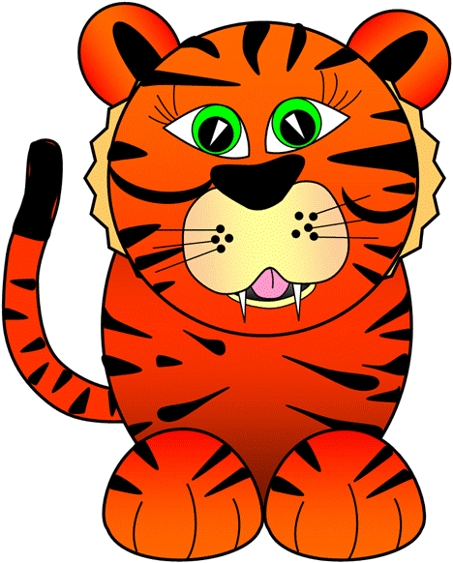
1lion
2bear
4monkey
3tiger
6rabbit
5panda

Slide 38
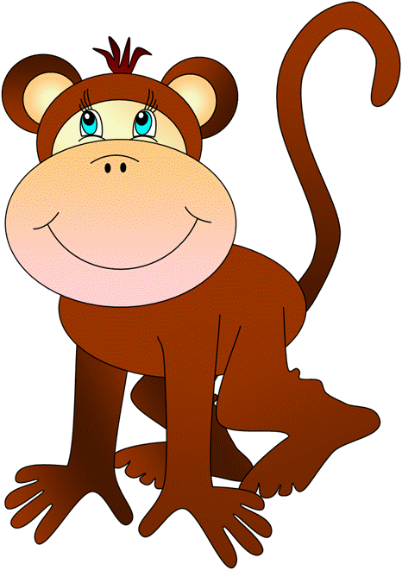
1lion
2bear
4monkey
3tiger
6rabbit
5panda

Slide 39
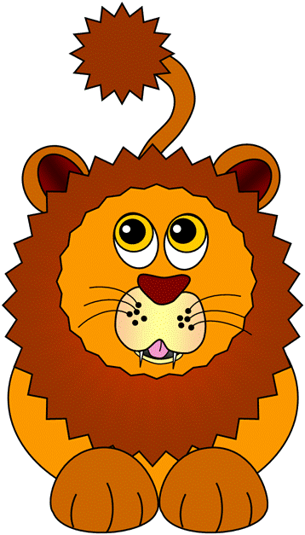
1lion
2bear
4monkey
3tiger
6rabbit
5panda

Slide 40
1lion
2rabbit
4monkey
3tiger
6bear
5panda

Slide 41
Animal Charades Game
1 rabbit =
2 dog =
3 cat =
4 lion =
5 tiger =
6 bear =
7 monkey =
8 panda =
9 hippo = 10 pig =
Is that a …. ?
Yes / No

Slide 42
Look at the animals in the zoo. How many animals? There are 7 animals!
Zoo

Slide 43
How many animals? There are 6 animals! Which is missing?
Zoo

Slide 44
How many animals? There are 5 animals! Which is missing?
Zoo

Slide 45
How many animals? There are 4 animals! Which is missing?
Zoo

Slide 46
How many animals? There are 3 animals! Which is missing?
Zoo

Slide 47
How many animals? There are 2 animals! Which is missing?
Zoo

Slide 48
How many animals? There is 1 animal! Which is missing?
Zoo

Slide 49
Where are my animals????
Zoo

Slide 50
Animal Guess Game
1 rabbit =
2 dog =
3 cat =
4 lion =
5 tiger =
6 bear =
7 monkey =
8 panda =
9 hippo = 10 pig =
It’s fat / thin. Its tail is long/short Its eyes are big/small Its ears are big/small What is it?
It’s a …

