Slide 1




Slide 2



What is your birthday month?

Slide 3
Let’s do the birthday month game video

Slide 4
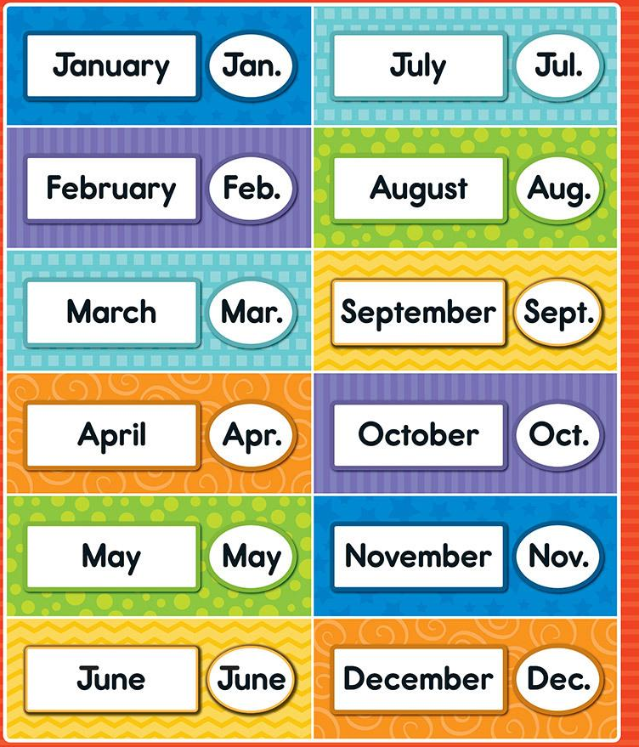
Let’s do the montherena dance video
https://www.youtube.com/watch?v=rZ6NJWNzBqE
January (R. Hand out palm down),
Feb (L hand out palm down),
March (r. Palm up),
and Apr. (L. Palm up)
May (R. Hand to L. Shoulder),
June (L. Hand to R. Shoulder)
July (R. Hand behind head) and
August (L. Hand behind head)
Sept. (R hand to l. Hip),
Oct. (L. Hand to R. Hip)
Nov. (R. Hand to R. Hip), and
Dec (L. Hand to L. Hip)
OH MONTHERENA!
(jump and turn ¼) repeat.

Slide 5

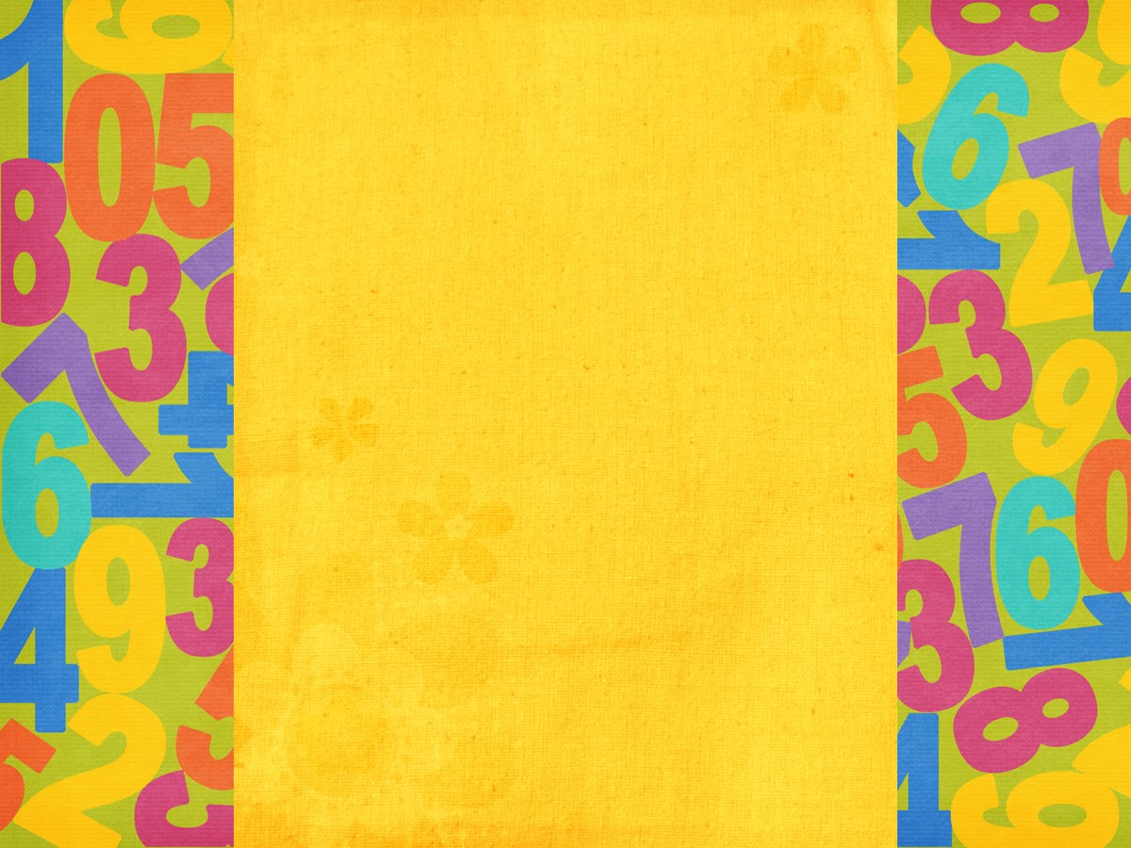
Ordinal
Numbers

Slide 6
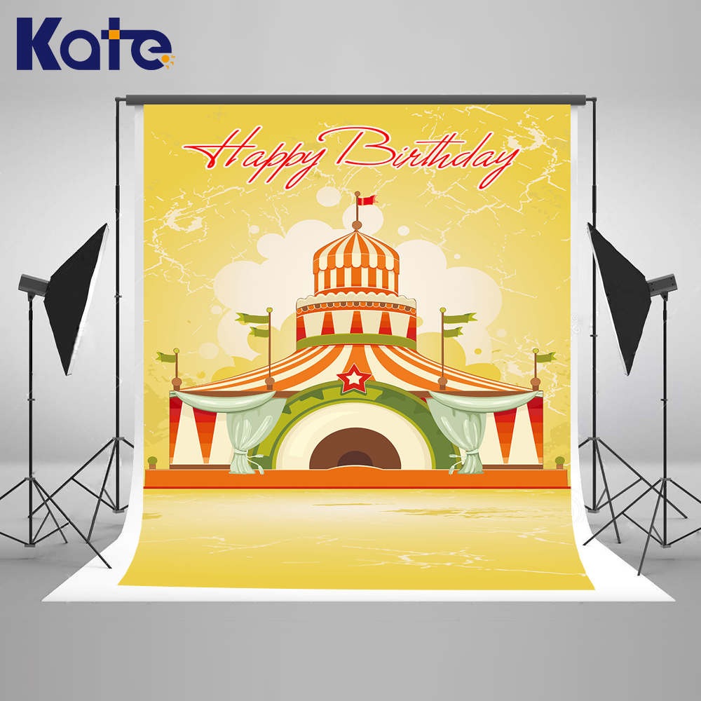

ordinal numbers
show the order of things
fifth
fourth
third
second
first
nd
rd
st

Slide 7
th is used a lot with ordinals.
th is a very important sound.
fifth
th
fourth
third
second
first
nd
rd
st

Slide 8

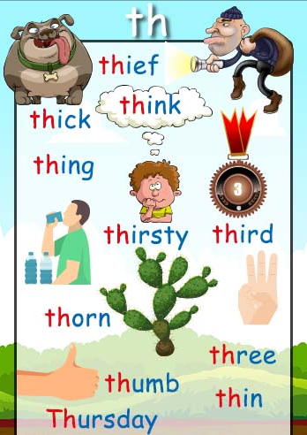

Slide 9
1 | one | first | 1st
2 | two | second | 2nd
3 | three | third | 3rd
4 | four | fourth | 4th
5 | five | fifth | 5th

Slide 10
6 | six | sixth | 6th
7 | seven | seventh | 7th
8 | eight | eighth | 8th
9 | nine | ninth | 9th
10 | ten | tenth | 10th

Slide 11
11 | eleven | eleventh | 11th
12 | twelve | twelfth | 12th
13 | thirteen | thirteenth | 13th
14 | fourteen | fourteenth | 14th
15 | fifteen | fifteenth | 15th

Slide 12
16 | sixteen | sixteenth | 16th
17 | seventeen | seventeenth | 17th
18 | eighteen | eighteenth | 18th
19 | nineteen | nineteenth | 19th
20 | twenty | twentieth | 20th

Slide 13
21 | twenty-one | twenty-first | 21st
22 | twenty-two | twenty-second | 22nd
23 | twenty-three | twenty-third | 23rd
24 | twenty-four | twenty-fourth | 24th
25 | twenty-five | twenty-fifth | 25th

Slide 14
26 | twenty-six | twenty-sixth | 26th
27 | twenty-seven | twenty-seventh | 27th
28 | twenty-eight | twenty-eighth | 28th
29 | twenty-nine | twenty-ninth | 29th
30 | thirty | thirtieth | 30th

Slide 15
31 | thirty-one | thirty-first | 31st
32 | thirty-two | thirty-second | 32nd
33 | thirty-three | thirty-third | 33rd
34 | thirty-four | thirty-fourth | 34th
35 | thirty-five | thirty-fifth | 35th

Slide 16
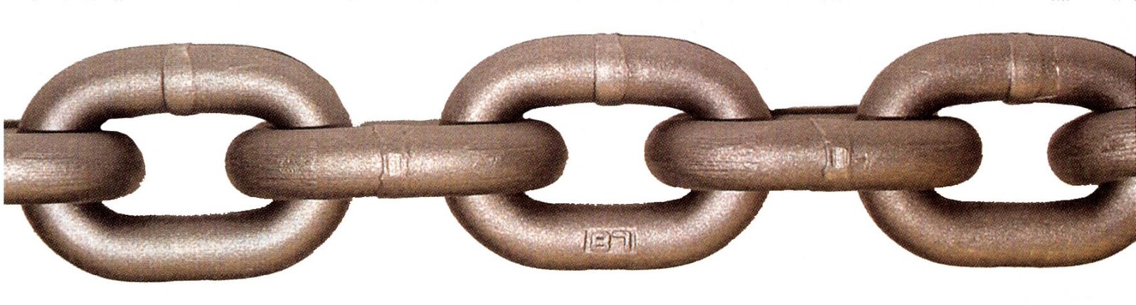
chain game
If the group can form a chain, the group will get a point. The members of the group with the most points will each get a sticker.

Slide 17
round 1: from the front to the back: 1st – 10th example
ninth
tenth
ninth
tenth
ninth
tenth
seventh
eighth
seventh
eighth
seventh
eighth
fifth
sixth
fifth
sixth
fifth
sixth
third
fourth
third
fourth
third
fourth
first
first
first
second
second
second

Slide 18
first
first
first
round 2: from the back to the front: 1st – 10th example
second
second
second
third
fourth
third
fourth
third
fourth
fifth
sixth
fifth
sixth
fifth
sixth
seventh
eighth
seventh
eighth
seventh
eighth
ninth
tenth
ninth
ninth
tenth
tenth

Slide 19
round 3: from the front to the back: 11th – 20th example
nineteenth
twentieth
nineteenth
twentieth
nineteenth
twentieth
seventeenth
eighteenth
seventeenth
eighteenth
seventeenth
eighteenth
fifteenth
sixteenth
fifteenth
sixteenth
fifteenth
sixteenth
thirteenth
fourteenth
thirteenth
fourteenth
thirteenth
fourteenth
eleventh
eleventh
eleventh
twelfth
twelfth
twelfth

Slide 20
eleventh
eleventh
eleventh
round 4: from the back to the front: 11th – 20th example
twelfth
twelfth
twelfth
thirteenth
fourteenth
thirteenth
fourteenth
thirteenth
fourteenth
fifteenth
sixteenth
fifteenth
sixteenth
fifteenth
sixteenth
seventeenth
eighteenth
seventeenth
eighteenth
seventeenth
eighteenth
nineteenth
twentieth
nineteenth
nineteenth
twentieth
twentieth

Slide 21
round 5: from the front to the back: 21st – 30th example
twenty-ninth
thirtieth
twenty-ninth
thirtieth
twenty-ninth
thirtieth
twenty-seventh
twenty-eighth
twenty-seventh
twenty-eighth
twenty-seventh
twenty-eighth
twenty-fifth
twenty-sixth
twenty-fifth
twenty-sixth
twenty-fifth
twenty-sixth
twenty-third
twenty-fourth
twenty-third
twenty-fouth
twenty-third
twenty-fourth
twenty-first
twenty-first
twenty-first
twenty-second
twenty-second
twenty-second

Slide 22
round 6: from the back to the front: 21st – 30th example
twenty-first
twenty-first
twenty-first
twenty-second
twenty-second
twenty-second
twenty-third
twenty-fourth
twenty-third
twenty-fourth
twenty-third
twenty-fourth
twenty-fifth
twenty-sixth
twenty-fifth
twenty-sixth
twenty-fifth
twenty-sixth
twenty-seventh
twenty-eighth
twenty-seventh
twenty-eighth
twenty-seventh
twenty-eighth
twenty-ninth
thirtieth
twenty-ninth
twenty-ninth
thirtieth
thirtieth

Slide 23



Slide 24



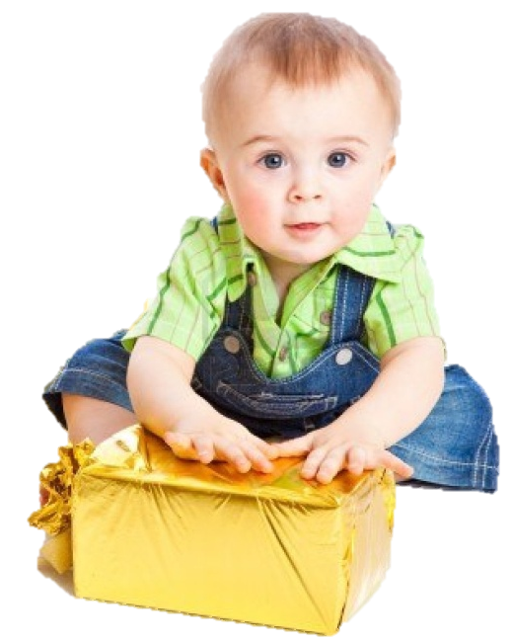

It’s on the first of January
He is one year old

Slide 25




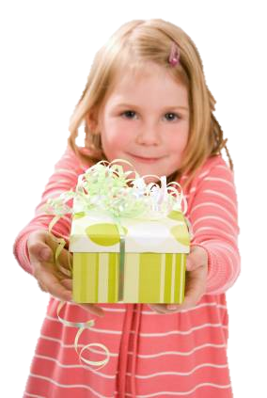


It’s on the third of July
She is five years old

Slide 26


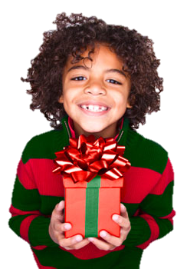
It’s on the eighth of June
She is seven years old

Slide 27


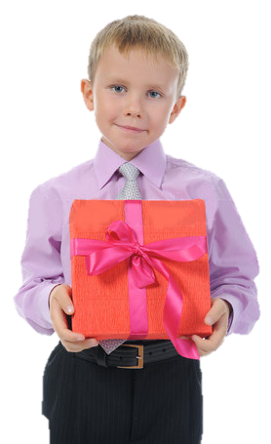
It’s on the fifth of April
He is eight years old

Slide 28

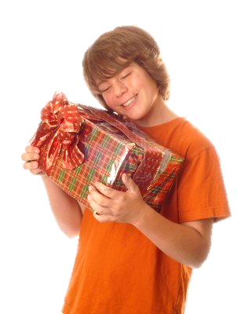

It’s on the thirty-first of December
She is fourteen years old

Slide 29



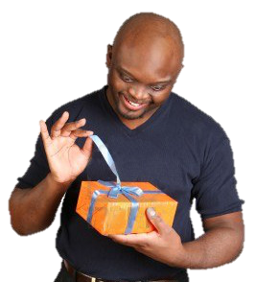
It’s on the second of May
He is eighteen years old

Slide 30

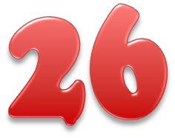

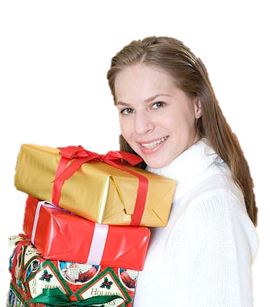
It’s on the twelfth of September
She is twenty-six years old

Slide 31

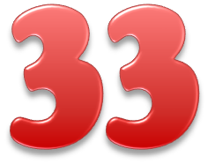

It’s on the twentieth of November
She is thirty-three years old

Slide 32


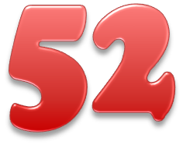
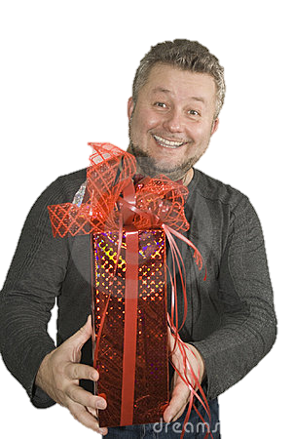
It’s on the tenth of October
He is fifty-two years old

Slide 33
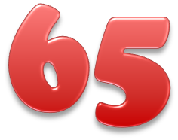
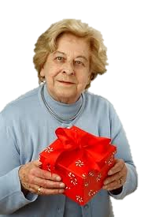
It’s on the first of March
She is sixty-five years old

Slide 34


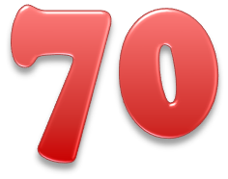
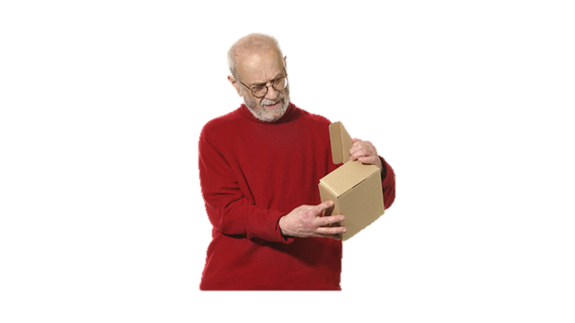
It’s on the ninth of August
He is seventy years old

Slide 35
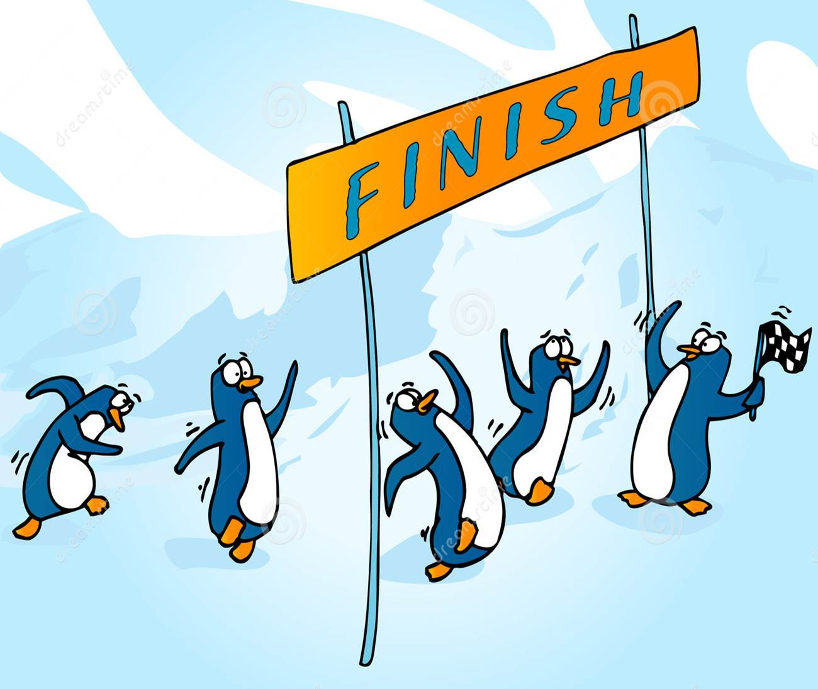
ORDINAL
RACE
NUMBERS

Slide 36
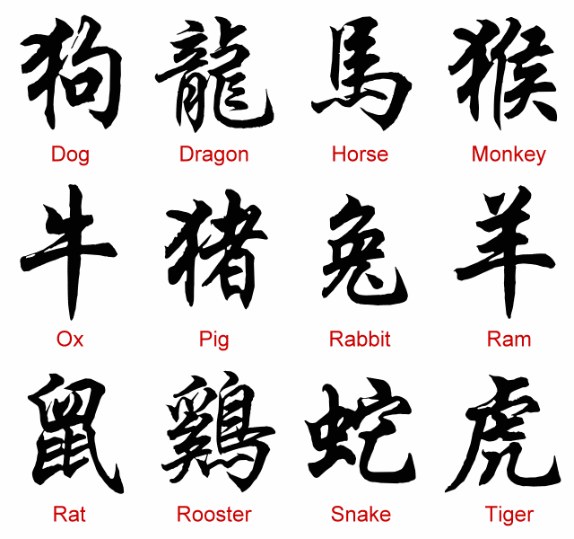
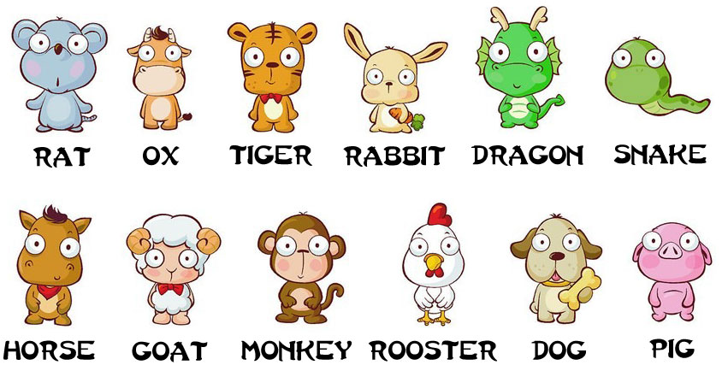
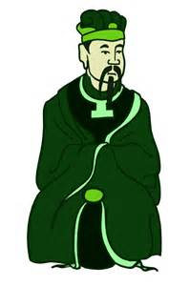

Chinese Zodiac - It is believed that the
Jade Emperor asked all the animals to meet him on Chinese New Year. Twelve animals came and emperor named a year after each one.
He said that the people born in each animal's year would have some of that animal's personality.

Slide 37

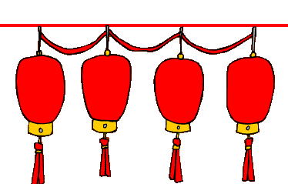
Lets watch the story of ‘the great race’.
By British council
Try to remember the order of the animals.

Slide 38
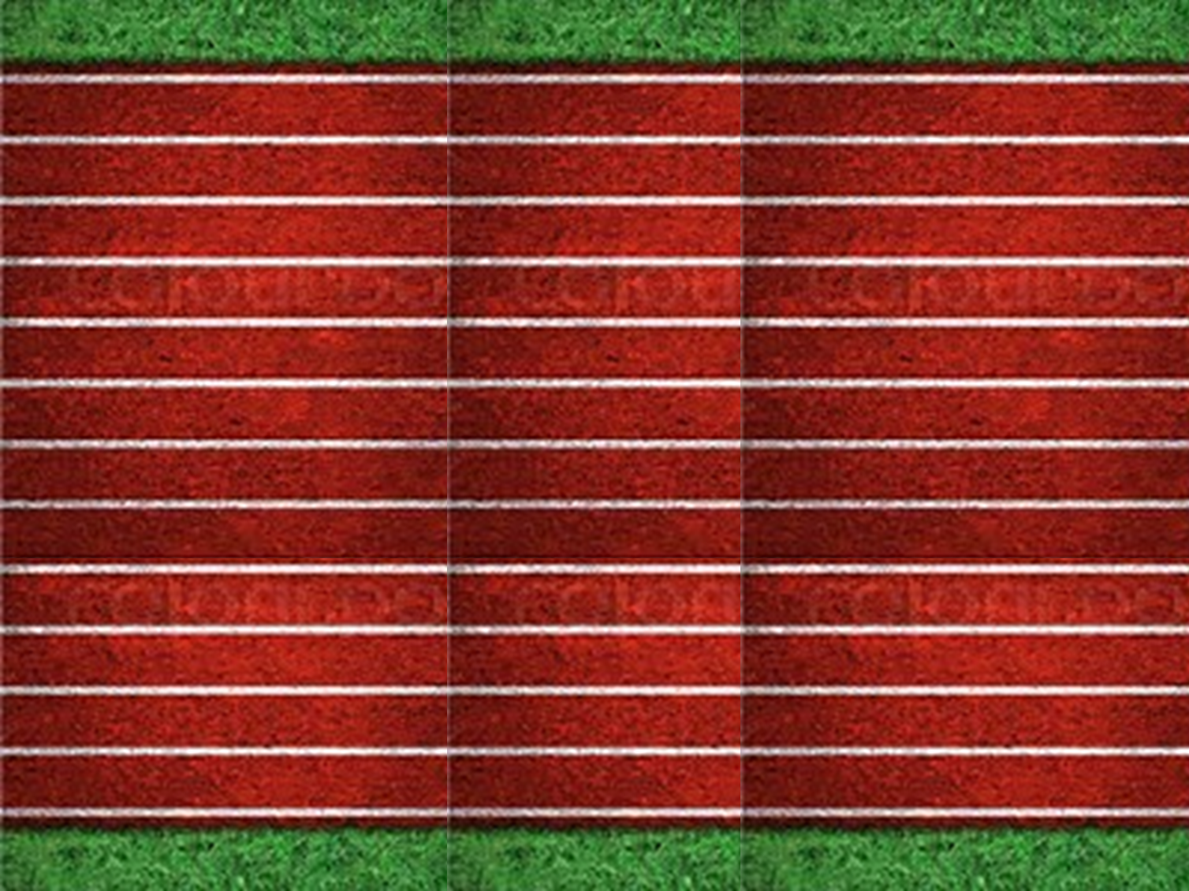

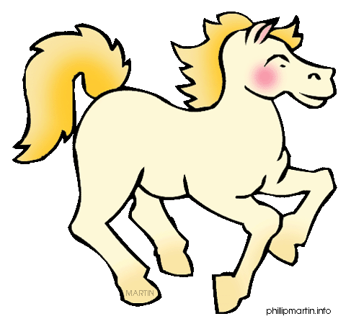
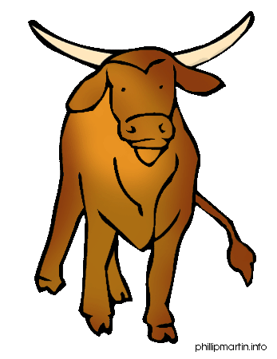




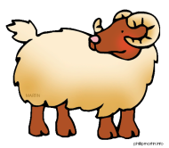





What order did the animals finish the race?
1st
2nd
3rd
4th
5th
6th
7th
8th
9th
10th
11th
12th
Click the ordinal number to reveal the answer.

Slide 39

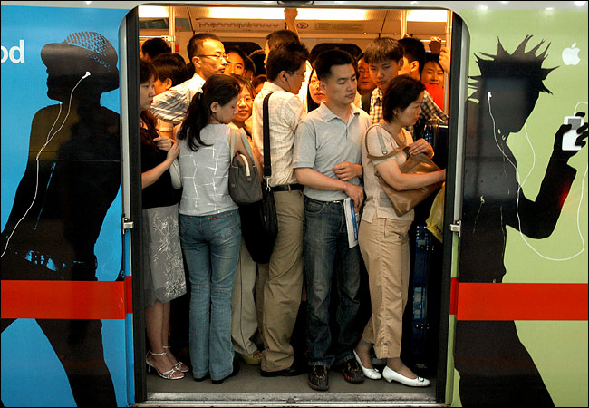
0
ORDINAL
FLOOR
NUMBERS

Slide 40


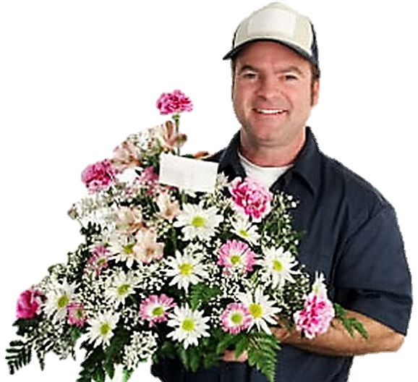
Help me, please! I’m going to the third floor
11
12
9
10
7
8
5
6
3
4
1
2

Slide 41
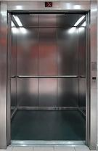
3 rd
third
Thank you!

Slide 42

I’m going to the fifth floor
11
12
9
10
7
8
5
6
3
4
1
2

Slide 43

5 th
fifth
Thank you!

Slide 44

I’m going to the ninth floor
11
12
9
10
7
8
5
6
3
4
1
2

Slide 45
9 th
ninth
Thank you!

Slide 46
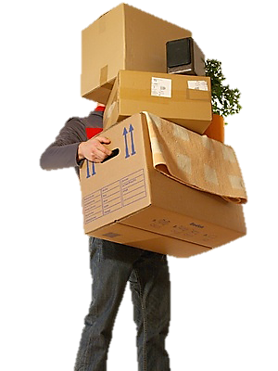
I’m going to the second floor
11
12
9
10
7
8
5
6
3
4
1
2

Slide 47
2 nd
second
Thank you!

Slide 48
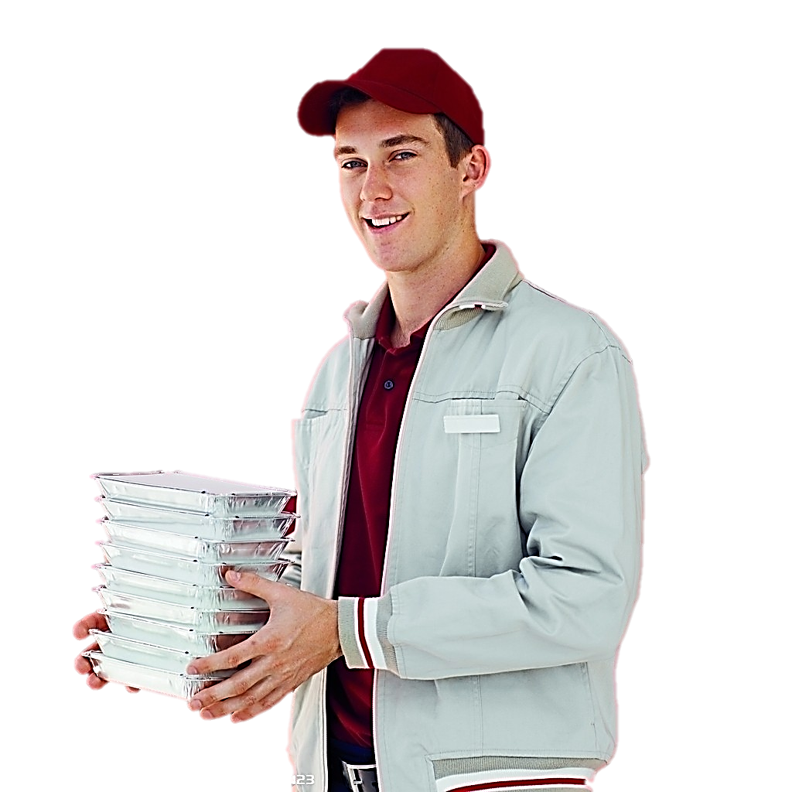
I’m going to the first floor
11
12
9
10
7
8
5
6
3
4
1
2

Slide 49
1 st
first
Thank you!

Slide 50

We’re going to the twelfth floor
11
12
9
10
7
8
5
6
3
4
1
2

Slide 51

12 th
twelfth
Thank you!

Slide 52
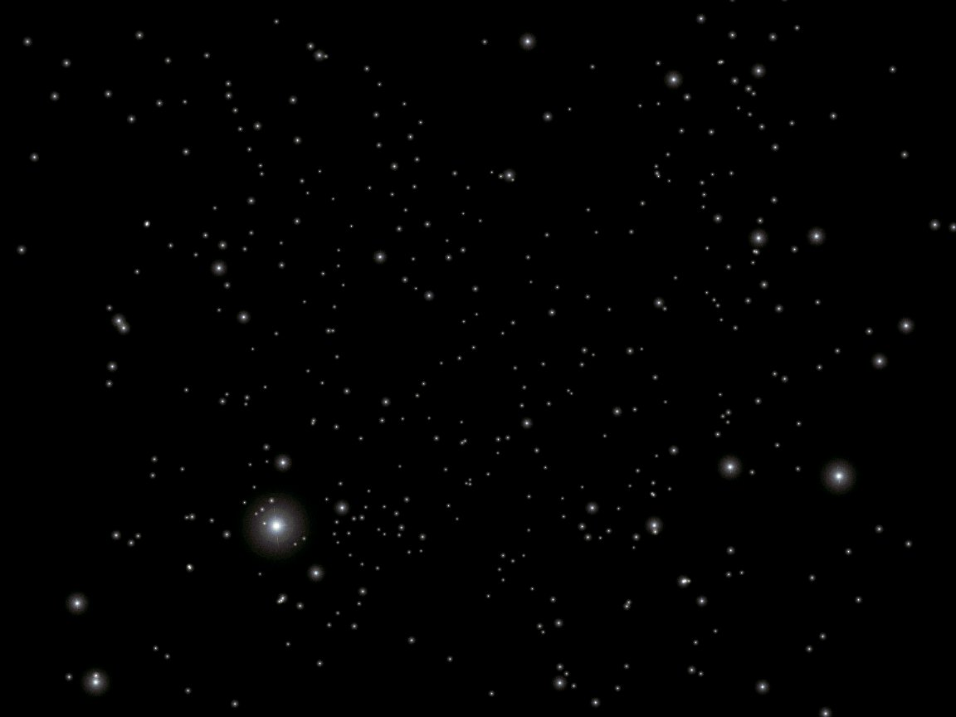

What floor are we on?
?

Slide 53
SURPRISE!
bonus round!

Slide 54

fifth
Final round: Random.
:
second
first
third
fourth

Slide 55
