Slide 1
Can you …?
ability
Yes! No!

Slide 2
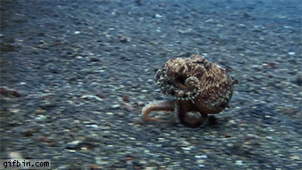
I can run

Slide 3
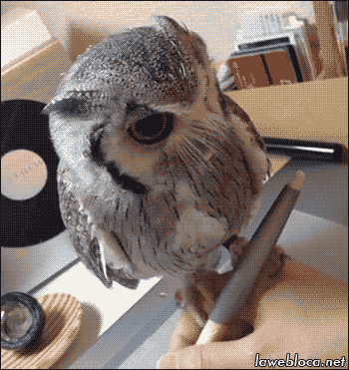
I can write

Slide 4
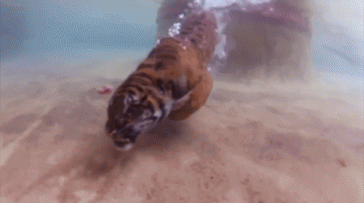
I can swim

Slide 5
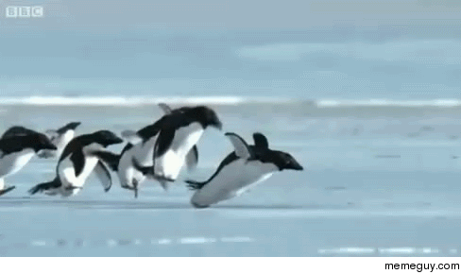
I can fly

Slide 6
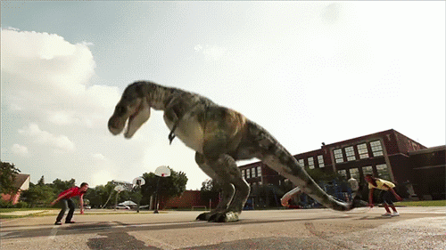
I can skip

Slide 7
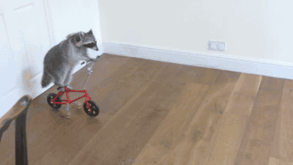
I can ride a bike

Slide 8
Can you …?
run?
write?
swim?
fly?
skip?
ride a bike?
Yes J
No L

Slide 9

Let’s sing
a song.
‘can you? chant’ by elf https://www.youtube.com/watch?v=qiAQQeTgGkk

Slide 10
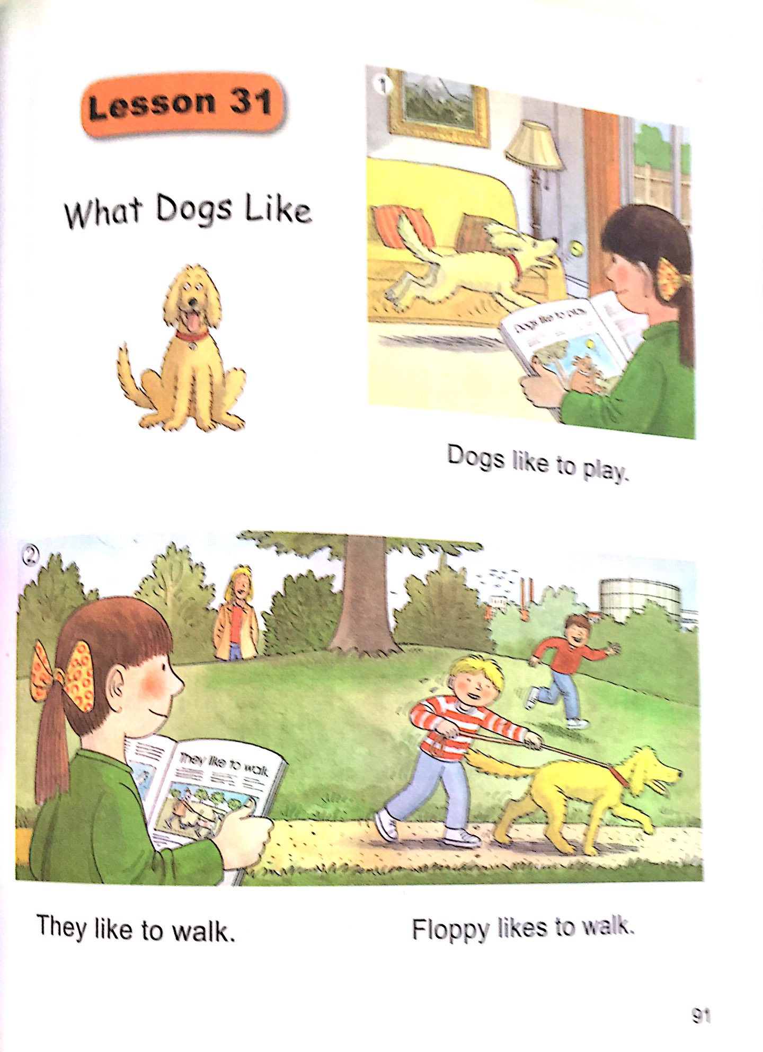
Let’s read
a story
‘the dog can’

Slide 11
The dog can walk.

Slide 12
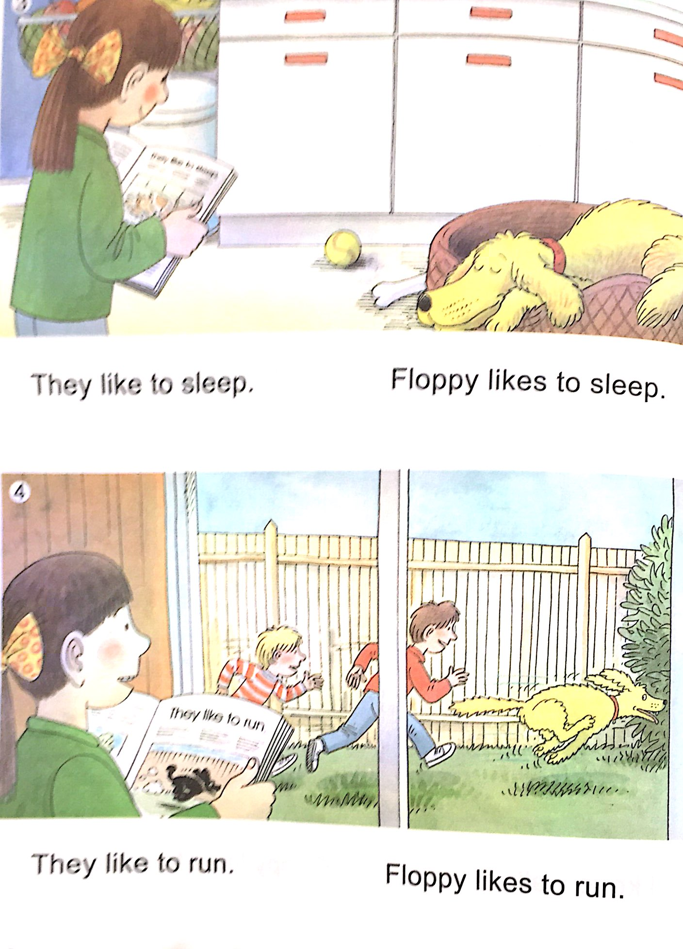
The dog can run.

Slide 13
The dog can play.

Slide 14
The dog can sleep.

Slide 15
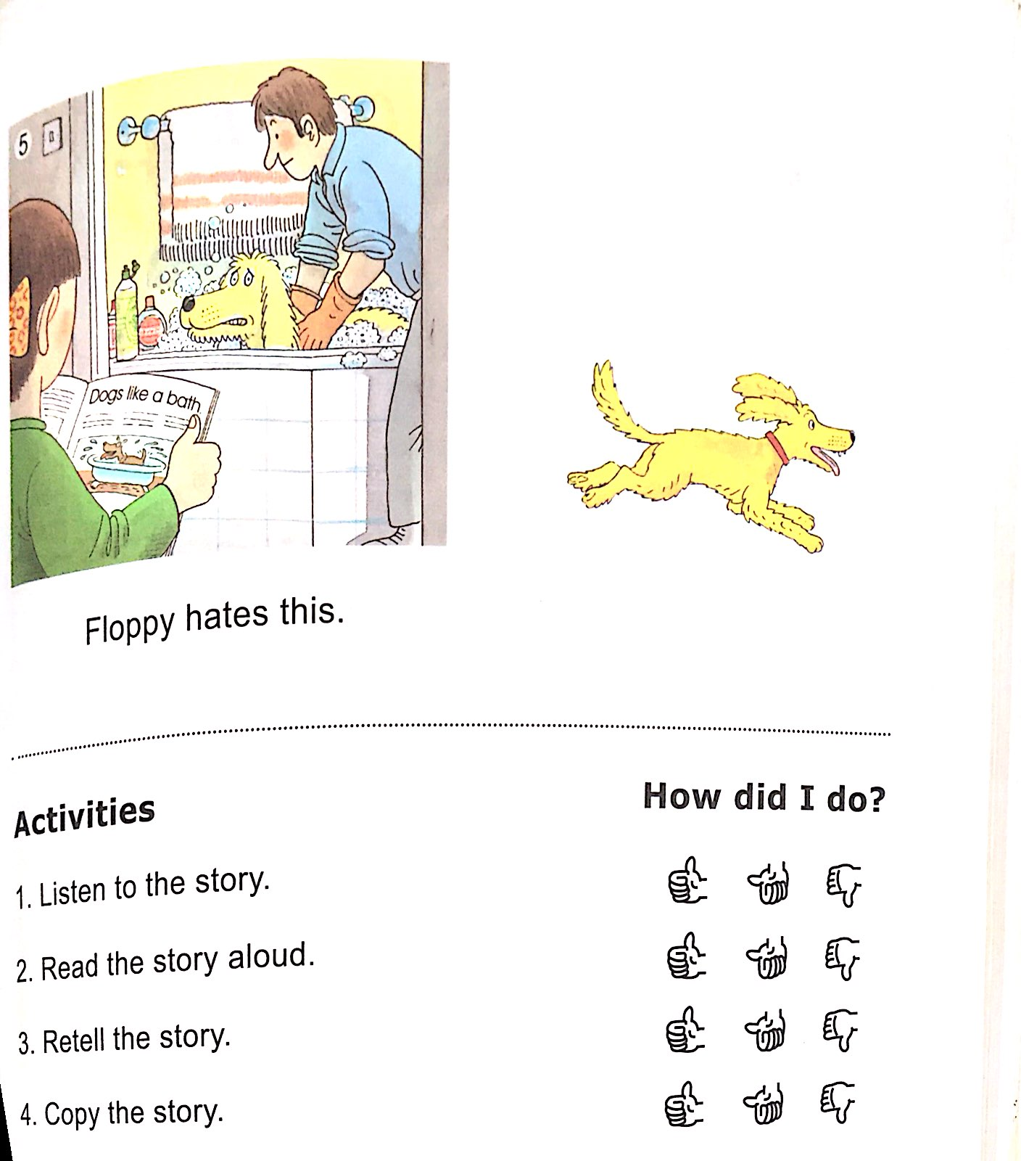
The dog can’t swim.

Slide 16
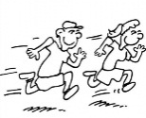



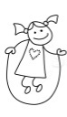
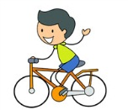
I can …
run
write
swim
fly
skip
ride a bike
What can you do?

Slide 17
Let’s sing
a song.
‘what can’ by dreamenglish
https://www.youtube.com/watch?v=7MKmbyfhkkE

Slide 18
Question
Game!!

Slide 19


Slide 20
run

Slide 21


Slide 22
write

Slide 23


Slide 24
swim

Slide 25


Slide 26
fly

Slide 27
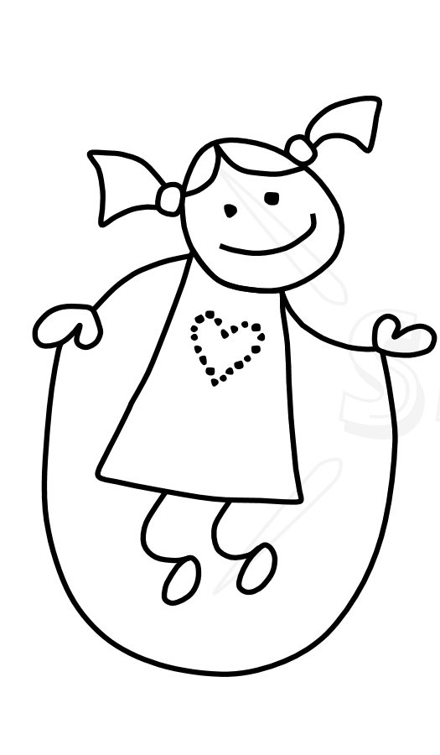

Slide 28
skip

Slide 29


Slide 30
ride a bike

Slide 31
Hidden
Picture
Game!!

Slide 38
Let’s sing
a song.
‘action’ by pinkfong
https://www.youtube.com/watch?v=_ZiQylXPQnE

Slide 39

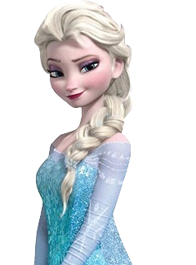
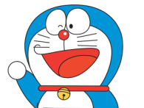
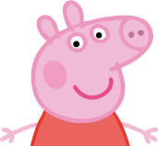
Can he/she? | Neil Teacher | Elsa | Doraemon | Peppa pig
Run | No L | Yes J | Yes J | No L
Write | No L | Yes J | Yes J | Yes J
Swim | No L | Yes J | No L | Yes J
Fly | Yes J | No L | No L | No L
Skip | No L | Yes J | No L | Yes J
Ride a bike | No L | Yes J | Yes J | No L

Slide 40
Charades Game
You can …
run
write
swim
fly
skip
ride a bike
What can I do ?

