Slide 1

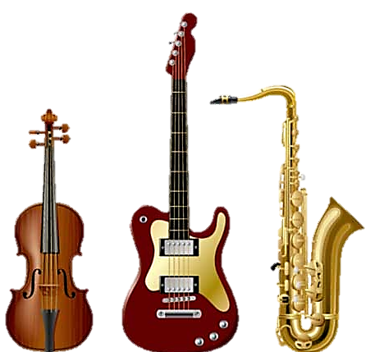


Slide 2
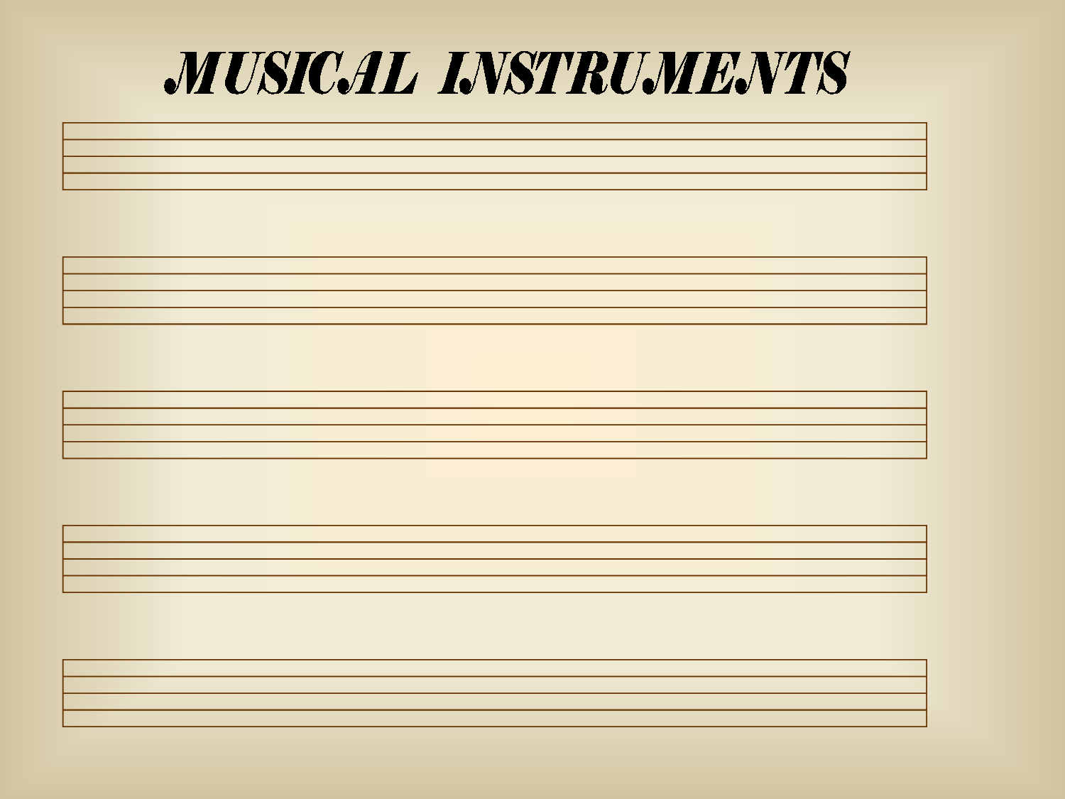
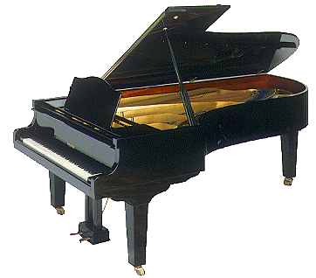


Slide 3


Slide 4
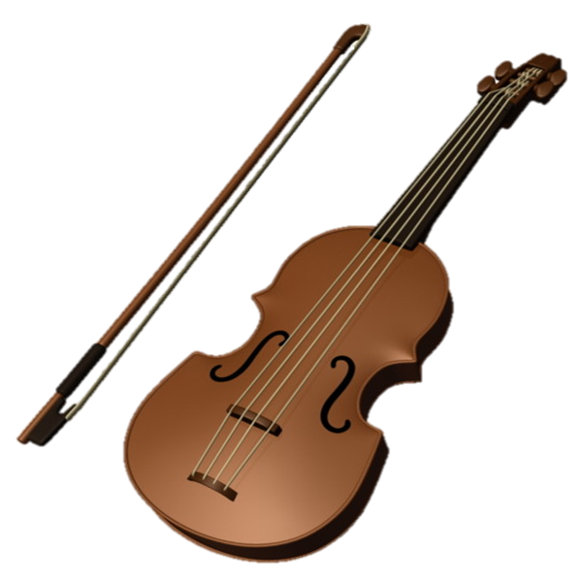

Slide 5
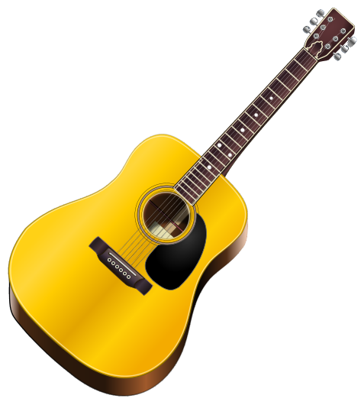

Slide 6
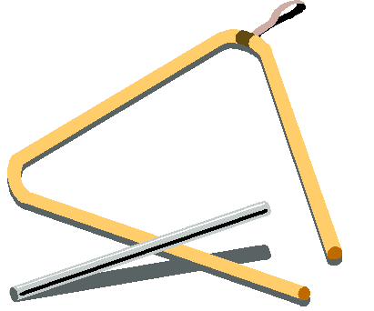

Slide 7

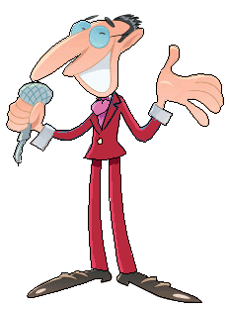
Welcome to the music contest!
Click on the speaker and guess what instrument they are playing

Slide 8
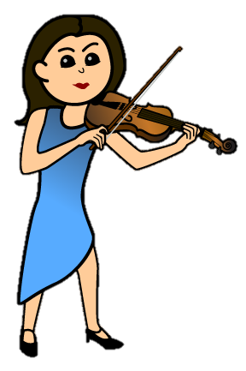

What can she play?
She is playing the violin

Slide 9

What can he play?
He is playing the guitar

Slide 10

What can he play?
He is playing the piano

Slide 11
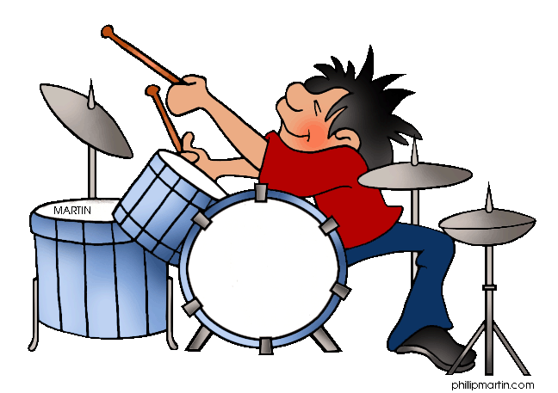
What can he play?
He is playing the drums

Slide 12


What can he play?
He is playing the triangle

Slide 13
Thank you for your attention!

Slide 14

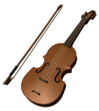

What can you play?
I can play the piano
I can play the drum
I can play the violin
I can play the guitar
I can play the triangle

Slide 15
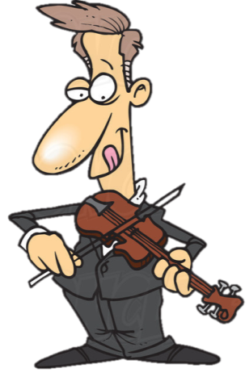
Let’s watch a video.
Peppa Pig – Musical Instruments.
https://www.youtube.com/watch?v=m-m2n7wyvCc
Whose violin is it?
Whose drum is it?

Slide 16


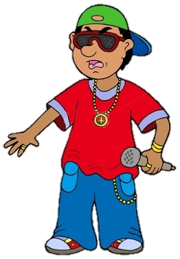

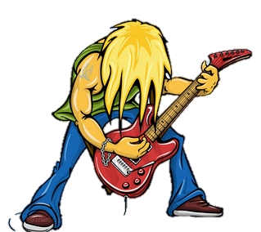

Slide 17


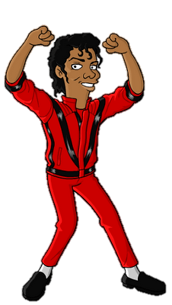

Slide 18

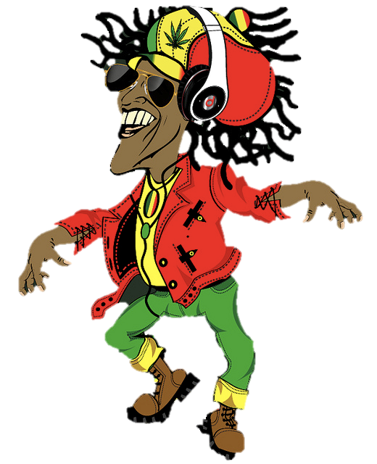

Slide 19

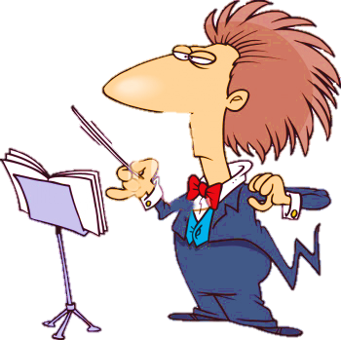
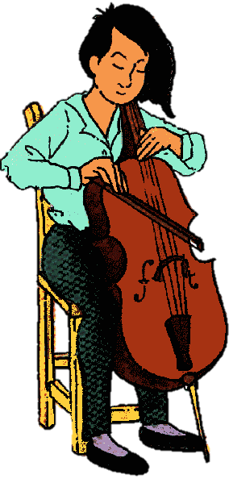

Slide 20

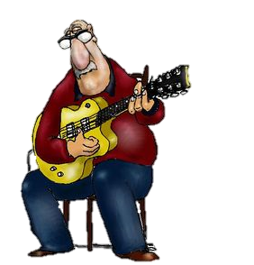
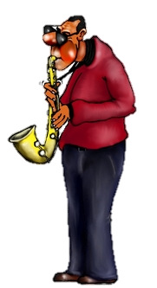

Slide 21

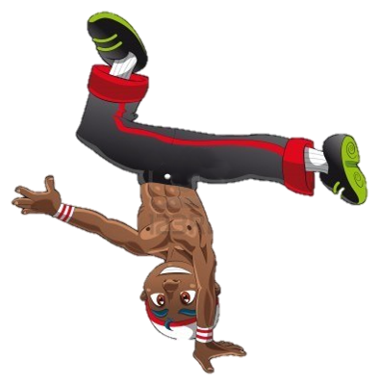


Slide 22


Slide 23




Slide 24

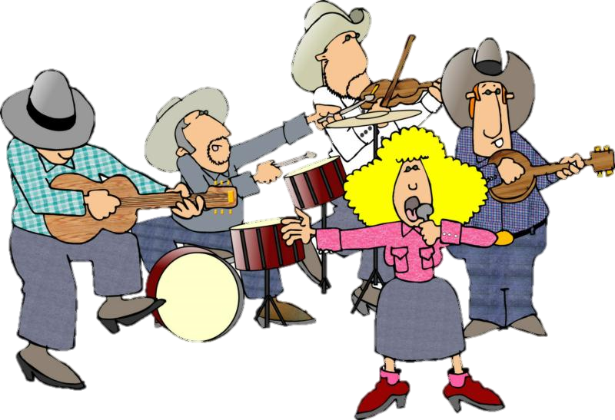

Slide 25

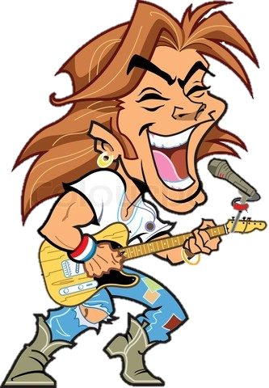

Slide 26



Slide 27


Slide 28




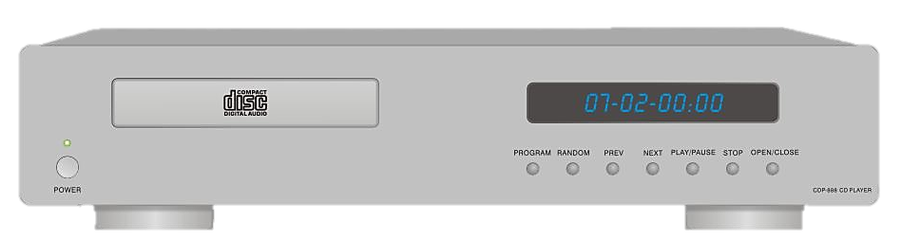


2
4
1
3
Push the play button and click on
the type of music you are hearing
PLAY

Slide 29

2
4
1
3
PLAY

Slide 30

2
4
1
3
PLAY

Slide 31


2
4
1
3
PLAY

Slide 32


2
4
1
3
PLAY

Slide 33


2
4
1
3
PLAY

Slide 34
2
4
1
3
PLAY

Slide 35
2
4
1
3
PLAY

Slide 36

2
4
1
3
PLAY

Slide 37
2
4
1
3
PLAY

Slide 38
I like …
1
3
2
5
6
7
8
4
9

Slide 39
Let’s sing
a song.
LearningStation – Music Man
https://www.youtube.com/watch?v=22kqia2ibVU

Slide 40
Instruments & Music

Slide 41

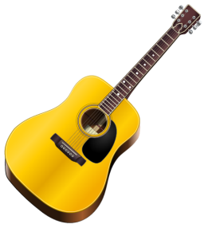
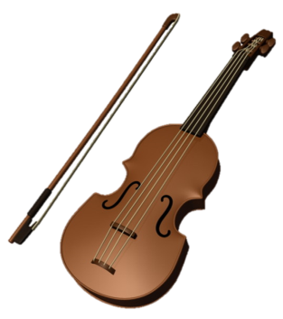
Instruments & Music
drums
piano
triangle
guitar
violin

Slide 42




Slide 43


Slide 44
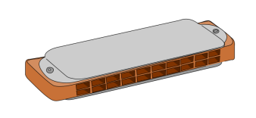

Slide 49
Let’s watch a video.
Mr Bean Dancing.
https://www.youtube.com/watch?v=koiPh6vVo8w
Guess the types of music

Slide 50
It’s …
drums
piano
triangle
guitar
violin

