Slide 1
& friends

Slide 2
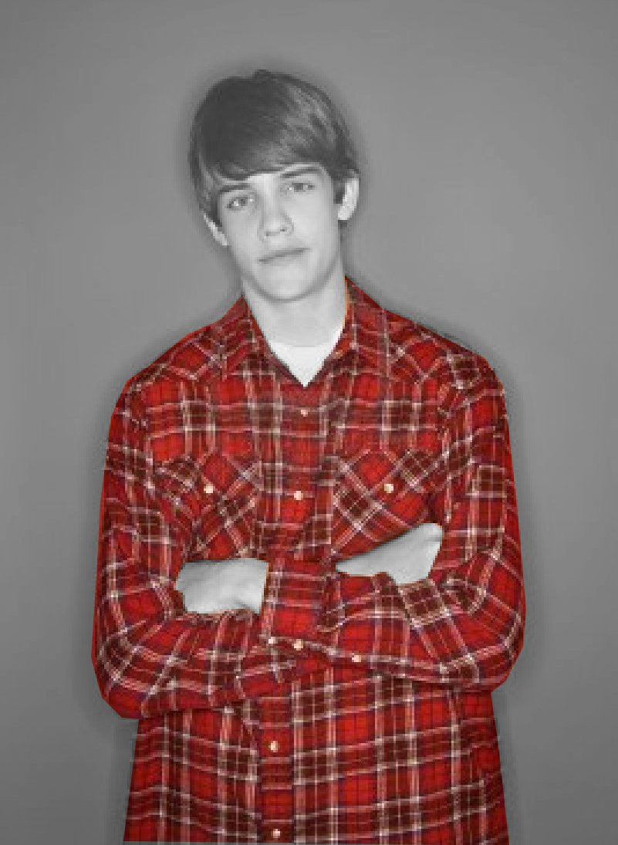
shirt

Slide 3
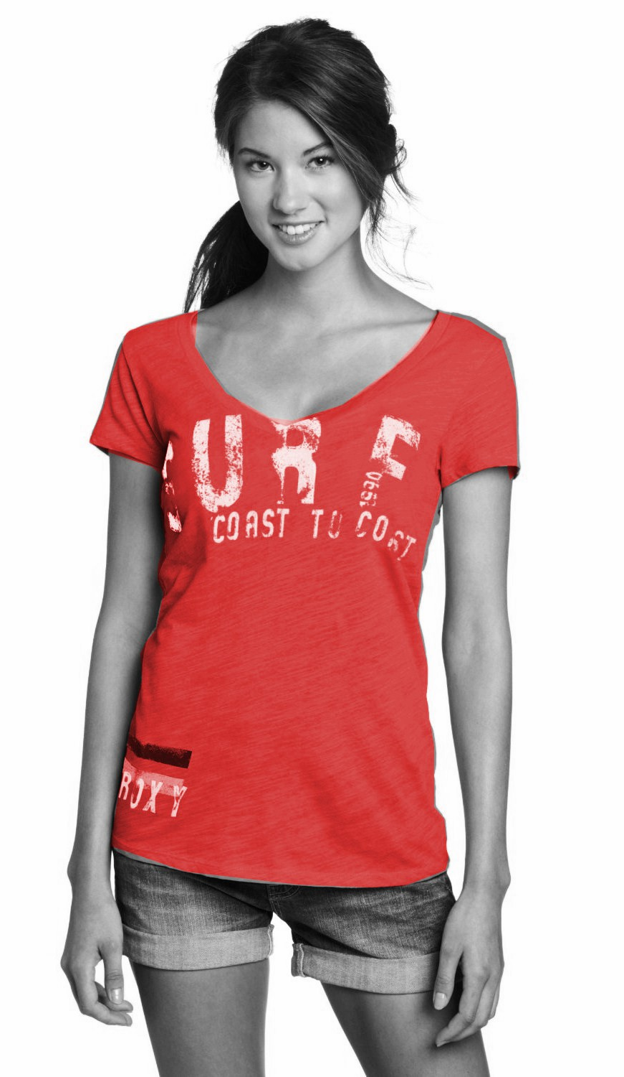
T-shirt

Slide 4
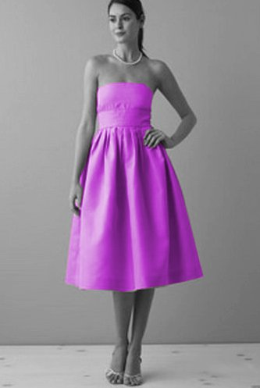
dress

Slide 5
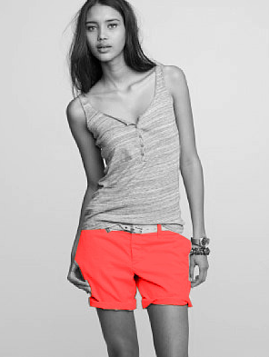
shorts

Slide 6
skirt

Slide 7
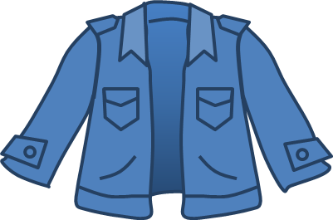
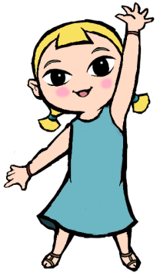
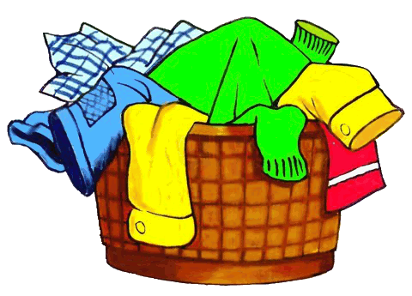
Let’s watch a ‘the clothing song’ by maple leaf video. https://www.youtube.com/watch?v=_cBmnRsh8Hw

Slide 8
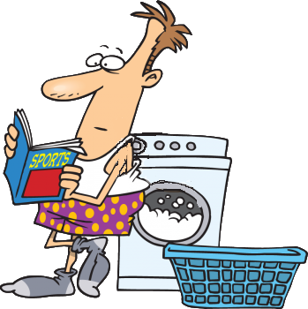
At the laundry game.
CLOTHES
PLAY

Slide 9
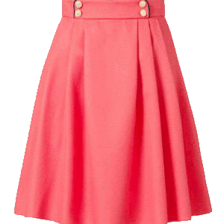
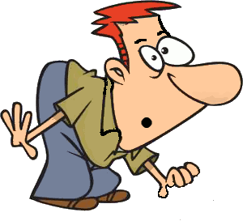
It has …
START
?
a skirt

Slide 10
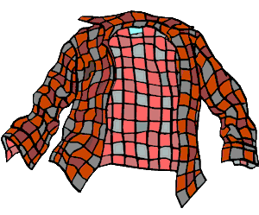
It has…
START
?
a shirt

Slide 11
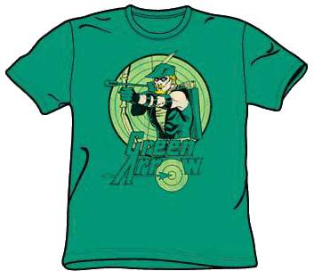
It has…
START
?
a T-shirt

Slide 12
It has…
START
?
a dress

Slide 13
My clothes go bye-bye!!!

Slide 14
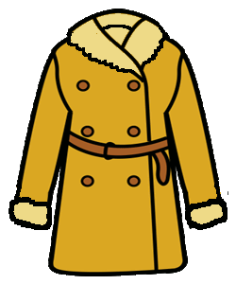
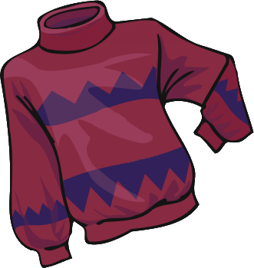
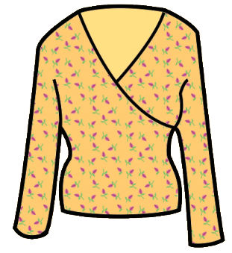
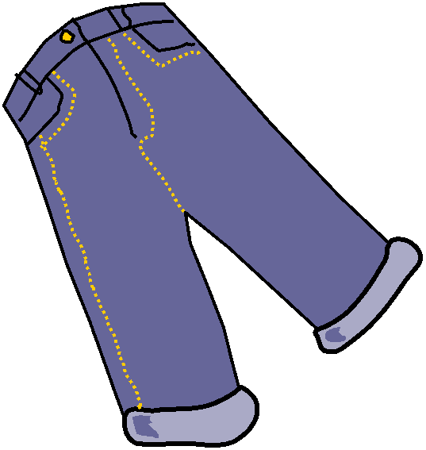
What’s gone with the wind?
?
a shirt

Slide 15
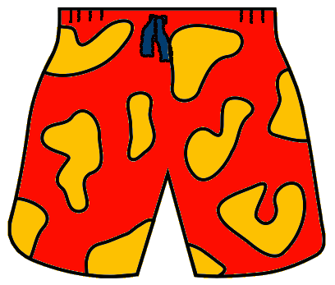
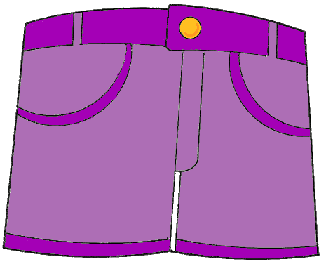
What’s gone with the wind?
?
a t-shirt

Slide 16
What’s gone with the wind?
?
shorts

Slide 17
What’s gone with the wind?
?
a dress

Slide 18
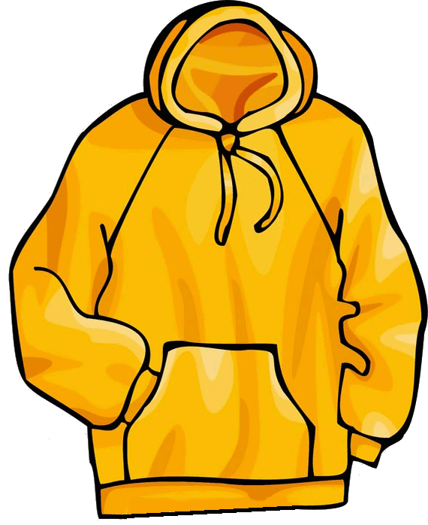
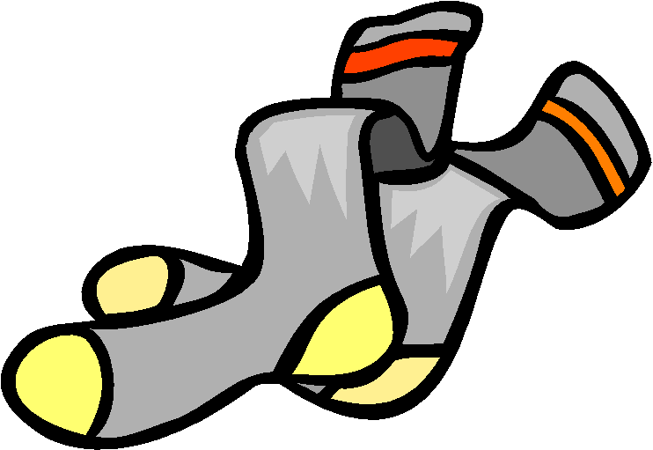
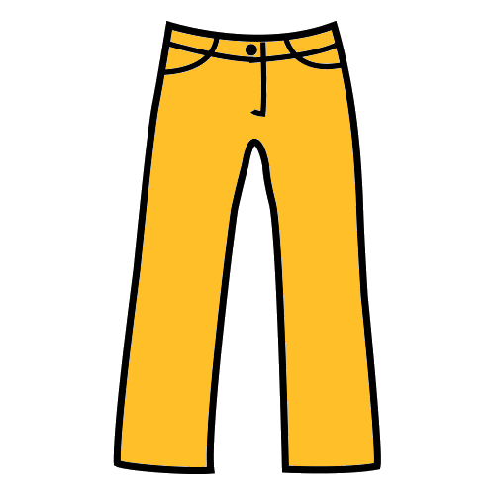
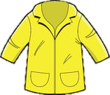
What’s gone with the wind?
?
a skirt

Slide 19
Let’s watch a ‘what do you look like’ by english tour video. https://www.youtube.com/watch?v=qhWV4fzchq4

Slide 21
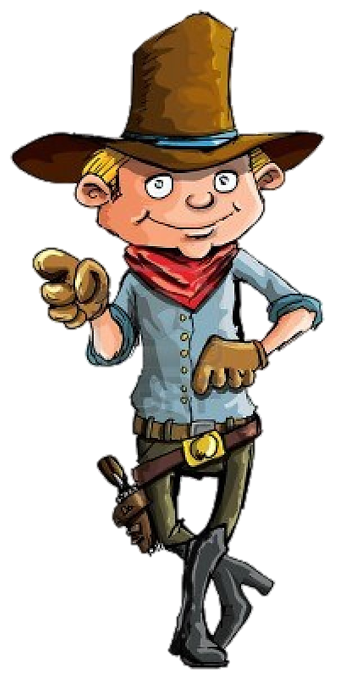
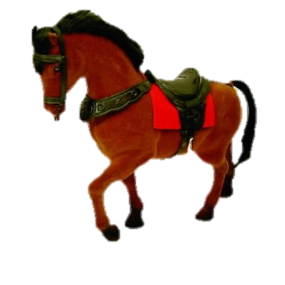
Read the descriptions and click on the right name to catch the bank robbers

Slide 22
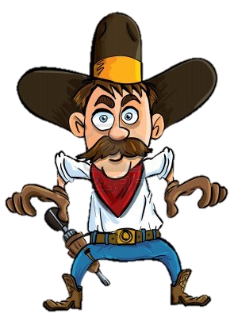
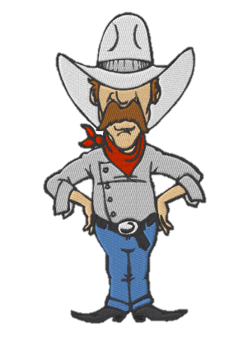
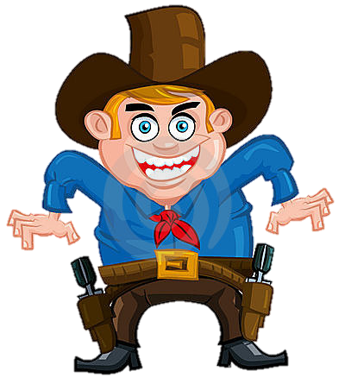
1 Tom
2 Peter
3 Ben

Slide 23
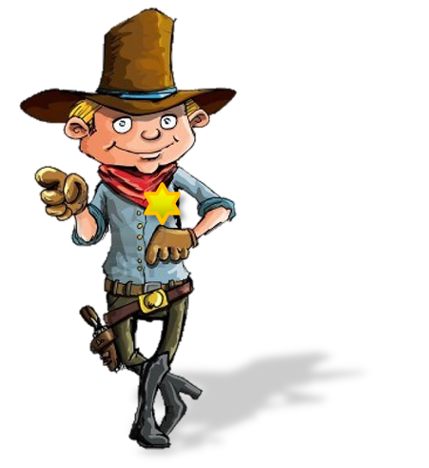
Thank you!
Oh, no!

Slide 24
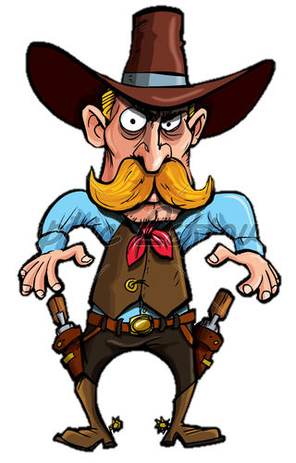
1 Tom
2 Peter
3 Ben

Slide 25
Thank you!
Oh, no!

Slide 26
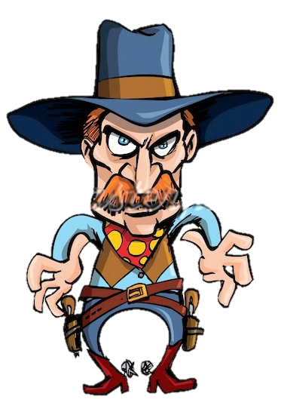
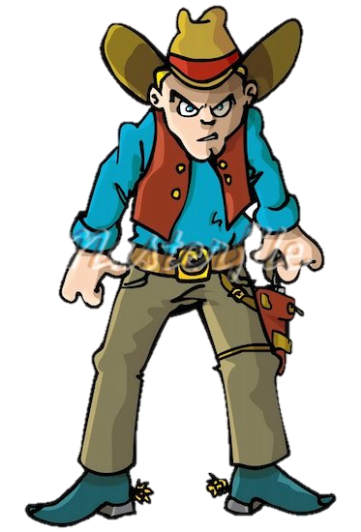
1 Tom
2 Peter
3 Ben

Slide 27
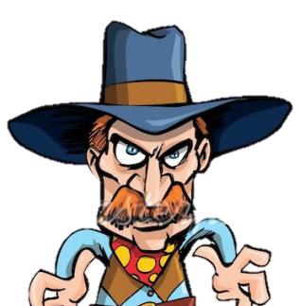
Thank you!
Oh, no!

Slide 28
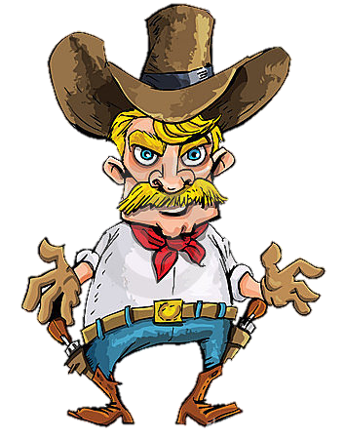
1 Tom
2 Peter
3 Ben

Slide 29
Thank you!
Oh, no!

Slide 30
1 Tom
2 Peter
3 Ben

Slide 31
Thank you!
Oh, no!

Slide 32
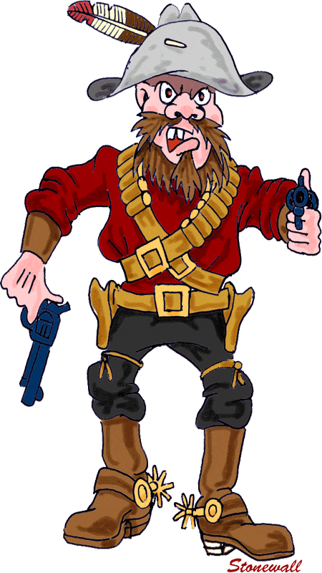
1 Tom
2 Peter
3 Ben

Slide 33
Thank you!
Oh, no!

Slide 34
1 Tom
2 Peter
3 Ben

Slide 35
Thank you!
Oh, no!

Slide 36
1 Tom
2 Peter
3 Ben

Slide 37
Thank you!
Oh, no!

Slide 38
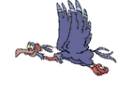
Thank you for making this town a safer place

Slide 39
This is Mike. He is my friend. He is short and thin. He has a white shirt and a blue shorts. He can play football.

Slide 40
This is Kitty. She is my friend. She is tall and thin. She has a white blouse and a red skirt. She can dance.
This is Kitty. She is my ……. . She is ……. and ……. . She has a ……. ……. and a ……. ……. . She can ……. .

Slide 41
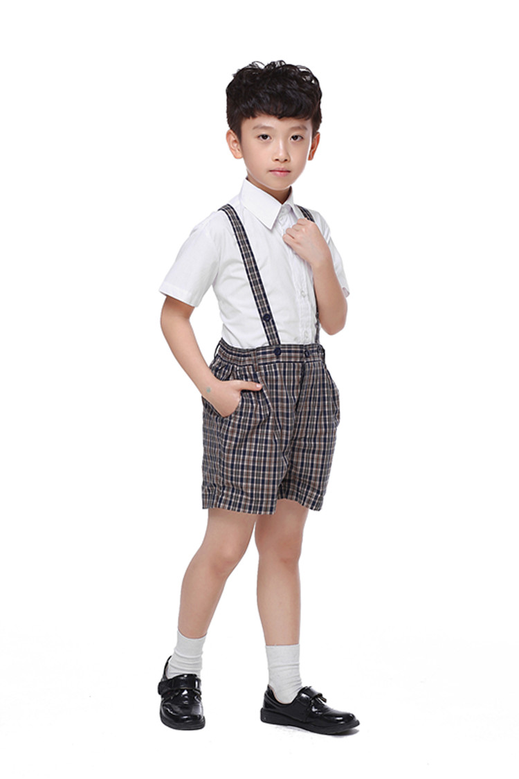
This is Joe. He is my friend. He is tall and thin. He has a white shirt and a brown shorts. He can swim.
This is Joe. He is my ……. He is ……. and …….. He has a ……. ……. and a ……. …….. He can ……..

Slide 42
This is John. He is my ……. He is ……. and …….. He has a ……. ……. and a ……. …….. He can ……. ……. ……..
This is John. He is my friend. He is tall and fat. He has a blue t-shirt and a blue shorts. He can ride a bike.

Slide 43
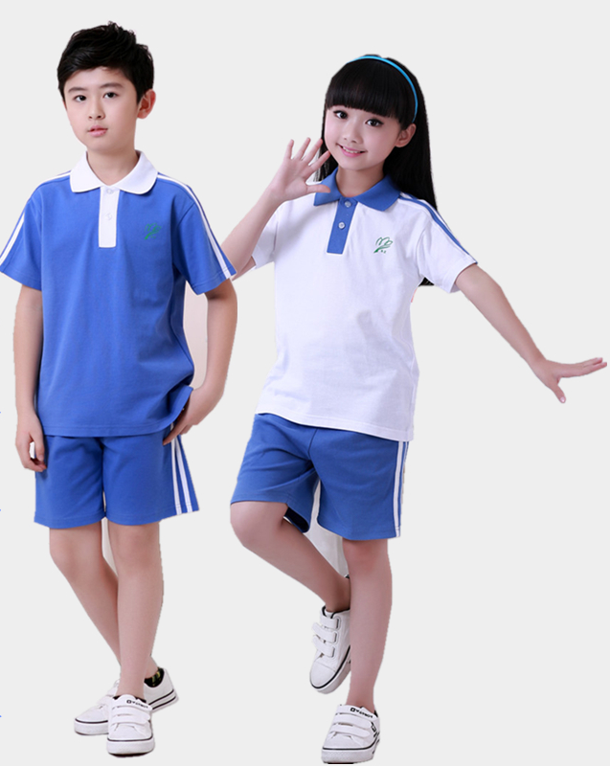
I have two friends They are Peter and Sally. Peter has a …… ……. He can …… ……. Sally has a …… ……. She can …….
I have two friends They are Peter and Sally. Peter has a blue t-shirt. He can eat soup. Sally has a white t-shirt. She can sing.

Slide 44
?
… is my friend. He / She is ... (short/tall/fat/thin). He/She is … .(eight/nine/ten). He/She has a … t-shirt. He/She can ….

