Slide 1
Good __________!

Slide 2
Traffic Rules
NEXT

Slide 3
Stop
NEXT

Slide 4
Wait
NEXT

Slide 5
Go
NEXT

Slide 6
Let’s…
Stop
Wait
Go
NEXT

Slide 7
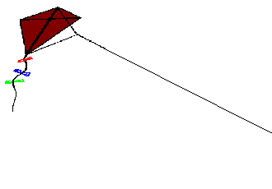
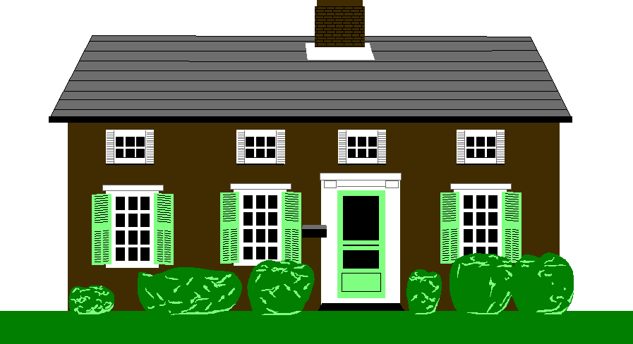
NEXT
Traffic Rules
The light is red. Stop!

Slide 8
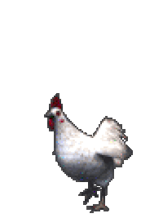
NEXT
Traffic Rules
The light is yellow. Wait!

Slide 9
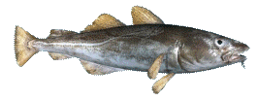
NEXT
Traffic Rules
The light is green. Go!

Slide 10
1. Stop
Stop
2. Wait
3. Go
NEXT

Slide 11
1. Stop
Wait
2. Wait
3. Go
NEXT

Slide 12
Go
1. Stop
2. Wait
3. Go
NEXT

Slide 13
1. Stop
Wait
2. Wait
3. Go
NEXT

Slide 14
Go
1. Stop
2. Wait
3. Go
NEXT

Slide 15
1. Stop
Stop
2. Wait
3. Go
NEXT

Slide 16
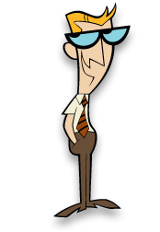
NEXT
Let’s sing Red Says STOP - kiboomers https://www.youtube.com/watch?v=Ow1i916uYYU

Slide 17
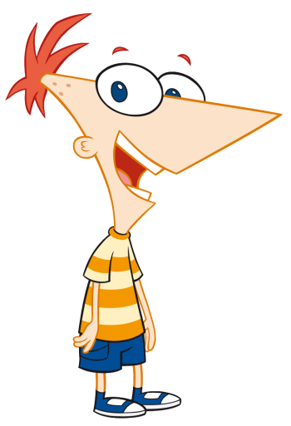
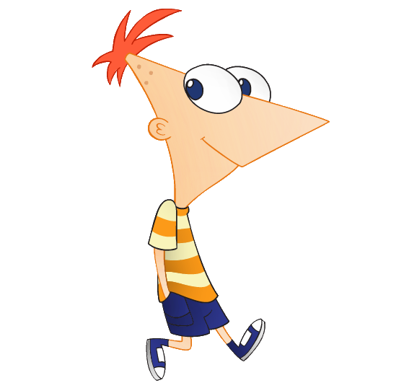
NEXT
Traffic Rules
Look at the light.
It’s red. Let’s stop...

Slide 18
NEXT
Stop by the road.

Slide 19
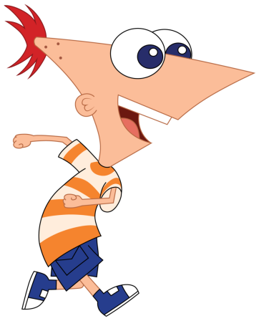
NEXT
Traffic Rules
Look at the light.
It’s green. Let’s go...

Slide 20
NEXT
Cross the road.

Slide 21
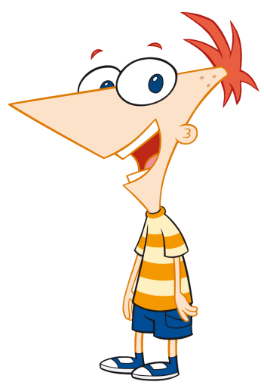
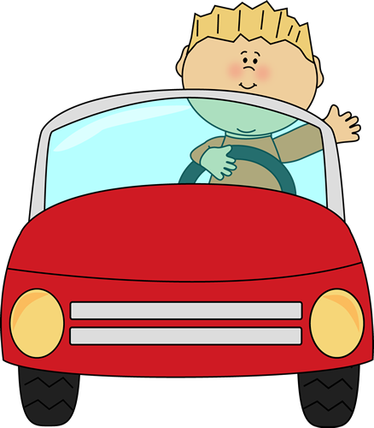
1. Stop by the road.
Stop by the road.
2. Cross the road.
NEXT

Slide 22
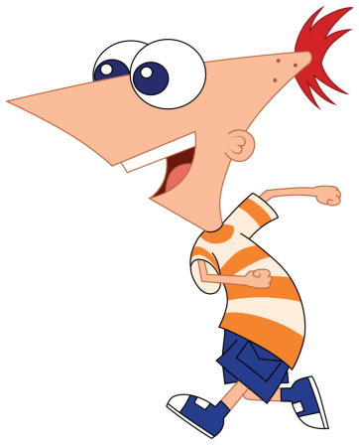
Cross the road
1. Stop by the road.
2. Cross the road.
NEXT

Slide 23
NEXT
Let’s sing Crossing The Street Safely -Vale & Vega https://www.youtube.com/watch?v=TKqk7B5cM9I
Let’s sing Twinkle Twinkle Traffic Light – pebbles https://www.youtube.com/watch?v=SXLQE86JPdA

Slide 24
NEXT
Let’s read a story.

Slide 25
The car is stuck 卡..
NEXT

Slide 26
Go! Mum! Go!
NEXT

Slide 27
Go! Brother! Go! Sister!
NEXT

Slide 28
Go! Brother! Go! Sister!
NEXT

Slide 29
Wait!
NEXT

Slide 30
Stop!
NEXT

Slide 31
1. Stop by the road.
Stop by the road.
2. Cross the road.
NEXT

Slide 32
Go
1. Stop
2. Wait
3. Go
NEXT

Slide 33
1. Stop
Stop
2. Wait
3. Go
NEXT

Slide 34
1. Stop
Wait
2. Wait
3. Go
NEXT

Slide 35
Cross the road
1. Stop by the road.
2. Cross the road.
NEXT

Slide 36
1. Stop
Go
2. Wait
3. Go
The light is green. Let’s …
NEXT

Slide 37
1. Stop
Wait
2. Wait
3. Go
The light is yellow. Let’s …
NEXT

Slide 38
1. Stop
Stop
2. Wait
3. Go
The light is red. Let’s …
NEXT

Slide 39
NEXT
Let’s sing Traffic Lights- Pink Fong https://www.youtube.com/watch?v=PR1NEvdWmmk
Let’s sing Traffic Lights Song – Turtle Interactive https://www.youtube.com/watch?v=HhrfOgLjBvg

Slide 40
NEXT
Let’s read a story.

Slide 41
Go.
NEXT

Slide 42
Go!
NEXT

Slide 43
Stop!
NEXT

Slide 44
Let’s…
Stop
Wait
Go
NEXT

Slide 45
I like … game.
I like spring. = I like summer. = I like autumn. = I like winter. =
What season do you like?
I like …

Slide 46
Animal Charades Game
1 elephant =
2 zebra =
3 snake =
4 lion =
5 tiger =
6 bear =
7 monkey =
8 panda =
9 hippo = 10 giraffe=
It’s a ….
Yes / No

