Slide 1
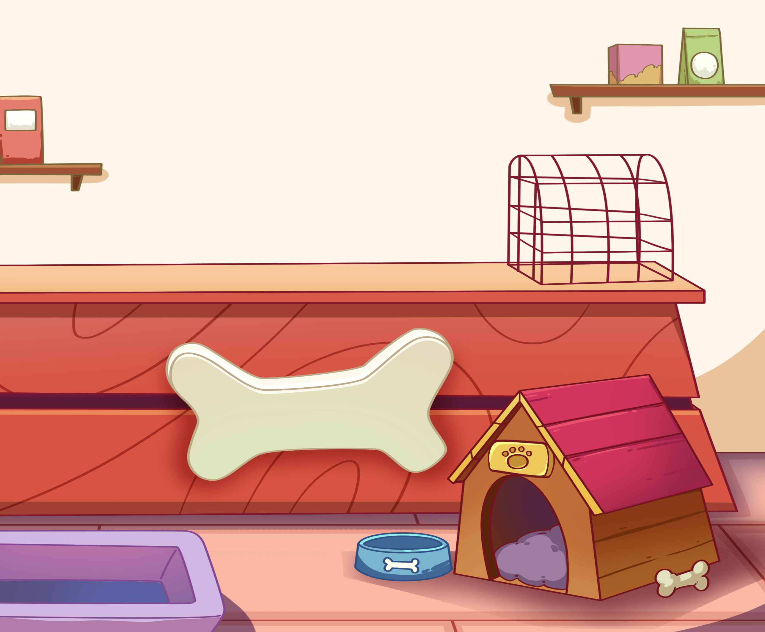
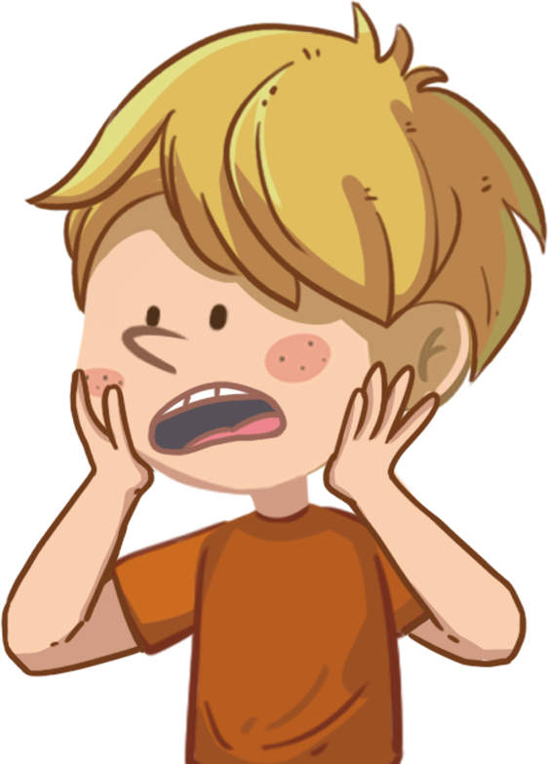
LO: Greet T and their partner; get a basic idea about the topic of
this lesson.
Greet Ss.
Ask Ss to greet T and their partner.
Introduce the topic to Ss.
Guide Ss to talk about the pictures on the slide.
TG
01:00
1/22

Slide 2
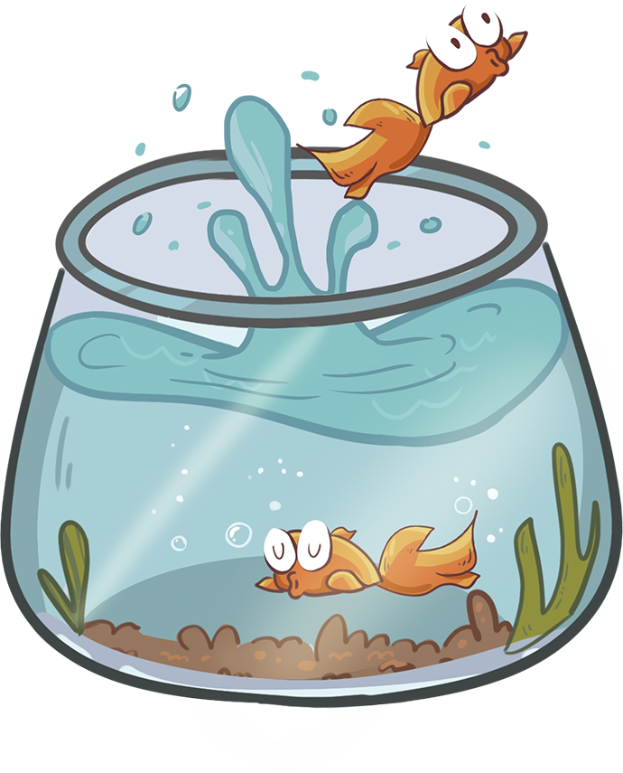
LO: Know the learning goals of this lesson.
Briefly go through the learning goals with Ss.
TG
Learning Goals
We are going to . . .
Learn and practice the consonant sound j in simple words.
Learn the key words pet, shop, snake, spider, and goldfish, and use them in sentences.
Read the story The Pet Shop and identify details in the pictures.
Practice using the sentence structure _____ wanted a _____.
00:30
2/22

Slide 3
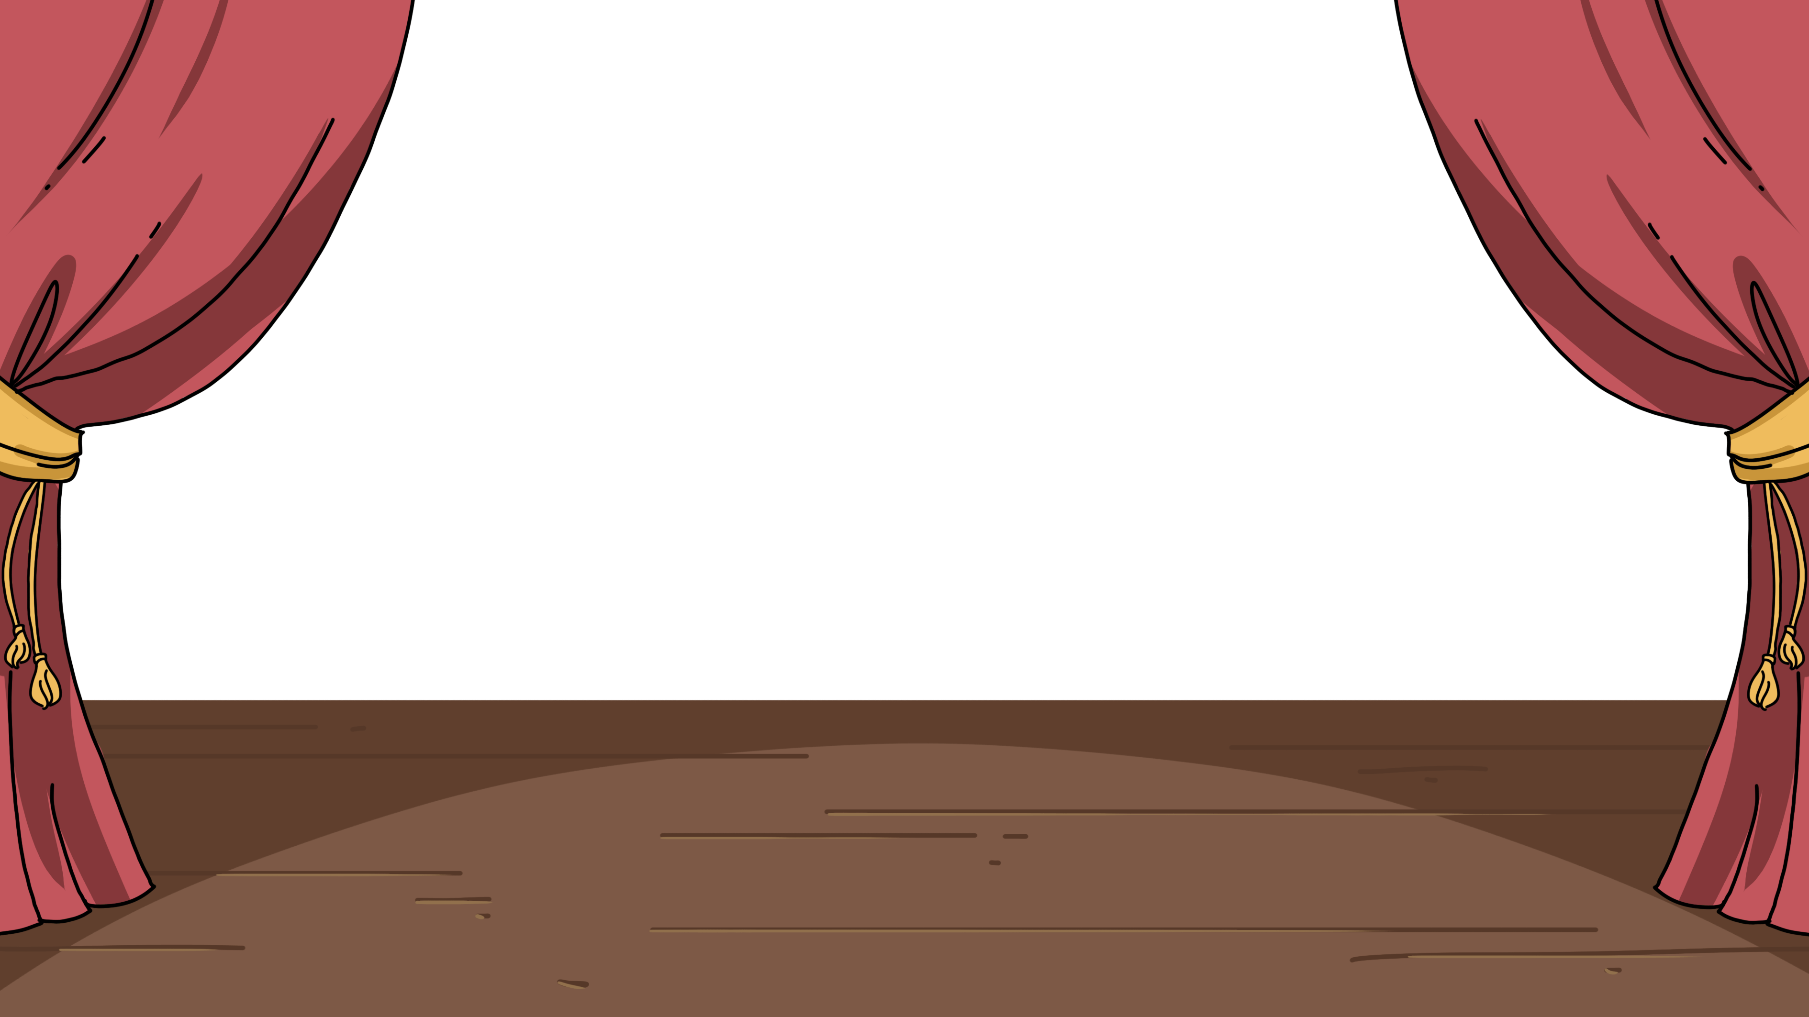
LO: Present homework; talk about what they have drawn.
Ask Ss to present their homework.
Encourage Ss to describe their homework.
Give feedback.
TG
Let’s Show
Presentation
Did you draw a picture of something you see a lot at Christmas?
Now, show it and say, “This is ______.”
02:30
3/22

Slide 4
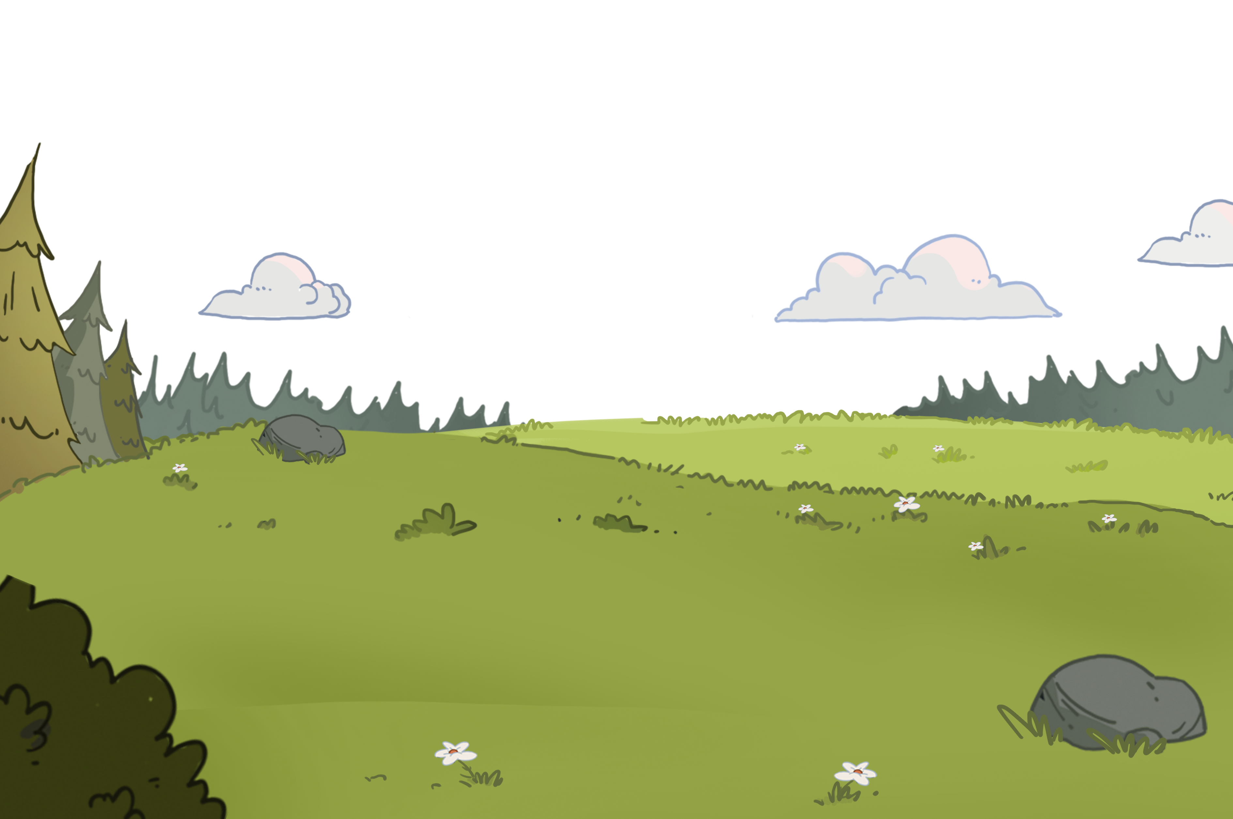
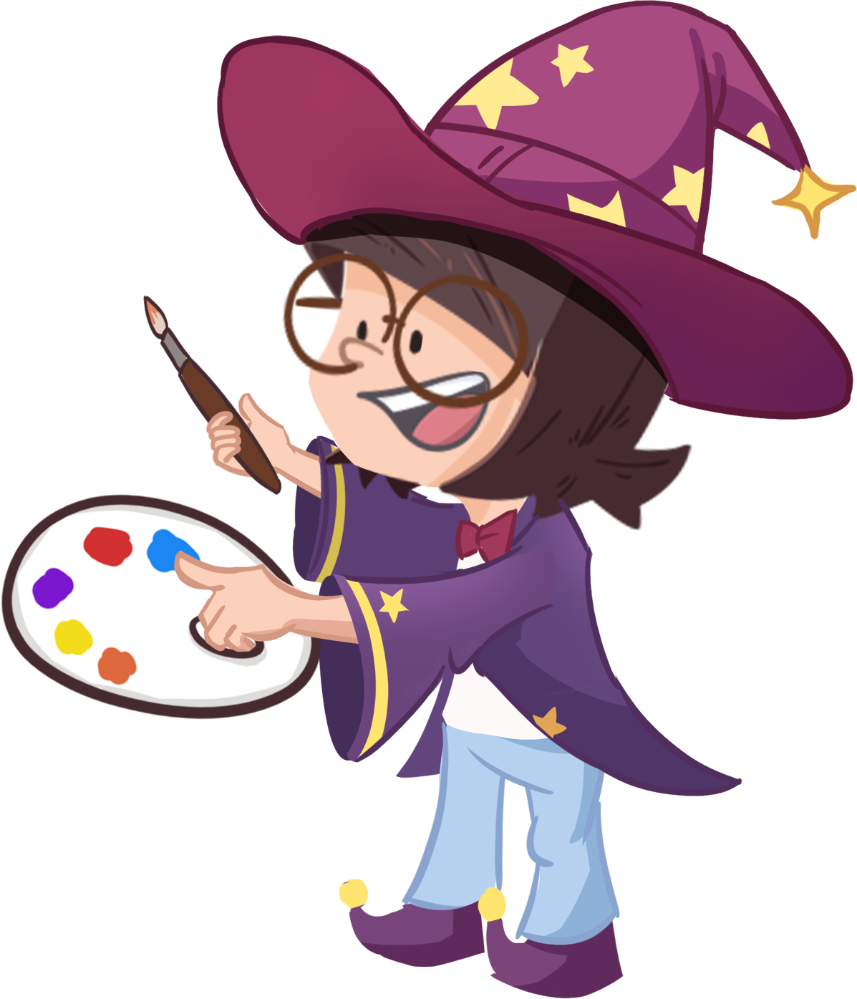
LO: Identify the consonant sound j.
Click and read each word to Ss like this: j-j-joy.
Click and guide Ss to read the sound j like this: j-j-j.
Note: On this slide, Ss don’t need to read the words after T.
TG
Let’s Listen
Phonics
Job
juice
jungle
jam
jelly
joy
j-j-j
01:00
4/22

Slide 5
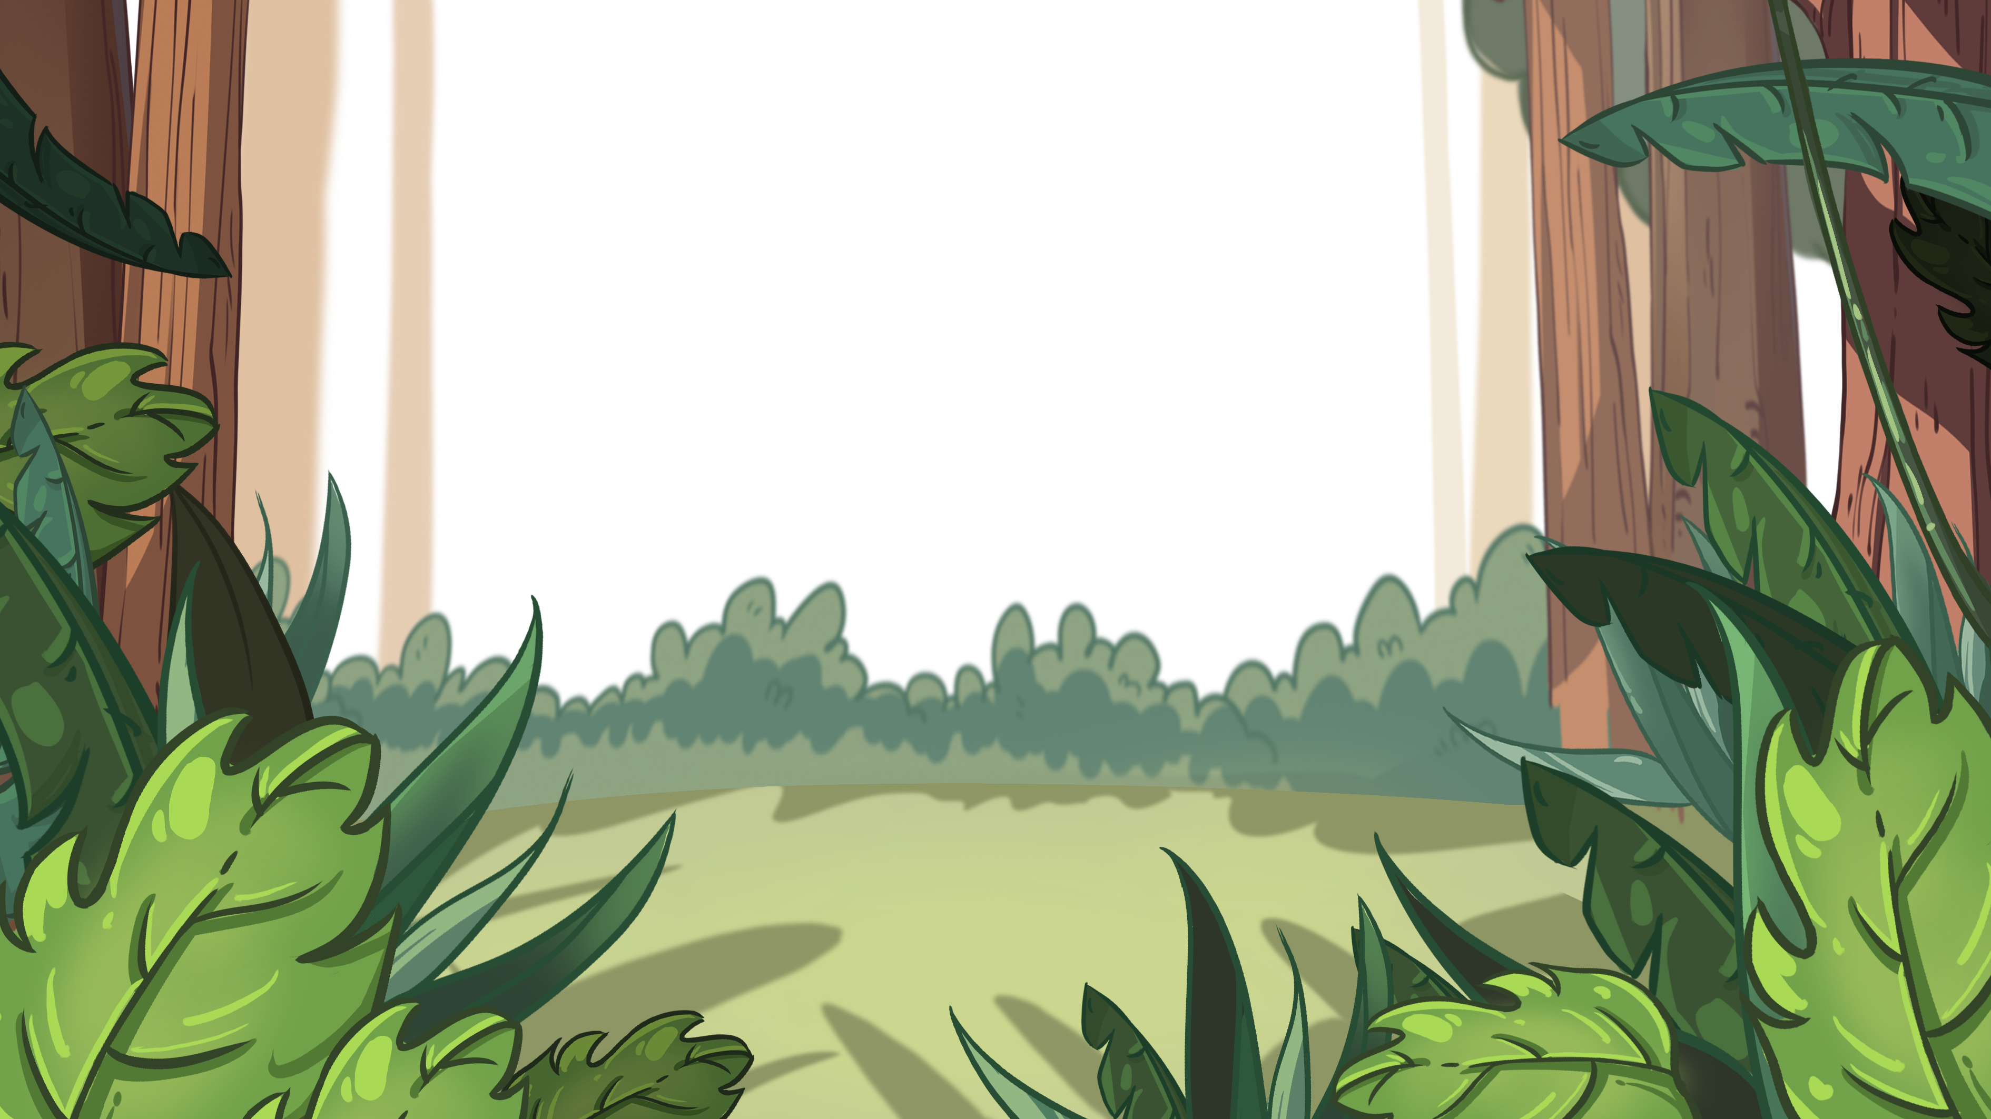
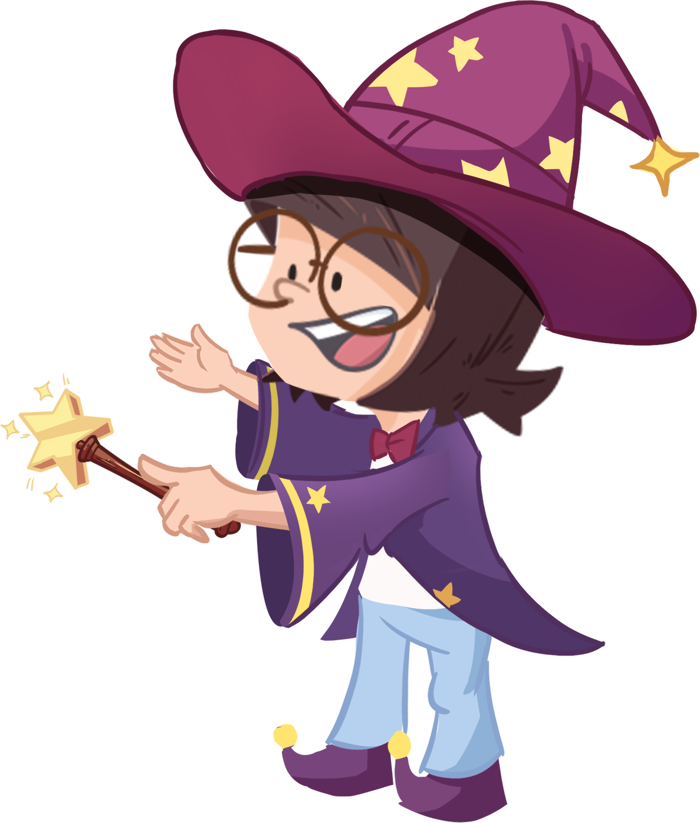
LO: Pronounce the words with the sound j.
Click and have Ss read each word together after T like this: j-j-joy; have Ss read each word together after T.
Note: After Ss read the words correctly, click and make the items in
pictures become real.
TG
Let’s Say
Phonics
jungle
jelly
Job
juice
jam
joy
02:30
5/22

Slide 6
LO: Decode the words learned in the text.
Click and read the chant to Ss with rhythm.
Guide Ss to repeat after T; ask them to take turns reading each sentence.
Give feedback.
TG
Let’s Chant
Phonics
Job is in the jungle.
Job has jam.
Job has juice.
Job has jelly.
Job has joy.
02:00
6/22

Slide 7
LO: Get to know the title, author, and illustrator of the book; use
the book cover to identify details and make predictions.
Guide Ss to look at the book cover and encourage them to talk about what they see.
Ask Ss to find the title, author, and illustrator.
Guide them to talk about the given questions.
TG
Introduction
Let’s Begin
Who can you see on the book cover?
Look at the title. Where is the family?
What animals can you see on the book cover?
Written by Roderick Hunt
Illustrated by Alex Brychta
02:00
7/22

Slide 8
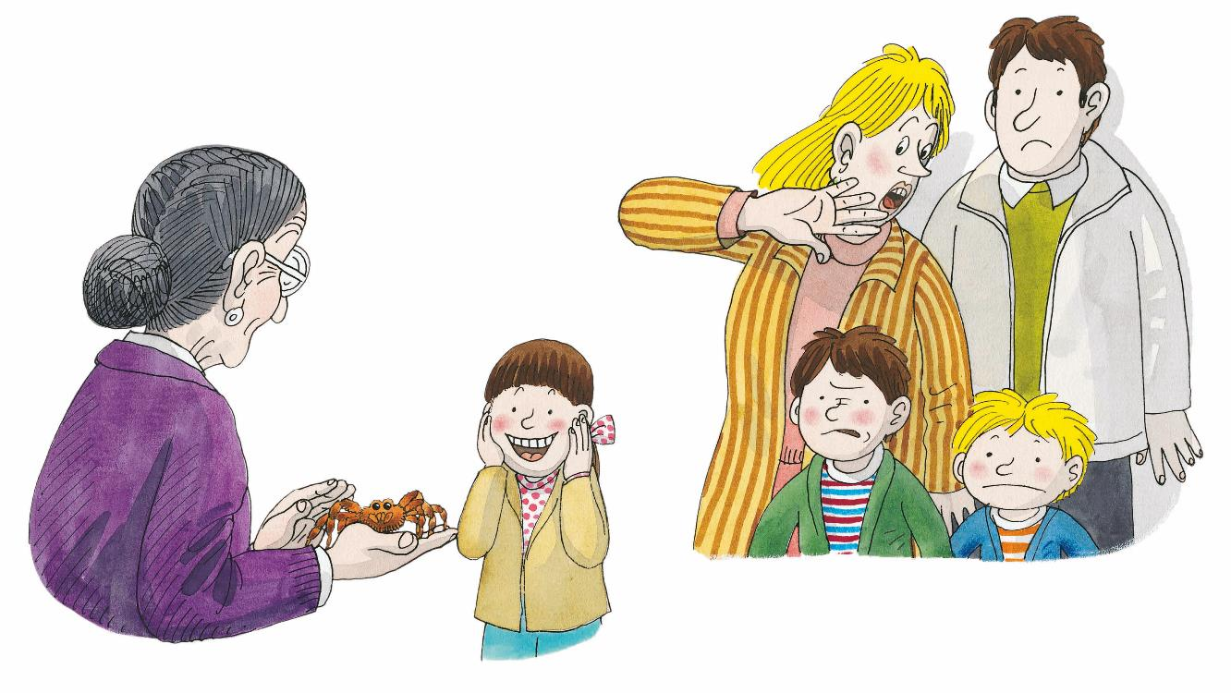
LO: Use the illustration to identify details and make predictions
about the story.
Guide Ss to look at the illustration and talk about what they see.
Ask Ss the given questions and encourage them to make predictions.
TG
Lead-in
Let’s Predict
1. How is Mum feeling?
2. What pet does Biff want
to have?
I think _____.
01:30
8/22

Slide 9
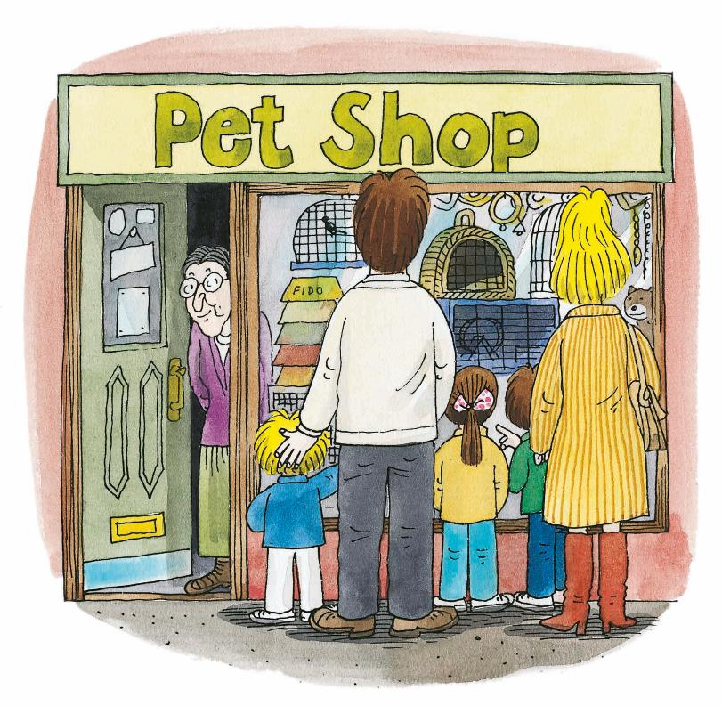
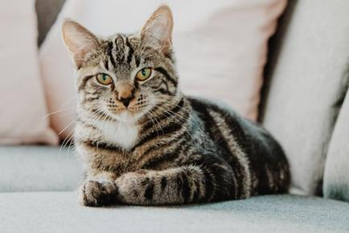
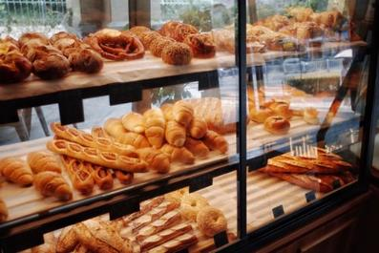
The Pet Shop
LO: Identify details using the illustration; know the meanings of the key
vocabulary words and make sentences with them; understand the
text; comprehend the story.
Read the text to Ss.
Explain the key vocabulary words and the example sentences; encourage Ss to make a sentence with each key vocabulary word.
Guide Ss to look at the illustration and talk about the given questions with complete sentences.
Guide Ss to read the text together.
Ask Ss to talk about the comprehension question.
TG
Reading
Details
Vocabulary
Vocabulary
Where did the family go?
What would the family see there?
Comprehension
pet
shop
Why did the family
go there?
It’s my pet cat.
It’s a bakery shop.
Decoding
Read accurately.
Everyone wanted a pet.
Vocabulary 2
Vocabulary 1
04:00
9/22

Slide 10
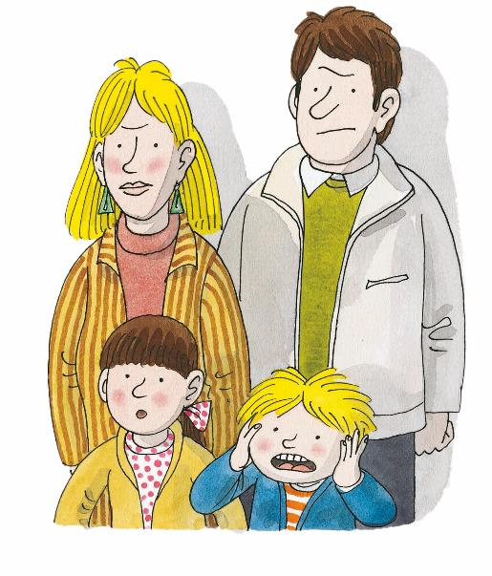
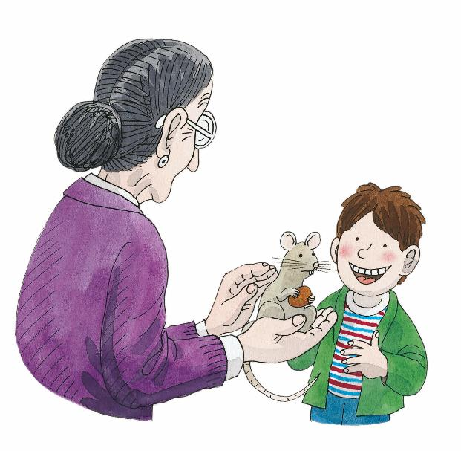
The Pet Shop
TG
LO: Identify details using the illustration; decode the sight words;
understand the text; read the text accurately.
Read the text to Ss.
Guide Ss to read the sight words.
Guide Ss to look at the illustration and talk about the given questions with complete sentences.
Guide Ss to take turns reading the text.
Ask Ss to talk about the comprehension question.
Reading
Details
Chip wanted a rat.
What pet did Chip want? Chip wanted a _____.
How did Chip feel?
What did Mum, Dad, Biff, and Kipper say?
Sight Word
Sight Word
wanted
no
Comprehension
Why do you think everyone said, “Oh no”?
“Oh no!” said everyone.
Sight Word 1
Sight Word 2
04:30
10/22

Slide 11
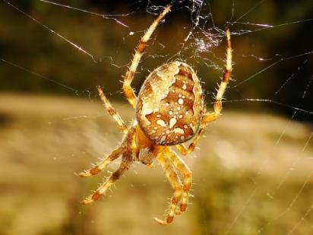
The Pet Shop
LO: Identify details using the illustration; know the meaning of the key
vocabulary word and make sentences with it; understand the text;
read the text accurately.
Read the text to Ss.
Explain the key vocabulary word and the example sentence; encourage Ss to make a sentence with the key vocabulary word.
Guide Ss to look at the illustration and talk about the given questions with complete sentences.
Guide Ss to take turns reading the text.
Check Ss’ accuracy and give feedback.
TG
Reading
Details
Vocabulary
Biff wanted a spider.
What pet did Biff want? Biff wanted a ____.
How did Mum feel? Did Mum like the spider?
spider
It’s a spider.
Decoding
Read accurately.
“Oh no!” said everyone.
Vocabulary
03:30
11/22

Slide 12
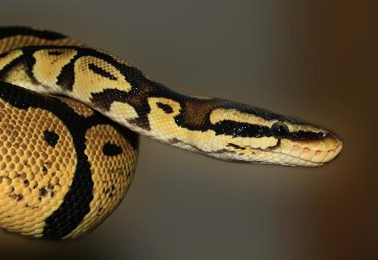
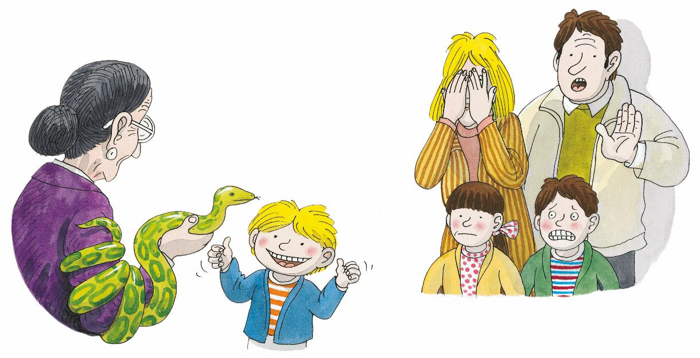
The Pet Shop
LO: Identify details using the illustration; know the meaning of the key
vocabulary word and make sentences with it; understand the text.
Read the text to Ss.
Explain the key vocabulary word and the example sentence; encourage Ss to make a sentence with the key vocabulary word.
Guide Ss to look at the illustration and talk about the given questions with complete sentences.
Encourage them to read the text together pretending they are afraid.
Ask Ss to talk about the comprehension question.
TG
Reading
Vocabulary
Details
Kipper wanted a snake.
What pet did Kipper want? Kipper wanted a _____.
Why did Mum, Dad, Biff, and Chip say, “Oh no”?
snake
It’s a snake.
Comprehension
Which pet do you think Mum disliked more, the
snake or the rat?
“Oh no!” said everyone.
Vocabulary
03:30
12/22

Slide 13
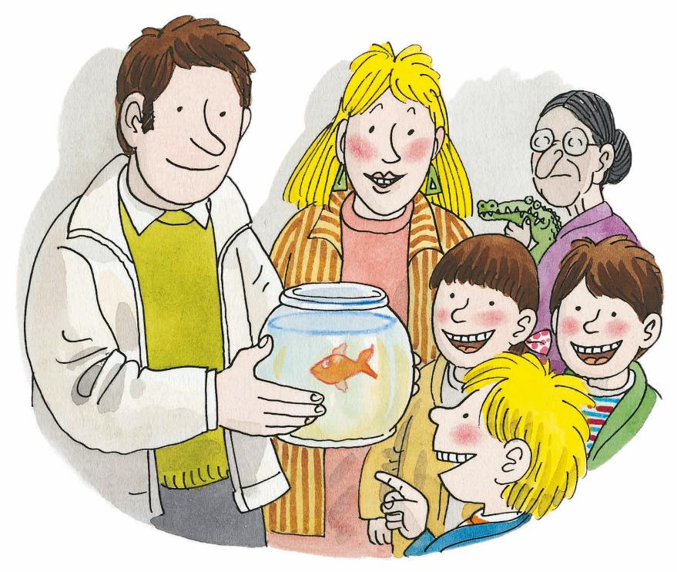
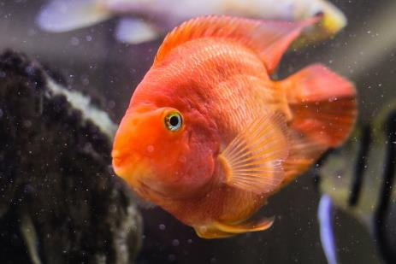
The Pet Shop
LO: Identify details using the illustration; know the meaning of the key
vocabulary word and make sentences with it; understand the text;
make connections.
Read the text to Ss.
Explain the key vocabulary word and the example sentence; encourage Ss to make a sentence with the key vocabulary word.
Guide Ss to look at the illustration and talk about the given questions with complete sentences.
Guide Ss to take turns reading the text.
Guide Ss to talk about the connections question; model first; encourage them to take turns talking more about themselves.
TG
Reading
Details
Vocabulary
What did the family want? They wanted a ____.
How did the children feel?
goldfish
It’s a goldfish.
Connections
List the pets that you DO NOT want.
Everyone wanted a goldfish.
Vocabulary
03:00
13/22

Slide 14
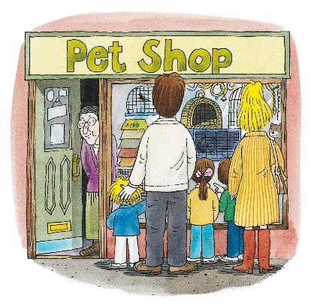
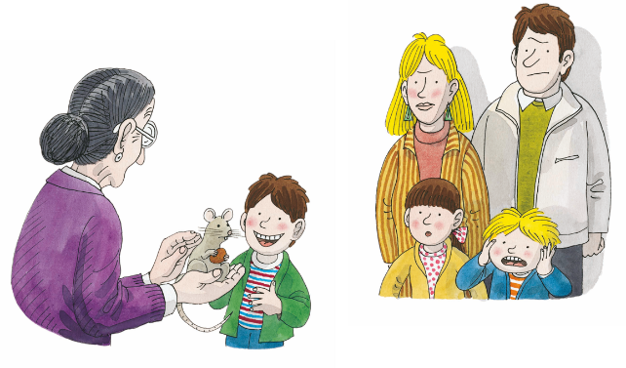
LO: Retell the story with the given sentence structure.
Guide Ss to recall some details in the story.
Click and model first; have Ss work together to retell the story using the given illustrations, helping words, and sentence structure.
Give feedback.
TG
Let’s Retell
Reading
1
2
3
Helping Words
· pet
· rat
· spider
· snake
· goldfish
___ wanted a _____.
4
5
03:00
14/22

Slide 15
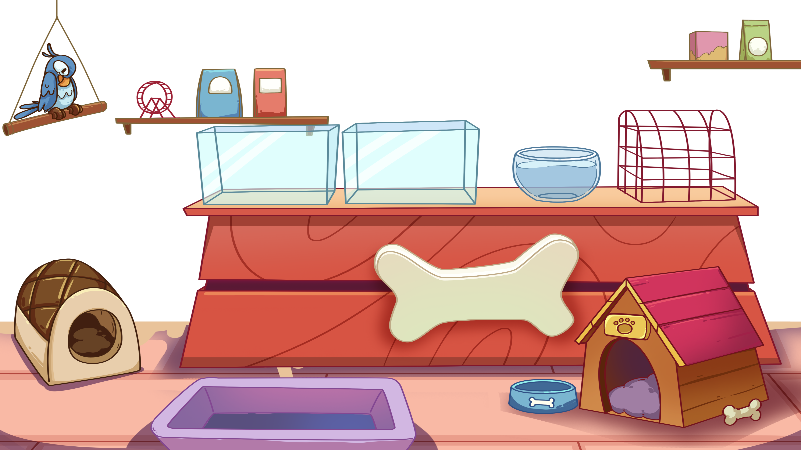
Vocabulary
TG
Let’s Say
LO: Check Ss’ understanding of the key vocabulary words learned in
the lesson.
Click and guide Ss to say the names of the shining shades of the animals.
Click to show the animals.
Give feedback.
snake
spider
goldfish
02:00
15/22

Slide 16
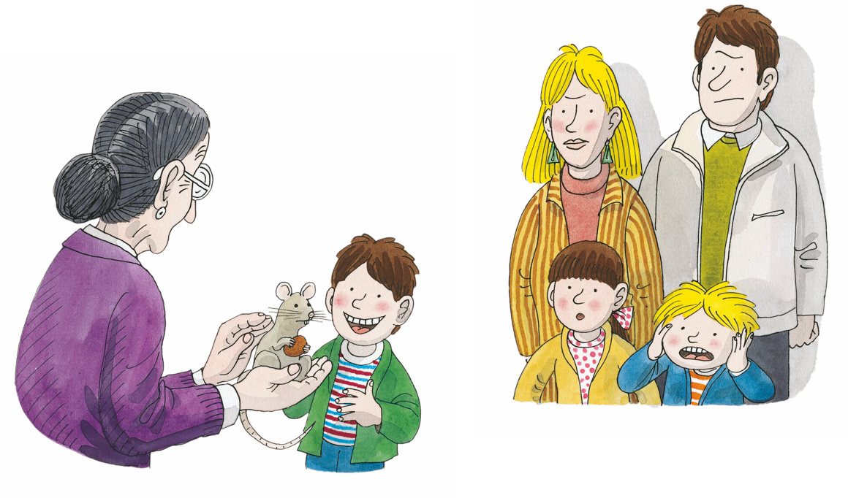
LO: Talk about the illustrations with the given sentence structure.
Ask Ss to look at the illustrations and identify the characters.
Read the given question and ask Ss to take turns answering the questions, one S for one question.
Give feedback.
Note: Ss should use complete sentences.
TG
Listening &
Speaking
Let’s Talk
2. —What pet did Chip want?
—Chip wanted a ________.
1. —What pet did Kipper want?
—Kipper wanted a ________.
Reading
rat
snake
spider
01:30
16/22

Slide 17
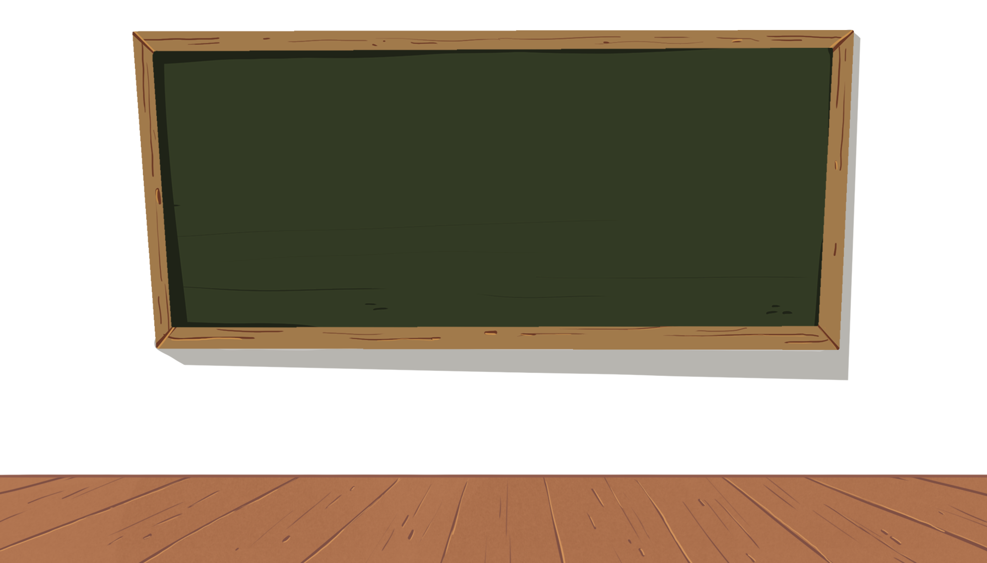
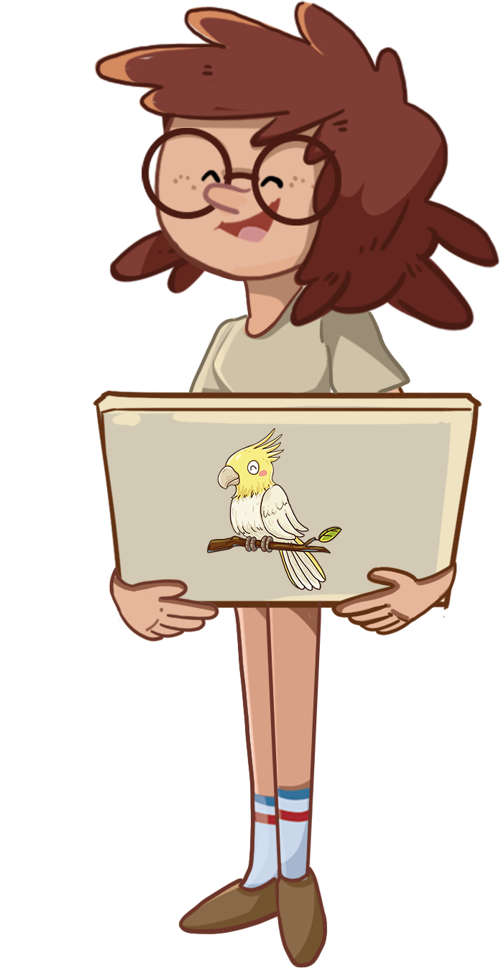
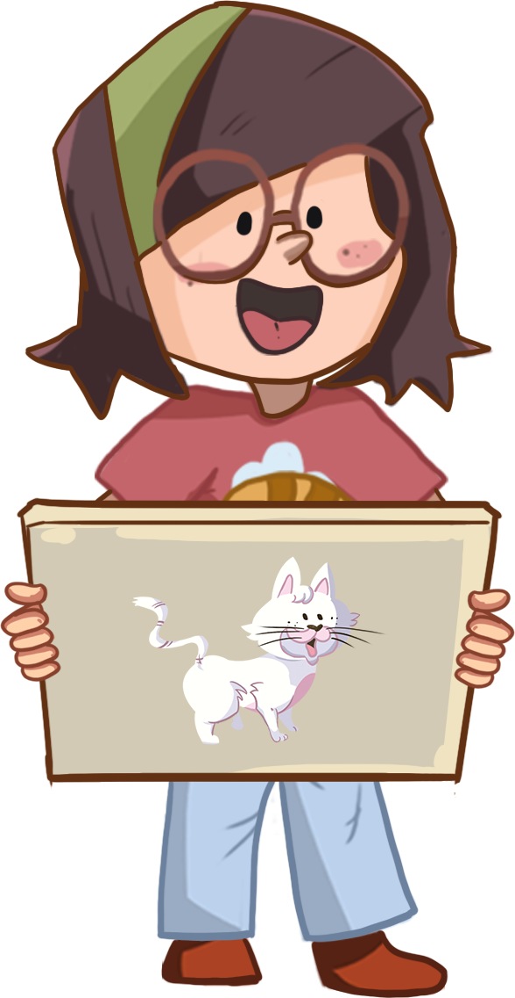
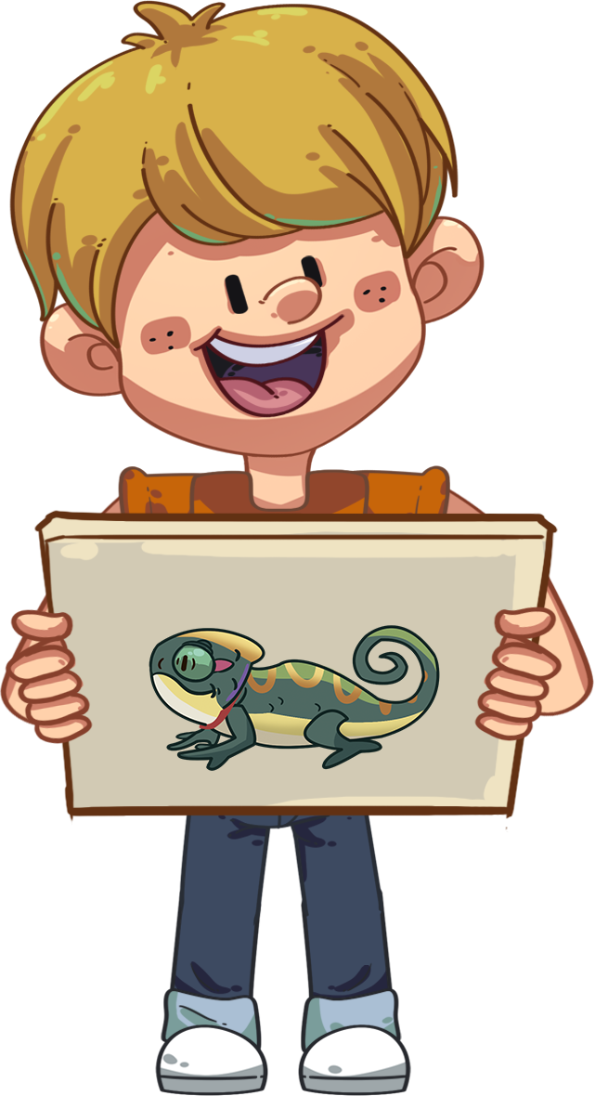
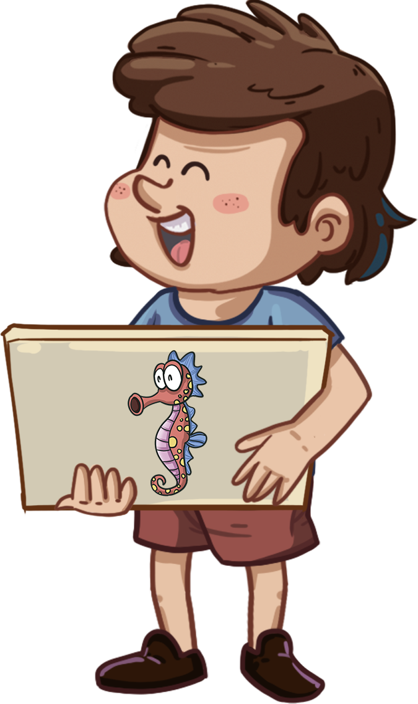
LO: Talk about the given pictures using the given sentence structure.
Guide Ss to look at the pictures and talk about what they see.
Model first; have Ss take turns talking about the given question.
Note: Each S should say at least two sentences.
TG
Let’s Talk
Listening &
Speaking
What pet did he/she want?
_____ wanted a _____.
Helping Words
· cat
· parrot
· lizard
· seahorse
03:00
17/22

Slide 18
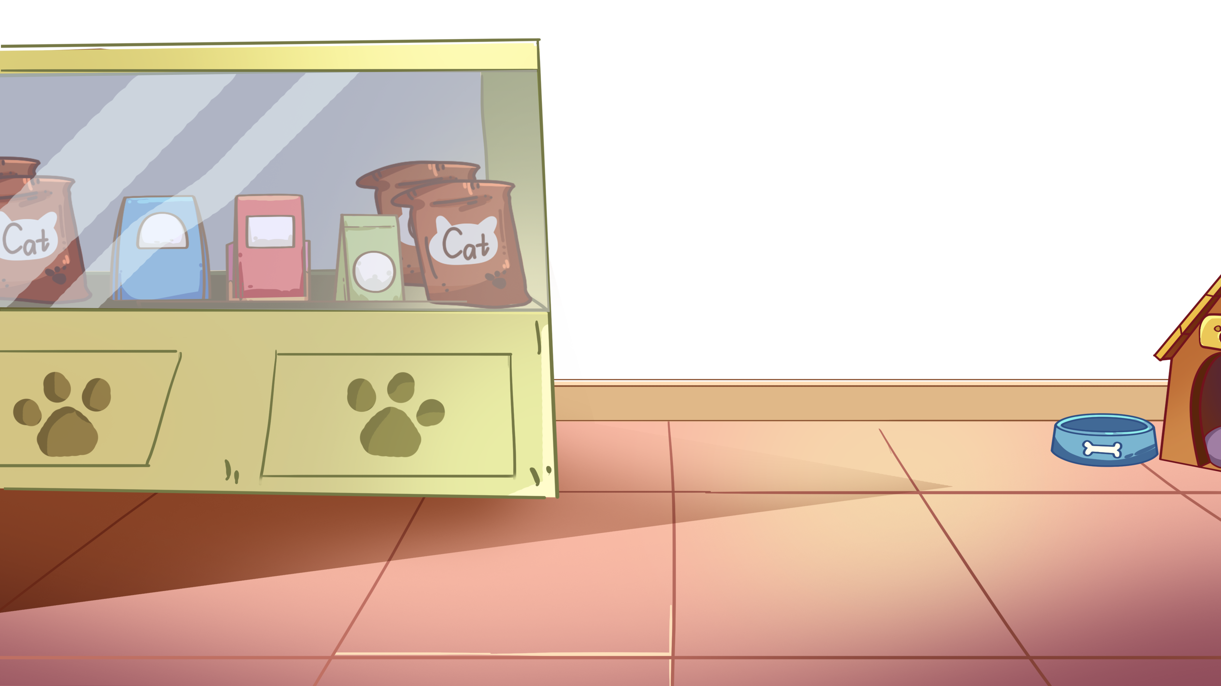
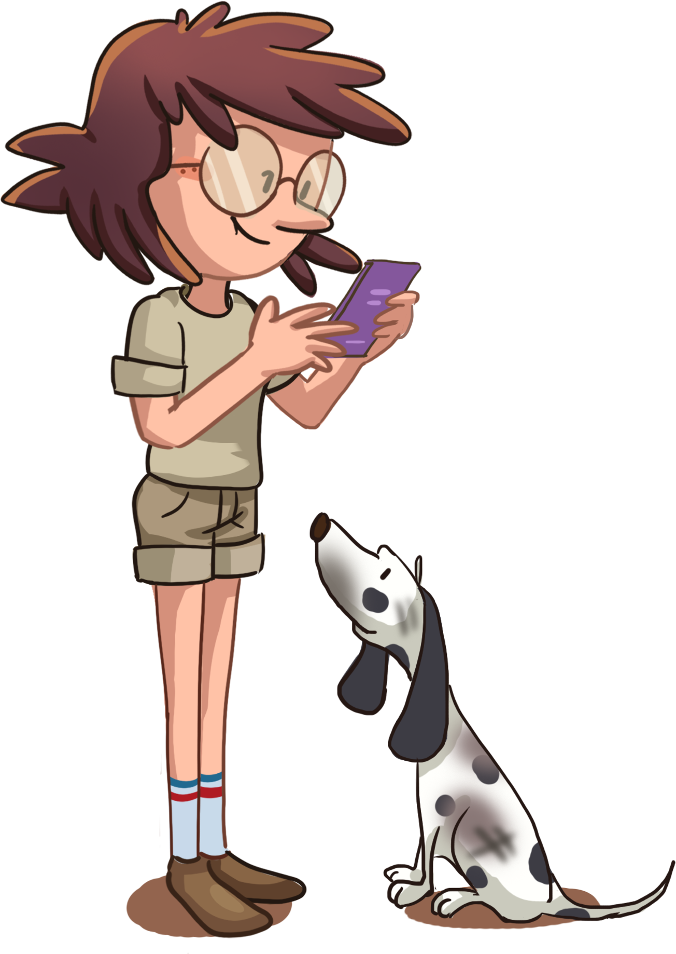
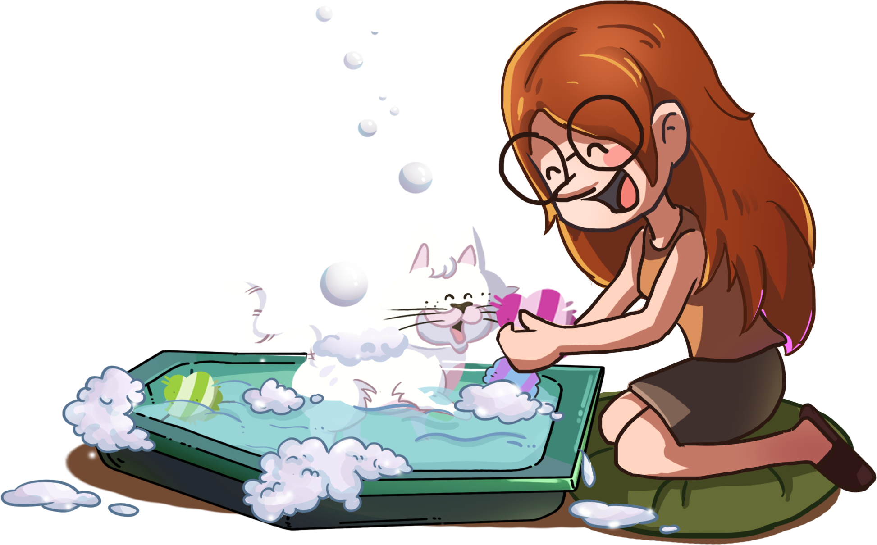
TG
LO: Know that they should take care of their pets in the right way.
Guide Ss to look at the pictures; click and ask them the given question.
Click and show the answers; make sure Ss know that they should take care of their pets in the right way; invite Ss to share their answers with others.
Value
Let’s Discuss
Do they take care of their pets in the right way?
1
2
01:00
18/22
17/22

Slide 19
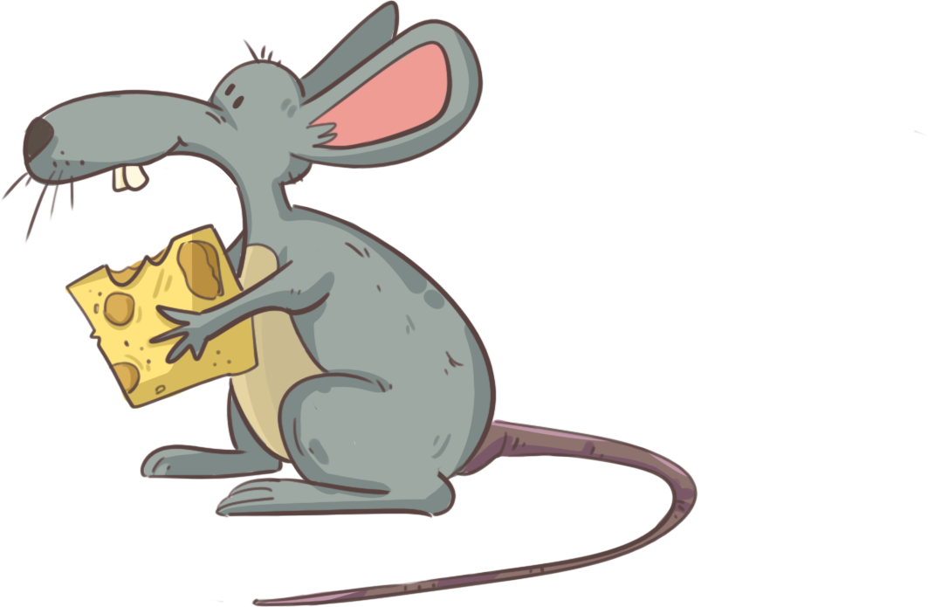
Get Ready to Present
LO: Talk about what they’ve learned from the story.
Ask Ss the given question and guide them to think about it.
Model first; guide Ss to talk about the question with the visual aids.
TG
Oral Writing
How did everyone decide on a pet that
they were all happy with?
What did he/she get?
_____ wanted a _____.
Everyone said, “_____.”(YES/NO)
03:00
19/22

Slide 20
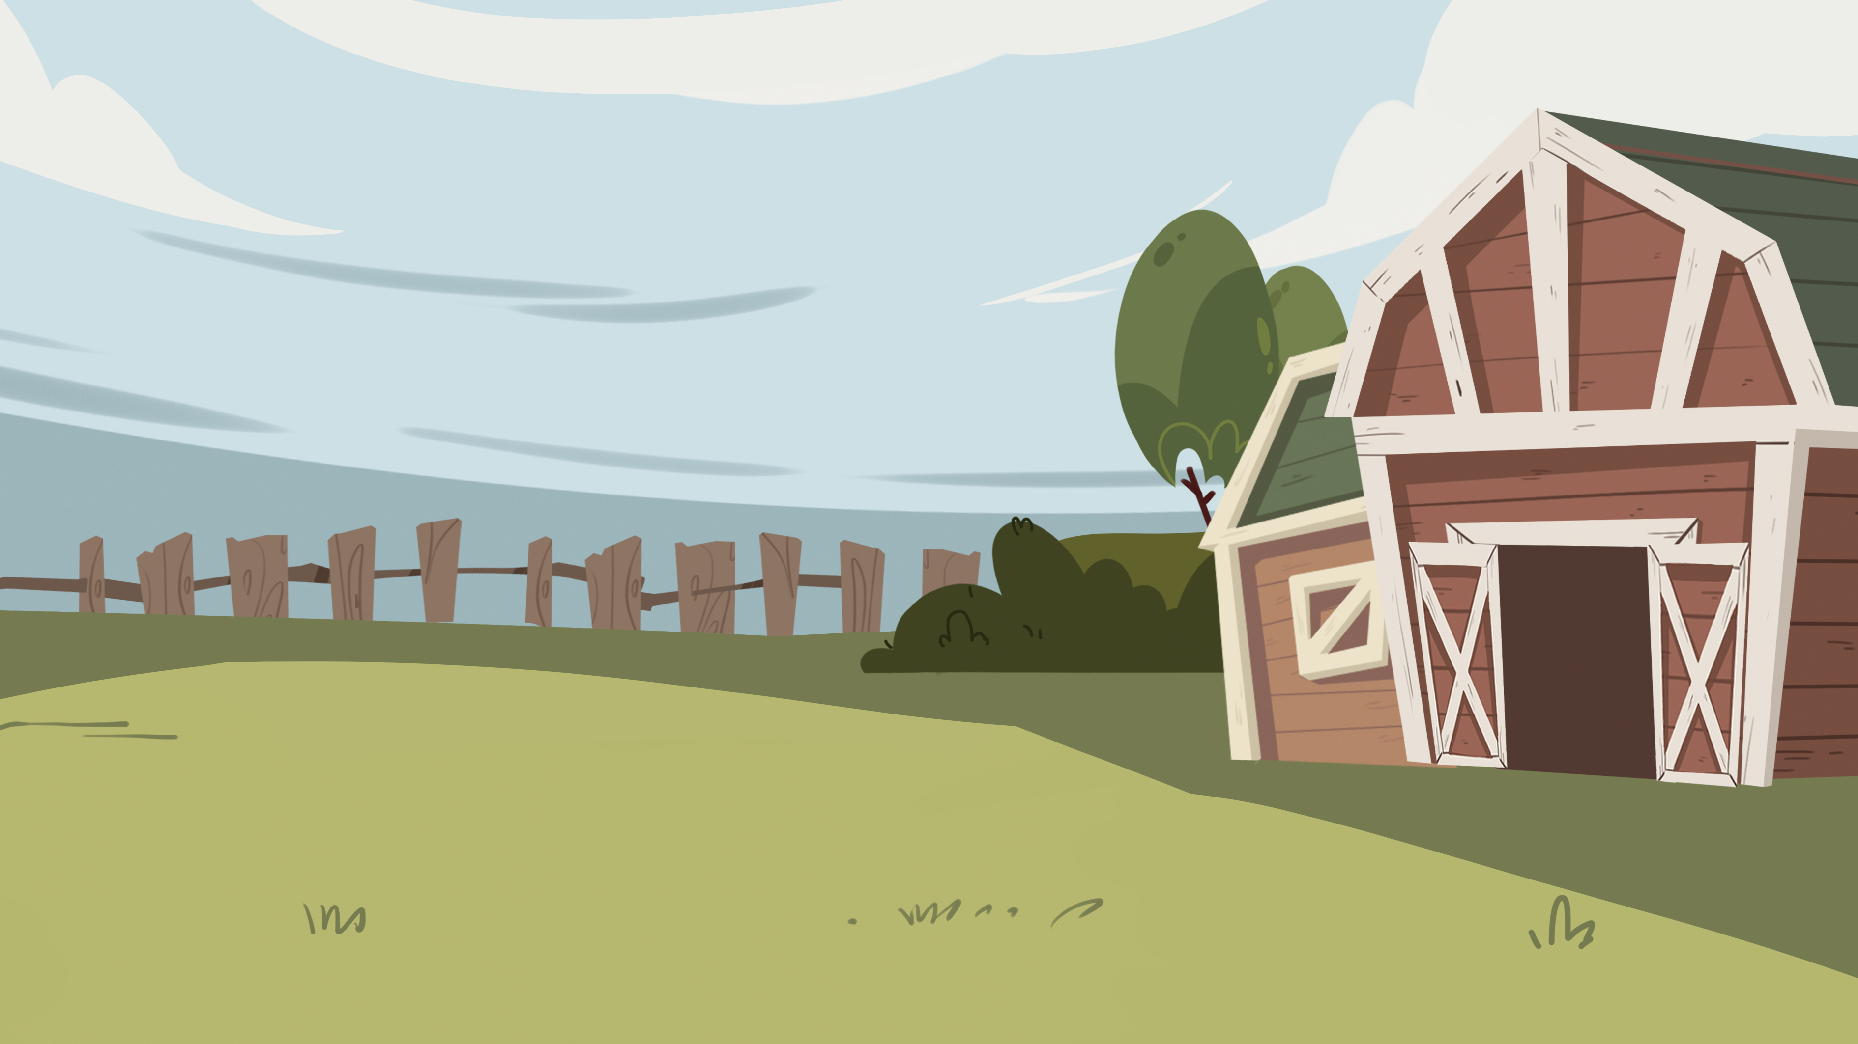
Let’s Draw & Say
LO: Understand what the homework is; know the post-class
video will help them finish the homework.
Explain the writing task to Ss and remind them to watch the post-class video before doing the homework.
Remind Ss to get ready to present their homework next class.
TG
Writing
Descriptive Writing
Now you will prepare for your writing task:
1. Draw a place for your pet to play.
2. Label it with the right name.
3. You can say, “This is a ____.”
farm
Tip: Remember to watch the post-class video.
01:30
20/22

Slide 21
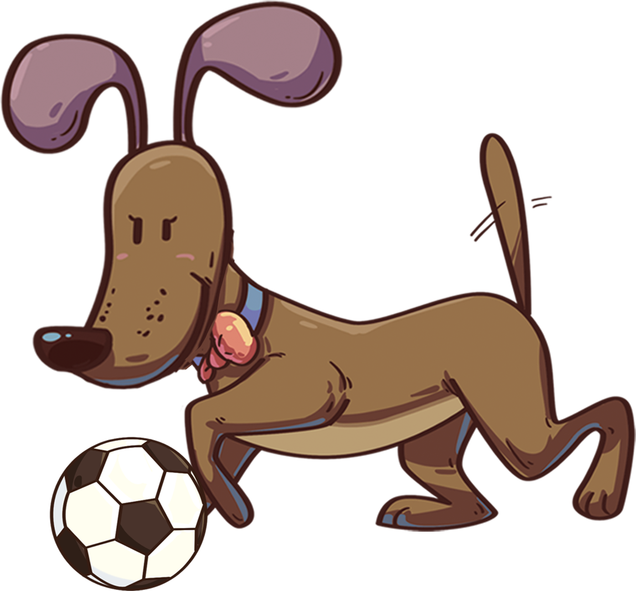
Let’s Review
TG
LO: Get a better idea of what they’ve learned in this lesson.
Ask Ss to read the words in the phonics section; correct Ss’ pronunciation if necessary.
Ask Ss to read the vocabulary; help Ss with the words they are struggling with if necessary.
Have each S make a sentence in turn using the sentence structure.
Review
Phonics:
jam/Job/jelly/joy/ jungle/juice
Vocabulary:
pet/shop/snake/
spider/goldfish
Sentence Structure:
_____ wanted a _____.
02:30
21/22

Slide 22
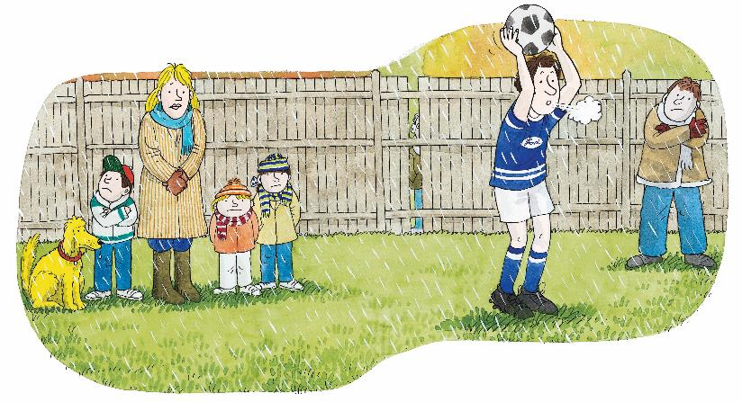
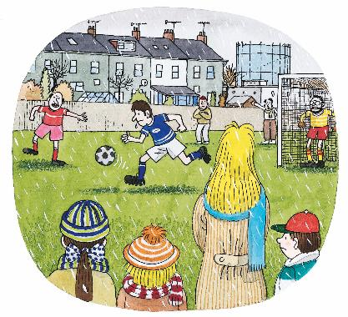
Briefly comment on Ss' progress and praise them for doing a good job.
Say goodbye to Ss.
TG
01:00
22/22

