Slide 1
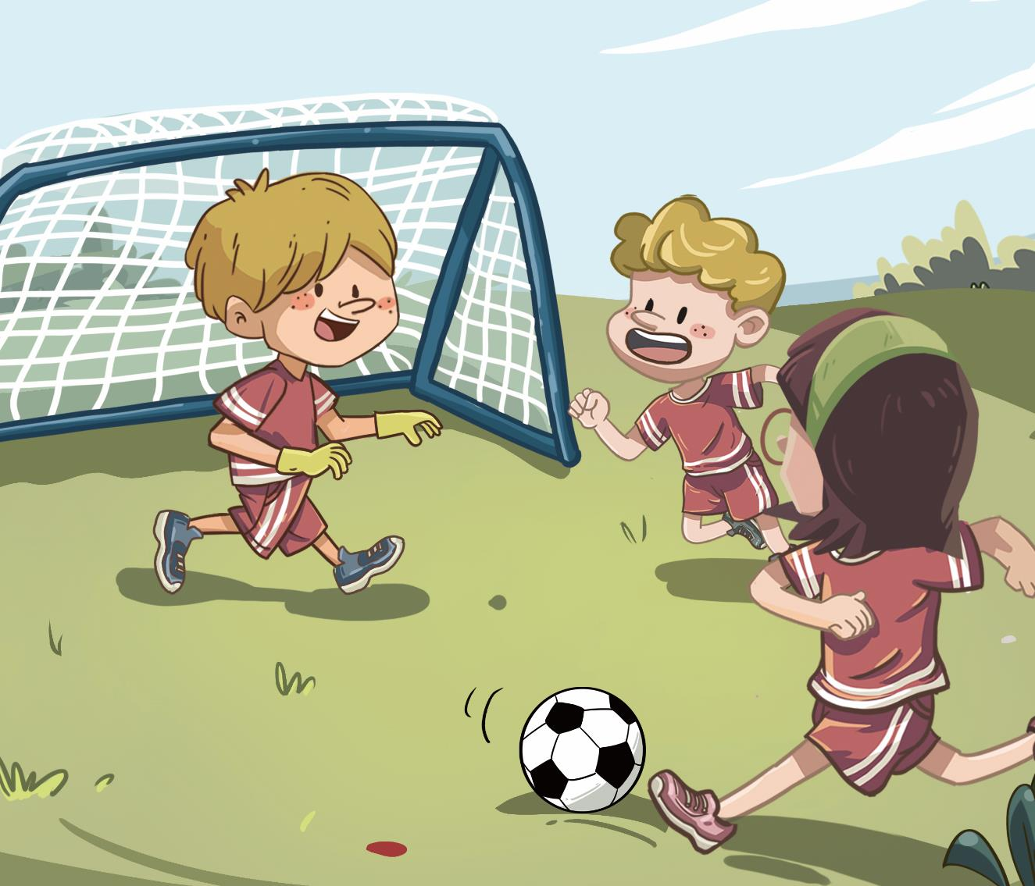
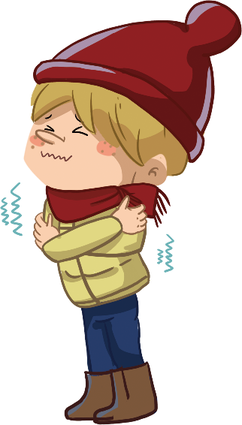
LO: Greet T and their partner; get a basic idea about the topic of
this lesson.
1. Greet Ss.
2. Ask Ss to greet T and their partner.
3. Introduce the topic to Ss.
4. Guide Ss to talk about the pictures on the slide.
TG
00:30
1/22

Slide 2
TG
LO: Know the learning goals of this lesson.
Briefly go through the learning goals with Ss.
We are going to . . .
Learning Goals
Learn and practice the consonant sound k in simple words.
Learn the key words cold, wet, tired, and goal, and use them in sentences.
Read the story Goal! and identify details in the pictures.
Practice using the sentence structure _____ got _____.
00:30
2/22

Slide 3
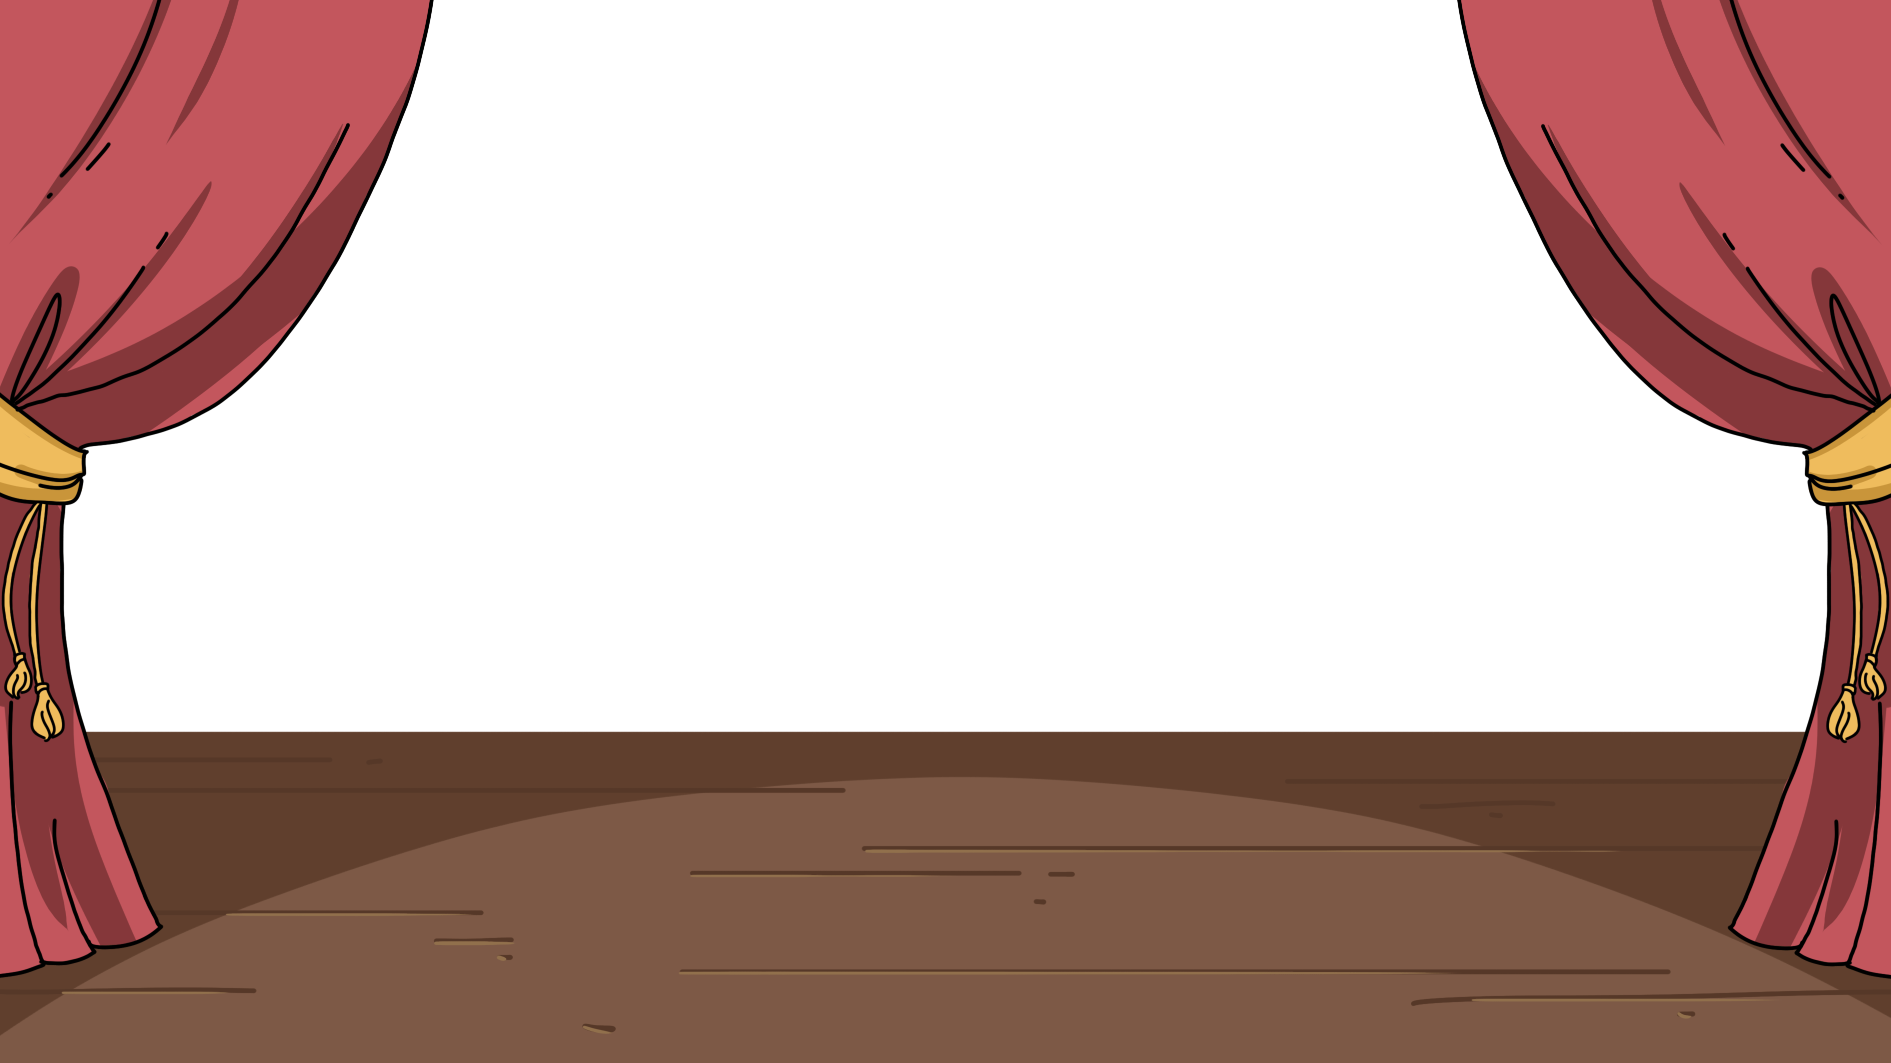
LO: Present homework; talk about what they have drawn.
1. Ask Ss to present their homework.
2. Encourage Ss to describe their homework.
3. Give feedback.
TG
Let’s Show
Presentation
Did you draw a place for your pet to play?
Now, show us your picture and say, “This is a ______.”
02:00
3/22

Slide 4
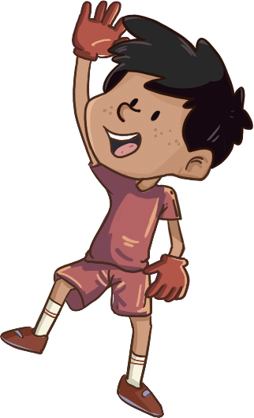
LO: Identify the consonant sound k.
Click and read each word to Ss like this: k-k-kit.
Click and guide Ss to read the sound k like this: k-k-k.
Note: On this slide, Ss don’t need to read the words after T.
TG
Let’s Listen
Phonics
kind
king
kin
k
Kit
kid
Kim
02:30
4/22

Slide 5
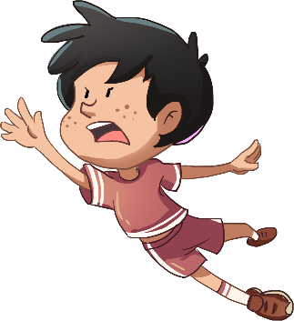
LO: Pronounce the words with the sound k.
Click and have Ss read each word together after T like this: k-k-kit.
Note: After Ss read the words correctly, click and the player in
white T-shirt will get a goal.
TG
Word
Let’s Say
Phonics
king
kind
Kit
Kin
Kim
kid
2
1
3
4
0
6
5
0
02:30
5/22

Slide 6
LO: Decode the words learned in the text.
Click and read the chant to Ss with rhythm.
Guide Ss to repeat after T; ask them to take turns reading one sentence.
Give feedback.
TG
Let’s Chant
Phonics
This is Kim.
This is Kit.
Kim is a king.
Kit is a kid.
Kim is kin to Kit.
Kit is kind to Kim.
02:00
6/22

Slide 7
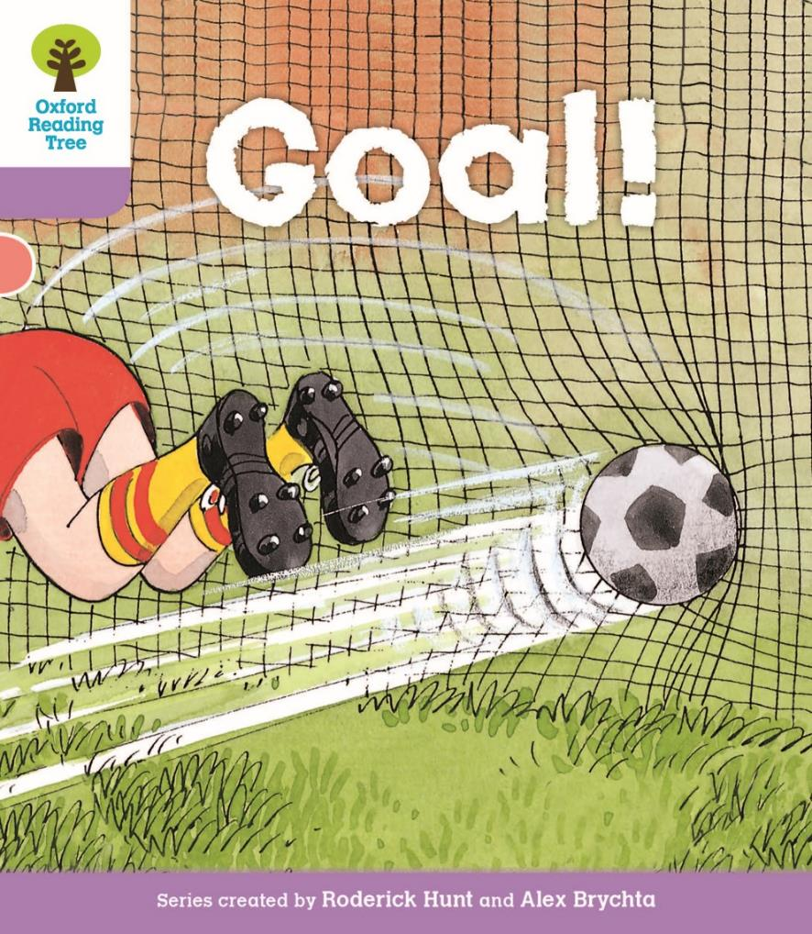
TG
LO: Get to know the title, author, and illustrator of the book; use the
book cover to identify details and make predictions.
Guide Ss to look at the book cover and encourage them to talk about what they see.
Ask Ss to find the title, author, and illustrator.
Guide them to talk about the given questions.
Note: On this slide, Ss don’t need to say the names of the author and
illustrator.
Introduction
Let’s Begin
What can you see on the book cover?
Look at the title. What will the story be about?
Written by Roderick Hunt
Illustrated by Alex Brychta
02:00
7/22

Slide 8
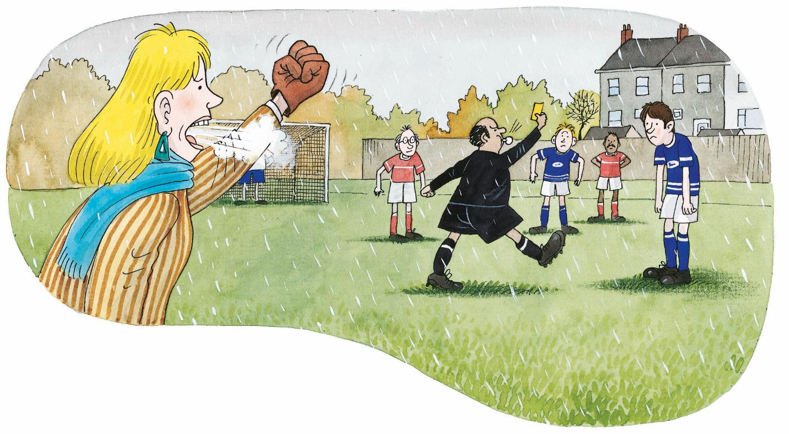
LO: Use pictures to identify details and make predictions about
the story.
Guide Ss to look at the illustration and talk about what they see.
Ask Ss the given questions and encourage them to make predictions.
TG
Lead-in
Let’s Predict
1. What is the weather
like in the picture?
It is ____________.
2. How is Mum feeling?
I think ___________.
02:00
8/22

Slide 9
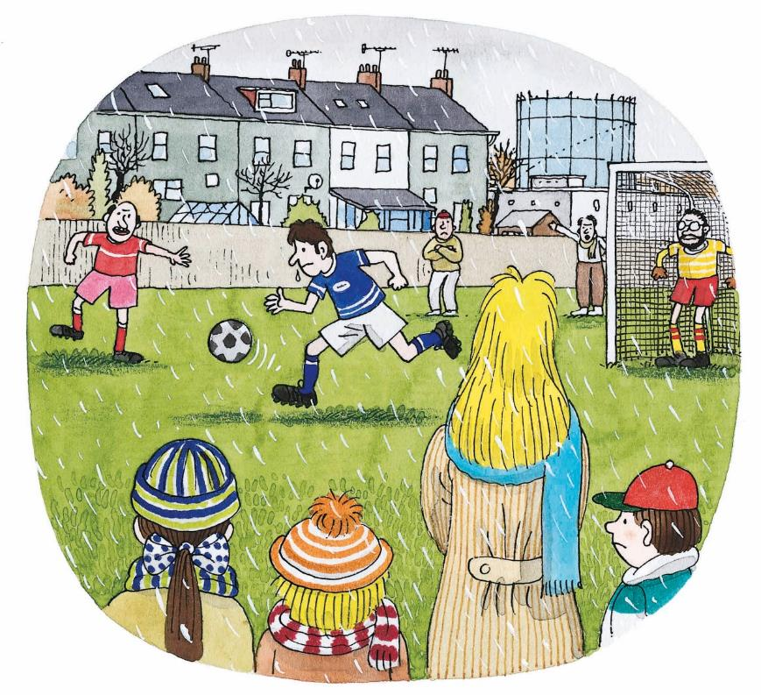
Goal!
LO: Identify details using the illustration; know the meaning of
the key vocabulary word and make a sentence with it; make
connections; understand the text.
Read the text to Ss.
Explain the key vocabulary word and the example sentence; encourage Ss to make sentences with the key vocabulary word.
Guide Ss to look at the illustration and talk about the given questions with complete sentences.
Guide Ss to talk about the connections question; model first; encourage them to take turns talking more about themselves.
Guide Ss to take turns reading the text and do the action of cold.
TG
Reading
Details
Vocabulary
What was the weather like? It was ______.
Who can you see in the story?
What was Dad doing?
cold
She feels cold.
Connections
What do you wear on
a cold day?
It was a cold day.
Vocabulary
03:00
9/22

Slide 10
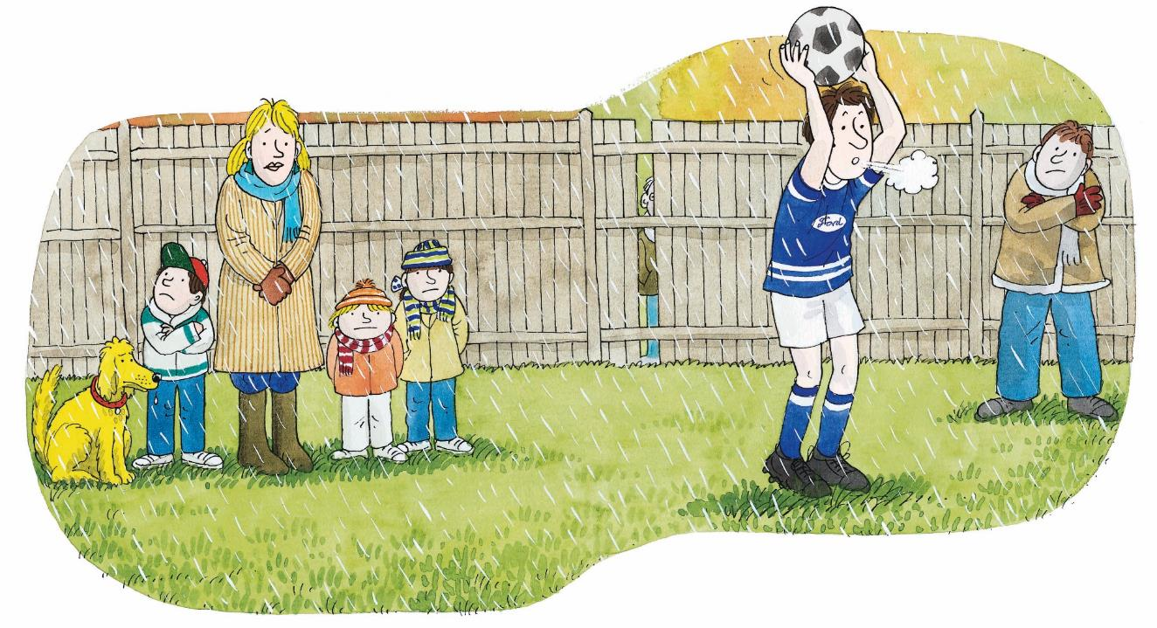
Goal!
LO: Identify details using the illustration; know the meaning of
the key vocabulary word and make a sentence with it;
understand the text.
Read the text to Ss.
Explain the key vocabulary word and the example sentence; encourage Ss to make sentences with the key vocabulary word.
Guide Ss to look at the illustration and talk about the given questions with complete sentences.
Guide Ss to take turns reading the text with finger reading
TG
Reading
Vocabulary
Details
Everyone got wet.
What were Mum and the children doing?
How did Mum and the children feel? They got _______.
wet
The leaves are wet.
Everyone got cold.
Vocabulary
03:00
10/22

Slide 11
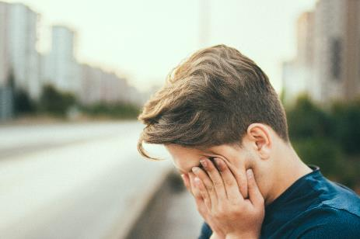
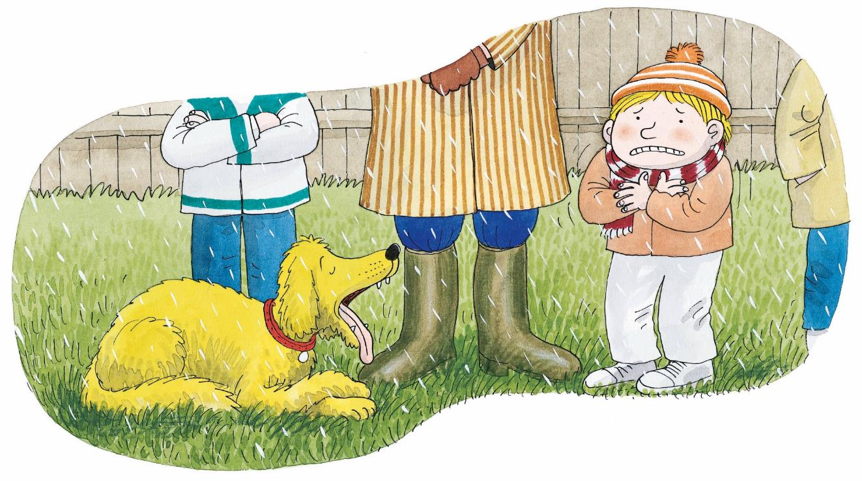
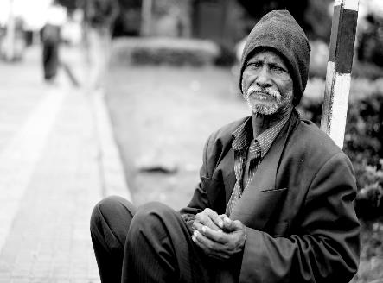
Goal!
TG
LO: Identify details using the illustration; know the meaning of
the key vocabulary word and make a sentence with it; understand
the meaning of the unfamiliar word; understand the text.
Read the text to Ss.
Explain the key vocabulary word and the example sentence; encourage Ss to make sentences with the key vocabulary word.
Explain the unfamiliar word and have Ss repeat after T.
Guide Ss to look at the illustration and talk about the given questions with complete sentences.
Guide Ss to take turns reading the text and do the action of tired.
Reading
Vocabulary
Details
Floppy got tired.
How did Floppy feel? Floppy got _____.
How did Kipper feel? Kipper got ____.
tired
He feels tired.
Vocabulary
Kipper got miserable.
miserable
04:00
11/22

Slide 12
Goal!
LO: Identify details using the illustration; decode the sight word;
understand the text.
Read the text to Ss.
Click the sight word button and guide Ss to read the sight word and have them repeat it.
Guide Ss to look at the illustration and talk about the given questions with complete sentences.
Guide Ss to take turns reading the text and do the action of angry.
TG
Reading
Sight Word
Details
What can you see in the hands of the man in black?
How did Mum feel? Mum got _____.
What do you think made Mum feel like that?
got
Mum got cross.
Sight Word
03:00
12/22

Slide 13
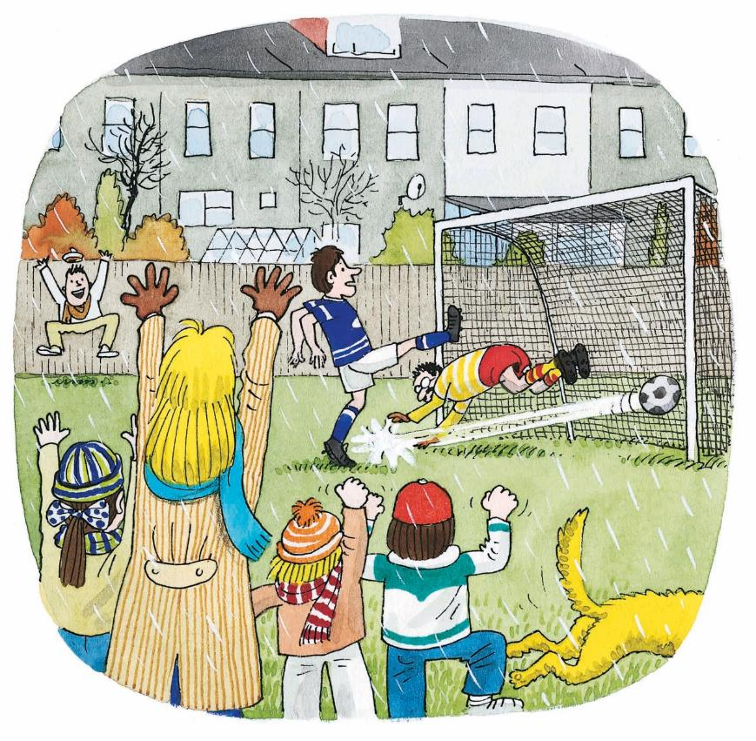
Goal!
TG
LO: Identify details using the illustration; know the meaning of
the key vocabulary word and make a sentence with it;
understand the text; read the text accurately.
Read the text to Ss.
Explain the key vocabulary word and the example sentence; encourage Ss to make sentences with the key vocabulary word.
Guide Ss to look at the illustration and talk about the given questions with complete sentences.
Guide Ss to read the text together do the action of goal.
Check Ss’ accuracy and give feedback.
Reading
Vocabulary
Details
What did Dad do?
How did Mum and Kipper feel? They got _______.
Connections
goal
Do you think they enjoyed Dad’s game?
He got a goal.
Decoding
Read accurately.
Dad got a goal.
Vocabulary
04:00
13/22

Slide 14
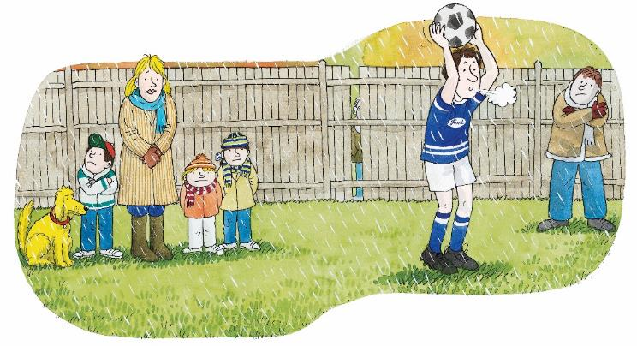
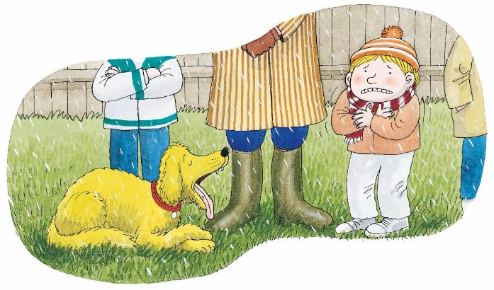
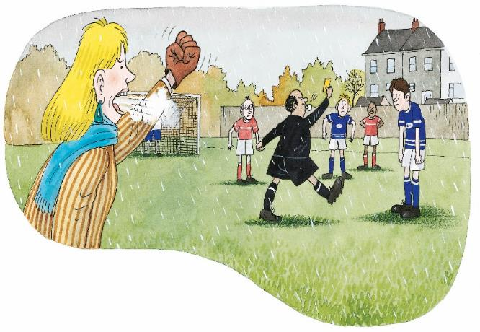
LO: Retell the story with the given sentence structures.
Guide Ss to recall some details in the story.
Model first; have Ss work together to retell the story using the given pictures and sentence structures.
Give feedback.
TG
Let’s Retell
Reading
Helping Words
· cold
· wet
· tired
· miserable
· cross
· goal
2
1
It was a _____ day.
___ got _____.
4
3
03:00
14/22

Slide 15
LO: Check Ss’ understanding of the key vocabulary words
learned in the lesson.
Guide Ss to say the key vocabulary words with the help of the pictures; give one point to the first S who answers correctly.
Click the triggers to show the right answers.
Announce the winner.
TG
Let’s Match
Let’s Match
Vocabulary
2
3
1
1
2
3
4
tired
cold
wet
goal
03:00
15/22

Slide 16
LO: Check Ss’ comprehension of the story; talk about the pictures
with the given sentence structure.
Ask Ss to look at the illustrations and identify the characters.
Read the given questions and ask Ss to answer each question in turns.
Give feedback.
Note: Ss should say with complete sentences.
TG
Listening &
Speaking
Let’s Talk
1. —How did Kipper feel?
—Kipper got ________.
Reading
2. —How did Mum feel?
—Mum got ________.
cross
miserable
a goal
02:00
16/22

Slide 17
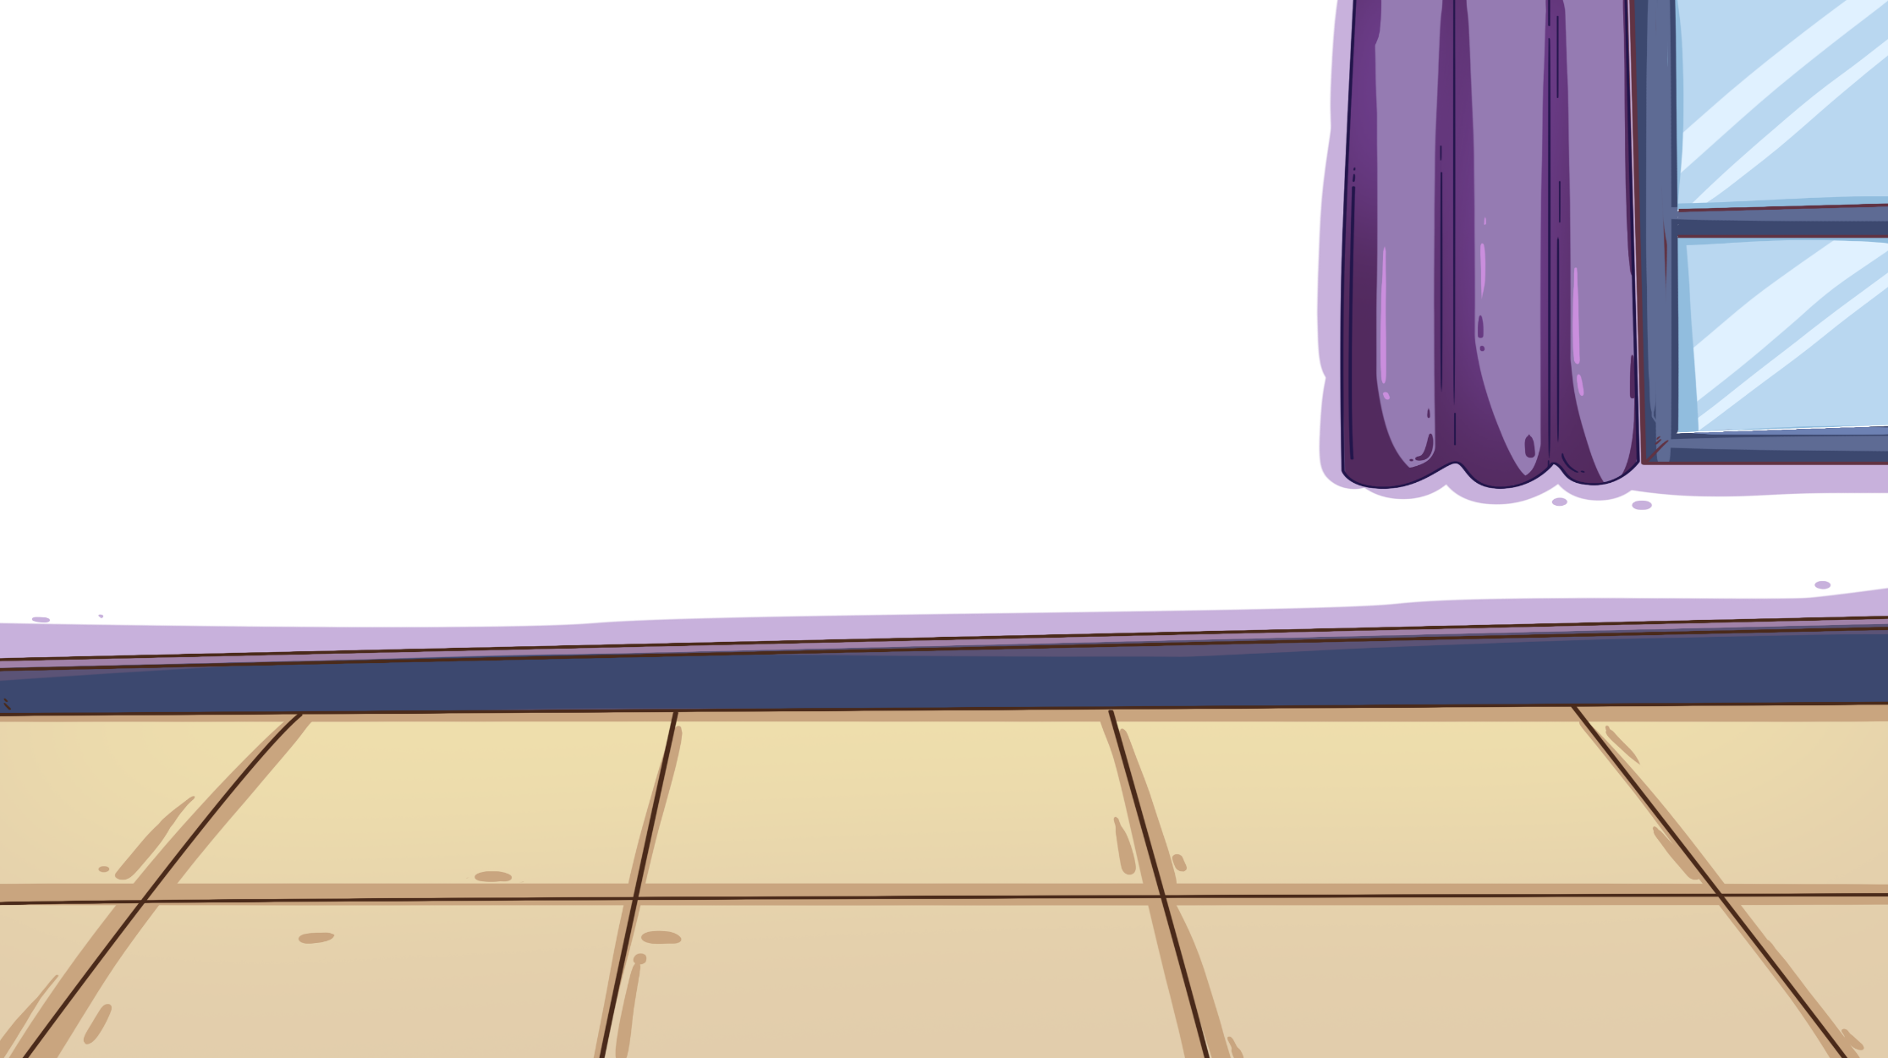
LO: Talk about the given pictures using the given sentence
structure.
Guide Ss to look at the pictures and talk about what they see.
Model first. And then have Ss take turns talking about the given question.
Note: Each S should say at least two sentences.
TG
Let’s Talk
Listening &
Speaking
How does the boy feel?
He gets _____.
Helping Words
· sad
· quiet
· happy
· surprised
03:00
17/22

Slide 18
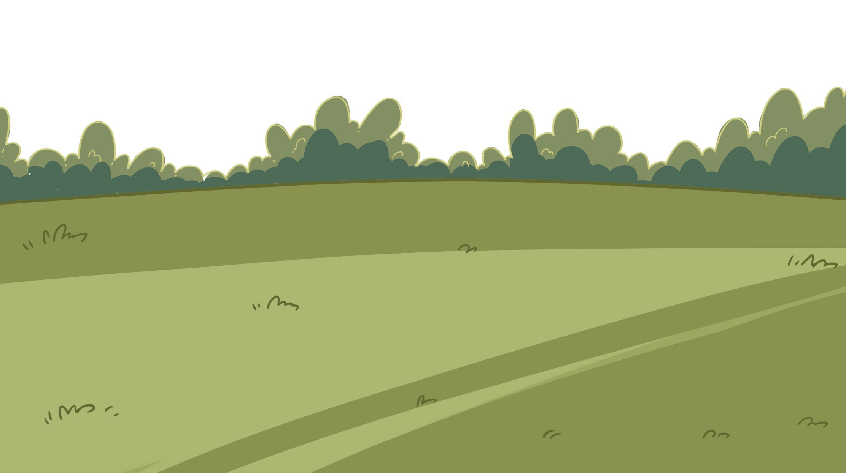
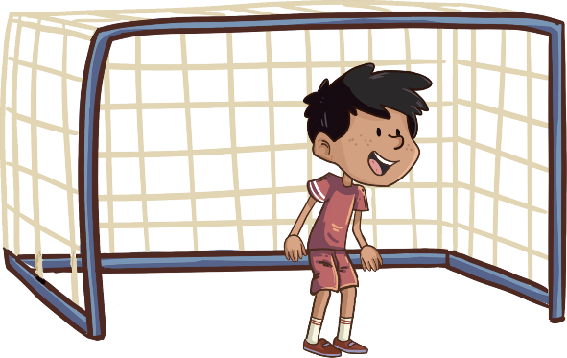
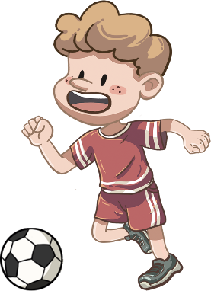
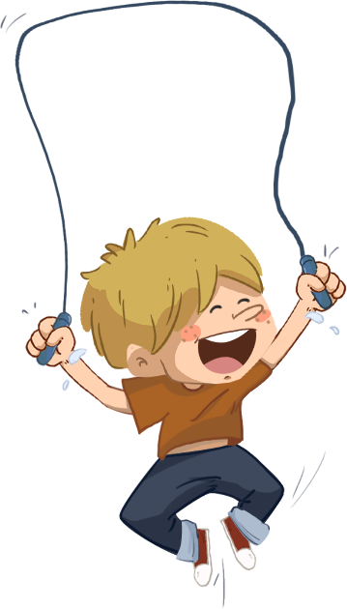
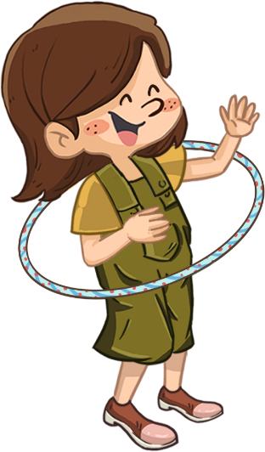
Let’s Discuss
LO: Build their awareness of loving sports.
Guide Ss to look at the picture; ask them the given question.
Click and show the answers; invite Ss to share their answers
with others; make sure Ss know that they should love doing
sports, especially doing sports outside.
TG
Value
Is it good to do sports outside?
03:00
18/22
17/22

Slide 19
Get Ready to Present
LO: Talk about what they’ve learned from the story.
Ask Ss the given question and guide them to think about it.
Model first; guide Ss to talk about the question with the visual aids and sentence structure.
TG
Oral Writing
Did Mum enjoy watching Dad’s game?
What did he/she get?
I think Mum ____ watching Dad’s game.
(enjoyed/didn’t enjoy)
Mum got _______.
cross
19/22
02:30

Slide 20
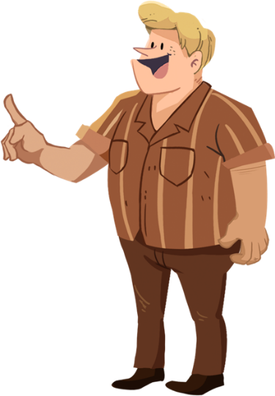
Let’s Draw & Say
LO: Understand what the homework is; know the post-class
video will help finish the homework.
Explain the writing task to Ss and remind them to watch the post-class video before doing the homework.
Remind Ss to get ready to present their homework in the next class.
TG
Writing
Descriptive Writing
Now you will prepare for your writing task:
Draw a picture of a person you like.
Label it with the right name.
You can say, “I like ____.”
my dad
Tip: Remember to watch the post-class video.
01:00
20/22

Slide 21
Let’s Review
LO: Get a better idea of what they’ve learned in this lesson.
Ask Ss to read the words in phonics part; correct Ss’ pronunciation if necessary.
Guide Ss to review the key vocabulary words; ask Ss to read the words individually.
Have Ss take turns making a sentence using the sentence structure.
TG
Review
Phonics: Kim/Kit/kid/king/kind/kin
Vocabulary:
cold/wet/tired/goal
Sentence Structure:
_____ got _____.
01:00
21/22

Slide 22
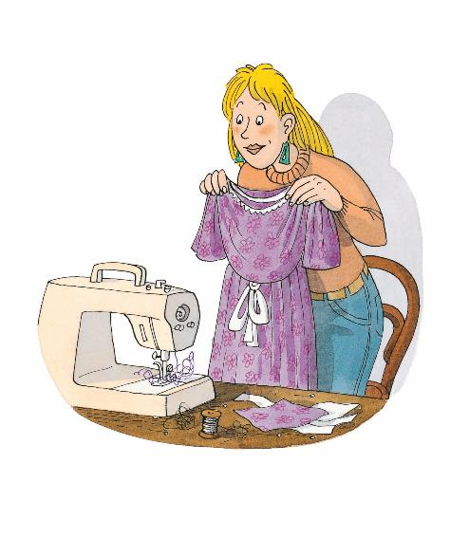
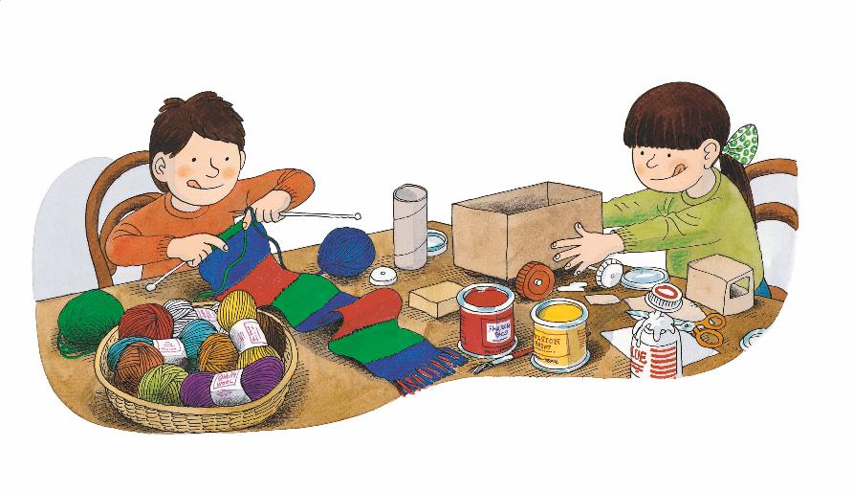
1. Briefly comment on Ss' progress and praise them for doing a good job.
2. Say goodbye to Ss.
TG
00:30
22/22

