Slide 1
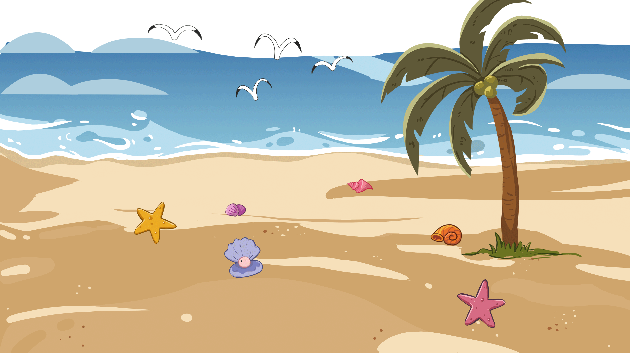
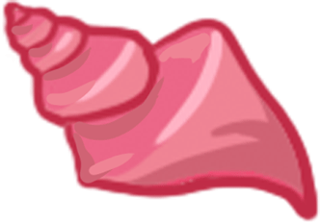
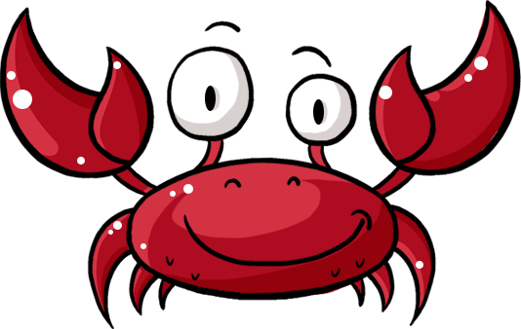
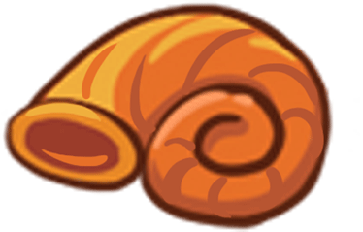
TG
LO: Get to know partners; get a basic idea about the topic of
today’s lesson.
Say hello to Ss; ask Ss to greet each other.
Introduce the topic of the lesson.
1:00
1/26

Slide 2
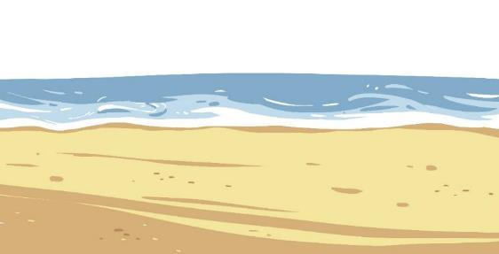
Learning
Goals
TG
LO: Get to know and understand what will be learned in this
lesson.
Go through the learning goals with Ss.
We are going to . . .
Identify and produce rhyming words that end with at.
Learn the new words and phrases crab, put back, wood, shell, and legs, and make sentences with them.
Read the story Put It Back and use the pictures and text to identify the characters of a story.
Practice using the sentence structure _____ had ____.
0:30
2/26

Slide 3
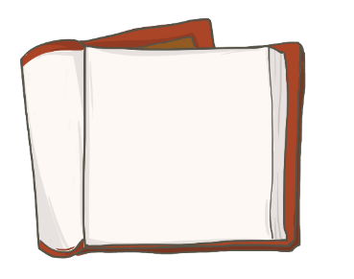
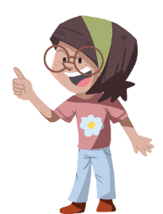
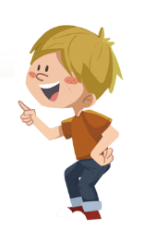
TG
Presentation
LO: Present and share the writing assignment from last lesson;
1. Invite Ss to take turns presenting their homework. If time is limited, tell
Ss they have one or two mins to present their writing.
2. Encourage Ss to listen carefully and to ask questions.
3. After both of the Ss have finished, give them feedback and awards
(Click the book picture beside the boy or the girl so that they can get
some awards).
4. Click and give each S a trophy to mark their good performance.
Note: You can click the picture of the boy or the girl to give Ss the trophy.
Let’s show!
This is the animal
I want to keep.
2:00
3/26

Slide 4
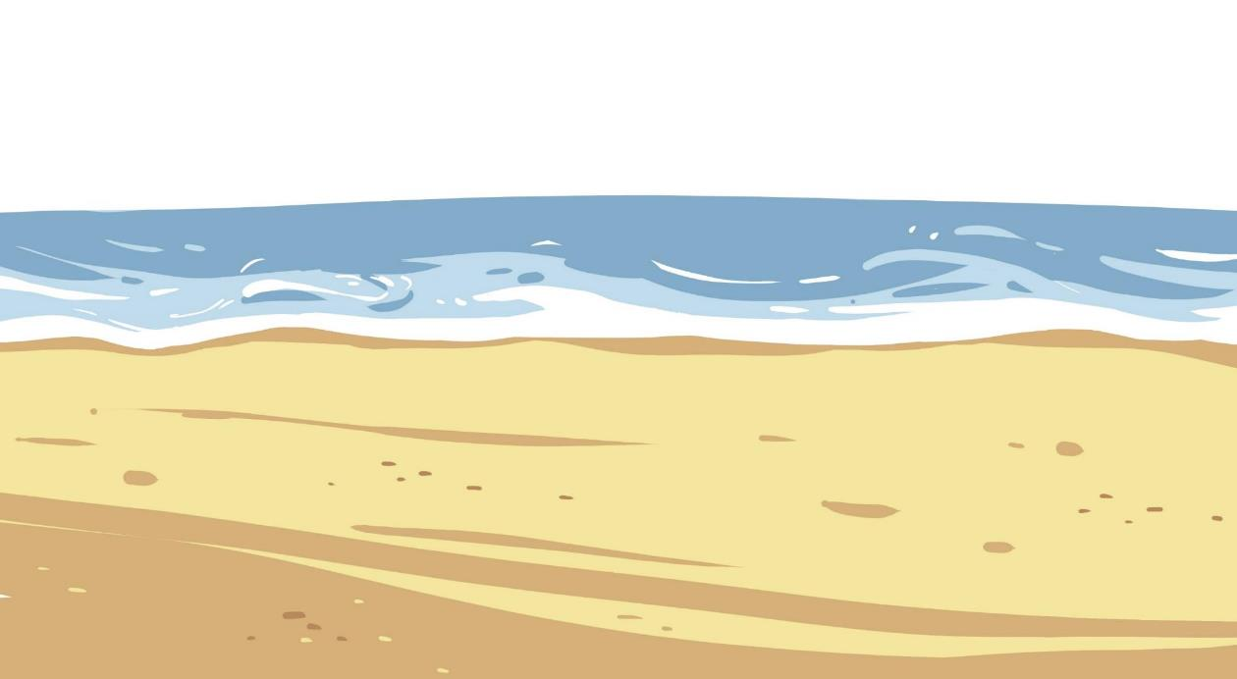
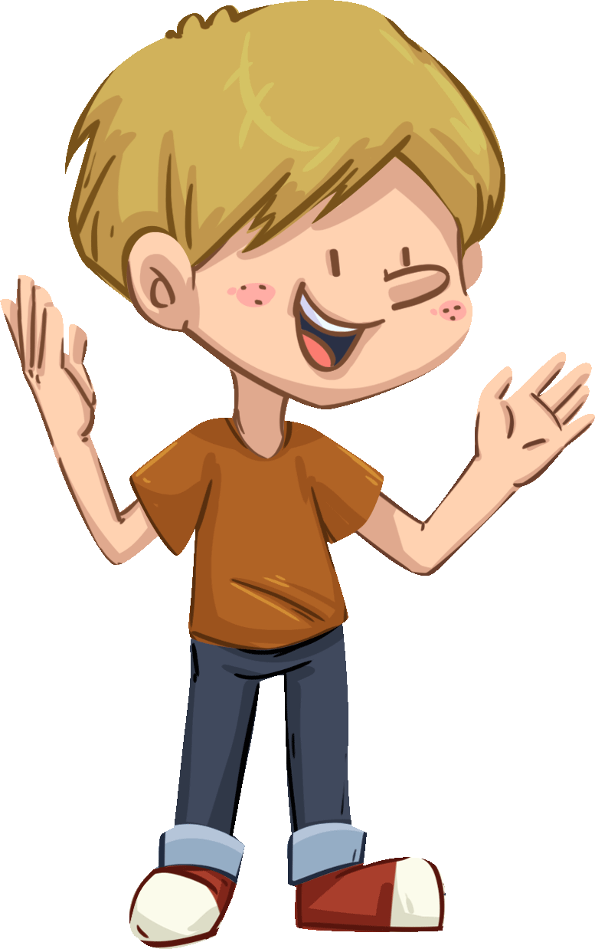
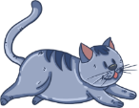
TG
LO: Identify the rhyming words that end in at.
1. Ask Ss to talk about what they can see in the picture and to guess what
the boy is going to do; click and describe the action briefly.
2. Click and read each word to Ss; ask Ss to tell what the words end with.
3. Say: These are rhyming words ending with at; at makes the sound
/æt/: ask Ss to read the sound after you.
bat
fat
sat
Let’s listen!
cat
hat
mat
What do these words end with?
mat
sat
hat
cat
fat
bat
2:30
4/26

Slide 5
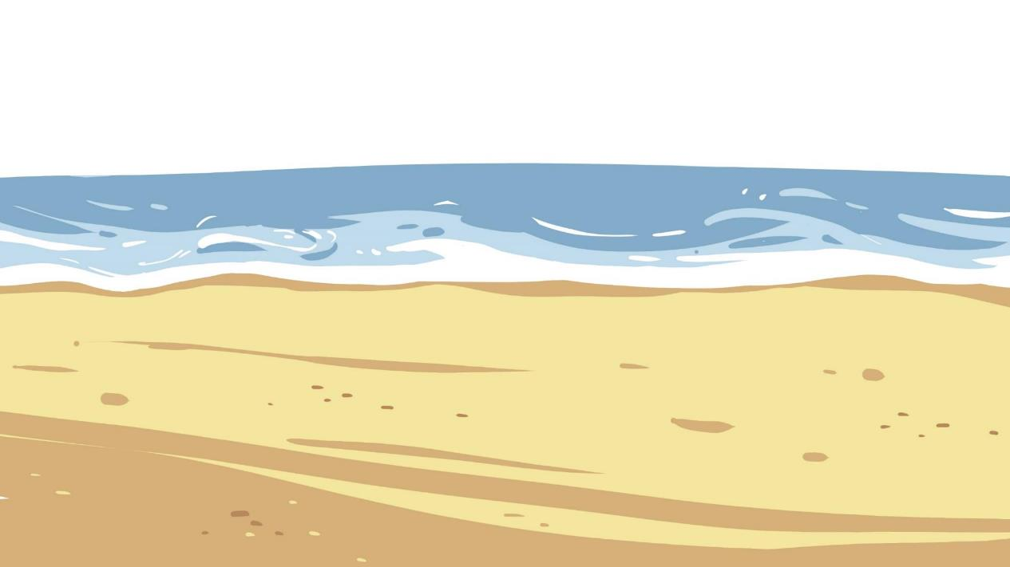
TG
Let’s say!
LO: Pronounce the rhyming words; produce the rhyming words using at.
1. Click and ask Ss to tell what sound the letter pair at makes.
2. Click and guide Ss to read each word ending with at; if Ss are capable
of reading these words, ask them to take turns reading each word.
3. Click and tell Ss they’re going to make new rhyming words ending with at.
4. Click and ask Ss take turns reading each new word; then give
feedback.
What sound does the letter team at make?
Let’s make new words!
Let’s read these words!
h
at
m
b
s
f
v
n
p
2:30
5/26

Slide 6
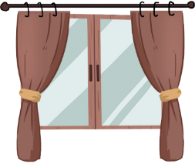
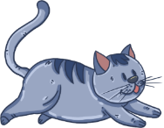
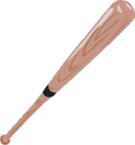
TG
Phonics
TG
LO: Decode the words learned in the text; read the text
fluently.
1. Click and read the phonics story to Ss with rhythm.
2. Guide Ss to take turns reading the highlighted words; guide
Ss to read together after you; ask them to take turns
reading one sentence at a time; give feedback.
Let’s chant!
A fat cat sat on the bat.
A fat cat sat on the mat.
A fat cat sat on the hat.
Cat, Cat, why are you so fat?
2:00
6/26

Slide 7
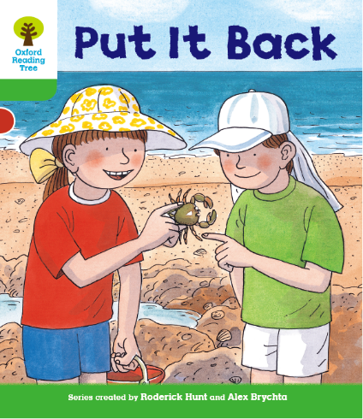
Lead-in
TG
LO: Use pictures to identify details and make predictions.
Have Ss look at the book cover closely and talk about what and who they can see on the book cover.
Encourage Ss to talk about the given questions to make some predictions and connections amongst themselves.
Before Reading
What is in Biff’s hand?
What might Biff and Chip find in the story?
Connections
What did you find at a beach? Did you find anything that was alive? What was it?
Written by Roderick Hunt
Illustrated by Alex Brychta
2:00
7/26

Slide 8
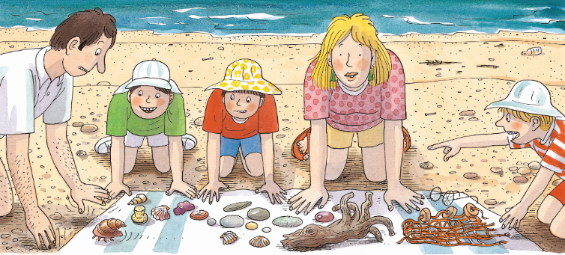
Let’s predict!
Reading
TG
LO: Make predictions about the story using the pictures;
motivate Ss’ interest in reading the story.
1. Remind ss to make guesses prior to reading the story by
looking at the illustrations.
2. Have Ss talk about the given questions.
Before Reading
What do you think Kipper is pointing at?
What might the family do at the beach?
2:00
8/26

Slide 9
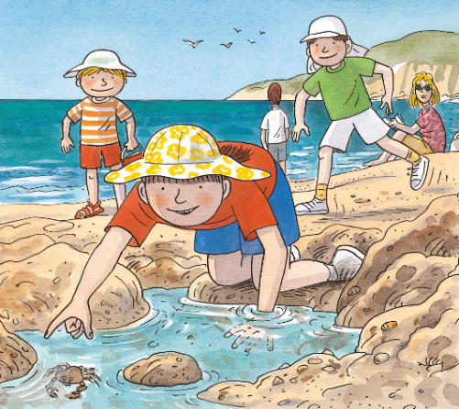
Put It Back
TG
Reading
LO: Identify the character and some details with prompts and support; understand the text.
1. Ask Ss to observe the illustration and identify the characters they know; have Ss talk about the
character questions and tell them that character is one of the main elements in a story.
2. Read the text to Ss; then guide Ss read the text together.
3. Invite one S to talk about the first comprehension question; have Ss take turns talking about the
second comprehension question.
Character
Who was in the story?
Look for clues in the illustration.
Comprehension
Where were the children?
What did Biff find?
“Look at this,” said Biff.
2:30
9/26

Slide 10
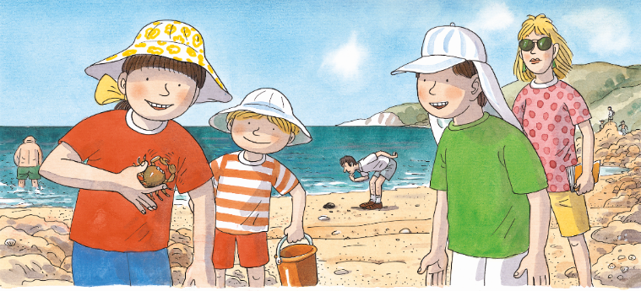
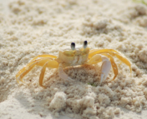
Put It Back
TG
LO: Identify the character with prompts and support; understand the meaning of the vocabulary word
and phrase crab and put back and make sentences with them; read the text accurately and
fluently.
1. Ask Ss to observe the illustration and talk about the character question.
2. Read the text to Ss and ask each S to find one of the given key words in the text; click the crab or put
back button to explain the key words; have Ss read the words and make sentences with them.
3. Have Ss talk about the comprehension questions.
4. Guide Ss to read the text together; then ask Ss to read the text fluently in turns; give feedback.
Reading
Character
Vocabulary
Vocabulary
Who had a crab?
Comprehension
What was Kipper holding?
What did Chip say?
crab
put back
The crab is walking on the bench.
Decoding
Please put the book back after reading.
Fluency.
She had a crab in her hand.
“Put it back,” said Chip.
crab
put back
3:00
10/26

Slide 11
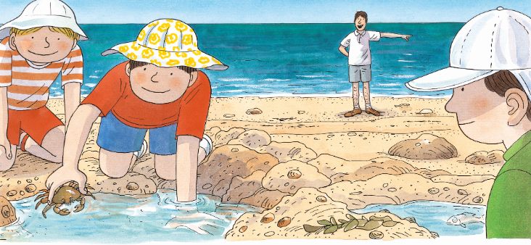
Put It Back
TG
LO: Identify the character and key details with prompts and support.
1. Read the text to Ss; have them talk about the comprehension questions;
encourage them to think and talk more about the second comprehension
question.
2. Ask Ss to look at the illustration closely and talk about the character question.
3. Have Ss talk about the connections question with each other.
Reading
Comprehension
What did Biff do?
Why do you think Biff did that?
Character
Who was standing at the beach? Look for clues in the illustration.
Connections
Biff put the crab back.
If you were Biff, would you do the same thing?
“Let’s look on the sand,” said Dad.
3:00
11/26

Slide 12
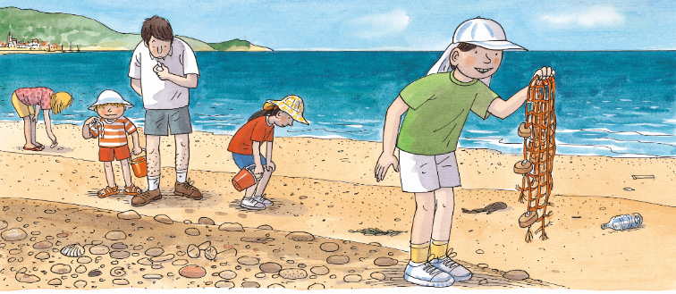
Put It Back
TG
Reading
LO: Identify some details with prompts and support; decode the sight words come and
see accurately in the text; read the text accurately and fluently.
1. Have Ss talk about the first comprehension question using the given sentence
structure; have Ss talk about the second comprehension question.
2. Ask Ss to find the sight words in the text and guide them to read it accurately.
3. Have Ss do the decoding practice in turns and read the text accurately and fluently.
Comprehension
What did Chip find?
How did Chip feel?
?
Chip had ______.
Sight Words
come, see
“Come and see this,” said Chip.
Decoding
He had a net.
Fluency.
2:00
12/26

Slide 13
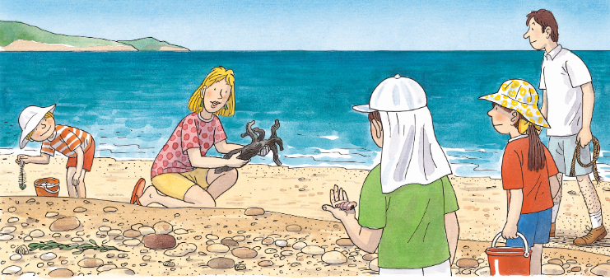
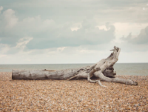
Put It Back
LO: Identify the character and key details with prompts and support;
understand the meaning of the vocabulary word wood.
1. Read the text to Ss and ask each Ss to find the given key word in the text; click
the wood button to explain the key word; have Ss read the word and make
sentences with it.
2. Have Ss talk about the question using the given sentence structure.
3. Ask Ss to look for the clue in the illustration and talk about the character question.
TG
Reading
Comprehension
Vocabulary
What did Mum find at the beach?
What was in Kipper’s hand?
?
Mum had ______.
wood
Character
There is a bit of wood at the beach.
Who was holding a bucket? Look for clues in the illustration.
“Come and see this,” said Mum.
She had a bit of wood.
wood
2:30
13/26

Slide 14
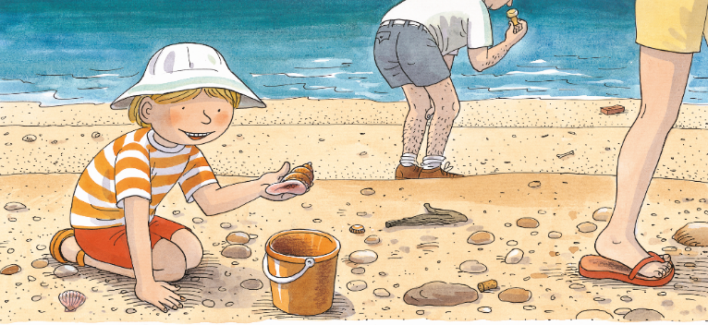
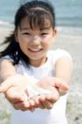
Put It Back
LO: Identity some details with prompts and support; understand the meaning of the
vocabulary word shell and make sentences with it .
1. Ask Ss to find the word shell in the text; click and explain the key word; have Ss
read the word and make sentences with it.
2. Have them talk about the first questions using the given sentence structure;
encourage Ss to share with each other what they think about the second question.
3. Have Ss talk about the connections question.
TG
Reading
Comprehension
Vocabulary
What did Kipper find at the beach?
What do you think Kipper was thinking?
?
Kipper had ______.
shell
Connections
The girl found a
shell at the beach.
What did you find at the beach with your family?
“Look at this shell,” said Kipper.
“This is the best of all.”
2:30
shell
14/26

Slide 15
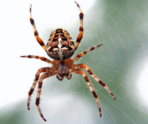
Put It Back
LO: Understand the text; understand the meaning of the vocabulary word legs and make
sentences with it; read the text accurately and fluently.
1. Read the text to Ss; ask Ss to find the word legs; click and explain the key word; have
Ss read the word and make sentences with it.
2. Have Ss talk about the first question using the given sentence structure; ask Ss to talk
about the next question.
3. Guide Ss to take turns reading the text; have them do pair reading; then give feedback.
TG
Reading
Comprehension
Vocabulary
What did the shell have?
?
The shell had _____.
2. Who found the shell
that had legs? Did he
or she know the shell
was alive?
legs
The spider has eight legs.
Decoding
The shell had legs.
Fluency.
“Oh no!” said Kipper.
“What is it?”
2:30
legs
15/26

Slide 16
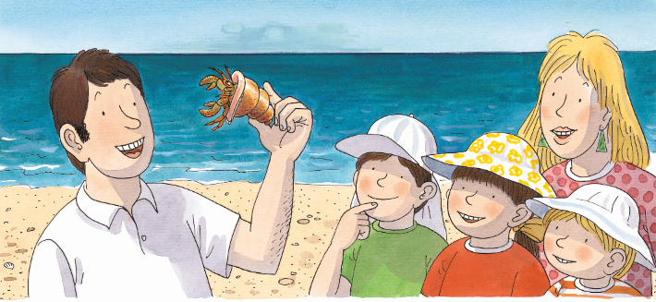
Put It Back
LO: Identify the character and details with prompts and support.
1. Ask Ss to observe the illustration and have Ss talk about the character
question.
2. Read the text to Ss; ask Ss if the hermit crab is the same as the crab they
often see; encourage them to find out the differences between a hermit
crab and a crab they often see.
3. Have Ss talk about the comprehension questions in pairs.
TG
Reading
Character
Who told everyone the name of the creature?
Comprehension
Why did the shell have legs?
Do you think the children saw this kind of shell before?
“It’s a hermit crab,” said Dad.
“It’s a crab that lives in a shell.”
2:00
16/26

Slide 17
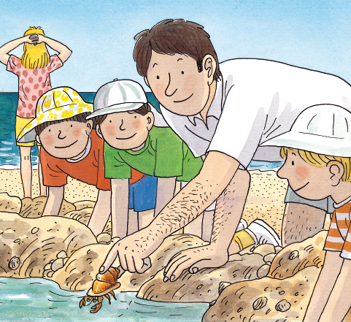
Put It Back
TG
Reading
LO: Identify the character and details with prompts and support; read the text accurately and fluently.
1. Have Ss to read the text like they were Kipper.
2. Guide Ss to look at the illustration and talk about the first comprehension question; have Ss talk about the
next comprehension question.
3. Encourage Ss to talk more about the connections question.
4. Have Ss do the decoding practice in turns and read the text accurately and fluently; then give feedback.
Comprehension
What did Kipper ask Dad to do with the hermit crab? Why do you think Dad did that?
Connections
If you were Kipper, what would you do with the crab?
Decoding
“Put it back,” said Kipper.
Fluency.
2:00
17/26

Slide 18
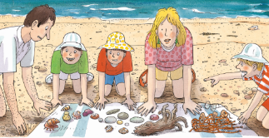
TG
Reading
LO: Retell the story with the visual support and assistance; help Ss to consider the moral of this
lesson: respect all living things.
1. Guide Ss to recall what happened in the story; share with them how some of the pictures are
in the wrong order.
2. Click and ask Ss to work together to put the pictures in the right order.
3. Have Ss work in pairs to recall the details of the story in the right sequence; model first.
4. Have Ss take turns retelling the story using the visual aids.
Notes: T can click Let’s Retell! to show the numbers. Then T can click the three bottom pictures
to present the numbers.
Let’s retell!
Number the pictures in order.
1
7
3
4
5
Come and see this!
____ had _____.
Put _____ back.
2
6
2:00
18/26

Slide 19
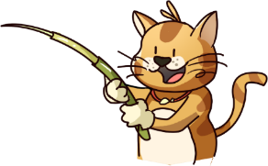
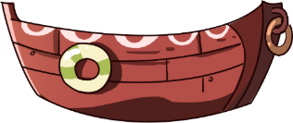
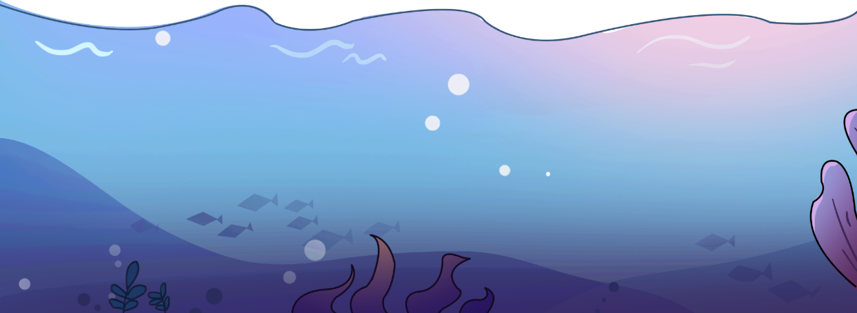
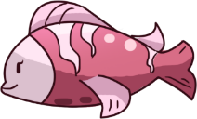
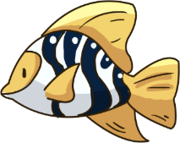
Let’s play!
LO: Check their understanding of the words in this lesson.
1. Ask Ss to compete and review all the learned words in this lesson by
playing the game; the first S who guesses correctly can get one point.
2. Whoever gets the most points is the winner.
3. Click and ask Ss to guess what the word is according to the picture.
4. Click to show the word and ask Ss to read the word together.
5. Announce the winner of the competition.
TG
Vocabulary
shell
crab
legs
wood
1:00
19/26

Slide 20
Listening &
Speaking
TG
LO: Use the given sentence structures to talk about what they
found at the beach in the story.
1. Have Ss work in pairs to talk about the given illustrations
using the sentence structures and helping words; model first.
2. Assist Ss if necessary.
Let’s talk!
—What did _____ find at the beach?
—_____ had _____.
Helping Words
Biff Chip Kipper Mum Dad | legs crab net wood hermit
2:00
20/26

Slide 21
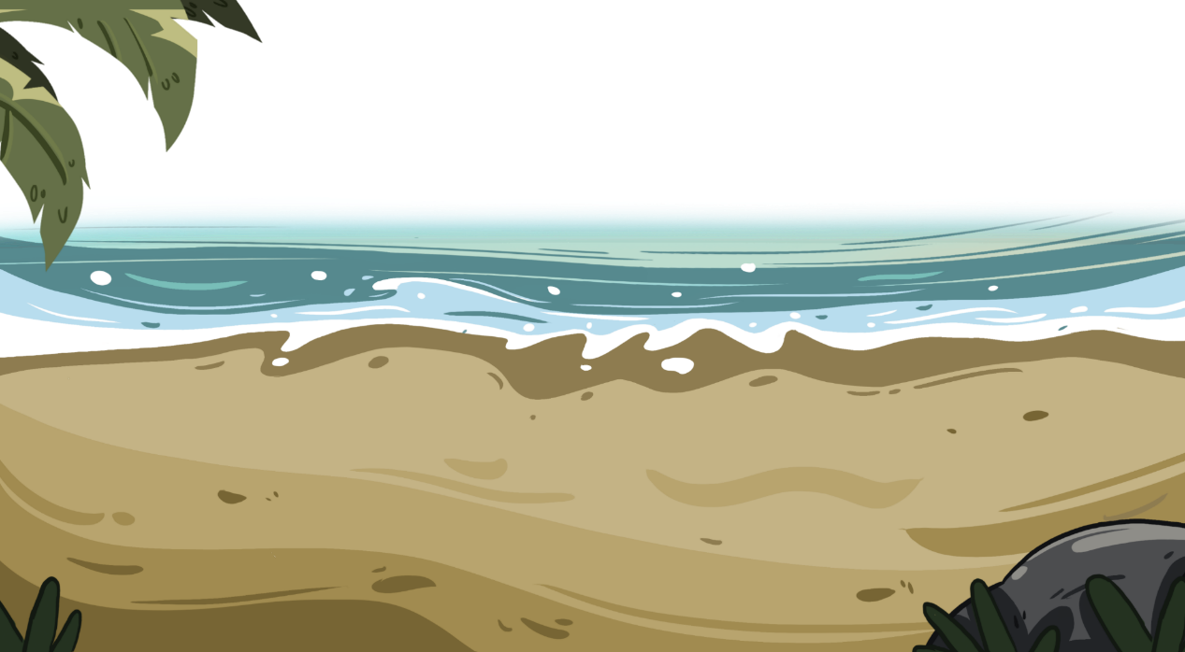
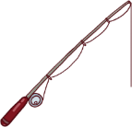
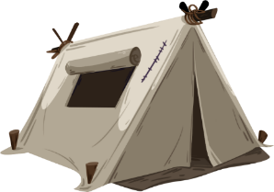
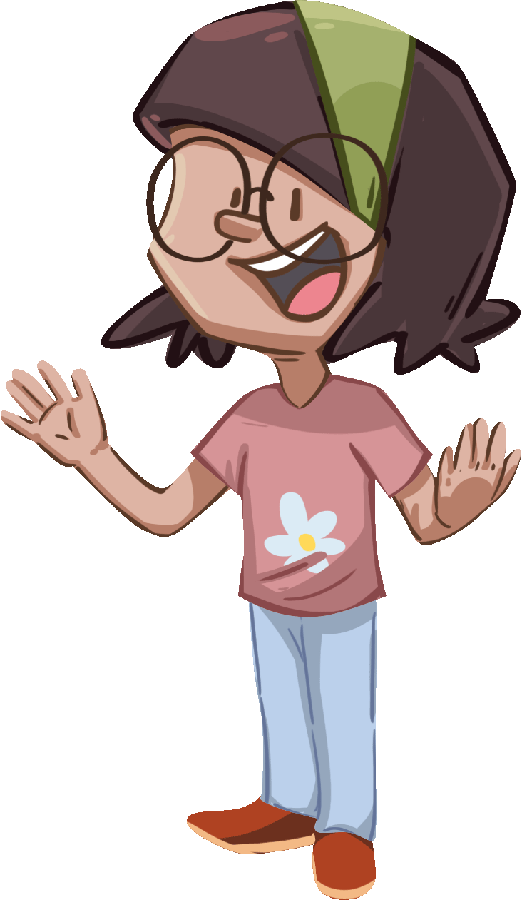
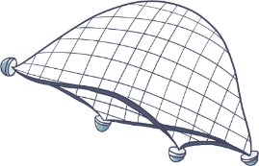
Listening &
Speaking
TG
LO: Use the sentence structures to talk about what they can they find at the beach.
1. Ask Ss to talk about where the objects are; encourage them to look at the picture closely and find as
many of the objects as they can.
2. Ask Ss to work in pairs to talk about at least three things they find on the beach by asking and
answering questions about the given illustration using the given language structures; model first.
3. Assist Ss if necessary.
Notes: T can click Let’s Talk! to present the sentence structure, and T can click again to make it disappear.
Let’s talk!
—What can you find at the beach?
—I can find _________.
a ball, a book, a swim ring . . .
2:30
21/26

Slide 22
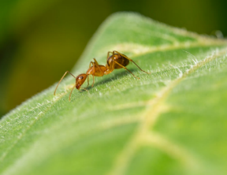
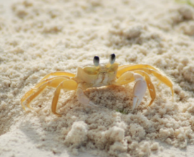
LO: Talk about the value of respecting all living things as shown in this
lesson.
1. Ask Ss to think about the given questions; model first.
2. Have Ss work in pairs to talk about the questions with the help of the
given pictures and sentence structure；make sure Ss know that they
should respect all the living things instead of controlling them.
3. Encourage Ss to talk more about respecting all the living things.
TG
Value
What small things can you find?
What should we do with them?
an ant
a crab
We should put ___ back.
2:00
22/26

Slide 23
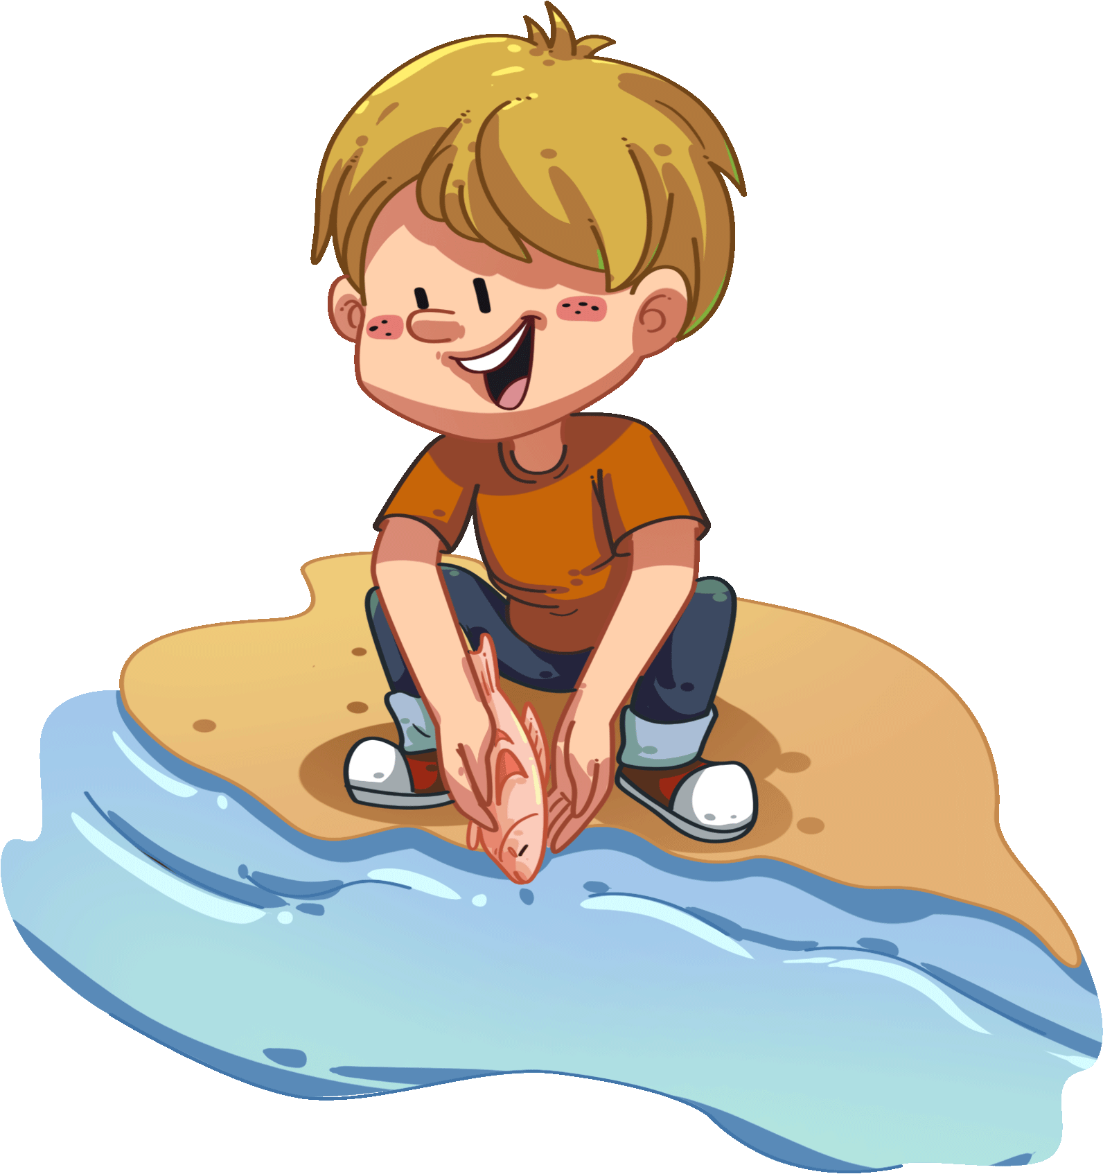
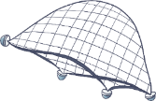
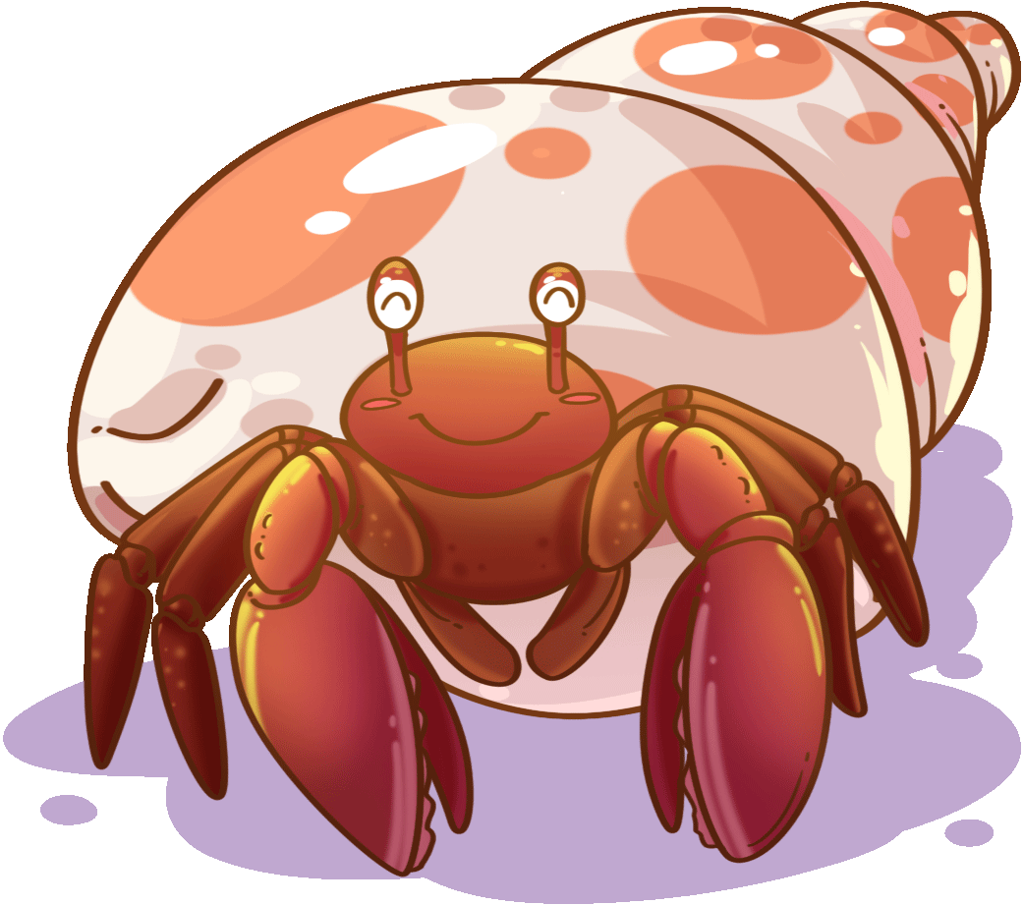
TG
LO: Talk about what they’ve learned from the story using the given structure
and language support.
1. Guide Ss to talk about what they’ve learned.
2. Ask Ss to think about the given questions; help Ss to organize ideas from the
story with the given visual support and tell them, “These are exercises to help you
with your after class homework assignment.”
3. Model the first question, and then ask Ss to take turns presenting their answers.
Oral Writing
Get ready to present!
What did the family do at the beach?
crab
put it back
net
wood
hermit crab
2:00
____ had _____.
“Put it back,” said _____.
23/26

Slide 24
TG
LO: Understand what the homework is.
1. Explain the writing task to Ss and check their understanding.
2. Tell Ss that they should finish their writing before next class. Make
sure they know they can upload their homework to the platform.
They will present their work next class.
3. Remind Ss to watch the post-class video and finish the writing task.
Writing
Let’s draw and write!
Now, please follow the steps to finish your homework and present it in the next class:
Draw what you want to bring to the beach.
Write at least two phrases about it with adjectives.
Watch the post-class video about the writing task.
0:30
24/26

Slide 25
TG
Review
LO: Review today’s lesson.
1. Guide Ss to review the phonics by pointing to some words
and ask Ss to read them aloud.
2. Guide Ss to review the sentence structure by asking Ss to
make sentences with it.
Review
Let’s review!
Phonics:
bat/cat/fat/hat/sat/mat
Sentence Structure:
_____ had _____.
Vocabulary:
crab/put back/
wood/shell/legs
1:00
25/26

Slide 26
TG
LO: End the lesson and encourage Ss to perform better in the
next class.
1. Give brief comments on Ss.
2. Say goodbye to students.
3. Ask Ss to preview the next lesson.
0:30
26/26

