Slide 1
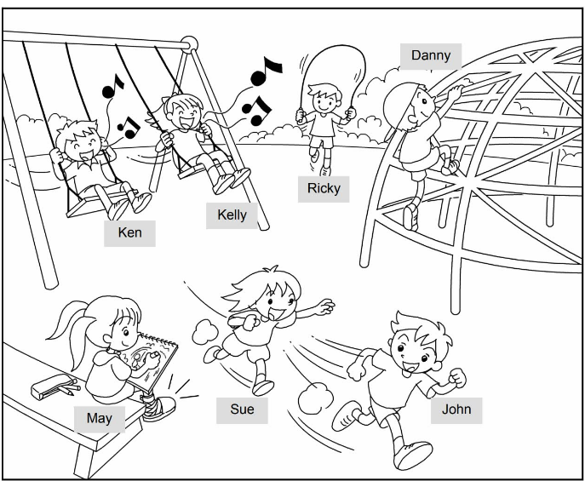
Picture Description
children are having fun. Study the picture and describe it. Answer the teacher’s questions.

Slide 2
Suggested questions:
1 What can Danny / Ricky / May do?
2 What can Sue and John / Kelly
and Ken do?
3 Look at May. What can’t
she do?
4 What can you do?
5 What can’t you do?

Slide 3
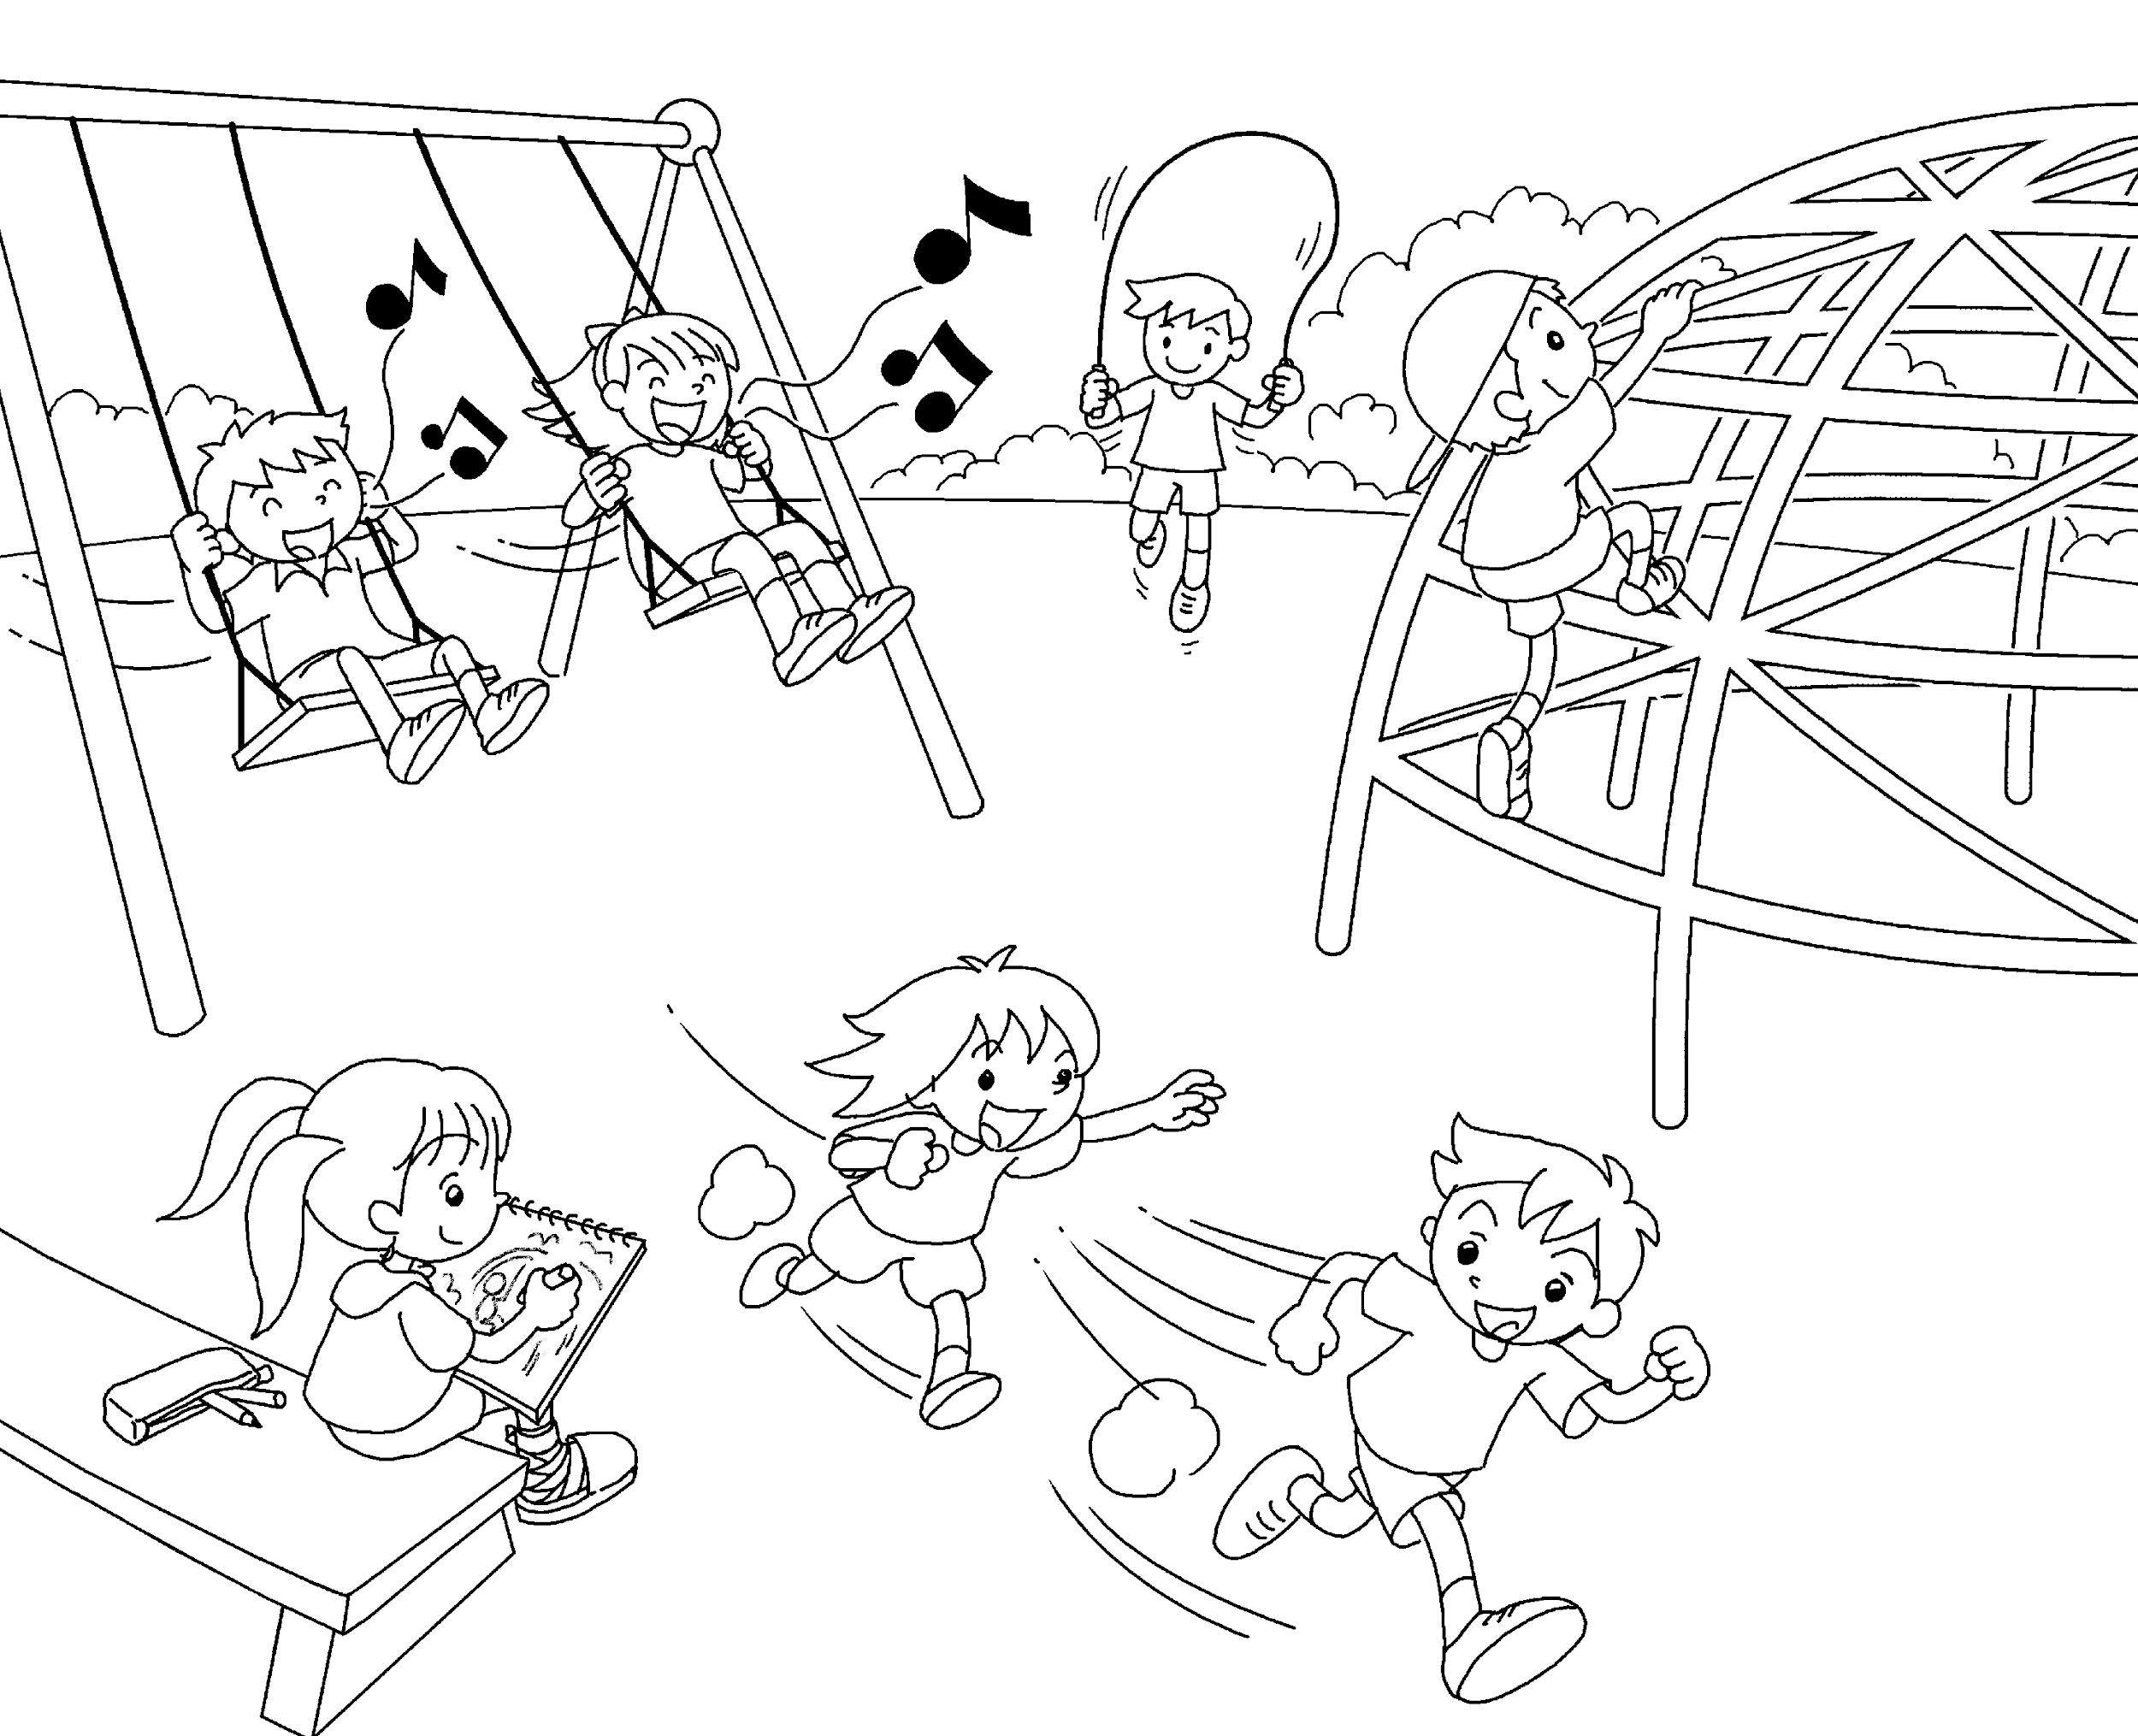
Suggested answers to the questions:
1 He / She can climb / skip / draw.
2 They can run (fast) / sing.
3 She can’t climb / skip / run / walk.
4 (pupils’ own answers)
5 (pupils’ own answers)
(Accept any reasonable answers.)

