Slide 1
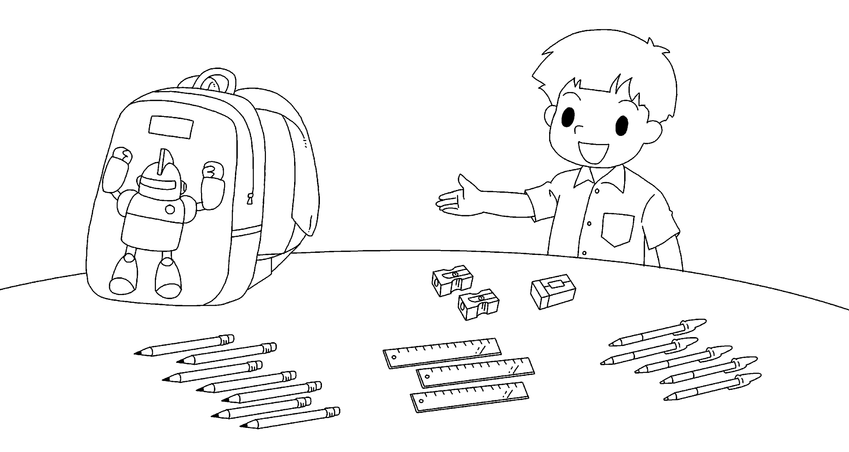
Picture Description
These are the things in John’s school bag. Study the picture and describe it. Answer the teacher’s questions.
Notes:
Give the pupil three minutes to look at the picture.
Encourage the pupil to talk about the picture as much as he / she can

Slide 2
Suggested questions:
1 (Pointing to the school bag) Look at the school bag. There is a picture on the school bag. What is it?
2 How many sharpeners does John have?
3 How many erasers does John have?
4 How many pens does John have?
5 What colour are the rulers?
Notes:
Give the pupil three minutes to look at the picture.
Encourage the pupil to talk about the picture as much as he / she can

Slide 3
Suggested answers to the questions:
1 It is a robot.
2 John / He has two sharpeners.
3 John / He has one / an eraser.
4 John / He has five pens.
5 The rulers / They are brown
and black / black and brown.
Notes:
Give the pupil three minutes to look at the picture.
Encourage the pupil to talk about the picture as much as he / she can

