Slide 1
A Reading aloud
Read the following text aloud.
About my friend
This is my friend Ken.
He is eight years old.
He is tall and thin.
He has small eyes.
He can’t climb but he can swim.
Notes:
Give the pupil two minutes to look at the text.

Slide 2
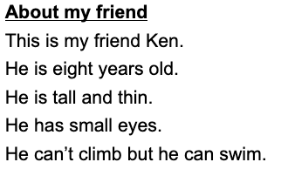
B Expression of personal experiences
Answer the teacher’s questions.
Suggested questions
Who is your best friend?
How old is he / she?
Is he / she tall / short / fat / thin?
Does he / she have big / small eyes?
What can / can’t he / she do?
.
Notes:
Ask the guiding questions below and encourage the pupil to say as much as he / she can, giving prompts where appropriate.
You can also ask other questions relevant to the theme of Part A.

