Slide 1
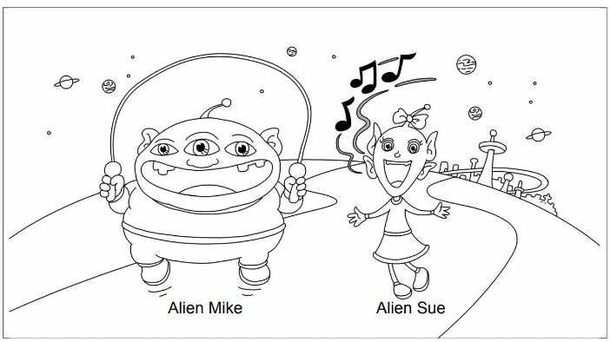
Picture Description
Alien Mike and Alien Sue live on Planet Gee. Study the picture and describe it. Answer the teacher’s questions.
Notes:
Give the pupil three minutes to look at the picture.
Encourage the pupil to talk about the picture as much as he / she can.

Slide 2
Suggested questions:
1 Talk about Alien Mike.
2 Talk about Alien Sue.
3 Look at Alien Mike. What can he do?
4 Look at Alien Sue.
What can she do?
5 What can you do?
Notes:
Give the pupil three minutes to look at the picture.
Encourage the pupil to talk about the picture as much as he / she can.

Slide 3
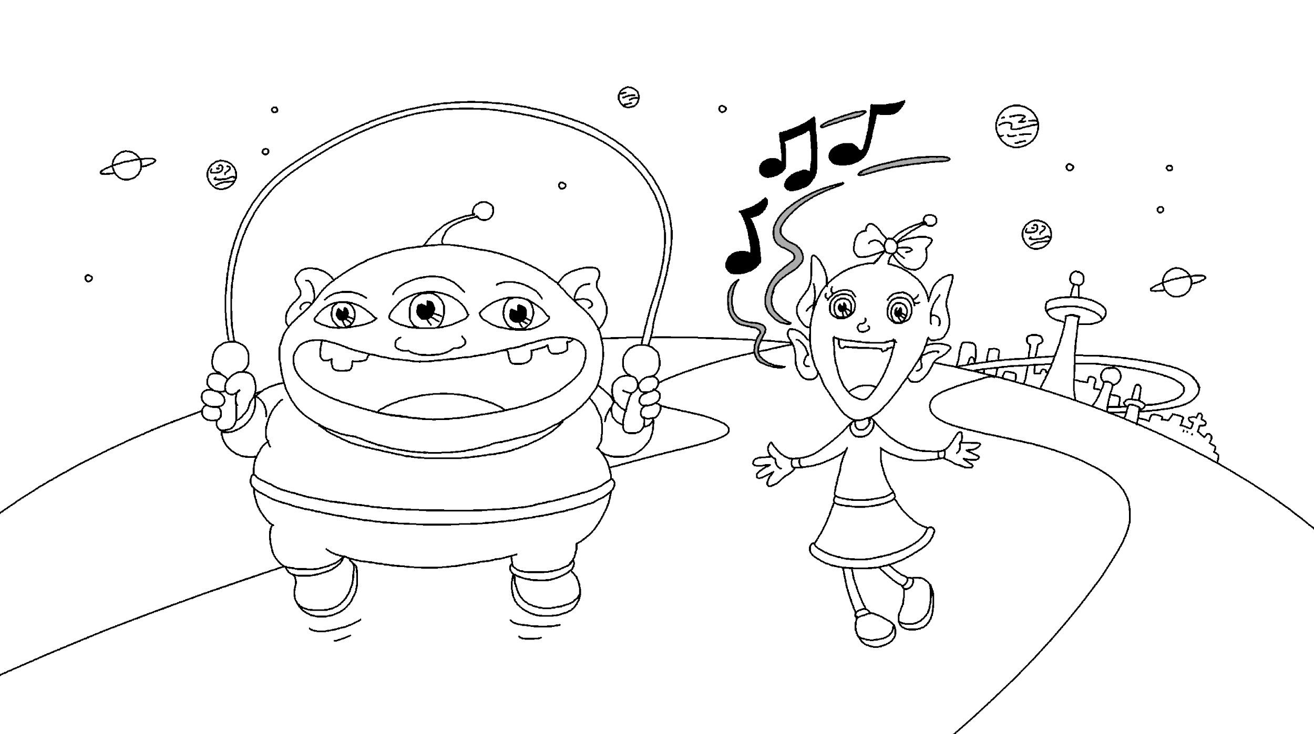
Suggested answers to the questions:
1 He is fat. He has three eyes. He has a big mouth.
2 She is thin. She has four ears. She has a small nose.
3 He can skip.
4 She can sing.
5 (pupils’ own answers)
(Accept any reasonable answers.
Notes:
Give the pupil three minutes to look at the picture.
Encourage the pupil to talk about the picture as much as he / she can.

