Slide 1
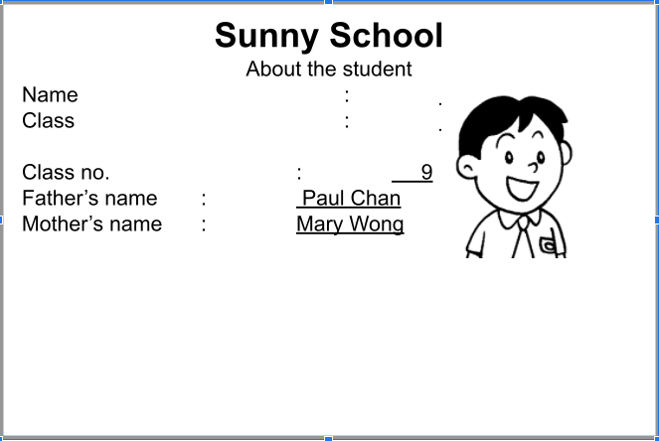
Picture description
Here is a picture of a boy’s school handbook. Study the picture and answer the teacher’s questions.
Notes:
Give the pupil three minutes to look at the picture and the information.
Encourage the pupil to talk about the picture as much as he / she can.

Slide 2
Suggested questions:
1 What is the name of the school?
2 What is the boy’s name?
3 What class is he in?
4 Who is the boy’s father?
5 Who is the boy’s mother?
Notes:
Give the pupil three minutes to look at the picture and the information.
Encourage the pupil to talk about the picture as much as he / she can.

Slide 3
Suggested answers to the questions:
1 Sunny School.
2 Sam Chan.
3 He is in Class 1A.
4 Paul Chan.
5 Mary Wong.
Notes:
Give the pupil three minutes to look at the picture and the information.
Encourage the pupil to talk about the picture as much as he / she can.

