Slide 1
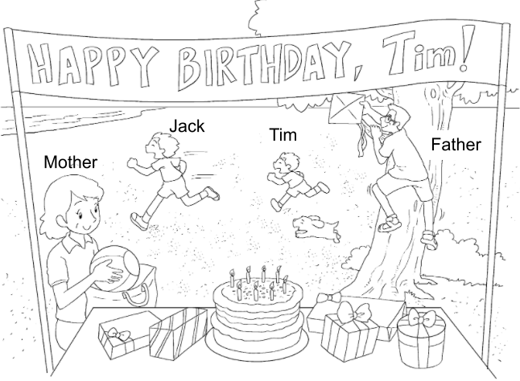
Picture Description
The Chan family are having a birthday party at the beach. Study the picture and talk about the family. Answer the teacher’s questions.

Slide 2
Suggested questions:
1 How old is Tim?
2 How many presents does he have?
3 What can Tim’s brother Jack do?
4 What can Tim’s father do?
5 Can you tell me about Tim’s father? Is he tall or short?
6 What does Tim’s mother have?
Notes:
Give the pupil three minutes to look at the picture.
Encourage the pupil to talk about the picture as much as he / she can.

Slide 3
Suggested answers to the questions:
1 Tim / He is eight (years old).
2 He has five presents.
3 Tim’s brother / Jack / He can
run (fast).
4 Tim’s father / He can climb
a tree.
5 Tim’s father / He is tall.
(He has glasses.)
6 Tim’s mother / She has a
ball / bag.
Notes:
Give the pupil three minutes to look at the picture.
Encourage the pupil to talk about the picture as much as he / she can.

