Slide 1
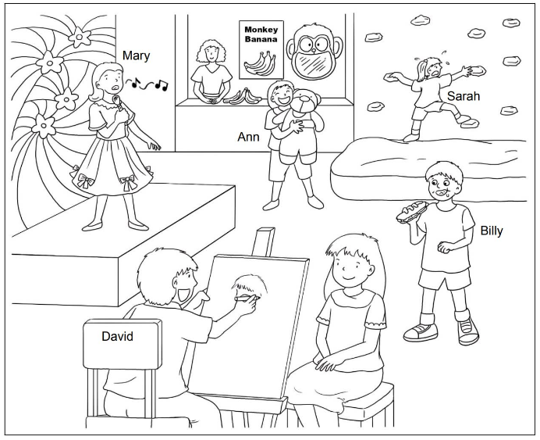
Picture Description
It is School Fun Day. Study the picture and describe it. Answer the teacher’s questions.
Notes:
Give the pupil three minutes to look at the picture.
Encourage the pupil to talk about the picture as much as he / she can.

Slide 2
Suggested questions:
1 What can Mary do?
2 What can David do?
3 Look at Sarah. Can she climb?
4 Look at Billy. Does he have big eyes or small eyes? Does he have long hair or short hair?
5 How does Ann feel? Why? What does she have?

Slide 3
Suggested answers to the questions:
1 Mary / She can sing.
2 David / He can draw.
3 No, she can’t.
4 Billy / He has big eyes
and short hair.
5 Ann / She is happy.
She has a teddy bear.
Notes:
.

