Slide 1
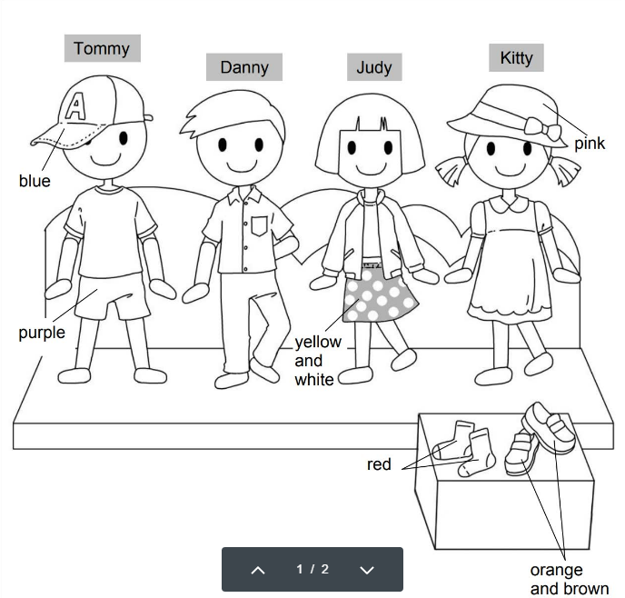
Longman Welcome to English Gold 1B Assessment Bank
Picture Description
Billy is in a clothes shop. Study the picture and describe it. Answer the teacher’s questions.
Notes:
Give the pupil three minutes to look at the picture.
Encourage the pupil to talk about the picture as much as he / she can.

Slide 2
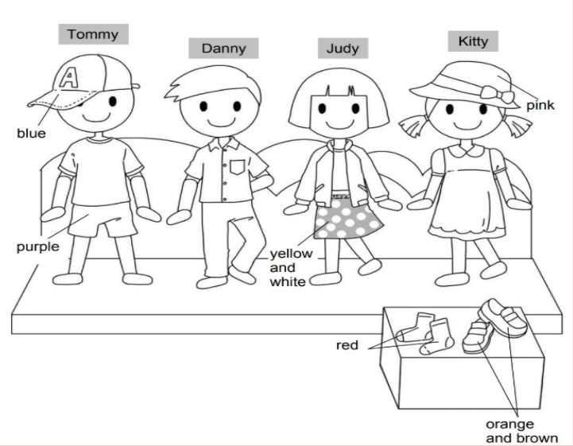
Longman Welcome to English Gold 1B Assessment Bank
Suggested questions:
1 What is Tommy / Danny / Judy / Kitty wearing?
2 What colour is the cap / skirt / hat ?
What colour are the shorts / socks / shoes?
3 What clothing items do you like to wear?
Notes:
Give the pupil three minutes to look at the picture.
Encourage the pupil to talk about the picture as much as he / she can.

Slide 3
Longman Welcome to English Gold 1B Assessment Bank
Suggested questions:
1 What is Tommy / Danny / Judy / Kitty wearing?
2 What colour is the cap / skirt / hat ?
What colour are the shorts / socks / shoes?
3 What clothing items do you like to wear?
Suggested answers to the questions:
1 Tommy / He is wearing a cap, a T-shirt and shorts.
Danny / He is wearing a shirt and trousers.
Judy / She is wearing a jacket and a skirt.
Kitty / She is wearing a hat and a dress.
2 The cap / It is blue.
The skirt / It is yellow and white.
The hat / It is pink.
The shorts / They are purple.
The socks / They are red.
The shoes / They are orange and brown.
3 (pupils’ own answers)
Notes:
Give the pupil three minutes to look at the picture.
Encourage the pupil to talk about the picture as much as he / she can.

