Slide 1
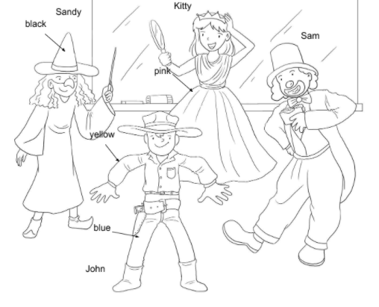
Longman Welcome to English Gold 1B Assessment Bank
Picture Description
The children are having a fancy dress party. Study the picture and describe it. Answer the teacher’s questions.
Notes:
Give the pupil three minutes to look at the picture.

Slide 2
Longman Welcome to English Gold 1B Assessment Bank
Suggested questions:
1 Where are the children?
2 What is Sam doing?
3 What is Kitty wearing?
4 What colour is it?
5 What colour is Sandy’s hat?
6 What colour are John’s clothes?
Notes:
Encourage the pupil to talk about the picture as much as he / she can.

Slide 3
Longman Welcome to English Gold 1B Assessment Bank
Suggested questions:
1 Where are the children?
2 What is Sam doing?
3 What is Kitty wearing?
4 What colour is it?
5 What colour is Sandy’s hat?
6 What colour are John’s clothes?
Suggested answers to the questions:
1 They are in the classroom.
2 He is eating.
3 She is wearing a dress.
4 It is pink.
5 It is black.
6 His shirt is yellow. His jeans / trousers are blue.

