Slide 1
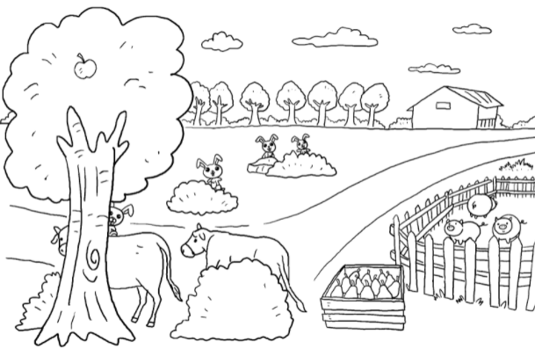
Longman Welcome to English Gold 1B Assessment Bank
Picture Description
Here is Peter’s picture. Study the picture and describe it. Answer the teacher’s questions.
Notes:
Give the pupil three minutes to look at the picture.
Encourage the pupil to talk about the picture as much as he / she ca

Slide 2
Longman Welcome to English Gold 1B Assessment Bank
Suggested questions:
How many rabbits / cows are there?
(Point to the pigs.) What are these?
(Point to the pears.) How many pears are there?
Where are the pears?
What is in the tree?
(Point to the house.) Where is the house?
Notes:
Give the pupil three minutes to look at the picture.
Encourage the pupil to talk about the picture as much as he / she ca

Slide 3
Longman Welcome to English Gold 1B Assessment Bank
Suggested questions:
How many rabbits / cows are there?
(Point to the pigs.) What are these?
(Point to the pears.) How many pears are there?
Where are the pears?
What is in the tree?
(Point to the house.) Where is the house?
Suggested answers to the questions:
There are four rabbits / two cows.
They are pigs.
There are twelve pears.
The pears / They are in a / the box.
There is an / one apple (in the tree).
It is near some trees.
(Accept any reasonable answers.)
Notes:
Give the pupil three minutes to look at the picture.
Encourage the pupil to talk about the picture as much as he / she ca

