Slide 1
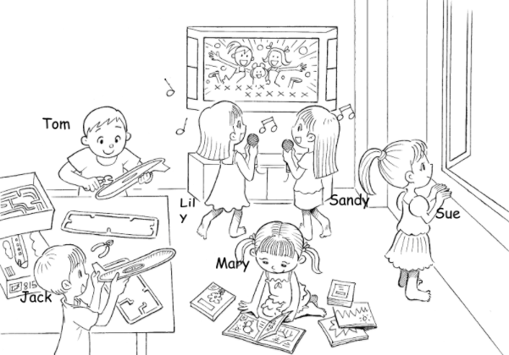
Longman Welcome to English Gold 1B Assessment Bank
Picture Description
Here is a picture of Tom and his friends. Study the picture and describe it. Answer the teacher’s questions.
Notes:
Give the pupil three minutes to look at the picture.
Encourage the pupil to talk about the picture as much as he / she can.

Slide 2
Longman Welcome to English Gold 1B Assessment Bank
Suggested questions:
1 How many boys / girls / children can you see?
2 What are the boys doing?
3 What are Lily and Sandy doing?
4 Who is reading?
How many books are there?
6 Where is Sue?
Notes:
Give the pupil three minutes to look at the picture.
Encourage the pupil to talk about the picture as much as he / she can.

Slide 3
Longman Welcome to English Gold 1B Assessment Bank
Suggested questions:
1 How many boys / girls / children can you see?
2 What are the boys doing?
3 What are Lily and Sandy doing?
4 Who is reading?
How many books are there?
6 Where is Sue?
Suggested answers to the questions:
1 I can see two boys / four girls / six children.
2 The boys / They are making models.
3 Lily and Sandy / They are singing.
4 Mary is reading.
There are five books.
6 Sue / She is near the window.
(Accept any reasonable answers.)
Notes:
Give the pupil three minutes to look at the picture.
Encourage the pupil to talk about the picture as much as he / she can.

