Slide 1
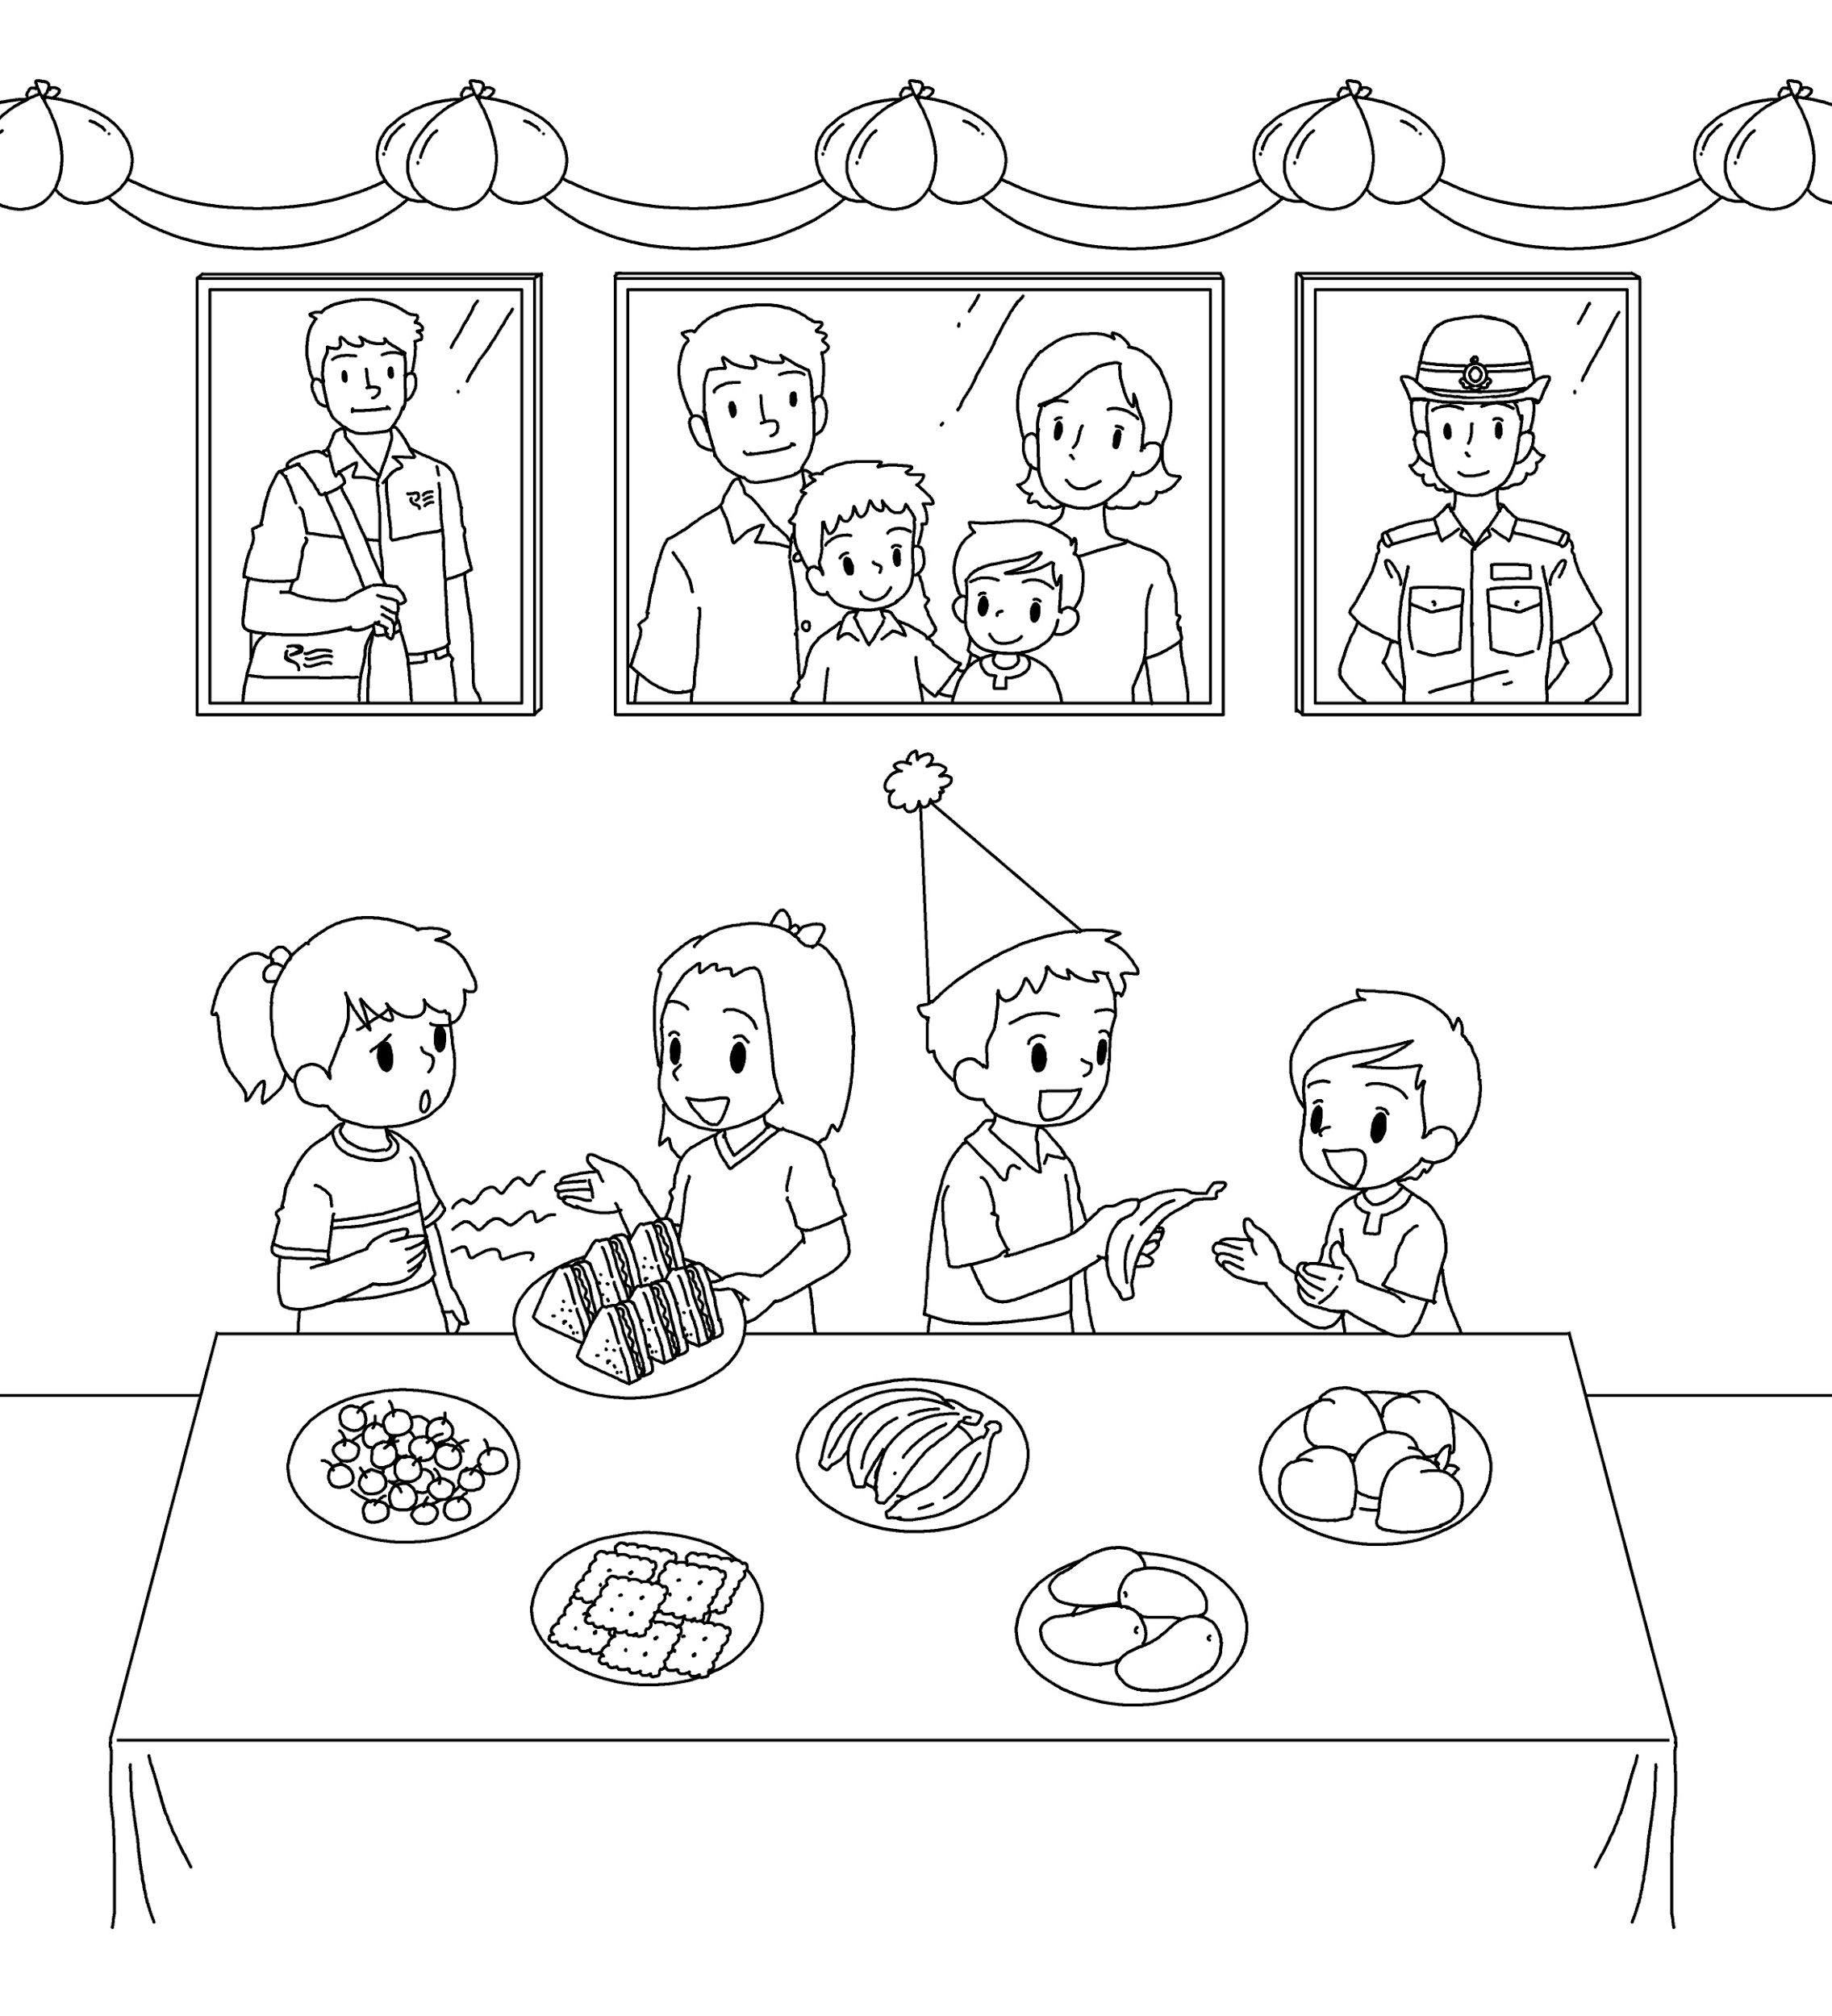
Longman Welcome to English Gold 2A Assessment Bank
Picture Description
The children are having a party. Study the picture and describe it. Answer the teacher’s questions.

Slide 2
Longman Welcome to English Gold 2A Assessment Bank
Suggested questions:
1 What is Alan’s father’s job?
2 What is Alan’s mother’s job?
3 How does Linda feel?
4 What is Betty doing?
5 What do you think of Betty?

Slide 3
Longman Welcome to English Gold 2A Assessment Bank
Suggested answers to the questions:
1 Alan’s father / He is a postman.
2 Alan’s mother / She is a policewoman.
3 Linda / She is hungry.
4 Betty / She is giving Linda some food.
5 She is kind.
(Accept any reasonable answers.)

