Slide 1
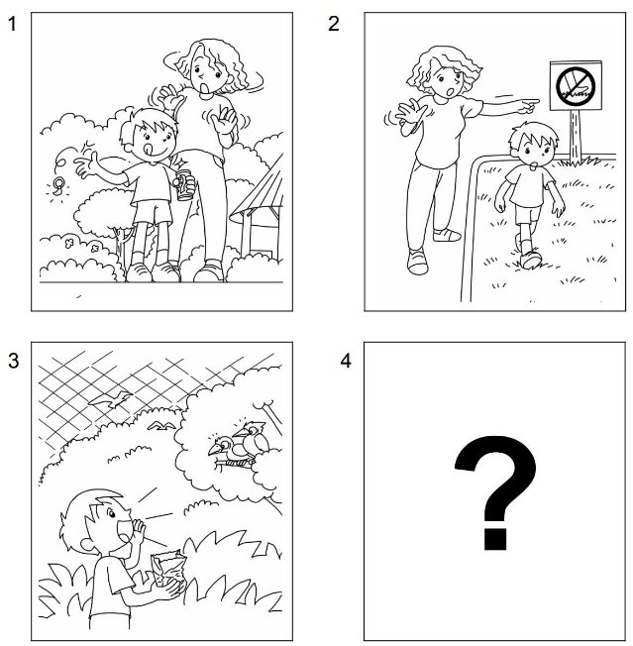
Longman Welcome to English Gold 2A Assessment Bank
Picture Description
Here are some pictures of Jack. Study the pictures and describe them. Answer the teacher’s questions.

Slide 2
Longman Welcome to English Gold 2A Assessment Bank
Suggested questions:
1 Where are Jack and his mum?
2 What does Mum say to Jack? (pointing to Picture 1)
3 What does this sign say? (pointing to the sign in Picture 2)
4 What can you say to Jack? (pointing to Picture 3)
5 Jack has a bag of bird food. What do you think he will do? (pointing to Picture 4)
6 What will his mum say to him?

Slide 3
Longman Welcome to English Gold 2A Assessment Bank
Suggested questions:
1 Where are Jack and his mum?
2 What does Mum say to Jack? (pointing to Picture 1)
3 What does this sign say? (pointing to the sign in Picture 2)
4 What can you say to Jack? (pointing to Picture 3)
5 Jack has a bag of bird food. What do you think he will do? (pointing to Picture 4)
6 What will his mum say to him?
Suggested answers to the questions:
1 They are in a park.
2 Don’t / Do not (throw) litter.
3 It says: Do not walk on the grass.
4 Do not make a noise.
5 He will feed / feeds the birds.
6 Do not feed the birds.
(Accept any reasonable answers.)

