Slide 1
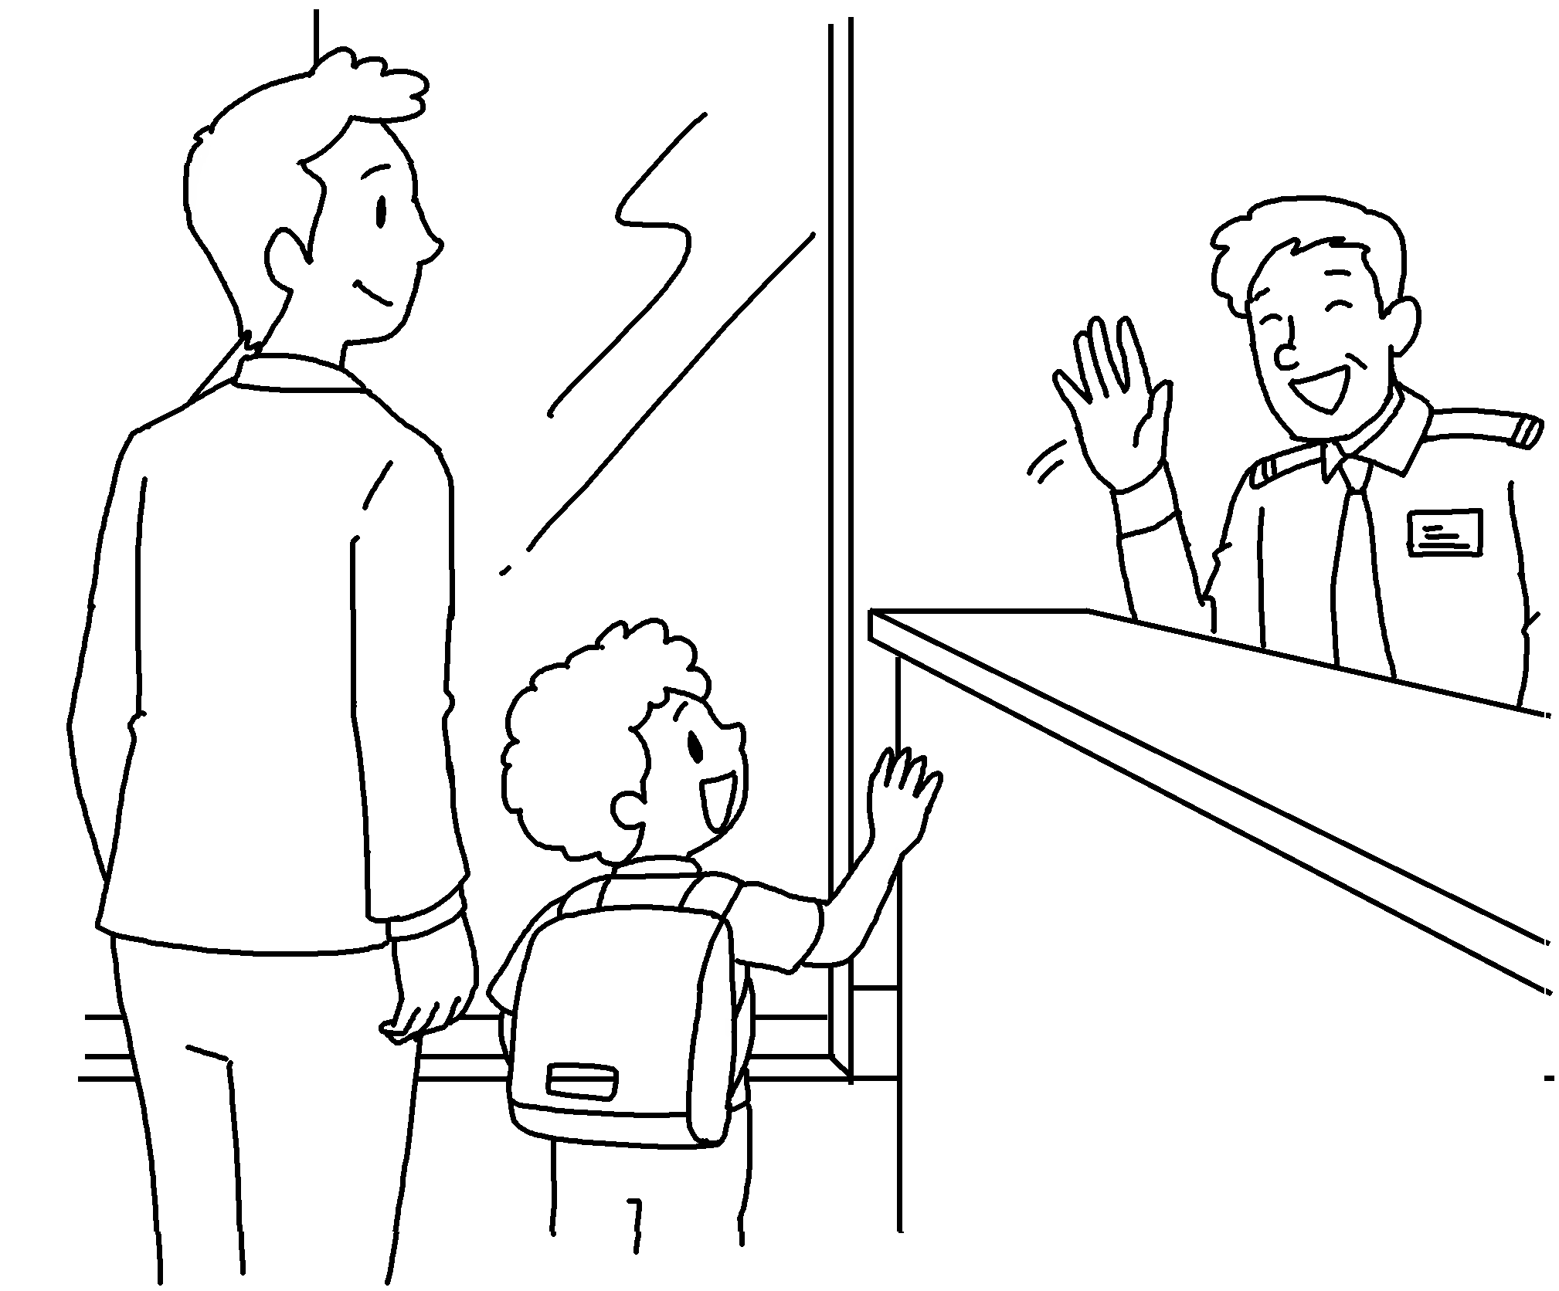
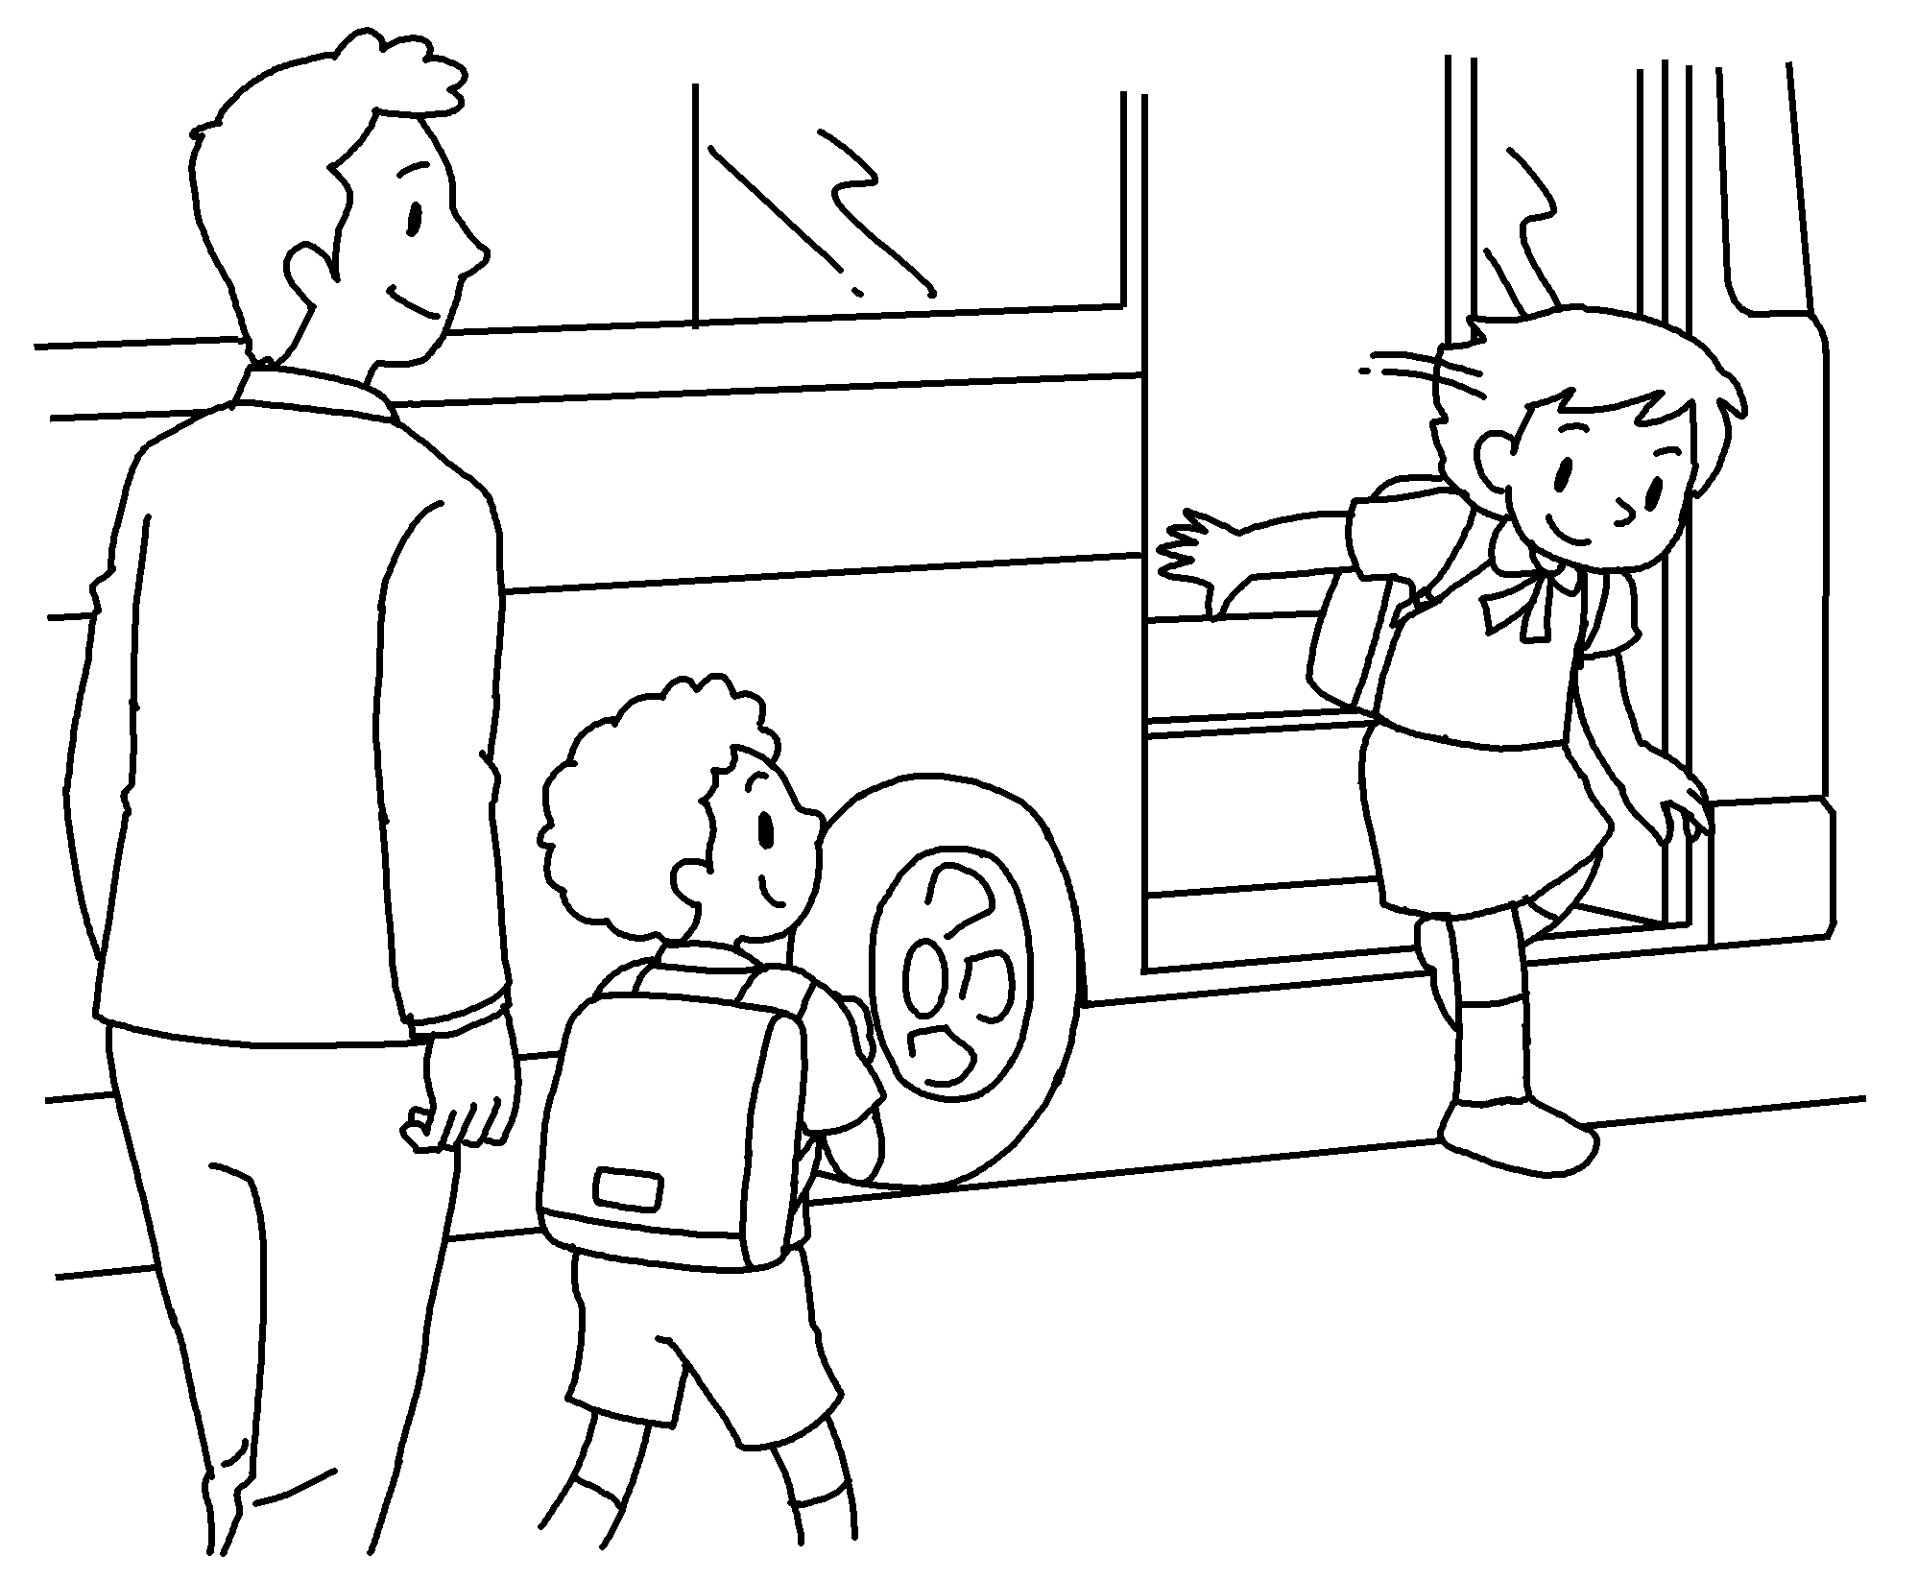
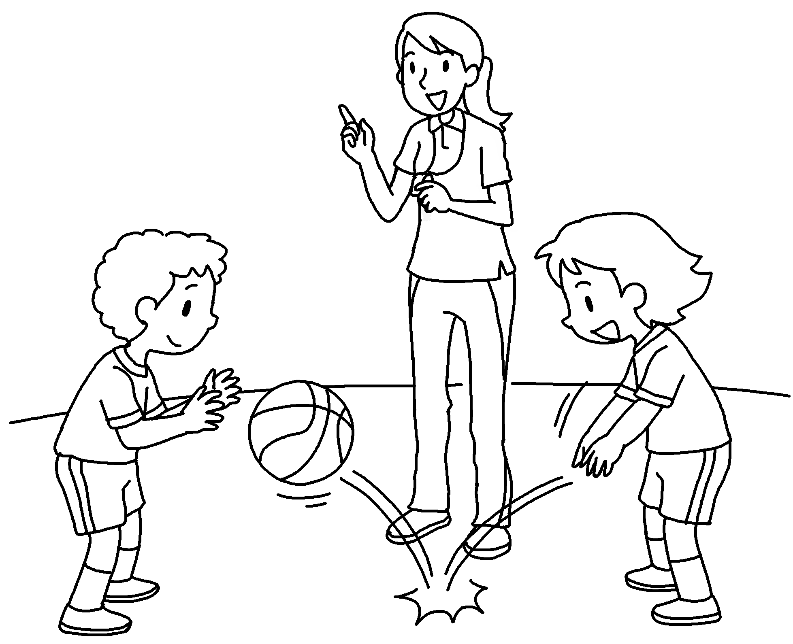
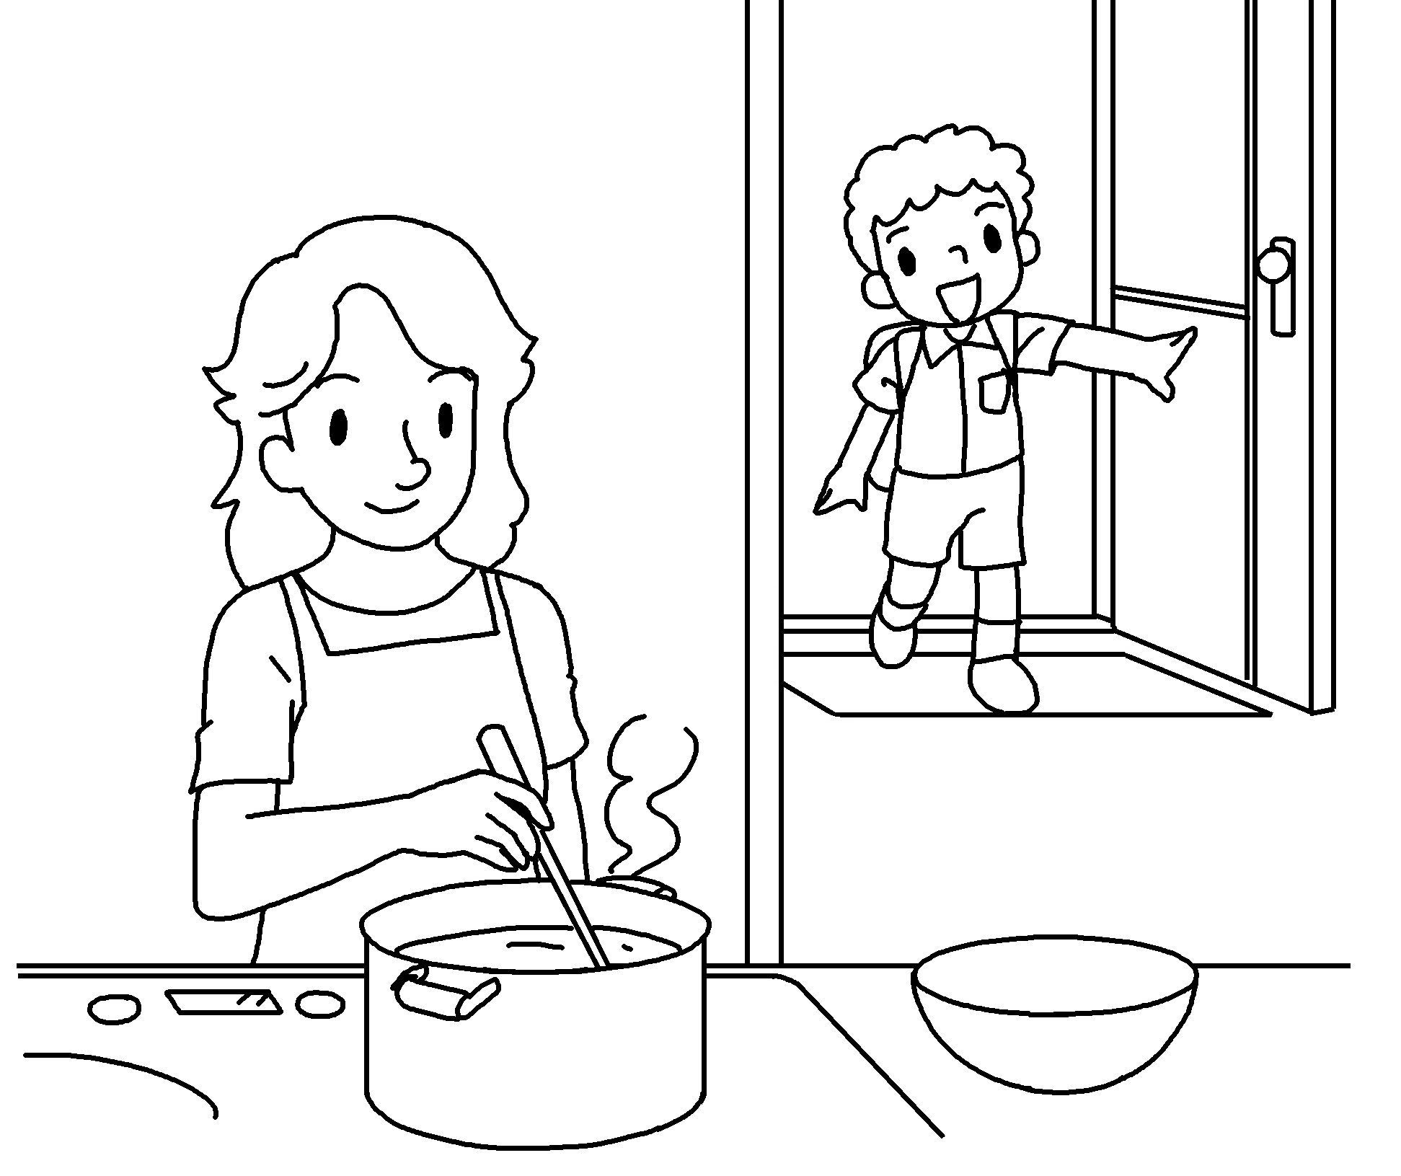
Longman Welcome to English Gold 2A Assessment Bank
Picture Description
Here are some pictures of Tony. Study the pictures and answer the teacher’s questions.

Slide 2
Longman Welcome to English Gold 2A Assessment Bank
Suggested questions:
1 What is Mr Wong’s job?
2 Is Mr Wong friendly?
3 How does Tony go to school?
4 How does Katie go to school?
5 What is Miss Mak’s job?
6 What does Tony’s mother do?

Slide 3
Longman Welcome to English Gold 2A Assessment Bank
Suggested questions:
1 What is Mr Wong’s job?
2 Is Mr Wong friendly?
3 How does Tony go to school?
4 How does Katie go to school?
5 What is Miss Mak’s job?
6 What does Tony’s mother do?
Suggested answers to the questions:
1 Mr Wong / He is a caretaker.
2 Yes, Mr Wong / he is (friendly).
3 Tony / He goes to school on foot. /
Tony / He walks to school.
4 Katie / She goes to school by school bus.
5 Miss Mak / She is a (PE) teacher. /
Miss Mak / She teaches PE.
6 Tony’s mother / She is a housewife. /
Tony’s mother / She looks after the family.

