Slide 1
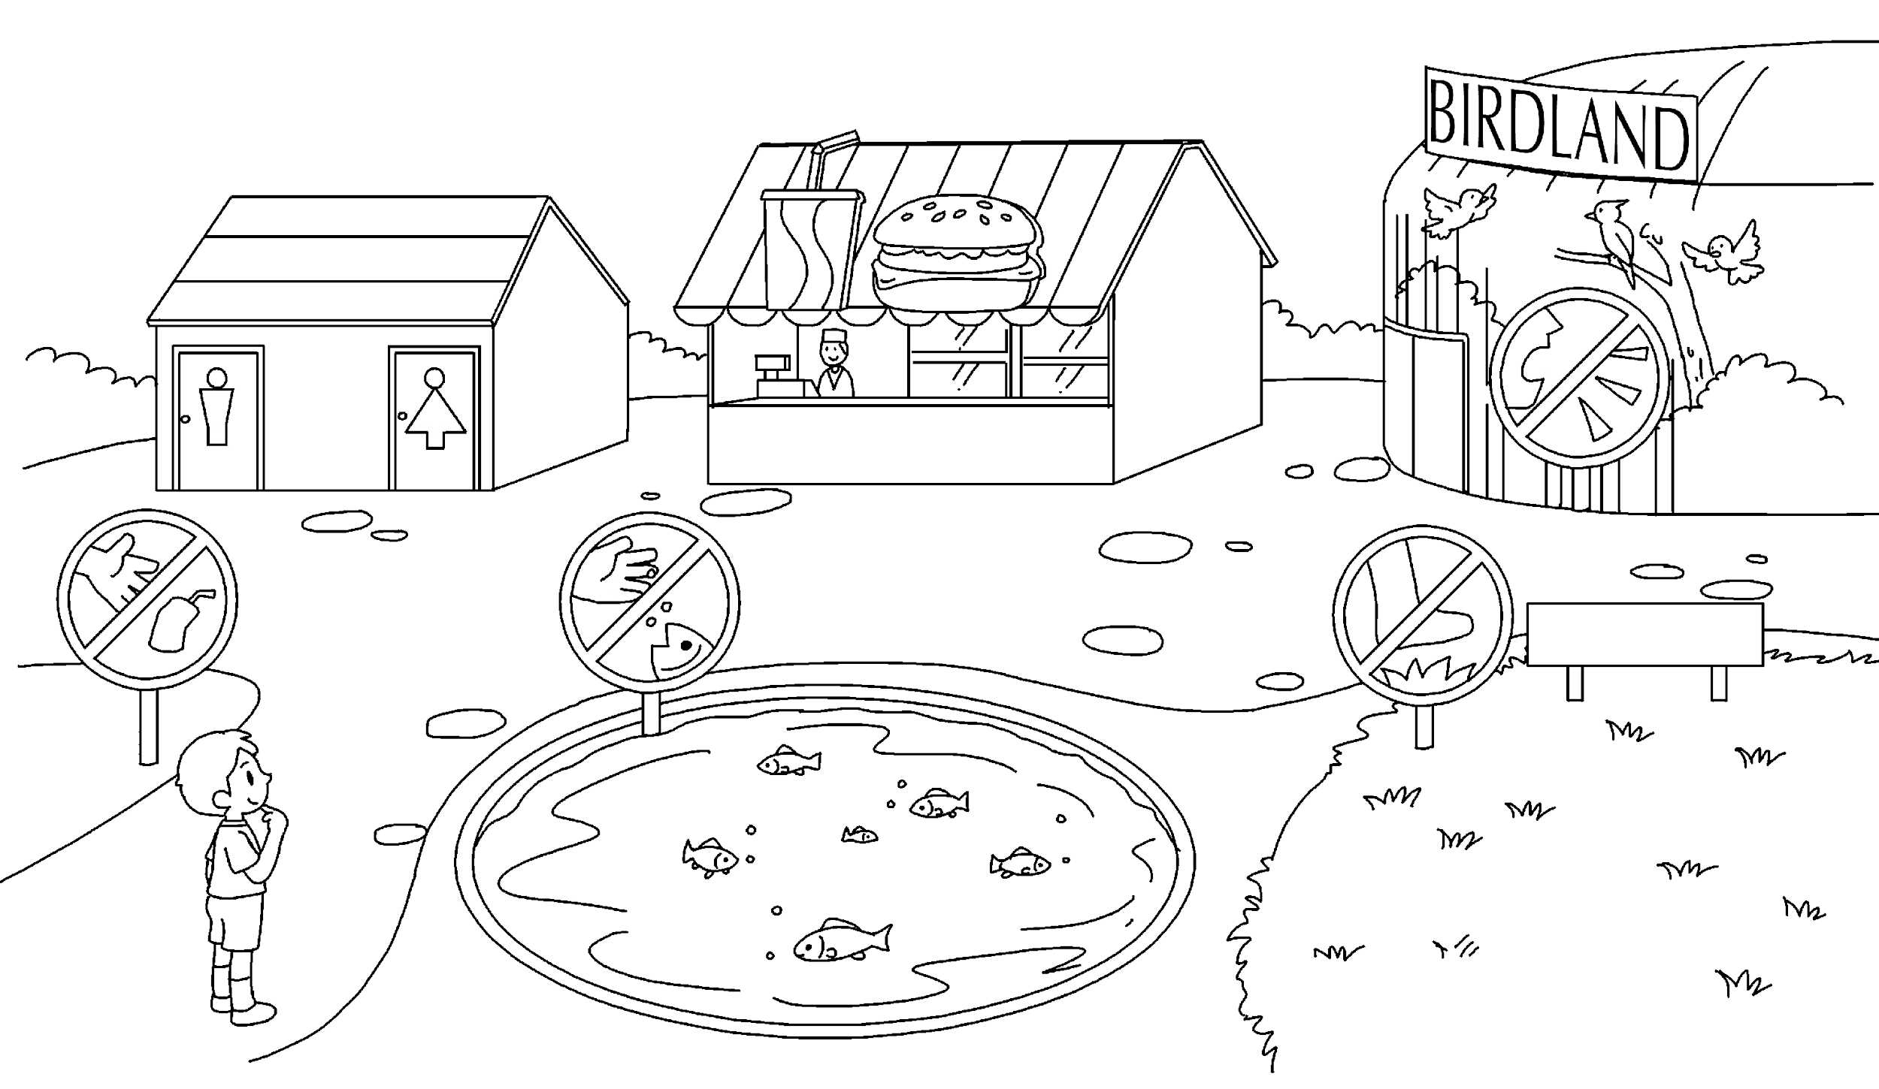
Longman Welcome to English Gold 2A Assessment Bank
Picture Description
Daniel is in Jolly Park. Here is a picture of the park. Study the picture and answer the teacher’s questions.

Slide 2
Longman Welcome to English Gold 2A Assessment Bank
Suggested questions:
1 Daniel wants to wash his hands. Where can he go?
2 Daniel wants to buy some food and drinks. Where can he go?
3 Where is Birdland / Grassland / the snack bar / pond?
4 (Pointing to the ‘Do not throw litter’ sign) Look at this sign. What can’t Daniel do in the park?
5 Can Daniel feed the fish in the pond? How do you know? Point to the sign.
6 (Pointing to the ‘Do not walk on the grass’ sign) Look at this sign. What does it mean?
7 (Pointing to the ‘Do not make a noise’ sign) What can’t Daniel do in Birdland?

Slide 3
Longman Welcome to English Gold 2A Assessment Bank
Suggested answers to the questions:
Daniel / He can go to the toilet(s).
Daniel / He can go to the snack bar.
Birdland / It is behind Grassland.
Grassland / It is in front of Birdland.
The snack bar / It is behind the pond / between the toilets and Birdland.
The pond / It is in front of the snack bar.
Daniel / He can’t (throw) litter (in the park).
No, Daniel / he can’t (feed the fish in the pond).
It means ‘Do not / Don’t walk on the grass’.
Daniel / He can’t make a noise (in Birdland).

