Slide 1
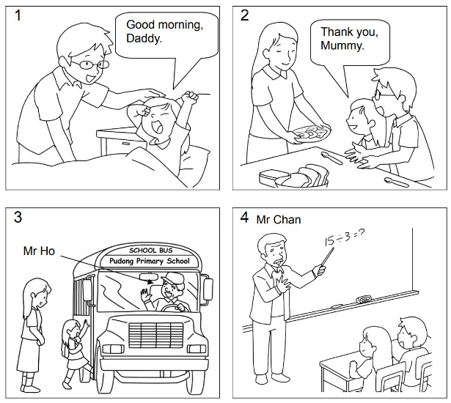
Longman Welcome to English Gold 2A Assessment Bank
Picture Description
Here are some pictures of Betty. Study the pictures and answer the teacher’s questions.
Notes:
Give the pupil three minutes to look at the pictures.

Slide 2
Longman Welcome to English Gold 2A Assessment Bank
Suggested questions:
1 Who wakes Betty up?
2 Who cooks breakfast for Betty?
3 How does Betty go to school?
4 Where is Betty’s school?
5 What is Mr Ho’s job?
6 What does Mr Chan do?
Notes:
Encourage the pupil to talk about the pictures as much as he / she can.Encourage the pupil to talk about the pictures as much as he / she can.Encourage the pupil to talk about the pictures as much as he / she can.Encourage the pupil to talk about the pictures as much as he / she can.

Slide 3
Longman Welcome to English Gold 2A Assessment Bank
Suggested questions:
1 Who wakes Betty up?
2 Who cooks breakfast for Betty?
3 How does Betty go to school?
4 Where is Betty’s school?
5 What is Mr Ho’s job?
6 What does Mr Chan do?
Suggested answers to the questions:
1 Her / Betty’s father (wakes her up).
2 Her / Betty’s mother (cooks breakfast for her).
3 Betty / She goes to school by school bus.
4 Her / Betty’s school is in Pudong.
5 Mr Ho / He is a school bus driver.
6 Mr Chan / He is a Maths teacher / teaches (Betty / the children) Maths.
Notes:
Encourage the pupil to talk about the pictures as much as he / she can.

