Slide 1
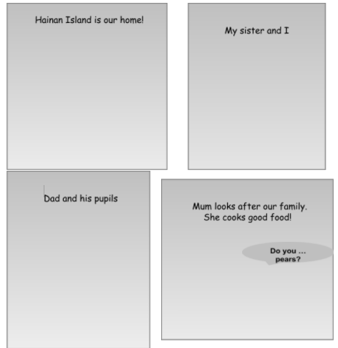
Longman Welcome to English Gold 2A Assessment Bank
Picture description
Here are some photos of Paul and his family. Study the photos and answer the teacher’s questions.

Slide 2
Longman Welcome to English Gold 2A Assessment Bank
1 Where does Paul live?
2 How many people are there in Paul’s family?
3 What is Paul’s father’s job?
4 What is Paul’s mother’s job?
5 (Point to Picture 4) What do you think the man says?
6 Does Paul have any brothers or sisters? What is his / her job?

Slide 3
Longman Welcome to English Gold 2A Assessment Bank
Suggested answers to the questions:
1 Paul lives on Hainan Island.
2 There are four people in Paul’s /
his family.
3 He is a teacher.
4 She is a housewife.
5 Do you want some pears?
6 Paul has a sister. She is a policewoman.

