Slide 1
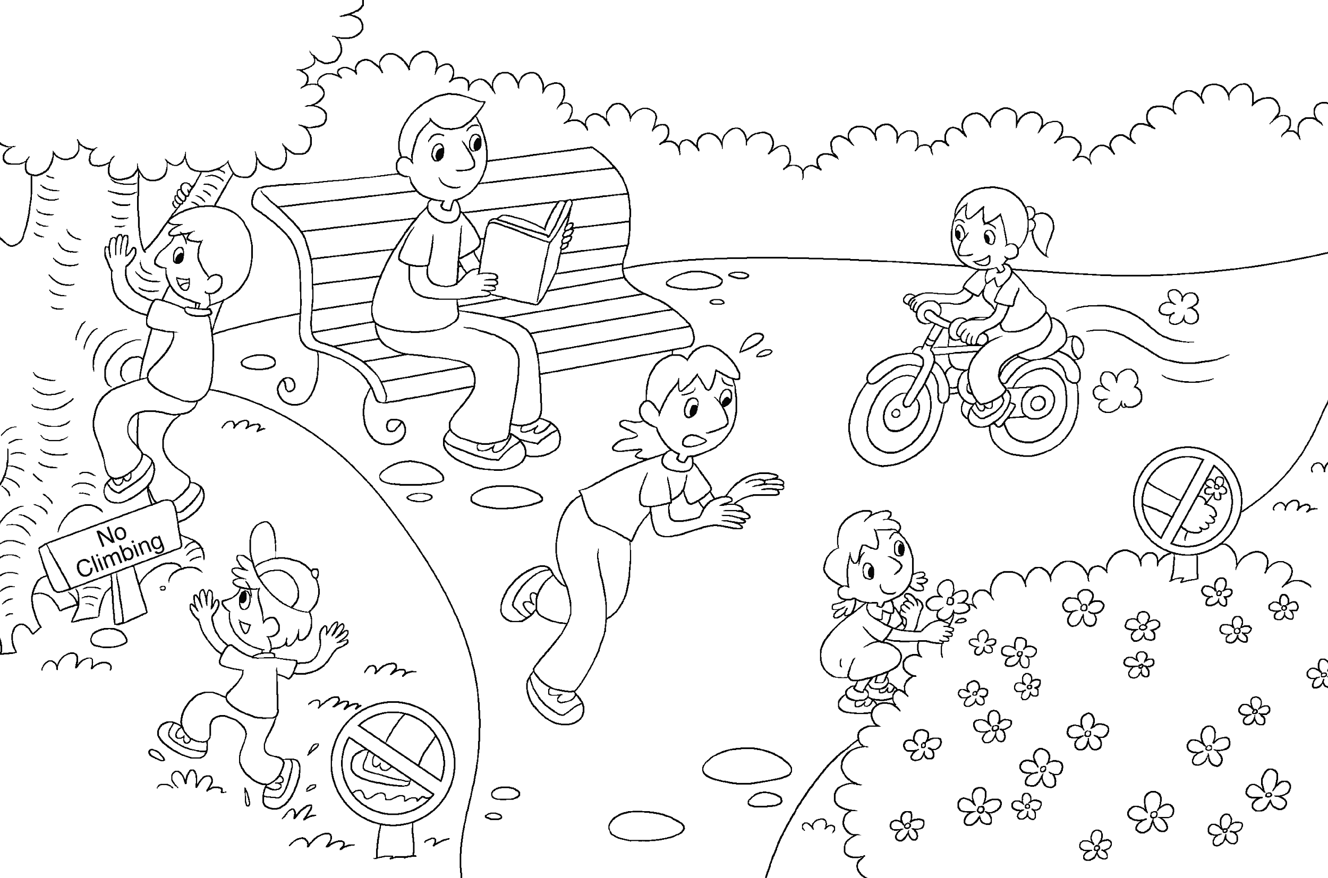
Longman Welcome to English Gold 2A Assessment Bank
Picture description
Here is a picture of the Ko family on Sunday. Study the picture and answer the teacher’s questions..
.
Notes:
Give the pupil two minutes to look at the PICTURE

Slide 2
Longman Welcome to English Gold 2A Assessment Bank
B Expression of personal experiences
Answer the teacher’s questions.
1 Where are the Ko family?
2 Where is Dad? What is he doing?
3 (Point to the woman) What is Mum saying?
4 (Point to the sign ‘Don’t walk on the grass.’) What does this sign mean?
5 (Point to the boy climbing the tree.) What is he doing? Is he right?
6 Who is a good child? Point to him / her.
What is he / she doing?
Notes:
Ask the guiding questions below and encourage the pupil to say as much as he / she can, giving prompts where appropriate.
You can also ask other questions relevant to the theme of Part A.

Slide 3
Longman Welcome to English Gold 2A Assessment Bank
B Expression of personal experiences
Answer the teacher’s questions.
Suggested answers to the questions:
1 The Ko family / They are in the park.
2 Dad is sitting on the bench. He is
reading (a book).
3 Don’t pick the flowers.
4 Don’t walk on the grass.
5 He is climbing the tree. He is not right.
6 Lily is a good child. She is riding a bicycle.
Notes:
Ask the guiding questions below and encourage the pupil to say as much as he / she can, giving prompts where appropriate.
You can also ask other questions relevant to the theme of Part A.

