Slide 1
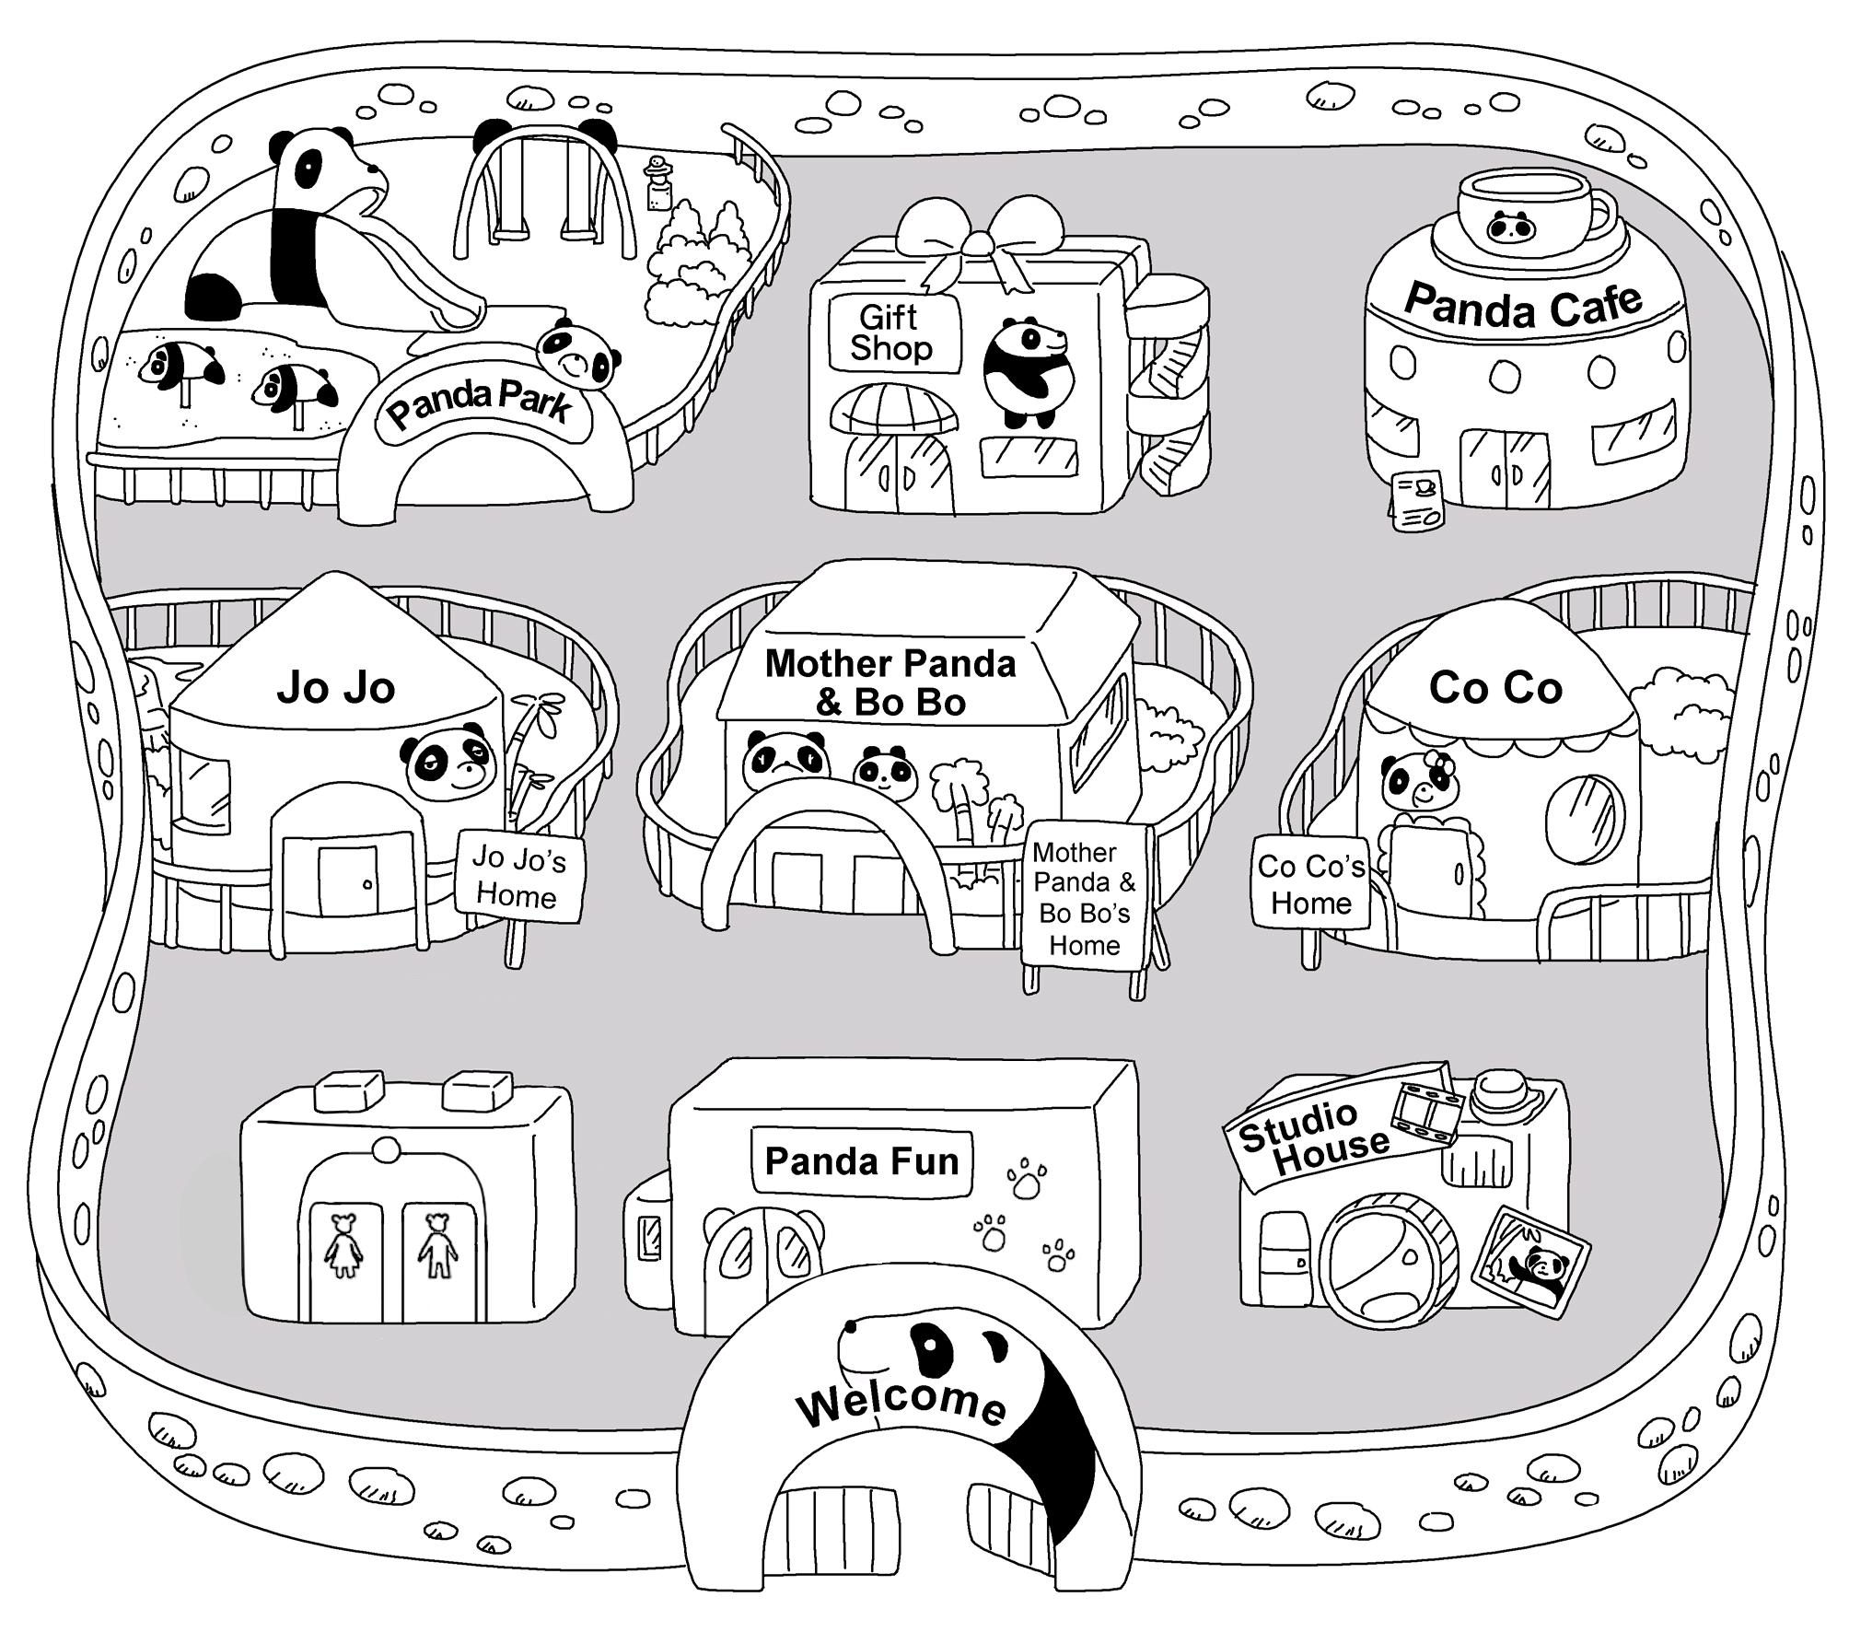
Longman Welcome to English Gold 2A Assessment Bank
Picture Description
Tom is in Pandaland. He is looking at a map. Study the map and answer the teacher’s questions.

Slide 2
Longman Welcome to English Gold 2A Assessment Bank
Suggested questions:
1 Where is Jo Jo’s Home / the Studio House / Mother Panda and Bo Bo’s home?
2 Tom is having lunch. Where is he?
3 Where is Panda Cafe?
4 Tom wants to buy a gift for his friend. Where can he go to?
5 Where is the Gift Shop?
6 Tom is now behind Jo Jo’s home. What is he doing?

Slide 3
Longman Welcome to English Gold 2A Assessment Bank
Suggested answers to the questions:
1 Jo Jo’s Home / It is in front of Panda Park / behind the toilets. / near Mother Panda & Bo Bo’s Home.
The Studio House / It is in front of Co Co’s Home / near Panda Fun.
Mother Panda and Bo Bo’s Home / It is between Jo Jo’s Home and Co Co’s Home / between the Gift Shop and Panda Fun / in front of the Gift Shop / behind Panda Fun / near Jo Jo’s Home / near Co Co’s Home.
2 Tom / He is in Panda Cafe.
3 Panda Café / It is near the Gift Shop / behind Co Co’s Home.
4 Tom / He can go to the Gift Shop.
5 The Gift Shop / It is behind Mother Panda and Bo Bo’s Home / between Panda Park and Panda Cafe.
6 Tom / He is playing in Panda Park / the playground.

