Slide 1
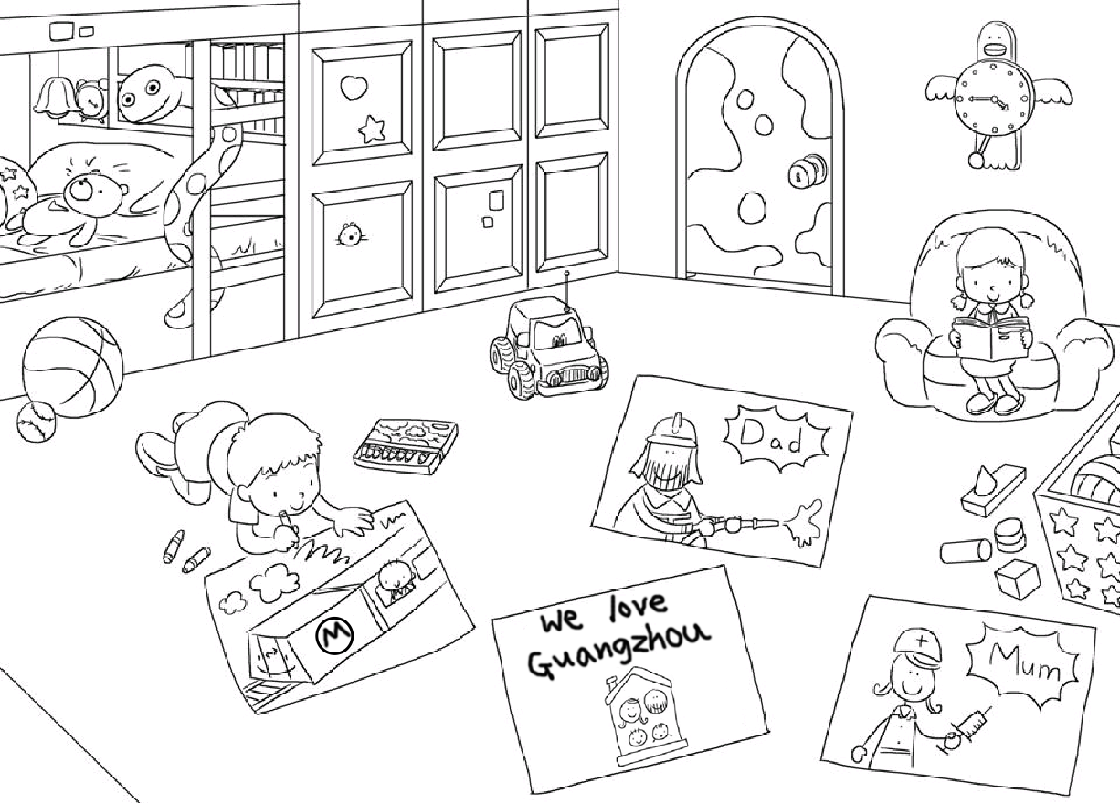
Longman Welcome to English Gold 2A Assessment Bank
Picture Description
Here is a picture of Tommy and his sister. Study the picture and describe it. Answer the teacher’s questions.

Slide 2
Longman Welcome to English Gold 2A Assessment Bank
Suggested questions:
1 Where are the children?
2 What is Tommy doing?
3 Where does Tommy live?
4 What is his father’s job?
What does he do?
5 What is his mother’s job?
What does she do?
6 (Point to the picture that Tommy is drawing.) How does Tommy go to school?

Slide 3
Longman Welcome to English Gold 2A Assessment Bank
Suggested answers to the questions:
1 They are at home / in their bedroom.
2 Tommy / He is drawing.
3 Tommy / He lives in Guangzhou.
4 Tommy’s / His father / He is a fireman. He puts out fires / saves / helps people.
5 Tommy’s / His mother / She is a nurse. She helps people / the doctor.
6 (Tommy / He goes to school) By metro.
(Accept any reasonable answers.)

