Slide 1
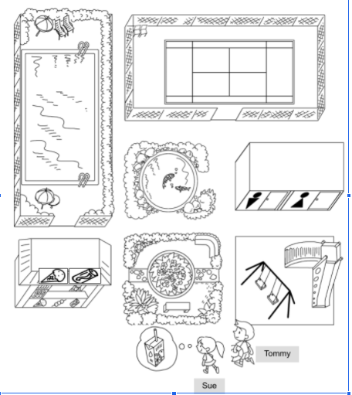
Longman Welcome to English Gold 2A Assessment Bank
Picture Description
Some children are in Happy Park. Study the map and describe it. Answer the teacher’s questions.

Slide 2
Longman Welcome to English Gold 2A Assessment Bank
1 Where is the playground?
2 Where is the fish pond?
3 Where are the toilets?
4 Sue wants some juice. Where can she go? Where is it?
5 Tommy wants to swim. Where can he go? Where is it?

Slide 3
Longman Welcome to English Gold 2A Assessment Bank
Suggested answers to the questions:
1 It is in front of the toilets.
2 It is behind the garden / in front of the tennis court / between the swimming pool and the toilets / between the tennis court and the garden.
3 They are behind the playground / between the playground and the tennis court.
4 She can go to the snack bar. It is in front of the swimming pool.
5 He can go to the swimming pool. It is behind the snack bar.
(Accept any reasonable answers.)

