Slide 1
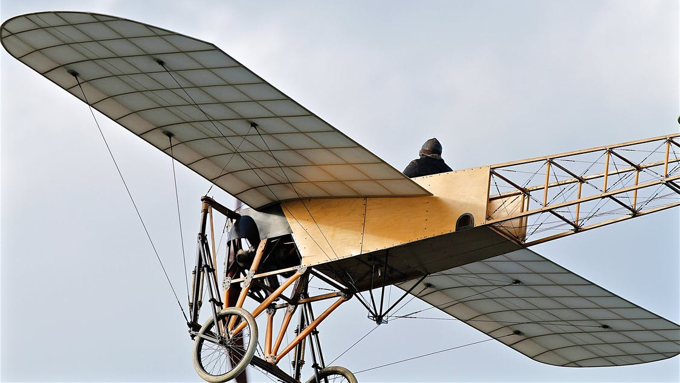
LO: Greet Ss; introduce the topic to Ss.
Guide Ss to ask and answer the given question.
Introduce the topic of the lesson.
Where would you want to fly if you had an aeroplane?
The Flying Machine 1
ORT-G2B Lesson 26
1:30
1:30
1/31

Slide 2
LO: Get to know what they will learn in this class.
Go through the learning goals with Ss. Make sure they know what they’re going to learn in the lesson.
Note: Don’t read the learning goals to the Ss.
Learning Goals
Decode words with the following common suffixes: -ize and -ify.
Learn the key words and phrase steward, passenger, engine, barn, spy, try out, hairy, and screw by understanding them in context.
Read the first half of the story The Flying Machine and apply different reading skills and strategies when comprehending and analyzing the content; summarize the story.
Talk about the story and discuss what the job of an airline pilot is like.
0:30
2/31

Slide 3
LO: Identify and pronounce the sounds -ize and -ify.
Click and read the first group of words to Ss; have them identify what different sounds ize makes.
Click and ask Ss to read the second group of words; ask them to identify what different sounds -ify makes.
Phonics Learning
Phonics
What do these words end with?
What do these words end with?
organize
memorize
recognize
simplify
classify
identify
2:00
3/31

Slide 4
LO: Decode the words in the text accurately
and fluently; read the text fluently.
Guide Ss to read the story aloud together and with rhythm.
Ask Ss to take turns reading the text one sentence at a time.
Phonics
Read on Your Own
The school will organize a competition in geographic knowledge. The student who can memorize the most countries and recognize them on the world map will be the champion. To simplify the competition, the school will classify the countries on different continents into different groups. In order to win the competition, students need to identify as many countries as possible.
1:30
4/31

Slide 5
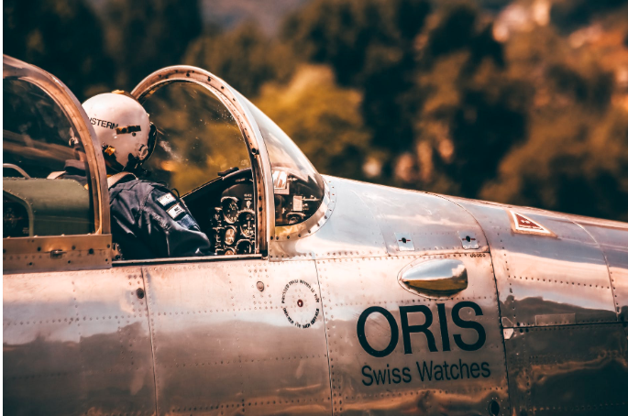
LO: Activate Ss’ background knowledge on the topic; get
to know more about a pilot.
Ask Ss to read the given passage silently.
Have Ss discuss the given questions.
Discussion
Background
A Pilot
An aircraft pilot is a person who controls the flight of an aircraft, with the tasks and duties of performing aircraft inspections, selecting flight routes, ensuring the safety and comfort of the passengers, crew, and aircraft, etc. Professional pilots fly and navigate airplanes, helicopters, and other types of aircraft. Airline pilots work for specific companies, transporting people and cargo on fixed schedules, while commercial pilots work for companies that offer charter flights, rescue operations, or aerial photography.
What do aircraft pilots do? What tasks and duties do they have?
What are the three main types of pilots? How are they different?
1:30
5/31

Slide 6
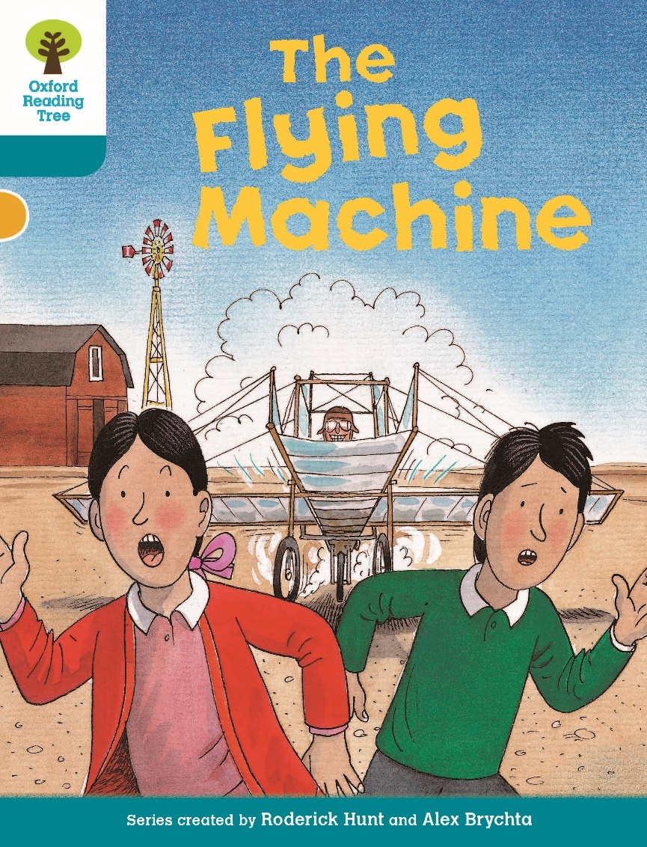
LO: Ask Ss to look at the book cover and to talk about what they can learn from the book cover; predict what might happen in the story and connect the story to real life experiences.
Have Ss discuss the given questions before reading.
Have Ss discuss the given questions in the connections section.
Book Cover
Lead-in
Before Reading
What is the machine behind Anneena and Nadim? How is it different from a modern aeroplane?
Connections
What kinds of flying machines do you know about? Which ones have you ridden in?
1:00
6/31

Slide 7
LO: Use details from the pictures to make predictions.
Help Ss to recall how to make predictions.
Guide Ss to make predictions by using the provided questions. Encourage Ss to answer the questions.
ns!
Lead-in
Make Predictions
Use details from the illustration to make guesses.
Who do you think the two men are?
What do you think Nadim and Anneena might do to help the men?
1:30
7/31

Slide 8
LO: Define the word steward in context.
Have Ss go through the text quickly to find the word and have Ss work together to define the word steward by using the illustration and the context clues; give feedback.
Note: If Ss can present a correct understanding of the unfamiliar word(s), it’s not necessary to teach the word(s) on the next slide.
The Flying Machine1
Reading
On the flight there was a surprise for Nadim.
The steward asked him if he wanted to see the controls.
Nadim was excited. He had always wanted to see the flight deck of an areoplane.
“Oh brilliant!” he said. “Yes, please!”
Vocabulary
Use the illustration and context clues to define the word steward.
Pages 1-3
0:30
8/31

Slide 9
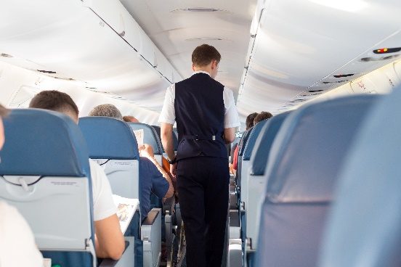
LO: Utilize the reading strategies and skills to assist in
reading comprehension; understand the word steward in context.
If Ss can present a good understanding of the word from the previous slide, skip the vocabulary teaching part. If not, explain the word steward with the sample sentence and ask Ss to make sentences with it.
Ask Ss to discuss the comprehension questions and give feedback.
The Flying Machine1
Reading
Read Pages 1-3
How did Nadim's dad feel about flying? Why?
How did Nadim feel when the steward asked him if he wanted to see the flight deck? Why?
steward (n.)
Definition: a person who works on a ship, plane, or train, looking after passengers and serving meals to them
Connections
Before the plane takes off, the steward asks everyone to fasten their seat belts.
How do you feel about flying? Have you ever been on a plane?
1:30
9/31

Slide 10
LO: Define the word passenger in context.
Have Ss go through the text quickly to find the word and have Ss work together to define the word passenger by using the illustration and the context clues; give feedback.
Note: If Ss can present a correct understanding of the unfamiliar word(s), it’s not necessary to teach the word(s) on the next slide.
The Flying Machine1
Reading
Vocabulary
Use the illustration and context clues to define the word passenger.
Pages 4-5
0:30
10/31

Slide 11
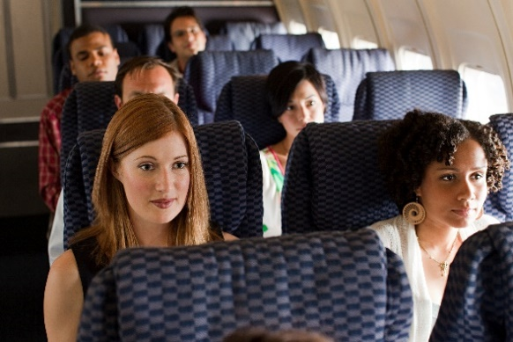
LO: Utilize the reading strategies and skills to assist in
reading comprehension; understand the academic word passenger in context.
If Ss can present a good understanding of the word from the previous slide, skip the vocabulary teaching part. If not, explain the word passenger with the sample sentence and ask Ss to make sentences with it.
Ask Ss to discuss the comprehension questions and encourage them to support their answers with details.
The Flying Machine1
Reading
Read Pages 4-5
What were the pilots doing when Nadim met them?
Do you think Nadim's dad felt better or worse after seeing the flight deck?
passenger (n.)
Definition: a person who is traveling in a car, bus, train, plane, or ship
The passengers took their seats after they got on the plane.
1:30
11/31

Slide 12
LO: Utilize the reading strategies and skills to assist in
reading comprehension.
Have Ss take turns discussing the comprehension questions and encourage them to support their answers with details.
Have Ss discuss the questions in the connections section.
The Flying Machine1
Reading
Read Pages 6-7
Imagine that you are Nadim. Tell your classmate about your experience visiting the flight deck.
What did Anneena think of Nadim's experience?
Where do you think the magic might take them? What do you think they would do on the adventure?
Pages 6-7
1:30
12/31

Slide 13
LO: Define the word engine in context.
Have Ss go through the text quickly to find the word and have Ss work together to define the word engine by using the illustration and the context clues; give feedback.
Note: If Ss can present a correct understanding of the unfamiliar word(s), it’s not necessary to teach the word(s) on the next slide.
The Flying Machine1
Reading
Vocabulary
Use the illustration and context clues to define the word engine.
Pages 8-9
0:30
13/31

Slide 14
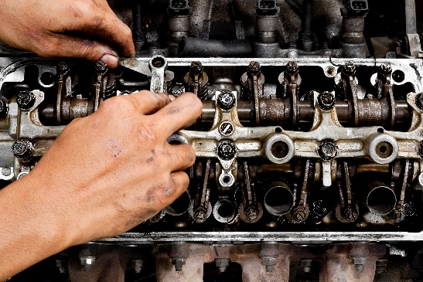
LO: Utilize the reading strategies and skills to assist in
reading comprehension; understand the academic word engine in context.
If Ss can present a good understanding of the word from the previous slide, skip the vocabulary teaching part. If not, explain the word engine with the sample sentence and ask Ss to make sentences with it.
Ask Ss to discuss the comprehension questions and encourage them to support their answers with details.
The Flying Machine1
Reading
Read Pages 8-9
engine
(n.)
Where were Nadim and Anneena? Describe the setting.
What did the man warn Nadim and Anneena about?
Definition: the part that produces the power which makes a vehicle move
He opened the hood to see if there was something wrong with the engine.
1:30
14/31

Slide 15
LO: Define the word barn in context.
Have Ss go through the text quickly to find the word and have Ss work together to define the word barn by using the illustration and the context clues; give feedback.
Note: If Ss can present a correct understanding of the unfamiliar word(s), it’s not necessary to teach the word(s) on the next slide.
The Flying Machine1
Reading
Vocabulary
Use the illustration and context clues to define the word barn.
Pages 10-11
0:30
15/31

Slide 16
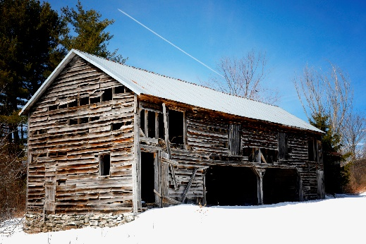
LO: Utilize the reading strategies and skills to assist in
reading comprehension; understand the academic word barn in context.
If Ss can present a good understanding of the word from the previous slide, skip the vocabulary teaching part. If not, explain the word barn with the sample sentence and ask Ss to make sentences with it.
Ask Ss to discuss the comprehension questions and encourage them to support their answers with details.
The Flying Machine1
Reading
Read Pages 10-11
Who were the men? What were they doing?
What did Harold think Anneena and Nadim might be doing? Why did he think that?
Why did the men want to keep the machine a secret?
barn (n.)
Definition: a large, plain building used for storage.
No one lives in the old barn because it is covered in snow and falling apart.
1:30
16/31

Slide 17
LO: Define the words spy and hairy and the phrase try
out in context.
Have Ss go through the text quickly to find the word and have Ss work together to define the words spy and hairy and the phrase try out by using the illustration and the context clues; give feedback.
Note: If Ss can present a correct understanding of the unfamiliar word(s), it’s not necessary to teach the word(s) on the next slide.
The Flying Machine1
Reading
Vocabulary
Pages 12-13
Use the illustration and context clues to define the words spy and hairy and the phrase try out.
0:30
17/31

Slide 18
LO: Utilize the reading strategies and skills to assist in
reading comprehension; understand the words spy and hairy and the phrase try out in context.
If Ss can present a good understanding of the word from the previous slide, skip the vocabulary teaching part. If not, explain the words spy and hairy and the phrase try out with the sample sentence and ask Ss to make sentences with it.
Ask Ss to discuss the comprehension questions and give feedback.
The Flying Machine1
Reading
spy (v.)
Read Pages 12-13
Definition: to watch secretly
He's spying on all these people in the corner of the room.
Why did Anneena think that the machine wouldn’t fly?
try out
Definition: to test something in order to find out how useful or effective it is
I want to try out some of my ideas.
Connections
How would you change the machine? Discuss some ideas with your classmate.
hairy (adj.)
Definition: dangerous but often exciting
Driving on icy roads can be hairy.
1:30
18/31

Slide 19
LO: Define the word screw in context.
Have Ss go through the text quickly to find the word and have Ss work together to define the word screw by using the illustration and the context clues; give feedback.
Note: If Ss can present a correct understanding of the unfamiliar word(s), it’s not necessary to teach the word(s) on the next slide.
The Flying Machine1
Reading
“It’s the propeller,” said Anneena. “It will never work. It’s too flat.”
She picked up two pieces of wood.
“It needs to be like this,” she said. “It acts like a screw to pull the plane through the air.”
“Well, we could try it,” said Henry.
Vocabulary
Use the illustration and context clues to define the word screw.
Pages 14-15
0:30
19/31

Slide 20
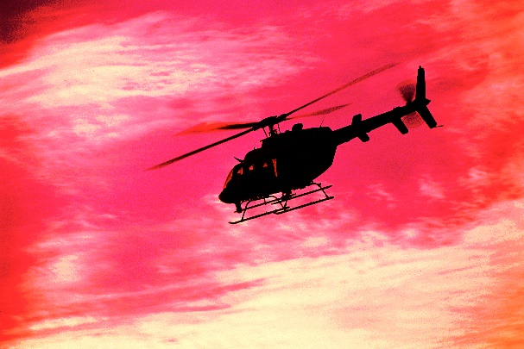
LO: Utilize the reading strategies and skills to assist in
reading comprehension; understand the academic word screw in context.
If Ss can present a good understanding of the word from the previous slide, skip the vocabulary teaching part. If not, explain the word screw with the sample sentence and ask Ss to make sentences with it.
Ask Ss to discuss the comprehension questions and encourage them to support their answers with details.
The Flying Machine1
Reading
Read Pages 14-15
screw
(n.)
What did Anneena suggest the twins do to make their plane work? Why did she think her idea would help?
How did the twins react to Anneena's idea?
Definition: a propeller on a ship, a boat, or an aircraft
Once the screw is damaged, the helicopter will not be able to take off.
1:30
20/31

Slide 21
LO: Review the concept of summarizing and introduce the sentence structure of summarizing.
Review the concept of summarizing.
Introduce the sentence structure of summarizing.
Click and model how to summarize the given text.
Reading Strategy
Reading Strategy
Summarize
When we summarize, we retell a story and mention the most important ideas, including the settings, the characters, and the plot, in our own words.
Settings
When?
Where?
Characters
Who?
Plot
What?
Summary
3:00
21/31
3:00

Slide 22
LO: Analyze the settings, characters and plot of the text by utilizing the reading skills and strategies.
Model how to analyze the settings of the text and complete the characters and plot of the summarizing chart.
Show and help Ss complete tasks.
Give feedback.
Read and Summarize Pages 1-5
Settings
Characters
Plot
Nadim and his parents flew home from America.
Nadim and his dad went to the flight deck to see the controls.
at an American airport, after a holiday,
on the flight
Nadim, Nadim’s mum, Nadim’s dad, the steward, the captain
Summary
Nadim and his parents flew home from America after their holiday. On the flight, Nadim went to the flight deck to see the controls with his dad.
22/31

Slide 23
LO: Analyze the settings, characters and plot of the text by utilizing the reading skills and strategies.
Model how to analyze the settings of the text and complete the characters and plot of the summarizing chart.
Show and help Ss complete tasks.
Give feedback.
Read and Summarize Pages 8-15
Settings
Characters
Plot
It’s your turn.
It’s your turn.
It’s your turn.
Summary
It’s your turn.
23/31

Slide 24
LO: Check if Ss understand the words in context.
Ask Ss to take turns reading the words aloud.
Ask Ss to read the sentences and to correctly fill in the blanks.
Notes: If time is limited, you can skip the slide.
Vocabulary
Read & Choose
engine
I switched the ________ off and got out of my car.
They could ______ on me through a porthole window.
All _____________ are subject to security inspection.
It was pretty ____________ climbing down the cliff.
spy
passengers
hairy
Complete the sentences. Use the correct form of the words in the box.
hairy, passenger,
spy, engine
1:30
24/31

Slide 25
LO: Talk about what Nadim learned about the captain’s job on the aeroplane.
Ask Ss to discuss what Nadim learned about the captain’s job on the aeroplane.
Encourage Ss to answer questions by using the given clues and to present their answers with at least three complete sentences. Assist Ss if necessary.
Listening & Speaking
What did Nadim learn about the captain’s job on the aeroplane?
on the flight deck
flying on auto-pilot
the controls
. . .
Tip: Use the given clues to discuss the question.
1:30
25/31

Slide 26
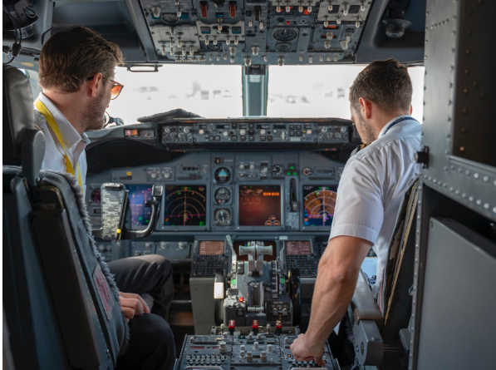
LO: Talk about what you knew about an airline pilot’s job
in your life.
Ask Ss to work together to talk about their ideas by asking the given question.
Encourage Ss to talk about the question in complete sentences with the given clues. Assist Ss if necessary.
Listening & Speaking
What do you know about airline pilots and their jobs?
fly aeroplanes
communicate with air traffic controllers
monitor instruments
. . .
1:30
26/31

Slide 27
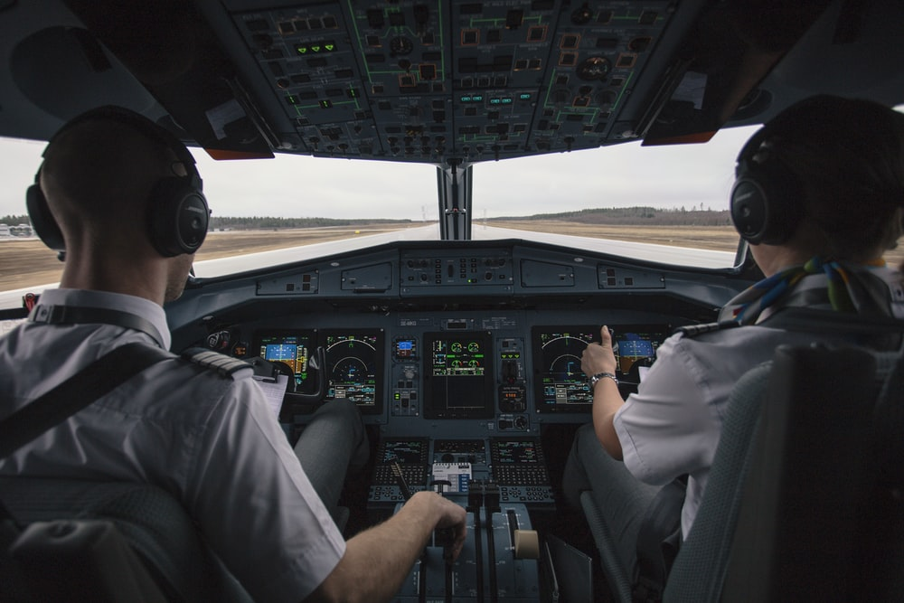
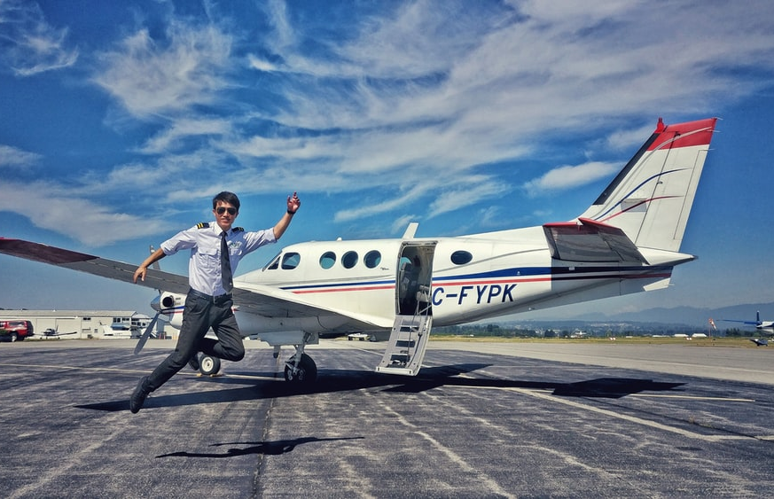
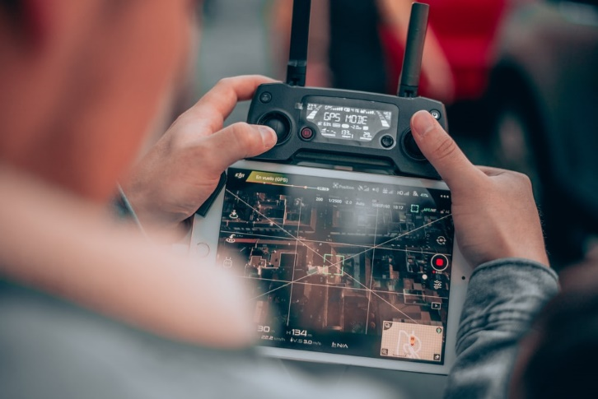
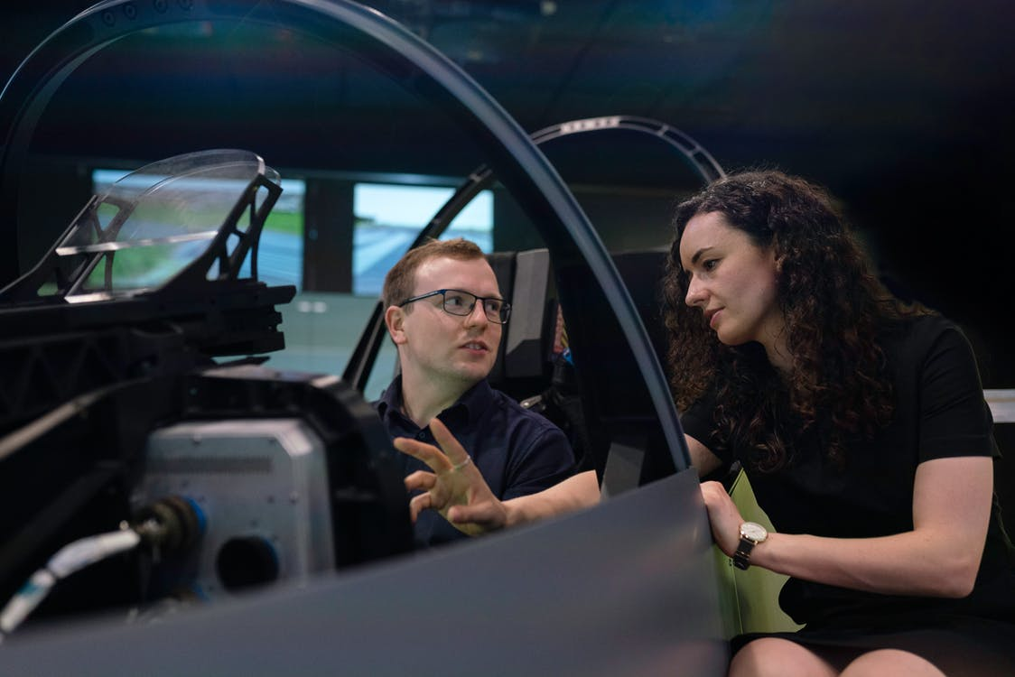
LO: Talk about how a person can become a pilot.
Guide Ss to look at the pictures; have Ss talk about different ways to prepare for writing a story.
Guide Ss to understand the importance of writing preparation. Assist Ss if necessary.
Value
How can a person become a pilot?
2:00
27/31

Slide 28
LO: Compare and contrast how the captain flied the plane and how the twins operated their flying machine by answering the questions in the chart below.
Explain the task to Ss.
Model first; have Ss discuss the setting, the characters, and the events in the beginning of Wilma’s story by using the given chart.
Give feedback.
Get Ready to Present
Oral Writing
Compare and contrast how the captain flew the plane and how the twins operated their flying machine by answering the questions in the chart below.
The Captain
Where did the captain operate the aeroplane?
How did the captain operate the aeroplane?
Who did the captain work with?
The Twins
Where did Harold operate the flying machine?
How did Harold operate the flying machine?
Who did Harold work with?
2:30
28/31

Slide 29
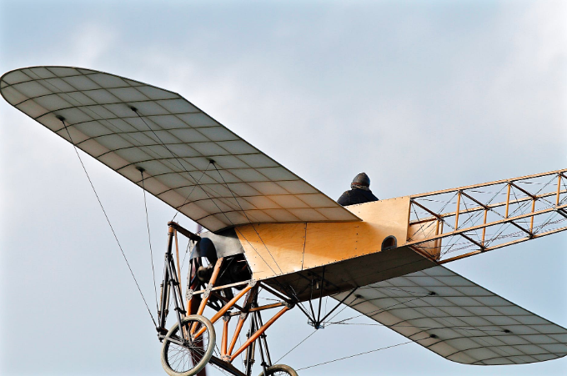
LO: Understand what the writing task is; know that they can complete the writing task with the help of the post-class instructional video.
Introduce and explain the writing task to Ss.
Ask Ss to finish the task before the next class, and to be ready to present.
Remind Ss to watch the post-class video before writing.
Writing
Homework: A Compare-and-Contrast Essay
Write a compare-and-contrast essay on modern aeroplanes and old-time aeroplanes in three paragraphs.
Step 1. Brainstorm : Collect Your Ideas
Step 2. Prewrite: Make a Plan for Your Writing
Step 3. Draft: Write Your First Version
Watch the post-class video before you start the task.
1:00
29/31

Slide 30
LO: Review the whole lesson.
Review the key words with Ss by asking Ss to make sentences with them.
Review the story with Ss by asking the given questions.
Ask Ss to think about what will happen next in the story.
Review
Let’s Review
Key Words and Phrases:
steward, passenger, engine, barn,
spy, try out, hairy, screw
Key Questions:
What did Nadim learn about the captain’s job on the aeroplane?
What do you know about airline pilots and their jobs?
1:00
30/31

Slide 31
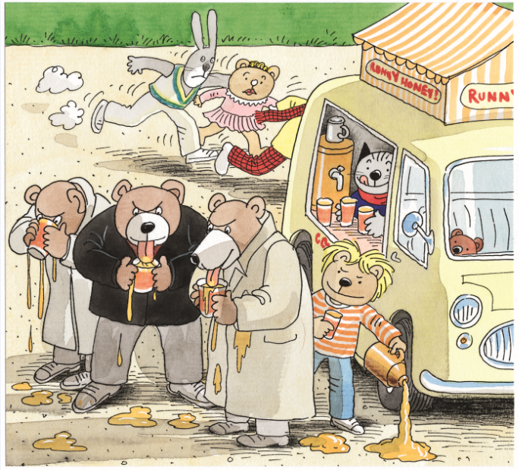
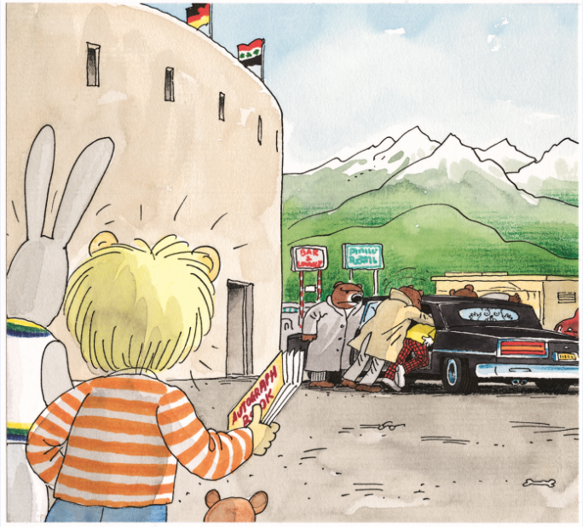
LO: End the lesson and encourage Ss to perform better in the next class.
Briefly comment on Ss’ performance.
Say goodbye to Ss.
Ask Ss to preview the next lesson.
0:30
31/31
Notes:
Suggested Time: 0.5min
TD
Give briefly comments to Ss and say goodbye.

