Slide 1
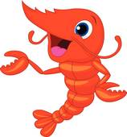
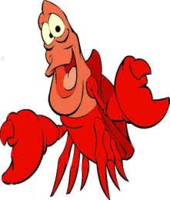
SEA ANIMALS

Slide 2
STARFISH
1
2
3

Slide 3
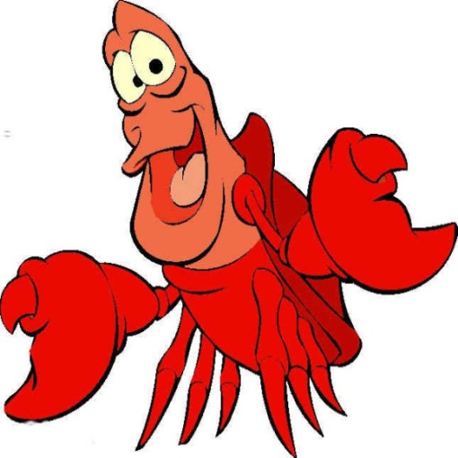
LOBSTER
1
2
3

Slide 4
SEA HORSE
1
2
3

Slide 5
SHRIMP
1
2
3

