Slide 1
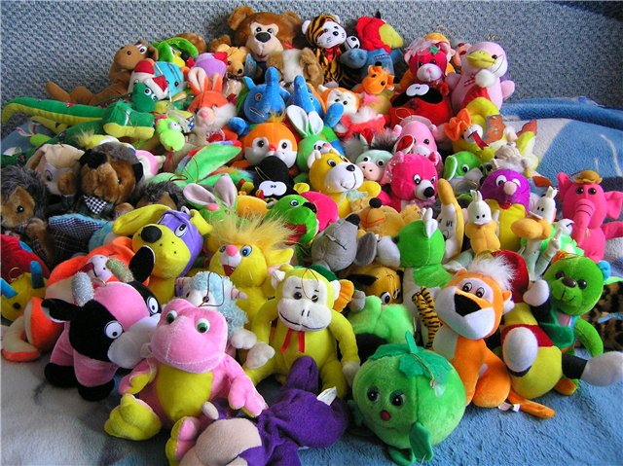
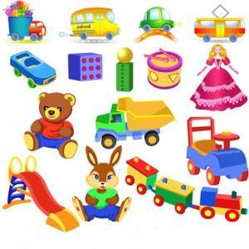
Toys

Slide 2
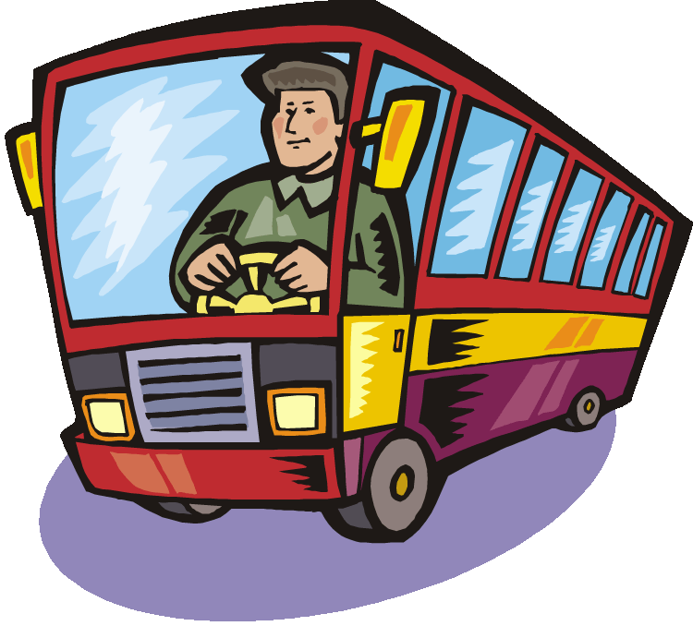
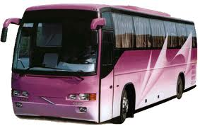
bus

Slide 3
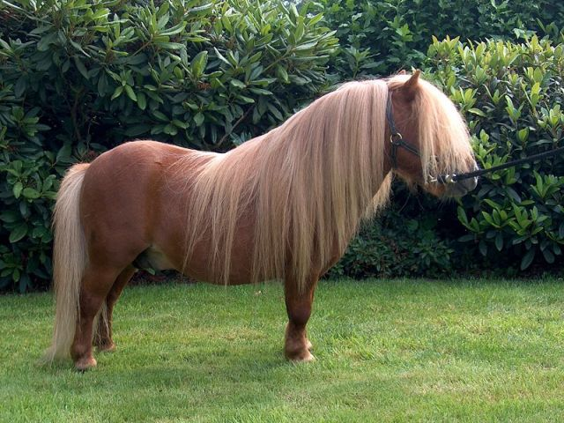
pony

Slide 4
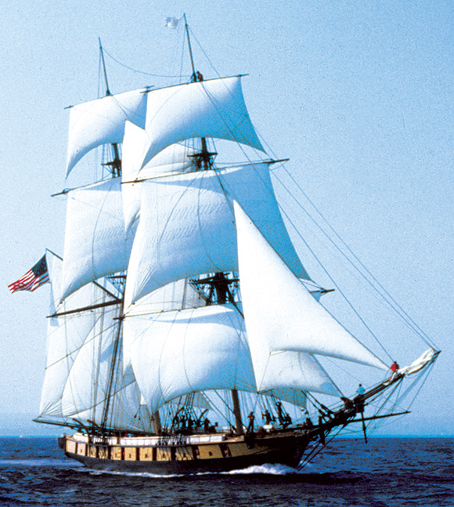
ship

Slide 5
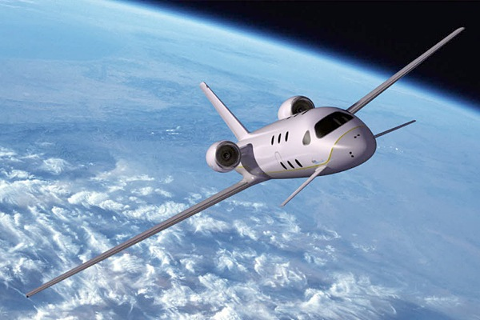
plane

Slide 6
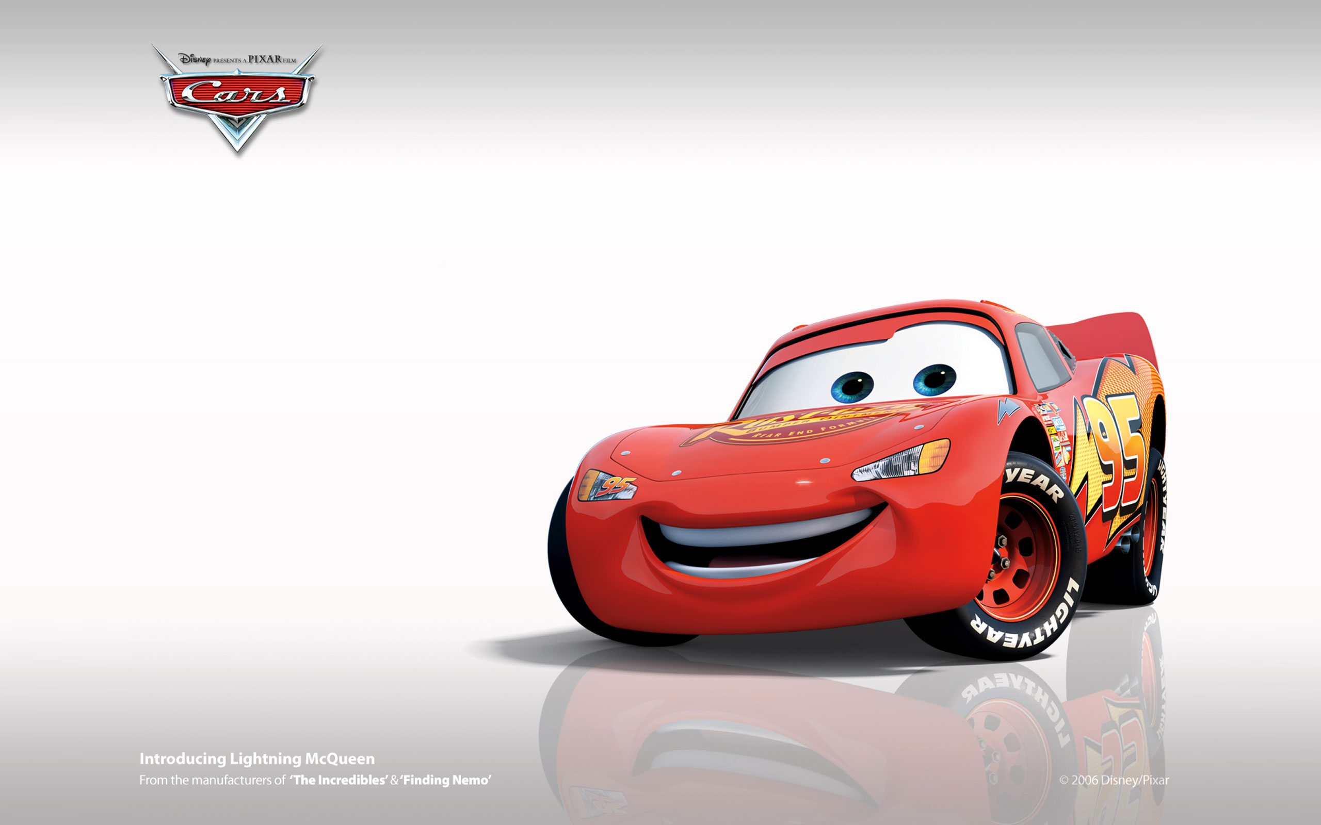
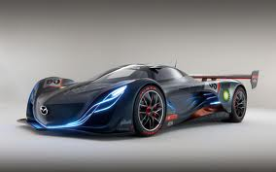
car

Slide 7
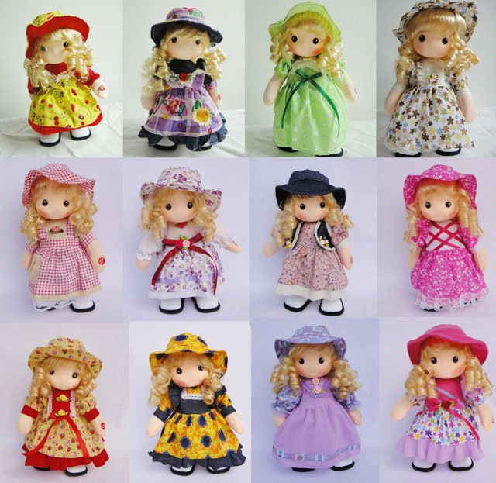
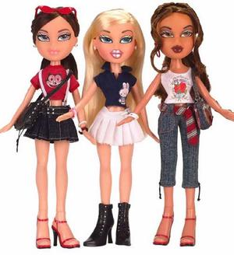
doll

Slide 8
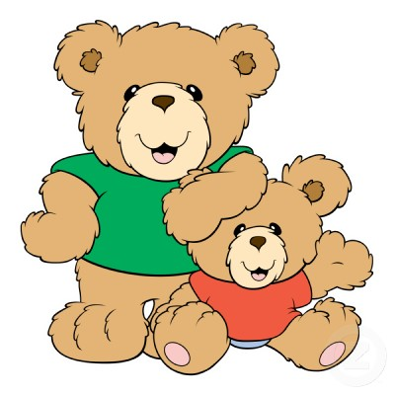
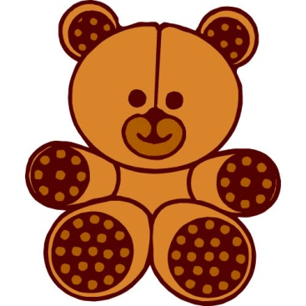
Teddy bear

Slide 9
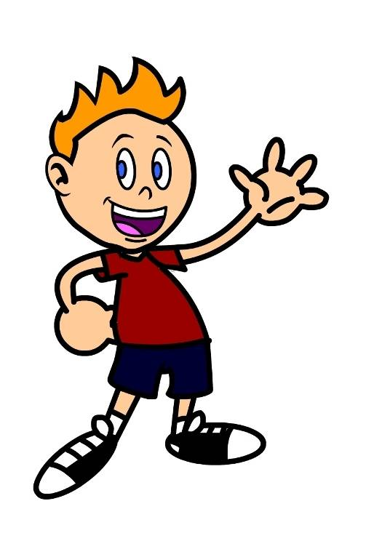
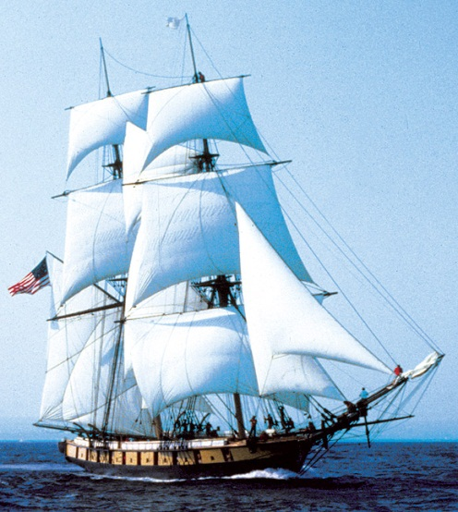
He has got …

Slide 10
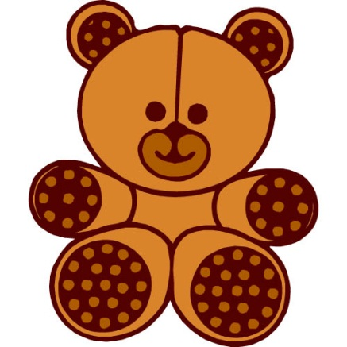
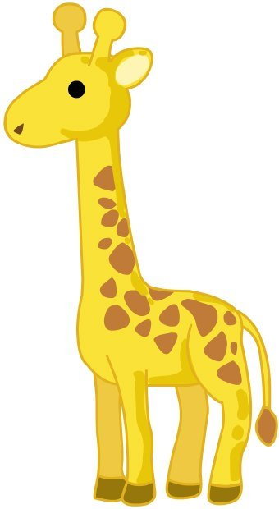
She has got …

Slide 11
Lesson 2. “Let’s play”

Slide 12
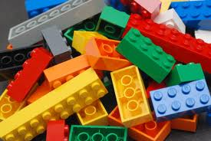
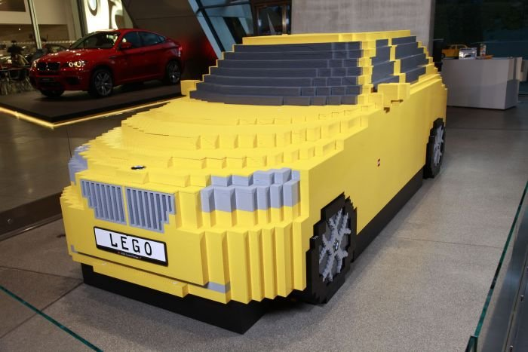
Lego

Slide 13
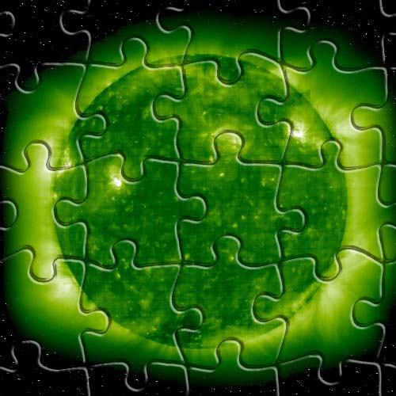
Puzzle

Slide 14
Cubes

Slide 16
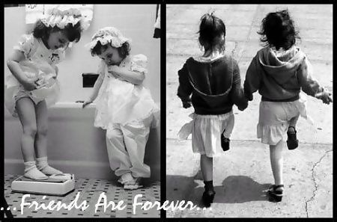
Friend

Slide 18
Read the sentences.
I like to play Lego.
He likes to play with cubes.
She likes to play with puzzles.
I learn English.
He has got many friends.
I like my friends.

Slide 19
Read the dialogue.
-Have you got a friend?
-Yes, I have.
-What is his name?
-His name is Anar.
-Has he got toys?
-Yes, a lot.
-What toys has he got?
-He has got frogs, planes.
-Does he like to play with puzzles?
-Yes, he does.

Slide 20
Complete the dialogue.
-Have you got a friend?
-Yes, I have.
-What is his name?
-His name is…
-Has he got toys?
-Yes, a lot.
-What toys has he got?
-He has got …
-Does he like to play with puzzles?
-Yes, he does.

Slide 21
Complete the dialogue.
-Have you got a friend?
-Yes, I have.
-What is her name?
-Her name is…
-Has she got toys?
-Yes, a lot.
-What toys has she got?
-She has got …
-Does she like to play with puzzles?
-Yes, she does.

Slide 22
Poem
Play with lego ,
Play with cubes,
Do the puzzle,
Study and learn.

