Slide 1
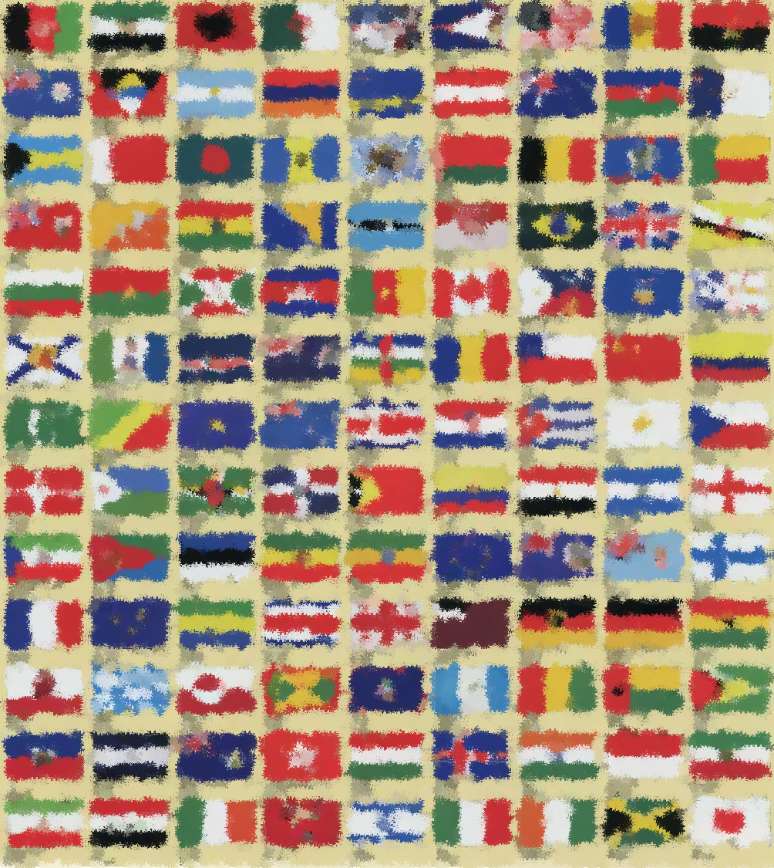

Which country is it?

Slide 2
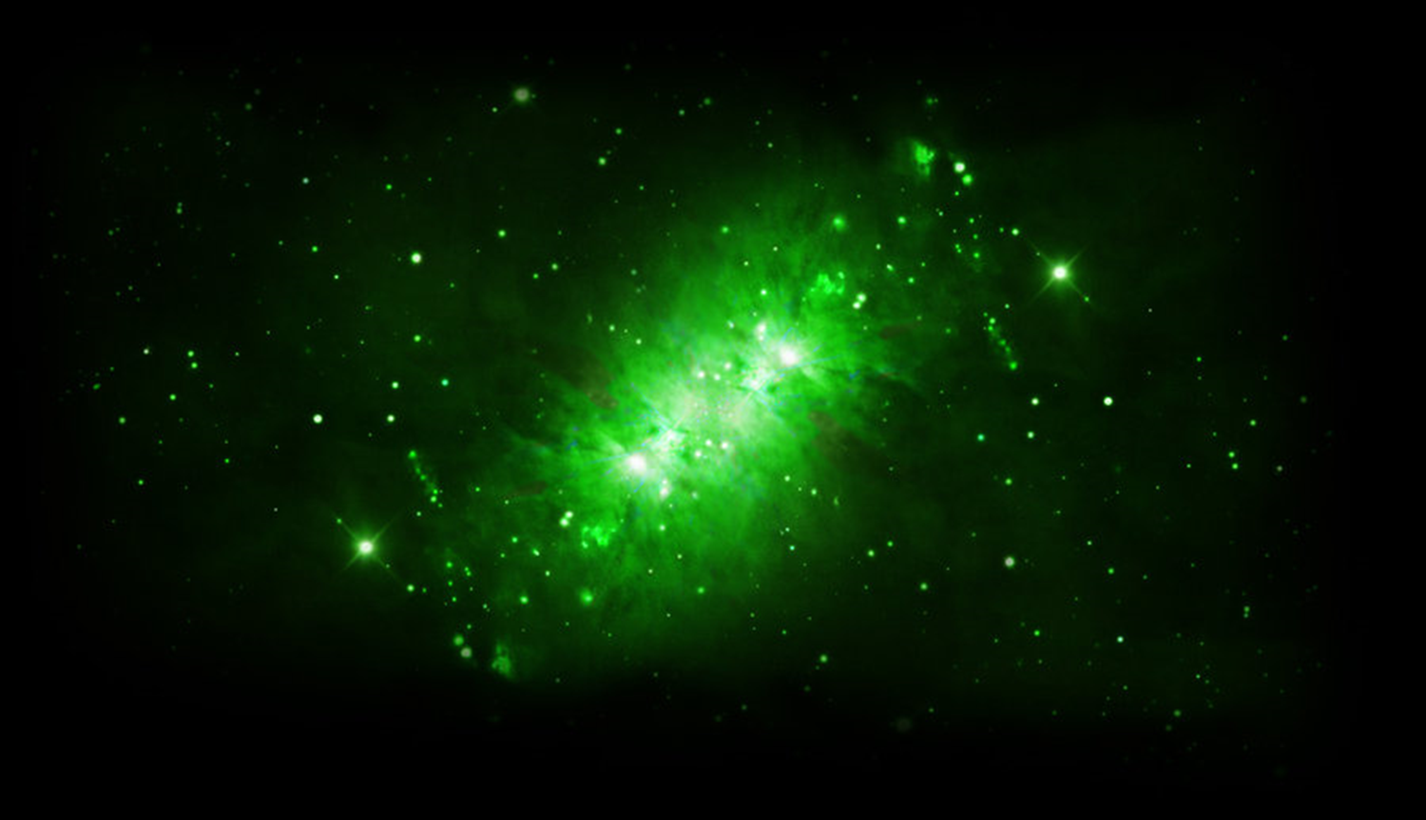
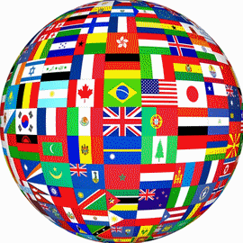


Which country is it?
Red and yellow
1.3 billion
1. Flag colors
2. Population
dumplings
‘ni hao’
3. Food
4. “Hello”
China
Beijing
Jackie Chan
5. Capital city
6. People

Slide 3
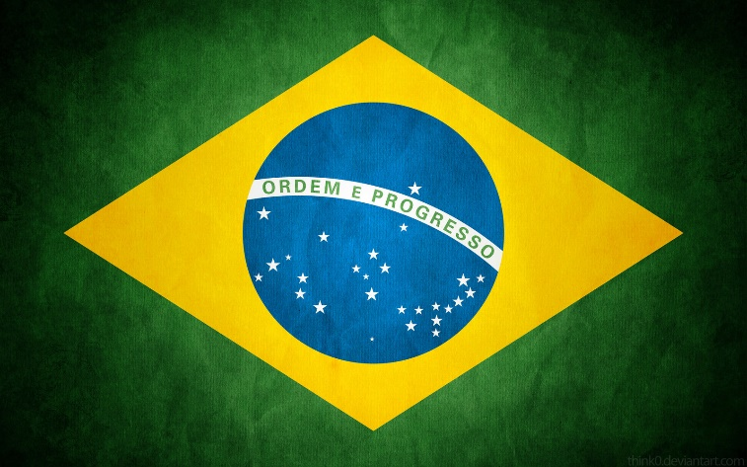
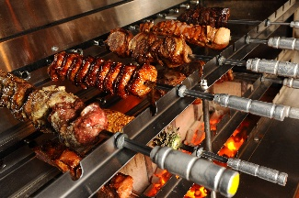
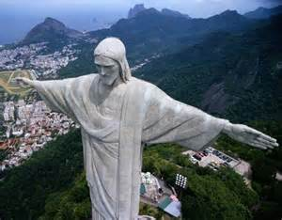
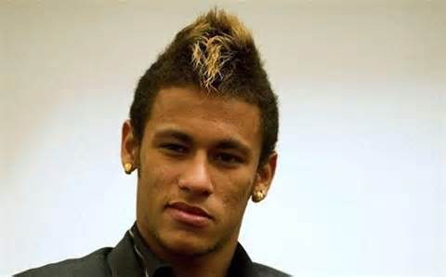
Which country is it?
Green, blue and yellow
206 million
1. Flag colors
2. Population
barbecue
‘ola’
3. Food
4. “Hello”
Brazil
Statue of
Christ
Neymar
5. Famous place
6. People

Slide 4
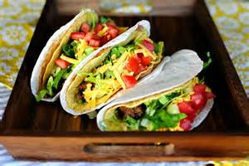
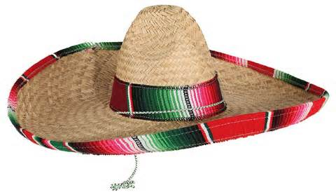
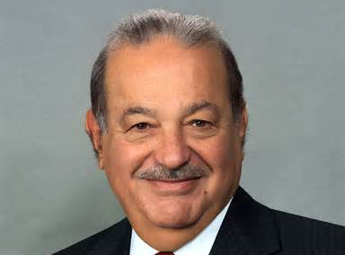
Which country is it?
Green, white and red
112 million
1. Flag colors
2. Population
tacos
Mexico
‘ola’
3. Food
4. “Hello”
sombrero
Carlos Slim
5. Clothes
6. People

Slide 5
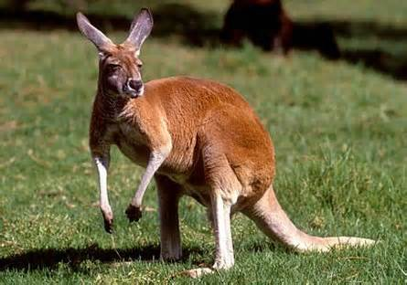
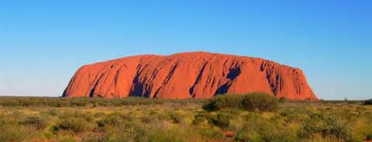
Which country is it?
Red, white and blue
22 million
1. Flag colors
2. Population
kangaroo
‘Good day’
3. Animal
4. “Hello”
Australia
Canberra
Ayers Rock
5. Capital city
6. Famous place

Slide 6
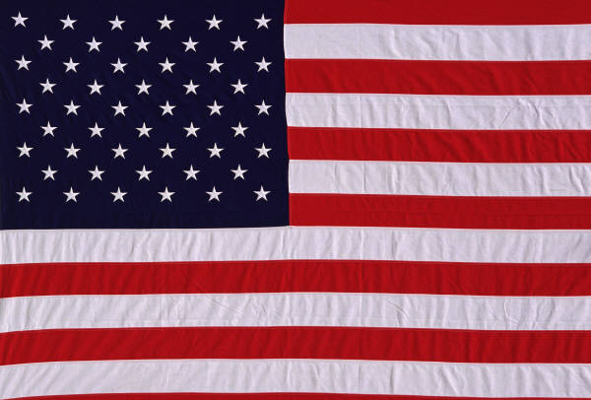
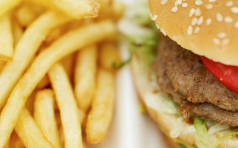
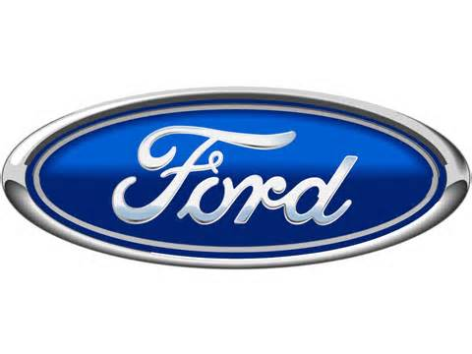
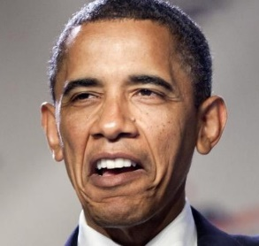
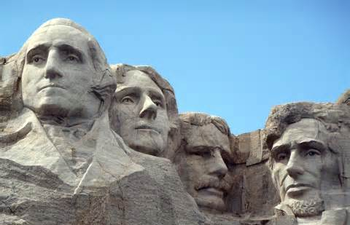
Which country is it?
Red, white and blue
315 million
1. Flag colors
2. Population
Fast food
Ford
3. Food
4. cars
America
Mount
Rushmore
Obama
5. Famous place
6. People

Slide 7
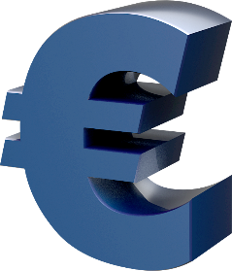
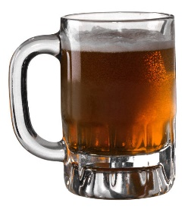
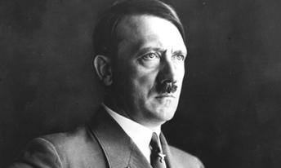
Which country is it?
Black,red and gold
euro
1. Flag colors
2. money
Germany
sausages
beer
3. Food
4. drink
Berlin
Hitler
5. Capital city
6. People

Slide 8
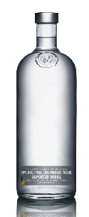

Which country is it?
Red, white and blue
140 million
1. Flag colors
2. Population
Russia
‘Privet’
Vodka
4. “Hello”
3. Drink
Moscow
Skoda
5. Capital city
6. Car

Slide 9
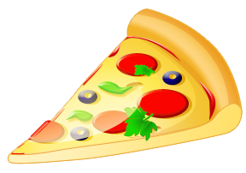
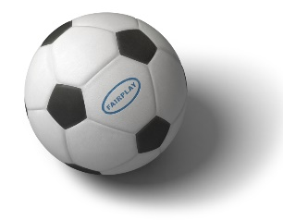
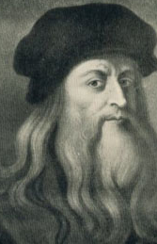
Which country is it?
green, white and red
60 million
1. Flag colors
2. Population
pizza
football
3. Food
4. Sport
Italy
Rome
Leonardo
Da Vinci
5. Capital city
6. People

Slide 10
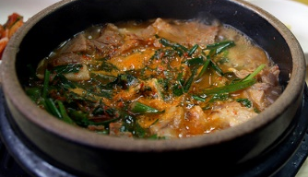
Which country is it?
Red, black, white and blue
49 million
1. Flag colors
2. Population
Dog soup
‘anneong hasseyo’
3. Food
4. “Hello”
Korea
Seoul
hambok
5. Capital city
6. Clothes

Slide 11
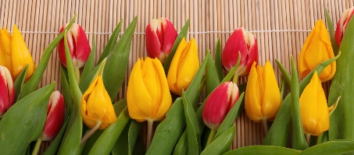
Which country is it?
Red, white and blue
17 million
1. Flag colors
2. Population
tulips
4. Map
3. Flowers
Holland
Amsterdam
Van Gogh
5. Capital city
6. People

Slide 12
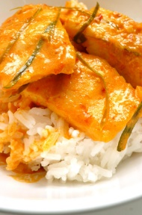
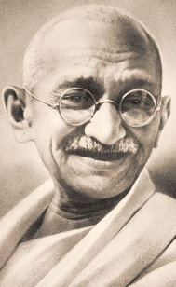
Which country is it?
Orange, white and green
1.2 billion
1. Flag colors
2. Population
Curry
and rice
India
Taj
Mahal
3. Food
4. Famous place
New Delhi
Gandhi
5. Capital city
6. People

Slide 13
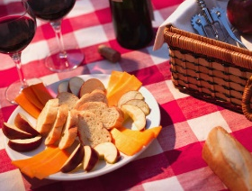
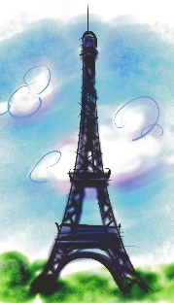
Which country is it?
Red, white and blue
66 million
1. Flag colors
2. Population
Bread,
wine
and cheese
‘bonjour’
3. Food
4. “Hello”
France
Paris
Eiffel
Tower
5. Capital city
6. Famous place

Slide 14
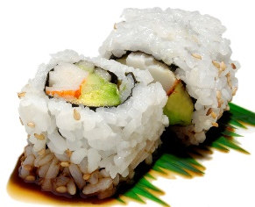

Which country is it?
Red and white
128 million
1. Flag colors
2. Population
sushi
Japan
‘konnichiwa’
3. Food
4. “Hello”
Tokyo
Hello
Kitty
5. Capital city
6. People

Slide 15
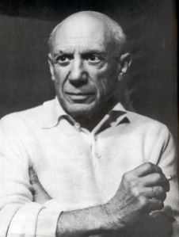
Which country is it?
Red and gold
47 million
1. Flag colors
2. Population
Bullfighting
‘ola’
3. Sport
4. “Hello”
Spain
Madrid
Picasso
5. Capital city
6. People

Slide 16
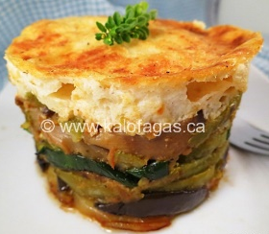
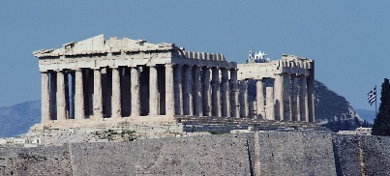
Which country is it?
White and blue
11 million
1. Flag colors
2. Population
moussaka
Greece
‘ya su’
3. Food
4. “Hello”
Athens
Pathenon
5. Capital city
6. Famous place

Slide 17
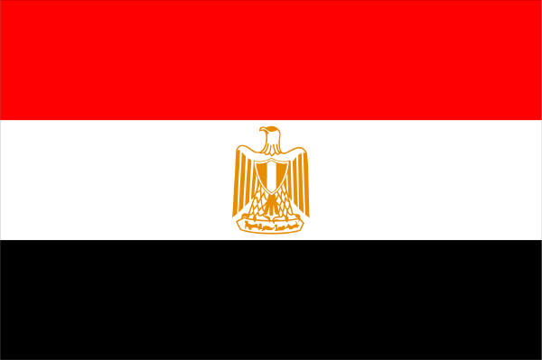
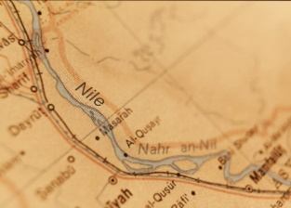
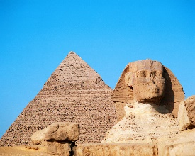
Which country is it?
Red, white and black
84 million
1. Flag colors
2. Population
River
Nile
The
Pyramids
3. Geography
4. Famous place
Egypt
Cairo
Cleopatra
5. Capital city
6. People

Slide 18
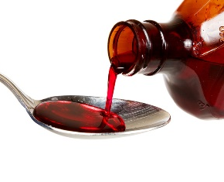
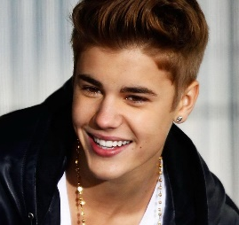
Which country is it?
Red and white
34 million
1. Flag colors
2. Population
Maple
syrup
4. Map
3. Food
Canada
Ottawa
Justin
Bieber
5. Capital city
6. People

Slide 19
Which country is it?
Red, white and blue
4 million
1. Flag colors
2. Population
lamb
4. Map
3. Food
New Zealand
Wellington
sheep
5. Capital city
6. Animals

Slide 20
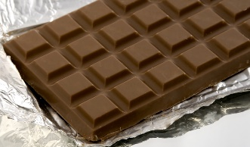
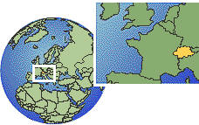

Which country is it?
Red and white
8 million
1. Flag colors
2. Population
chocolate
4. Map
3. Food
Switzerland
Berne
Pocket
knife
5. Capital city
6. Make

Slide 21
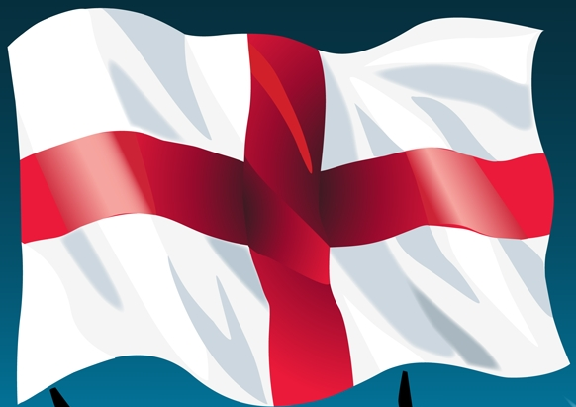
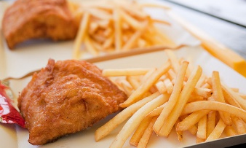
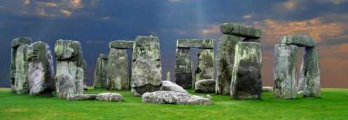
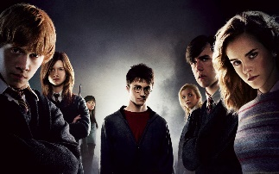
Which country is it?
Red and white
55 million
1. Flag colors
2. Population
England
Stonehenge
Fish
and
chips
4. Famous place
3. Food
London
Harry
Potter
5. Capital city
6. People

Slide 22
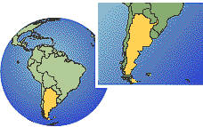
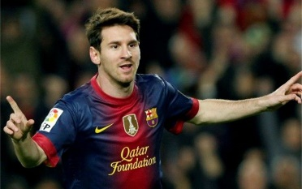
Which country is it?
White and blue
42 million
1. Flag colors
2. Population
Argentina
‘ola’
3. Map
4. “Hello”
Buenos Aires
Messi
5. Capital city
6. People

Slide 23


Slide 24
Which country is it?
1.
2.
1. Flag colors
2. Population
3.
4.
3. Food
4. “Hello”
5.
6.
5. Capital city
6. People

Slide 25
1.
2.
3.
4.
5.
6.

