Slide 1
European Cognates Quiz

Slide 2
What is a cognate?
Cognates are words which look or sound similar and have the same or similar meanings to words in your own language.
Have you come across any cognates in your language lessons so far this year?
See if you can work out what these European cognates mean and which language they come from.

Slide 3
Calculatrice
Calculator
French

Slide 4
Fisch
Fish
German

Slide 5
Hipopótamo
Hippopotamus
Spanish

Slide 6
Paradiso
Paradise
Italian

Slide 7
Restoran
Restaurant
Croatian

Slide 8
Kečup
Ketchup
Czech

Slide 9
Ekspert
Expert
Danish

Slide 10
Huis
House
Dutch

Slide 11
αυτόγραφο
Autograph
Greek

Slide 12
календар
Calendar
Bulgarian

Slide 13
Kahvi
Coffee
Finnish

Slide 14
Szponzor
Sponsor
Hungarian

Slide 15
Skuzi
Excuse me
Maltese

Slide 16
Pieprz
Pepper
Polish

Slide 17
Miljons
Million
Latvian

Slide 18
Dragão
Dragon
Portuguese

Slide 19
Ploom
Plum
Estonian

Slide 20
Hotelov
Hotel
Slovene

Slide 21
Moncaí
Monkey
Irish

Slide 22
Sestra
Sister
Slovak

Slide 23
Flirta
To flirt
Swedish

Slide 24
Applauze
Applause
Romanian

Slide 25
мама
Mum
Russian

Slide 26
Fforc
Fork
Welsh

Slide 27
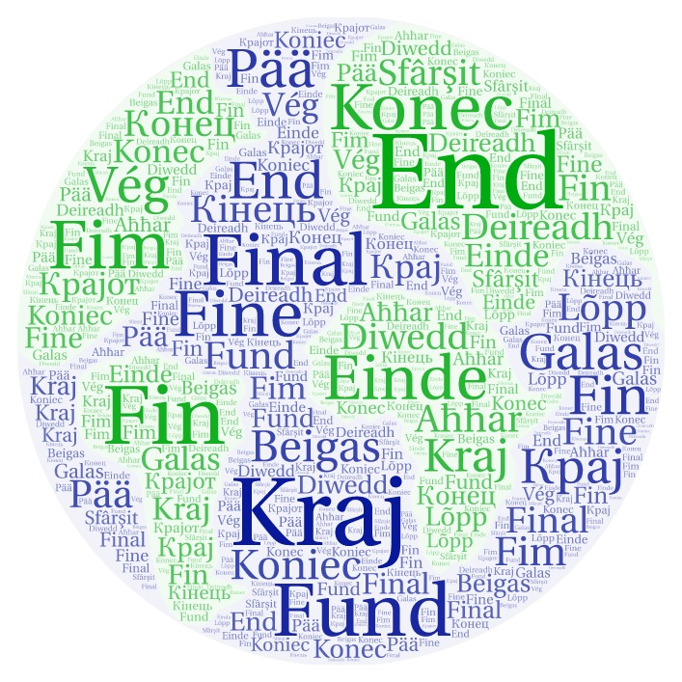
How many did you get right?
Which other European language would you like to learn?

